Slide 1
One hidden layer
Neural Network
Activation functions

Slide 2


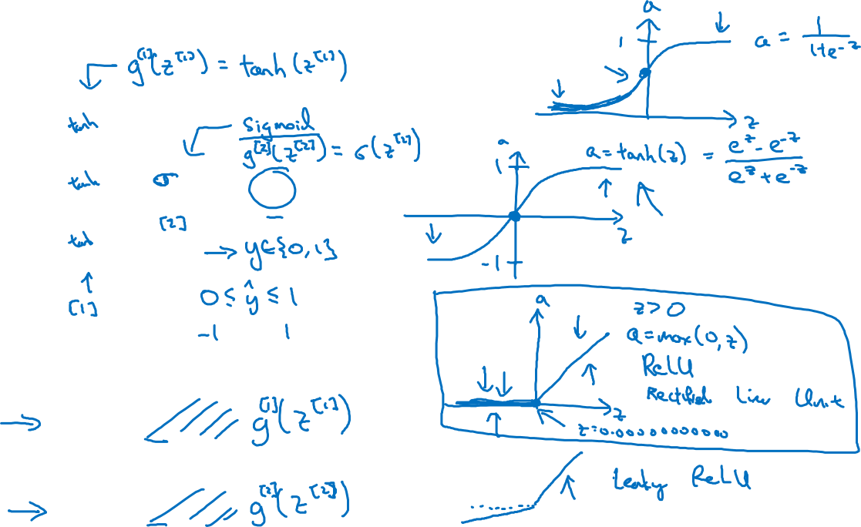




Activation functions
$$x_{1}$$
$$x_{2}$$
$$\hat{y}$$
$$x_{3}$$
Given x:
$$z^{\left[1\right]}=W^{\left[1\right]}x+b^{\left[1\right]}$$
$$a^{\left[1\right]}=σ(z^{\left[1\right]})$$
$$z^{\left[2\right]}=W^{\left[2\right]}a^{\left[1\right]}+b^{\left[2\right]}$$
$$a^{\left[2\right]}=σ(z^{\left[2\right]})$$
Notes:
Tanh almost always better than sigmoid as the mean center on 0, not 0.5; except for perhaps binary classification for output layer…
Downsides for both sigmoid and tanh is the gradient goes very small for larger inputs.
ReLU generally better than tanh; and leaky ReLU generally better than ReLU

Slide 3
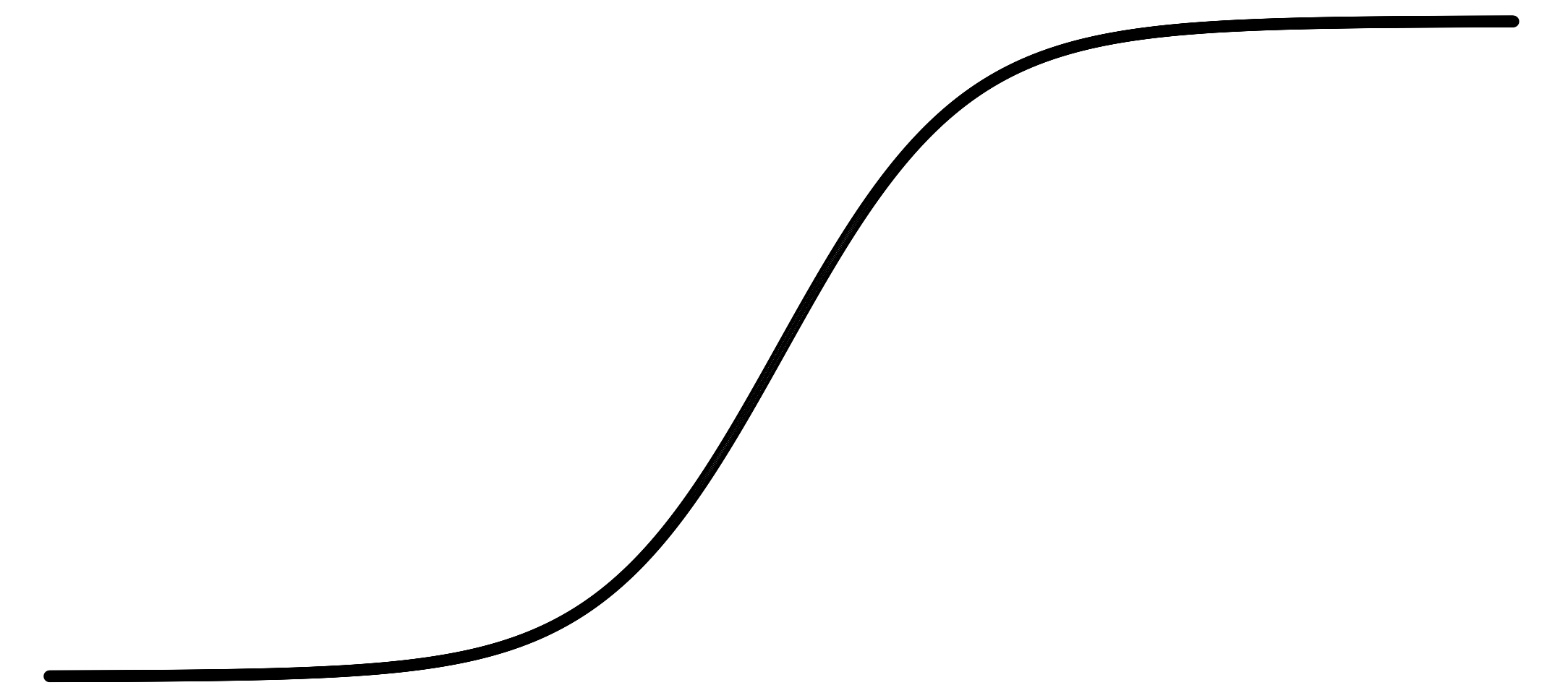
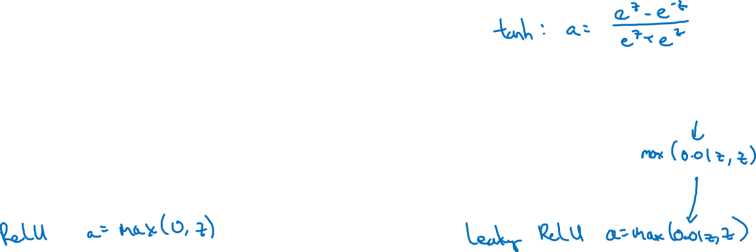
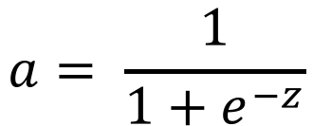
Pros and cons of activation functions
a
a
x
z
$$a= \frac{1}{1+e^{−z}}$$
sigmoid:
a
a
z
z
Notes:
Never use sigmoid, except for perhaps last layer in binary nnet
Use tanh instead of sigmoid
But ReLU better than tanh, so use that instead
Leaky ReLU with max(0.01z,z) better than ReLU, but not used as much. The 0.01 is a tuning parameter that does not make that much of a difference.

