Slide 1
One hidden layer
Neural Network
Why do you
need non-linear
activation functions?

Slide 2



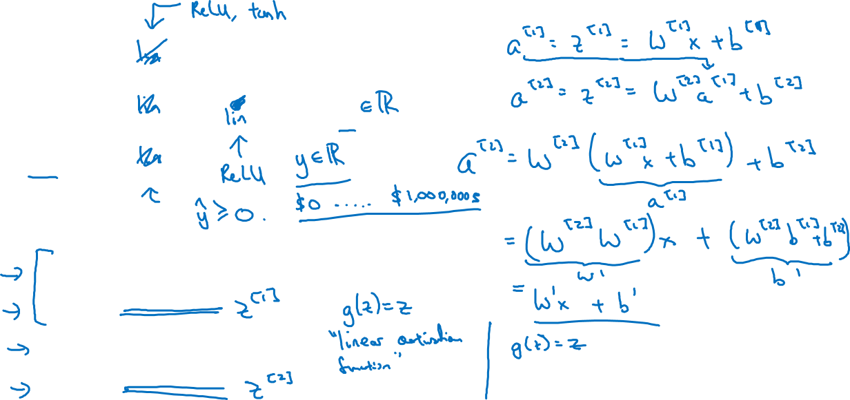





Activation function
Need nonlinear activation function, otherwise yhat is just a linear comb of X, no matter how many layers!
(could then represent all as a single layer)
$$x_{1}$$
$$x_{2}$$
$$\hat{y}$$
$$x_{3}$$
Given x:
$$z^{\left[1\right]}=W^{\left[1\right]}x+b^{\left[1\right]}$$
$$a^{\left[1\right]}=g^{[1]}(z^{\left[1\right]})$$
$$z^{\left[2\right]}=W^{\left[2\right]}a^{\left[1\right]}+b^{\left[2\right]}$$
$$a^{\left[2\right]}=g^{[2]}(z^{\left[2\right]})$$
Notes:
In the last output layer, you can use a linear activation function (no activation function), so that outputs are unchanged, and can represent, say housing cost in dollars.

