Slide 1
One hidden layer
Neural Network
Gradient descent for
neural networks

Slide 2
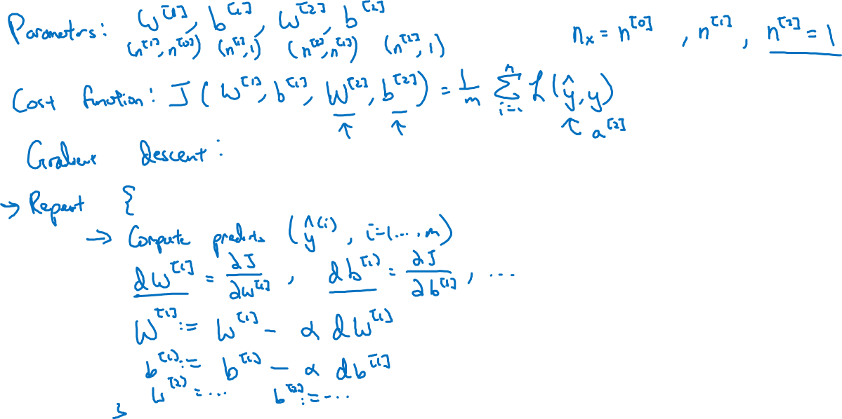
Gradient descent for neural networks
n[2]×1
n[1]×1
# inputs
# hidden units
n[1]×n[0]
n[2]×n[1]
# outputs
Avg loss

Slide 3
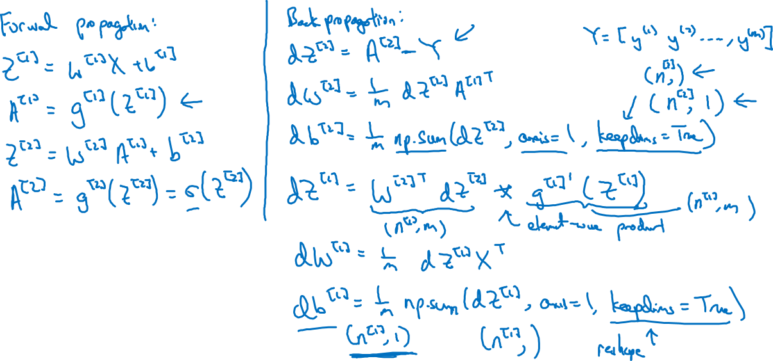
Formulas for computing derivatives
Y is 1×m matrix
Sum horiz
Output (n^{[2]}×1) instead of (n^{[2]},)
(n^{[1]}×m)
(n^{[1]}×m)
“.*”

