Slide 1
Deep Neural Networks
Getting your matrix
dimensions right

Slide 2

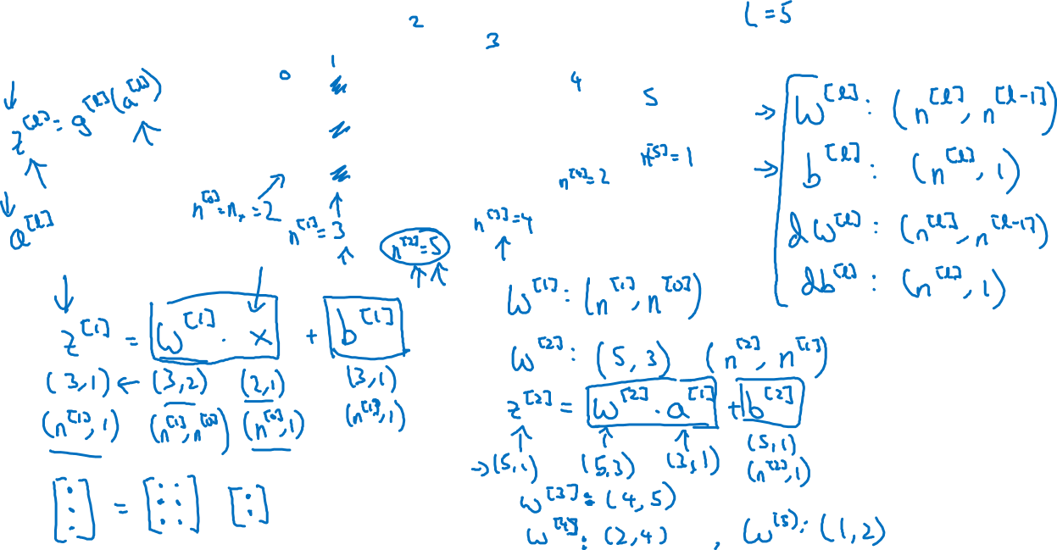



Parameters $W^{[l]}$ and $b^{[l]}$
$$x_{1}$$
$$\hat{y}$$
$$x_{2}$$
(a same dimensions as z)

Slide 3
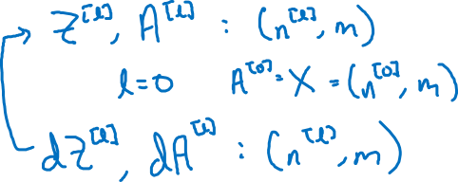
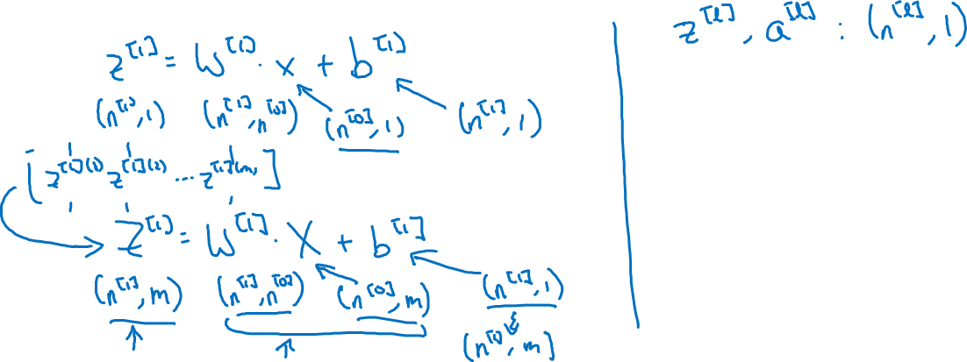
Vectorized implementation
$$x_{1}$$
$$\hat{y}$$
$$x_{2}$$
B is (n^[1],1), but python broadcasting will make n^[1],m)

