Slide 1


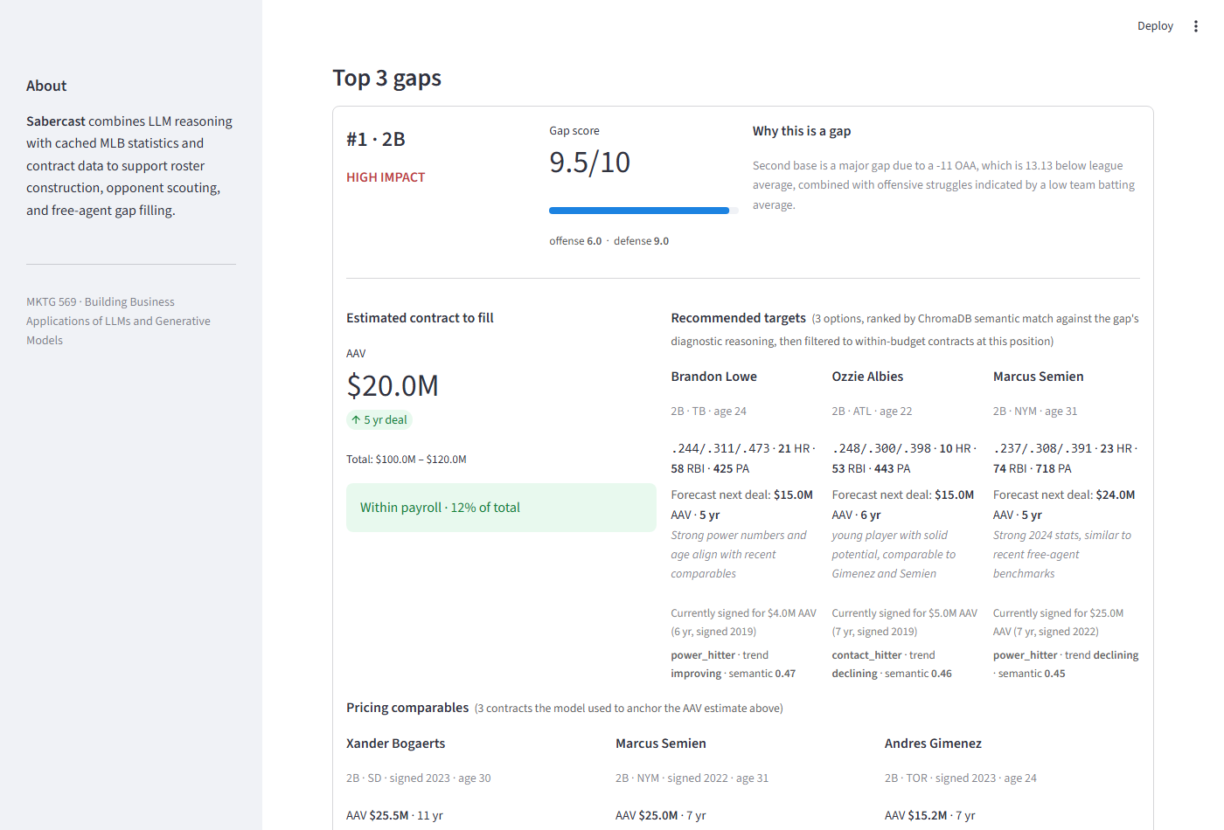





Sabercast
From roster gaps to ranked free-agent targets — in 13 seconds.
Plus lineup planning and series scouting. Built for small / mid-market MLB front offices needing analyst leverage without a 20-person R&D shop.
13 sec
3.1×
1,254
60%
Decisions in real time
Better FA recommendations
FA contracts indexed
Validated gap diagnosis
Use during trade calls, not after
Top-10 surfaces players you'd consider
Pricing context for every position
Up to 74% at specific positions
THREE GM-OFFICE JOBS
• Plan tonight's lineup vs. the opponent
• Scout the team you're facing
• Diagnose roster gaps + rank FA targets
COMPLETE COVERAGE
All 30 MLB teams
999 player profiles with Statcast
5+ seasons of historical performance
READY FOR YOUR WORKFLOW
Live web app · no install · try any team
Position gap diagnosed · 3 free-agent targets ranked · 3 pricing comparables
Decision support — augments your analysts, doesn't replace them.
Every recommendation cites comparables · diagnosis shows its confidence
Powered by
Try the live app · sabercast-mlb.streamlit.app
MKTG 569 · Spring 2026
github.com/rwpeugh/sabercast

