Slide 1
Smartphone Battery Drain Analysis
Module 6: Visual Narratives from Real‑World Data
Name: Ryan Pursley
Course: Generative AI Data Analyst

Slide 2
Dataset Overview
Dataset contains smartphone usage and battery performance metrics
Variables include CPU usage, screen brightness, RAM usage, temperature, and battery drain
Goal: Identify factors that contribute most to smartphone battery consumption

Slide 3
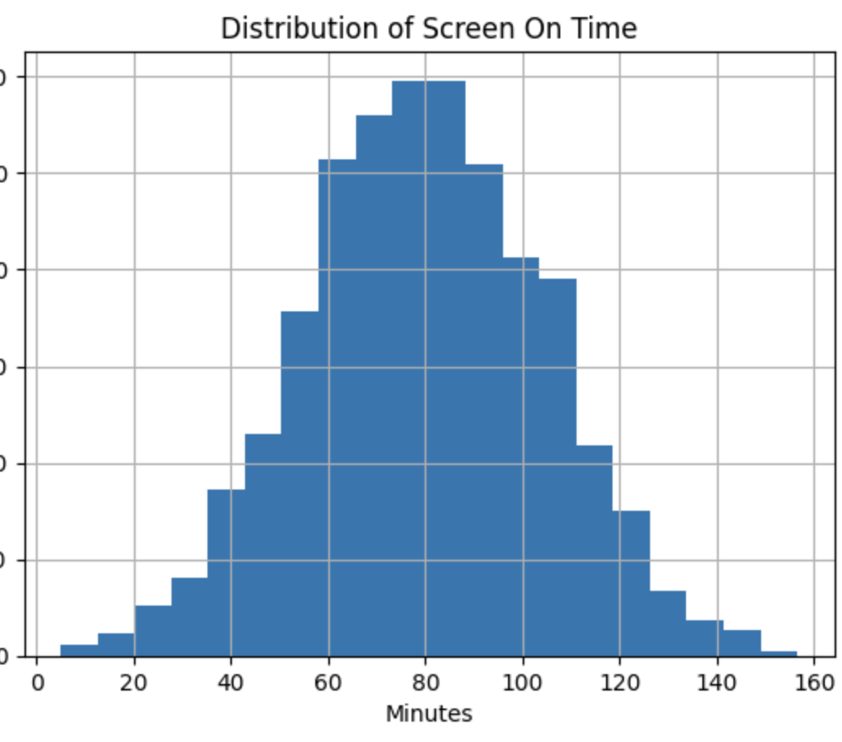
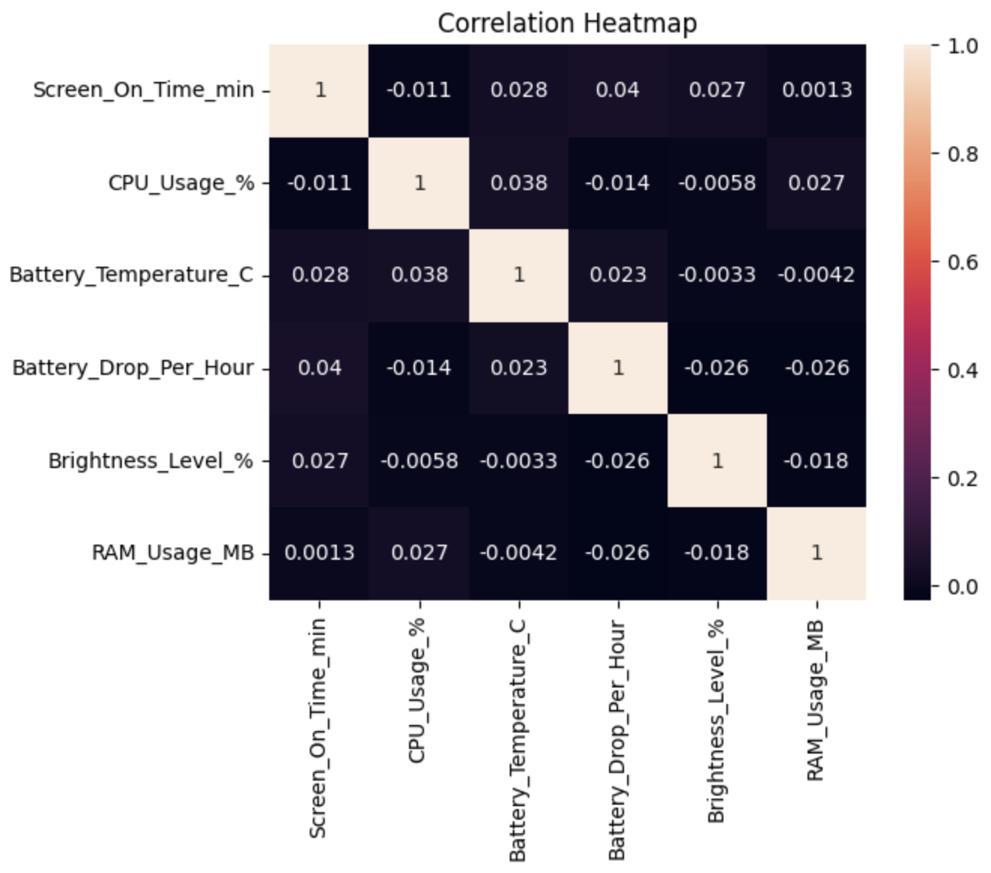
Exploratory Data Analysis
Examined summary statistics, correlations, and data types
Looked for trends between device performance metrics and battery drain
Visualizations were created to better understand patterns in the data

Slide 4
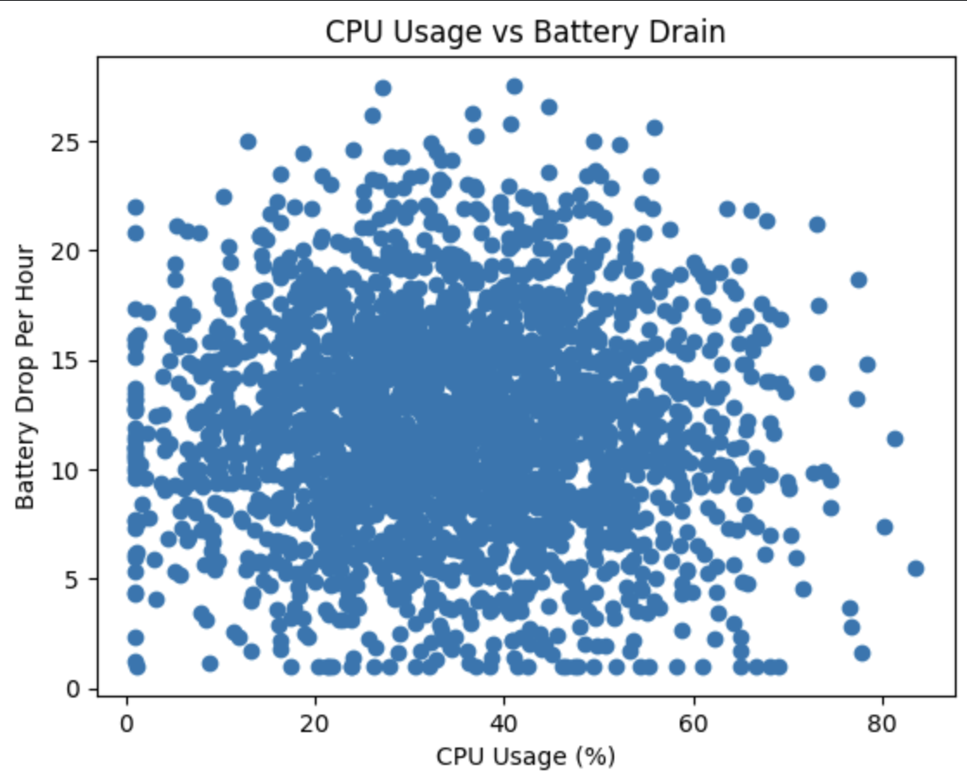
CPU Usage vs Battery Drain
Scatter plot visualization compares CPU usage with battery drop per hour
Higher CPU activity tends to correlate with faster battery consumption
Resource‑heavy applications increase device workload

Slide 5
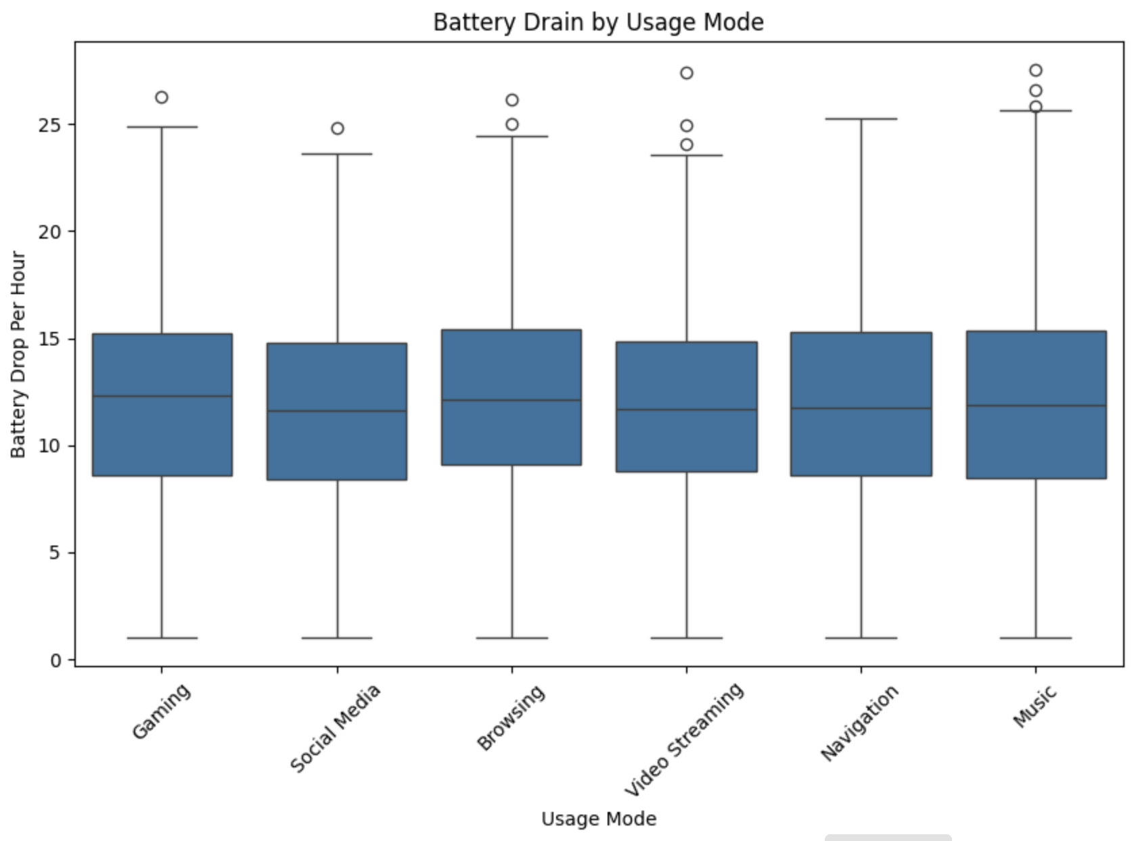
Battery Drain by Usage Mode
Box plot compares battery drain across different activities
Gaming and streaming show higher battery consumption
Browsing and messaging typically use less power

Slide 6
Key Insights and Conclusion
Higher CPU usage increases battery drain
Screen brightness also contributes to battery consumption
Gaming and streaming are the most battery‑intensive activities
Managing settings and usage habits can help extend battery life

