Slide 1
Nutrition Tracker
A food log I use every day.
Built end to end with AI agents — and directed as an engineering project.
Next.js · TypeScript · Python (FastAPI) · SQLite · Docker · Telegram
github.com/rwragg/nutrition-tracker
1

Slide 2
What it is
THE APP
— A daily food and macro log: what I ate, what it came to, and what is left against target
— Next.js and TypeScript front end, Python (FastAPI) API, SQLite and Docker
— A Telegram bot as a second client of the same API, so it works from a phone
— Multiple accounts, isolated from each other at the API and in the database
— No model in the product: AI wrote most of the code, the app is deterministic code
github.com/rwragg/nutrition-tracker
2

Slide 3
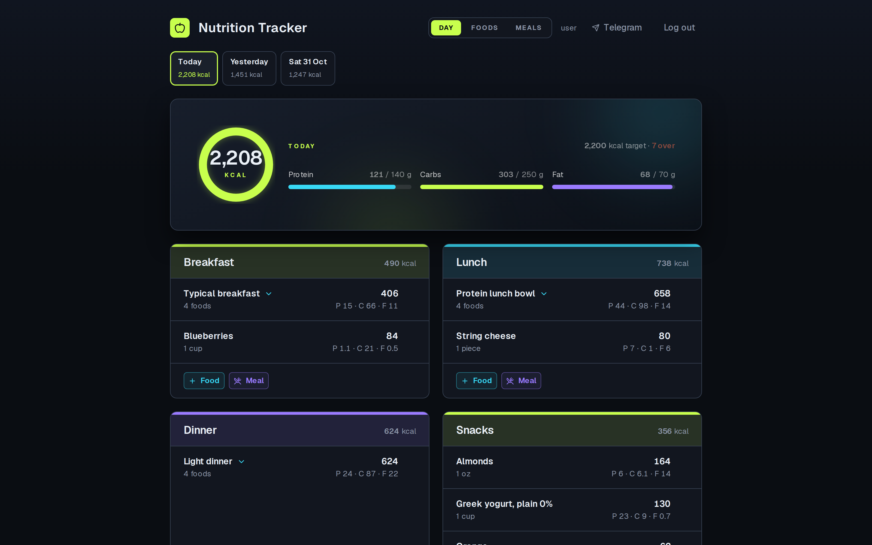
The day view
ON OPEN
Sections, entries, running totals, and macro bars against target.
github.com/rwragg/nutrition-tracker
3

Slide 4
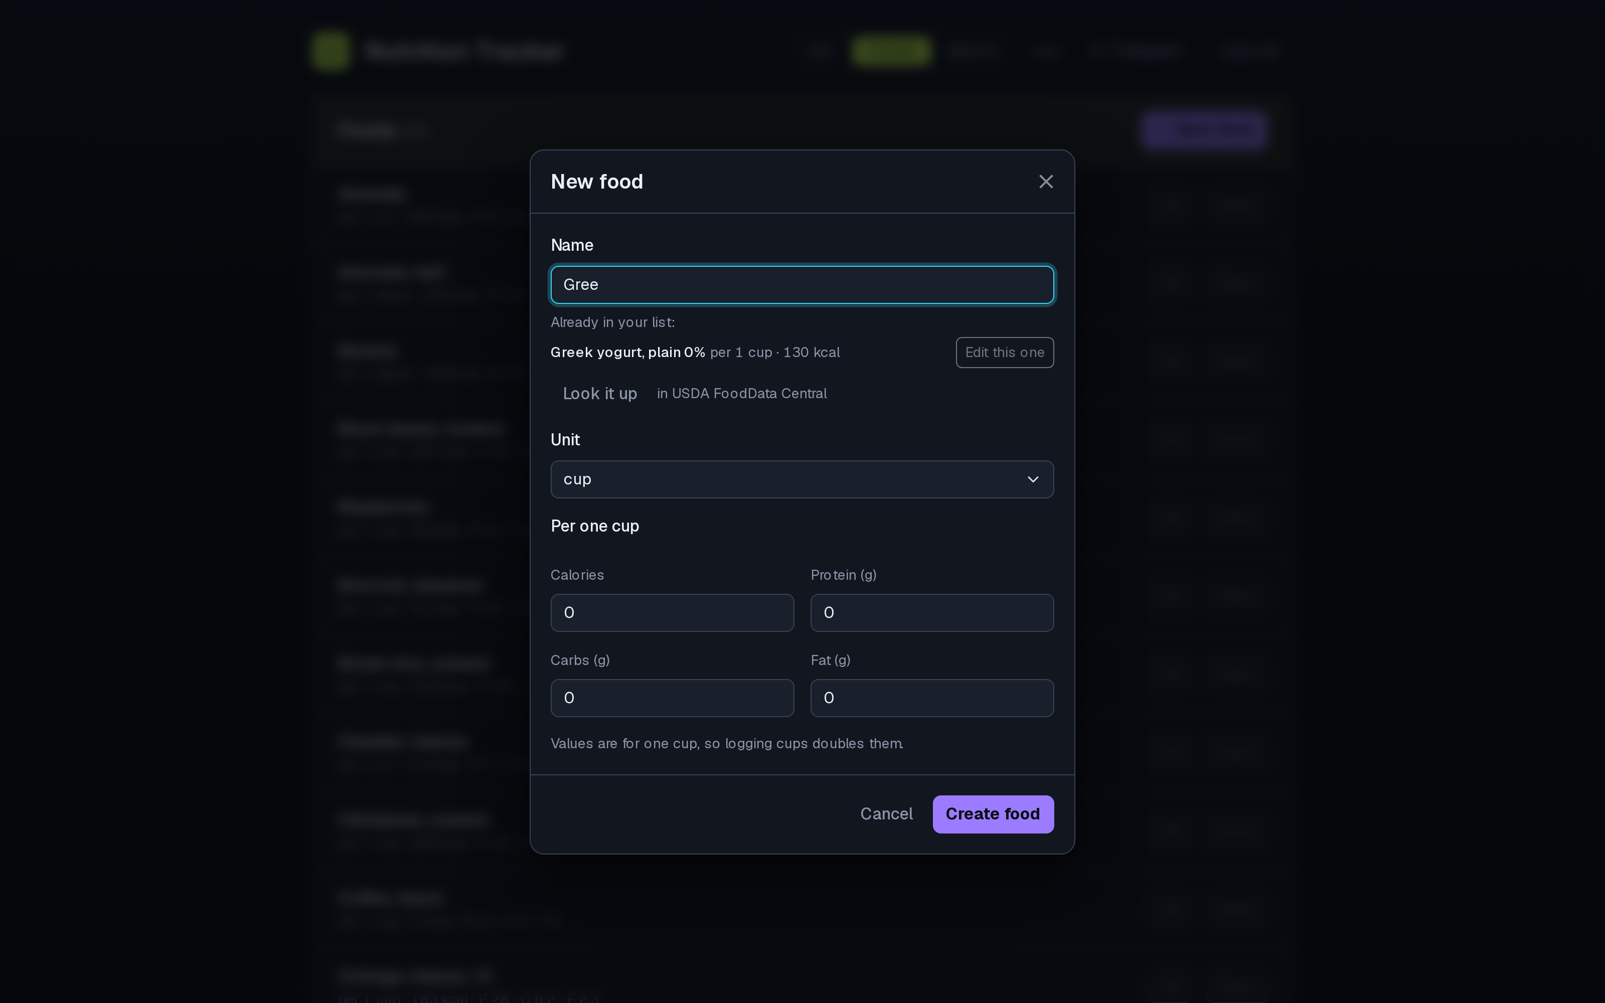
Adding a food you already know
THE CATALOGUE
A near-duplicate already in the list is offered instead of silently created.
github.com/rwragg/nutrition-tracker
4

Slide 5
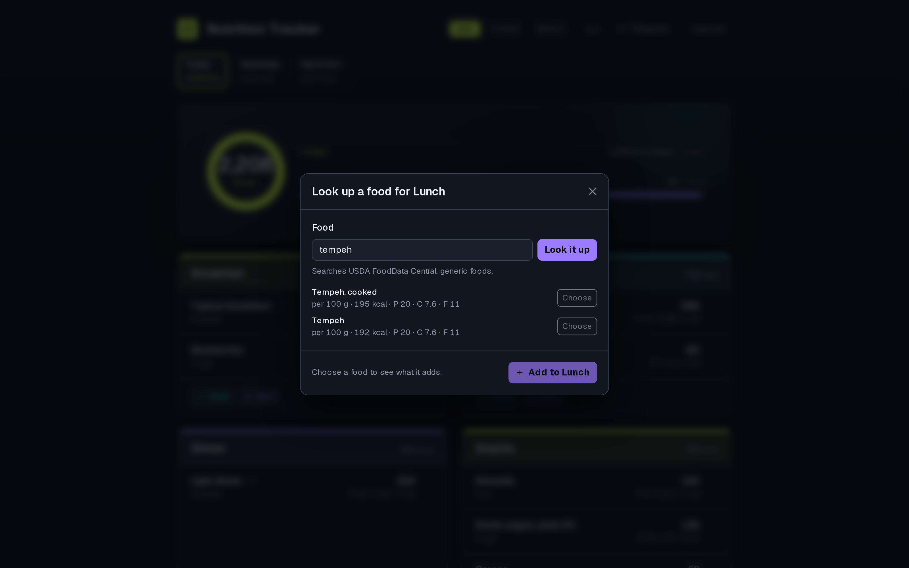
Foods the catalogue does not have
USDA FOODDATA CENTRAL
A live USDA search: generic foods, up to three candidates, per-100 g figures.
github.com/rwragg/nutrition-tracker
5

Slide 6
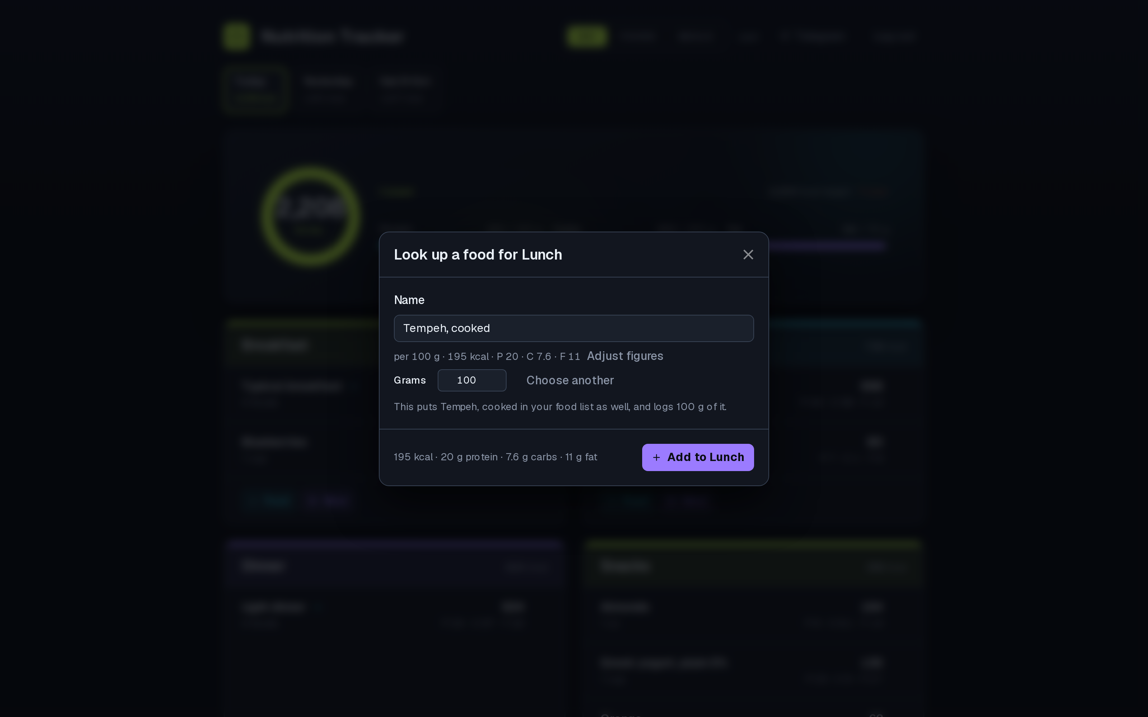
Nothing is written until you confirm
CONFIRM
Per 100 g in, grams out: name and figures stay editable. One button logs it.
github.com/rwragg/nutrition-tracker
6

Slide 7
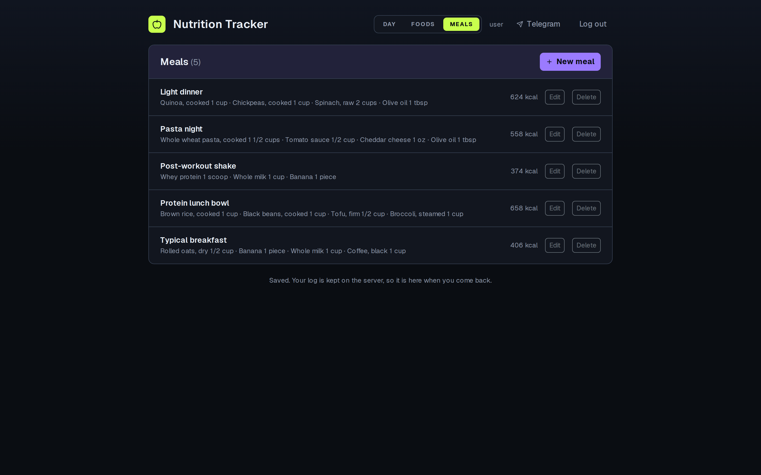
Meals as shortcuts
REPEATABLE MEALS
A named meal logs all of its items in one step. A definition is a snapshot, so it cannot drift.
github.com/rwragg/nutrition-tracker
7

Slide 8
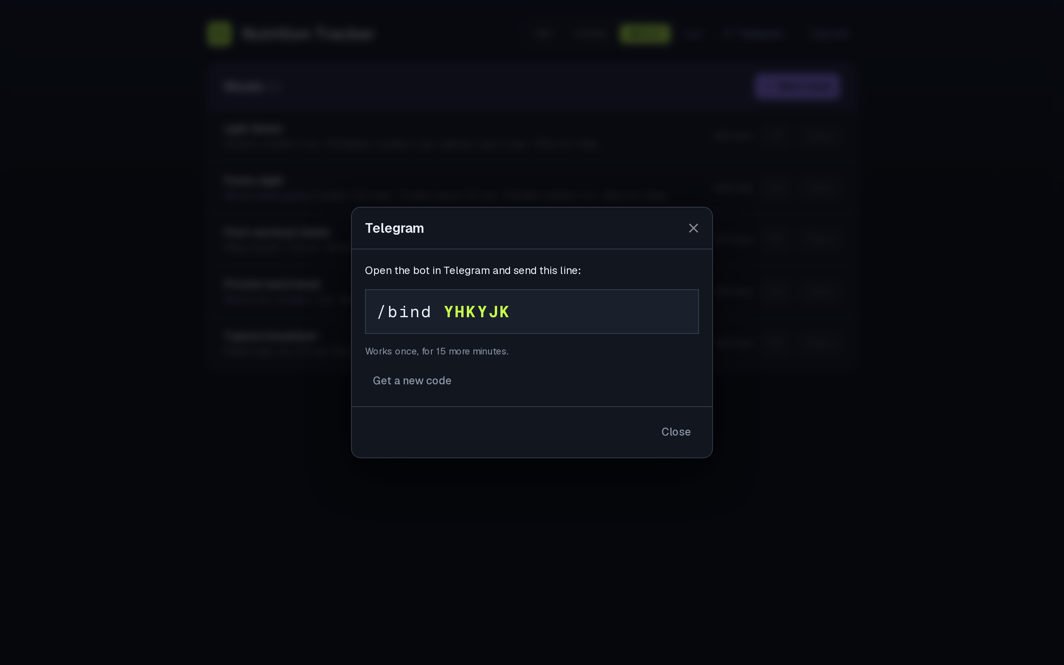
The chat client
A SECOND CALLER OF THE SAME API
Linking a chat means minting a one-time code and sending it to the bot.
github.com/rwragg/nutrition-tracker
8

Slide 9
No password ever goes into a chat
SECURITY
— Minted by the app, redeemed in the chat, burned on use — and any other code the account held dies with it
— The bot proves who it is with a shared secret compared in constant time
— The account it acts for comes from the binding, not from the caller
— One function decides who may ask, for person and machine alike
— Per-account daily caps, per-chat attempt limits, codes that expire in fifteen minutes
— Account isolation is proved by tests, not asserted
github.com/rwragg/nutrition-tracker
9

Slide 10
How it fits together
ARCHITECTURE
Browser UI
Next.js + TypeScript
The one gate
FastAPI: sessions, quotas, validation, ownership
SQLite
schema v6, migrations, delete guards
Telegram bot
long polling, no public port
Second caller
same routes, same rules
USDA
server-side key, per-account caps
One API, two callers. The person and the bot authenticate to the same gate, so a route the person cannot reach is a route the bot cannot reach — and an unbound chat is refused everything.
The figures come from USDA and the person's own list, never from a model: the model that built the app is not part of the app.
github.com/rwragg/nutrition-tracker
10

Slide 11
Data, and how it changes shape safely
THE DATABASE
— SQLite at schema version 6, with a migration chain that refuses a schema it cannot carry forward
— Deletes are guarded in the database, so an entry cannot lose the food underneath it
— Entries carry literal figures: correcting a value never rewrites what a day was logged as
— Every account's rows are its own — enforced at the API, and proved by tests
github.com/rwragg/nutrition-tracker
11

Slide 12
How it was built: the process, not a long chat
HOW, NOT JUST WHAT
— A written brief: 30 numbered requirements and 24 recorded decisions, each with its reasoning
— A plan file stating every part's substeps, its tests and its success criteria
— A review gate at every part — nothing starts before the previous part is verified
— The state after each part written down for whoever picks it up next
— Every claim in the documentation is a command that prints it
github.com/rwragg/nutrition-tracker
12

Slide 13
How it was built: the agents
MULTI-MODEL, DIRECTED
— AI agents wrote most of the code; I set the requirements, the boundaries and the gates
— Separate agents on isolated profiles, each with only the tools its own job needs
— Private health and training data stays on a model I run myself; general work goes to a hosted one
— Unknown values are refused rather than guessed; credentials carry the least access that works
— The result is not a demo: it is the app I log my own meals in
github.com/rwragg/nutrition-tracker
13

Slide 14
Evidence, and how to check it
EVIDENCE
Suite | Command | Result
Backend (pytest) | uv run python -m pytest | 282 passed
Front-end unit (Vitest) | npm test | 140 passed, 14 files
End-to-end (Playwright) | npm run test:e2e | 28 passed, real container
Schema version | db.py SCHEMA_VERSION | 6
Every figure here came from re-running the command, not from memory. The end-to-end suite starts its own container from a freshly seeded database, so it asserts against a known state rather than whatever happens to be on the machine.
github.com/rwragg/nutrition-tracker
14

Slide 15
What it does not do yet
HONESTLY
— No voice input: the bot skips any update with no text field — left off until it exists
— One person, one machine: there is no hosting story yet
— Household units are partial: grams, cups, each, tablespoons
— Rate limits live in memory and reset with the process
— Next: a second account on real hardware, then hosting, then voice
github.com/rwragg/nutrition-tracker
15

