Slide 1

API Integration Report
Usage of the SerpAPI wrapper around the Google Jobs API in the TRKR app.
Authored by Data Geek | Rebecca Wright.

Slide 2
What is TRKR?
TRKR is a job application organization tool.
Developed as part of a month-long product club, TRKR is a web-based app focused on streamlining the job search experience and providing a tracking log interface by which to organize and monitor pending applications.

Slide 3
Understanding the Problem:
Insights from the UX Team
UX found many users felt a need to use multiple job-seeking platforms to find and apply for jobs.
This complicates their process, creating a need for multiple external accounts, and creates the risk for repeated application to the same job position through different platform access points.

Slide 4
The Solution:
Integrate Google Jobs API within the local job search interface.
The SerpAPI wrapper provided methods for querying the Google Jobs API and, when combined with a call to the Google Jobs Listing API, returned job search results along with all associated url access points for direct external job application submission (ie Glassdoor, Indeed, etc).
The SerpAPI can be accessed using multiple programming languages including python and javascript.
This gives the user more control over how many additional platforms they choose to sign up for, and streamlines their application process.

Slide 5
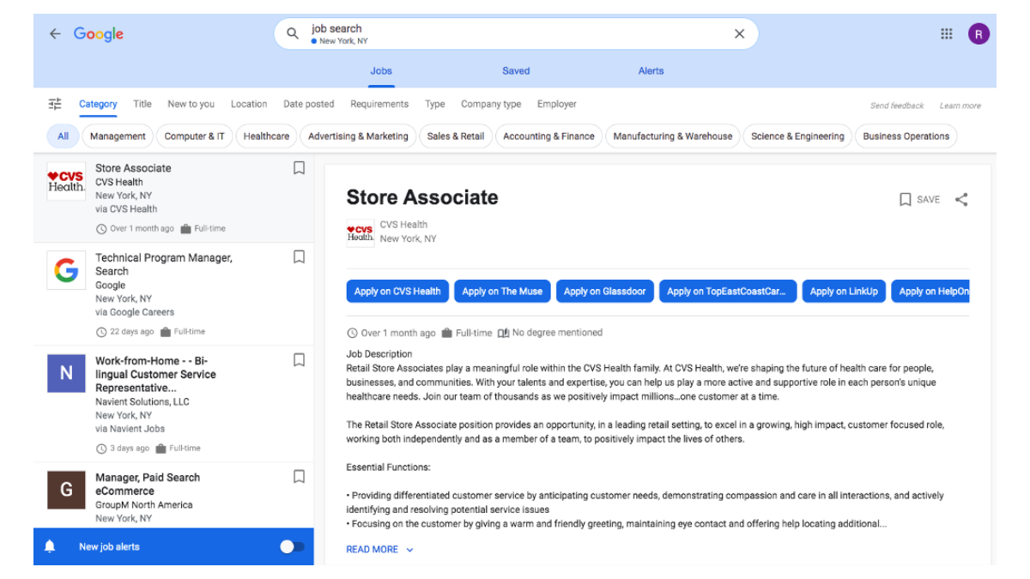
Outlining TRKR feature goals:
A look at the existing Google Jobs interface.
Step 1
Understanding desirable user features through existing product research.
* Google Jobs screenshot

Slide 6
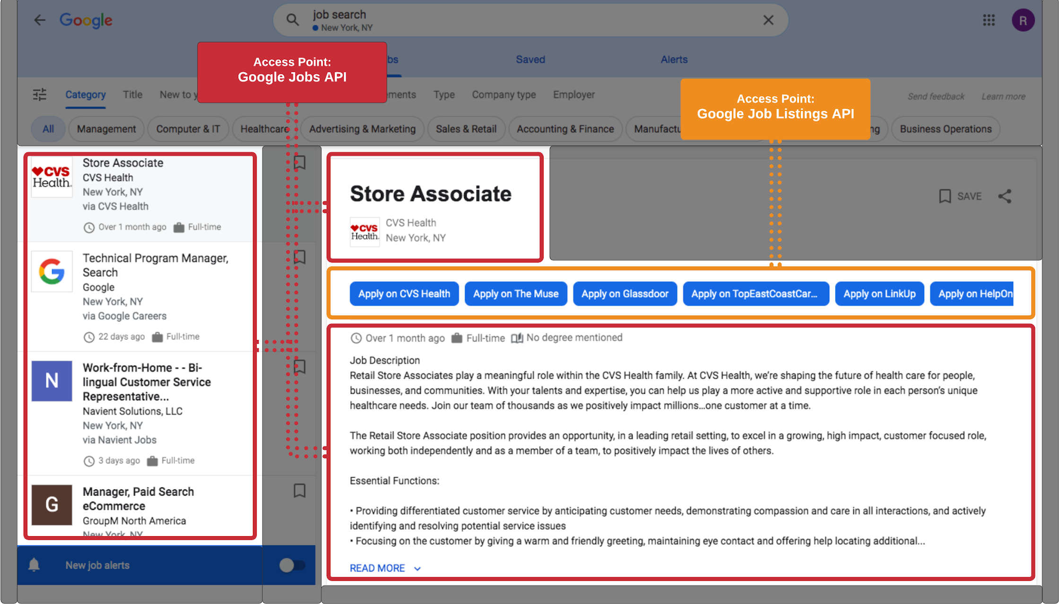
Outlining TRKR feature goals:
Isolating accessible features and their related APIs.
Step 2
Identifying which APIs can access the relevant data points.
* Google Jobs screenshot

Slide 7
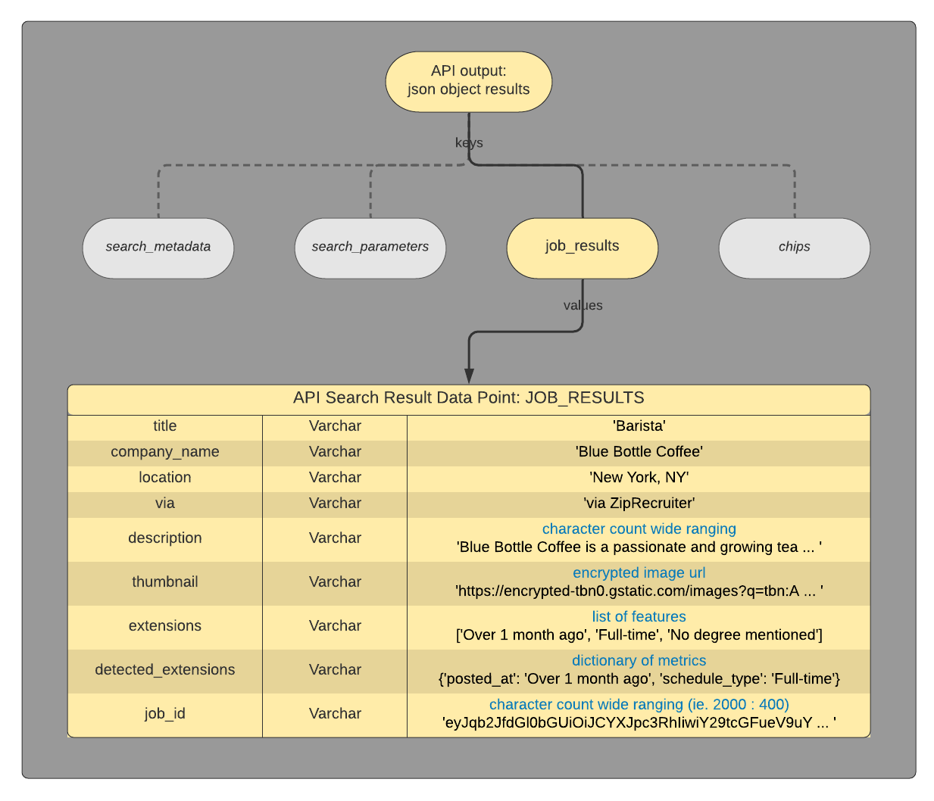
Step 3
Accessing
Results
－
A look at the
Job Results Key
data points.
SerpAPI Google Jobs Wrapper

Slide 8
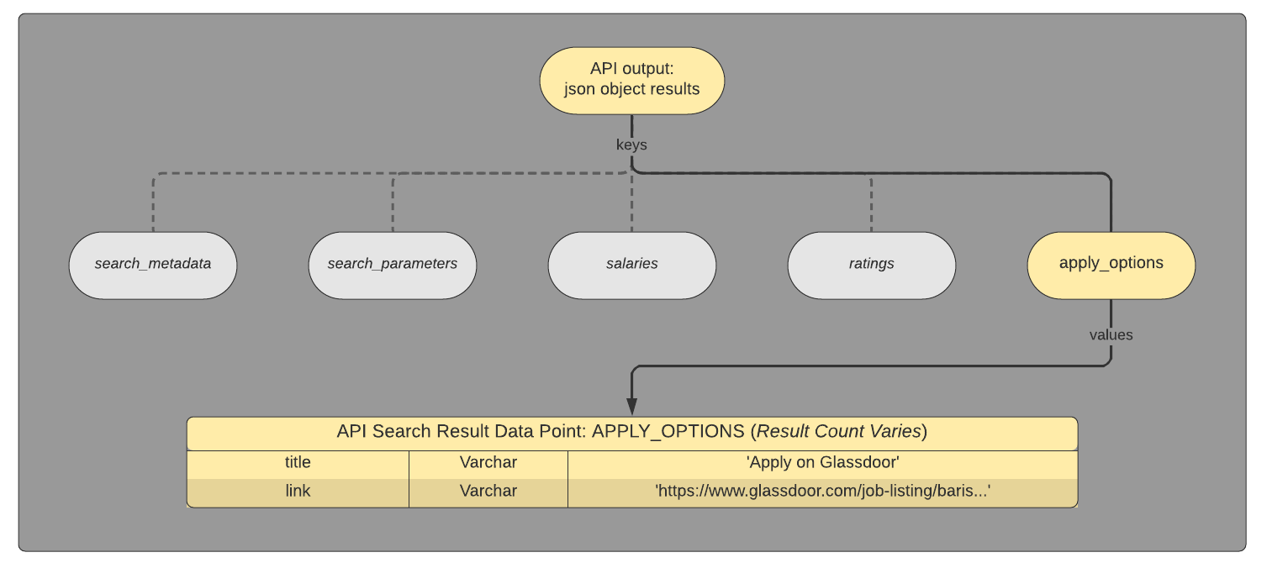
Accessing
Results
－
Apply Options Data Points
SerpAPI Google Jobs Listing Wrapper

Slide 9
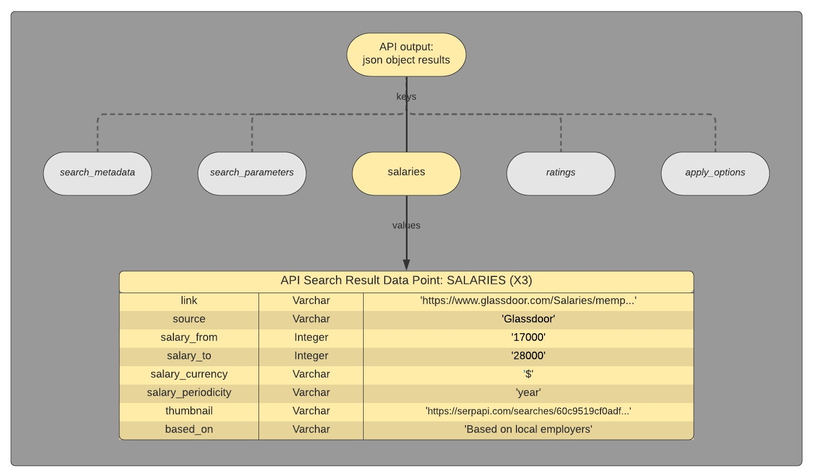
Accessing
Results
－
Salary Comparison Data Points
SerpAPI Google Jobs Listing Wrapper

Slide 10
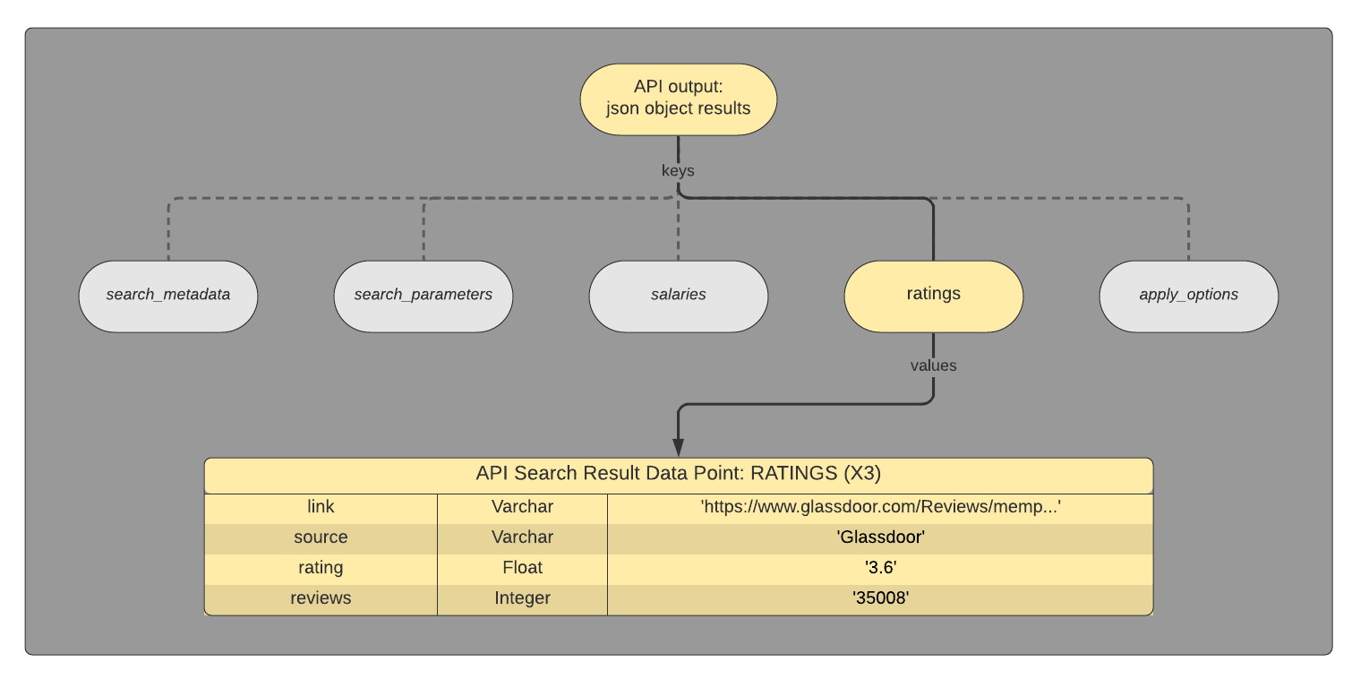
Accessing
Results
－
Company Ratings Data Points
SerpAPI Google Jobs Listing Wrapper

Slide 11
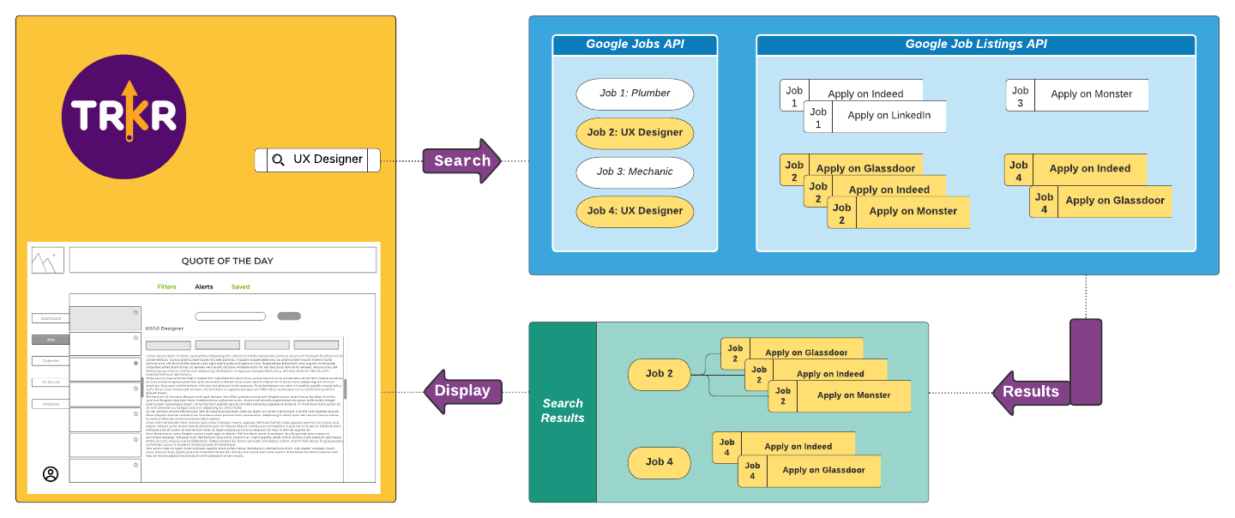
API Process Summary:
Integration Overview
This analysis looks at which campaigns were the most successful at getting funded based on type of project, length of campaign, and fundraising goal.

Slide 12
Want to see my code?
－
View it on Github.
Available on Github:
In Python:
Executable scripts:
Query Google Jobs API
Query Google Jobs Listing API
Jupyter notebooks:
Generate sample query results
Generate sample user trackerlog entries dataset
In Javascript:
Code block for API query

Slide 13

Meet the Geek
www.rebeccawright.tech
Notes:
Thank you so much.

