Slide 1

Fifth Mountain Engineering, PLLC

Slide 2

Fifth Mountain Engineering, PLLC

Slide 3


Slide 4
Fifth Mountain Engineering, PLLC

Slide 5
Fifth Mountain Engineering, PLLC

Slide 6

Fifth Mountain Engineering, PLLC

Slide 7


Slide 9

Fifth Mountain Engineering, PLLC

Slide 10
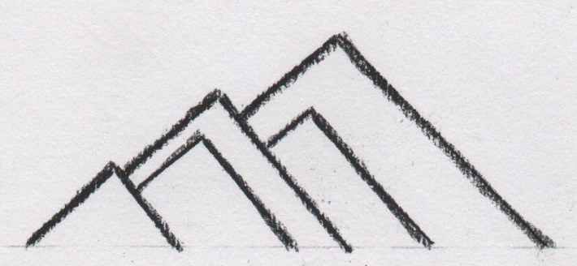

Slide 11


