Slide 1
Please pull from
DS-SF-32
Reid Offringa, PhD
Data Scientist, Glooko

Slide 2
STATISTICS FUNDAMENTALS
Reid Offringa, PhD
Data Scientist, Glooko

Slide 3
LEARNING OBJECTIVES
STATISTICS FUNDAMENTALS
Use NumPy and Pandas libraries:
Analyze datasets using basic summary statistics:
mean, median, mode, max, min, quartile, inter-quartile range, variance, standard deviation, and correlation
Create data visualizations:
line graphs, box plots, and histograms- to discern characteristics and trends in a dataset
Discuss distributions within a dataset using summary statistics and visualization
ID variable types and complete dummy coding by hand

Slide 4
PANDAS and
PEER GRADING
Reid Offringa, PhD
Data Scientist, Glooko

Slide 5
Overview
Peer Grading
You will each grade two home works
You will assign each question a 0, 1, or 2
0: did not complete
1: partially completed
2: completed fully
Goal: See how your fellow students approached the same problems

Slide 6
OPENING
STATISTICS FUNDAMENTALS

Slide 7
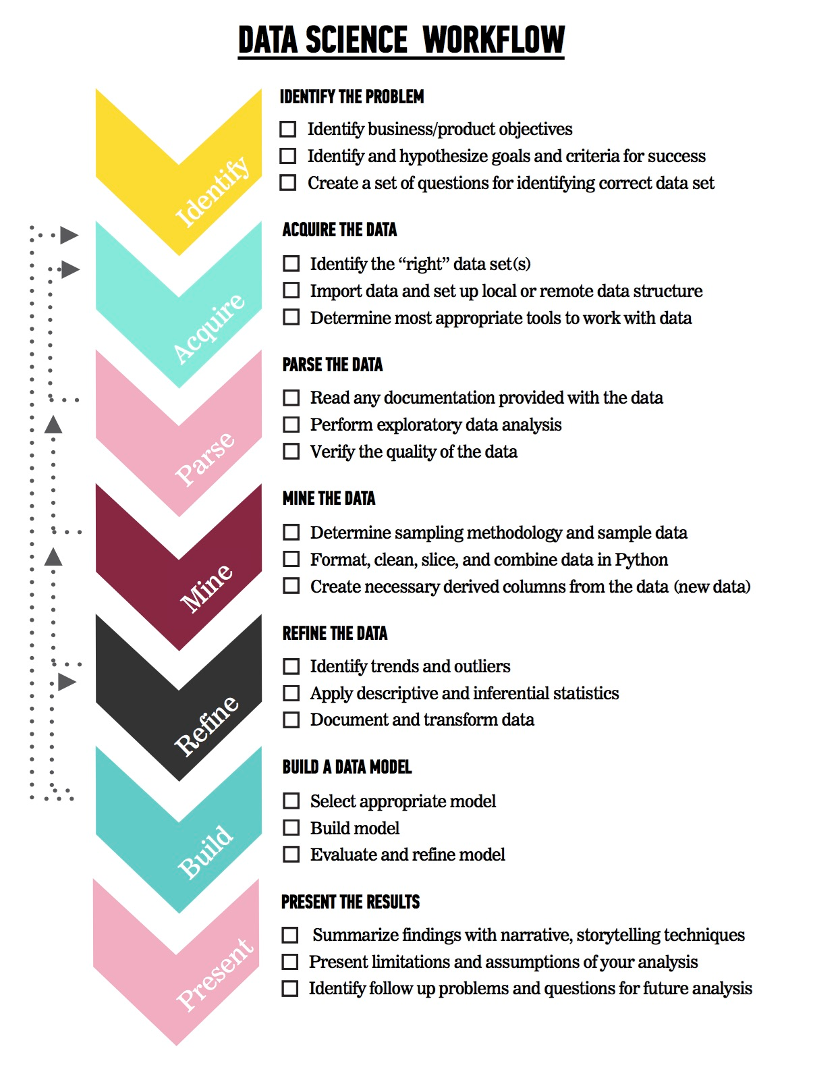
LET’S REVIEW THE DATA SCIENCE WORKFLOW
The steps:
Identify the problem
Acquire the data
Parse the data
Mine the data
Refine the data
Build a data model
Present the results

Slide 8
CODEALONG
SUMMARY STATISTICS IN PANDAS

Slide 9
CODEALONG PART 1: STATS REFERENCE
We can use Pandas to calculate the mean, median, mode, min, and max.
Methods available include: .min() - Compute minimum value .max() - Compute maximum value .mean() - Compute mean value .median() - Compute median value .mode() - Compute mode value .count() - Count the number of observations

Slide 10
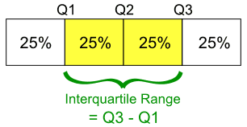
QUARTILES AND INTERQUARTILE RANGE
Quartiles divide a rank-ordered data set into four equal parts.
The values that divide each part are called first, second, and third quartiles, denoted Q1, Q2, and Q3, respectively.
The interquartile range (IQR) is Q3 - Q1, a measure of variability.

Slide 11
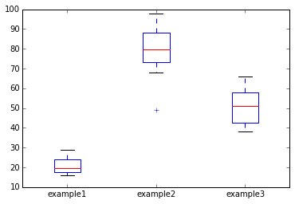
CODEALONG PART 2: BOX PLOT
Box plots give a nice visual of min, max, mean, median, and the quartile and interquartile range.

Slide 12
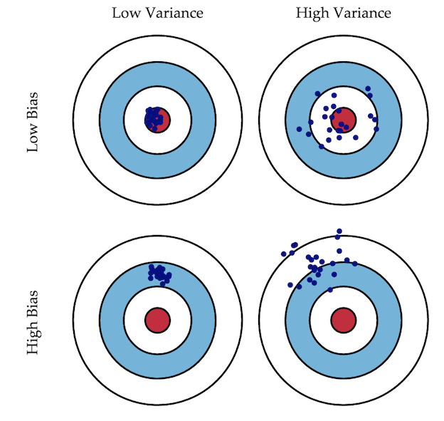
BIAS VS. VARIANCE

Slide 13
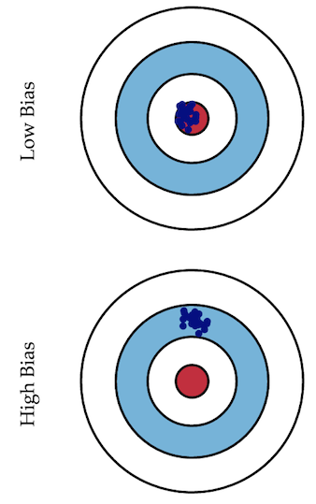
BIAS VS. VARIANCE
Error due to bias is calculated at the difference between the expected prediction of our model and the correct value we are trying to predict.
Imagine creating multiple models on various datasets. Bias measures how far off in general models’ predictions are from the correct value.

Slide 14
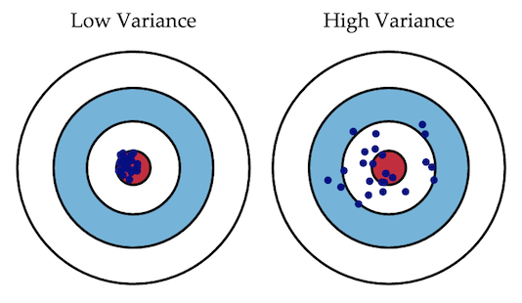
BIAS VS. VARIANCE
Error due to variance is taken as the variability of a model prediction for a given point.
Imagine creating multiple models on various datasets. The variance is how much the predictions for a given point vary between different realizations of the model.

Slide 15
BIAS VS. VARIANCE

Slide 16
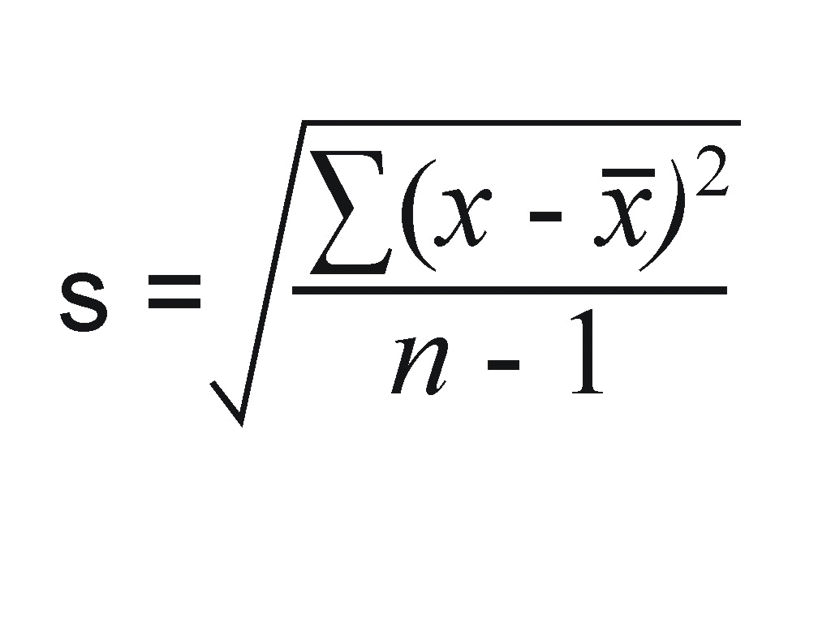
STANDARD DEVIATION
Standard deviation (SD, σ for population, s for sample) is a measure that is used to quantify the amount of variation or dispersion of a set of data values.
Standard deviation is the square root of variance.

Slide 17
STANDARD ERROR
The standard error of the mean (SEM) quantifies the precision of the mean.
It is a measure of how far your sample mean is likely to be from the true population mean.
It generally increases with the size of an estimate, meaning a large standard error may not indicate the estimate of the mean is unreliable.
It’s often better to compare the error in relation to the size of the estimate.

Slide 18
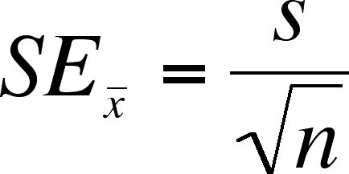
STANDARD ERROR

Slide 19
CODEALONG PART 3: STANDARD DEVIATION & VARIANCE
You can calculate variance and standard deviation easily in Pandas.
Methods include: .std() - Compute Standard Deviation .var() - Compute variance .describe() - short cut that prints out count, mean, std, min, quartiles, max

Slide 20
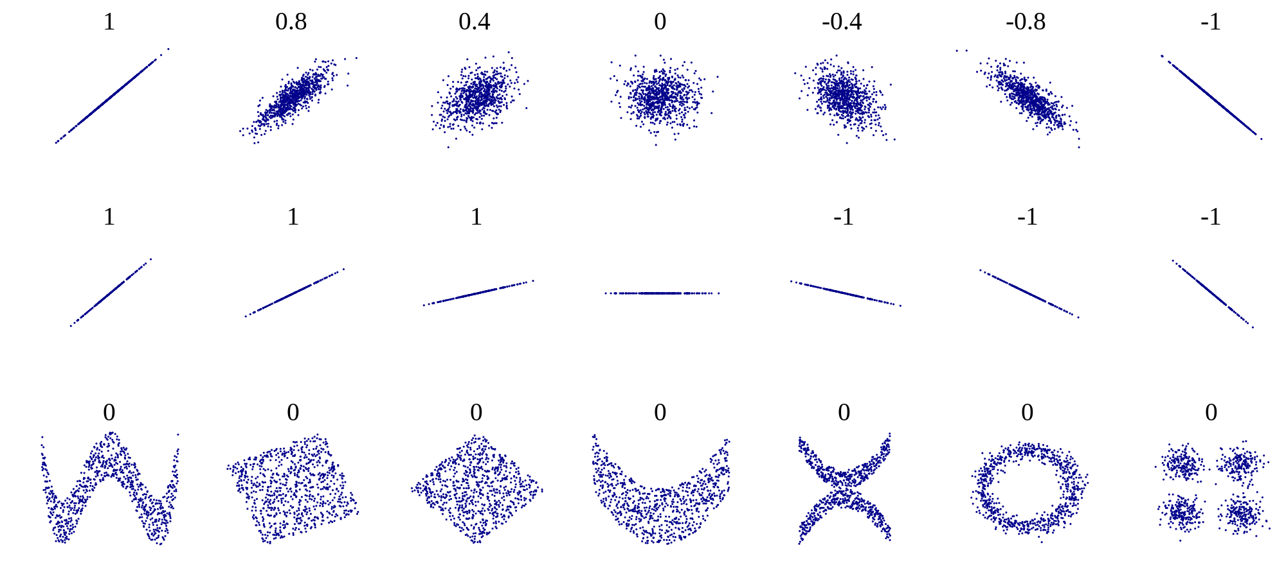
CORRELATION
The correlation measures the extent of interdependence of variable quantities.
Example correlation values

Slide 21
Descriptive vs Inferential Stats
For most projects, descriptive stats will come first.
These help you get to know your dataset better.
Sometimes, descriptive stats may be all you need to answer your question.
Other times, we need to make “inferences”

Slide 22
Distributions
IS THIS NORMAL?

Slide 23
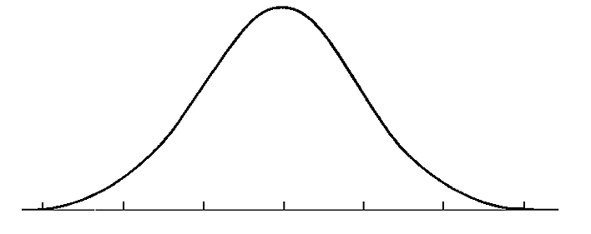
THE NORMAL DISTRIBUTION
A normal distribution is often a key assumption to many models.
The normal distribution depends upon the mean and the standard deviation.
The mean determines the center of the distribution. The standard deviation determines the height and width of the distribution.

Slide 24
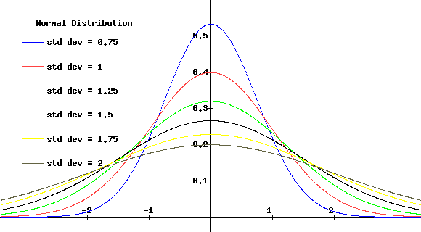
THE NORMAL DISTRIBUTION
Normal distributions are symmetric, bell-shaped curves.
When the standard deviation is large, the curve is short and wide.
When the standard deviation is small, the curve it tall and narrow.

Slide 25
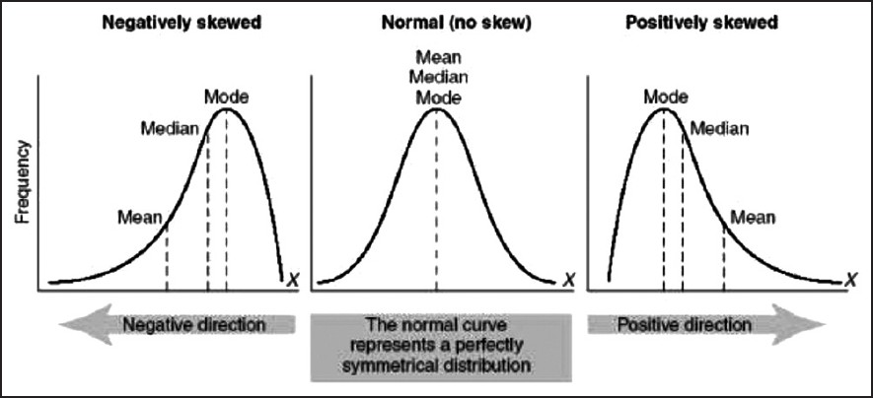
SKEWNESS
Skewness is a measure of the asymmetry of the distribution of a random variable about its mean.
Skewness can be positive or negative, or even undefined.

Slide 26
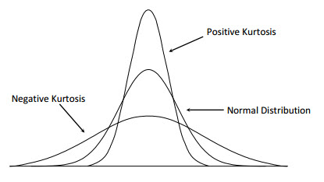
KURTOSIS
Kurtosis is a measure of whether the data are peaked or flat relative to a normal distribution.
Datasets with high kurtosis tend to have a distinct peak near the mean, decline rather rapidly, and have heavy tails.

Slide 27
Class Coding: Please Open Widget For Gaussian

Slide 28
Introduction
Intro to Inferential Statistics

Slide 29
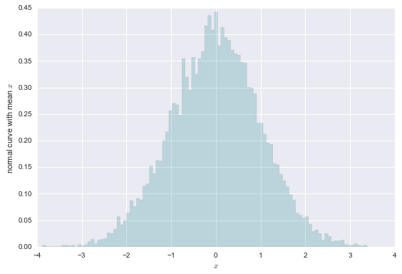
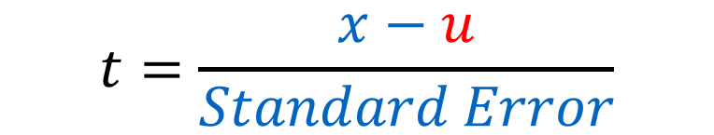
One sample T-tests: Is this significantly different from the u?
$$t=\frac{x−u}{Standard Error}$$

Slide 30
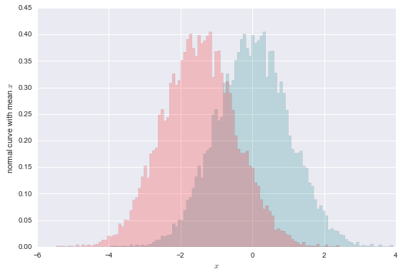
Independent t-tests: Are these two different populations?

Slide 31
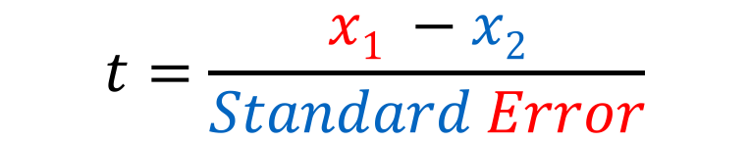
Independent t-tests: Are these two different populations?
$$t=\frac{x1 −x2}{Standard Error}$$

Slide 32
T-tests
Compare Two Samples or Populations
Over their combined standard error
Assume a normal distribution
Give 3 important stats:
t-value
df
p-value

Slide 33
DEMO
Let’s Explore Distributions and Inferential Stats

Slide 34
DETERMINING THE SIGNIFICANCE OF YOUR DATA
Follow along as we walk through this in an Jupyter Notebook.
Open up “Inferential Stats”

Slide 35
DEMO
DEALING WITH CATEGORICAL DATA

Slide 36
CLASS/DUMMY VARIABLES
Let’s say we have the categorical variable area, which takes on one of the following values: rural, suburban, and urban.
We need to represent these numerically for a model. So how do we code them?

Slide 37
CLASS/DUMMY VARIABLES
How about 0=rural, 1=suburban, and 2=urban?

Slide 38
CLASS/DUMMY VARIABLES
But this implies an ordered relationship
Is urban twice suburban? That doesn’t make sense.
However, we can represent this information by converting the one area variable into two new variables: area_urban and area_suburban.

Slide 39
CLASS/DUMMY VARIABLES
We’ll draw out how categorical variables can be represented without implying order.
First, let’s choose a reference category. This will be our “base” category.
It’s often good to choose the category with the largest sample size and a criteria that will help model interpretation. If we are testing for a disease, the reference category would be people without the disease.

Slide 40
CLASS/DUMMY VARIABLES
Step 1: Select a reference category. We’ll choose rural as our reference category.
Step 2: Convert the values urban, suburban, and urban into a numeric representation that does not imply order.
Step 3: Create two new variables: area_urban and area_suburban.

Slide 41
CLASS/DUMMY VARIABLES
Why do we need only two dummy variables?
We can derive all of the possible values from these two. If an area isn’t urban or suburban, we know it must be rural.
In general, if you have a categorical feature with k categories, you need to create k-1 dummy variable to represent all of the information.
rural | urban | suburban

Slide 42
CLASS/DUMMY VARIABLES
Let’s see our dummy variables.
As mentioned before, if we know area_urban=0 and area_suburban=0, then the area must be rural.
 | area_urban | area_suburban
rural | 0 | 0
suburban | 0 | 1
urban | 1 | 0

Slide 43
CLASS/DUMMY VARIABLES
We can do this for a gender variable with two categories: male and female.
How many dummy variables need to be created?

Slide 44
CLASS/DUMMY VARIABLES
# of categories - 1 = 2 -1 = 1

Slide 45
CLASS/DUMMY VARIABLES
We will make female our reference category. Thus, female=0 and male=1.
This can be done in Pandas with the get_dummies method.
 | gender_male
female | 0
male | 1

Slide 46
INDEPENDENT PRACTICE
DUMMY COLORS

Slide 47

ACTIVITY: DUMMY COLORS
It’s important to understand the concept before we use the Pandas function get_dummies to create dummy variables. So today, we’ll create our dummy variables by hand.
Draw a table like the one on the white board.
Create dummy variables for the variable “colors” that has 6 categories: blue, red, green, purple, grey, and brown. Use grey as the reference.
DIRECTIONS (15 minutes)
EXERCISE
DELIVERABLE
Dummy variables table for colors

Slide 48
CONCLUSION
TOPIC REVIEW

Slide 49
LESSON
EXIT TICKET
DON’T FORGET TO FILL OUT YOUR EXIT TICKET

