Slide 1
STATISTICS FUNDAMENTALS, PART 2
Reid Offringa, PhD
Data Scientist, Glooko

Slide 2
T-tests
Reid Offringa, PhD
Data Scientist, Glooko

Slide 3
LEARNING OBJECTIVES & AGENDA
STATISTICS FUNDAMENTALS, PART 2
Review t-tests and Hypothesis testing
Validate your findings using statistical analysis
(p-values, confidence intervals)
Introduce Correlation and Linear Regression
Interpreting Results

Slide 4
OPENING
STATISTICS FUNDAMENTALS, PART 2

Slide 5
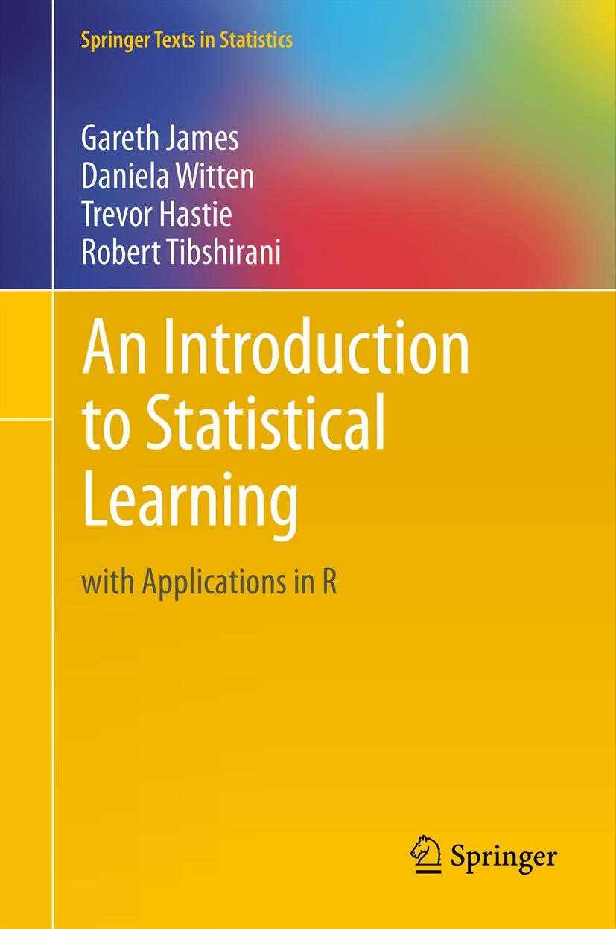
Book recommendation
An Introduction to Statistical Learning.

Slide 6
INTRODUCTION
Review of Hypothesis Testing
With t-tests

Slide 7
Hypothesis Testing
T-test is a common question in job interviews!
Research question: Is there a difference between two groups?
Check out means, but how can we tell if that diff is significant?
Statistical significance (p-value)
is the likelihood that a result or relationship is caused by something other than random chance.
Statistical hypothesis testing
Like a t-test
Traditionally employed to determine if a result is statistically significant or not

Slide 8
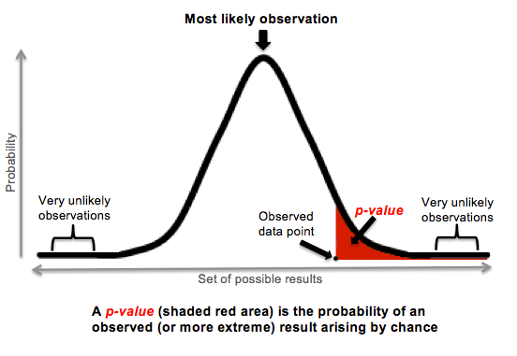
Hypothesis Testing
Typically, a cut point of 5% is used. This means that we say something is statistically significant if there is a less than a 5% chance that our finding was due to random chance alone.

Slide 9
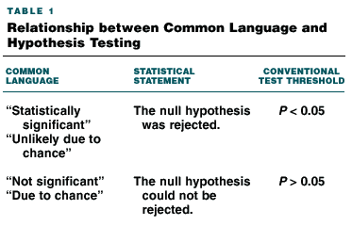
Hypothesis Testing

Slide 10
Hypothesis Testing
When we present results, we say we found something significant using this criteria.
We will use an example to dive further into this and understand p-values and confidence intervals.

Slide 11
Hypothesis Testing: TYPES OF ERROR
Type I error - saying there IS a relationship when there ISN’T.
“False Positive”
Related term: ‘alpha’
Type II error – saying there is NO relationship when there IS.
“False Negative”
Related term: ‘beta’
Related term: ‘Power’ (1-beta)

Slide 12
DEMO
P-VALUES AND CONFIDENCE INTERVALS CASE STUDY

Slide 13
P-VALUES AND CONFIDENCE INTERVALS CASE STUDY
We’re now going to walk through Part 2 of the guided-demo-starter-code notebook in the class repo for lesson 4.
There are several questions to answer. We’ll answer those questions in small groups and then discuss with the class.

Slide 14

ACTIVITY: KNOWLEDGE CHECK
ANSWER THE FOLLOWING QUESTIONS
EXERCISE
What does a 95% confidence interval indicate?
DELIVERABLE
Answers to the above questions

Slide 15
INDEPENDENT PRACTICE
Correlation and Regression Introduction

Slide 16
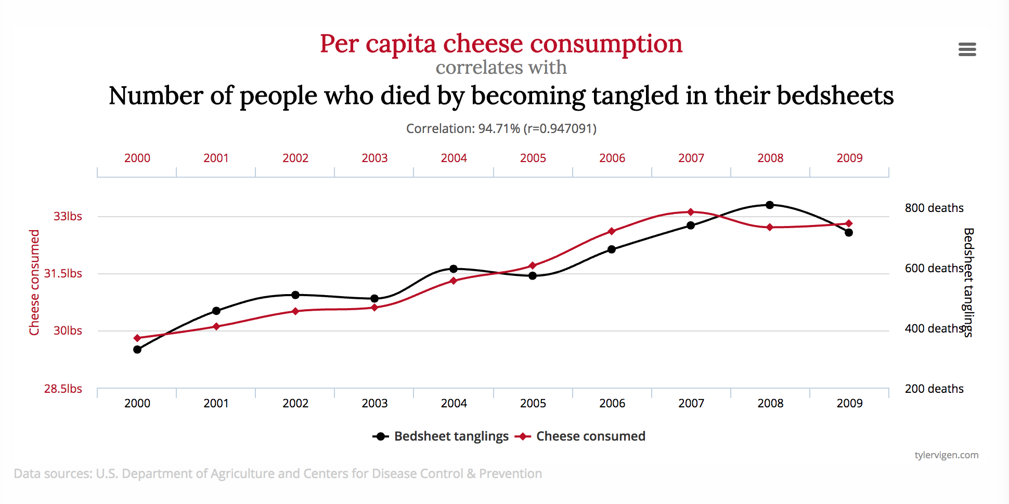
Correlations

Slide 17
LINEAR REGRESSION
A correlation explains a % of total variance (R squared)
Regression is a big correlation with multiple variables
Each variable explains a percent of remaining variance

Slide 18
LINEAR REGRESSION
Total VARIANCE

Slide 19
LINEAR REGRESSION
REMAINING VARIANCE
Variable X

Slide 20
LINEAR REGRESSION
Variable X2
REMAINING
VARIANCE
Variable X1

Slide 21
LINEAR REGRESSION
Variable X2
REMAINING
VARIANCE
Variable X1

Slide 22
INDEPENDENT PRACTICE
INTERPRETING RESULTS

Slide 23
ACTIVITY: INTERPRETING RESULTS
DIRECTIONS (35 minutes)
EXERCISE
Using the lab-start-code-4, you will look through a variety of analyses and interpret the findings.
You will be presented with a series of outputs and tables from a published analysis.
Read the outputs and determine if the findings are statistically significant or not.
DELIVERABLE
Answers to the questions in the notebook

Slide 24
INTRODUCTION
CAUSATION AND CORRELATION

Slide 25
CAUSAL CRITERIA
Causal criteria is one approach to assessing causal relationships.
However, it’s very hard to define universal causal criteria.
One attempt that is commonly used in the medical field is based on work by Bradford Hill.

Slide 26
CAUSAL CRITERIA
This is not an exhaustive checklist, but it’s useful for understanding that your predictor/exposure:
must have occurred before your outcome.
For example, in order for smoking to cause cancer,
one must have started smoking prior to getting cancer.

Slide 27
CAUSAL CRITERIA
Most commonly, we find an association between two variables. This means there is an observed correlation between the variables.
We may not fully understand the causal direction (e.g. does smoking cause cancer or does cancer cause smoking?).
We also might not understand other factors influencing the association.

Slide 28
INTRODUCTION
CONFOUNDING AND DAGS
DIRECTED ACYCLIC GRAPHS

Slide 29
CONFOUNDING
Associations may be influenced by another confounding factor.
Let’s say we did an analysis to understand healthy diets
We find that “Eating nuts” is related to various healthier outcomes
Does this mean that eating nuts is healthy?

Slide 30
CONFOUNDING: DIRECTED ACYCLIC GRAPH
Eating Raw Nuts
Healthy Outcomes
Being a generally healthy person with disposable income who does all sorts of healthy stuff

Slide 31
MEDIATION: DIRECTED ACYCLIC GRAPH
Eating Raw Nuts
Healthy Outcomes
Drinking more water

Slide 32
MODERATION: DIRECTED ACYCLIC GRAPH
Eating Raw Nuts
Healthy Outcomes
Portion Size

Slide 33
ACTIVITY: DAGS
DIRECTIONS
EXERCISE
Return to your starter code example:
which type of ad is associated with higher sales?
Break small groups.
Create a better model for predicting sales
How high can you can your R²?
Draw a basic DAG on your table. This DAG should show the relationship between ads and higher sales.
Discuss your DAGs in small groups and be ready to share one or two examples with the class.
DELIVERABLE
Insert Deliverable

Slide 34
Interactions
Linear regression is about linear relationships
MOSTLY
Interactions:
When two variables “interact”
Can be an example of “synergy”
ie: TV and Radio ad dollars
Can be an example of “moderation effect”
ie: All groups decline in Sx, but..
experimental groups declines more than control

Slide 35
A FEW KEY TAKEAWAYS
It is important to have deep subject area knowledge to be aware of biases in your field. This knowledge supplements statistical techniques.
A DAG can be a useful tool for thinking through the logic of your model.
There is a difference between causation and correlation. Statistics usually show correlation, not causation (remember our smoking example).
Good data is important. Your analysis is only as good as your understanding of the problem and the data you have to work with.

Slide 36
DUE DATE
BEFORE NEXT CLASS
Project: Unit Project 2

Slide 37
LESSON
Q & A

Slide 38
LESSON
EXIT TICKET
DON’T FORGET TO FILL OUT YOUR EXIT TICKET

Slide 39
THANKS!
NAME
Body Level One
Body Level Two
Body Level Three
Body Level Four
Body Level Five
Body Level One
Body Level Two
Body Level Three
Body Level Four
Body Level Five
Optional Information:
Email?
Website?
Twitter?

