Slide 1
Electronics

Slide 2
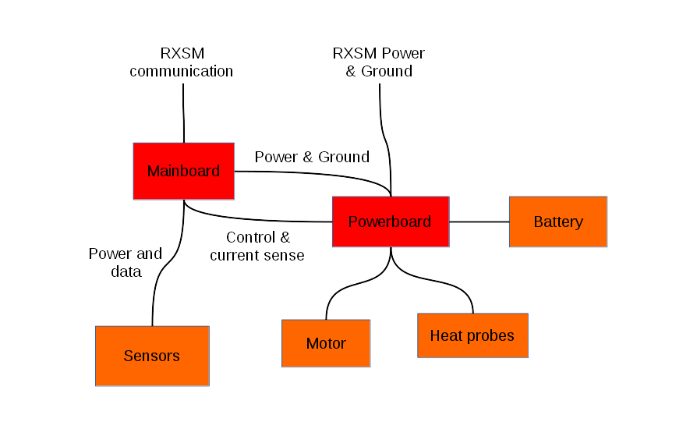

Slide 3
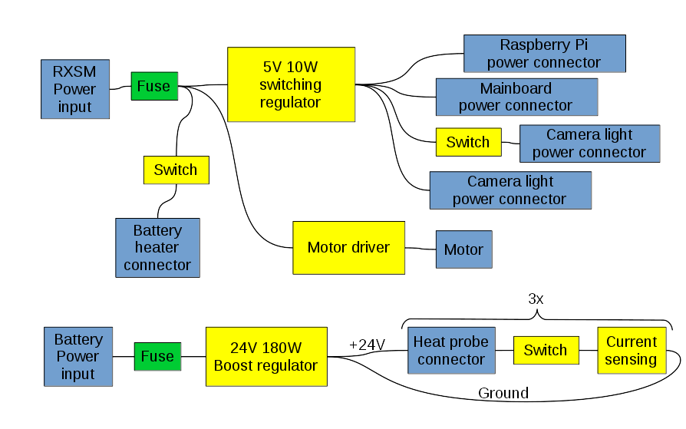

Slide 4
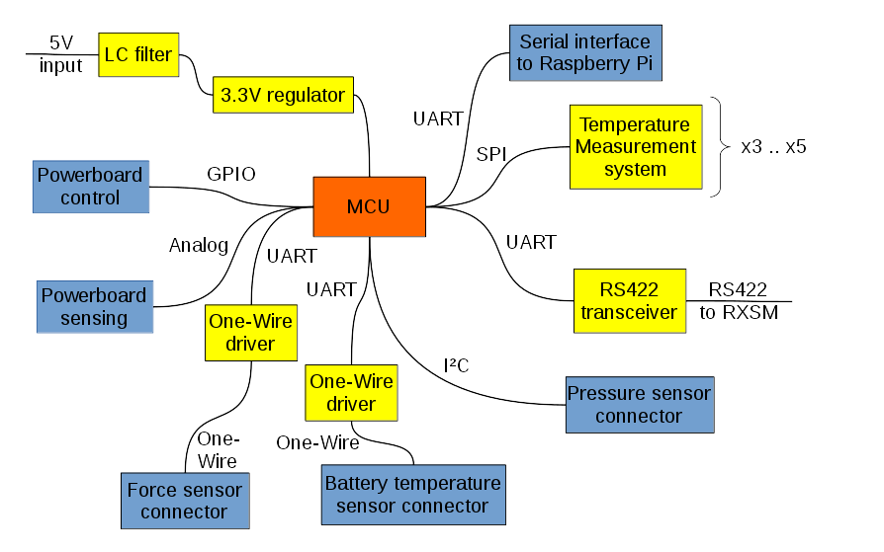

Slide 5
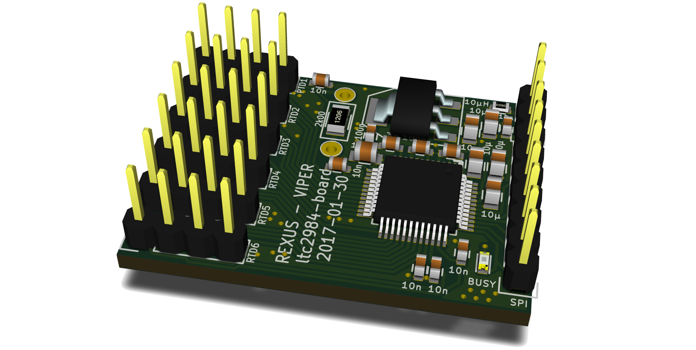
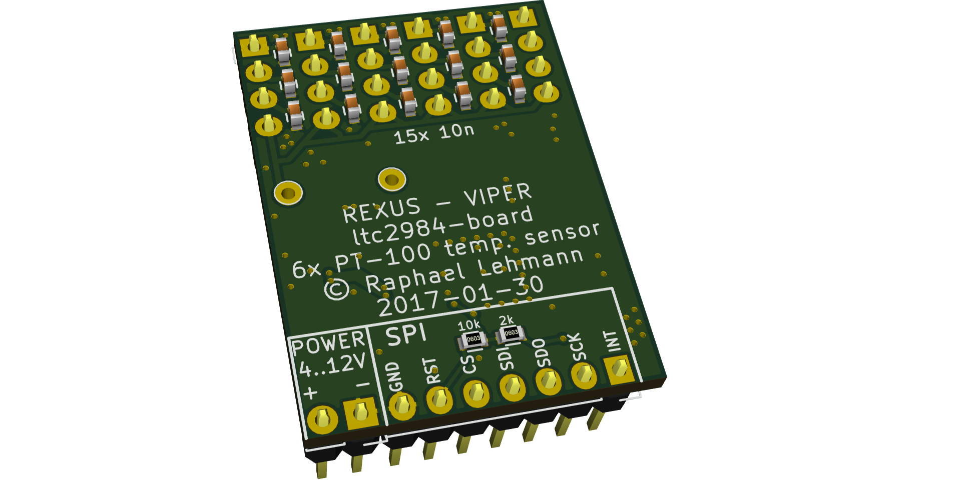
Temperature Sensor Board

Slide 6
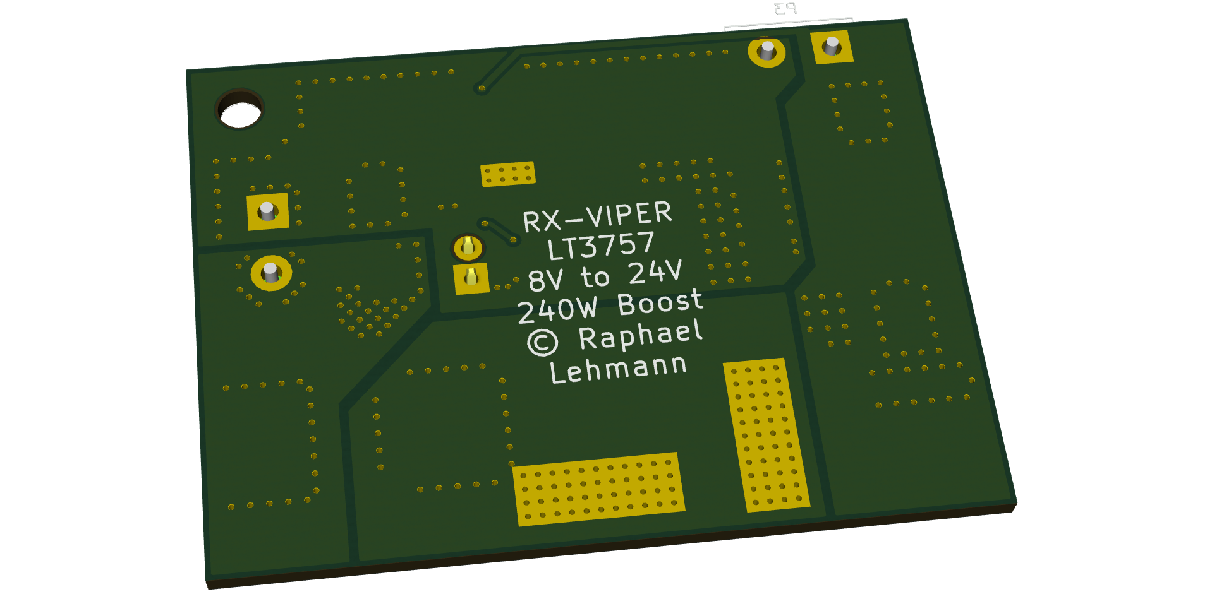
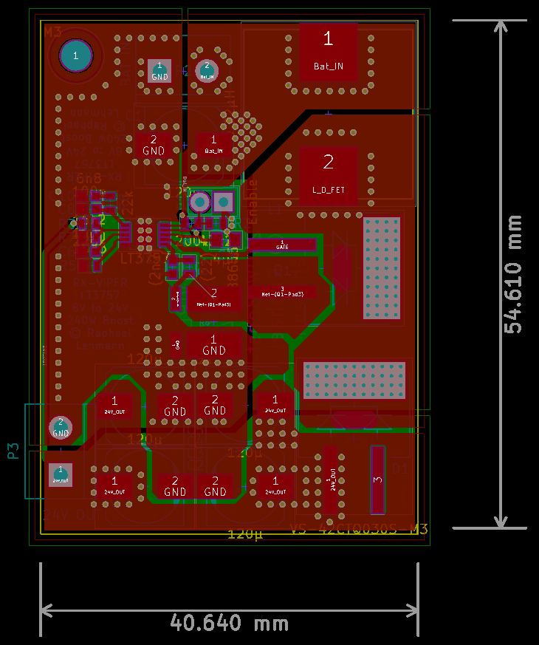
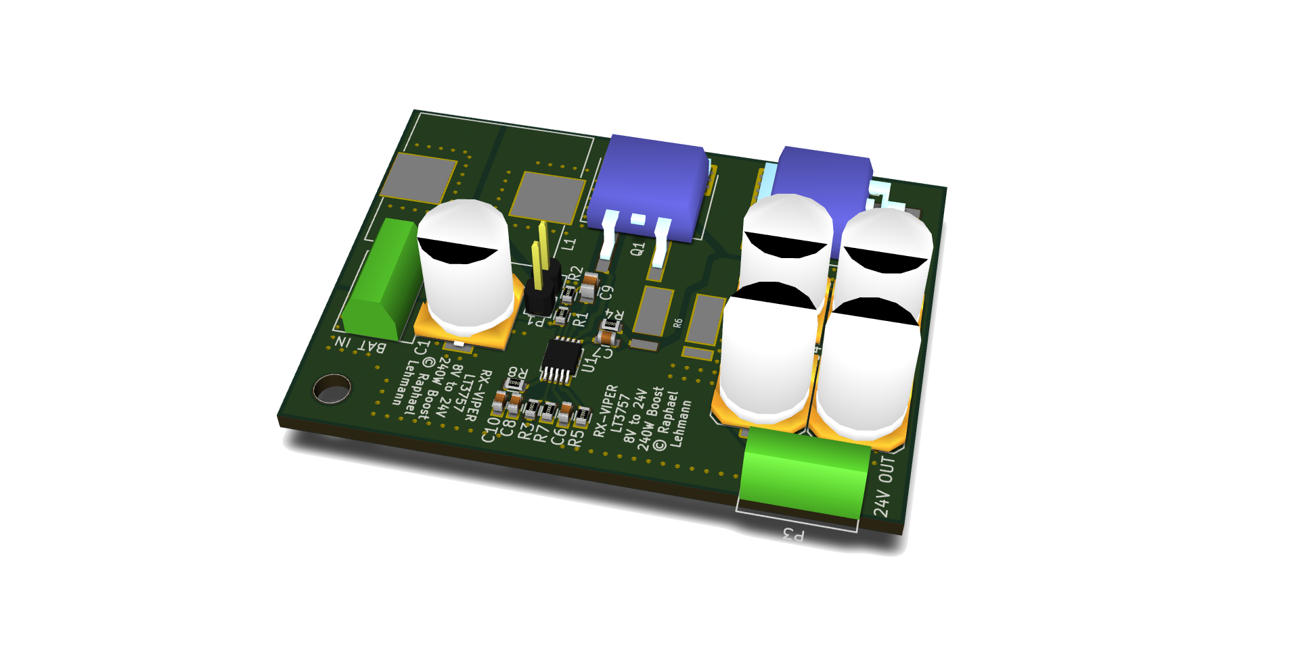
Boost regulator test board

Slide 7
Software Design

Slide 8
Onboard Software (Microcontroller)
STM32 microcontroller
xpcc framework (C++)
Raspberry Pi: Linux
Communication:
XPCC
Experiment ↔ ground station
Byte-packed

Slide 9
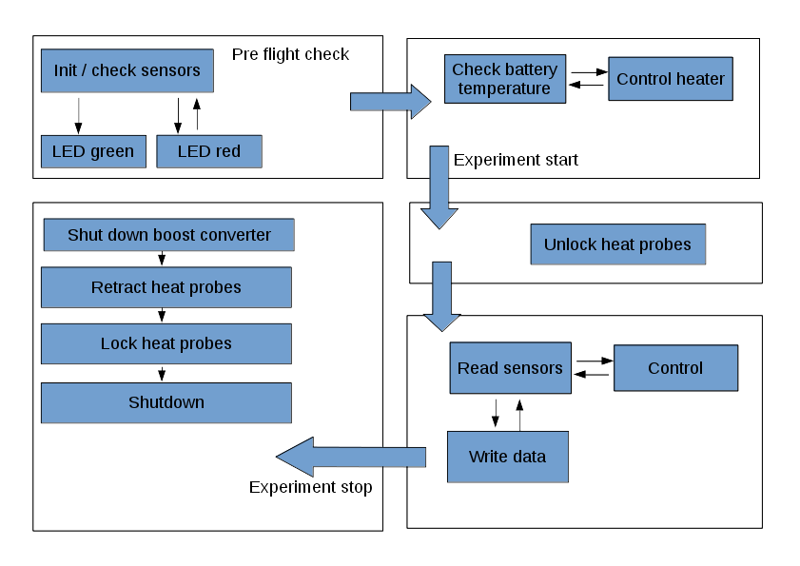
Software Flowchart

Slide 10
Ground Station
Experiment status overwiew
Qt QUI (C++)

Slide 11
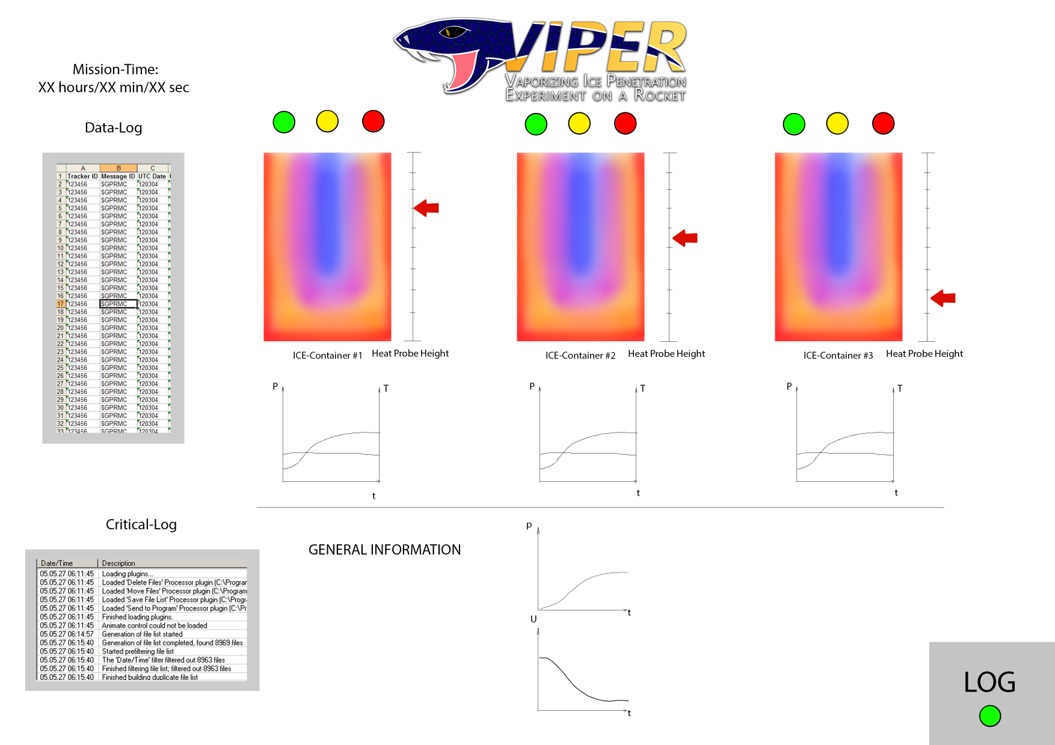
Ground Station GUI

