Slide 1
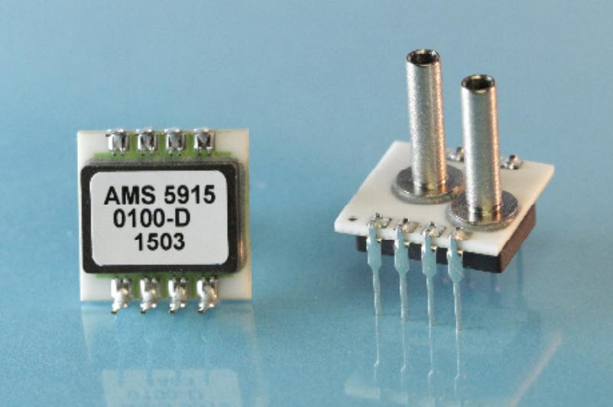
Pressure sensor
AMS 5915-0010-D
I²C
differential, 0..10mbar
temperature compensated -25..85°C
available, 25€

Slide 2
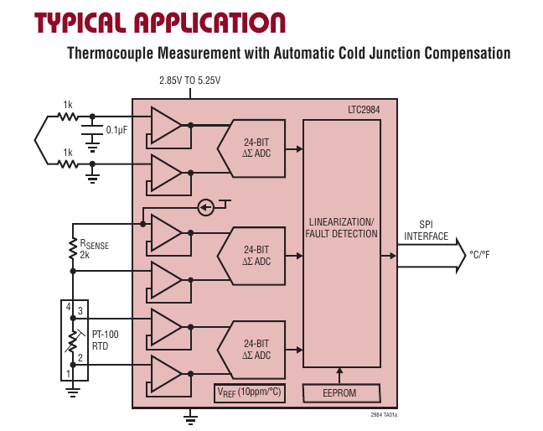
Temperature sensing
Requirement
  Accuracy 0.5% or better
  Range: -100°C .. 20°C
PT-100
LTC2984 integrated temperature measurement system
4-wire connections

