Slide 1
Electronics

Slide 2
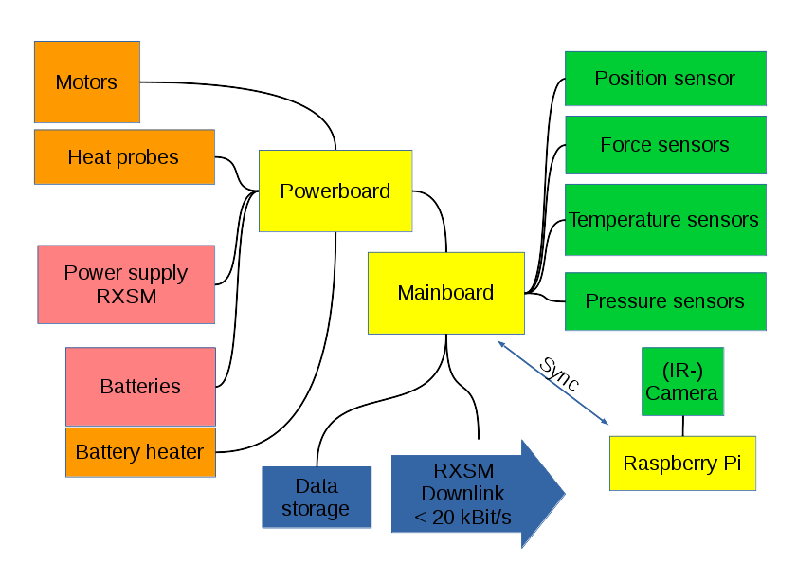
Overview

Slide 3
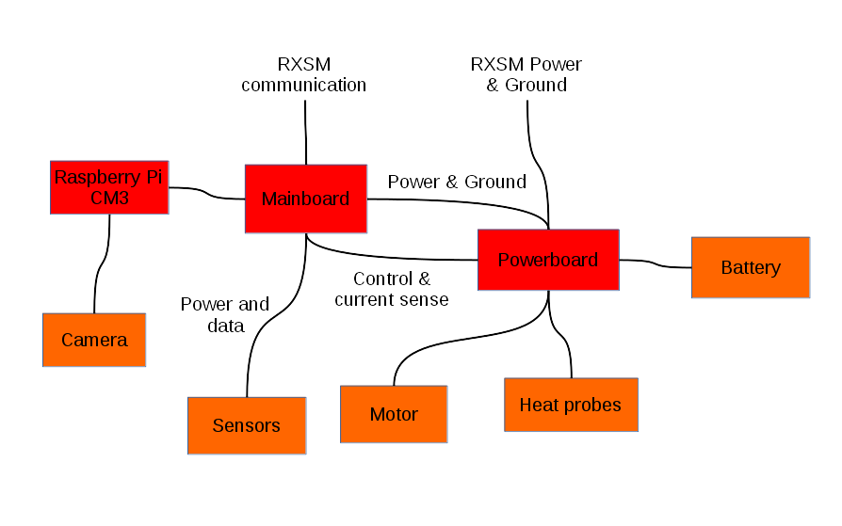
Overview

Slide 4
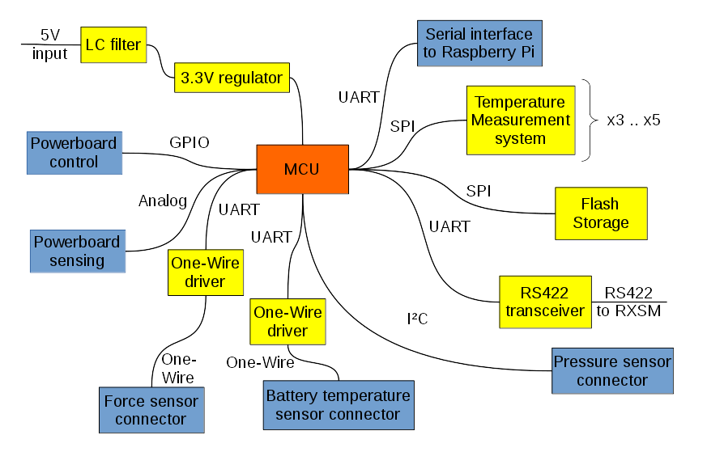
Mainboard

Slide 5
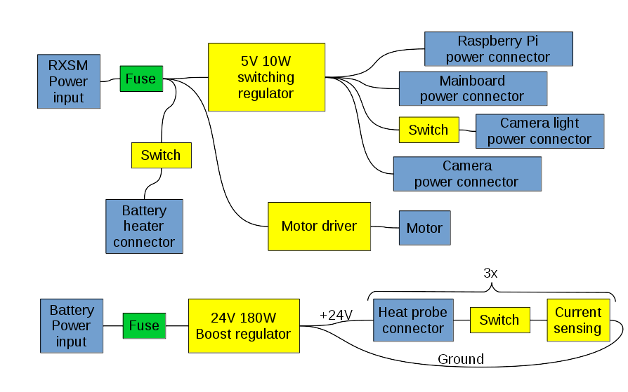
Powerboard

Slide 6

Battery
Panasonic BK300SCP
  NiMH
  1.2 V
  3 Ah
  4 mΩ
8..10 cells
25..35 Wh
Temperature monitoring
Battery heater

Slide 7
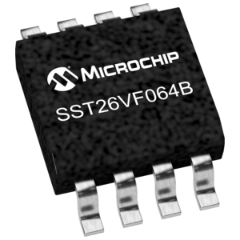
Data storage
Flash Chip
Serial interface (SPI)
64MBit
2x for redundancy
+ Store on Raspberry
+ Transmit to Ground

Slide 8
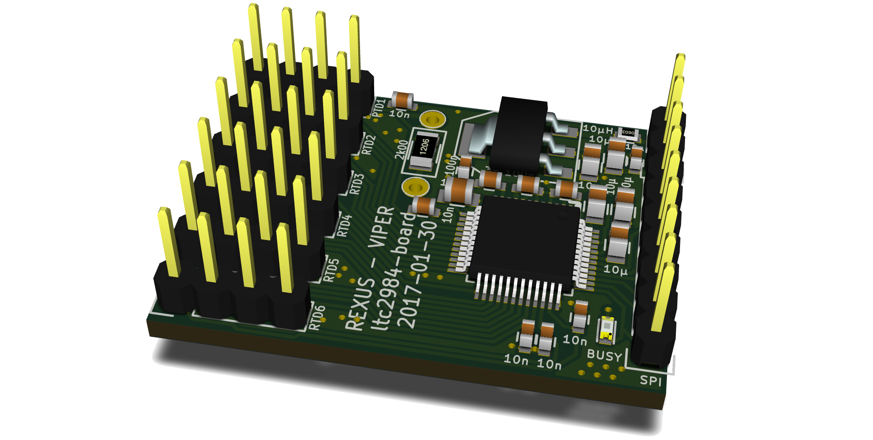
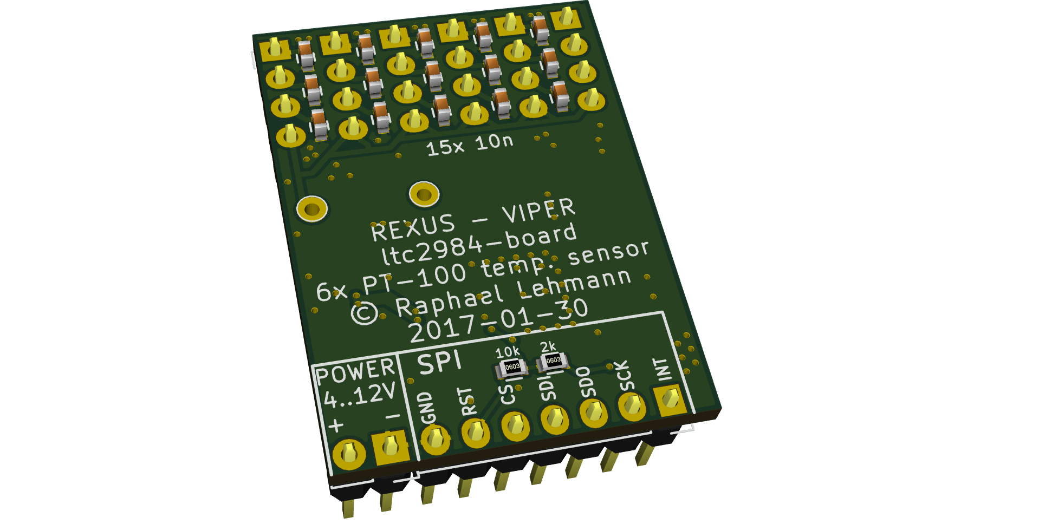
Temperature Sensor Board

Slide 9
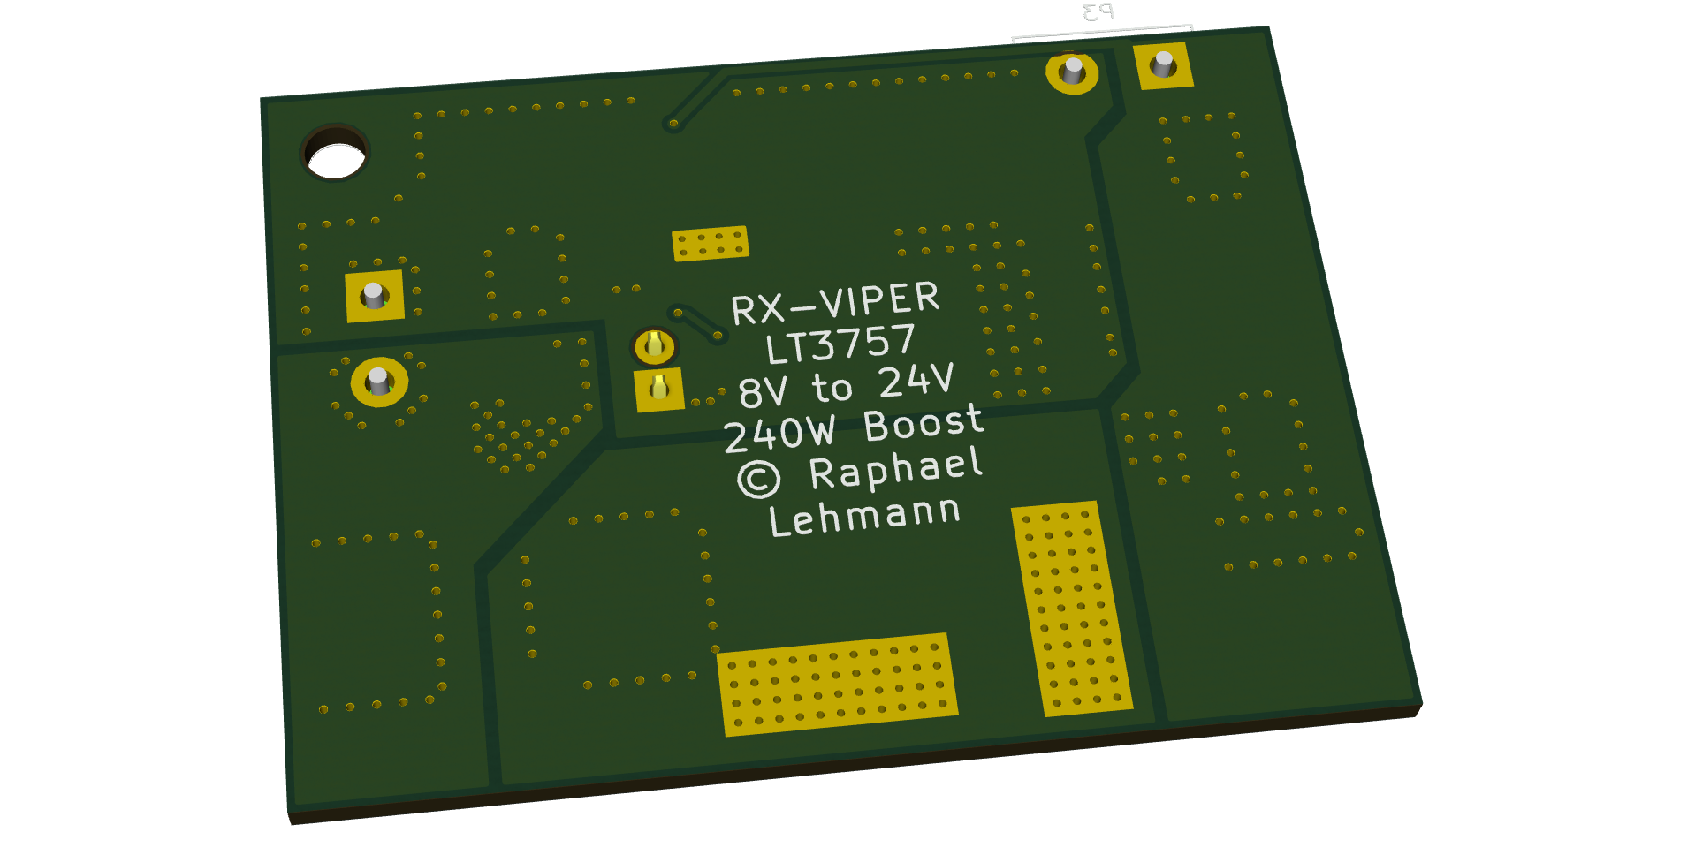
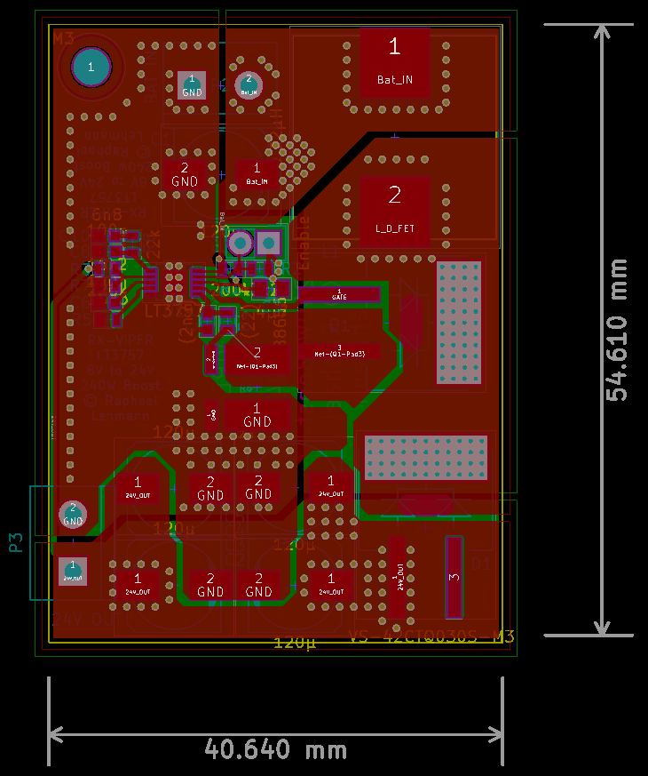
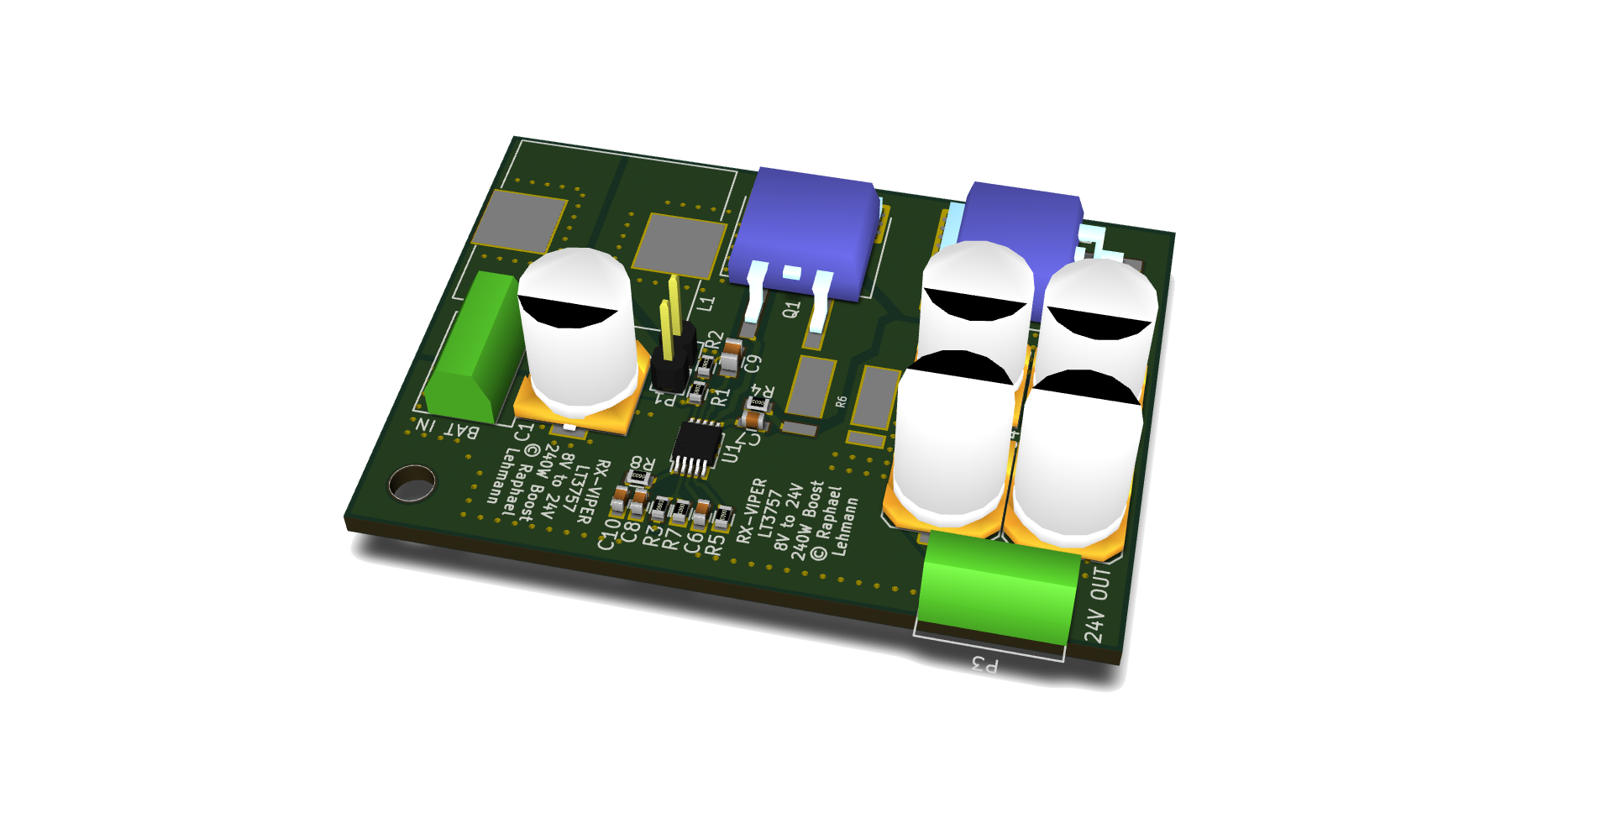
Boost regulator test board

Slide 10
Software Design

Slide 11


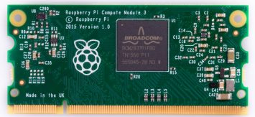
Onboard Software
STM32 microcontroller
xpcc framework
  C++
Raspberry Pi: Linux
Communication:
xpcc
Experiment ↔ ground station

Slide 12
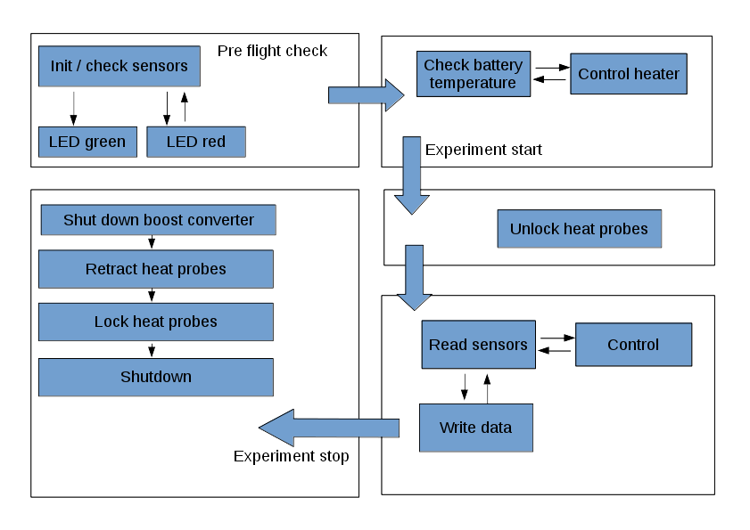
Software Flowchart

Slide 13
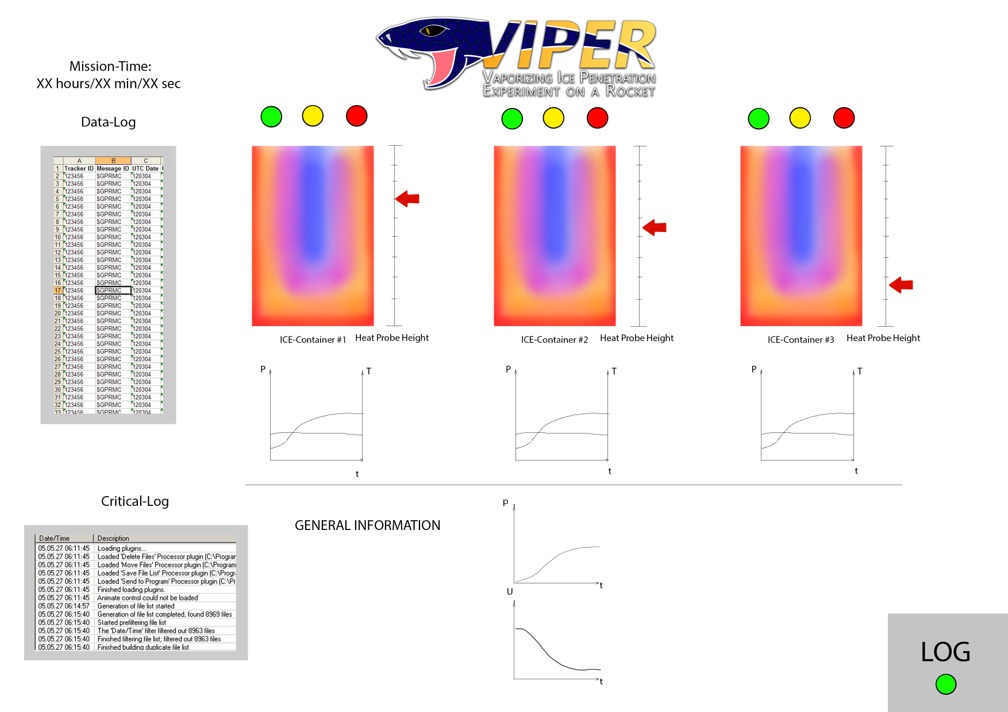
Ground Station
Experiment status overview
Record received data
Qt GUI (C++)

