Slide 1

Good Tech Scholars Program AV management system Innovation in Autonomous Vehicles/Robot industry
By
Riya J MBCET\
May 2022

Slide 2



‹#›
Table of Contents
Problem Statement and its relevance
Solution Approach
Architecture diagram
Demo
Q&A

Slide 3


Problem statement and relevance
Context
Problem Summary
Outcomes
Impact
There has been significant advancements in the field of AVs.
But the future of fully autonomous vehicles faces complex issues. The need for expertise limits the accessibility and consumer use.
The management and control of AV devices requires expertise.
This limits their accessibility and increases cost.
Create an easy to use interface that allows anyone to monitor an AV
Control an AV without expertise
AV devices will become more accessible
‹#›
Notes:
Revision 1 (20/09/21:09:30AM): <ANBU>
1. Hands-on experience lets them develop industry/pro skills. And opportunity is already mentioned in the sub-title – hence removed.
2. Additional Info to be used as talking points: The UN had the following Sustainable Development Goals to achieve by 2030 – we can mention a few if required: (1) No Poverty, (2) Zero Hunger, (3) Good Health and Well-being, (4) Quality Education, (5) Gender Equality, (6) Clean Water and Sanitation, (7) Affordable and Clean Energy, (8) Decent Work and Economic Growth, (9) Industry, Innovation and Infrastructure, (10) Reducing Inequality, (11) Sustainable Cities and Communities, (12) Responsible Consumption and Production, (13) Climate Action, (14) Life Below Water, (15) Life On Land, (16) Peace, Justice, and Strong Institutions, (17) Partnerships for the Goals.
</ANBU>

Slide 4
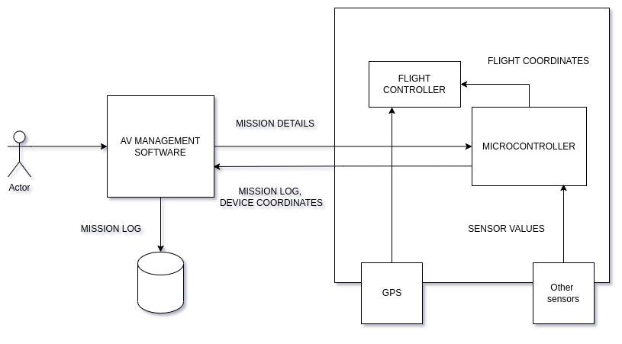
Solution description
Description
Architecture diagram-1
An interface to create missions and monitor an AV system without the added complexity of knowing how to operate it. The interface will communicate with the target device to input coordinates and receive flight path and device status.
The AV management system interacts with embedded controller
Controller receives mission details and send coordinates to flight controller
Flight controller updates path with input from sensors and microcontroller
‹#›

Slide 5
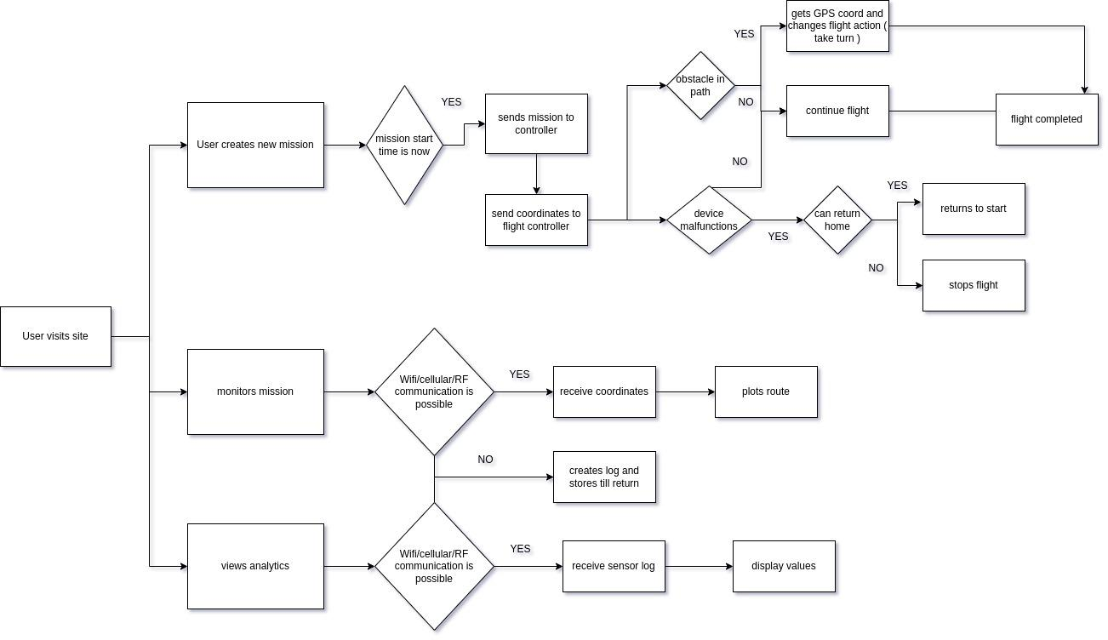
Architecture diagram-2
‹#›

Slide 6
Demo
https://youtu.be/AtD0-upR0Pc

Slide 7
Q&A
‹#›

