Slide 1

Exploratory Data Analysis
G2M Case Study
21-Feb-2023

Slide 2

Problem Statement XYZ, a private equity firm in the United States, is considering investing in the cab industry, which has experienced significant growth in recent years and has multiple major players in the market. The goal is to offer practical guidance to assist XYZ in selecting the best company to invest in.

Slide 3
Data Exploration Total 17 features (including derived features). Total data points 359,393 Assumptions: 1.Price charged has an outlier but due to lack of information we will not consider that. 2.The conclusion are only derived based on the factors we have in our data, although there could be other factors as well which will affect the output.

Slide 4
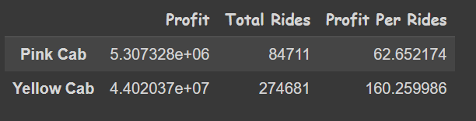
Profit Analysis
We can observe Yellow cab is more profitable both in terms of total rides and profit per rides.

Slide 5
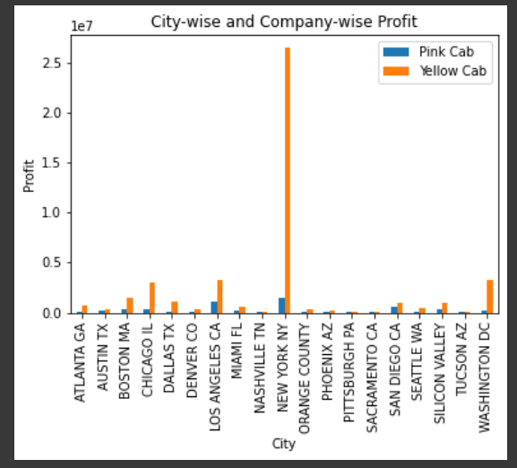
City-wise and Company-wise Profit
Newyork has the highest profit (Yellow Cab),also it can be easily seen in all the city's the profit of yellow cab is more.

Slide 6
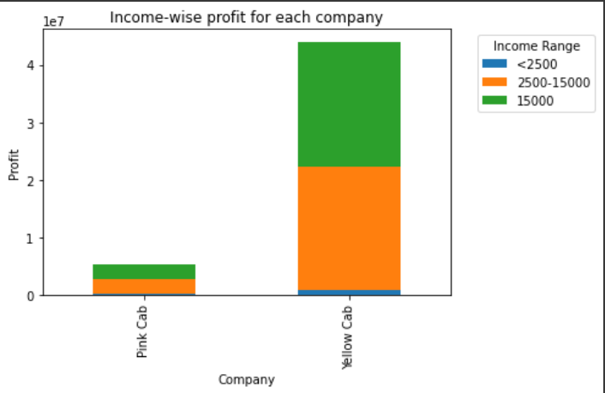
Income-wise profit for each Company
Middle class(2500 <Salary<15000 ) and rich class(salary > 15000$) are the main clients of both of the two cab companies.

Slide 7
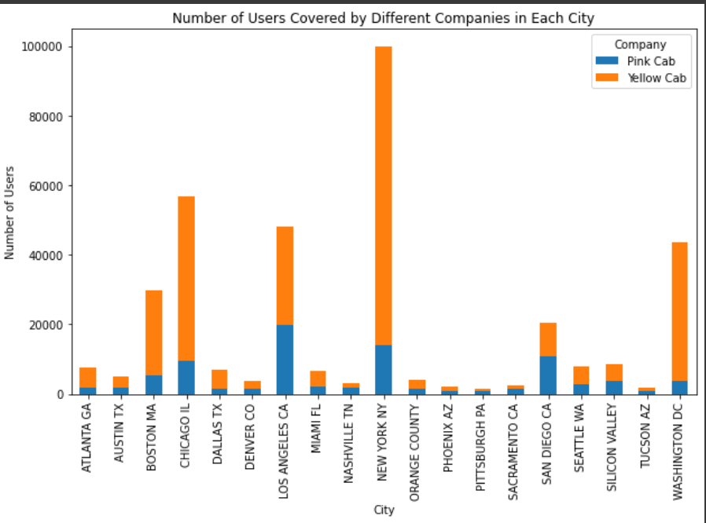
Users Distribution
City like San Diego, Sacramento , Pittsburgh, Nashville and Tucson are dominated by the Pink Cab company, or Users prefer more pink cab in these towns.

Slide 8
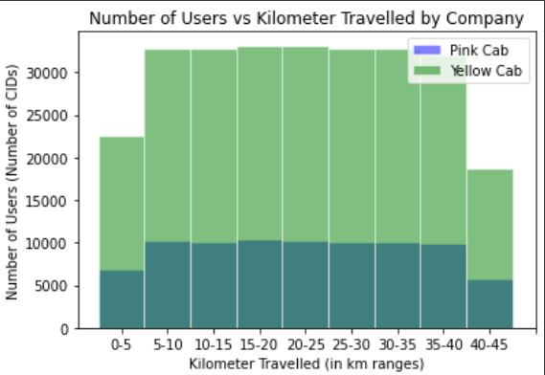
Relation between Users count and Km travelled
However we have the data only for a certain period we can see that yellow cab has more kilometers covered than Pink cab which mean it is used more by the customers.

Slide 9
Analysis and Hypothesis
Profit :In terms of overall profit yellow cab has 8% higher profit than pink cab
Customers reach : Out of 19 cities, yellow cab is used more in 16 cities while one can see the dominance of pink cab in just 4 cities.
Income Wise: Both the cab has same distribution of providing services to low, medium and high income people however the distribution of yellow cab is much more clean.
KM-Wise Profit: Yellow Cab has more profit per km than of pink cab.
On the basis of my analysis ,I recommend Yellow cab over the Pink Cab.

Slide 10
Thank You

