Slide 1
K-Nearest Neighbor (KNN)
By
Dr. Farman Ali
Assistant Professor
CS Department BU

Slide 2
Introduction to knn
KNN is one of the most basic yet essential classification algorithms in machine learning.
It belongs to the supervised learning domain and finds many applications in pattern recognition, data mining.
K-NN algorithm assumes the similarity between the new case/data and available cases and put the new case into the category that is most similar to the available categories.
This means when new data appears then it can be easily classified into a well suite category by using K- NN algorithm.
K-NN algorithm can be used for Regression as well as for Classification but mostly it is used for the Classification problems.
It is also called a lazy learner algorithm because it does not learn from the training set immediately instead it stores the dataset and at the time of classification, it performs an action on the dataset.
KNN algorithm at the training phase just stores the dataset and when it gets new data, then it classifies that data into a category that is much similar to the new data.

Slide 3
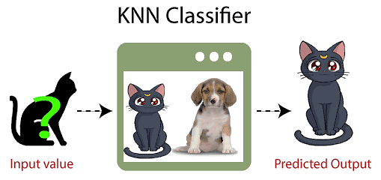
Example
Suppose, we have an image that looks similar to cat and dog,
We want to know either it is a cat or dog.
We can use the KNN algorithm, as it works on a similarity measure.
KNN model will find the similar features of the new data set to the cats and dogs images.
Based on the most similar features it will put it in either cat or dog category.

Slide 4
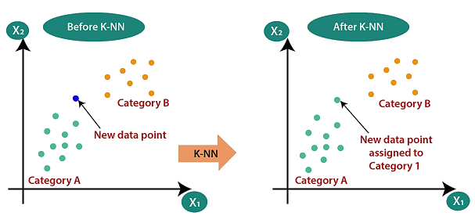
How do we need knn
Suppose there are two categories, i.e., Category A and Category B.
we have a new data point x1, so this data point will lie in which of these categories.
To solve this type of problem, we need a K-NN algorithm.
With the help of K-NN, we can easily identify the category or class of a particular dataset.

Slide 5
How does K-NN work
Step-1: Select the number K of the neighbors
Step-2: Calculate the Euclidean distance of K number of neighbors
Step-3: Take the K nearest neighbors as per the calculated Euclidean distance.
Step-4: Among these k neighbors, count the number of the data points in each category.
Step-5: Assign the new data points to that category for which the number of the neighbor is maximum.
Step-6: The model is ready.

Slide 6
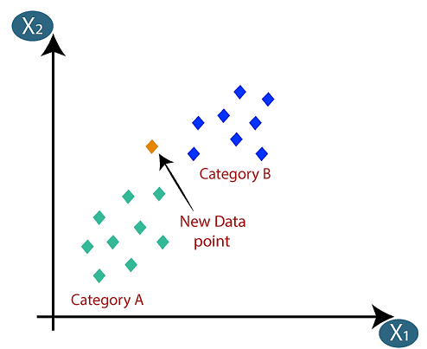
Solved example
Suppose we have a new data point and we need to put it in the required category.
Consider the image:
Firstly, choose the number of neighbors, so we will choose the k=5
Next, calculate the Euclidean distance between the data points.
Euclidean distance is the distance between two points.

Slide 7
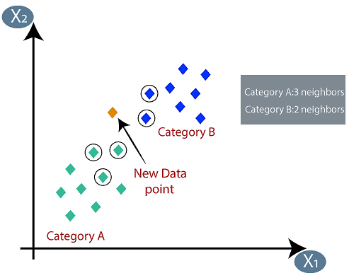
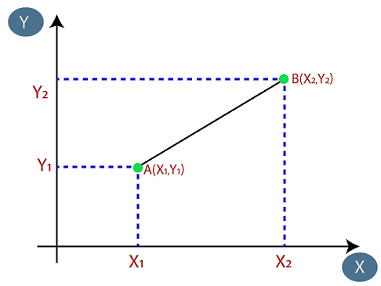
By calculating the Euclidean distance, we got the nearest neighbors, as three nearest neighbors in category A and two nearest neighbors in category B.

Slide 8
How to select the value of K
There is no particular way to determine the best value for "K".
We need to try some values randomly to find the best out of them.
The most preferred value for K is 5.

Slide 9
PROS AND CONS OF KNN
PROS
Easy to implement as the complexity of the algorithm is not that high.
Adapts Easily – As per the working of the KNN algorithm it stores all the data in memory storage and hence whenever a new example or data point is added then the algorithm adjusts itself as per that new example and has its contribution to the future predictions as well.
Few Hyperparameters – The only parameters which are required in the training of a KNN algorithm are the value of k and the choice of the distance metric (Euclidean, Hamming) which we would like to choose from our evaluation metric.
CONS
Does not scale – As we have heard about this that the KNN algorithm is also considered a Lazy Algorithm. The main significance of this term is that this takes lots of data storage. This makes this algorithm both time-consuming and resource exhausting.
Curse of Dimensionality the algorithm faces a hard time classifying the data points properly when the dimensionality is too high.
Overfitting issue– As the algorithm is affected due to the curse of dimensionality it is prone to the problem of overfitting as well.

