Slide 1
Naive Bayes
By
Dr. Farman Ali
Assistant Professor
CS Department BU

Slide 2
Introduction to naive bayes
Naive Bayes algorithm is a supervised learning algorithm, which is based on Bayes theorem.
It is mainly used in classification problems such as Text that includes a high-dimensional training dataset.
Naive: It is called Naïve because it assumes that the occurrence of a certain feature is independent of the occurrence of other features.
Example: if the fruit is identified on the bases of color, shape, and taste.
Then red, spherical, and sweet fruit is recognized as an apple.
Each feature individually contributes to identify that it is an apple without depending on each other.
Bayes: It is called Bayes because it depends on the principle of Bayes' Theorem.

Slide 3
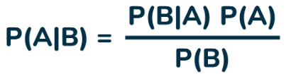
Bayes theorem
“The conditional probability of an event A, given the occurrence of another event B, is equal to the product of the event of B, given A and the probability of A divided by the probability of event B.”
For any two events A and B, the formula for the Bayes theorem is:
P(A) and P(B) are the probabilities of events A and B also P(B) is never equal to zero.
P(A) is Prior Probability: Probability of hypothesis before observing the evidence.
Example: Suppose you're flipping a coin. Before the flip, the probability of getting heads (P(Heads)) is 0.5. This is the prior probability.
P(B) is Marginal Probability: Probability of Evidence
Example: Continuing with the coin flip, the marginal probability of getting heads (P(Heads)) is still 0.5, even if you know the previous flip was tails.

Slide 4
Bayes theorem
P(A|B) and P(B|A) are conditional probabilities:
P(A|B) is the probability of getting heads on the third flip, given that the first two flips were tails.
conditional probability: It is the probability of event B when A happens
P(B|A) is the probability of getting tails on the third flip, given that the first two flips were heads.

Slide 5
Weather Forecast Example
We have the following weather dataset with 14 observations.
Each observation has four features (Outlook, Temperature, Humidity, and Wind) and one target label (Rain?).
Outlook | Temperature | Humidity | Wind | Rain?
Sunny | Hot | High | Weak | No
Sunny | Hot | High | Strong | No
Overcast | Hot | High | Weak | Yes
Rainy | Mild | High | Weak | Yes
Rainy | Cool | Normal | Weak | Yes
Rainy | Cool | Normal | Strong | No
Overcast | Cool | Normal | Strong | Yes
Sunny | Mild | High | Weak | No
Sunny | Cool | Normal | Weak | Yes
Rainy | Mild | Normal | Weak | Yes
Sunny | Mild | Normal | Strong | Yes
Overcast | Mild | High | Strong | Yes
Overcast | Hot | Normal | Weak | Yes
Rainy | Mild | High | Strong | No

Slide 6
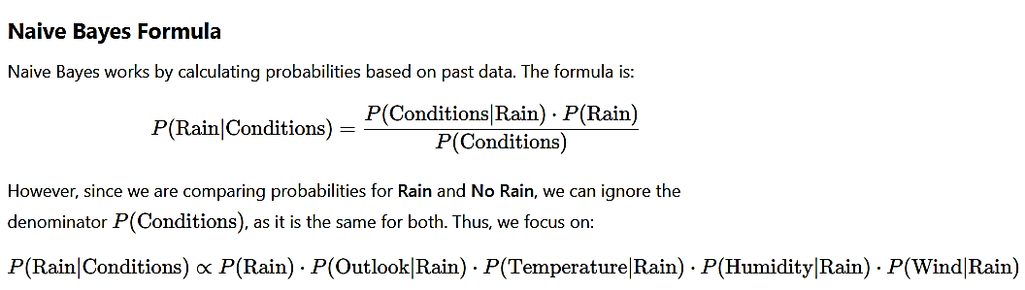
Weather Forecast Example

Slide 7
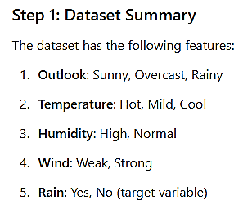
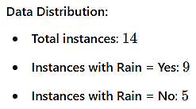
Weather Forecast Example

Slide 8
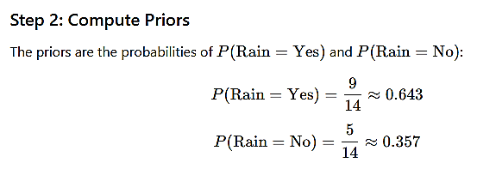
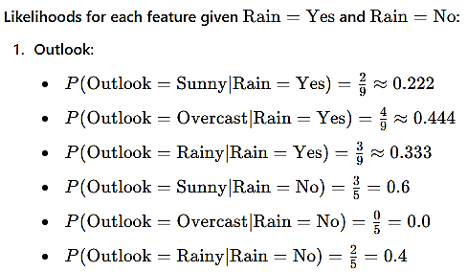
Weather Forecast Example
Step 3: Compute Conditional probability

Slide 9
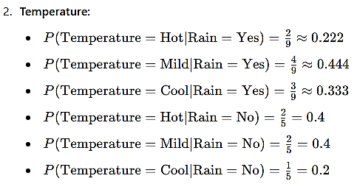
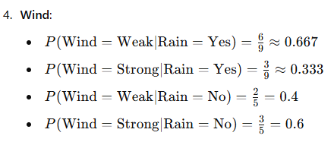
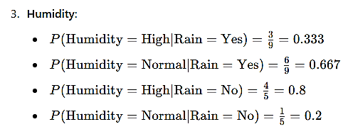
Weather Forecast Example

Slide 10
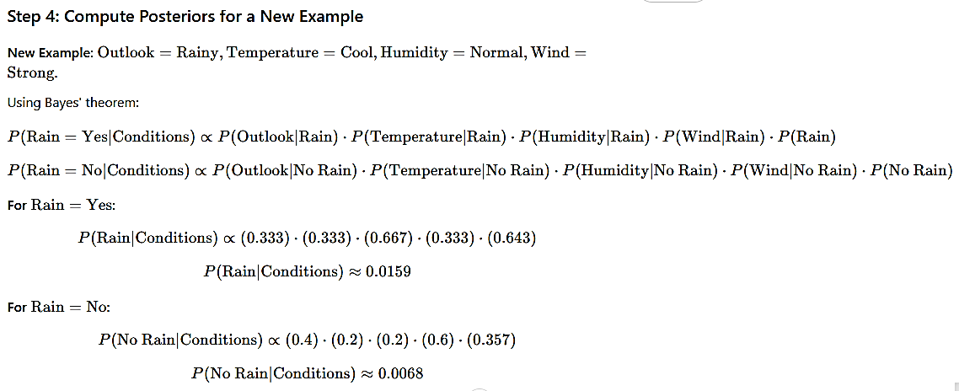
Weather Forecast Example
Step 4: Compute Conditional probability

Slide 11
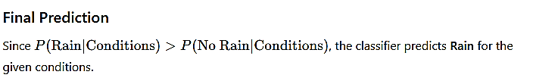

Slide 12
Advantages
Easy to implement and computationally efficient.
Effective in cases with a large number of features.
Performs well even with limited training data.
It performs well in the presence of categorical features.
Disadvantages
Assumes that features are independent, which may not always hold in real-world data.
Can be influenced by irrelevant attributes.
May assign zero probability to unseen events, leading to poor generalization.

