Slide 1
Feature Selection Algorithms (FSA)
By
Dr. Farman Ali
Assistant Professor
CS Department BU

Slide 2
Introduction to FSA
Feature selection is a process that chooses a subset of features from the original features.
The role of feature selection in machine learning is:
1. To reduce the dimensionality of feature space
2. To speed up a learning algorithm
3. To improve the predictive accuracy of a classification algorithm
There are three general classes of feature selection algorithms:
Filter methods
Wrapper methods
Embedded methods

Slide 3
Filter Methods
These methods are generally used while doing the pre-processing step.
These methods select features from the dataset irrespective of the use of any machine learning algorithm.
In terms of computation, they are fast and less computational.
Good for removing redundant features.

Slide 4
Filter Method algorithms
Information Gain
It is defined as the amount of information provided by the feature for identifying the class label
measures reduction in the entropy values.
Information gain of each attribute is calculated considering the target values for feature selection
Fisher’s Score
It evaluates the importance of individual features by measuring their discriminatory power between different classes
Fisher's Score calculates the ratio of:
Between-Class Variance: The difference between the means of the classes for a specific feature.
Within-Class Variance: The variance of the feature values within each class.

Slide 5
Filter Method categories
Correlation Coefficient
A statistical measure that quantifies the strength and direction of the relationship between two features.
It indicates whether an increase in one feature corresponds to an increase or decrease in another, and how closely the two features are linearly related
Types of Correlation Coefficient:(1) Pearson Correlation Coefficient (2) Spearman Rank Correlation
Mutual Dependence
This method measures if two variables are mutually dependent
Provides the amount of information obtained for one variable on observing the other variable.
Depending on the presence/absence of a feature, it measures the amount of information that feature contributes to making the target prediction.

Slide 6

Wrapper methods
Train the algorithm by using a subset of features in an iterative manner
Addition and removal of features takes place.
Stopping criteria for selecting the best subset are usually pre-defined
Such as when the performance of the model decreases or a specific number of features has been achieved.
They provide an optimal set of features for training the model, thus resulting in better accuracy
Computationally more expensive

Slide 7
Wrapper method categories
Forward selection
This method is an iterative approach where we initially start with an empty set of features
keep adding a feature which best improves our model after each iteration
The stopping criterion is till the addition of a new feature does not improve the performance of the model
Backward elimination
This method is also an iterative approach which initially start with all features
after each iteration, least significant feature is removed.
The stopping criterion is till no improvement in the performance of the model is observed after the feature is removed
Bi-directional elimination
This method uses both forward selection and backward elimination technique simultaneously to reach one unique solution.

Slide 8
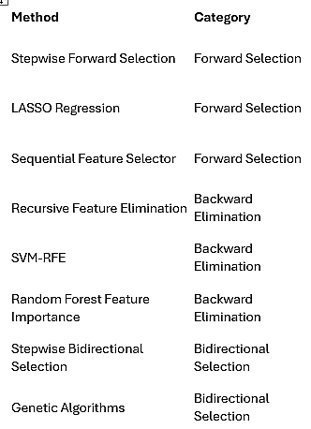
Wrapper methods categories

Slide 9
embedded methods
Embedded methods encounter the drawbacks of filter and wrapper methods and merge their advantages
These methods are faster like filter methods
More accurate like wrapper methods
These are further classified as (i) Regularization-based methods, and (ii) Tree-based methods
1. Regularization-Based Methods
LASSO:
Shrinks coefficients of less important features to zero, effectively selecting only the most relevant ones
Works well for linear models with many irrelevant features.
Elastic Net:
Combines L1 and L2 penalties for feature selection.
Suitable when features are correlated

Slide 10
embedded methods
2. Tree-Based Methods
Decision Tree and Random Forest:
Feature importance is calculated based on metrics like Gini impurity or information gain
Features with high-ranking scores are considered

Slide 11
embedded methods
3. Neural Network-Based Techniques
Attention Mechanisms
In deep learning models, attention mechanisms can focus on specific features or regions of data that contribute the most to prediction
Example: Attention layers in sequence models like transformers highlight important input features
Gradient Boosted Trees (e.g., XGBoost, LightGBM):
Similar to random forests but uses boosting techniques to refine the model iteratively.
Provides importance scores for features based on their contribution to the model

