Slide 1
Machine Learning (ML)
By
Dr. Farman Ali
Assistant Professor
CS Department BU

Slide 2
About Instructor
PhD (China)
Research areas: Artificial Intelligence, Machine Learning, Deep Learning, Bioinformatics
Published 57 research papers in International Journals
2944 google citations (https://scholar.google.co.uk/citations?user=GzlaocQAAAAJ&hl=en)
Email: farman.buic@bahria.edu.pk
Office: Room no.6, near to Sickbay

Slide 3
Marks distribution
Quiz = 10%
Assig = 20%
Mid = 30%
Final = 40%
Recommended Books:
1. Pattern recognition and machine learning
2. Machine Learning
3. Python Machine Learning

Slide 4
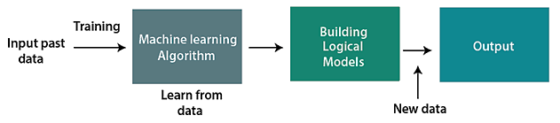
Introduction to ml
A subset of AI focuses on the creation of algorithms.
Enable a computer/system to learn from data and previous experiences.
Arthur Samuel first used the term "machine learning" in 1959.
Create a model, without being explicitly programmed, aids in making predictions

Slide 5
Features of ml
ML detects various patterns in a given dataset.
It can learn from past data and improve automatically.
It is a data-driven technology.
ML is much similar to data mining as it also deals with the huge amount of the data.
Classification/Types of ML
Supervised learning
Unsupervised learning
Semi-supervised learning
Reinforcement learning

Slide 6
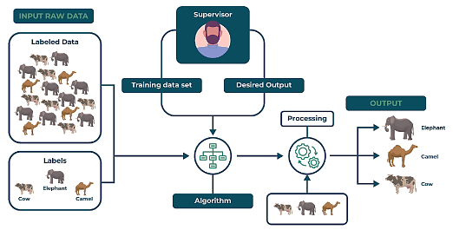
Classification of ml
Supervised Learning (SL)
Labeled data are provided to the machine learning system for training
System then predicts the output based on the training data
Labeled data is used to build a model
The model is used to predict a testing data to see if it can accurately predict the output.

Slide 7
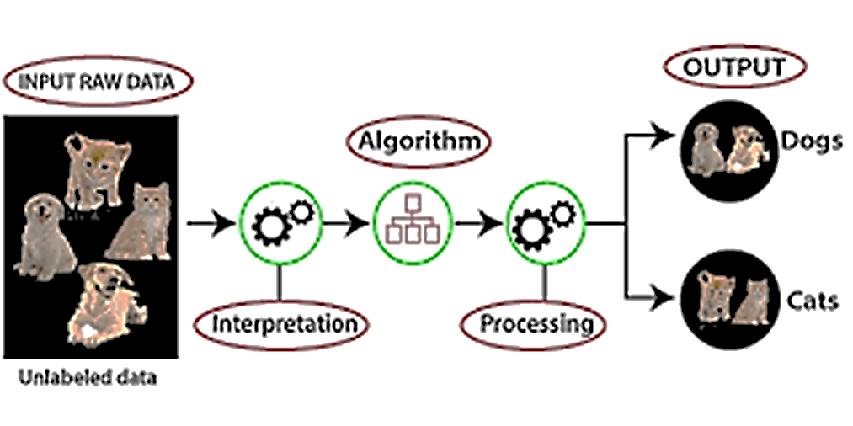
Classification of ml
Un-supervised Learning (USL)
Unsupervised learning learns without any supervision
The training is provided to the machine with the set of data that has not been labelled
USL makes group of objects with similar patterns

Slide 8
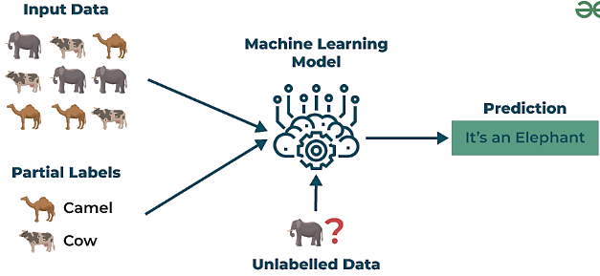
Classification of ml
Semi-Supervised Learning (SSL)
SSL works between the supervised and unsupervised learning
It uses both labelled and unlabelled data
This approach is useful when the dataset is expensive and time-consuming
SSL is chosen when labeled data requires skills and relevant resources
It deals with data that is a little bit labeled and the rest large portion of it is unlabeled

Slide 9
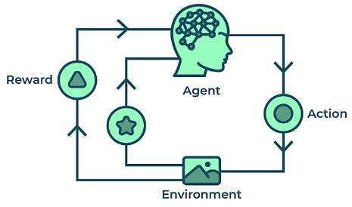
Classification of ml
Reinforcement Machine Learning
A learning method that interacts with the environment by producing actions and discovering errors
In this technique, the model keeps on increasing its performance using Reward Feedback to learn the behavior or pattern
These algorithms are specific to a particular problem.
Example:
Consider that you are training an AI agent to play a game like cricket.
The agent explores different balling or batting moves and receives positive or negative feedback based on the outcome.

Slide 10
Applications of Supervised Learning
Image classification: Identify objects, faces, and other features in images.
Speech recognition: Convert spoken language into text.
Predictive analytics: Predict outcomes, such as sales, and stock prices.
Medical diagnosis: Detect diseases and other medical conditions.
Fraud detection: Identify fraudulent transactions.
Email spam detection: Classify emails as spam or not spam.
Credit scoring: Assess the risk of a borrower defaulting on a loan.
Weather forecasting: Make predictions for temperature, and rain parameters.

Slide 11
Applications of un-Supervised Learning
Clustering: Group similar data points into clusters.
Anomaly detection: Identify outliers or anomalies in data.
Dimensionality reduction: Reduce the dimensionality of data while preserving its essential information.
Image and video compression: Reduce the amount of storage required for multimedia content.
Data preprocessing: Help with data preprocessing tasks such as data cleaning.
Market basket analysis: Discover associations between products.
Genomic data analysis: Identify patterns or group genes with similar expression profiles.
Image segmentation: Segment images into meaningful regions.
Customer behavior analysis: Uncover patterns and insights for better marketing and product recommendations.
Content recommendation: Classify and tag content to make it easier to recommend similar items to users.

Slide 12
Applications of semi-Supervised Learning
Image Classification and Object Recognition: Improve the accuracy of models by combining a small set of labeled images with a larger set of unlabeled images.
Natural Language Processing (NLP): Enhance the performance of language models and classifiers by combining a small set of labeled text data with a vast amount of unlabeled text.
Speech Recognition: Improve the accuracy of speech recognition by leveraging a limited amount of transcribed speech data and a more extensive set of unlabeled audio.
Healthcare and Medical Imaging: Enhance medical image analysis by utilizing a small set of labeled medical images alongside a larger set of unlabeled images.

Slide 13
Applications of reinforcement learning
Game Playing: RL can teach agents to play games.
Robotics: RL can teach robots to perform tasks autonomously.
Autonomous Vehicles: RL can help self-driving cars navigate and make decisions.
Healthcare: RL can be used to optimize treatment plans and drug discovery.
Natural Language Processing (NLP): RL can be used in dialogue systems and chatbots.
Finance and Trading: RL can be used for algorithmic trading.
Supply Chain and Inventory Management: RL can be used to optimize supply chain operations.
Adaptive Personal Assistants: RL can be used to improve personal assistants.
Industrial Control: RL can be used to optimize industrial processes.

Slide 14
Types of Supervised Learning
There are two types of supervised learning (1) Regression (2) Classification
1. Regression
Technique used to predict continuous numerical values based on input features
It aims to establish a functional relationship between independent variables and a dependent variable
Examples: Predicting house prices based on features like size, bedrooms, and location.
2. Classification
categorizes input data into predefined labels.
It involves training a model on labeled examples to learn patterns between input features and output classes.
In classification, the target variable is a categorical value
Example: Classifying emails as spam or not.

Slide 15
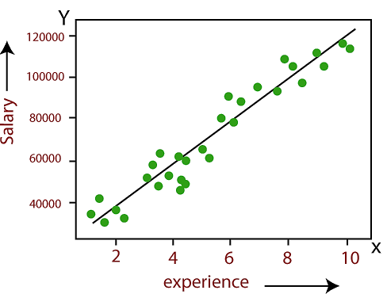
Regression Algorithms
Linear Regression:
A shows the relationship between a dependent (target) and independent variable.
Helps us to understand how the value of the dependent variable is changing corresponding to an independent variable.
It predicts continuous values such as temperature, salary, price, etc.
Example: Predicting the salary (dependent) of an employee on the basis of the year of experience (independent).

Slide 16
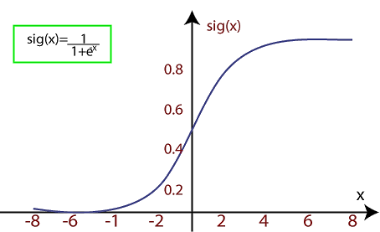

Regression Algorithms
Logistic Regression:
Algorithm which is used to solve the classification problem
Logistic regression algorithm works with the categorical variable such as 0 or 1, Yes or No, True or False
It is a predictive analysis algorithm which works on the concept of probability
It is a type of regression, but it is different from the linear regression algorithm in the term how they are used
It uses sigmoid function or logistic function which can be represented as:
f(x)= Output between the 0 and 1 value.
x= input to the function
e= base of natural logarithm
When we provide the input values (data) to the function, it gives the S-curve as follows:

Slide 17
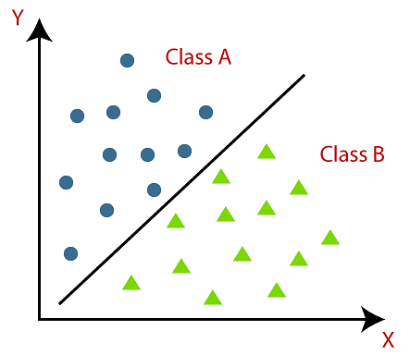
Classification Algorithm
A Supervised Learning technique that is used to identify the category of new data on the basis of training data.
In Classification, a program learns from the given dataset or observations
Then classifies new observation into a number of classes Such as, Yes or No, Spam or Not Spam, cat or dog, etc
Unlike regression, the output variable of Classification is a category, not a value
Example is Email Spam Detector
The main goal of the Classification algorithm is to identify the category of a given dataset, and these algorithms are mainly used to predict the output for the categorical data

Slide 18
Types of ML Classification Algorithms
Classification Algorithms are divided into two categories
1. Linear Models
Logistic Regression
Support Vector Machines (SVM)
2. Non-linear Models
K-Nearest Neighbours
Kernel SVM
Naive Bayes
Decision Tree
Random Forest

Slide 19
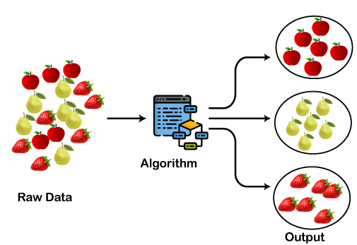
Types of Unsupervised Learning
There are two types (1) Clustering (2) Association rule learning
1. Clustering
The process of categorizing unlabeled data into groups based on their similarities
The goal of clustering is to identify patterns and relationships in the data without any prior knowledge
It finds similar patterns in the unlabelled dataset such as shape, size, color, etc.
Then divides them as per the presence and absence of those similar patterns
Example: In shopping mall, things with similar usage are grouped together.
Clustering algorithms
K-means Clustering
Hierarchical Clustering
Spectral Clustering

Slide 20
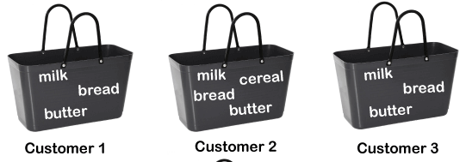
Types of Unsupervised Learning
(2) Association Rule Learning
Checks for the dependency of one data item on another data item
Maps accordingly so that it can be more profitable.
It tries to find some interesting relations or associations among the variables of dataset.
It is based on different rules to discover the interesting relations between variables in the database.
It is employed in Market Basket analysis, Web usage mining, etc.
Example, if a customer buys bread, he most likely can also buy butter, eggs, or milk, so these products are stored within a shelf or mostly nearby.

Slide 21
association rule learning Algorithms
Apriori
Eclat
F-P Growth Algorithm

