Slide 1
Model Development in ML
By
Dr. Farman Ali
Assistant Professor
CS Department BU

Slide 2
Ml model Life cycle
Steps for a ML model development
Data Collection
Preprocessing Data
Selection of ML algorithm
Model Training
Model Evaluation
Model Testing
Model Deployment

Slide 3
Data Collection
Dataset
Dataset is essentially the backbone for all operations, techniques or models
Datasets are used to train and test AI models
They provide the raw material for computers to learn patterns and make predictions
Datasets involve a large amount of data points grouped into one table
In a dataset, the rows represent the number of data points and the columns represent the features of the Dataset
Datasets may require cleaning and preprocessing to ensure data quality.
Datasets can be stored in multiple formats. The most common ones are .txt, CSV, Excel, JSON, and zip files for large datasets.

Slide 4
Data Collection
Types of Datasets
Training Dataset: It is used to train the machine learning model
Validation set: A subset of the dataset that is used evaluate performance during training of the model.
Test Set: It is used to evaluate final model performance on unseen data
Numerical Dataset: It includes temperature, marks etc.
Categorical Dataset: It includes categories such as colour, gender, occupation
Image Dataset: It includes a dataset consisting of images. This is mostly used to differentiate the types of diseases, heart conditions
Ordered Dataset: These datasets contain data that are ordered in ranks, for example, customer reviews, movie ratings
Partitioned Dataset: These datasets have data points segregated into different partitions.

Slide 5
Data Collection
Dataset collection/construction
Online Repositories: Websites like Kaggle, UCI (University of California, Irvine), Machine Learning Repository offer a vast collection of public datasets for various domains.
Government Agencies: Government agencies often release public datasets on topics like economics, healthcare, and environment.
Research Institutions: Universities and research organizations may share their datasets for public use.
Novel dataset construction: Novel dataset can be constructed like taking MRI images of brain tumor, Skin cancer, or any other kind of cancer from hospitals

Slide 6
Preprocessing Data
Data Cleaning:
Handling Missing Values: Replace missing values with appropriate values (e.g., mean, median, mode) or remove rows or columns with too many missing values.
Correcting Errors: Identify and correct any inconsistencies or errors in the data, such as typos or incorrect data formats.
Data Transformation:
Normalization: Scale numerical features to a specific range (e.g., 0-1 or -1 to 1) to ensure they have a similar impact on the model.
Feature Engineering/Encoding: Convert sequential data into numerical representations (e.g., one-hot encoding)
Data Reduction:
Feature Selection: Select the most relevant features to improve model efficiency.
Dimensionality Reduction: Use techniques like Principal Component Analysis (PCA) to reduce the number of features while preserving important information.

Slide 7
Selection of ML algorithm
Selecting the right ML algorithm plays a pivotal role in building of successful model
Understanding the nature of the problem like classification, regression, or clustering
Understanding a variety of machine learning algorithms suitable for your problem type
The best approach is often to experiment with multiple models, evaluate their metrics
and generalization to unseen/testing data
Training Model
Input the preprocessed data into the selected ML algorithm
ML algorithm learns patterns, features, and associations from the data
Optimization techniques like grid search can be used to tune the hyperparameters.

Slide 8
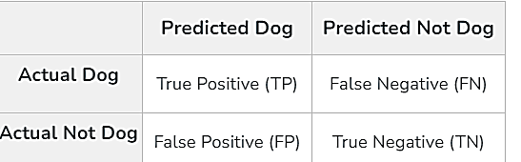
Model Evaluation:
Various metrics used to evaluate model performance
For classification tasks, the following metrics are used
Confusion Matrix:
It is a matrix that summarizes the performance of a classification model
It calculates true positives (TP), true negatives (TN), false positives (FP), and false negatives (FN) instances
Confusion Matrix For binary classification:
A 2X2 Confusion matrix is shown below for the image recognition having a Dog image or Not Dog image
True Positive (TP): It is the total counts having both predicted and actual values are Dog.
True Negative (TN): It is the total counts having both predicted and actual values are Not Dog.
False Positive (FP): It is the total counts having prediction is Dog while actually Not Dog.
False Negative (FN): It is the total counts having prediction is Not Dog while actually, it is Dog.

Slide 9
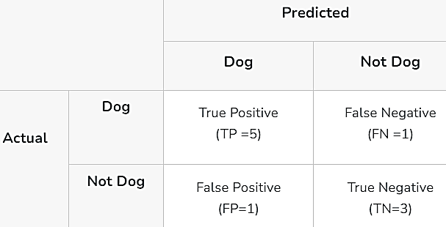

Actual Dog Counts = 6
Actual Not Dog Counts = 4
True Positive Counts = 5
False Positive Counts = 1
True Negative Counts = 3
False Negative Counts = 1
Evaluation metrics
1. Accuracy:
It is used to measure the performance of the model. It is the ratio of Total correct instances to the total instances.
Accuracy = (5+3)/(5+3+1+1) = 8/10 = 0.8

Slide 10


2. Precision
Precision is a measure of how accurate a model’s positive predictions are.
It is defined as the ratio of true positive predictions to the total number of positive predictions made by the model
For the above case:
Precision = 5/(5+1) =5/6 = 0.8333
3. Recall
It is the ratio of the number of true positive (TP) instances to the sum of true positive and false negative (FN) instances.
For the above case:
Recall = 5/(5+1) =5/6 = 0.8333

Slide 11


4. F1-Score
It is used to evaluate the overall performance of a classification model.
For the above case:
F1-Score: = (2* 0.8333* 0.8333)/( 0.8333+ 0.8333) = 0.8333
5. Specificity
It measures the ability of a model to correctly identify negative instances.
It is also known as the True Negative Rate.
For example,
Specificity=3/(1+3)​=3/4=0.75

Slide 12
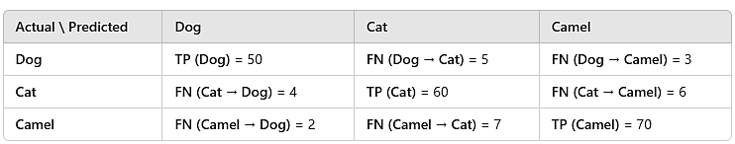
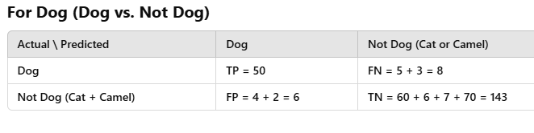
Confusion Matrix for multiclass problem
Confusion Matrix for 3-classes (Dog, Cat, Camel) problem
Dog=58, Cat=70, Camel=79
Compute confusion matrix for each class, also called one vs all confusion matrix

Slide 13
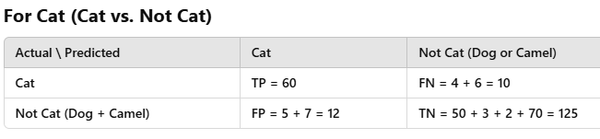
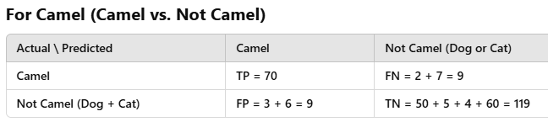

Slide 14
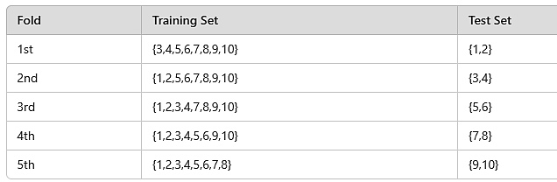
Model evaluation
Model cross validation methods
(1) K-fold (2) Leave-One-Out, (3) Hold-out validation
1) K-fold Cross-Validation:
Divide the dataset into k equal-sized folds.
Train the model on k-1 folds and evaluate on the remaining fold.
Repeat k times, using each fold for validation once.
Average the performance metrics across all iterations
Example (k=5):
Consider 10 data points:
{1,2,3,4,5,6,7,8,9,10} We divide them into 5 folds:

Slide 15
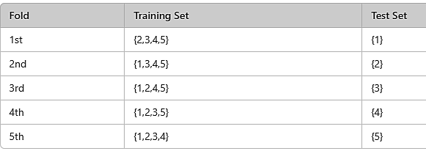
2) Leave-One-Out Cross-Validation
A special case of k-fold cross-validation where k equals the number of samples in the dataset.
Leave one sample out for validation in each iteration.
Train the model on the remaining samples and evaluate on the left-out sample.
Repeat for all samples
Example:
Dataset: {1,2,3,4,5}

Slide 16
3. Hold-Out Validation
This is the simplest method where the dataset is divided into two sets:
Training set (used to train the model)
Test set (used to evaluate the model)
Numerical Example:
Imagine we have 10 data points:
80% Training Set: {1,2,3,4,5,6,7,8}
20% Test Set: {9,10}

Slide 17
Model Testing
After model construction, it is evaluated by unseen/testing dataset.
It determine the generalization power of the model
It shows the overall model performance
Model Deployment
During model deployment, it’s essential to ensure that the system can handle high user loads
Operate smoothly without crash\hang, and be easily updated.

