Slide 1
Support Vector Machine (SVM)
By
Dr. Farman Ali
Assistant Professor
CS Department BU

Slide 2
Introduction to svm
SVM is a supervised machine learning algorithm that uses for classification problems like Spam detection (spam vs. not spam), cancer detection (malignant vs. benign tumors).
It was proposed by Vapnik in 1960 and widely recognized in 1990.
Its modern formulation was published in 1992.
Its main goal is to find a hyperplane that classifies the data points/samples into categories/classes.
SVM works by maximizing the margin between the data points of different classes, making it effective for high-dimensional data.

Slide 3
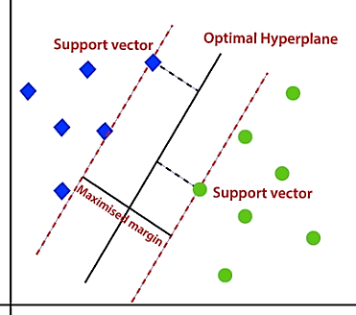
Basic terms in svm
Hyperplane
A decision boundary that separates data points into different classes.
Support Vectors
Support vectors are the data points that lie closest to the hyperplane.
These points are crucial because they define the margin around the hyperplane.
SVM algorithm focuses on maximizing the distance between the hyperplane and these support vectors.
Margin
The distance between the hyperplane and support vectors.
Maximum Margin
The distance between support vectors

Slide 4
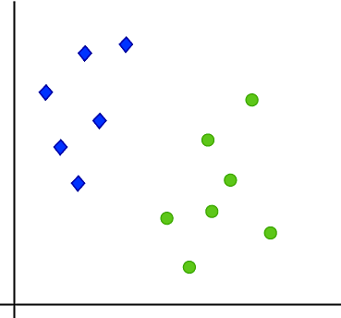
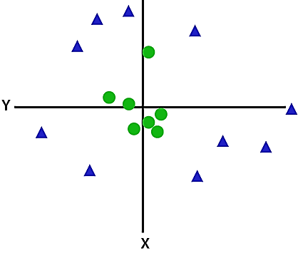
Types of svm
Linear SVM:
Linear SVM is used for linearly separable data.
If a dataset can be classified into two classes by using a single straight line.
such data is termed as linearly separable data, and classifier is used called as Linear SVM
Non-linear SVM:
Non-Linear SVM is used for non-linearly separated data
if a dataset cannot be classified by using a straight line
such data is termed as non-linear data and classifier used is called as Non-linear SVM.

Slide 5
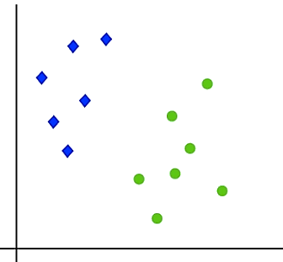
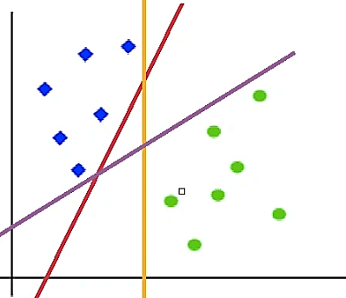
How linear svm works
Let’s understand the working of SVM using an example
Suppose we have a dataset that has two classes (green and blue)
We want to classify that the new data point as either blue or green
To classify these points, we can have many decision boundaries
The question is which one is the best and how do we find it?
The best hyperplane is that has the maximum distance from both the classes

Slide 6
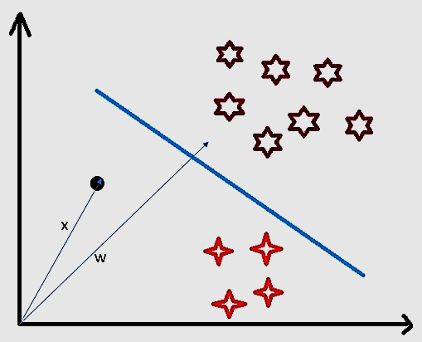
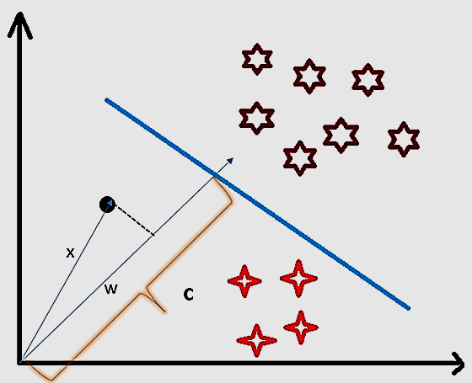
How svm classifies a new sample
Consider a random point X and we want to know whether it lies on the right side of the hyperplane or the left side of the plane.
To find this first we assume this point is a vector (X).
Then we make a vector (w) which is perpendicular to the hyperplane.
Let’s say the distance of vector w from origin to decision boundary is ‘c’.
Now we take the projection of X vector on w.
We take the dot product of x and w vectors.

Slide 7
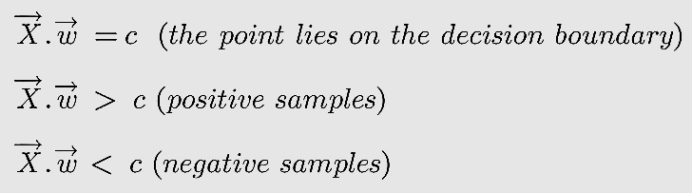
If the dot product is greater than ‘c’ then we can say that the point lies on the right side.
If the dot product is less than ‘c’ then the point is on the left side
if the dot product is equal to ‘c’ then the point lies on the decision boundary.

Slide 8
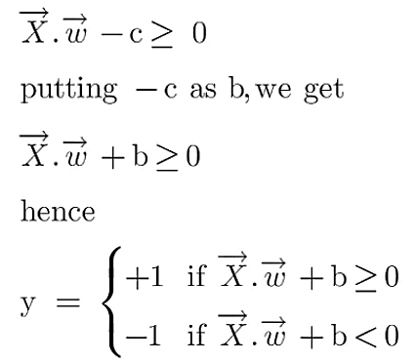
A hyperplane is w.x+b=0 where w is a vector normal to hyperplane and b is an offset/bias (distance of the hyperplane from the origin along the normal vector w).
w is the normal vector (perpendicular) to the hyperplane
x is the input vector (point in space)
b is the offset or bias term
To classify a point as negative or positive we need to define a decision rule. We can define decision rule as:

Slide 9
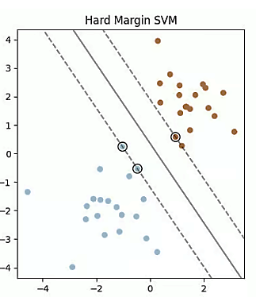
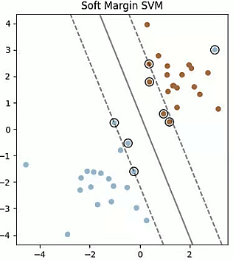
Hard Margin
A hyperplane that properly separates the data points of different categories without any misclassifications.
Soft Margin
When the data is not perfectly separable.
SVM permits a soft margin technique.
SVM softens the strict margin requirement and permits certain misclassifications or violations.

Slide 10
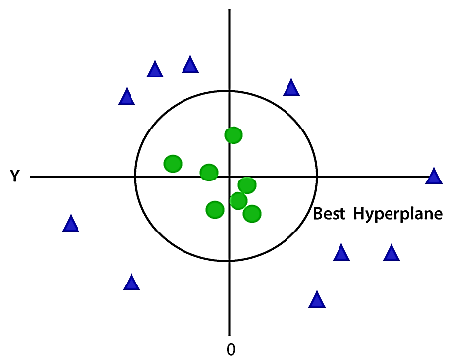
How non-linear svm works
Non-linear data, cannot be separated by a single straight line.
Non-linear SVM classifies non-linear data by transforming to high dimensional space (2D to 3D or higher according to the problem)
This transformation is performed by kernel functions.

Slide 11
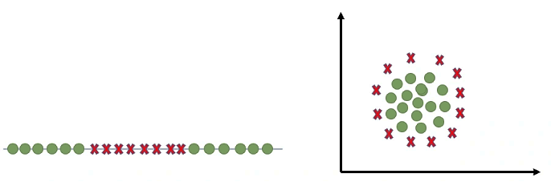
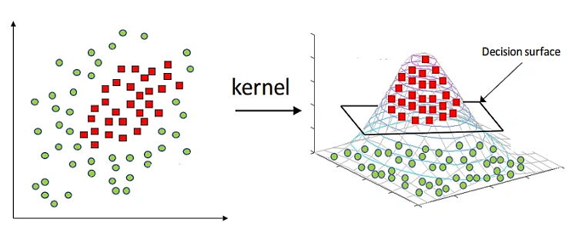
Kernel Function
Linear (used for linear classification)
Radial Basis Function (RBF)
Sigmoid
Polynomial

Slide 12
hyperparameters
Parameters that are not learned from the data but are set before training an SVM model.
They control the behavior of the model and can significantly impact its performance.
SVM hyperparameters are: (1) Kernel Function (2) Regularization (c) and (3) Gamma (γ).
(1) Kernel Function
Transform the data to higher dimensional space
(2) Regularization (C)
A small C allows the margin to be wider, even if it means more misclassified points, whereas a large C aims to classify all training points correctly but risks overfitting
(3) Gamma (γ)
A small gamma means the model has a large influence area, making the decision boundary smoother, while a large gamma means the model will be more sensitive to individual data points, potentially leading to overfitting.

Slide 13
Choosing the Right Hyperparameters
The optimal hyperparameters for an SVM model depend on the specific dataset and problem
Common techniques for selecting hyperparameters include:
Grid Search: Manually specifying a grid of hyperparameter values and evaluating the model's performance for each combination.
Random Search: Randomly sampling hyperparameter values and evaluating the model's performance.
Common problems during model training
Overfitting
Occurs when a model is too complex and fits the training data too closely
Capturing not just the underlying pattern but also the noise
The model performs well on the training data but fails to generalize to new, unseen/testing data
Underfitting
Occurs when a model is too simple and cannot capture the underlying patterns in the data.
It performs poorly on both the training data and new data because it has not learned the relationship well enough.

Slide 14
Pros and Cons of SVM
Pros:
Effective for both linear and non-linear classification: SVM can handle both linearly separable and non-linearly separable data using kernel functions.
Works well with high-dimensional data: SVM can effectively handle data with many features.
Can handle both binary and multi-class classification: SVM can be extended to handle multi-class classification problems.
Cons:
Computationally expensive: SVM can be computationally expensive for large datasets, especially when using kernel functions.
Choosing the right kernel function: Selecting the appropriate kernel function can be challenging and requires domain knowledge or experimentation.
Sensitive to the scale of features: The performance of SVM can be affected by the scale of the features. Normalization or standardization can help mitigate this issue.

