Slide 1
Decision Tree (DT)
By
Dr. Farman Ali
Assistant Professor
CS Department BU

Slide 2
Introduction to dt
DT is a type of supervised learning algorithm that is commonly used in machine learning to design a model and predict outcomes.
It is a tree-like structure where each internal node tests on attribute/feature.
Each branch corresponds to attribute value and each leaf node represents the final decision or prediction.
Used to solve both regression and classification problems.
The goal of using a Decision Tree is to create a training model that can use to predict the class of the target sample by learning simple decision rules.

Slide 3
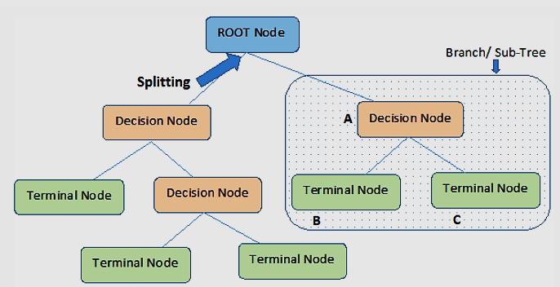
Basic terms in dt
Root Node: The starting/first node of the tree, representing the initial decision.
Splitting: It is a process of dividing a node into two or more sub-nodes.
Decision Node: When a sub-node splits into further sub-nodes, then it is called the decision node.
Leaf / Terminal Node: Nodes do not split is called Leaf or Terminal node.
Pruning: Removing of sub-nodes of a decision node is called pruning. You can say the opposite process of splitting.
Branch / Sub-Tree: A subsection of the entire tree is called branch or sub-tree.

Slide 4
How dt works
The whole training set is considered as the root
Feature values are preferred to be categorical like Colors (red, blue, green), sizes (small, medium, large)
If the values are continuous then they are discretized prior to building the model
Discretization is the process of converting continuous data into discrete categories.
Example: A continuous variable "Age" ranging from 1 to 100 can be classified as
Young: 1-29
Middle-Aged: 30-59
Old: 60-100
Records are distributed recursively on the basis of attribute values

Slide 5
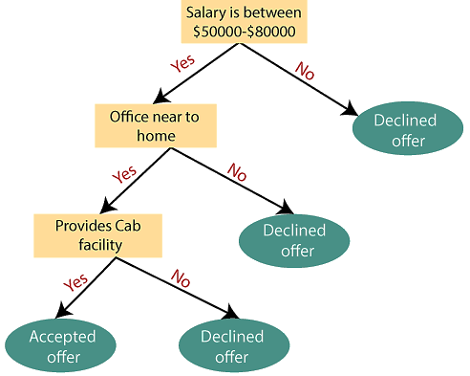
Example
Suppose there is a candidate who has a job offer and wants to decide whether he should accept the offer or Not.
To solve this problem, the decision tree starts with the root node (Salary attribute)
The root node splits further into the next decision node (distance from the office)
The next decision node further gets split into one decision node (Cab facility)
Finally, the decision node splits into two leaf nodes (Accepted offers and Declined offer)

Slide 6

Attribute Selection Measures
The main issue arises that how to select the best attribute for the root node and for sub-nodes.
To solve such problems there is an approach which is called as Attribute selection measure (ASM).
By this measurement, we can easily select the best attribute for the nodes of the tree.
There are two popular techniques for ASM, which are:
(1) Entropy (2) Information gain
Entropy:
Entropy is a metric to measure the impurity in a given attribute.
Entropy can be calculated as:
S= sample
p1​ is the proportion of class 1,
p2​ is the proportion of class 2.

Slide 7

Example: Predicting Loan Customers
Imagine a bank wants to classify customers as "high-risk" or "low-risk" based on their financial history.
If the dataset has 50 customers, and 25 are high-risk (1) and 25 are low-risk (0)
The entropy is maximum because there is an equal split between the two classes.
The dataset is highly uncertain.
The value of Entropy is ranging from 0 to 1
Higher value of Entropy leads to low accuracy
Lower value of Entropy rises the accuracy
In the above example, value is maximum means there is high risk

Slide 8

Information Gain (IG)
Measures the reduction in entropy after a dataset is split on a particular feature
In decision trees, the goal is to find the feature that maximizes information gain, i.e., the feature that gives the most reduction in uncertainty about the class.
IG is computed as:
S is the original dataset
A is the feature on which the dataset is split
H(S) is the entropy of the dataset before the split
H(Sv​) is the entropy of the subsets after the split on feature A.

Slide 9
Example: Predicting Student Performance
Consider a school predicting whether students will pass or fail based on features like "hours studied" and "attendance."
Initially, the data may have equal instances of passing and failing students, leading to high entropy
Splitting on "attendance" could give a large information gain.
For example, if 80% of students with high attendance pass, the entropy will decrease significantly
The information gain will be high.
Therefore, the decision tree will prioritize "attendance" as the first split.

Slide 10
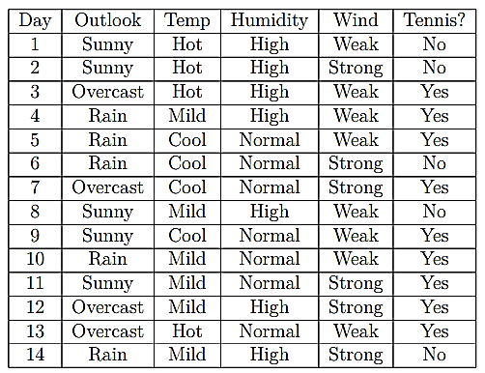
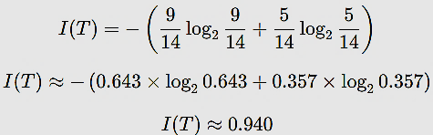

Example: prediction of tennis to play or not
Step-by-step construction of Decision Tree for the dataset
Step 1: Calculate the Initial Entropy of the Dataset
We have the following results:
9 instances of "Yes" (tennis is played)
5 instances of "No" (tennis is not played)
The entropy for the dataset is:

Slide 11



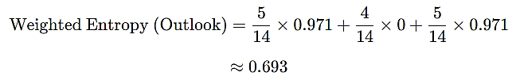
Step 2: Calculate Information Gain for Each Attribute
We now calculate the information gain for each attribute: Outlook, Temperature, Humidity, and Wind.
2.1 Information Gain for Outlook:
Outlook has 3 values: Sunny, Overcast, and Rain. Determine Entropy for each value.
Sunny: 5 samples (3 "No", 2 "Yes")
Overcast: 4 samples (all "Yes")
Rain: 5 samples (2 "No", 3 "Yes")
The weighted entropy for Outlook is:

Slide 12



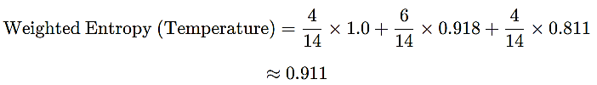
The information gain for Outlook is:
2.2 Information Gain for Temperature:
Temperature has 3 values: Hot, Mild, and Cool.
Hot: 4 samples (2 "No", 2 "Yes")
Mild: 6 samples (2 "No", 4 "Yes")
Cool: 4 samples (1 "No", 3 "Yes")
The total entropy for Temperature is:

Slide 13




The information gain for Temperature is:
2.3 Information Gain for Humidity:
Humidity has 2 values: High and Normal.
High: 7 samples (4 "No", 3 "Yes")
Normal: 7 samples (1 "No", 6 "Yes")
The total entropy for Humidity is:
The information gain for Humidity is:

Slide 14




2.4 Information Gain for Wind:
Wind has 2 values: Weak and Strong.
Weak: 8 samples (2 "No", 6 "Yes")
Strong: 6 samples (3 "No", 3 "Yes")
The weighted entropy for Wind is:
The information gain for Wind is:

Slide 15
Step 3: Choose the Best Attribute for the Root Node
The information gains for each attribute are:
Outlook: 0.247
Temperature: 0.029
Humidity: 0.151
Wind: 0.048
Since Outlook has the highest information gain (0.247), we choose Outlook as the root node.
Step 4: Split the Dataset on Outlook
4.1 Subtree for Outlook = Overcast:
All examples are "Yes", so this is a leaf node with label Yes.
4.2 Subtree for Outlook = Sunny:
Now we have 5 samples (3 "No", 2 "Yes"). We repeat the process for these samples using the remaining attributes (Humidity, Wind).
Humidity gives the highest information gain for this subset (computed earlier).
If Humidity = High, then the label is No (since all instances with high humidity are "No").
If Humidity = Normal, then the label is Yes.

Slide 16
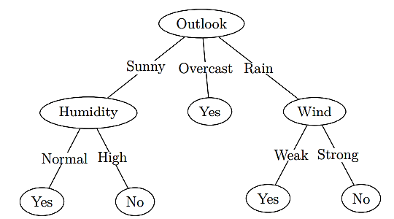
4.3 Subtree for Outlook = Rain:
For the subset where Outlook = Rain, we have 5 samples (2 "No", 3 "Yes").
The attribute with the highest information gain here is Wind.
If Wind = Weak, then the label is Yes.
If Wind = Strong, then the label is No.
Prediction of the DT: There are 3 Yes and 2 No, Tennis will be played

Slide 17
Pros and cons of dt
Pros
Easy to understand and interpret, making them accessible to non-experts.
Handle both numerical and categorical data without requiring extensive preprocessing.
Provides insights into feature importance for decision-making.
Applicable to both classification and regression tasks.
Cons
Potential for overfitting
Sensitivity to small changes in data, limited generalization if training data is not representative
Potential bias in the presence of imbalanced data.

