Slide 1
Random Forest (RF)
By
Dr. Farman Ali
Assistant Professor
CS Department BU

Slide 2
Introduction to RF
RF is a popular machine learning algorithm that belongs to the supervised learning.
It is based on the concept of ensemble learning (EL).
EL is a process of combining multiple classifiers to solve a complex problem.
Used to solve both regression and classification problems.
A classifier that contains a number of decision trees on various subsets of the given dataset.
Takes the prediction from each tree and based on the majority votes of predictions, it predicts the final output.
The greater number of trees in the forest leads to higher accuracy and prevents the problem of overfitting.

Slide 3
How rf works
Select random K data points from the training set
Build the decision trees associated with the selected data points (Subsets).
Choose the number N for decision trees that you want to build.
Repeat Step 1 & 2.
For new data points, find the predictions of each decision tree, and assign the new data points to the category that wins the majority votes.

Slide 4
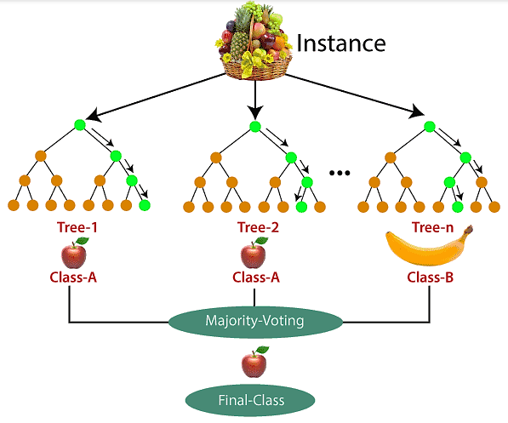
Example
Suppose there is a dataset that contains multiple fruit images.
This dataset is given to the Random forest classifier.
The dataset is divided into subsets and given to each decision tree.
During the training phase, each decision tree produces a prediction result.
when a new data point occurs, then based on the majority of results, the Random Forest classifier predicts the final decision.

Slide 5
Hyperparameters in rf
Hyperparameters are used in RF to either enhance predictive power of models or to make the model faster.
Increase the Predictive Power
n_estimators: Number of trees the algorithm builds before averaging the predictions.
max_features: Maximum number of features random forest considers splitting a node.
mini_sample_leaf: Determines the minimum number of leaves required to split an internal node.
criterion: How to split the node in each tree? (Entropy/Gini impurity).
max_leaf_nodes: Maximum leaf nodes in each tree.

Slide 6
Hyperparameters in rf
Increase the Speed
n_jobs: it tells the engine how many processors it is allowed to use. If the value is 1, it can use only one processor, but if the value is -1, there is no limit.
random_state: controls randomness of the sample. The model will always produce the same results if it has a definite value of random state and has been given the same hyperparameters and training data.
oob_score: OOB means out of the bag. It is a random forest cross-validation method. In this, one-third of the sample is not used to train the data; instead used to evaluate its performance. These samples are called out-of-bag samples.

Slide 7
Ensemble learning
Ensemble means combining multiple models.
Ensemble uses two types of methods: 1) Bagging 2)Boosting
1) Bagging
Multiple week models are trained on different subsets of the training data parallelly
Averaging or voting their predictions.
By combining the predictions of multiple models, prevents overfitting
Example: Random Forest
2)Boosting
Works by training multiple models sequentially
Each model focuses on correcting the errors of the previous models
Boosting aims to improve the model’s accuracy
Example: ADA BOOST, XG BOOST

Slide 8
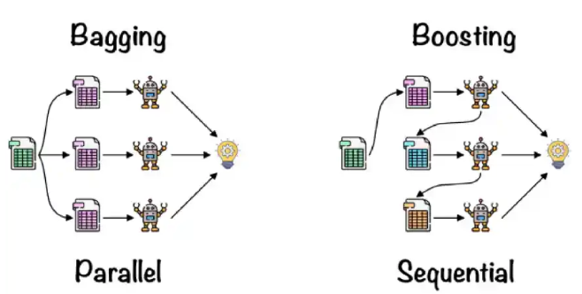
Ensemble learning

Slide 9
Features of Random Forest
Diversity: Each decision tree in the RF is built from a different subset of data and features. This diversity helps in reducing overfitting and improving the model’s generalization capability.
Robustness: By averaging the results from multiple trees, RF improves the performance of the predictions.
Handling of Missing Values: It can handle missing values internally by averaging results from other trees.
Feature Importance: It provides insights into the importance of each feature in the prediction process. This can be particularly useful for feature selection and understanding the underlying data patterns.
Scalability: RF can be parallelized because each tree is built independently of the others. This makes it scalable to large datasets and high-dimensional data.
Versatility: It can be used for both classification and regression tasks. The algorithm is also effective for tasks involving categorical and continuous variables.

Slide 10
Feature selection with Random Forests
Can be used for feature selection process.
Used to rank the importance of features in a classification problem
By analyzing how different features contribute to the model's decision-making process,
Can help identify the most relevant features, which can improve its performance

Slide 11
Difference Between Decision Tree and Random Forest
Decision trees | Random Forest
1. Decision trees normally suffer from the problem of overfitting if it’s allowed to grow without any control. | 1. Random forests are created from subsets of data, and the final output is based on average or majority ranking; hence the problem of overfitting is taken care of.
2. A single decision tree is faster in computation. | 2. It is comparatively slower.
3. When a data set with features is taken as input by a decision tree, it will formulate some rules to make predictions. | 3. Random forest randomly selects observations, builds a decision tree, and takes the average result. It doesn’t use any set of formulas.

