Slide 1
Databases
Software
e)
f)
g)
h)
Notes:
Figure 1

Slide 2
Absolute
Relative
Proportion of reads
Number of reads
Notes:
Figure 2

Slide 3
Databases
Software
d)
e)
f)
Notes:
Figure 3

Slide 4
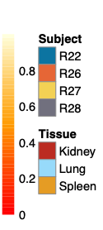
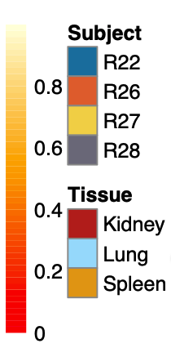
a)
Databases
b)
Software
Notes:
Figure 4

Slide 5
c)
a)
b)
Notes:
Figure 5

Slide 6
Absolute
Relative
Notes:
Top 3 genus per sample & software
Figure S1

Slide 7
a)
c)
b)
Notes:
Figure s2

Slide 8
a)
c)
b)
Notes:
Figure S3

