Slide 1
The Gowanus Canal
Superfund Site
Sivan Spiel, Rachel Lee, Ruslana Bukalo

Slide 2
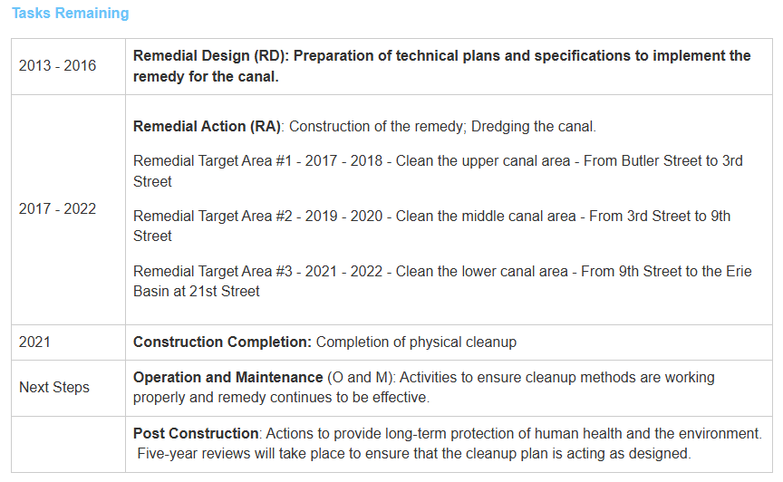
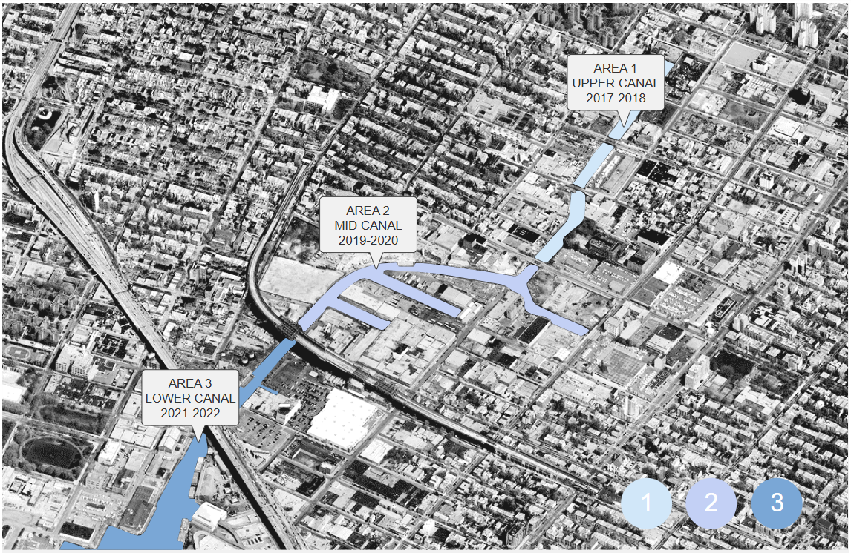
Gowanus Canal Superfund Site - History
The Gowanus canal and surrounding area was developed in the 19th century and was home to chemical plants, coal yards, paint factories, and several other industrial sites.
The canal was used as a waste disposal for these factories, and over the next 150 years, the canal became one of the most polluted bodies of water in America.
The different areas are ordered by cleanup priority, with area 1 being the first zone treated for contaminants.

Slide 3
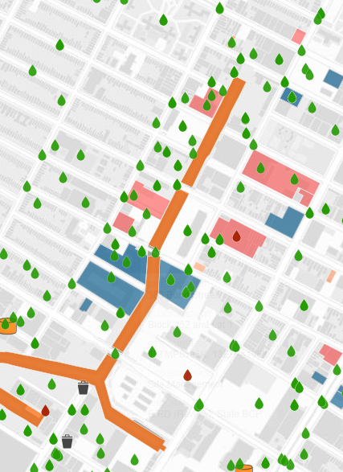
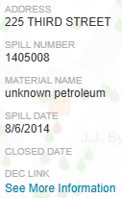
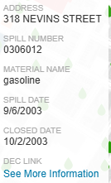
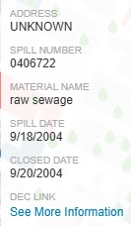
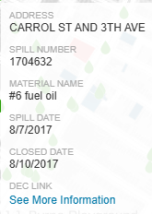
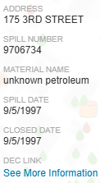
History of Chemical Spills
This map of the Gowanus Canal shows the history of chemical spills occurring from 1978 – 2025. This leaves out around 100 years of poor waste disposal practices.
The green droplets represent the sites that were cleaned up, and the red droplets represent areas that are still contaminated. Some of the active sites have been opened for more than a decade.

Slide 4
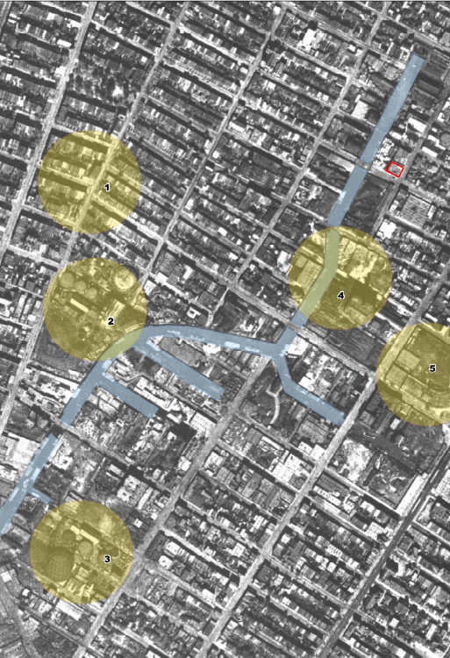
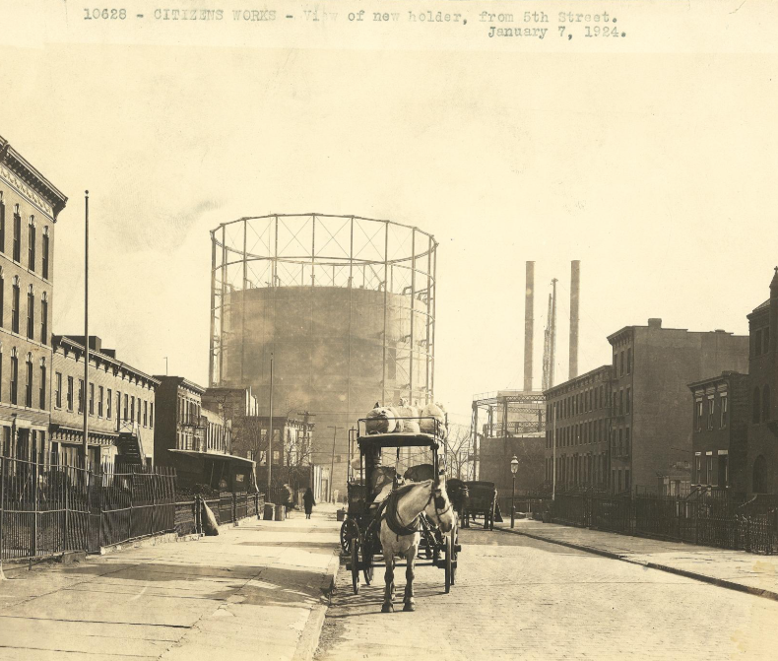
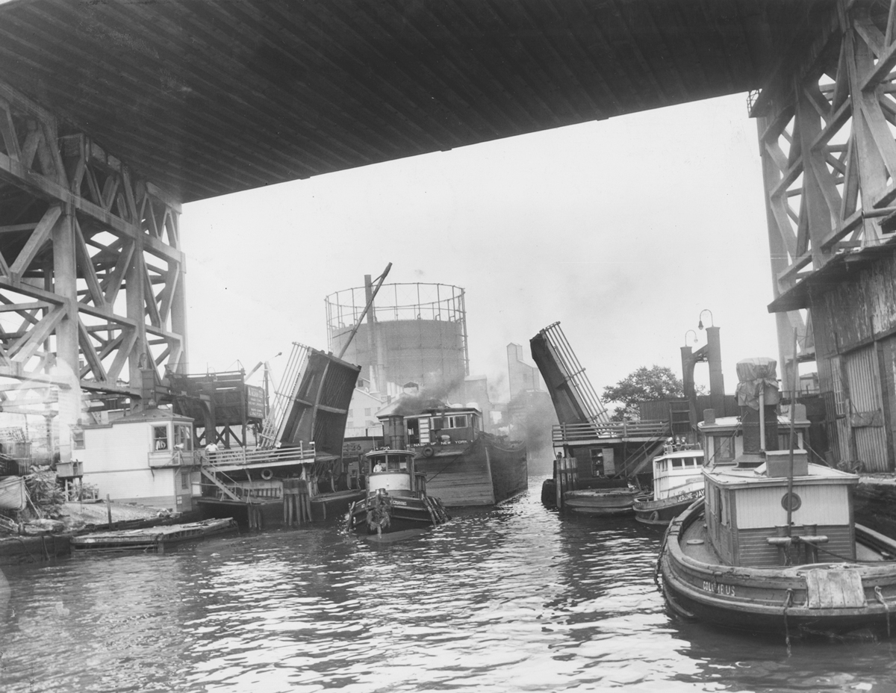
History of Chemical Spills
By 1869 (when the Gowanus Canal was completed), many industries were already present at its banks, including:
Manufactured gas plants (like Metropolitan Gas Works)
Foundries
Machine shops
Coal yards
Ship yards
Chemical plants
These industries, along with persistent sewage overflow, contaminated the Gowanus Canal with toxic chemicals. The toxic sludge at the bottom of the Gowanus Canal is nicknamed “Black Mayonnaise” (mixture of pollutants and decomposing organic matter). Due to the lack of environmental protection laws at the time, byproducts were released and/or incorrectly stored:
Polychlorinated biphenyls (PCBs) (for pigment production, plasticizers)
Coal combustion products (heavy metals like mercury, lead)
1924 aerial photograph of the Gowanus:
1: The future Carroll Street Subway Station;
2: Citizens Gas Works;
3: Metropolitan Gas Works;
4: The 1st Street Basin and;
5 - The Brooklyn Trolley Dodgers Stadium
Admin, G. C. C. Hall of Gowanus. ArcGIS StoryMaps. https://storymaps.arcgis.com/stories/629c46b2651f4ceab0f4678250dfbbc2.
One of three Citizens Manufactured gas plants, built by the Citizens Gas Company, around the Gowanus. The plant supplied energy to Brooklyn from the 1860s to 1960s.
Admin, G. C. C. Hall of Gowanus. ArcGIS StoryMaps. https://storymaps.arcgis.com/stories/629c46b2651f4ceab0f4678250dfbbc2.
Image of a shipyard in the Gowanus Canal in the 1850s.
History. Gowanus Canal Conservatory. https://gowanuscanalconservancy.org/history/.

Slide 5
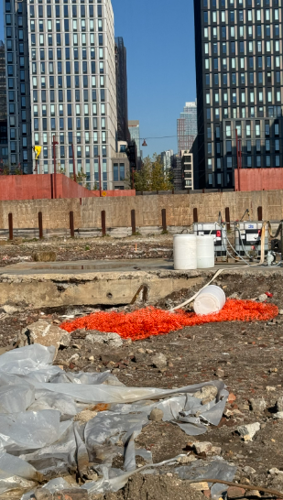
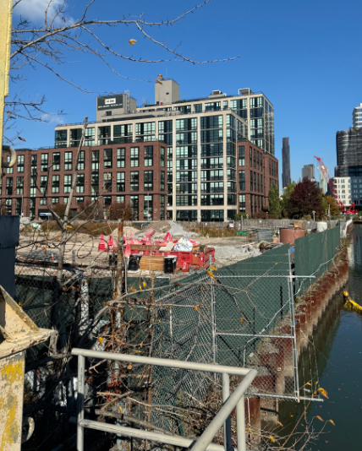
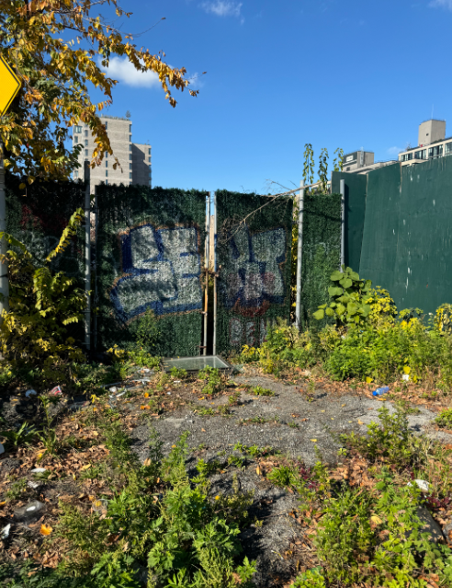
Current Status: Construction
While most of the fossil fuel manufacturing facilities have been destroyed, there are mass amounts of construction happening in the area, mostly residential, a recent count, estimating 141 residential projects currently in development. An 82-acre rezoning plan approved in November of 2021, is slated to bring upwards of 9,000 units or 20,000 new residents by 2035.
“More housing is going up right now [in Gowanus] than anywhere else in the city.” – Brad Lander
The first of many residential blocks in the new rezoning to be completed was 420 Carrol Street by fxcollaborative and began move-ins back in February. These luxury housing complexes glossing over or romanticizing the canal’s history, only to posit themselves on the forefront of the area’s transformation into a sort of Venice or Copenhagen of New York. However, the neighborhood has allocated $20 million for improvements to be done to two nearby New York City Housing Authority sites: the Gowanus Houses and the Wyckoff Gardens.
Not only are the construction sites filled with debris, but the surrounding canal and public spaces are also being treated as disposal sites for these projects, some of which look abandoned.

Slide 6
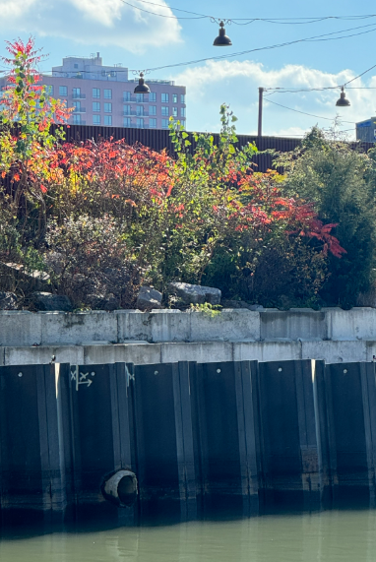
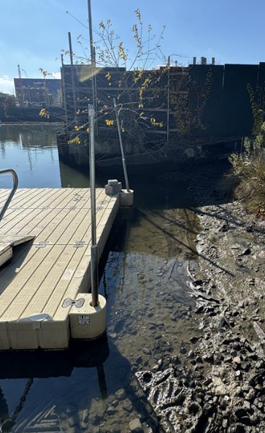
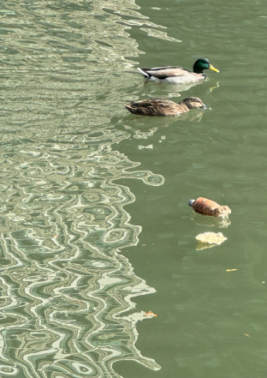
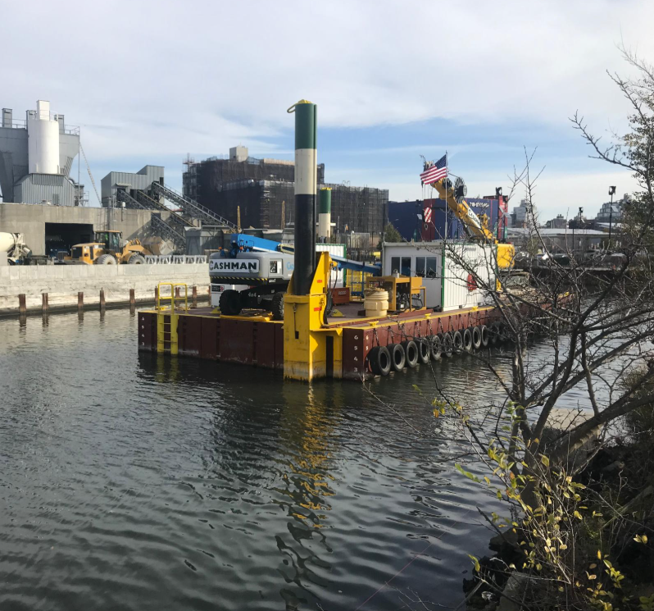
Waste Disposal + Public Areas
The superfund site has multiple public spaces such as seating areas, kayaking docks, and small gardens surrounding the canal.
These areas at first glance look clean, but at closer inspection there are old tarps sitting under the sand, rusted disposal ports leading to the water, and trash floating up and down the canal.
The sediment along the canal is still incredibly contaminated, containing mercury, lead, and polychlorinated biphenyls .
Currently, the EPA is overseeing cleanup of the site by removing approximately 10 feet of sludge from the canal bottom along the entire length of the canal.
Cleanup efforts consist of removing 10 feet of sludge from the bottom of the canal.
Admin, G. C. C. Hall of Gowanus. ArcGIS StoryMaps. https://storymaps.arcgis.com/stories/629c46b2651f4ceab0f4678250dfbbc2.
Notes:
- GOWANUS CANAL | Superfund Site Profile | Superfund Site Information | US EPA

Slide 7
Soil Testing (PCB)
For the soil testing, we focused on area 1, this zone should be the least contaminated and we hypothesized we wouldn’t see noticeable levels of polychlorinated biphenyls (PCBs) in any of the selected areas.
Biological effects of exposure to PCBs include (according to the CDC):
Respiratory problems
Carcinogenesis
Dermal, reproductive, and developmental toxicity
Fatty liver
Neurotoxicity
Note: most of these toxic responses were determined through animal studies. Further validation is needed to determine potential adverse human health effects from low-level environmental exposure of PCBs.
Mechanism of PCB Toxicity:
PCBs are metabolized in the body and produce arene oxides intermediates and methylsulfonyl metabolites
Arene oxides are electrophilic and can bind to proteins, DNA, RNA (induce DNA strand breaks)
Binding of methylsulfonyl metabolites to certain proteins produces toxic adducts.
1
3
2
4
5
6

Slide 8
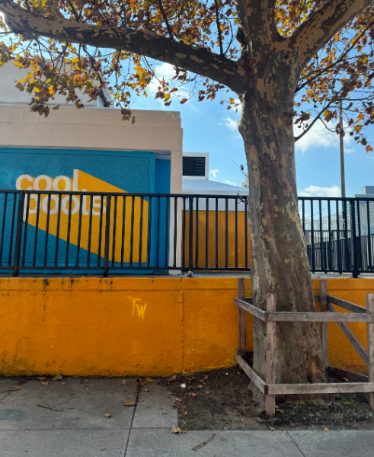
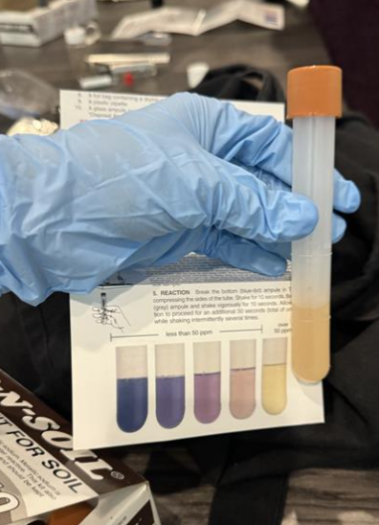
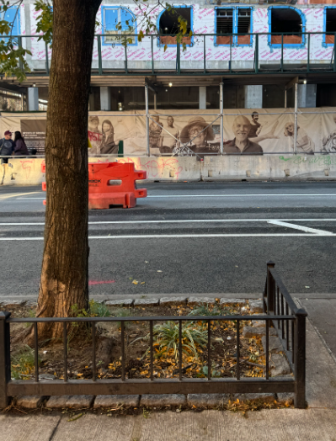
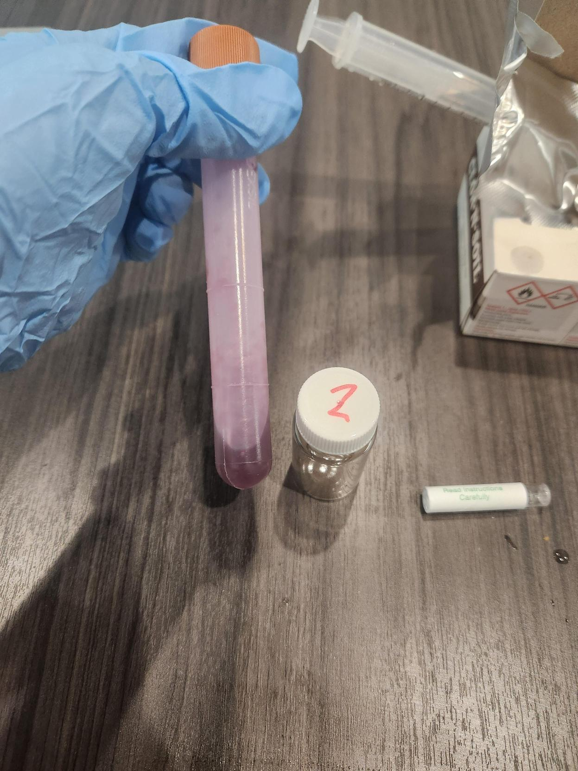
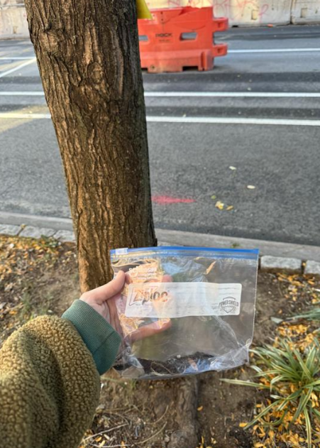
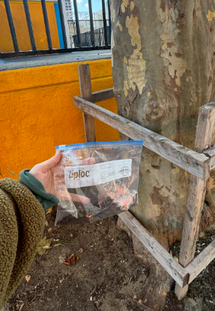
Soil Testing (PCB)
1
2
Soil was collected from public gardens along the canal, construction sites, or tree plots from surrounding blocks. The first sample was taken around a block away from the canal and contained over 50 ppm PCB.
The second sample was collected at a similar tree plot a couple blocks south of the initial test and contained less than 50 ppm PCB.

Slide 9
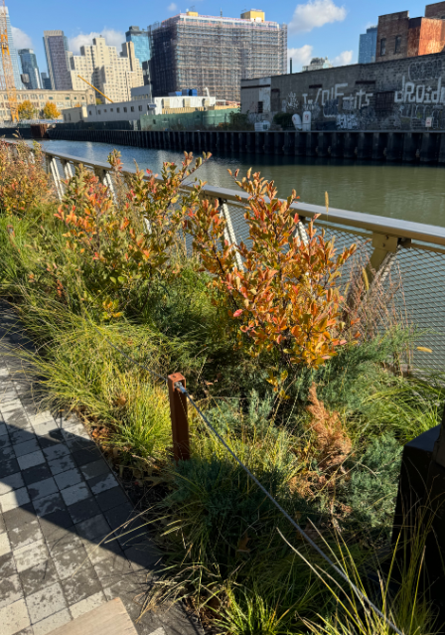
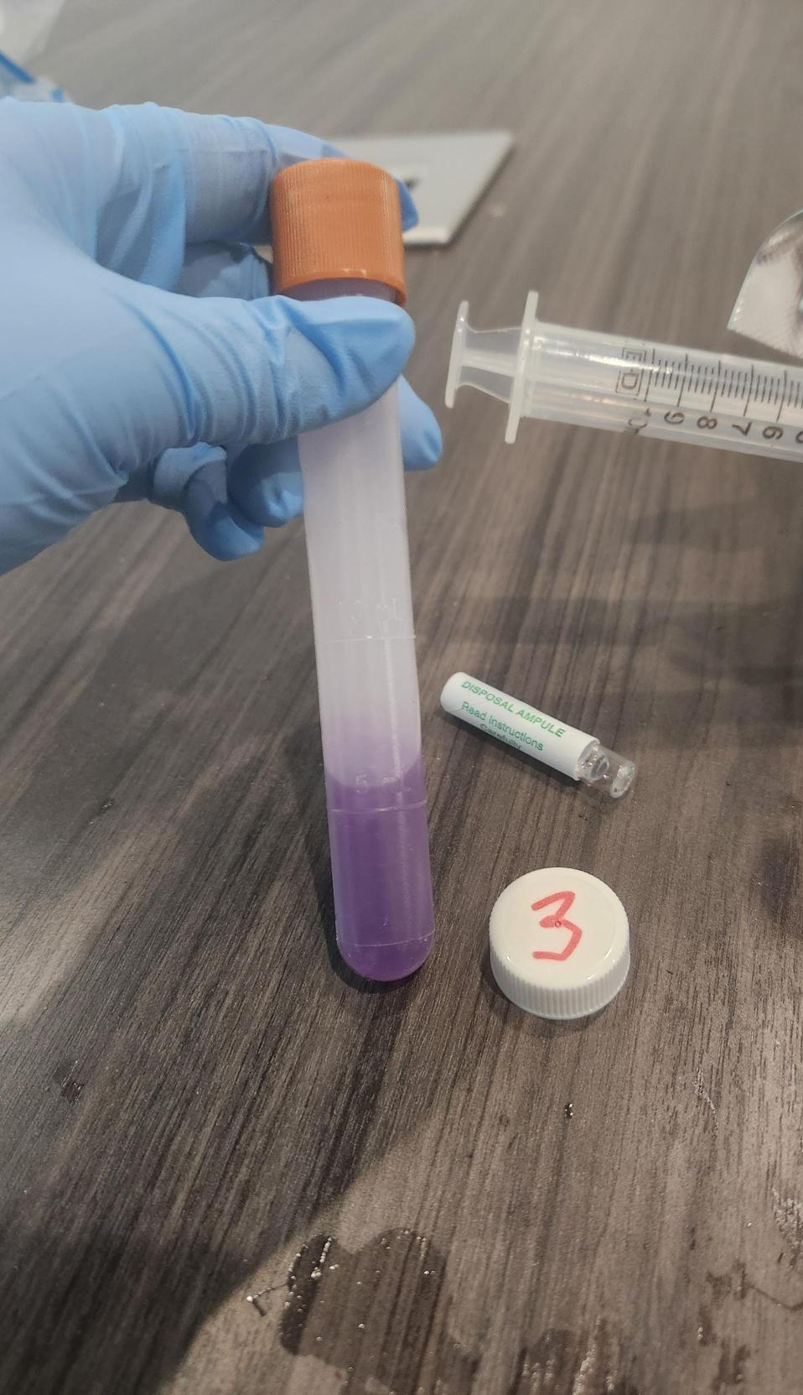
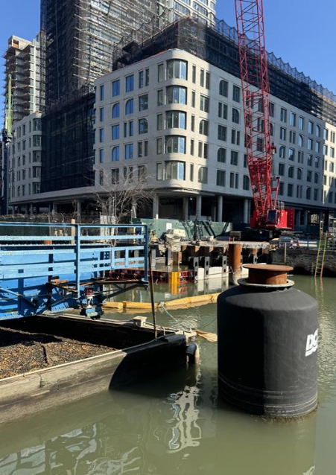
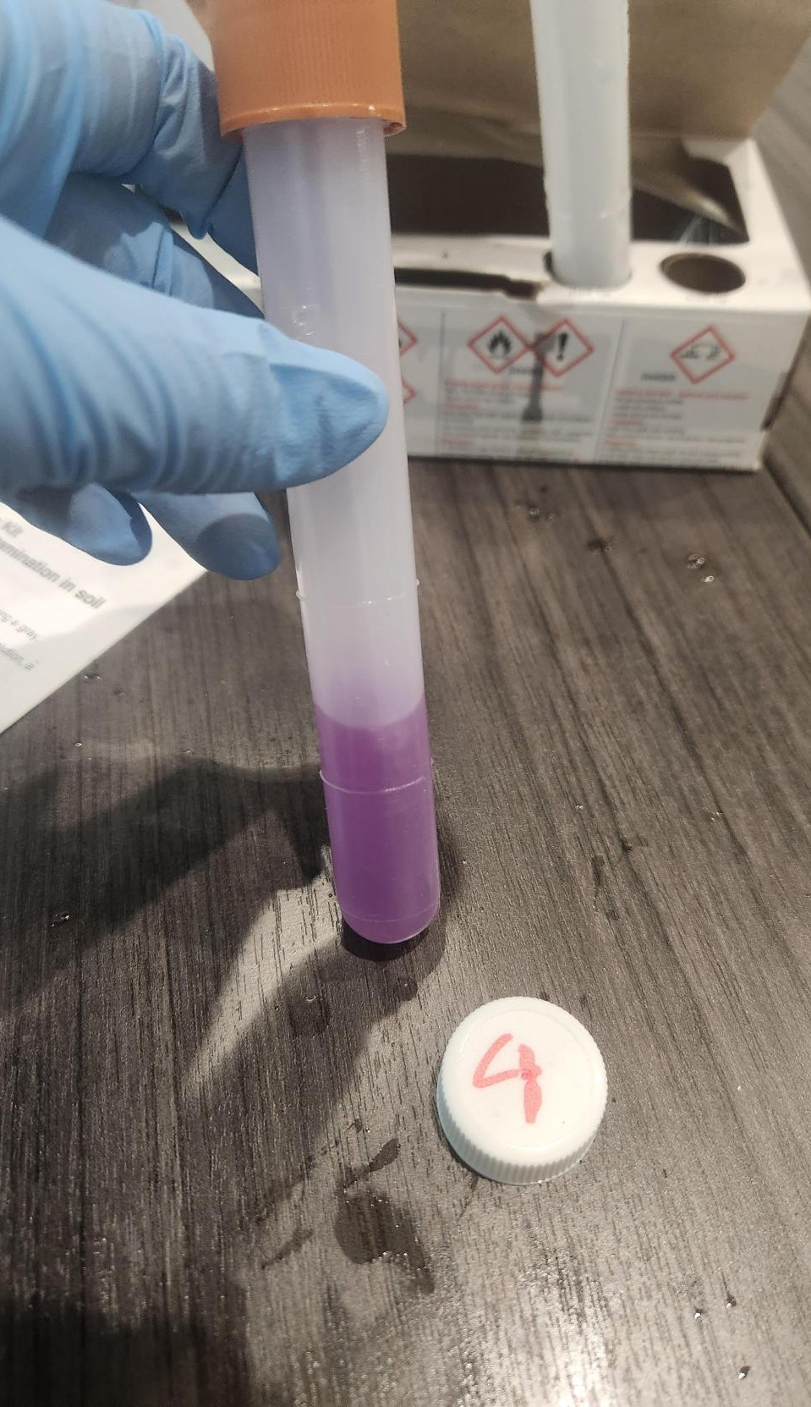
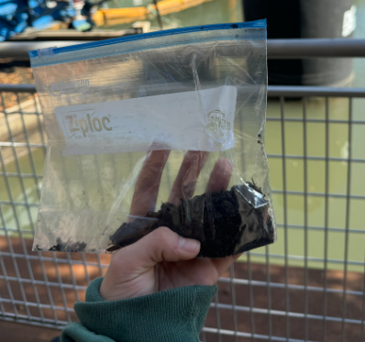
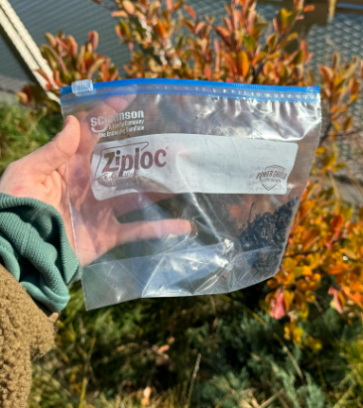
Soil Testing (PCB)
3
4
The 3rd and 4th sample were taken at two different public gardens along the canal and both contained less than 50 ppm PCB.

Slide 10
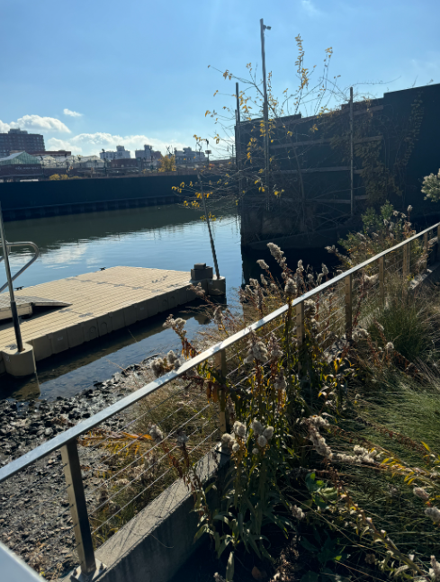
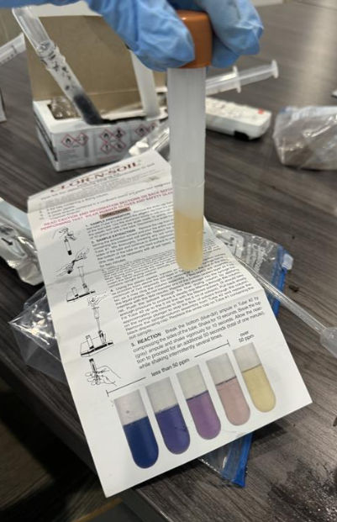
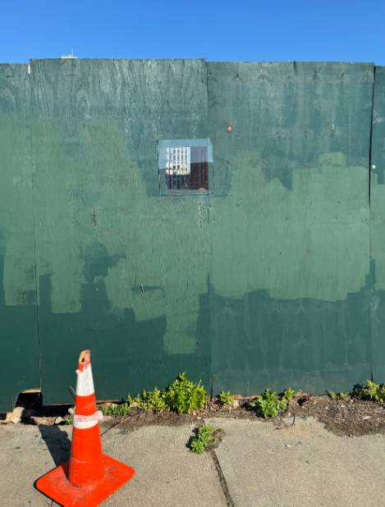
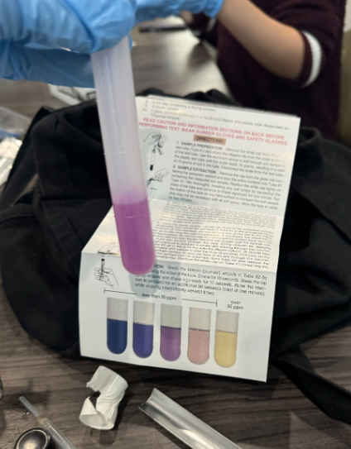
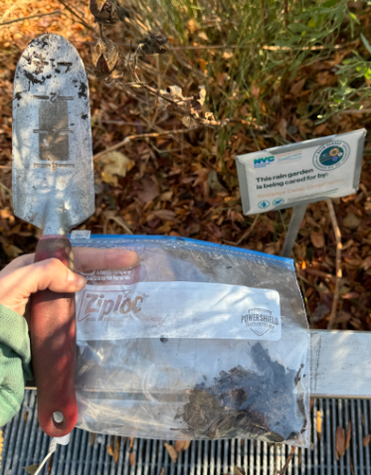
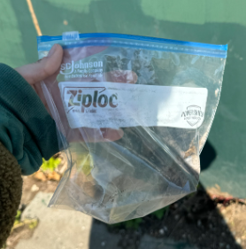
Soil Testing (PCB)
5
6
The 5th sample was taken out of a rain garden overseen by the Gowanus Conservatory and contained over 50ppm PCB. The 6th and final sample was taken from a construction site, which had a negligible amount of PCB in the soil.
The current remediation process for new buildings require that land is treated before any construction, and the amount of contamination removal required depends on the type of building. Which is most likely the reason for the low PCB content. This could mean that land not being used commercially/residentially has not been treated.

Slide 11
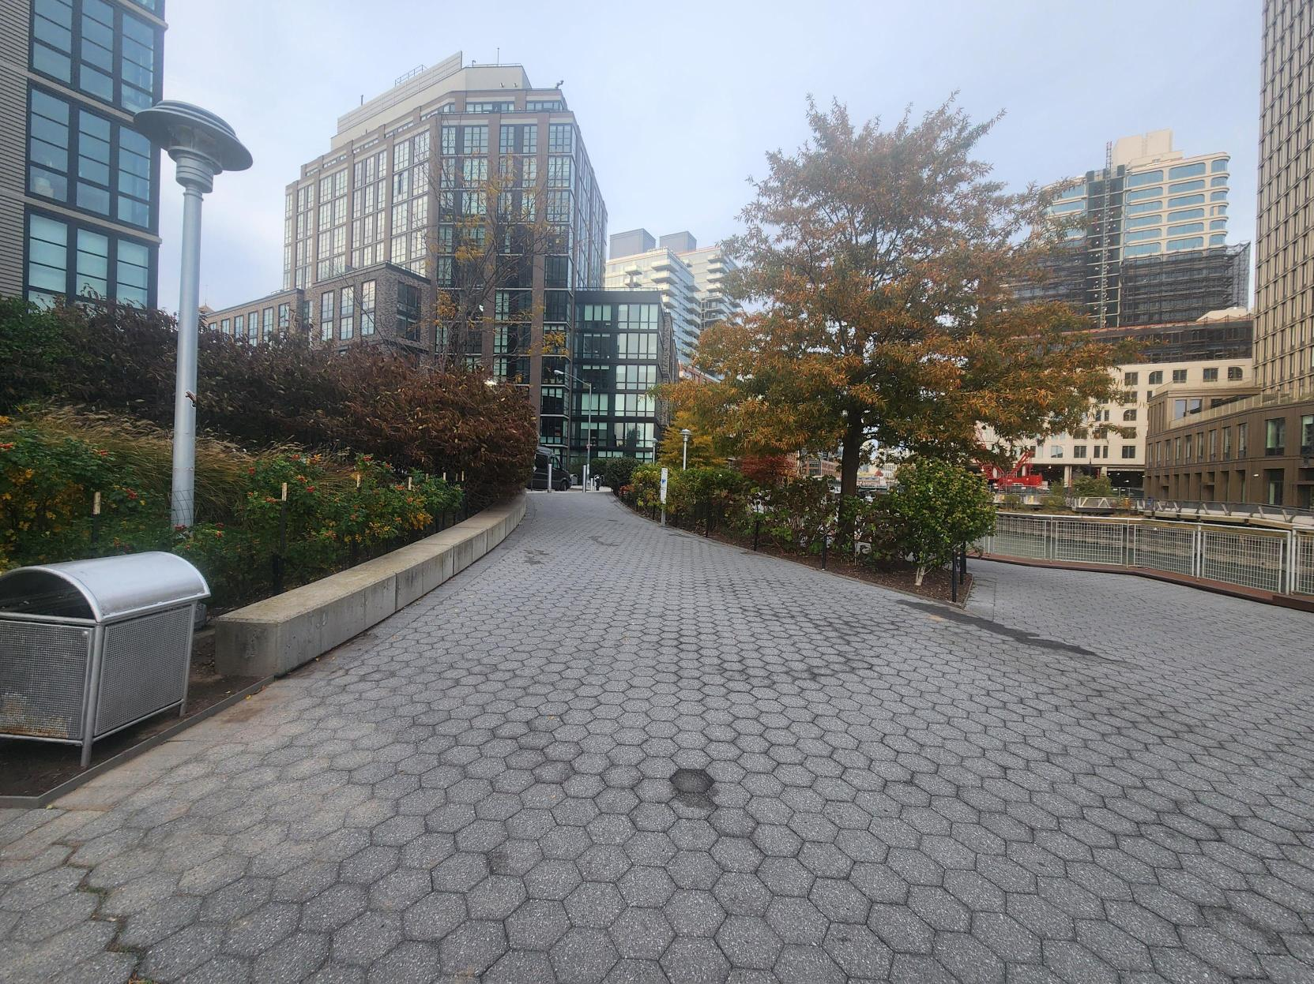
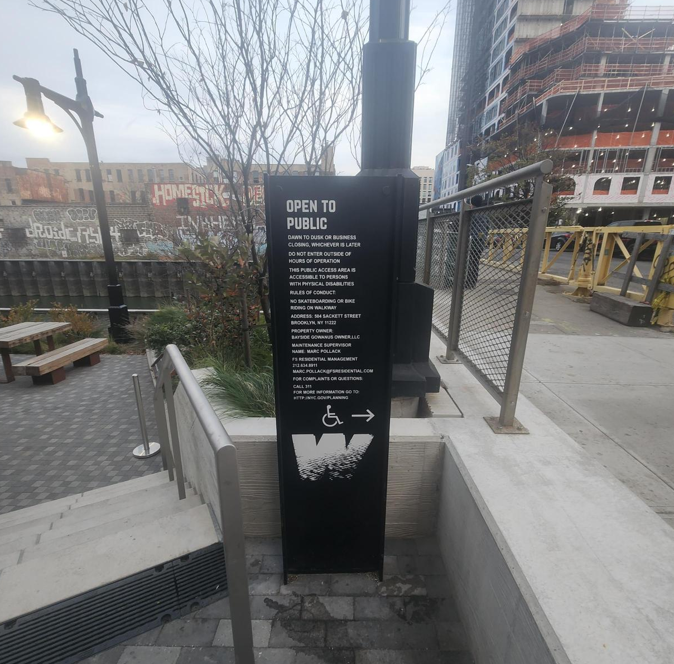
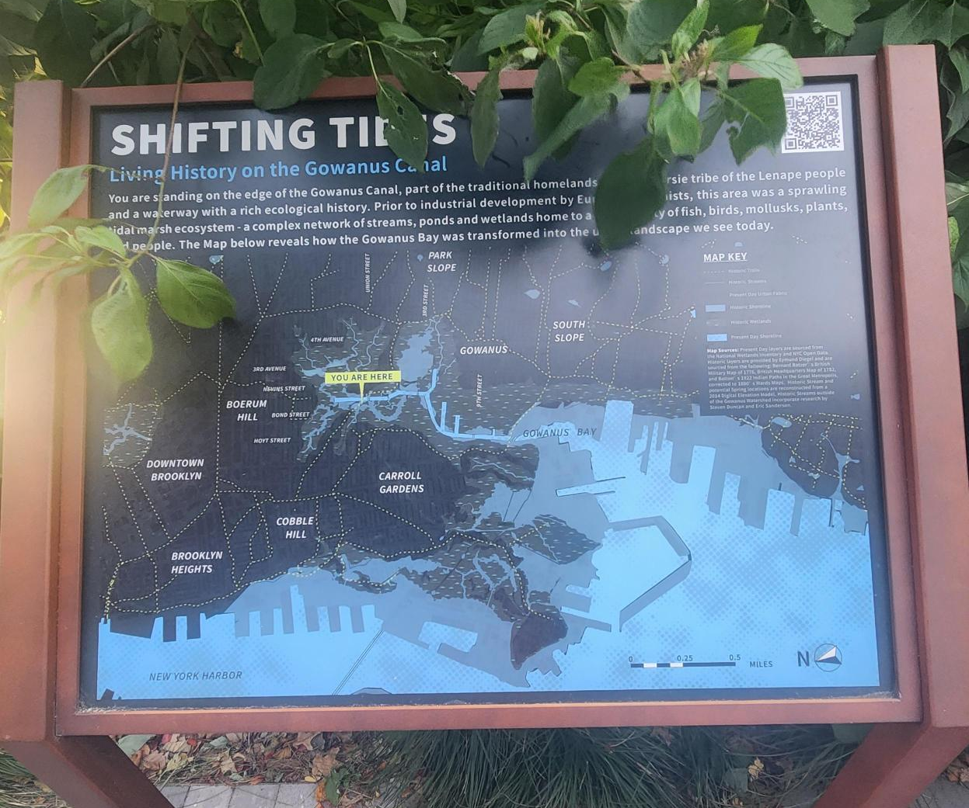
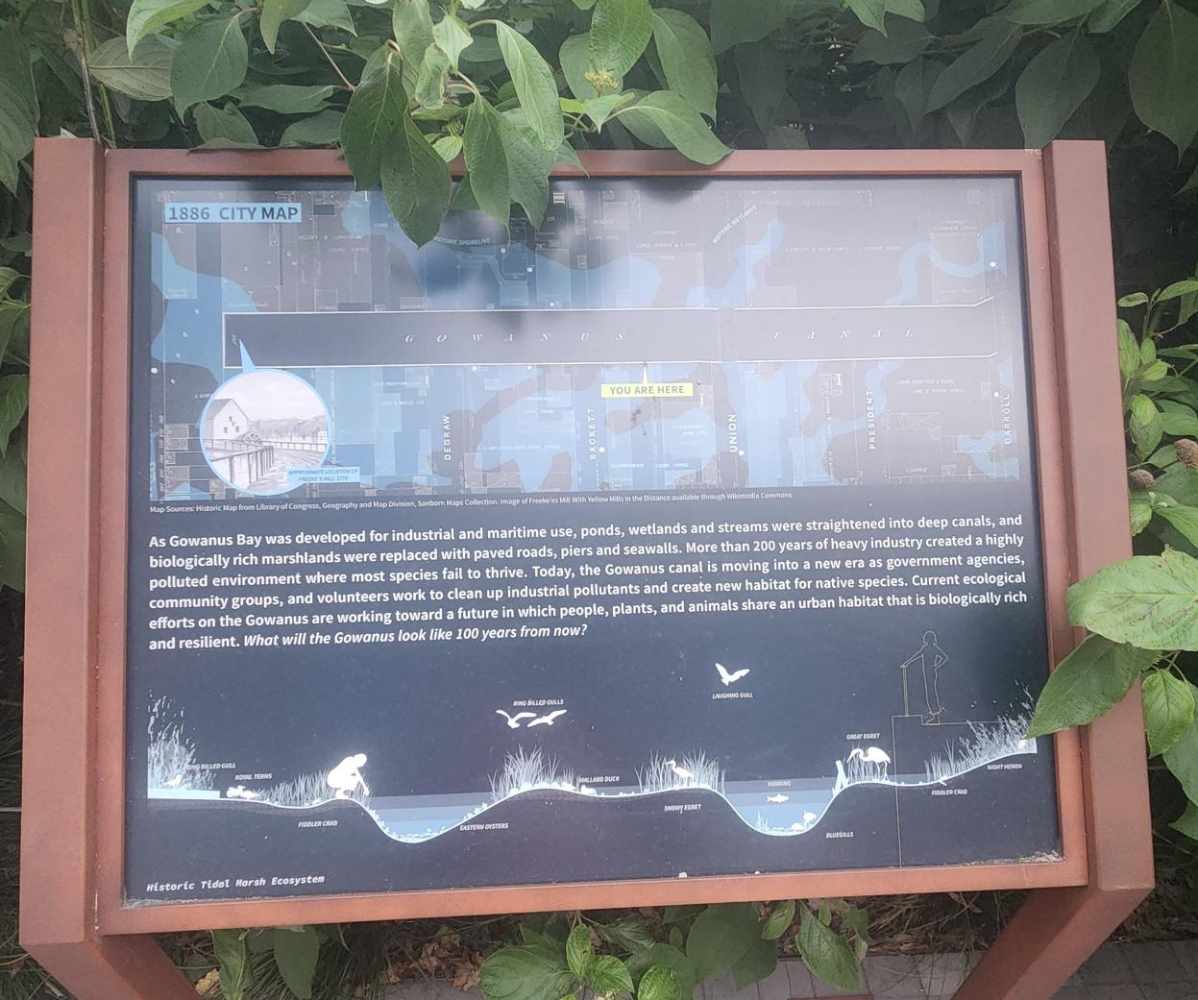
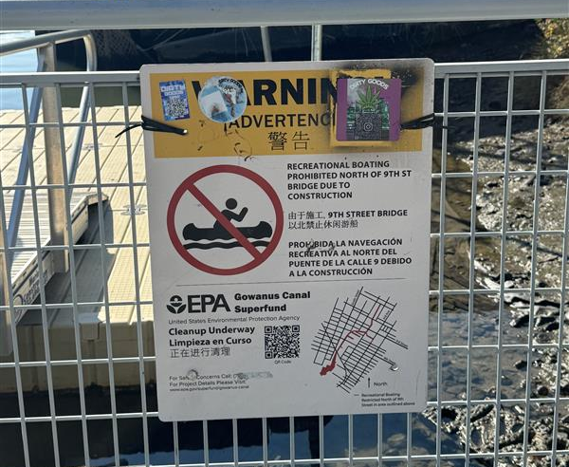
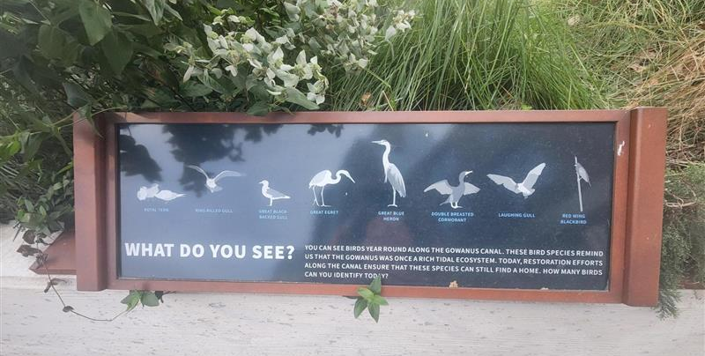
Gaps in Coverage
We noticed many signs along the walkway discussing the history of the Gowanus Canal and the local native wildlife. However, we noticed that there were minimal signage that went into detail about what chemicals are present in the area and risks of exposure. Given that this is a public space that is clearly intended for the community to enjoy, the ongoing construction that is disrupting the soil and potentially exposing pollutants, and the fact that 2 out of the 6 soil samples we collected from the area had significant levels of PCBs, we thought that this was a major gap in coverage.
Walking along the Gowanus Canal, we could see that much effort has been made into beautifying the surrounding area and turning the area into a public space.

