Slide 1


| Tech Management, SRI-B
CLAWS
CLASH OF THE
RVCE_MergeMind
Two Openclaw agents, connected across devices
Rachit Mittal – 1RV24CI089
Aayush Bhandari – 1RV24CI149

Slide 2
Idea
Problem Statement
OpenClaw agents on separate devices lack a reliable way to discover each other, establish trust, and maintain a live two-way communication channel, which prevents them from coordinating state or exchanging actions across machines.

Slide 3
Idea
Current Solution & Gaps
The main project is the connection between two OpenClaw nodes.
Once connected, the nodes can discover each other, negotiate trust, and exchange messages and actions.
This creates a mesh-style agent link that can be used for many workflows, not just file sharing.
File tracking is one example application that demonstrates what the connection layer can do.

Slide 4
Idea
Your Solutions
Two agents on separate machines can cooperate like one distributed system.
They can exchange state, sync updates, coordinate tasks, and react to events from either side.
This opens the door to remote automation, multi-device workflows, collaboration tools, and live synchronization.
The connection layer is the foundation; applications built on top of it can be much broader.

Slide 5
Idea
What the extension does
Discovers nearby OpenClaw nodes on the network.
Establishes a secure peer connection between two devices.
Lets the nodes exchange messages, events, manifests, and actions.
Supports approval before a new peer joins the mesh.
Keeps the two agents aware of each other’s state and changes.

Slide 6
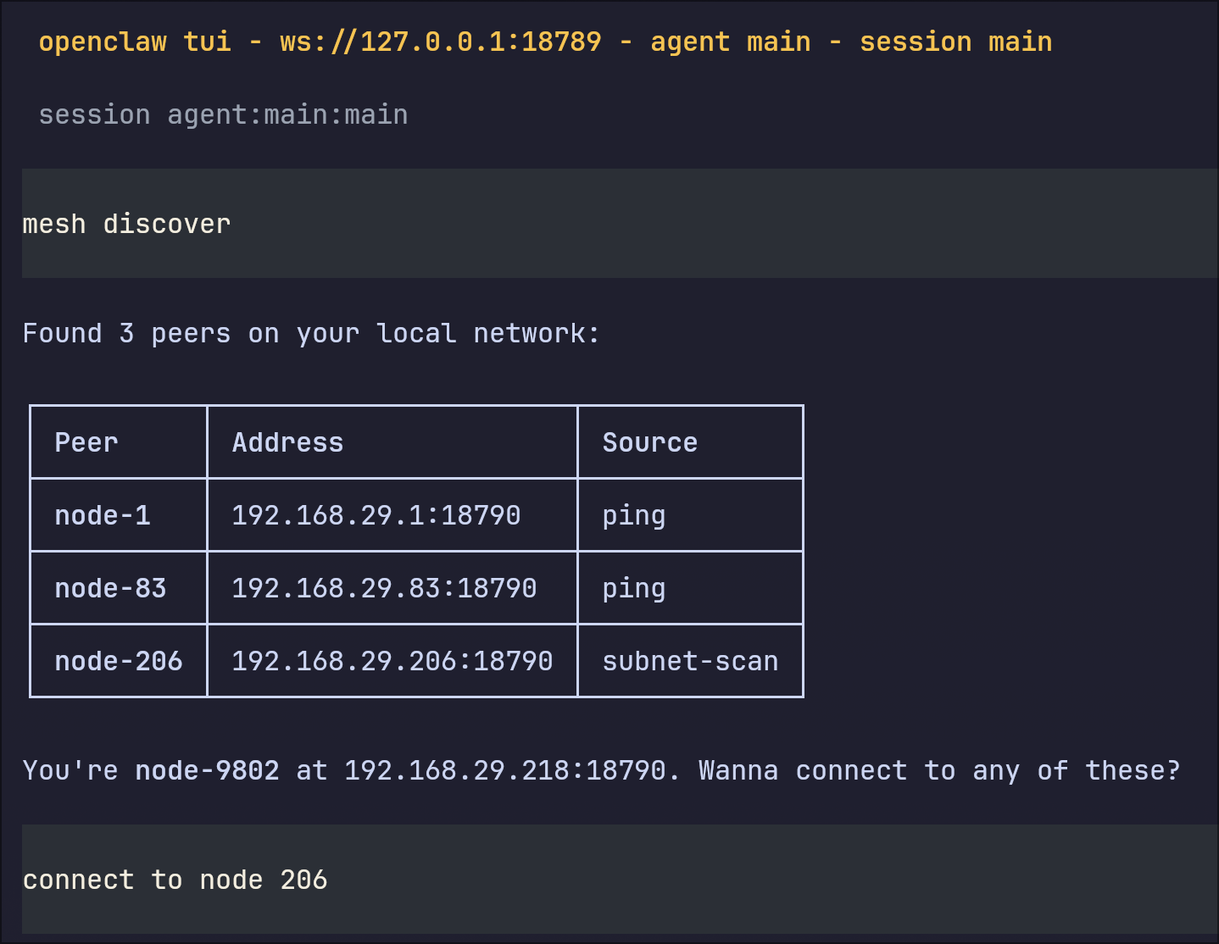
Idea
Demo/Product Walkthrough

Slide 7
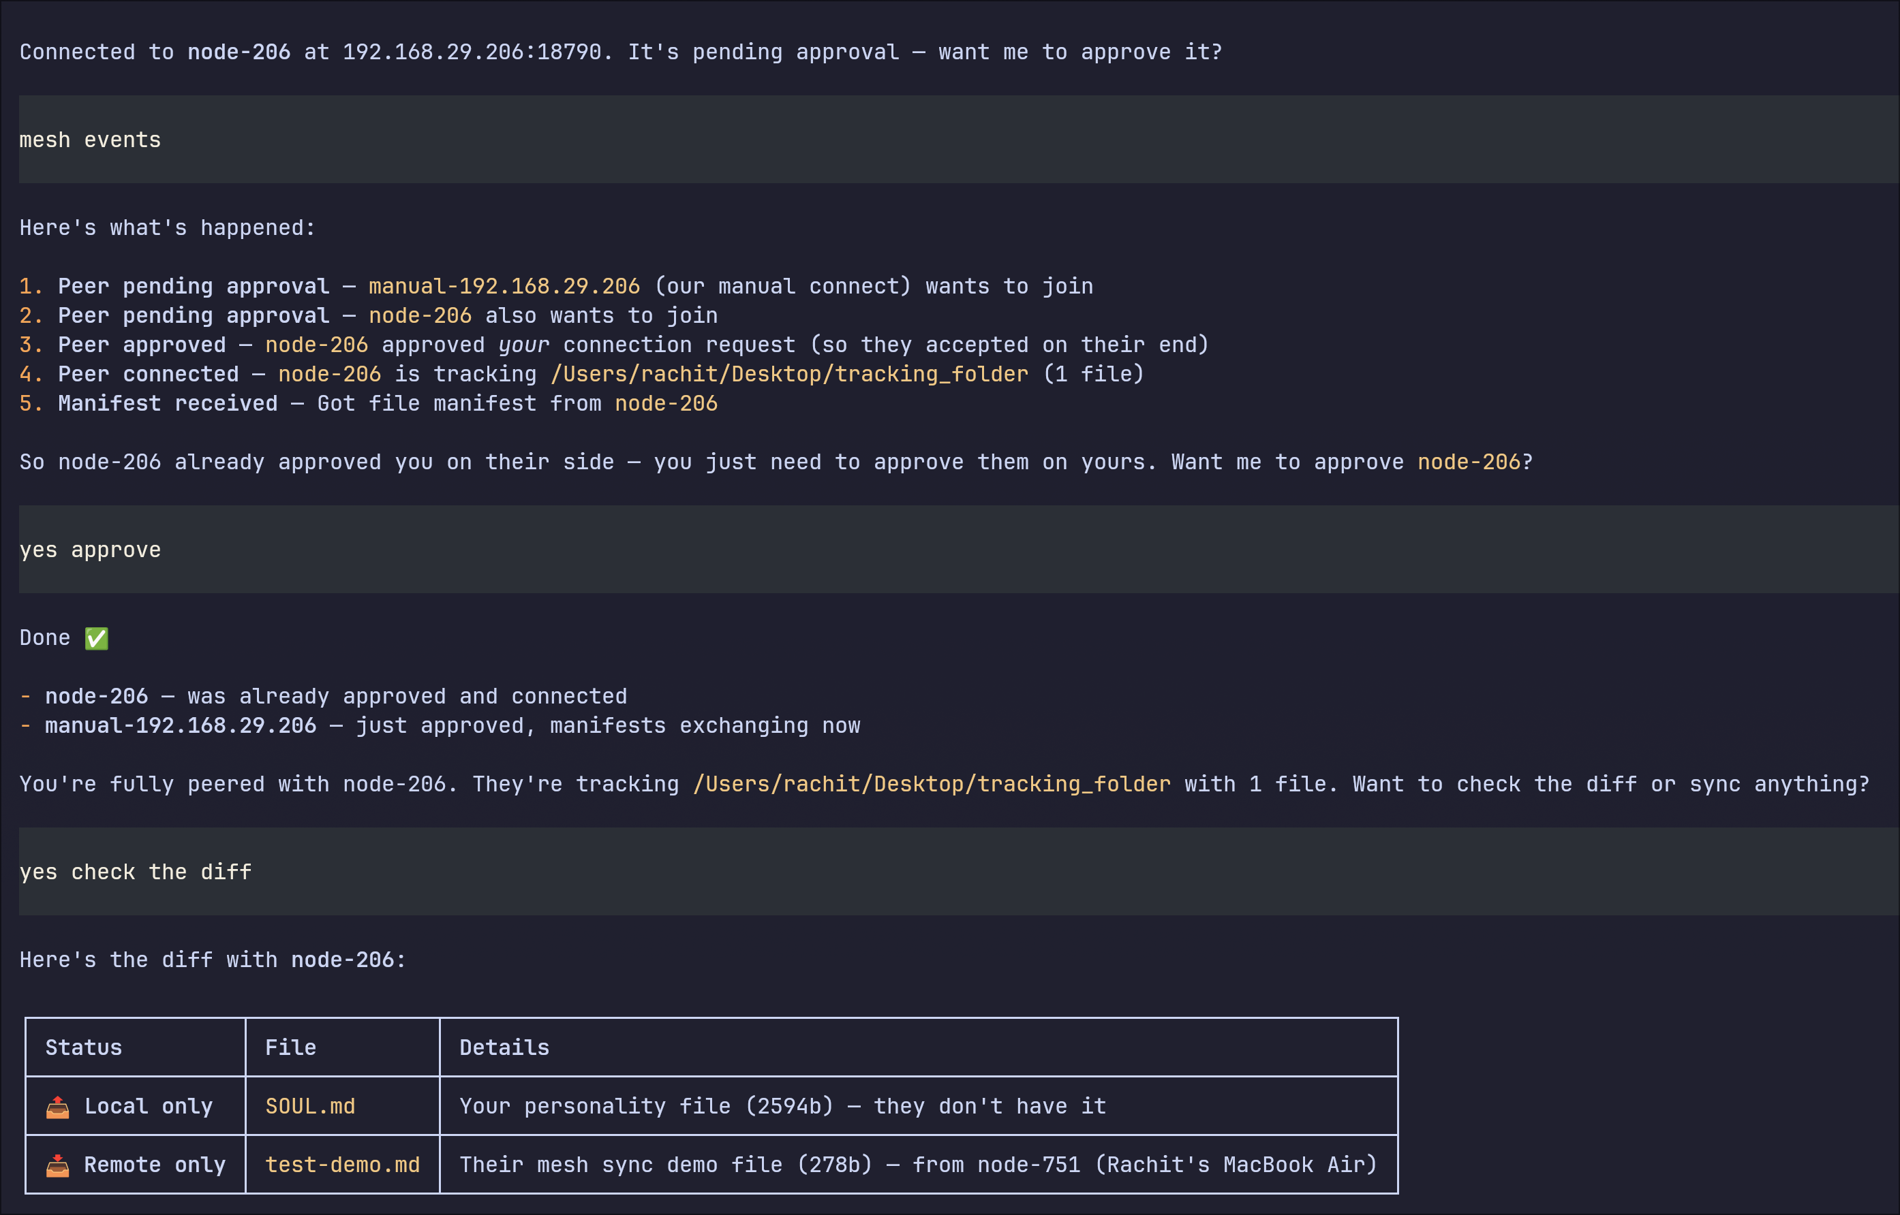
Idea

Slide 8
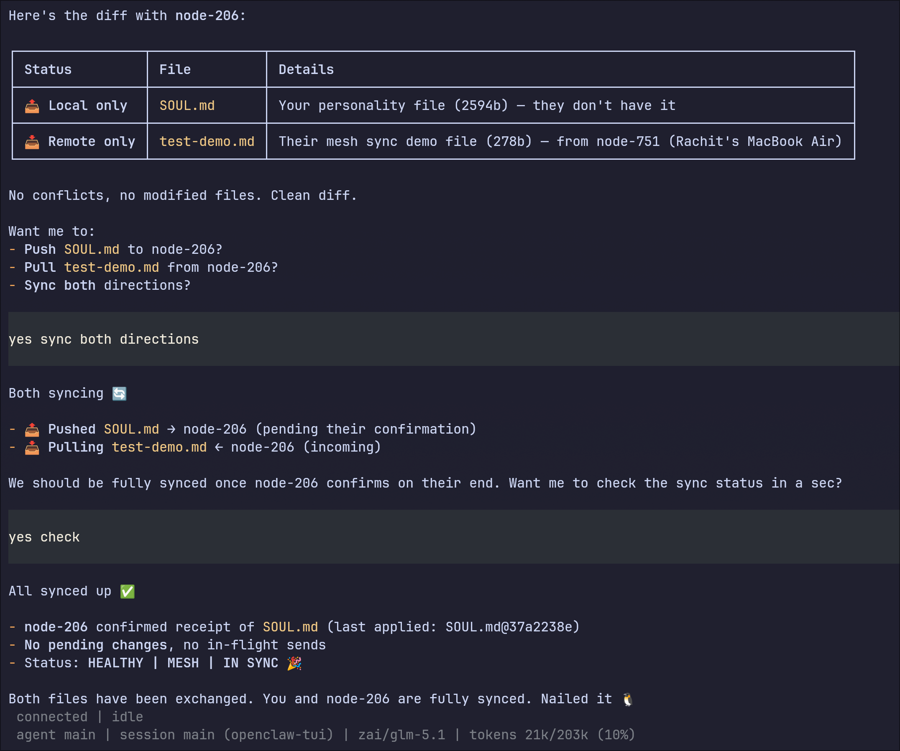
Idea

Slide 9
Idea
Tech & Architecture
OpenClaw Gateway
Mesh Extension
Discovery: subnet scan + mDNS
Transport: WebSocket approval, manifest exchange, push/pull
Sync state: hash tracking, pending changes, conflict detection
File watcher: all files, deletions, binary support, feedback-loop suppression
Tech stack: TypeScript, Node.js 22+, OpenClaw plugin runtime

Slide 10
Idea
Impact & Use cases
Remote collaboration between agents on different machines
Shared task execution across devices
Live propagation of state and events
Distributed workflows for labs, teams, and offline networks
File tracking is only one proof-of-power example, not the limit of the system

Slide 11
Idea
Differentiation
Direct peer-to-peer agent linking on local networks: OpenClaw nodes can discover, trust, and communicate with each other without relying on a central server or cloud backend.
Reusable connection layer for many use cases: the same mesh channel can power file sync, shared state, remote actions, and future multi-agent workflows, making the core system much more valuable than a single demo feature.

Slide 12
Idea
Demo Link
https://github.com/rxchitrx/openclaw-mesh-extension https://drive.google.com/drive/folders/1h6EmILlajb08m-4zhbxEZOVtthdrEanX?usp=sharing

Slide 13
Idea
Thank You!

