Slide 1
SMMP: A Secure, Multi-party Messaging Protocol
David R. Andersen
Electrical and Computer Engineering
The University of Iowa
Iowa City IA 52242
k0rx@uiowa.edu

Slide 2
Outline
Background
Definitions
Threat model
Review of one-on-one messaging protocols
Review of multi-party messaging protocols
SMMP – key agreement
SMMP – send/receive
SMMP – resync/join/depart
Security analysis
Demonstration of multi-party chat client

Slide 3
Motivation
Mimic private group conversation with an online tool
  Confidentiality – in a physical conversation, there is no long-lived record beyond the memory of the participants
  Authentication – in a physical conversation, participants can authenticate each other face-to-face as well as authenticate the communicator of a message
  Repudiation – during or following a physical conversation, participants can deny having made a statement or taken part to a 3rd party (deniability)
Achieving these goals is not possible in a plaintext network – logs, transcripts, persistent bulk surveillance, ...
As a result, online privacy concerns have become paramount – NSA, GCHQ, hackers, organized crime, ...

Slide 4
Definitions
Perfect forward secrecy (PFS): compromise of a message key does not compromise previous keys
Perfect future secrecy (PFuS): compromise of a message key does not compromise future keys
Plausible deniability (PD): the ability of a participant in a conversation to plausibly deny having taken part in the conversation – no algorithmic proof of participation
Ratchet: a mechanism for deterministically changing symmetric encryption keys on a per-message basis that provides both PFS and PFuS

Slide 5
Threat Model
We use a generalized mpOTR threat model with the following players (after Goldberg, et.al. 2009).
Security adversary – The goal of this entity is to read messages he is not entitled to.
  Global passive adversary
  Cannot ask for participant private information until after the conversation is over (so-called rubber hose cryptography)
  Cannot participate in the conversation or control those who do
Consensus adversary – The goal of this entity is to get an honest user Alice to reach consensus with another honest user Bob on a transcript where the transcripts do not actually match.
  Can control dishonest participants to make conflicting statements to different participants
  Can drop, duplicate, reorder, and replay messages – these actions may or may not be useful depending on the protocol
Privacy adversary – the goal of this entity is, given a (real or fake) transcript of a conversation, to convince a judge (online or offline) that Alice took part in the conversation, i.e. read messages in the conversation, or authored messages in the conversation.
  Can participate in the conversation
  Offline judges are only given a transcript after the conversation is over
  Online judges can also participate in the conversation
I. Goldberg, M. D. Van Gundy, B. Ustanoglu, and H. Chen, CSS'09, pp. 358-368, ACM (2009).

Slide 6
Adversary Capabilities
Security adversary remains passive until the group conversation is complete. He may then ask participants for their private keys.
Consensus and privacy adversaries may participate in the conversation as dishonest participants or control those who do.
  Consensus and privacy adversaries have access to a complete (plaintext and ciphertext) transcript of the conversation.
Consensus and privacy adversaries may or may not follow the protocol faithfully in order not to reveal their adversarial nature, but may ask honest users to send particular messages as part of the conversation.
  Consensus and privacy adversaries who do not follow the protocol faithfully will ultimately be removed and the group will re-form without them.
  Protocol should detect bad actors (those who do not follow the protocol faithfully).

Slide 7
Review of One-on-One Messaging Protocols
N. Borisov, I. Goldberg, and E. Brewer, WPES'04, ACM (2004).
OTR
  Advertise → Acknowledge → Use ephemeral rekeying
    Multiple messages compromised if one ephemeral key is compromised (window of compromise)
  Requires publishing ephemeral keys for PD
  Self-healing
SCIMP
  newKey = hash(oldKey) rekeying
  No PFuS
Axolotl
  Hybrid rekeying – combination of hash() iteration and new ephemeral key
    Asynchronous – allows for out-of-order message receipt with reduction in PFS
  Self-healing
M. D. Raimondo, R. Gennaro, and H. Krawczyk, WPES'05, ACM (2005).
V. Moscaritolo, G. Belvin, and P. Zimmerman,
http://silentcircle.com/static/download/SCIMP%20paper.pdf
T. Perrin and M. Marlinspike,
https://github.com/trevp/axolotol/wiki/newversion

Slide 8
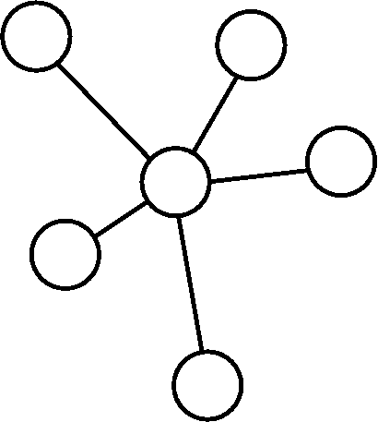
Review of multi-party messaging protocols
Group OTR
  virtual server must be assumed honest: decrypt/reencrypt
  leaks conversation metadata
  no transcript verification
  no authentication of participants except to server
E
F
A
B
D
C
J. Bian, R. Seker, and U. Topaloglu, IRI'07, IEEE Comp. Soc. (2007).

Slide 9
multi-party OTR
PD against offline judges only
Links all messages together – if you commit to one part of a conversation, you've committed to it all
Requires more than one party to forge a transcript – affects PD
Allows a “window of compromise” - one key compromise allows attacker to read several messages in the chain
Requires broadcasting ephemeral keys at end of the conversation for PD
I. Goldberg, M. D. Van Gundy, B. Ustanoglu, and H. Chen, CSS'09, ACM (2009).

Slide 10
Improved mpOTR
Complexity – 6 round GKA required each time ephemeral group key is updated
Complexity – each participant becomes 2(N-1) nodes for 2-layer group key agreement
Underlying binary secure channels between users are required
Requires broadcasting of ephemeral keys at end of conversation for PD
H. Liu, E. Y. Vasserman, and N. Hopper, WPES'13, ACM (2013).

Slide 11
SMMP – Required cryptographic primitives
Underlying secure symmetric encryption algorithm c=e(k,m), m=d(k,c) (e.g. AES256)
ECDH on some elliptic curve (e.g. curve25519)
DH on some finite field (e.g. 2048 bit MODP prime from RFC 3526)
Secure cryptographic hash function (e.g. SHA256)
Secure cryptographic message authentication code (e.g. HMAC)
Secure key definition function (e.g. PBKDF2)

Slide 12
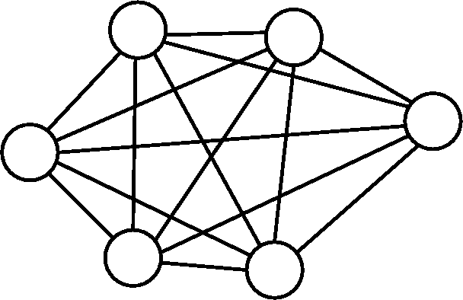
SMMP – Key Agreement
Requirements
  Peer-to-peer
  Each peer should independently authenticate every other peer
  No security requirements should be imposed on the underlying transport layer (information exchange in plaintext)
Burmester-Desmedt¹ group key agreement
takes place over a fully-connected network
Identity is proved by knowledge of a private
key corresponding to a known public key
Authentication is provided via a triple DH
Mechanism – a variant of Just and Vaudenay²
¹M. Burmester and Y. Desmedt, EUROCRYPT'94, LN in CS v. 950 (1995).
²M. Just and S. Vaudenay, ASIACRYPT'96 (1996).

Slide 13
Authenticated BD Group Key Exchange
A
B
C
A

Slide 14
Key Agreement steps
Preliminary Steps
  The total number of participants N is distributed to all putative participants.
  Diffie-Hellman parameters for both ECDH and DH protocols are agreed upon by all participants.
  A unique participant index i is assigned to each participant [known by persistent identity key (bi, Bi)]. The method of assigning this index is application-dependent and may e.g. be assigned based on the ordering of the participant public identity keys.

Slide 15
Key Agreement continued
Each participant Pj completes the following steps:
  Each participant Pj generates an ephemeral ECDH ratchet key pair (rj, Rj) and an ephemeral finite-field DH handshake key pair (hj, Hj).
  Participant Pj broadcasts Bj and Rj.
  Participant Pj computes the set of keys:
  and macs:

Slide 16
Key Agreement continued
  Pj sends Hj || maci to participant Pi for all participants.
  Pj receives Hi || macj from each participant Pi.
  Pj confirms the mac for each handshake key, thereby authenticating the identity of each Pi.
  Pj Computes Kj = (Hj+1/Hj-1)^{hj} mod p. Pj broadcasts Kj to all participants Pi.
  Pj receives Ki from each participant Pi and computes the master key:

Slide 17
Initial Ratchet State
Root Key:
Ratchet Keys:
Message Key:
Private Ratchet Key:
Group Private Key:
Initialization Ratchet Keys:
Digest:
Initialization Private Ratchet Key:
Resync Flag:
Group Parameters:

Slide 18
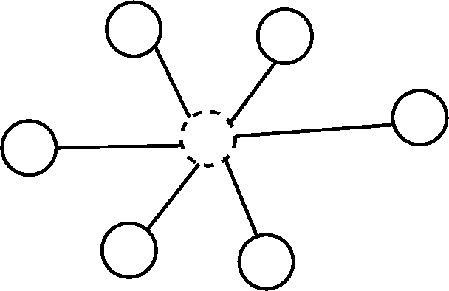
Fully-connected graph
Routing server model
Router is not part of group and does
not have encryption/decryption
capabilities
Routing server leaks no more metadata
than a fully-connected graph does to a GPA
(transport metadata only)

Slide 19
SMMP – Message format (from Pj)
(r^{new}, R^{new})
digest
R0
R1
R2
v
mk
Ci:
digest
R0
R1
R2
v
mk

Slide 20
SMMP – Send
Pj creates a message m.
Pj generates a new ephemeral ratchet key:
Pj computes a new conversation digest:
For all , Pj computes the set of N-1 preliminary ciphertexts:
Pj computes the set of N-1 MACs:
Pj forms the set of N-1 ciphertexts:
Pj sends ci to Pi for all all participants using a collision-avoidance algorithm appropriate for the transport.

Slide 21
SMMP – Send continued
Pj updates his ratchet state:

Slide 22
SMMP - Receive
Upon receipt of a ciphertext c, Pj separates it into c' and cmac parts.
Pj tests if hash(v, c') = cmac. If they do not match, he raises a Bad_HMAC exception and goes no further.
Pj obtains q || R || m = d(mk, c'). If this operation fails, he raises a Message_Undecryptable exception, sets the resync_required flag True, and passes c' and control to the message-received housekeeping routine.
Pj computes a new conversation digest:
and sets:

Slide 23
SMMP – Receive continued
Pj updates his ratchet state:

Slide 24
SMMP - Housekeeping
Resynchronization
  Necessary due to dropped and broken messages (collisions, network failures, bad actors)
  Send
  Receive
Add/remove participant
  Re-run group key agreement for add/remove (moving to a different room)
  Participant may drop themselves by simply not updating ratchet state
IM within SMMP (whispering)
  Bootstrap a private conversation using SMMP infrastructure

Slide 25
SMMP – Resync message format (from Pj)
(r^{new}, R^{new})
v^{new}
rj
v
C:
R0^{init}
R1^{init}
R2^{init}
v^{new}
R0
R1
R2
v
mk
digest

Slide 26
SMMP – Resynchronization - Send
Pj generates a new group private key v^{new}.
Pj generates a new ratchet key pair (r^{new}, R^{new}).
Pj computes preliminary ciphertext:
Pj computes mac:
Pj forms:
Pj delays according to a transport-specific collision-avoidance algorithm.
Pj tests resync_required. If False, a resynchronization message was received and no further action is necessary. If True, Pj broadcasts c to all participants Pi.

Slide 27
Resynchronization – Send continued
Pj updates his ratchet state as follows:

Slide 28
SMMP – Resynchronization - Receive
Pj obtains c' from a failed Receive protocol
Pj computes m = q || vnew || Rq^{new} = d(v,c') and sets:
If this decryption fails, Pj raises a Message_Undecryptable exception and goes no further
Pj updates his ratchet state:

Slide 29
SMMP – Security Analysis
Security adversary
  The computationally-bounded security adversary cannot control {Ri} or v and does not have access to plaintext, therefore if the underlying symmetric encryption algorithm is secure against a ciphertext-only attack, SMMP is secure. Further, due to inclusion of new key material with each message, a key compromise at any stage of the conversation will not compromise keys for messages earlier or later in the conversation chain, resulting in PFS and PFuS.
Consensus adversary
  A group conversation digest is updated and passed with each message, therefore if the hash function used to compute the conversation digest has collision resistance a participant will not be able to reach consensus given a fake message.
Privacy adversary
  Group key agreement is based only on knowledge of a participant's public keys, therefore a fake transcript involving an honest participant can be created without his participation. This provides information-theoretic PD for both online and offline judges.

Slide 30
SMMP – Efficiency Analysis
Only 3 rounds are required for authenticated GKA.
  GKA is only required once – the ratchet advances with new key material from participants at each message.
Each participant only manages the state of a single node in the network.
GKA and message exchange are O(N) in complexity.
SMMP represents a significant improvement over improved-mpOTR [Liu, et.al.], both for initial GKA, as well as during messaging.

Slide 31
Three may keep a secret,
if two of them are dead.
Benjamin Franklin,
Poor Richard's Almanack

Slide 32
Demonstration
Ratchet visualization
  Simulated conversation with eight participants
  Observe changes in ratchet keyset and state
  Observe resynchronization
Chat client
  Arbitrary number of participants
  Uses routing server – server may run as TOR hidden service if desired to obfuscate transport metadata
  Collision avoidance algorithm is TDMA
  ncurses-based, written in Python

