Slide 1
HALLUCINATION DETECTION in LARGE LANGUAGE MODELS
Members: Krutik, Ethan, Radhika

Slide 2
CONTENTS
01
02
03
04
05
06
Overview
Research Questions
Literature Review
Methodology
Results
Conclusion

Slide 3
Overview
Prominence of LLMs
Areas for Refinement
Rapid advancements exemplified by OpenAI's GPT series and Meta's contributions to AI research.
Human-like communication capabilities sparking significant investment.
Developing more effective, nuanced LLMs requires understanding their strengths and weaknesses in realistic scenarios
Hallucination responses are responses that are actually incorrect or unrelated to the context
These responses seem plausible and coherent but lack truthfulness or relevance.

Slide 4
Research Questions
Motivations
Objectives
Research Scope
Addressing the issue of hallucinations in LLM outputs will be a growth factor for incorporating LLMs into broad-based applications
Utilizing specific metrics allow for optimal measures of the semantic similarity of responses to ground truth
Evaluate how LLMs perform in generating responses relative to ground truth using both human evaluations and computational measures.
Analyze how the choice of datasets across various domains, Impact the performance of LLMs
TriviaWeb, TriviaWiki, TruthfulQA, and HotpotQA datasets to provide diverse challenges in terms of question complexity and information requirement.
LLAMA 65b model will be used for automated processing of responses

Slide 5
Literature Review
Can an LLM retrieve and process relevant knowledge to answer questions?
How well do different Conversational LLMs perform in generating natural language from factual data?
Can using wikipedia for fact verification improve LLMs?
How do linguistic factors in prompts, influence the occurrence of hallucinations in LLMs?
Can intentionally induced hallucinations help in the identification and mitigation of subsequent errors?
Can unanswerable questions be identified by a model?

Slide 6
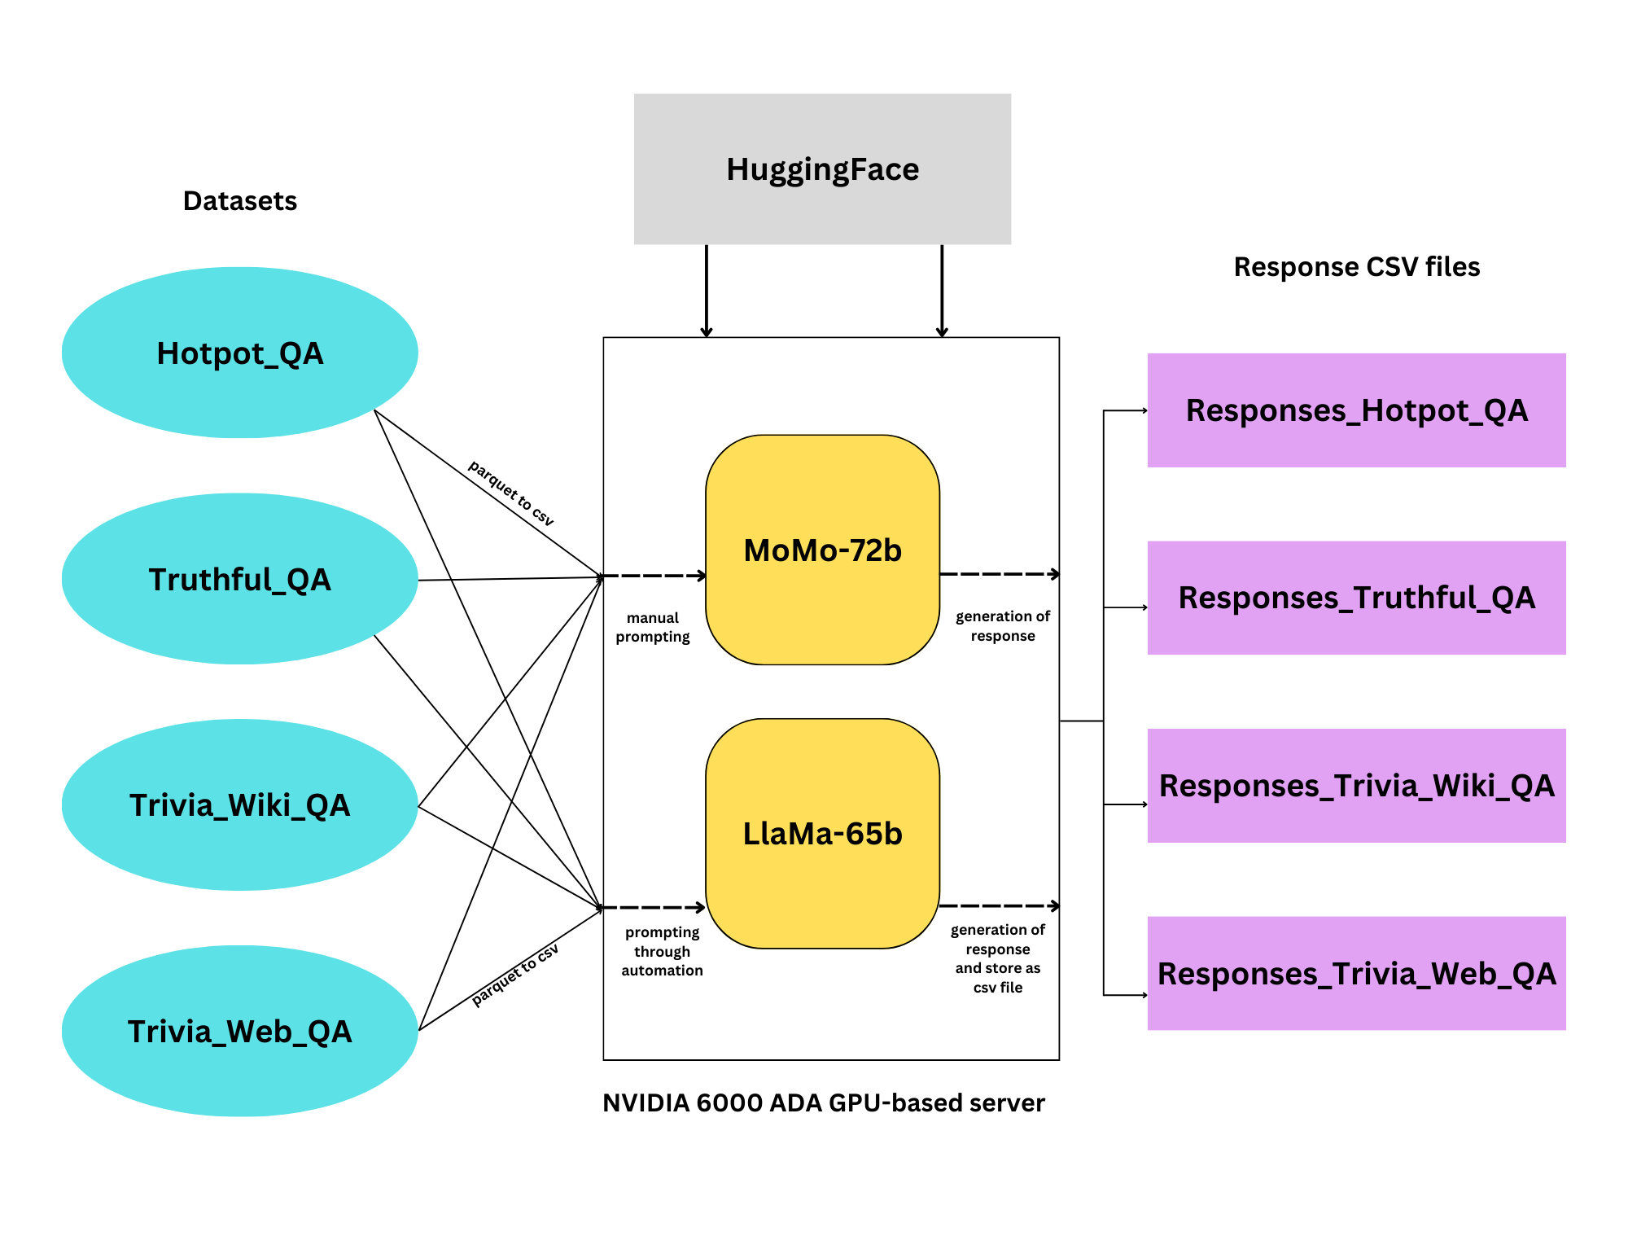
Methodology
Datasets extracted from HuggingFace
Manual Prompting done into the Momo 72b model - which is fine turned version of Smaug model by Abacas AI
Response generated and compared with the expected result
Automated prompting done on all the datasets through Llama 65b model - developed by Meta and responses saved into csv file
Performance metrics utilized to determine how hallucinated each response is
Edit distance, cosine similarity and human evaluations perfomed

Slide 7
Results
Edit Distance
Cosine Similarity
Human Evaluation
Edit distance (Levenshtein distance) quantifies the number of single-character edits required to change one word or text into another.
Variations in syntax can alter the edit distance and overstating the perceived error magnitude.
Cosine similarity measures the cosine of the angle between two non-zero vectors
Cosine similarity focuses on the direction of vectors and can miss syntactical inaccuracies.
Scores are assigned based on the relevance and accuracy of the model's answers using human inference.
Scored from 0 to 3
Evaluators might have inherent biases that could influence their judgment.

Slide 8
Edit Distance
TriviaWiki dataset displays moderate variability with some cases of perfect matches and significant mismatches.
TriviaWeb has a similar central tendency to TriviaWiki with answers clustering more closely around the median
Extremely high discrepancies within TruthfulQA indicating significant textual divergence also driven by syntatic variations.
Greater divergence compared to TriviaWiki and TriviaWeb, with notable variability in responses.
Edit Distance | TriviaWiki | TriviaWeb | TruthfulQA | HotpotQA
Mean | 62.86 | 65.55 | 447.91 | 80.86
75th Percentile | 83.00 | 79.00 | 521.00 | 108.50
50th Percentile | 64.00 | 64.50 | 316.50 | 77.00
25th Percentile | 44.00 | 43.00 | 213.50 | 52.25
Standard Deviation | 29.62 | 30.48 | 432.35 | 45.68

Slide 9
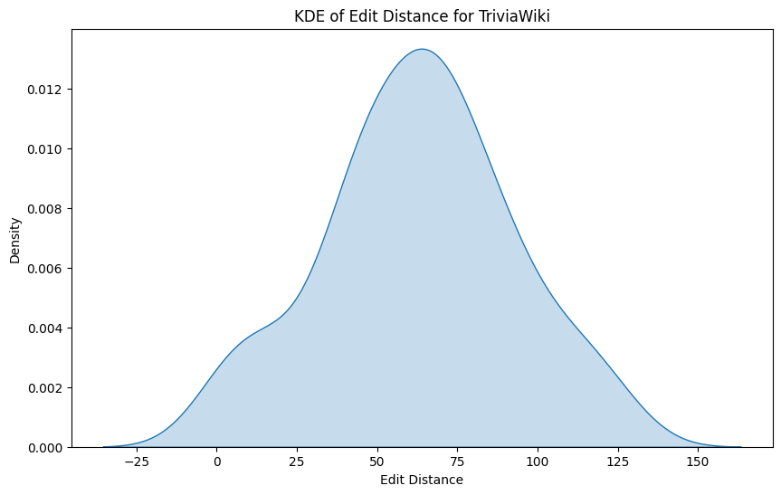
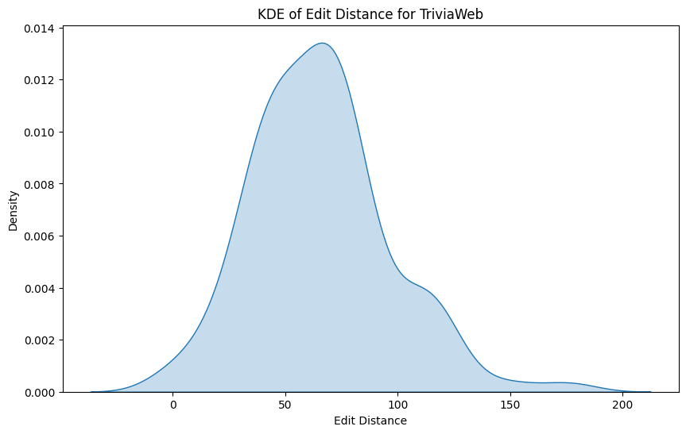
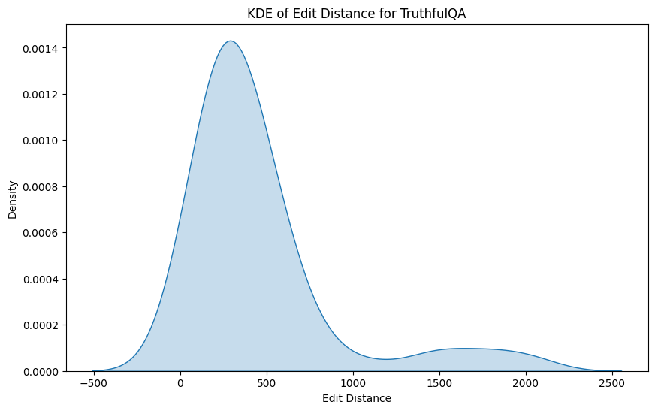
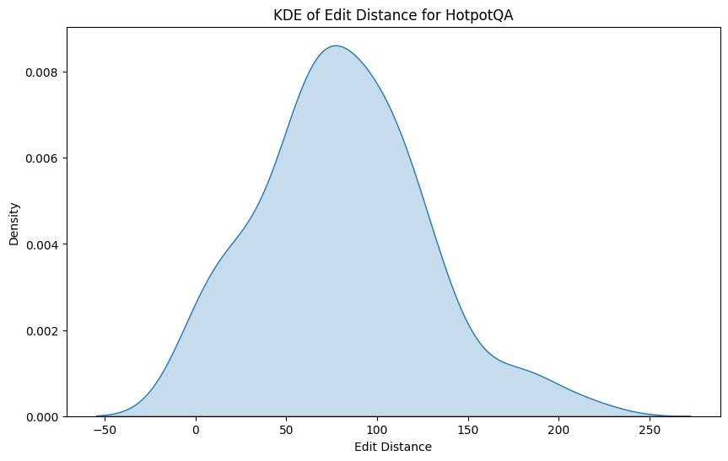
Edit Distance

Slide 10
Cosine Similarity
TriviaWiki dataset displays moderate cosine similarity on average with some cases of perfect semantic alignment.
TriviaWeb shows lower average similarity with a significant portion of answers shows no semantic similarity.
TruthfulQA has the highest average similarity suggesting better semantic alignment which is contrast from edit distance scores
Low median and high variability within HotpotQA shows relatively higher difficulty in grasping context of questions within this dataset
Cosine Similarity | TriviaWiki | TriviaWeb | TruthfulQA | HotpotQA
Mean | 0.27 | 0.20 | 0.29 | 0.18
75th Percentile | 0.30 | 0.28 | 0.39 | 0.25
50th Percentile | 0.24 | 0.20 | 0.27 | 0.08
25th Percentile | 0.18 | 0 | 0.15 | 0
Standard Deviation | 0.20 | 0.18 | 0.19 | 0.25

Slide 11
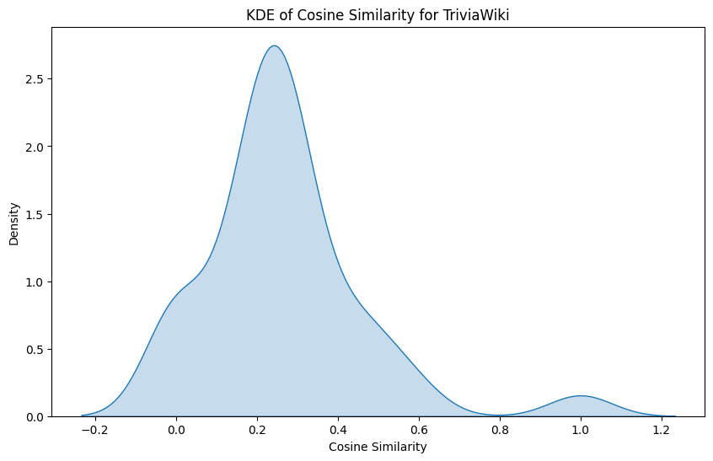
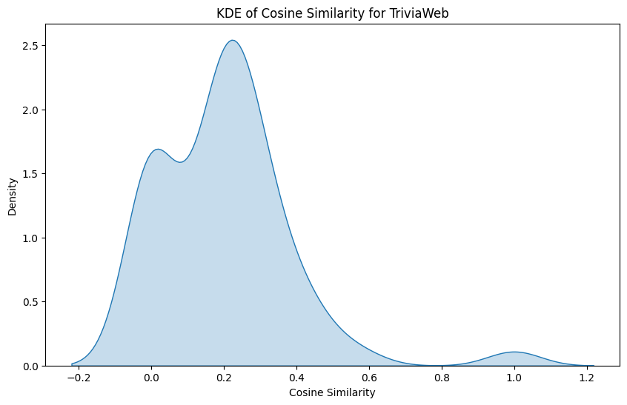
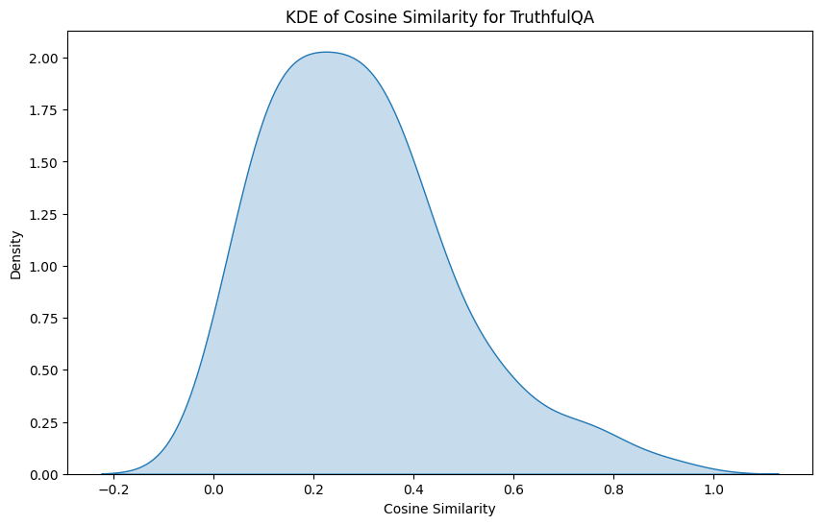
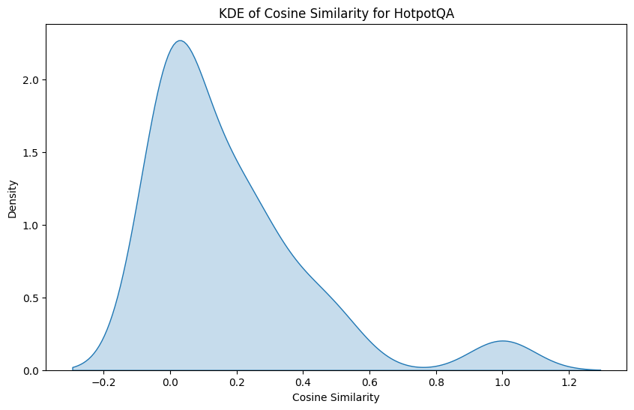
Cosine Similarity

Slide 12
Human Evaluation
TriviaWiki dataset has High accuracy which aligns with the other metrics
TriviaWeb also shows comparable performance but slightly worse. There is more variability between 3 & 2 scores which indicate issues with precision
TruthfulQA shows significant accuracy with a majority of responses close to correct, which contrasts with edit distance scores
High variability in the semantic similarity score of responses for HotpotQA is shown also in human evaluation
Score | TriviaWiki | TriviaWeb | TruthfulQA | HotpotQA
0 | 14 | 24 | 15 | 38
1 | 2 | 4 | 4 | 13
2 | 1 | 11 | 2 | 2
3 | 83 | 61 | 79 | 47

Slide 13
Conclusion
Takeaways
Future Work
The LLama65B model can capture contextual accuracy but struggle with exact syntatic replication.
LLama65B tends to generate syntatically inconcise responses despite having correct context knowledge
Limitations were spotted of using edit distance as a sole metric for model evaluation.
TriviaWeb and HotpotQA shows relatively lower scores in all metrics
The TriviaWeb dataset is composed of trivia questions derived from various online sources
HotpotQA requires models to explain the reasoning behind their answers by citing facts.
This highlights challenges in handling complex question structures and factual content from varying sources.
Incorporate a broader range of models, including newer or differently trained LLMs
Datasets that focus on specific themes/topics might provide deeper insights into the specialized performance
Expanding the research to include multilingual datasets to evaluate the performance of LLMs across different languages

Slide 14
Thank you!

