Slide 1


Baby PIH: Parameterized Inapproximability of Min CSP
Venkatesan Guruswami
UC Berkeley
Xuandi Ren
UC Berkeley
Sai Sandeep
UC Berkeley

Slide 2
Outline
Background
Parameterized Complexity
Constraint Satisfaction Problem (CSP)
Parameterized Inapproximability Hypothesis (PIH)
Our Result
Baby PIH
Proof Overview

Slide 3
Outline
Background
Parameterized Complexity
Constraint Satisfaction Problem (CSP)
Parameterized Inapproximability Hypothesis (PIH)
Our Result
Baby PIH
Proof Overview

Slide 4



Parameterized Complexity
How to cope with an NP-hard problem?
Associate each instance $x$ with a parameter $k∈ℕ$
$k≪|x|$
Measure complexity over $n=\left|x\right|$ and $k$
FPT (Fixed-Parameter Tractable, Analogue of P):
Problems that admit $f(k)∙n^{O(1)}$ time algorithms for some computable function $f$
$k$-Vertex Cover
Input:
$G=\left(V,E\right)$ and parameter $k$
Output:
$∃v_{1},…, v_{k}∈V$ covering all the edges?
has an $O(2^{k}⋅n^{O(1)})$ enumeration algorithm
Efficient for small $k$!
$$∈$$
FPT

Slide 5




Parameterized Complexity
How to cope with an NP-hard problem?
Associate each instance $x$ with a parameter $k∈ℕ$
$k≪|x|$
Measure complexity over $n=\left|x\right|$ and $k$
W[1] (Analogue of NP): widely believed W[1] $≠$ FPT
$k$-Clique
Input:
$G=\left(V,E\right)$ and parameter $k$
Output:
$∃v_{1},…, v_{k}∈V$ forming a clique?
Unlikely to have an $f(k)∙n^{O(1)}$ time algorithm
No algorithm known with runtime $n^{o(k)}$
W[1]
-complete

Slide 6
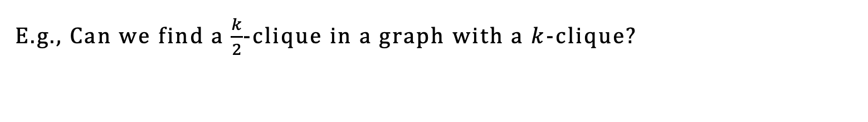
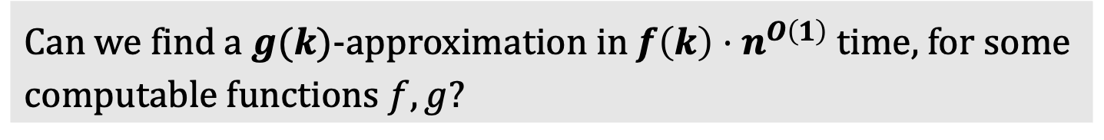
Parameterized Approximation
Can we find a $g(k)$-approximation in $f\left(k\right)⋅n^{O\left(1\right)}$ time, for some computable functions $f,g$?
E.g., Can we find a $\frac{k}{2}$-clique in a graph with a $k$-clique?

Slide 7
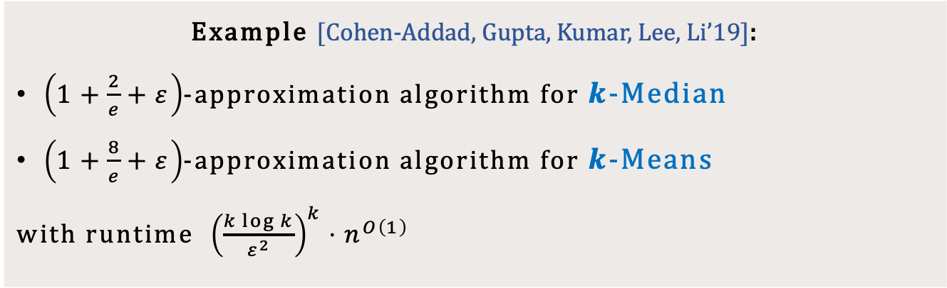

Parameterized Approximation
Can we find a $g(k)$-approximation in $f\left(k\right)⋅n^{O\left(1\right)}$ time, for some computable functions $f,g$?
Optimal ratio in FPT
Beat polytime algorithms: $2.611+ε$ for $k$-Median, $9+ε$ for $k$-Means
Example [Cohen-Addad, Gupta, Kumar, Lee, Li’19]:
$\left(1+\frac{2}{e}+ε\right)$-approximation algorithm for $k$-Median
$\left(1+\frac{8}{e}+ε\right)$-approximation algorithm for $k$-Means
with runtime ${\left(\frac{k\log{k}}{ε^{2}}\right)}^{k}⋅n^{O\left(1\right)}$

Slide 8
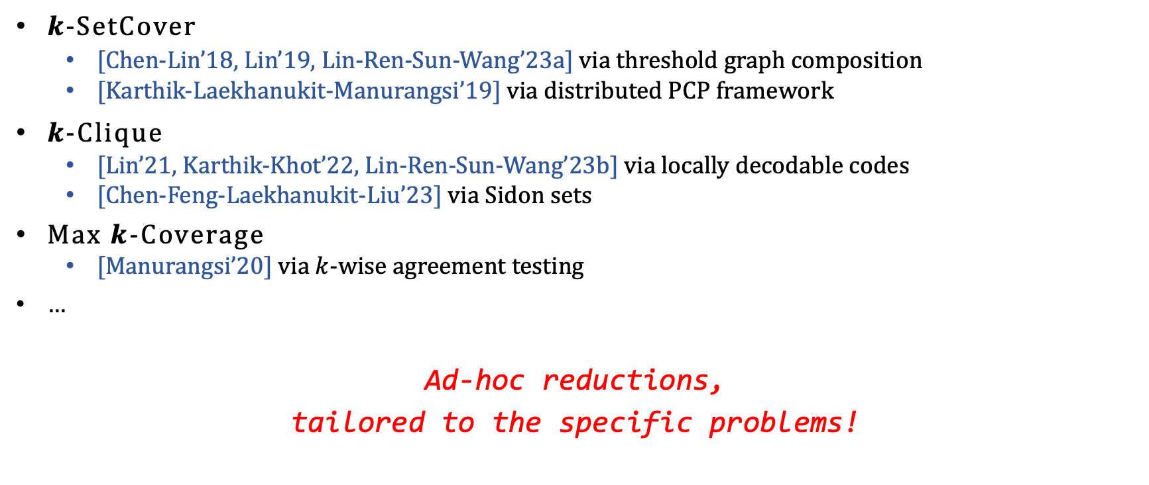
Parameterized Hardness of Approximation
$k$-SetCover
[Chen-Lin’18, Lin’19, Lin-Ren-Sun-Wang’23a] via threshold graph composition
[Karthik-Laekhanukit-Manurangsi’19] via distributed PCP framework
$k$-Clique
[Lin’21, Karthik-Khot’22, Lin-Ren-Sun-Wang’23b] via locally decodable codes
[Chen-Feng-Laekhanukit-Liu’23] via Sidon sets
Max $k$-Coverage
[Manurangsi’20] via $k$-wise agreement testing
…
Ad-hoc reductions,
tailored to the specific problems!

Slide 9
Parameterized Hardness of Approximation
Unified and powerful machinery for parameterized inapproximability?
Parameterized PCP-type theorem!

Slide 10

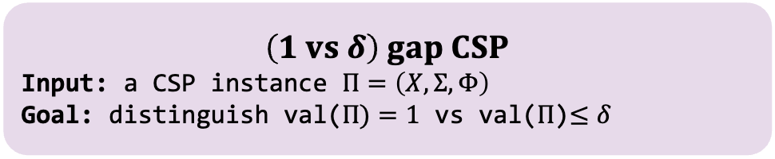
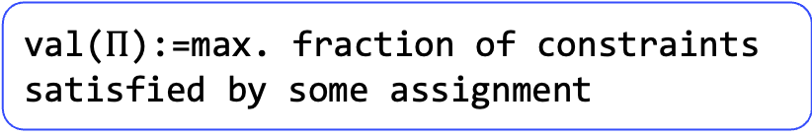

Recall: PCP Theorem
PCP Theorem:
For any constant $Σ$ and let $n=|X|$, there is no $n^{O(1)}$ time algorithm for (1 vs 0.9) gap CSP assuming P$≠$NP.
val($Π$):=max. fraction of constraints satisfied by some assignment
$$Constraint Satisfaction Problem$$
Input: $Π=\left(X,Σ,Φ\right)$
$X$: variables
$Σ$: alphabet
$Φ:$ constraints
Output:
$∃σ:X→Σ$ satisfying all constraints?
$$\left(1 vs δ\right) gap CSP$$
Input: a CSP instance $Π=\left(X,Σ,Φ\right)$
Goal: distinguish val($Π)=1$ vs val($Π$)$≤δ$

Slide 11
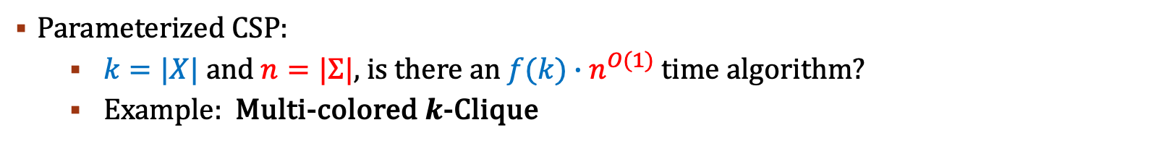
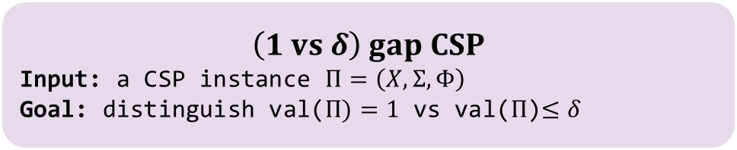
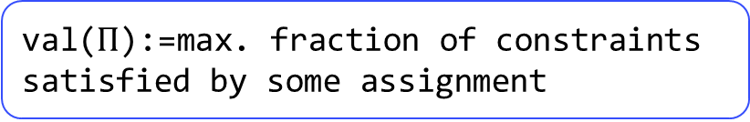
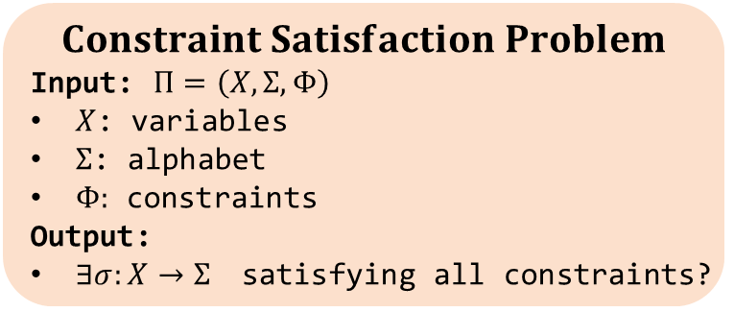
Parameterized Inapproximability Hypothesis
val($Π$):=max. fraction of constraints satisfied by some assignment
$$Constraint Satisfaction Problem$$
Input: $Π=\left(X,Σ,Φ\right)$
$X$: variables
$Σ$: alphabet
$Φ:$ constraints
Output:
$∃σ:X→Σ$ satisfying all constraints?
$$\left(1 vs δ\right) gap CSP$$
Input: a CSP instance $Π=\left(X,Σ,Φ\right)$
Goal: distinguish val($Π)=1$ vs val($Π$)$≤δ$
Parameterized CSP:
$k=|X|$ and $n=|Σ|$, is there an $f(k)∙n^{O(1)}$ time algorithm?
Example: Multi-colored $k$-Clique
PIH (Parameterized Inapproximability Hypothesis) [Lokshtanov-Ramanujan-Saurabh-Zehavi’20]:
Let $k=|X|$ and $n=|Σ|$, there is no ${f(k)∙n}^{O(1)}$ time algorithm for (1 vs 0.9) gap parameterized CSP.

Slide 12
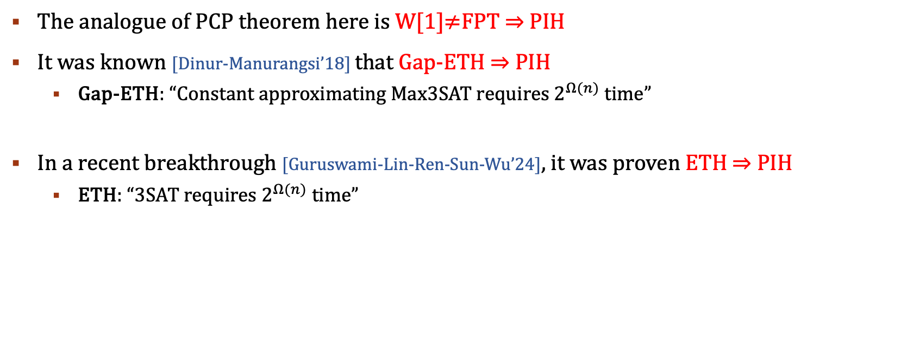
Parameterized Inapproximability Hypothesis
The analogue of PCP theorem here is W[1]$≠$FPT $⇒$ PIH
It was known [Dinur-Manurangsi’18] that Gap-ETH $⇒$ PIH
Gap-ETH: “Constant approximating Max3SAT requires $2^{Ω(n)}$ time”
In a recent breakthrough [Guruswami-Lin-Ren-Sun-Wu’24], it was proven ETH $⇒$ PIH
ETH: “3SAT requires $2^{Ω(n)}$ time”

Slide 13
Outline
Background
Parameterized Complexity
Constraint Satisfaction Problem (CSP)
Parameterized Inapproximability Hypothesis (PIH)
Our Result
Baby PIH
Proof Overview

Slide 14
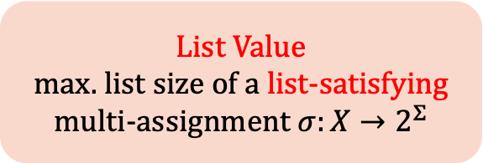
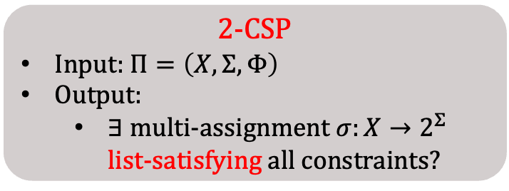
List Satisfiability of CSP
2-CSP
Input: $Π=\left(X,Σ,Φ\right)$
Output:
$∃$ multi-assignment $σ:X→2^{Σ}$ list-satisfying all constraints?
List Value
max. list size of a list-satisfying multi-assignment $σ:X→2^{Σ}$
A constraint on $(x,y)$ is list-satisfied iff $∃u∈σ\left(x\right), v∈σ(y)$, s.t. $(u,v)$ satisfies this constraint.

Slide 15







List Satisfiability of CSP
2-CSP
Input: $Π=\left(X,Σ,Φ\right)$
Output:
$∃$ multi-assignment $σ:X→2^{Σ}$ list-satisfying all constraints?
List Value
max. list size of a list-satisfying multi-assignment $σ:X→2^{Σ}$
A constraint on $(x,y)$ is list-satisfied iff $∃u∈σ\left(x\right), v∈σ(y)$, s.t. $(u,v)$ satisfies this constraint.
$$Σ=\{0,1,2,3\}$$
$$x_{2}$$
$$σ\left(x_{1}\right)=σ(x_{2})$$
$$σ\left(x_{2}\right)+σ\left(x_{3}\right)=2$$
$$x_{1}$$
$$x_{3}$$
$$σ\left(x_{1}\right)+σ\left(x_{3}\right)=3$$

Slide 16
List Satisfiability of CSP
2-CSP
Input: $Π=\left(X,Σ,Φ\right)$
Output:
$∃$ multi-assignment $σ:X→2^{Σ}$ list-satisfying all constraints?
List Value
max. list size of a list-satisfying multi-assignment $σ:X→2^{Σ}$
A constraint on $(x,y)$ is list-satisfied iff $∃u∈σ\left(x\right), v∈σ(y)$, s.t. $(u,v)$ satisfies this constraint.
$$Σ=\{0,1,2,3\}$$
$$x_{2}$$
[1]
$$σ\left(x_{1}\right)=σ(x_{2})$$
$$σ\left(x_{2}\right)+σ\left(x_{3}\right)=2$$
$$x_{1}$$
$$x_{3}$$
[1]
[1,2]
$$σ\left(x_{1}\right)+σ\left(x_{3}\right)=3$$

Slide 17

List Satisfiability of CSP
2-CSP
Input: $Π=\left(X,Σ,Φ\right)$
Output:
$∃$ multi-assignment $σ:X→2^{Σ}$ list-satisfying all constraints?
List Value
max. list size of a list-satisfying multi-assignment $σ:X→2^{Σ}$
A constraint on $(x,y)$ is list-satisfied iff $∃u∈σ\left(x\right), v∈σ(y)$, s.t. $(u,v)$ satisfies this constraint.
$$Σ=\{0,1,2,3\}$$
$$x_{2}$$
[1]
$$σ\left(x_{1}\right)=σ(x_{2})$$
$$σ\left(x_{2}\right)+σ\left(x_{3}\right)=2$$
$$x_{1}$$
$$x_{3}$$
[1]
[1,2]
$$σ\left(x_{1}\right)+σ\left(x_{3}\right)=3$$

Slide 18

List Satisfiability of CSP
2-CSP
Input: $Π=\left(X,Σ,Φ\right)$
Output:
$∃$ multi-assignment $σ:X→2^{Σ}$ list-satisfying all constraints?
List Value
max. list size of a list-satisfying multi-assignment $σ:X→2^{Σ}$
A constraint on $(x,y)$ is list-satisfied iff $∃u∈σ\left(x\right), v∈σ(y)$, s.t. $(u,v)$ satisfies this constraint.
$$Σ=\{0,1,2,3\}$$
$$x_{2}$$
[1]
$$σ\left(x_{1}\right)=σ(x_{2})$$
$$σ\left(x_{2}\right)+σ\left(x_{3}\right)=2$$
$$x_{1}$$
$$x_{3}$$
[1]
[1,2]
$$σ\left(x_{1}\right)+σ\left(x_{3}\right)=3$$

Slide 19

List Satisfiability of CSP
2-CSP
Input: $Π=\left(X,Σ,Φ\right)$
Output:
$∃$ multi-assignment $σ:X→2^{Σ}$ list-satisfying all constraints?
List Value
max. list size of a list-satisfying multi-assignment $σ:X→2^{Σ}$
A constraint on $(x,y)$ is list-satisfied iff $∃u∈σ\left(x\right), v∈σ(y)$, s.t. $(u,v)$ satisfies this constraint.
$$Σ=\{0,1,2,3\}$$
$$x_{2}$$
[1]
$$σ\left(x_{1}\right)=σ(x_{2})$$
$$σ\left(x_{2}\right)+σ\left(x_{3}\right)=2$$
$$x_{1}$$
$$x_{3}$$
[1]
[1,2]
$$σ\left(x_{1}\right)+σ\left(x_{3}\right)=3$$

Slide 20
List Satisfiability of CSP
2-CSP
Input: $Π=\left(X,Σ,Φ\right)$
Output:
$∃$ multi-assignment $σ:X→2^{Σ}$ list-satisfying all constraints?
List Value
max. list size of a list-satisfying multi-assignment $σ:X→2^{Σ}$
We say a 2-CSP is $r$-list satisfiable iff $∃σ$ with $\max_{x∈X}\left|σ\left(x\right)\right|≤r$ list-satisfying all constraints.

Slide 21
List Satisfiability of CSP
2-CSP
Input: $Π=\left(X,Σ,Φ\right)$
Output:
$∃$ multi-assignment $σ:X→2^{Σ}$ list-satisfying all constraints?
List Value
max. list size of a list-satisfying multi-assignment $σ:X→2^{Σ}$
We say a 2-CSP is $r$-list satisfiable iff $∃σ$ with $\max_{x∈X}\left|σ\left(x\right)\right|≤r$ list-satisfying all constraints.
CSP Value=1 $⇔$ 1-list satisfiable $⇒$ $r$-list satisfiable for $r≥2$
$r$-list satisfiable $⇒$ CSP Value $≥1/r^{2}$

Slide 22
Baby PCP
2-CSP
Input: $Π=\left(X,Σ,Φ\right)$
Output:
$∃$ multi-assignment $σ:X→2^{Σ}$ list-satisfying all constraints?
List Value
max. list size of a list-satisfying multi-assignment $σ:X→2^{Σ}$
We say a 2-CSP is $r$-list satisfiable iff $∃σ$ with $\max_{x∈X}\left|σ\left(x\right)\right|≤r$ list-satisfying all constraints.
CSP Value=1 $⇔$ 1-list satisfiable $⇒$ $r$-list satisfiable for $r≥2$
$r$-list satisfiable $⇒$ CSP Value $≥1/r^{2}$
Baby PCP [Barto-Kozik’22]
For any $r>1,$It’s NP-hard to distinguish between [1-list satisfiable] and [not even $r$-list satisfiable].

Slide 23


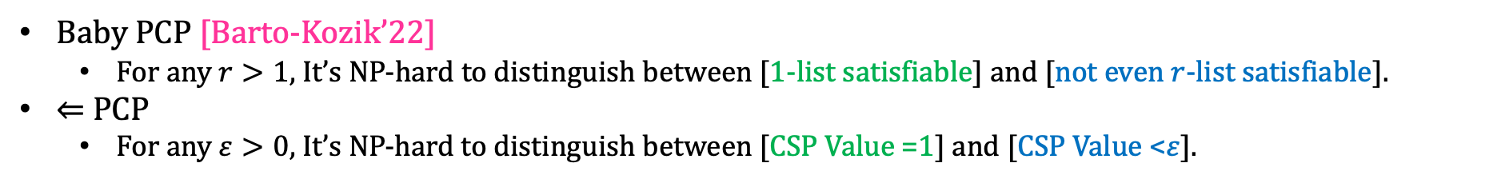

Baby PCP
2-CSP
Input: $Π=\left(X,Σ,Φ\right)$
Output:
$∃$ multi-assignment $σ:X→2^{Σ}$ list-satisfying all constraints?
List Value
max. list size of a list-satisfying multi-assignment $σ:X→2^{Σ}$
We say a 2-CSP is $r$-list satisfiable iff $∃σ$ with $\max_{x∈X}\left|σ\left(x\right)\right|≤r$ list-satisfying all constraints.
CSP Value=1 $⇔$ 1-list satisfiable $⇒$ $r$-list satisfiable for $r≥2$
$r$-list satisfiable $⇒$ CSP Value$≥1/r^{2}$
Baby PCP [Barto-Kozik’22]
For any $r>1,$It’s NP-hard to distinguish between [1-list satisfiable] and [not even $r$-list satisfiable].
$⇐$ PCP
For any $ε>0$, It’s NP-hard to distinguish between [CSP Value =1] and [CSP Value <$ε$].
$$⇐$$
$$⇐$$
(when $ε<1/r^{2}$)

Slide 24
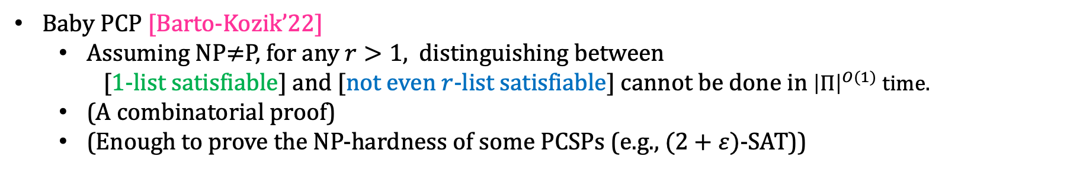
Baby PCP
Baby PCP [Barto-Kozik’22]
Assuming NP$≠$P, for any $r>1,$ distinguishing between
[1-list satisfiable] and [not even $r$-list satisfiable] cannot be done in ${\left|Π\right|}^{O(1)}$ time.
(A combinatorial proof)
(Enough to prove the NP-hardness of some PCSPs (e.g., $(2+ε)$-SAT))

Slide 25
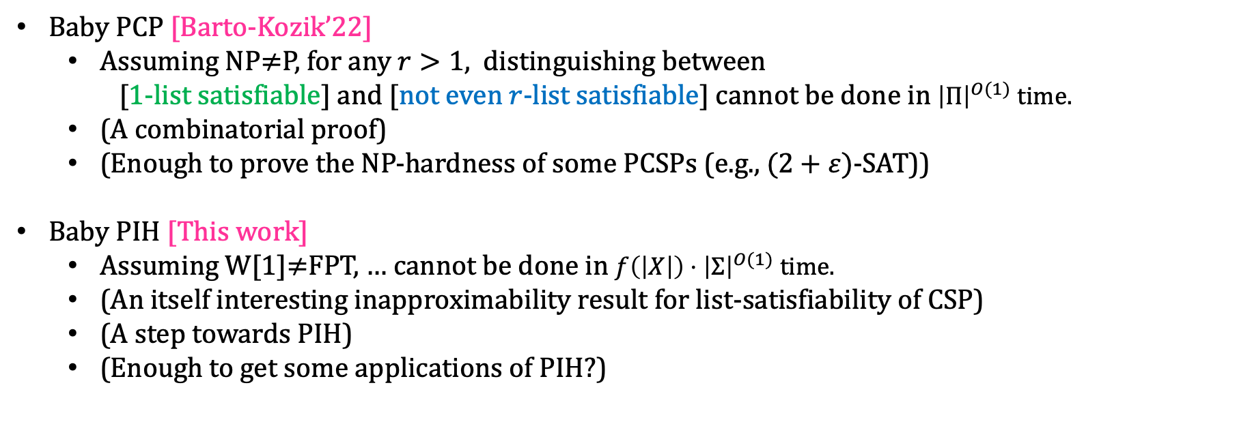
Baby PIH
Baby PCP [Barto-Kozik’22]
Assuming NP$≠$P, for any $r>1,$ distinguishing between
[1-list satisfiable] and [not even $r$-list satisfiable] cannot be done in ${\left|Π\right|}^{O(1)}$ time.
(A combinatorial proof)
(Enough to prove the NP-hardness of some PCSPs (e.g., $(2+ε)$-SAT))
Baby PIH [This work]
Assuming W[1]$≠$FPT, … cannot be done in $f\left(\left|X\right|\right)⋅{\left|Σ\right|}^{O(1)}$ time.
(An itself interesting inapproximability result for list-satisfiability of CSP)
(A step towards PIH)
(Enough to get some applications of PIH?)

Slide 26
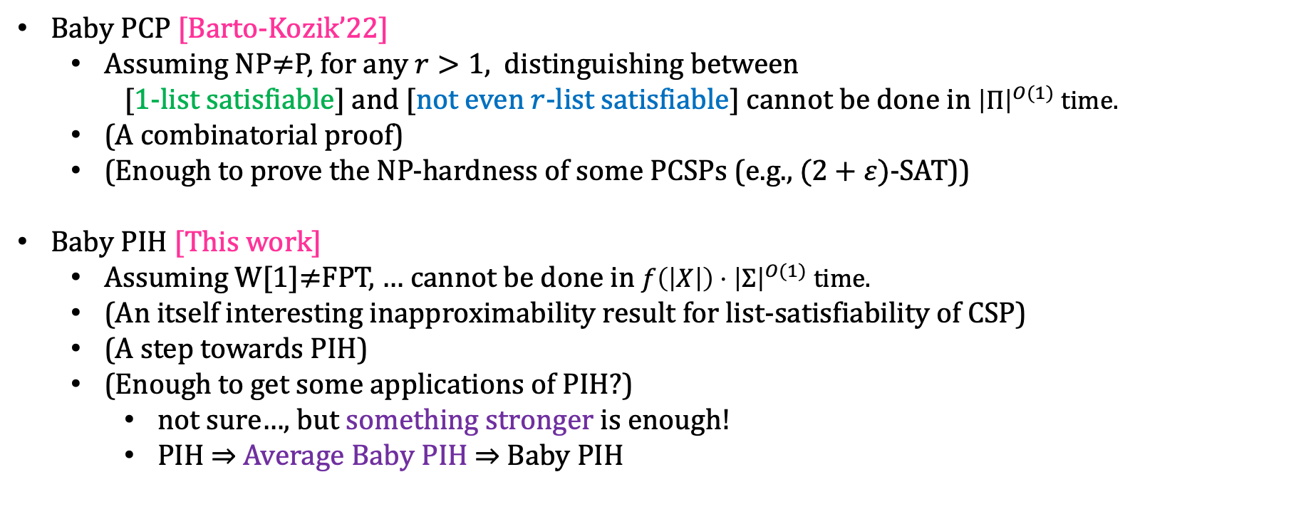
Baby PIH
Baby PCP [Barto-Kozik’22]
Assuming NP$≠$P, for any $r>1,$ distinguishing between
[1-list satisfiable] and [not even $r$-list satisfiable] cannot be done in ${\left|Π\right|}^{O(1)}$ time.
(A combinatorial proof)
(Enough to prove the NP-hardness of some PCSPs (e.g., $(2+ε)$-SAT))
Baby PIH [This work]
Assuming W[1]$≠$FPT, … cannot be done in $f\left(\left|X\right|\right)⋅{\left|Σ\right|}^{O(1)}$ time.
(An itself interesting inapproximability result for list-satisfiability of CSP)
(A step towards PIH)
(Enough to get some applications of PIH?)
not sure…, but something stronger is enough!
PIH $⇒$ Average Baby PIH $⇒$ Baby PIH

Slide 27
Outline
Background
Parameterized Complexity
Constraint Satisfaction Problem (CSP)
Parameterized Inapproximability Hypothesis (PIH)
Our Result
Baby PIH
Proof Overview

Slide 28
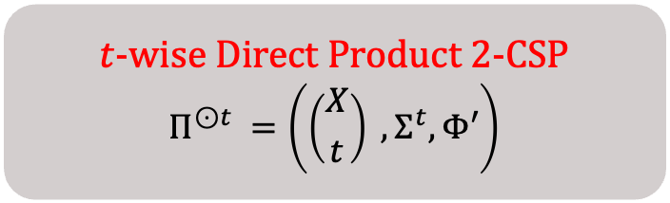
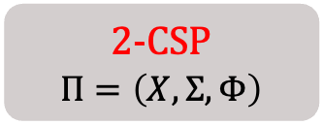
Proof Overview
Follows from and extends [Barto-Kozik’22]’s proof of Baby PCP Theorem
Direct Product Construction
$t$-wise Direct Product 2-CSP
$$Π^{⊙t }=\left(\left({X \atop t}\right) ,Σ^{t},Φ′\right)$$
2-CSP
$$Π=\left(X,Σ,Φ\right)$$
partial satisfying assignments
for the set of variables

Slide 29
Proof Overview
Follows from and extends [Barto-Kozik’22]’s proof of Baby PCP Theorem
Direct Product Construction
$t$-wise Direct Product 2-CSP
$$Π^{⊙t }=\left(\left({X \atop t}\right) ,Σ^{t},Φ′\right)$$
2-CSP
$$Π=\left(X,Σ,Φ\right)$$
consistency checks

Slide 30
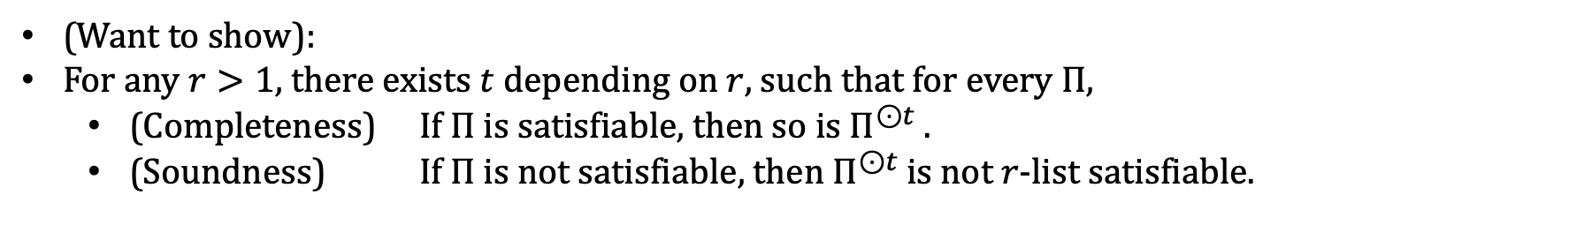
Proof Overview
Follows from and extends [Barto-Kozik’22]’s proof of Baby PCP Theorem
Direct Product Construction
$t$-wise Direct Product 2-CSP
$$Π^{⊙t }=\left(\left({X \atop t}\right) ,Σ^{t},Φ′\right)$$
2-CSP
$$Π=\left(X,Σ,Φ\right)$$
partial satisfying assignments
for the set of variables
consistency checks
(Want to show):
For any $r>1$, there exists $t$ depending on $r$, such that for every $Π$,
(Completeness) If $Π$ is satisfiable, then so is $Π^{⊙t }$.
(Soundness) If $Π$ is not satisfiable, then $Π^{⊙t }$is not $r$-list satisfiable.

Slide 31
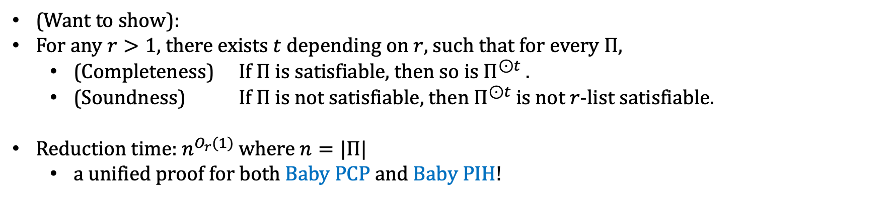
Proof Overview
Follows from and extends [Barto-Kozik’22]’s proof of Baby PCP Theorem
Direct Product Construction
$t$-wise Direct Product 2-CSP
$$Π^{⊙t }=\left(\left({X \atop t}\right) ,Σ^{t},Φ′\right)$$
2-CSP
$$Π=\left(X,Σ,Φ\right)$$
partial satisfying assignments
for the set of variables
consistency checks
(Want to show):
For any $r>1$, there exists $t$ depending on $r$, such that for every $Π$,
(Completeness) If $Π$ is satisfiable, then so is $Π^{⊙t }$.
(Soundness) If $Π$ is not satisfiable, then $Π^{⊙t }$is not $r$-list satisfiable.
Reduction time: $n^{O_{r}(1)}$ where $n=|Π|$
a unified proof for both Baby PCP and Baby PIH!

Slide 32
















Proof Overview
$$(1,3,1,2)$$
$$(1,1,1,2)$$
$$(3,3,2,1)$$
$$↦$$
$$(x_{1},x_{3},x_{4},x_{10})$$
$$(x_{1},x_{2},x_{5},x_{7})$$
$$↦$$
$$(2,1,2,3)$$
$$(2,2,3,1)$$
$$(3,1,2,2)$$
$$(1,1,3,2)$$
and so on …
$$(x_{1},x_{2},x_{4},x_{9})$$
$$↦$$
$$(2,2,3,3)$$
$$(1,1,3,1)$$
A 3-list satisfying assignment for $Π^{⊙4}$

Slide 33




Proof Overview
$$(1,3,1,2)$$
$$(1,1,1,2)$$
$$(3,3,2,1)$$
$$↦$$
$$(x_{1},x_{3},x_{4},x_{10})$$
$$(x_{1},x_{2},x_{5},x_{7})$$
$$↦$$
$$(2,1,2,3)$$
$$(2,2,3,1)$$
$$(3,1,2,2)$$
$$(1,1,3,2)$$
and so on …
$$(x_{1},x_{2},x_{4},x_{9})$$
$$↦$$
$$(2,2,3,3)$$
$$(1,1,3,1)$$
A 3-list satisfying assignment for $Π^{⊙4}$

Slide 34




Proof Overview
$$(1,3,1,2)$$
$$(1,1,1,2)$$
$$(3,3,2,1)$$
$$↦$$
$$(x_{1},x_{3},x_{4},x_{10})$$
$$(x_{1},x_{2},x_{5},x_{7})$$
$$↦$$
$$(2,1,2,3)$$
$$(2,2,3,1)$$
$$(3,1,2,2)$$
$$(1,1,3,2)$$
and so on …
$$(x_{1},x_{2},x_{4},x_{9})$$
$$↦$$
$$(2,2,3,3)$$
$$(1,1,3,1)$$
A 3-list satisfying assignment for $Π^{⊙4}$

Slide 35




Proof Overview
$$(1,3,1,2)$$
$$(1,1,1,2)$$
$$(3,3,2,1)$$
$$↦$$
$$(x_{1},x_{3},x_{4},x_{10})$$
$$(x_{1},x_{2},x_{5},x_{7})$$
$$↦$$
$$(2,1,2,3)$$
$$(2,2,3,1)$$
$$(3,1,2,2)$$
$$(1,1,3,2)$$
and so on …
$$(x_{1},x_{2},x_{4},x_{9})$$
$$↦$$
$$(2,2,3,3)$$
$$(1,1,3,1)$$
A 3-list satisfying assignment for $Π^{⊙4}$

Slide 36
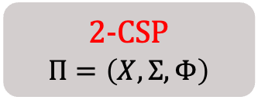
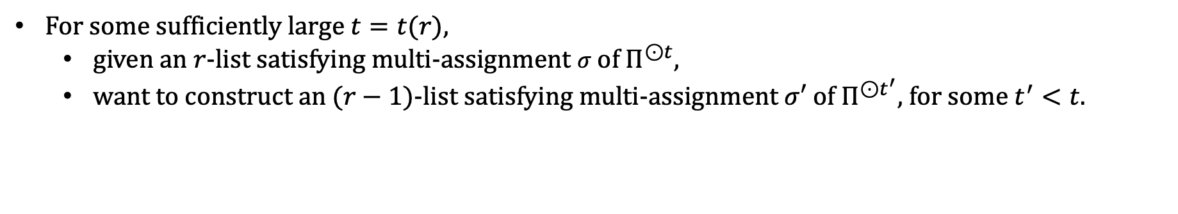
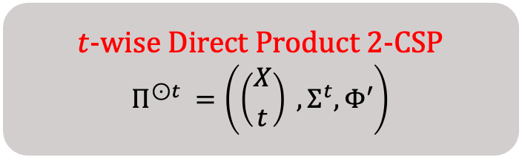
Proof Overview
$t$-wise Direct Product 2-CSP
$$Π^{⊙t }=\left(\left({X \atop t}\right) ,Σ^{t},Φ′\right)$$
2-CSP
$$Π=\left(X,Σ,Φ\right)$$
For some sufficiently large $t=t(r)$,
given an $r$-list satisfying multi-assignment $σ$ of $Π^{⊙t}$,
want to construct an $(r−1)$-list satisfying multi-assignment $σ′$ of $Π^{⊙t^{′}}$, for some $t^{′}<t$.

Slide 37
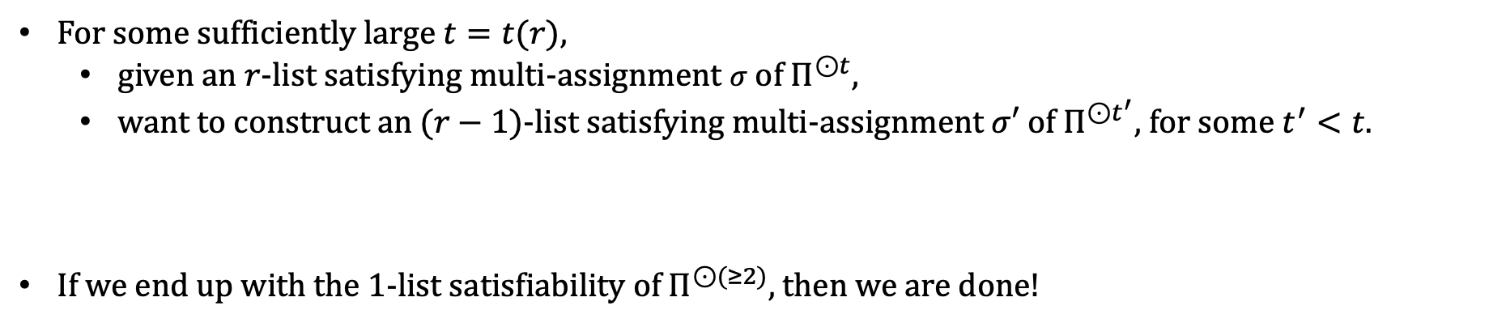
Proof Overview
$t$-wise Direct Product 2-CSP
$$Π^{⊙t }=\left(\left({X \atop t}\right) ,Σ^{t},Φ′\right)$$
2-CSP
$$Π=\left(X,Σ,Φ\right)$$
For some sufficiently large $t=t(r)$,
given an $r$-list satisfying multi-assignment $σ$ of $Π^{⊙t}$,
want to construct an $(r−1)$-list satisfying multi-assignment $σ′$ of $Π^{⊙t^{′}}$, for some $t^{′}<t$.
If we end up with the 1-list satisfiability of $Π^{⊙(≥2)}$, then we are done!

Slide 38
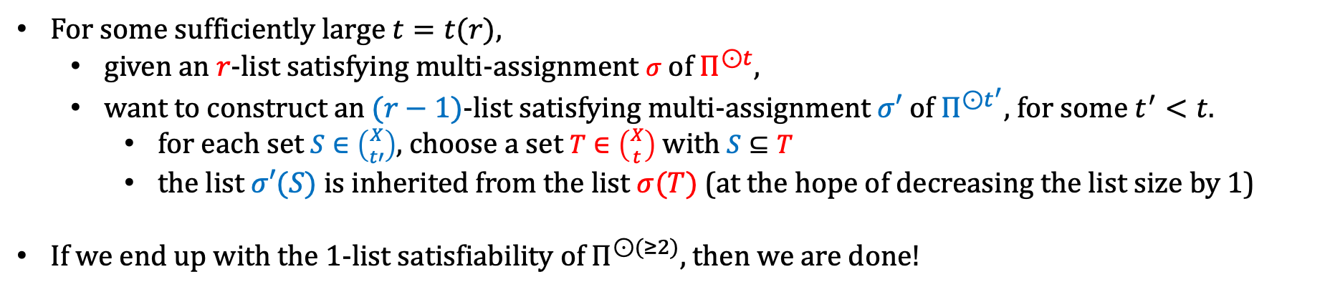
Proof Overview
$t$-wise Direct Product 2-CSP
$$Π^{⊙t }=\left(\left({X \atop t}\right) ,Σ^{t},Φ′\right)$$
2-CSP
$$Π=\left(X,Σ,Φ\right)$$
For some sufficiently large $t=t(r)$,
given an $r$-list satisfying multi-assignment $σ$ of $Π^{⊙t}$,
want to construct an $(r−1)$-list satisfying multi-assignment $σ′$ of $Π^{⊙t^{′}}$, for some $t^{′}<t$.
for each set $S∈\left({X \atop t′}\right)$, choose a set $T∈\left({X \atop t}\right)$ with $S⊆T$
the list $σ′(S)$ is inherited from the list $σ(T)$ (at the hope of decreasing the list size by 1)
If we end up with the 1-list satisfiability of $Π^{⊙(≥2)}$, then we are done!

Slide 39
Proof Overview
$$(1,3,1,2)$$
$$(1,1,1,2)$$
$$(3,3,2,1)$$
$$↦$$
$$(x_{1},x_{3},x_{4},x_{10})$$
$$(x_{1},x_{2},x_{5},x_{7})$$
$$↦$$
$$(2,1,2,3)$$
$$(2,2,3,1)$$
$$(3,1,2,2)$$
$$(1,1,3,2)$$
and so on …
$$(x_{1},x_{2},x_{4},x_{9})$$
$$↦$$
$$(2,2,3,3)$$
$$(1,1,3,1)$$
A 3-list satisfying assignment for $Π^{⊙4}$

Slide 40



















Proof Overview
$$(1,3,1,2)$$
$$(1,1,1,2)$$
$$(3,3,2,1)$$
$$↦$$
$$(x_{1},x_{3},x_{4},x_{10})$$
$$(x_{1},x_{2},x_{5},x_{7})$$
$$↦$$
$$(2,1,2,3)$$
$$(2,2,3,1)$$
$$(3,1,2,2)$$
$$(1,1,3,2)$$
inherit
and so on …
$$(x_{1},x_{2},x_{4},x_{9})$$
$$↦$$
$$(2,2,3,3)$$
$$(1,1,3,1)$$
A 3-list satisfying assignment for $Π^{⊙4}$
$$(1,3,1)$$
$$↦$$
$$(x_{1},x_{3},x_{4})$$
$$(x_{1},x_{2},x_{5})$$
$$(2,2,3)$$
and so on …
$$(x_{1},x_{2},x_{4})$$

Slide 41
















Proof Overview
$$(1,3,1,2)$$
$$(1,1,1,2)$$
$$(3,3,2,1)$$
$$↦$$
$$(x_{1},x_{3},x_{4},x_{10})$$
$$(x_{1},x_{2},x_{5},x_{7})$$
$$↦$$
$$(2,1,2,3)$$
$$(2,2,3,1)$$
$$(3,1,2,2)$$
$$(1,1,3,2)$$
and so on …
$$(x_{1},x_{2},x_{4},x_{9})$$
$$↦$$
$$(2,2,3,3)$$
inherit
$$(1,1,3,1)$$
A 3-list satisfying assignment for $Π^{⊙4}$
$$(1,3,1)$$
$$(1,1,1)$$
$$↦$$
$$(x_{1},x_{3},x_{4})$$
$$(x_{1},x_{2},x_{5})$$
$$↦$$
$$(2,2,3)$$
$$(3,1,2)$$
and so on …
$$(x_{1},x_{2},x_{4})$$

Slide 42











Proof Overview
$$(1,3,1,2)$$
$$(1,1,1,2)$$
$$(3,3,2,1)$$
$$↦$$
$$(x_{1},x_{3},x_{4},x_{10})$$
$$(x_{1},x_{2},x_{5},x_{7})$$
$$↦$$
$$(2,1,2,3)$$
$$(2,2,3,1)$$
$$(3,1,2,2)$$
$$(1,1,3,2)$$
and so on …
$$(x_{1},x_{2},x_{4},x_{9})$$
$$↦$$
$$(2,2,3,3)$$
$$(1,1,3,1)$$
A 3-list satisfying assignment for $Π^{⊙4}$
$$(1,3,1)$$
$$(1,1,1)$$
$$↦$$
$$(x_{1},x_{3},x_{4})$$
$$(x_{1},x_{2},x_{5})$$
$$↦$$
inherit
$$(2,2,3)$$
$$(3,1,2)$$
$$(1,1,3)$$
and so on …
$$(x_{1},x_{2},x_{4})$$
$$↦$$
$$(2,2,3)$$

Slide 43














Proof Overview
$$(1,3,1,2)$$
$$(1,1,1,2)$$
$$(3,3,2,1)$$
$$↦$$
$$(x_{1},x_{3},x_{4},x_{10})$$
$$(x_{1},x_{2},x_{5},x_{7})$$
$$↦$$
$$(2,1,2,3)$$
$$(2,2,3,1)$$
$$(3,1,2,2)$$
$$(1,1,3,2)$$
and so on …
$$(x_{1},x_{2},x_{4},x_{9})$$
$$↦$$
$$(2,2,3,3)$$
$$(1,1,3,1)$$
A 3-list satisfying assignment for $Π^{⊙4}$
$$(1,3,1)$$
$$(1,1,1)$$
$$↦$$
$$(x_{1},x_{3},x_{4})$$
$$(x_{1},x_{2},x_{5})$$
$$↦$$
$$(2,2,3)$$
$$(3,1,2)$$
$$(1,1,3)$$
and so on …
$$(x_{1},x_{2},x_{4})$$
$$↦$$
$$(2,2,3)$$
A 2-list satisfying assignment for $Π^{⊙3}$?

Slide 44
Proof Overview
How can we discard one assignment safely?
the one that is never used to meet any consistency constraints!

Slide 45































Proof Overview
How can we discard one assignment safely?
the one that is never used to meet any consistency constraints!
Suppose we have the following bipartite direct product instance:
$$(1,2,1)$$
$$(x_{1},x_{2},x_{3})$$
$$(x_{1},x_{2},x_{3})$$
$$(1,2,1)$$
$$↦$$
$$↦$$
$$(3,3,2)$$
$$(2,3,2)$$
$$(1,2,1)$$
$$(x_{1},x_{2},x_{4})$$
$$(x_{1},x_{2},x_{4})$$
$$(1,2,1)$$
$$↦$$
$$↦$$
$$(2,3,3)$$
$$(2,3,3)$$
$$(1,1,1)$$
$$(x_{1},x_{3},x_{4})$$
$$(x_{1},x_{3},x_{4})$$
$$(2,1,3)$$
$$↦$$
$$↦$$
$$(3,3,2)$$
$$(1,1,1)$$
$$(1,3,1)$$
$$(x_{2},x_{3},x_{4})$$
$$(x_{2},x_{3},x_{4})$$
$$(2,1,1)$$
$$↦$$
$$↦$$
$$(2,1,1)$$
$$(2,3,2)$$

Slide 46


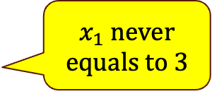







Proof Overview
How can we discard one assignment safely?
the one that is never used to meet any consistency constraints!
Suppose we have the following bipartite direct product instance:
$$(1,2,1)$$
$$(x_{1},x_{2},x_{3})$$
$$(x_{1},x_{2},x_{3})$$
$$(1,2,1)$$
$$↦$$
$$↦$$
$$(3,3,2)$$
$$(2,3,2)$$
$x_{1}$ never equals to 3
$$(1,2,1)$$
$$(x_{1},x_{2},x_{4})$$
$$(x_{1},x_{2},x_{4})$$
$$(1,2,1)$$
$$↦$$
$$↦$$
$$(2,3,3)$$
$$(2,3,3)$$
$$(1,1,1)$$
$$(x_{1},x_{3},x_{4})$$
$$(x_{1},x_{3},x_{4})$$
$$(2,1,3)$$
$$↦$$
$$↦$$
$$(3,3,2)$$
$$(1,1,1)$$
$$(1,3,1)$$
$$(x_{2},x_{3},x_{4})$$
$$(x_{2},x_{3},x_{4})$$
$$(2,1,1)$$
$$↦$$
$$↦$$
$$(2,1,1)$$
$$(2,3,2)$$

Slide 47


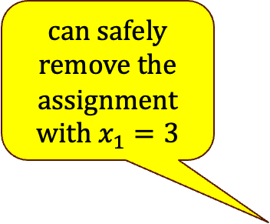
Proof Overview
How can we discard one assignment safely?
the one that is never used to meet any consistency constraints!
Suppose we have the following bipartite direct product instance:
$$(1,2,1)$$
$$(x_{1},x_{2},x_{3})$$
$$(x_{1},x_{2},x_{3})$$
$$(1,2,1)$$
can safely remove the assignment with $x_{1}=3$
$$↦$$
$$↦$$
$$(3,3,2)$$
$$(2,3,2)$$
$x_{1}$ never equals to 3
$$(1,2,1)$$
$$(x_{1},x_{2},x_{4})$$
$$(x_{1},x_{2},x_{4})$$
$$(1,2,1)$$
$$↦$$
$$↦$$
$$(2,3,3)$$
$$(2,3,3)$$
$$(1,1,1)$$
$$(x_{1},x_{3},x_{4})$$
$$(x_{1},x_{3},x_{4})$$
$$(2,1,3)$$
$$↦$$
$$↦$$
$$(3,3,2)$$
$$(1,1,1)$$
$$(1,3,1)$$
$$(x_{2},x_{3},x_{4})$$
$$(x_{2},x_{3},x_{4})$$
$$(2,1,1)$$
$$↦$$
$$↦$$
$$(2,1,1)$$
$$(2,3,2)$$

Slide 48
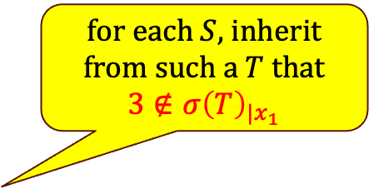
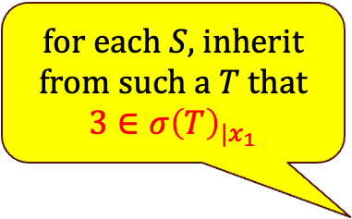
Proof Overview
How can we discard one assignment safely?
the one that is never used to meet any consistency constraints!
Suppose we have the following bipartite direct product instance:
$$(1,2,1)$$
$$(x_{1},x_{2},x_{3})$$
$$(x_{1},x_{2},x_{3})$$
$$(1,2,1)$$
$$↦$$
$$↦$$
for each $S$, inherit from such a $T$ that $3∈σ{\left(T\right)}_{|x_{1}}$
$$(3,3,2)$$
$$(2,3,2)$$
for each $S$, inherit from such a $T$ that $3∉σ{\left(T\right)}_{|x_{1}}$
$$(1,2,1)$$
$$(x_{1},x_{2},x_{4})$$
$$(x_{1},x_{2},x_{4})$$
$$(1,2,1)$$
$$↦$$
$$↦$$
$$(2,3,3)$$
$$(2,3,3)$$
$$(1,1,1)$$
$$(x_{1},x_{3},x_{4})$$
$$(x_{1},x_{3},x_{4})$$
$$(2,1,3)$$
$$↦$$
$$↦$$
$$(3,3,2)$$
$$(1,1,1)$$
$$(1,3,1)$$
$$(x_{2},x_{3},x_{4})$$
$$(x_{2},x_{3},x_{4})$$
$$(2,1,1)$$
$$↦$$
$$↦$$
$$(2,1,1)$$
$$(2,3,2)$$

Slide 49
Proof Overview
How can we discard one assignment safely?
the one that is never used to meet any consistency constraints!
Suppose we have the following bipartite direct product instance:
$$(1,2,1)$$
$$(x_{1},x_{2},x_{3})$$
$$(x_{1},x_{2},x_{3})$$
$$(1,2,1)$$
$$↦$$
$$↦$$
for each $S$, inherit from such a $T$ that $3∈σ{\left(T\right)}_{|x_{1}}$
$$(3,3,2)$$
$$(2,3,2)$$
for each $S$, inherit from such a $T$ that $3∉σ{\left(T\right)}_{|x_{1}}$
$$(1,2,1)$$
$$(x_{1},x_{2},x_{4})$$
$$(x_{1},x_{2},x_{4})$$
$$(1,2,1)$$
$$↦$$
$$↦$$
$$(2,3,3)$$
$$(2,3,3)$$
$$(1,1,1)$$
$$(x_{1},x_{3},x_{4})$$
$$(x_{1},x_{3},x_{4})$$
$$(2,1,3)$$
$$↦$$
$$↦$$
by discarding this assignment, list size is decreased by 1
$$(3,3,2)$$
$$(1,1,1)$$
$$(1,3,1)$$
$$(x_{2},x_{3},x_{4})$$
$$(x_{2},x_{3},x_{4})$$
$$(2,1,1)$$
$$↦$$
$$↦$$
$$(2,1,1)$$
$$(2,3,2)$$

Slide 50

Proof Overview
Bipartite $(r,1)$-case
Bipartite ($r,q$)-case
Non-bipartite $r$-case

Slide 51

Proof Overview
Bipartite $(r,1)$-case
Bipartite ($r,q$)-case
Non-bipartite $r$-case

Slide 52

Takeaway
Parameterized Inapproximability Hypothesis – parameterized analog of PCP
Baby PIH – inapproximability of the list-satisfiability of (parameterized) 2CSP
W[1]-hard to distinguish between [1-list satisfiable] and [not even $r$-list satisfiable]
Proof Idea: induction on the list size

Slide 53
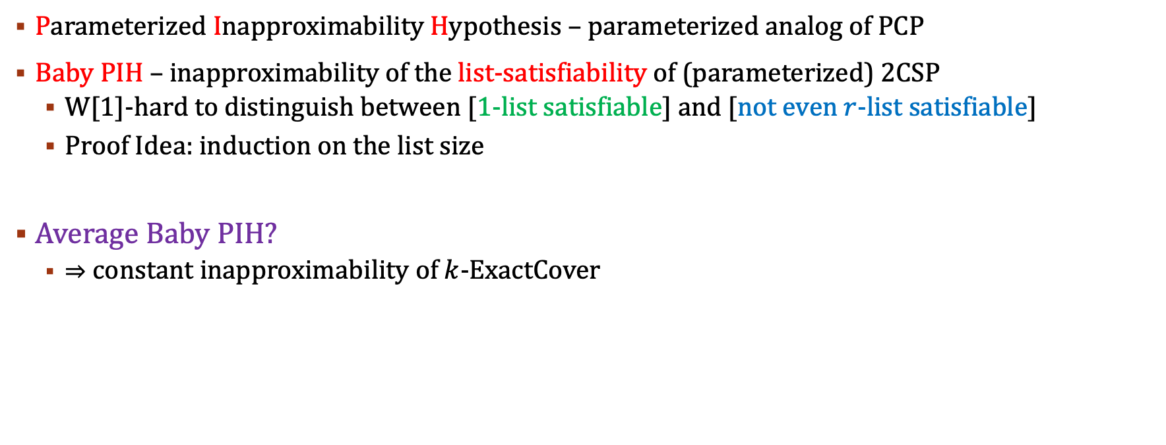
Takeaway
Parameterized Inapproximability Hypothesis – parameterized analog of PCP
Baby PIH – inapproximability of the list-satisfiability of (parameterized) 2CSP
W[1]-hard to distinguish between [1-list satisfiable] and [not even $r$-list satisfiable]
Proof Idea: induction on the list size
Average Baby PIH?
$⇒$ constant inapproximability of $k$-ExactCover

Slide 54
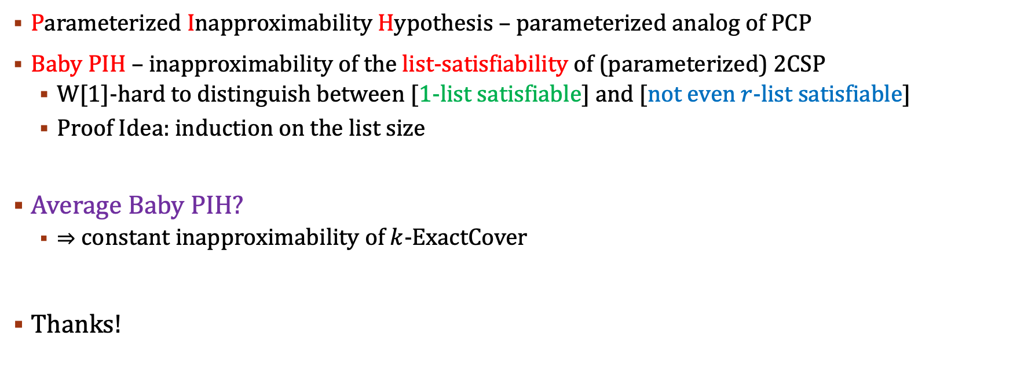
Takeaway
Parameterized Inapproximability Hypothesis – parameterized analog of PCP
Baby PIH – inapproximability of the list-satisfiability of (parameterized) 2CSP
W[1]-hard to distinguish between [1-list satisfiable] and [not even $r$-list satisfiable]
Proof Idea: induction on the list size
Average Baby PIH?
$⇒$ constant inapproximability of $k$-ExactCover
Thanks!

