Slide 1


Parameterized
Inapproximability for Min-CSP:
From Baby PIH to Average Baby PIH
Xuandi Ren
UC Berkeley
Workshop on Hardness of Approximation in P
@DIMACS, Rutgers

Slide 2
Outline
Background
  Parameterized Complexity
  Constraint Satisfaction Problem (CSP)
  Parameterized Inapproximability Hypothesis (PIH)
From Baby PIH to Average Baby PIH
Proof Overview
  Baby PIH
  Average Baby PIH

Slide 3
Outline
Background
  Parameterized Complexity
  Constraint Satisfaction Problem (CSP)
  Parameterized Inapproximability Hypothesis (PIH)
From Baby PIH to Average Baby PIH
Proof Overview
  Baby PIH
  Average Baby PIH

Slide 4



Parameterized Complexity
How to cope with an NP-hard problem?
Associate each instance $x$ with a parameter $k∈ℕ$
  $k≪|x|$
  Measure complexity over $n=\left|x\right|$ and $k$
FPT (Fixed-Parameter Tractable, Analogue of P):
  Problems that admit $f(k)∙n^{O(1)}$ time algorithms for some computable function $f$
$k$-Vertex Cover
Input:
  $G=\left(V,E\right)$ and parameter $k$
Output:
  $∃v_{1},…, v_{k}∈V$ covering all the edges?
has an $O(2^{k}⋅n^{O(1)})$ enumeration algorithm
Efficient for small $k$!
$$∈$$
FPT

Slide 5




Parameterized Complexity
How to cope with an NP-hard problem?
Associate each instance $x$ with a parameter $k∈ℕ$
  $k≪|x|$
  Measure complexity over $n=\left|x\right|$ and $k$
W[1] (Analogue of NP): widely believed W[1] $≠$ FPT
$k$-Clique
Input:
  $G=\left(V,E\right)$ and parameter $k$
Output:
  $∃v_{1},…, v_{k}∈V$ forming a clique?
Unlikely to have an $f(k)∙n^{O(1)}$ time algorithm
No algorithm known with runtime $n^{o(k)}$
W[1]
-complete

Slide 6
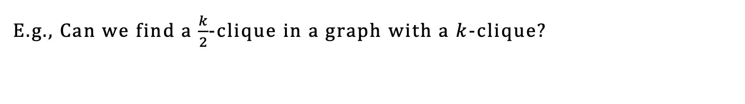
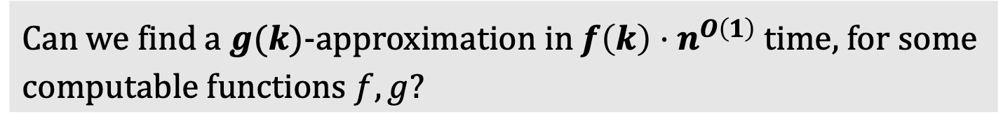
Parameterized Approximation
Can we find a $g(k)$-approximation in $f\left(k\right)⋅n^{O\left(1\right)}$ time, for some computable functions $f,g$?
E.g., Can we find a $\frac{k}{2}$-clique in a graph with a $k$-clique?

Slide 7
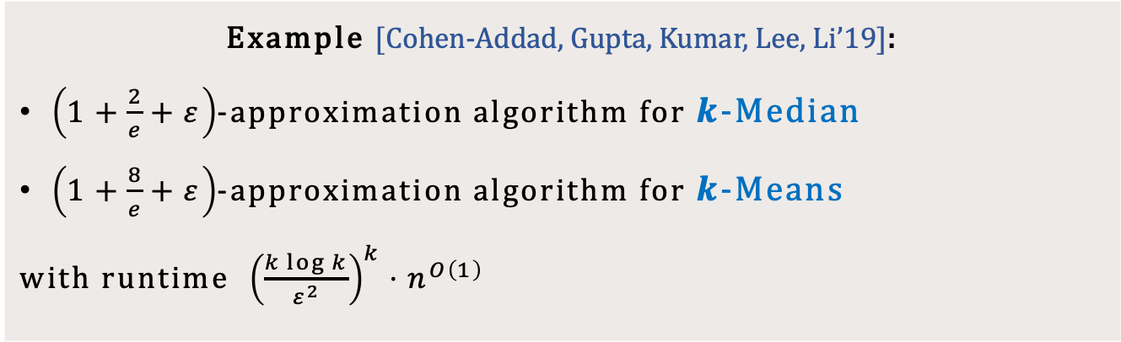

Parameterized Approximation
Can we find a $g(k)$-approximation in $f\left(k\right)⋅n^{O\left(1\right)}$ time, for some computable functions $f,g$?
Optimal ratio in FPT
Beat polytime algorithms: $2.611+ε$ for $k$-Median, $6.357$ for $k$-Means
Example [Cohen-Addad, Gupta, Kumar, Lee, Li’19]:
$\left(1+\frac{2}{e}+ε\right)$-approximation algorithm for $k$-Median
$\left(1+\frac{8}{e}+ε\right)$-approximation algorithm for $k$-Means
with runtime ${\left(\frac{k\log{k}}{ε^{2}}\right)}^{k}⋅n^{O\left(1\right)}$

Slide 8
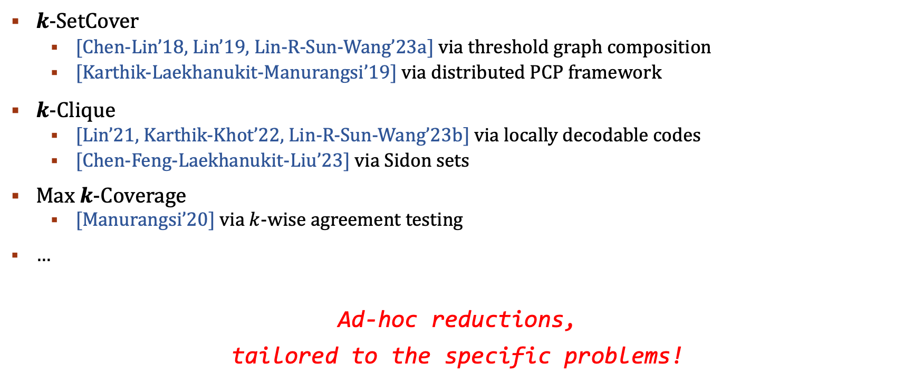
Parameterized Hardness of Approximation
$k$-SetCover
  [Chen-Lin’18, Lin’19, Lin-R-Sun-Wang’23a] via threshold graph composition
  [Karthik-Laekhanukit-Manurangsi’19] via distributed PCP framework
$k$-Clique
  [Lin’21, Karthik-Khot’22, Lin-R-Sun-Wang’23b] via locally decodable codes
  [Chen-Feng-Laekhanukit-Liu’23] via Sidon sets
Max $k$-Coverage
  [Manurangsi’20] via $k$-wise agreement testing
…
Ad-hoc reductions,
tailored to the specific problems!

Slide 9
Parameterized Hardness of Approximation
Unified and powerful machinery for parameterized inapproximability?
  Parameterized PCP-type theorem!

Slide 10

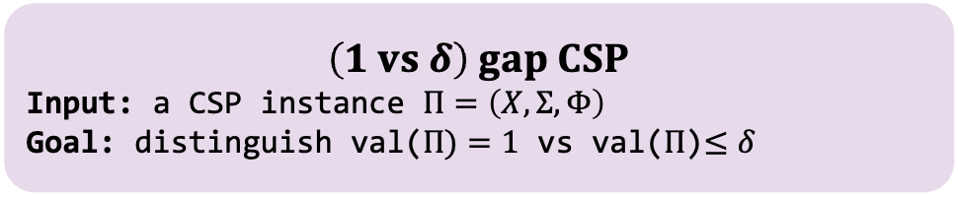
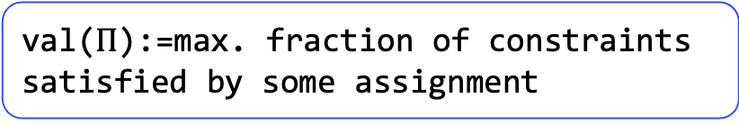

Recall: PCP Theorem
PCP Theorem:
  For any constant $Σ$ and let $n=|X|$, there is no $n^{O(1)}$ time algorithm for (1 vs 0.9) gap CSP assuming P$≠$NP.
val($Π$):=max. fraction of constraints satisfied by some assignment
$$Constraint Satisfaction Problem$$
Input: $Π=\left(X,Σ,Φ\right)$
$X$: variables
$Σ$: alphabet
$Φ:$ constraints
Output:
$∃σ:X→Σ$ satisfying all constraints?
$$\left(1 vs δ\right) gap CSP$$
Input: a CSP instance $Π=\left(X,Σ,Φ\right)$
Goal: distinguish val($Π)=1$ vs val($Π$)$≤δ$

Slide 11
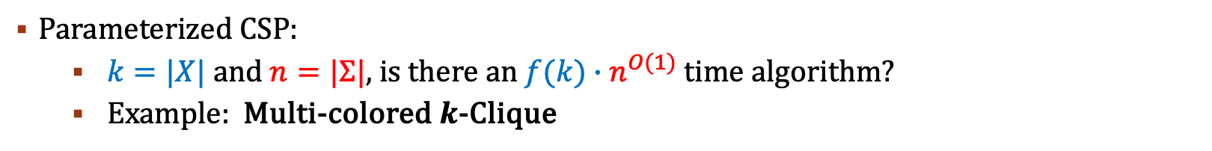
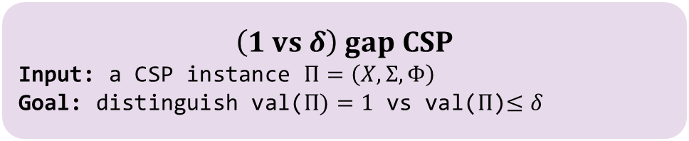
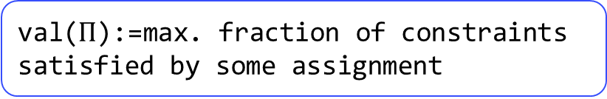
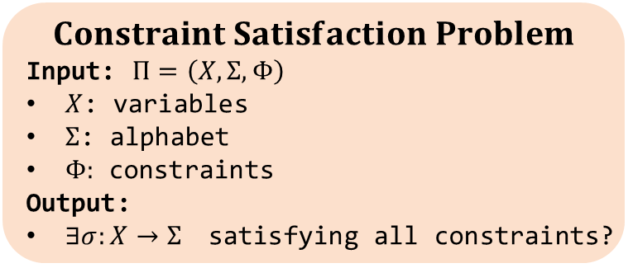
Parameterized Inapproximability Hypothesis
val($Π$):=max. fraction of constraints satisfied by some assignment
$$Constraint Satisfaction Problem$$
Input: $Π=\left(X,Σ,Φ\right)$
$X$: variables
$Σ$: alphabet
$Φ:$ constraints
Output:
$∃σ:X→Σ$ satisfying all constraints?
$$\left(1 vs δ\right) gap CSP$$
Input: a CSP instance $Π=\left(X,Σ,Φ\right)$
Goal: distinguish val($Π)=1$ vs val($Π$)$≤δ$
Parameterized CSP:
  $k=|X|$ and $n=|Σ|$, is there an $f(k)∙n^{O(1)}$ time algorithm?
  Example: Multi-colored $k$-Clique
PIH (Parameterized Inapproximability Hypothesis) [Lokshtanov-Ramanujan-Saurabh-Zehavi’20]:
Let $k=|X|$ and $n=|Σ|$, there is no ${f(k)∙n}^{O(1)}$ time algorithm for (1 vs 0.9) gap parameterized CSP.

Slide 12
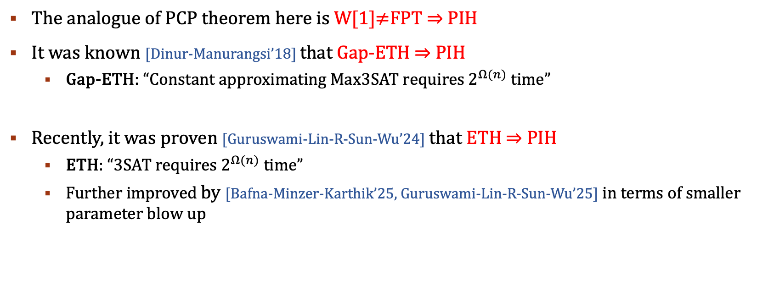
Parameterized Inapproximability Hypothesis
The analogue of PCP theorem here is W[1]$≠$FPT $⇒$ PIH
It was known [Dinur-Manurangsi’18] that Gap-ETH $⇒$ PIH
  Gap-ETH: “Constant approximating Max3SAT requires $2^{Ω(n)}$ time”
Recently, it was proven [Guruswami-Lin-R-Sun-Wu’24] that ETH $⇒$ PIH
  ETH: “3SAT requires $2^{Ω(n)}$ time”
  Further improved by [Bafna-Minzer-Karthik’25, Guruswami-Lin-R-Sun-Wu’25] in terms of smaller parameter blow up

Slide 13
Outline
Background
  Parameterized Complexity
  Constraint Satisfaction Problem (CSP)
  Parameterized Inapproximability Hypothesis (PIH)
From Baby PIH to Average Baby PIH
Proof Overview
  Baby PIH
  Average Baby PIH

Slide 14
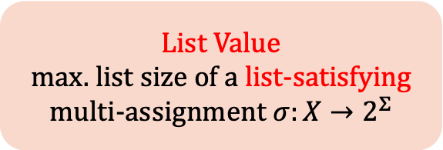
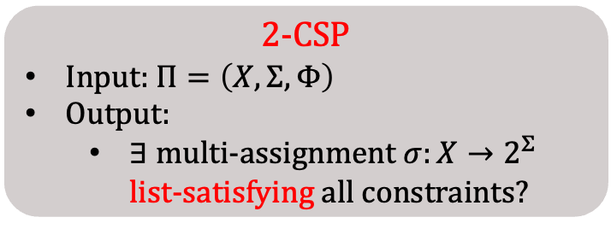
List Satisfiability of CSP
2-CSP
Input: $Π=\left(X,Σ,Φ\right)$
Output:
  $∃$ multi-assignment $σ:X→2^{Σ}$ list-satisfying all constraints?
List Value
max. list size of a list-satisfying multi-assignment $σ:X→2^{Σ}$
A constraint on $(x,y)$ is list-satisfied iff $∃u∈σ\left(x\right), v∈σ(y)$, s.t. $(u,v)$ satisfies this constraint.

Slide 15







List Satisfiability of CSP
2-CSP
Input: $Π=\left(X,Σ,Φ\right)$
Output:
  $∃$ multi-assignment $σ:X→2^{Σ}$ list-satisfying all constraints?
List Value
max. list size of a list-satisfying multi-assignment $σ:X→2^{Σ}$
A constraint on $(x,y)$ is list-satisfied iff $∃u∈σ\left(x\right), v∈σ(y)$, s.t. $(u,v)$ satisfies this constraint.
$$Σ=\{0,1,2,3\}$$
$$x_{2}$$
$$σ\left(x_{1}\right)=σ(x_{2})$$
$$σ\left(x_{2}\right)+σ\left(x_{3}\right)=2$$
$$x_{1}$$
$$x_{3}$$
$$σ\left(x_{1}\right)+σ\left(x_{3}\right)=3$$

Slide 16
List Satisfiability of CSP
2-CSP
Input: $Π=\left(X,Σ,Φ\right)$
Output:
  $∃$ multi-assignment $σ:X→2^{Σ}$ list-satisfying all constraints?
List Value
max. list size of a list-satisfying multi-assignment $σ:X→2^{Σ}$
A constraint on $(x,y)$ is list-satisfied iff $∃u∈σ\left(x\right), v∈σ(y)$, s.t. $(u,v)$ satisfies this constraint.
$$Σ=\{0,1,2,3\}$$
$$x_{2}$$
[1]
$$σ\left(x_{1}\right)=σ(x_{2})$$
$$σ\left(x_{2}\right)+σ\left(x_{3}\right)=2$$
$$x_{1}$$
$$x_{3}$$
[1]
[1,2]
$$σ\left(x_{1}\right)+σ\left(x_{3}\right)=3$$

Slide 17

List Satisfiability of CSP
2-CSP
Input: $Π=\left(X,Σ,Φ\right)$
Output:
  $∃$ multi-assignment $σ:X→2^{Σ}$ list-satisfying all constraints?
List Value
max. list size of a list-satisfying multi-assignment $σ:X→2^{Σ}$
A constraint on $(x,y)$ is list-satisfied iff $∃u∈σ\left(x\right), v∈σ(y)$, s.t. $(u,v)$ satisfies this constraint.
$$Σ=\{0,1,2,3\}$$
$$x_{2}$$
[1]
$$σ\left(x_{1}\right)=σ(x_{2})$$
$$σ\left(x_{2}\right)+σ\left(x_{3}\right)=2$$
$$x_{1}$$
$$x_{3}$$
[1]
[1,2]
$$σ\left(x_{1}\right)+σ\left(x_{3}\right)=3$$

Slide 18

List Satisfiability of CSP
2-CSP
Input: $Π=\left(X,Σ,Φ\right)$
Output:
  $∃$ multi-assignment $σ:X→2^{Σ}$ list-satisfying all constraints?
List Value
max. list size of a list-satisfying multi-assignment $σ:X→2^{Σ}$
A constraint on $(x,y)$ is list-satisfied iff $∃u∈σ\left(x\right), v∈σ(y)$, s.t. $(u,v)$ satisfies this constraint.
$$Σ=\{0,1,2,3\}$$
$$x_{2}$$
[1]
$$σ\left(x_{1}\right)=σ(x_{2})$$
$$σ\left(x_{2}\right)+σ\left(x_{3}\right)=2$$
$$x_{1}$$
$$x_{3}$$
[1]
[1,2]
$$σ\left(x_{1}\right)+σ\left(x_{3}\right)=3$$

Slide 19

List Satisfiability of CSP
2-CSP
Input: $Π=\left(X,Σ,Φ\right)$
Output:
  $∃$ multi-assignment $σ:X→2^{Σ}$ list-satisfying all constraints?
List Value
max. list size of a list-satisfying multi-assignment $σ:X→2^{Σ}$
A constraint on $(x,y)$ is list-satisfied iff $∃u∈σ\left(x\right), v∈σ(y)$, s.t. $(u,v)$ satisfies this constraint.
$$Σ=\{0,1,2,3\}$$
$$x_{2}$$
[1]
$$σ\left(x_{1}\right)=σ(x_{2})$$
$$σ\left(x_{2}\right)+σ\left(x_{3}\right)=2$$
$$x_{1}$$
$$x_{3}$$
[1]
[1,2]
$$σ\left(x_{1}\right)+σ\left(x_{3}\right)=3$$

Slide 20
List Satisfiability of CSP
2-CSP
Input: $Π=\left(X,Σ,Φ\right)$
Output:
  $∃$ multi-assignment $σ:X→2^{Σ}$ list-satisfying all constraints?
List Value
max. list size of a list-satisfying multi-assignment $σ:X→2^{Σ}$
We say a 2-CSP is $r$-list satisfiable iff $∃σ$ with $\max_{x∈X}\left|σ\left(x\right)\right|≤r$ list-satisfying all constraints.

Slide 21
List Satisfiability of CSP
2-CSP
Input: $Π=\left(X,Σ,Φ\right)$
Output:
  $∃$ multi-assignment $σ:X→2^{Σ}$ list-satisfying all constraints?
List Value
max. list size of a list-satisfying multi-assignment $σ:X→2^{Σ}$
We say a 2-CSP is $r$-list satisfiable iff $∃σ$ with $\max_{x∈X}\left|σ\left(x\right)\right|≤r$ list-satisfying all constraints.
  CSP Value=1 $⇔$ 1-list satisfiable $⇒$ $r$-list satisfiable for $r≥2$
  $r$-list satisfiable $⇒$ CSP Value $≥1/r^{2}$

Slide 22
Baby PCP
2-CSP
Input: $Π=\left(X,Σ,Φ\right)$
Output:
  $∃$ multi-assignment $σ:X→2^{Σ}$ list-satisfying all constraints?
List Value
max. list size of a list-satisfying multi-assignment $σ:X→2^{Σ}$
We say a 2-CSP is $r$-list satisfiable iff $∃σ$ with $\max_{x∈X}\left|σ\left(x\right)\right|≤r$ list-satisfying all constraints.
  CSP Value=1 $⇔$ 1-list satisfiable $⇒$ $r$-list satisfiable for $r≥2$
  $r$-list satisfiable $⇒$ CSP Value $≥1/r^{2}$
Baby PCP [Barto-Kozik’22]
  For any $r>1,$It’s NP-hard to distinguish between [1-list satisfiable] and [not even $r$-list satisfiable].

Slide 23


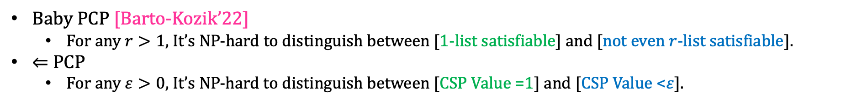

Baby PCP
2-CSP
Input: $Π=\left(X,Σ,Φ\right)$
Output:
  $∃$ multi-assignment $σ:X→2^{Σ}$ list-satisfying all constraints?
List Value
max. list size of a list-satisfying multi-assignment $σ:X→2^{Σ}$
We say a 2-CSP is $r$-list satisfiable iff $∃σ$ with $\max_{x∈X}\left|σ\left(x\right)\right|≤r$ list-satisfying all constraints.
  CSP Value=1 $⇔$ 1-list satisfiable $⇒$ $r$-list satisfiable for $r≥2$
  $r$-list satisfiable $⇒$ CSP Value$≥1/r^{2}$
Baby PCP [Barto-Kozik’22]
  For any $r>1,$It’s NP-hard to distinguish between [1-list satisfiable] and [not even $r$-list satisfiable].
$⇐$ PCP
  For any $ε>0$, It’s NP-hard to distinguish between [CSP Value =1] and [CSP Value <$ε$].
$$⇐$$
$$⇐$$
(when $ε<1/r^{2}$)

Slide 24
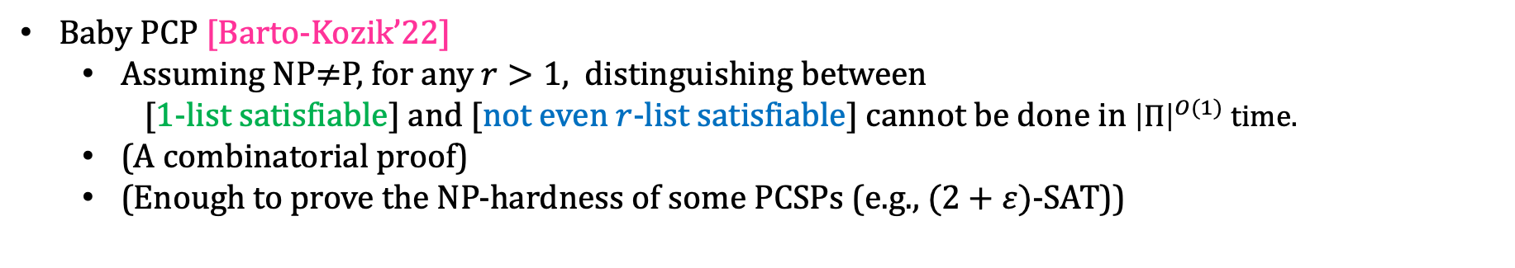
Baby PCP
Baby PCP [Barto-Kozik’22]
  Assuming NP$≠$P, for any $r>1,$ distinguishing between
    [1-list satisfiable] and [not even $r$-list satisfiable] cannot be done in ${\left|Π\right|}^{O(1)}$ time.
  (A combinatorial proof)
  (Enough to prove the NP-hardness of some PCSPs (e.g., $(2+ε)$-SAT))

Slide 25
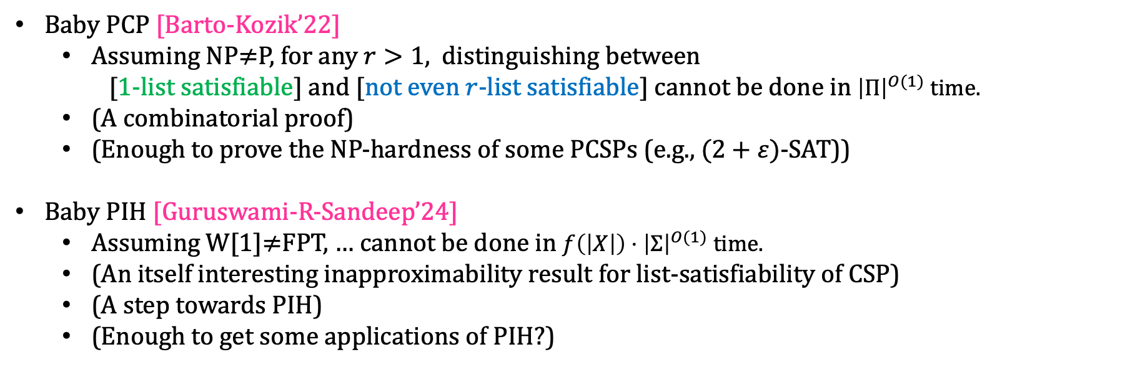
Baby PIH
Baby PCP [Barto-Kozik’22]
  Assuming NP$≠$P, for any $r>1,$ distinguishing between
    [1-list satisfiable] and [not even $r$-list satisfiable] cannot be done in ${\left|Π\right|}^{O(1)}$ time.
  (A combinatorial proof)
  (Enough to prove the NP-hardness of some PCSPs (e.g., $(2+ε)$-SAT))
Baby PIH [Guruswami-R-Sandeep’24]
  Assuming W[1]$≠$FPT, … cannot be done in $f\left(\left|X\right|\right)⋅{\left|Σ\right|}^{O(1)}$ time.
  (An itself interesting inapproximability result for list-satisfiability of CSP)
  (A step towards PIH)
  (Enough to get some applications of PIH?)

Slide 26
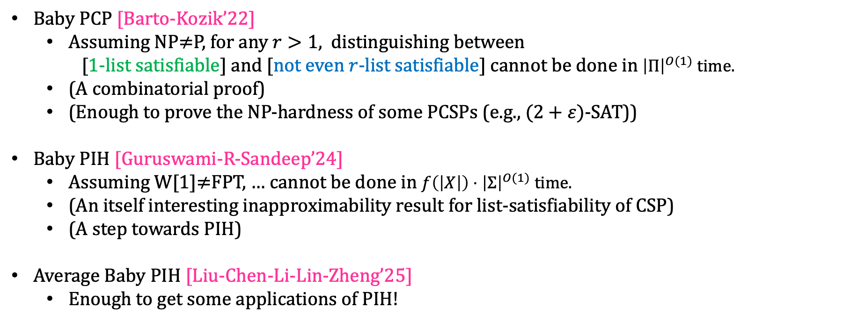
Baby PIH
Baby PCP [Barto-Kozik’22]
  Assuming NP$≠$P, for any $r>1,$ distinguishing between
    [1-list satisfiable] and [not even $r$-list satisfiable] cannot be done in ${\left|Π\right|}^{O(1)}$ time.
  (A combinatorial proof)
  (Enough to prove the NP-hardness of some PCSPs (e.g., $(2+ε)$-SAT))
Baby PIH [Guruswami-R-Sandeep’24]
  Assuming W[1]$≠$FPT, … cannot be done in $f\left(\left|X\right|\right)⋅{\left|Σ\right|}^{O(1)}$ time.
  (An itself interesting inapproximability result for list-satisfiability of CSP)
  (A step towards PIH)
Average Baby PIH [Liu-Chen-Li-Lin-Zheng’25]
  Enough to get some applications of PIH!

Slide 27
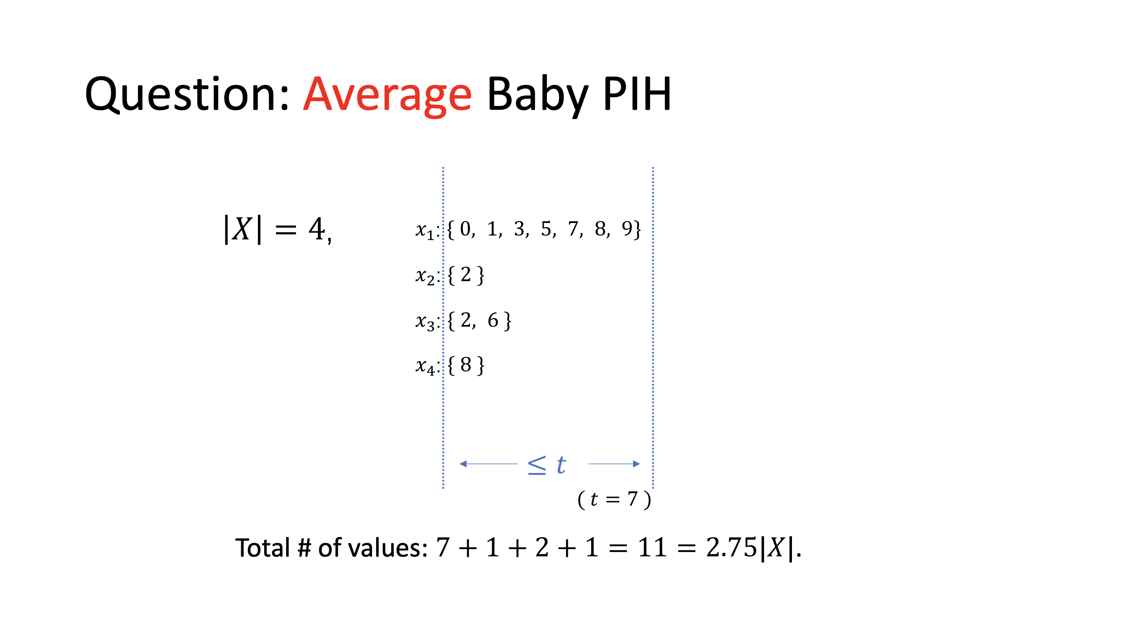

Slide 28
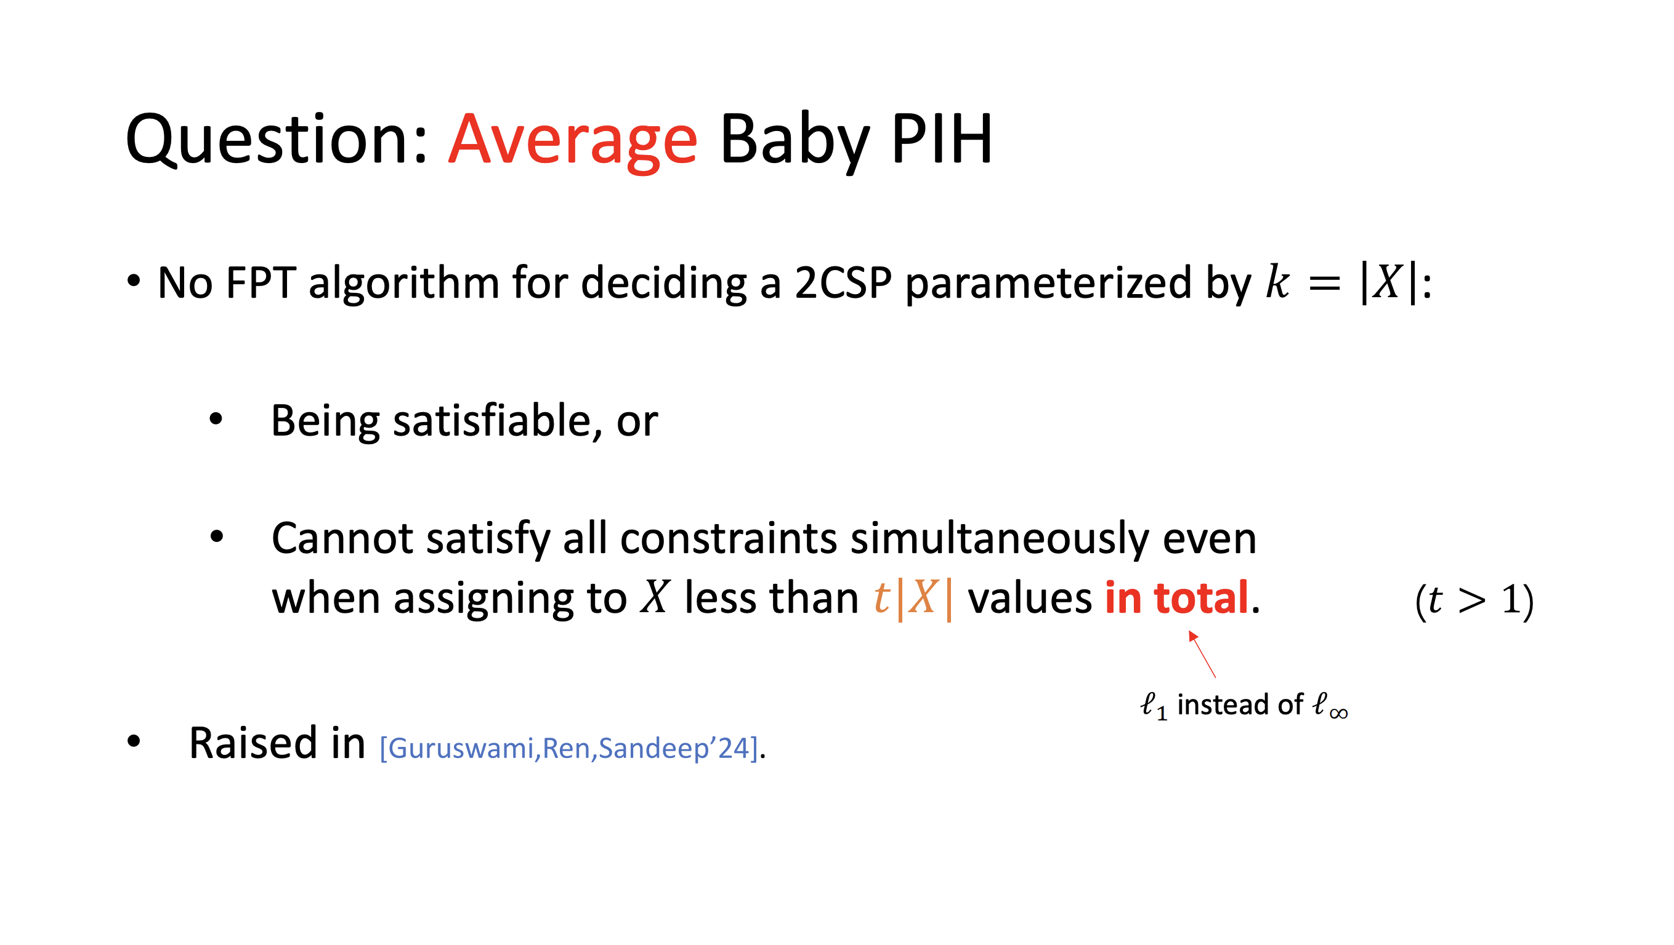

Slide 29
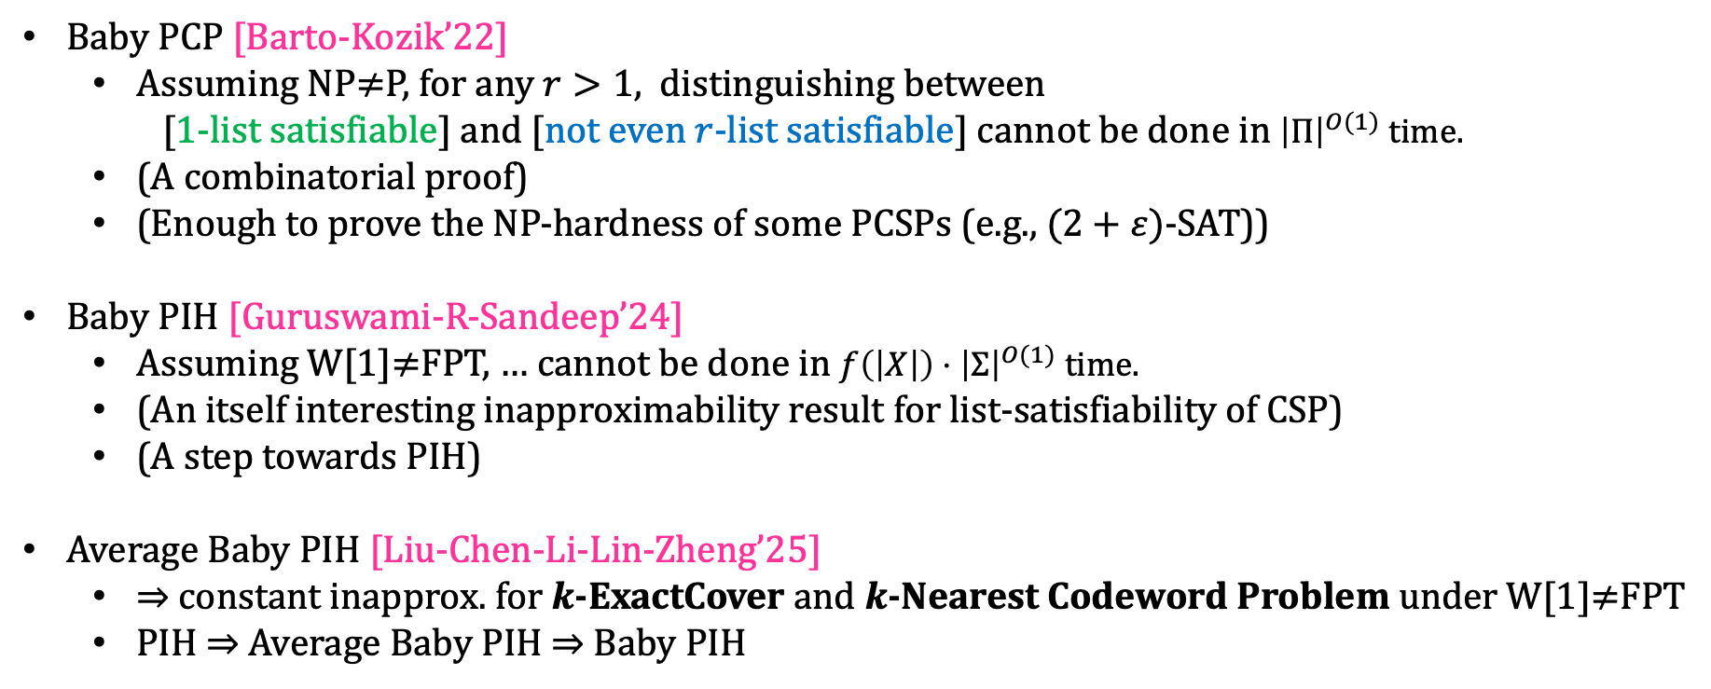
Baby PIH
Baby PCP [Barto-Kozik’22]
  Assuming NP$≠$P, for any $r>1,$ distinguishing between
    [1-list satisfiable] and [not even $r$-list satisfiable] cannot be done in ${\left|Π\right|}^{O(1)}$ time.
  (A combinatorial proof)
  (Enough to prove the NP-hardness of some PCSPs (e.g., $(2+ε)$-SAT))
Baby PIH [Guruswami-R-Sandeep’24]
  Assuming W[1]$≠$FPT, … cannot be done in $f\left(\left|X\right|\right)⋅{\left|Σ\right|}^{O(1)}$ time.
  (An itself interesting inapproximability result for list-satisfiability of CSP)
  (A step towards PIH)
Average Baby PIH [Liu-Chen-Li-Lin-Zheng’25]
  $⇒$ constant inapprox. for $k$-ExactCover and $k$-Nearest Codeword Problem under W[1]$≠$FPT
  PIH $⇒$ Average Baby PIH $⇒$ Baby PIH

Slide 30
Outline
Background
  Parameterized Complexity
  Constraint Satisfaction Problem (CSP)
  Parameterized Inapproximability Hypothesis (PIH)
From Baby PIH to Average Baby PIH
Proof Overview
  Baby PIH
  Average Baby PIH

Slide 31
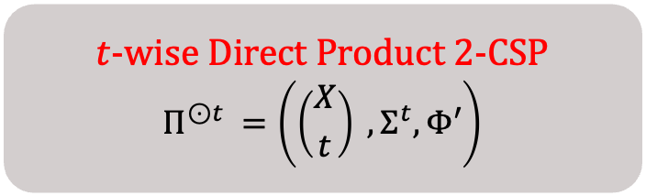
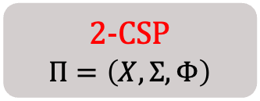
Proof Overview – Baby PIH
Follows from and extends [Barto-Kozik’22]’s proof of Baby PCP Theorem
Direct Product Construction
$t$-wise Direct Product 2-CSP
$$Π^{⊙t }=\left(\left({X \atop t}\right) ,Σ^{t},Φ′\right)$$
2-CSP
$$Π=\left(X,Σ,Φ\right)$$
partial satisfying assignments
for the set of variables

Slide 32
Proof Overview – Baby PIH
Follows from and extends [Barto-Kozik’22]’s proof of Baby PCP Theorem
Direct Product Construction
$t$-wise Direct Product 2-CSP
$$Π^{⊙t }=\left(\left({X \atop t}\right) ,Σ^{t},Φ′\right)$$
2-CSP
$$Π=\left(X,Σ,Φ\right)$$
consistency checks

Slide 33
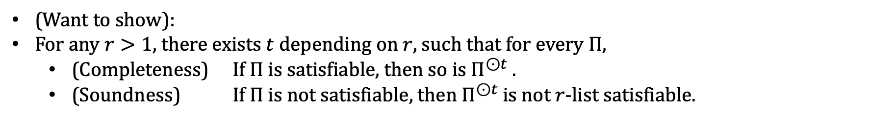
Proof Overview – Baby PIH
Follows from and extends [Barto-Kozik’22]’s proof of Baby PCP Theorem
Direct Product Construction
$t$-wise Direct Product 2-CSP
$$Π^{⊙t }=\left(\left({X \atop t}\right) ,Σ^{t},Φ′\right)$$
2-CSP
$$Π=\left(X,Σ,Φ\right)$$
partial satisfying assignments
for the set of variables
consistency checks
(Want to show):
For any $r>1$, there exists $t$ depending on $r$, such that for every $Π$,
  (Completeness) If $Π$ is satisfiable, then so is $Π^{⊙t }$.
  (Soundness) If $Π$ is not satisfiable, then $Π^{⊙t }$is not $r$-list satisfiable.

Slide 34
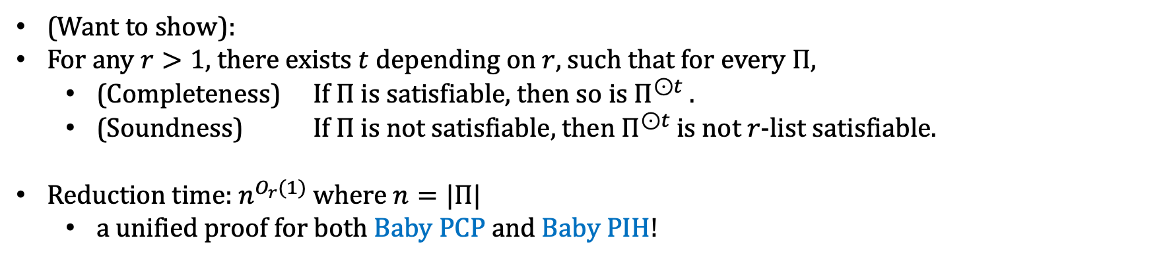
Proof Overview – Baby PIH
Follows from and extends [Barto-Kozik’22]’s proof of Baby PCP Theorem
Direct Product Construction
$t$-wise Direct Product 2-CSP
$$Π^{⊙t }=\left(\left({X \atop t}\right) ,Σ^{t},Φ′\right)$$
2-CSP
$$Π=\left(X,Σ,Φ\right)$$
partial satisfying assignments
for the set of variables
consistency checks
(Want to show):
For any $r>1$, there exists $t$ depending on $r$, such that for every $Π$,
  (Completeness) If $Π$ is satisfiable, then so is $Π^{⊙t }$.
  (Soundness) If $Π$ is not satisfiable, then $Π^{⊙t }$is not $r$-list satisfiable.
Reduction time: $n^{O_{r}(1)}$ where $n=|Π|$
  a unified proof for both Baby PCP and Baby PIH!

Slide 35
















Proof Overview – Baby PIH
$$(1,3,1,2)$$
$$(1,1,1,2)$$
$$(3,3,2,1)$$
$$↦$$
$$(x_{1},x_{3},x_{4},x_{10})$$
$$(x_{1},x_{2},x_{5},x_{7})$$
$$↦$$
$$(2,1,2,3)$$
$$(2,2,3,1)$$
$$(3,1,2,2)$$
$$(1,1,3,2)$$
and so on …
$$(x_{1},x_{2},x_{4},x_{9})$$
$$↦$$
$$(2,2,3,3)$$
$$(1,1,3,1)$$
A 3-list satisfying assignment for $Π^{⊙4}$

Slide 36




Proof Overview – Baby PIH
$$(1,3,1,2)$$
$$(1,1,1,2)$$
$$(3,3,2,1)$$
$$↦$$
$$(x_{1},x_{3},x_{4},x_{10})$$
$$(x_{1},x_{2},x_{5},x_{7})$$
$$↦$$
$$(2,1,2,3)$$
$$(2,2,3,1)$$
$$(3,1,2,2)$$
$$(1,1,3,2)$$
and so on …
$$(x_{1},x_{2},x_{4},x_{9})$$
$$↦$$
$$(2,2,3,3)$$
$$(1,1,3,1)$$
A 3-list satisfying assignment for $Π^{⊙4}$

Slide 37




Proof Overview – Baby PIH
$$(1,3,1,2)$$
$$(1,1,1,2)$$
$$(3,3,2,1)$$
$$↦$$
$$(x_{1},x_{3},x_{4},x_{10})$$
$$(x_{1},x_{2},x_{5},x_{7})$$
$$↦$$
$$(2,1,2,3)$$
$$(2,2,3,1)$$
$$(3,1,2,2)$$
$$(1,1,3,2)$$
and so on …
$$(x_{1},x_{2},x_{4},x_{9})$$
$$↦$$
$$(2,2,3,3)$$
$$(1,1,3,1)$$
A 3-list satisfying assignment for $Π^{⊙4}$

Slide 38




Proof Overview – Baby PIH
$$(1,3,1,2)$$
$$(1,1,1,2)$$
$$(3,3,2,1)$$
$$↦$$
$$(x_{1},x_{3},x_{4},x_{10})$$
$$(x_{1},x_{2},x_{5},x_{7})$$
$$↦$$
$$(2,1,2,3)$$
$$(2,2,3,1)$$
$$(3,1,2,2)$$
$$(1,1,3,2)$$
and so on …
$$(x_{1},x_{2},x_{4},x_{9})$$
$$↦$$
$$(2,2,3,3)$$
$$(1,1,3,1)$$
A 3-list satisfying assignment for $Π^{⊙4}$

Slide 39
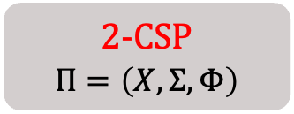
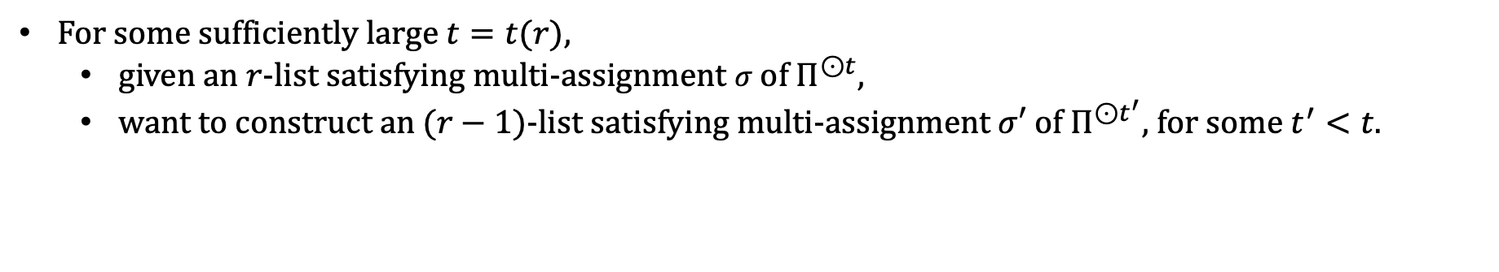
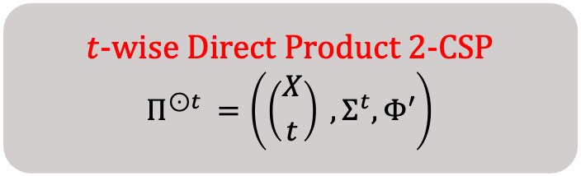
Proof Overview – Baby PIH
$t$-wise Direct Product 2-CSP
$$Π^{⊙t }=\left(\left({X \atop t}\right) ,Σ^{t},Φ′\right)$$
2-CSP
$$Π=\left(X,Σ,Φ\right)$$
For some sufficiently large $t=t(r)$,
  given an $r$-list satisfying multi-assignment $σ$ of $Π^{⊙t}$,
  want to construct an $(r−1)$-list satisfying multi-assignment $σ′$ of $Π^{⊙t^{′}}$, for some $t^{′}<t$.

Slide 40
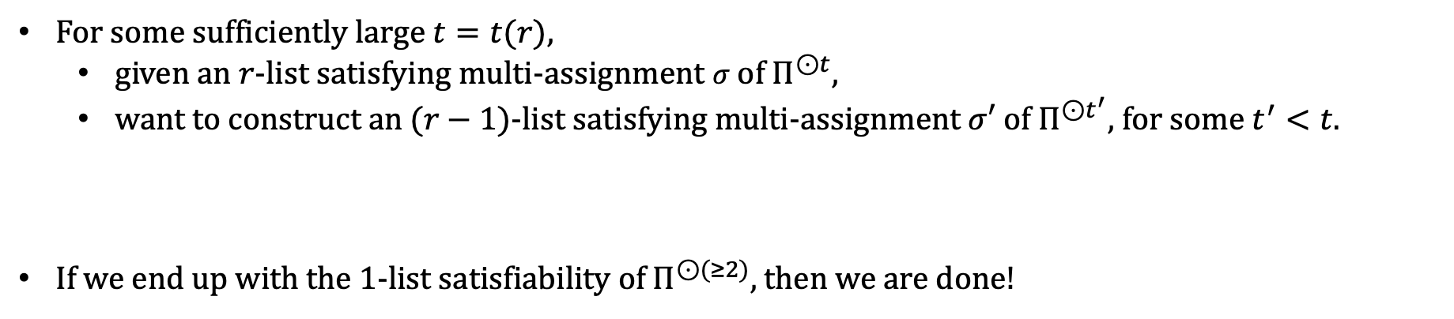
Proof Overview – Baby PIH
$t$-wise Direct Product 2-CSP
$$Π^{⊙t }=\left(\left({X \atop t}\right) ,Σ^{t},Φ′\right)$$
2-CSP
$$Π=\left(X,Σ,Φ\right)$$
For some sufficiently large $t=t(r)$,
  given an $r$-list satisfying multi-assignment $σ$ of $Π^{⊙t}$,
  want to construct an $(r−1)$-list satisfying multi-assignment $σ′$ of $Π^{⊙t^{′}}$, for some $t^{′}<t$.
If we end up with the 1-list satisfiability of $Π^{⊙(≥2)}$, then we are done!

Slide 41
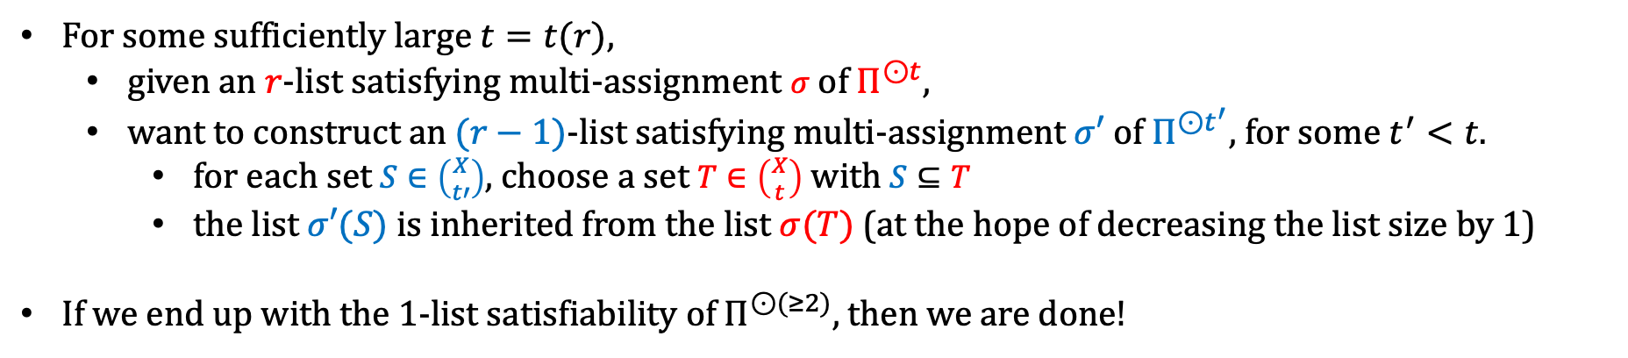
Proof Overview – Baby PIH
$t$-wise Direct Product 2-CSP
$$Π^{⊙t }=\left(\left({X \atop t}\right) ,Σ^{t},Φ′\right)$$
2-CSP
$$Π=\left(X,Σ,Φ\right)$$
For some sufficiently large $t=t(r)$,
  given an $r$-list satisfying multi-assignment $σ$ of $Π^{⊙t}$,
  want to construct an $(r−1)$-list satisfying multi-assignment $σ′$ of $Π^{⊙t^{′}}$, for some $t^{′}<t$.
    for each set $S∈\left({X \atop t′}\right)$, choose a set $T∈\left({X \atop t}\right)$ with $S⊆T$
    the list $σ′(S)$ is inherited from the list $σ(T)$ (at the hope of decreasing the list size by 1)
If we end up with the 1-list satisfiability of $Π^{⊙(≥2)}$, then we are done!

Slide 42
Outline
Background
  Parameterized Complexity
  Constraint Satisfaction Problem (CSP)
  Parameterized Inapproximability Hypothesis (PIH)
From Baby PIH to Average Baby PIH
Proof Overview
  Baby PIH
  Average Baby PIH

Slide 43
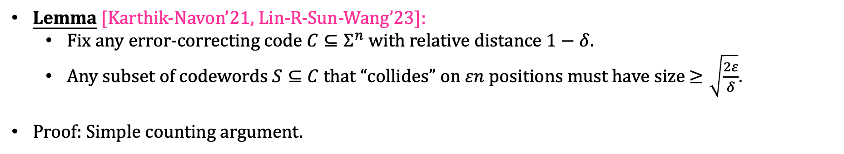
Proof Overview – Average Baby PIH
Lemma [Karthik-Navon’21, Lin-R-Sun-Wang’23]:
  Fix any error-correcting code $C⊆Σ^{n}$ with relative distance $1−δ$.
  Any subset of codewords $S⊆C$ that “collides” on $εn$ positions must have size $≥\sqrt{\frac{2ε}{δ}}$.
Proof: Simple counting argument.

Slide 44
Proof Overview – Average Baby PIH
Fix an error-correcting code $C:Σ→𝔽^{n}$.
Given a 2CSP instance $Π=\left(X,Σ,Φ\right)$ that is either satisfiable or not (2r)-list satisfiable,

Slide 45
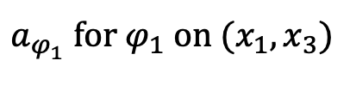







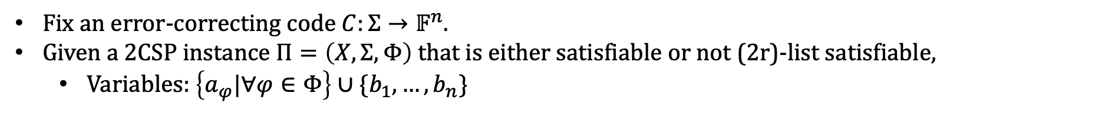











Proof Overview – Average Baby PIH
Fix an error-correcting code $C:Σ→𝔽^{n}$.
Given a 2CSP instance $Π=\left(X,Σ,Φ\right)$ that is either satisfiable or not (2r)-list satisfiable,
  Variables: $\left\{a_{φ}|∀φ∈Φ\right\}∪\{b_{1},…,b_{n}\}$
Alphabet:${ 𝔽}^{2n}$
$$b_{1}$$
$$b_{2}$$
$$b_{3}$$
$$b_{4}$$
$$b_{5}$$
$$b_{6}$$
$$b_{7}$$
$$b_{8}$$
$$b_{9}$$
$$b_{10}$$
$$x_{1}$$
$$C(σ\left(x_{1}\right))$$
$a_{φ_{1}}$ for $φ_{1}$ on $(x_{1},x_{3})$
$$x_{2}$$
$$x_{3}$$
$$C(σ\left(x_{3}\right))$$
$$x_{4}$$
$$x_{5}$$

Slide 46

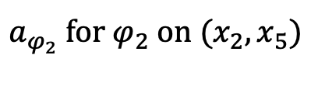

Proof Overview – Average Baby PIH
Fix an error-correcting code $C:Σ→𝔽^{n}$.
Given a 2CSP instance $Π=\left(X,Σ,Φ\right)$ that is either satisfiable or not (2r)-list satisfiable,
  Variables: $\left\{a_{φ}|∀φ∈Φ\right\}∪\{b_{1},…,b_{n}\}$
Alphabet:${ 𝔽}^{2n}$
$$b_{1}$$
$$b_{2}$$
$$b_{3}$$
$$b_{4}$$
$$b_{5}$$
$$b_{6}$$
$$b_{7}$$
$$b_{8}$$
$$b_{9}$$
$$b_{10}$$
$$x_{1}$$
$$x_{2}$$
$$C(σ\left(x_{2}\right))$$
$a_{φ_{2}}$ for $φ_{2}$ on $(x_{2},x_{5})$
$$x_{3}$$
$$x_{4}$$
$$x_{5}$$
$$C(σ\left(x_{5}\right))$$

Slide 47


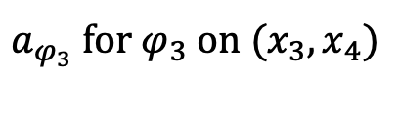
Proof Overview – Average Baby PIH
Fix an error-correcting code $C:Σ→𝔽^{n}$.
Given a 2CSP instance $Π=\left(X,Σ,Φ\right)$ that is either satisfiable or not (2r)-list satisfiable,
  Variables: $\left\{a_{φ}|∀φ∈Φ\right\}∪\{b_{1},…,b_{n}\}$
Alphabet:${ 𝔽}^{2n}$
$$b_{1}$$
$$b_{2}$$
$$b_{3}$$
$$b_{4}$$
$$b_{5}$$
$$b_{6}$$
$$b_{7}$$
$$b_{8}$$
$$b_{9}$$
$$b_{10}$$
$$x_{1}$$
$$x_{2}$$
$$x_{3}$$
$$C(σ\left(x_{3}\right))$$
$a_{φ_{3}}$ for $φ_{3}$ on $(x_{3},x_{4})$
$$x_{4}$$
$$C(σ\left(x_{4}\right))$$
$$x_{5}$$

Slide 48

Proof Overview – Average Baby PIH
Fix an error-correcting code $C:Σ→𝔽^{n}$.
Given a 2CSP instance $Π=\left(X,Σ,Φ\right)$ that is either satisfiable or not (2r)-list satisfiable,
  Variables: $\left\{a_{φ}|∀φ∈Φ\right\}∪\{b_{1},…,b_{n}\}$
Alphabet:${ 𝔽}^{k}$
$$b_{1}$$
$$b_{2}$$
$$b_{3}$$
$$b_{4}$$
$$b_{5}$$
$$b_{6}$$
$$b_{7}$$
$$b_{8}$$
$$b_{9}$$
$$b_{10}$$
$$x_{1}$$
$$x_{2}$$
$$x_{3}$$
$$x_{4}$$
$$x_{5}$$

Slide 49
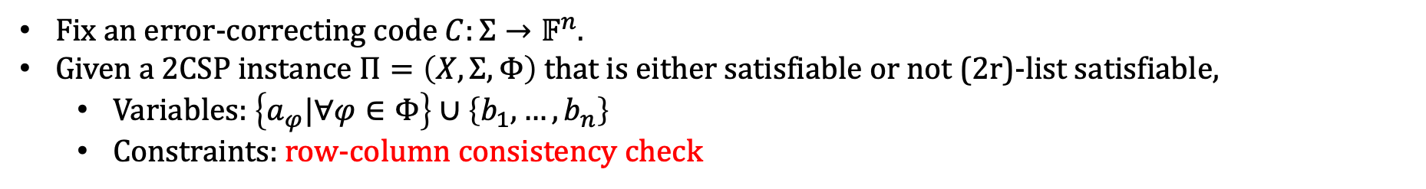
Proof Overview – Average Baby PIH
Fix an error-correcting code $C:Σ→𝔽^{n}$.
Given a 2CSP instance $Π=\left(X,Σ,Φ\right)$ that is either satisfiable or not (2r)-list satisfiable,
  Variables: $\left\{a_{φ}|∀φ∈Φ\right\}∪\left\{b_{1},…,b_{n}\right\}$
  Constraints: row-column consistency check
$$b_{1}$$
$$b_{2}$$
$$b_{3}$$
$$b_{4}$$
$$b_{5}$$
$$b_{6}$$
$$b_{7}$$
$$b_{8}$$
$$b_{9}$$
$$b_{10}$$
$$x_{1}$$
$$x_{2}$$
$$x_{3}$$
$$C(σ\left(x_{3}\right))$$
$a_{φ_{3}}$ for $φ_{3}$ on $(x_{3},x_{4})$
$$x_{4}$$
$$C(σ\left(x_{4}\right))$$
$$x_{5}$$

Slide 50
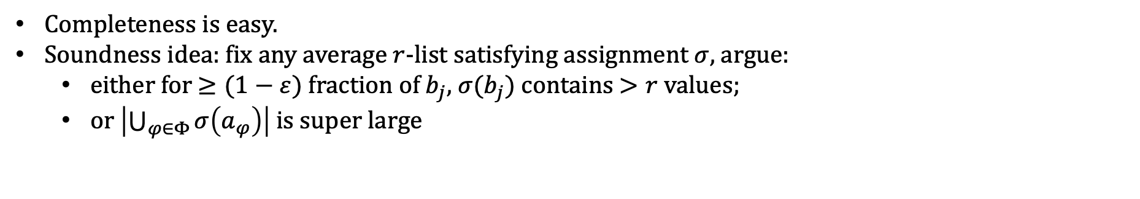
Proof Overview – Average Baby PIH
Completeness is easy.
Soundness idea: fix any average $r$-list satisfying assignment $σ$, argue:
  either for $≥(1−ε)$ fraction of $b_{j}$, $σ(b_{j})$ contains $>r$ values;
  or $\left|\bigcup_{φ∈Φ}{σ\left(a_{φ}\right)}\right|$ is super large
$$b_{1}$$
$$b_{2}$$
$$b_{3}$$
$$b_{4}$$
$$b_{5}$$
$$b_{6}$$
$$b_{7}$$
$$b_{8}$$
$$b_{9}$$
$$b_{10}$$
$$x_{1}$$
$$x_{2}$$
$$x_{3}$$
$$C(σ\left(x_{3}\right))$$
$a_{φ_{3}}$ for $φ_{3}$ on $(x_{3},x_{4})$
$$x_{4}$$
$$C(σ\left(x_{4}\right))$$
$$x_{5}$$

Slide 51
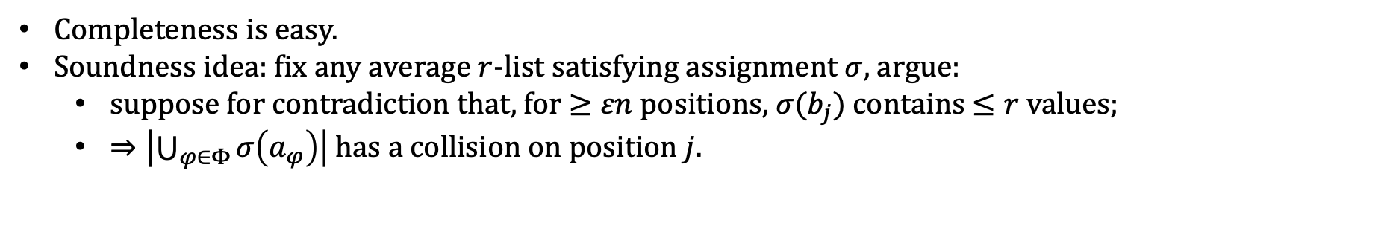
Proof Overview – Average Baby PIH
Completeness is easy.
Soundness idea: fix any average $r$-list satisfying assignment $σ$, argue:
  suppose for contradiction that, for $≥εn$ positions, $σ(b_{j})$ contains $≤r$ values;
  $⇒\left|\bigcup_{φ∈Φ}{σ\left(a_{φ}\right)}\right|$ has a collision on position $j.$
$$b_{1}$$
$$b_{2}$$
$$b_{3}$$
$$b_{4}$$
$$b_{5}$$
$$b_{6}$$
$$b_{7}$$
$$b_{8}$$
$$b_{9}$$
$$b_{10}$$
$$x_{1}$$
$$x_{2}$$
$$x_{3}$$
$$C(σ\left(x_{3}\right))$$
$a_{φ_{3}}$ for $φ_{3}$ on $(x_{3},x_{4})$
$$x_{4}$$
$$C(σ\left(x_{4}\right))$$
$$x_{5}$$

Slide 52

Takeaway
Parameterized Inapproximability Hypothesis – parameterized analog of PCP
Baby PIH – inapproximability of the list-satisfiability of (parameterized) 2CSP
  W[1]-hard to distinguish between [1-list satisfiable] and [not even $r$-list satisfiable]
  Proof Idea: induction on the list size

Slide 53
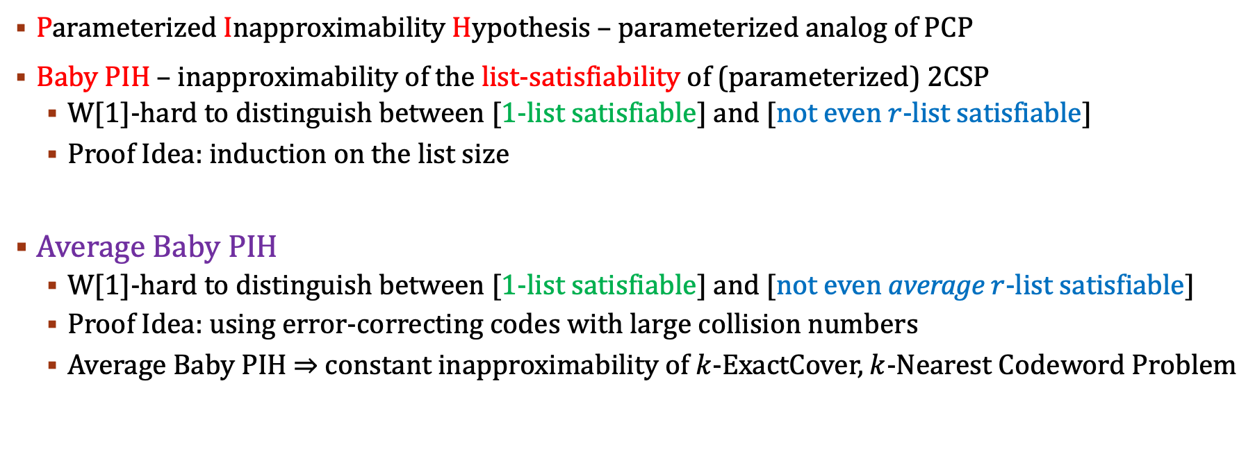
Takeaway
Parameterized Inapproximability Hypothesis – parameterized analog of PCP
Baby PIH – inapproximability of the list-satisfiability of (parameterized) 2CSP
  W[1]-hard to distinguish between [1-list satisfiable] and [not even $r$-list satisfiable]
  Proof Idea: induction on the list size
Average Baby PIH
  W[1]-hard to distinguish between [1-list satisfiable] and [not even average $r$-list satisfiable]
  Proof Idea: using error-correcting codes with large collision numbers
  Average Baby PIH $⇒$ constant inapproximability of $k$-ExactCover, $k$-Nearest Codeword Problem

Slide 54
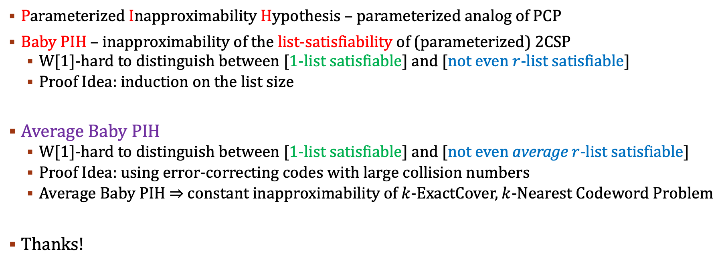
Takeaway
Parameterized Inapproximability Hypothesis – parameterized analog of PCP
Baby PIH – inapproximability of the list-satisfiability of (parameterized) 2CSP
  W[1]-hard to distinguish between [1-list satisfiable] and [not even $r$-list satisfiable]
  Proof Idea: induction on the list size
Average Baby PIH
  W[1]-hard to distinguish between [1-list satisfiable] and [not even average $r$-list satisfiable]
  Proof Idea: using error-correcting codes with large collision numbers
  Average Baby PIH $⇒$ constant inapproximability of $k$-ExactCover, $k$-Nearest Codeword Problem
Thanks!

