Slide 1
PCP-free Inapproximability of Nearest Codeword and Minimum Distance
Xuandi Ren
UC Berkeley
Based on a joint work with
Vijay Bhattiprolu, Venkat Guruswami, and Euiwoong Lee

Slide 2
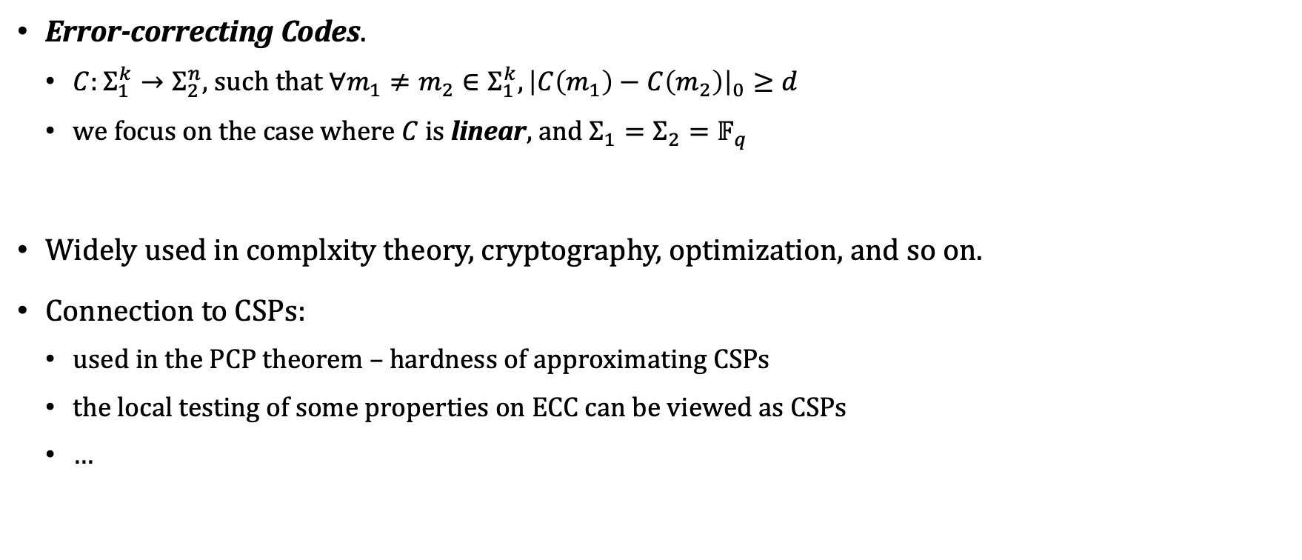
Error-correcting Codes
Error-correcting Codes.
  $C:Σ_{1}^{k}→Σ_{2}^{n}$, such that $∀m_{1}≠m_{2}∈Σ_{1}^{k}, {\left|C\left(m_{1}\right)−C\left(m_{2}\right)\right|}_{0}≥d$
  we focus on the case where $C$ is linear, and $Σ_{1}=Σ_{2}=𝔽_{q}$
Widely used in complxity theory, cryptography, optimization, and so on.
Connection to CSPs:
  used in the PCP theorem – hardness of approximating CSPs
  the local testing of some properties on ECC can be viewed as CSPs
  …

Slide 3

Problems
Nearest Codeword Problem
  Input: a linear code $C⊆𝔽_{q}^{n},$and a vector $b∈𝔽_{q}^{n}$.
  Output: the minimum distance from $b$ to any codeword in $C$, i.e., $\min_{c∈C}{|{\left.​b−c\right|}_{0}}$.

Slide 4

Problems
Nearest Codeword Problem (An Equivalent View)
  Input: an affine subspace $V⊆𝔽_{q}^{n}$.
  Output: the minimum Hamming weight of a vector $x∈V.$

Slide 5

Problems
Nearest Codeword Problem (An Equivalent View)
  Input: an affine subspace $V⊆𝔽_{q}^{n}$.
  Output: the minimum Hamming weight of a vector $x∈V.$
Minimum Distance Problem
  Input: a linear code (a.k.a. subspace) $C⊆𝔽_{q}^{n}$.
  Output: the minimum Hamming weight of a non-zero codeword in $C$.

Slide 6
Hardness of NCP and MDP
NP-hardness of NCP:
  reducing from ExactCover.
NP-hardness of MDP:
  [Vardy’97], using as a gadget a Reed-Solomon code concatenated with Hadamard code.
NP-hardness of approximating NCP:
  still from ExactCover, a corollary of PCP theorem
NP-hardness of approximating MDP:
    [Dumer-Micciancio-Sudan’03], a randomized reduction, using locally dense code as a gadget
    derandomized by [Cheng-Wan’12, Austrin-Khot’14, Micciancio’14]

Slide 7
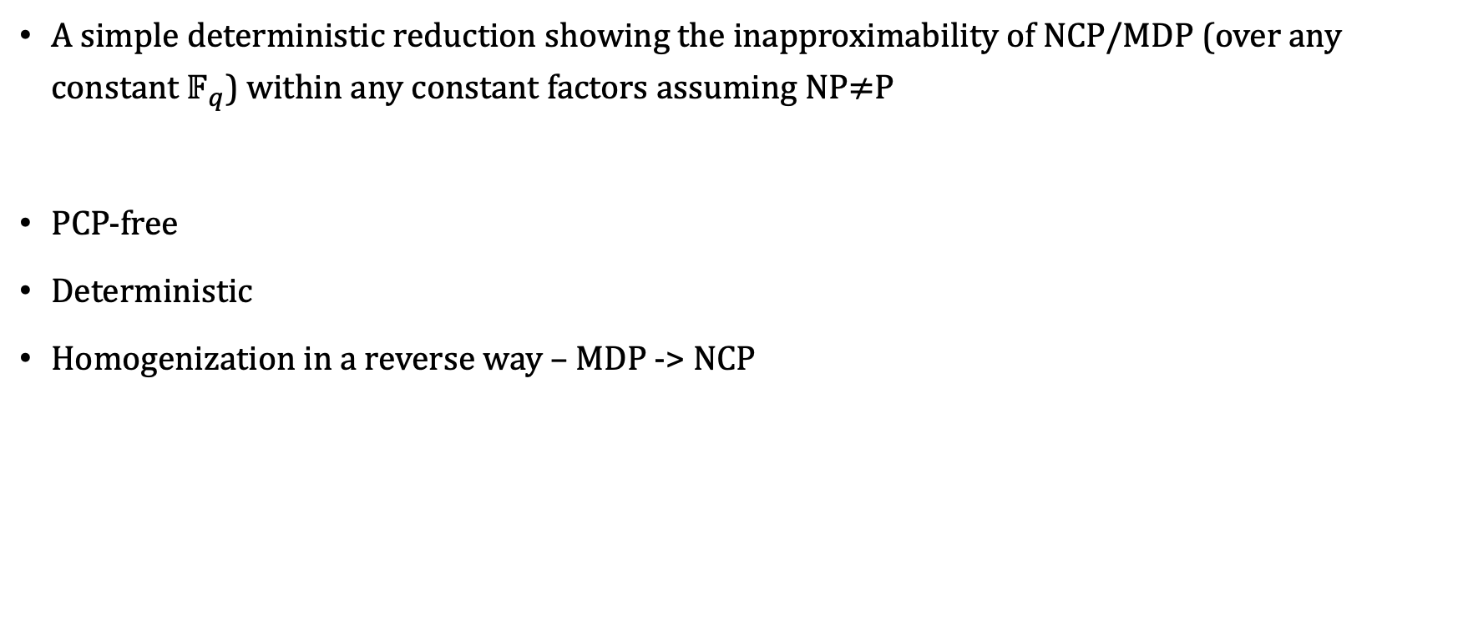
Our Results
A simple deterministic reduction showing the inapproximability of NCP/MDP (over any constant $𝔽_{q}$) within any constant factors assuming NP$≠$P
PCP-free
Deterministic
Homogenization in a reverse way – MDP -> NCP

Slide 8
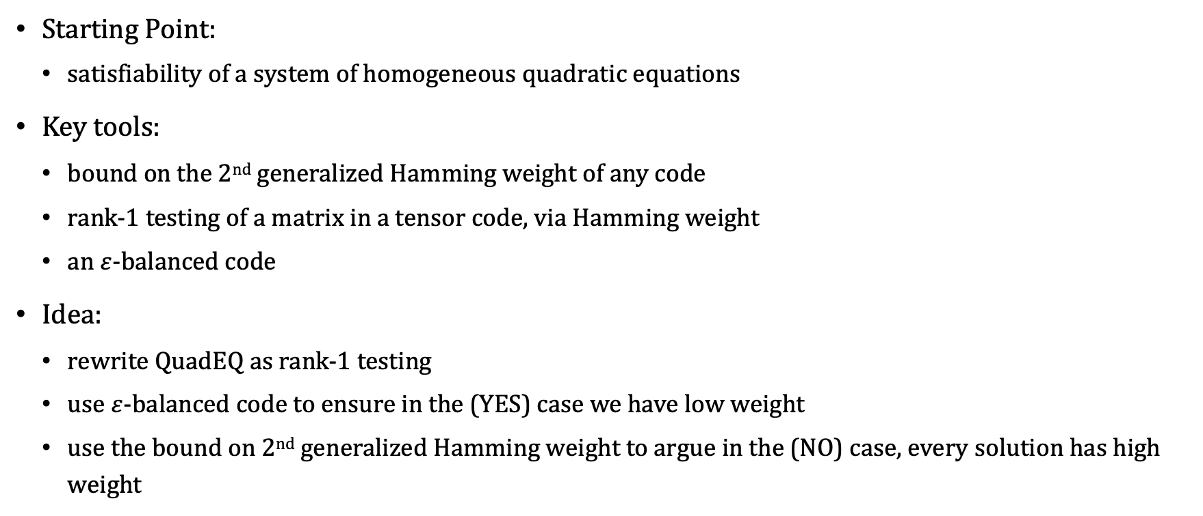
Proof Overview
Starting Point:
  satisfiability of a system of homogeneous quadratic equations
Key tools:
  bound on the 2nd generalized Hamming weight of any code
  rank-1 testing of a matrix in a tensor code, via Hamming weight
  an $ε$-balanced code
Idea:
  rewrite QuadEQ as rank-1 testing
  use $ε$-balanced code to ensure in the (YES) case we have low weight
  use the bound on 2nd generalized Hamming weight to argue in the (NO) case, every solution has high weight

Slide 9

2nd Generalized Hamming Weight
For any linear code $C⊆𝔽_{q}^{n}$ with distance $d(C)$, the 2nd generalized Hamming weight, written as $d_{2}(C)$, is defined as the minimum of
$\left|supp\left(u\right)∪supp\left(v\right)\right|,$
for any linearly independent codewords $u,v∈C$.

Slide 10
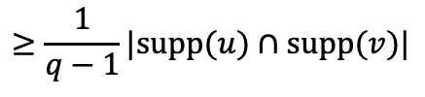






2nd Generalized Hamming Weight
For any linear code $C⊆𝔽_{q}^{n}$ with distance $d(C)$, the 2nd generalized Hamming weight, written as $d_{2}(C)$, is defined as the minimum of
$\left|supp\left(u\right)∪supp\left(v\right)\right|,$
for any linearly independent codewords $u,v∈C$.
Fact: $d_{2}(C)≥\left(1+\frac{1}{q}\right)d(C)$.
Proof:
  Since $C$ is a linear code, $∀λ∈𝔽_{q}$, $u+λv$ also belongs to $C$
  The sparsest vector $u+λv$ among all choices of $λ$ has weight $≤$
  ${\left|u\right|}_{0}+{\left|v\right|}_{0}−\left(1+\frac{1}{q−1}\right)\left|supp\left(u\right)∩supp\left(v\right)\right|$
  by pigeonhole, but this should be $≥d(C)$
  Rearranging gives desired bound
$$supp(u)$$
$$u$$
$$supp(v)$$
$$v$$
$$u+λv$$
$$≥\frac{1}{q−1}|supp(u)∩supp(v)|$$

Slide 11



Rank-1 Testing via Hamming Weights
For any linear code $C⊆𝔽_{q}^{n}$ with distance $d(C)$, consider the tensor code $C⨂C$, we have:
  (1) Some rank-1 matrix $M∈C⨂C$ achieves ${\left|M\right|}_{0}={d(C)}^{2}$.
  (2) Every rank-($≥$2) matrix $M∈C⨂C$ has ${\left|M\right|}_{0}≥\left(1+\frac{1}{q}\right){d(C)}^{2}$.
Proof of (2):
  Any matrix $M$ of rank $≥2$ has two linearly independent rows $r_{1},r_{2}$
$$r_{1}$$
$$r_{2}$$

Slide 12


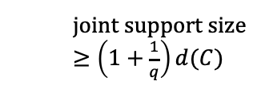

Rank-1 Testing via Hamming Weights
For any linear code $C⊆𝔽_{q}^{n}$ with distance $d(C)$, consider the tensor code $C⨂C$, we have:
  (1) Some rank-1 matrix $M∈C⨂C$ achieves ${\left|M\right|}_{0}={d(C)}^{2}$.
  (2) Every rank-($≥$2) matrix $M∈C⨂C$ has ${\left|M\right|}_{0}≥\left(1+\frac{1}{q}\right){d(C)}^{2}$.
Proof of (2):
  Any matrix $M$ of rank $≥2$ has two linearly independent rows $r_{1},r_{2}$
  By the bound on 2nd generalized Hamming weight, $r_{1},r_{2}$ have joint support size $≥\left(1+\frac{1}{q}\right)d(C)$
$$r_{1}$$
  joint support size $≥\left(1+\frac{1}{q}\right)d(C)$
$$r_{2}$$

Slide 13
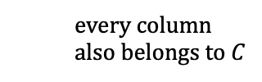

Rank-1 Testing via Hamming Weights
For any linear code $C⊆𝔽_{q}^{n}$ with distance $d(C)$, consider the tensor code $C⨂C$, we have:
  (1) Some rank-1 matrix $M∈C⨂C$ achieves ${\left|M\right|}_{0}={d(C)}^{2}$.
  (2) Every rank-($≥$2) matrix $M∈C⨂C$ has ${\left|M\right|}_{0}≥\left(1+\frac{1}{q}\right){d(C)}^{2}$.
Proof of (2):
  Any matrix $M$ of rank $≥2$ has two linearly independent rows $r_{1},r_{2}$
  By the bound on 2nd generalized Hamming weight, $r_{1},r_{2}$ have joint support size $≥\left(1+\frac{1}{q}\right)d(C)$
  For each column $c$ in their joint support, $c$ has weight $≥d\left(C\right)$ since $M∈C⨂C$
  every column also belongs to $C$

Slide 14
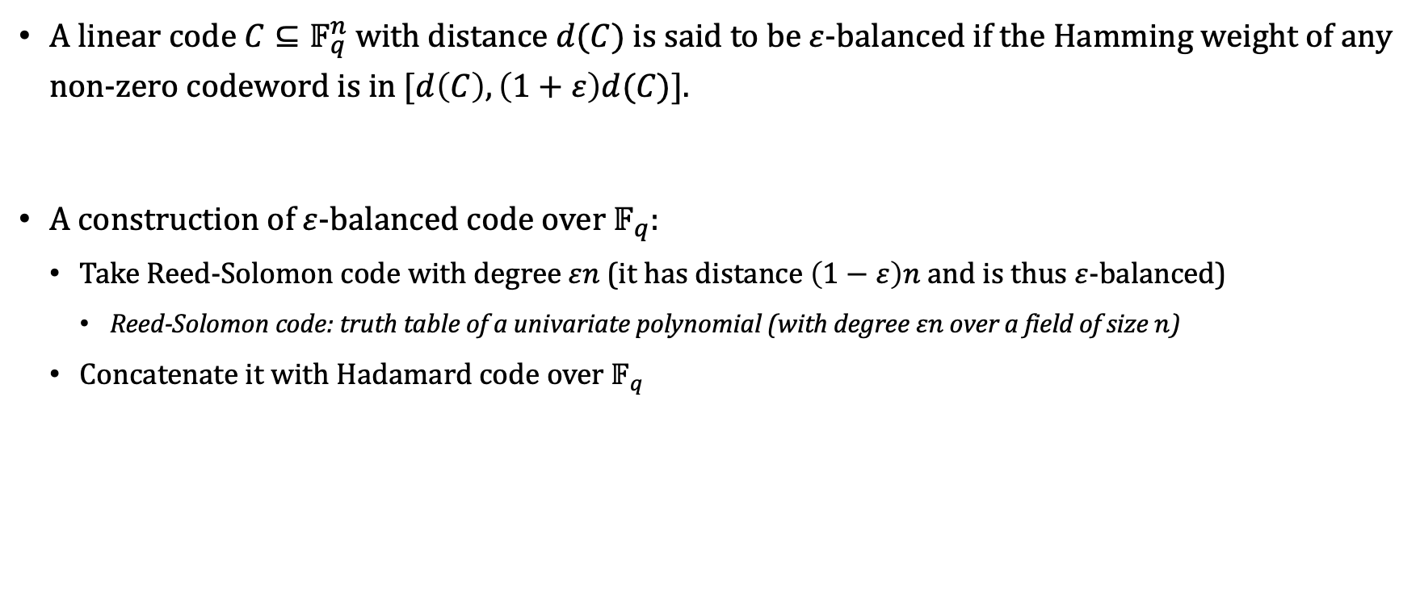

$ε$-Balanced Codes
A linear code $C⊆𝔽_{q}^{n}$ with distance $d(C)$ is said to be $ε$-balanced if the Hamming weight of any non-zero codeword is in $[d\left(C\right),\left(1+ε\right)d(C)]$.
A construction of $ε$-balanced code over $𝔽_{q}$:
  Take Reed-Solomon code with degree $εn$ (it has distance $\left(1−ε\right)n$ and is thus $ε$-balanced)
    Reed-Solomon code: truth table of a univariate polynomial (with degree $εn$ over a field of size $n$)
  Concatenate it with Hadamard code over $𝔽_{q}$

Slide 15

NP-hardness of QuadEQ
(Non-homogeneous) QuadEQ:
  Input: a system of $m$ quadratic equations on $n$ variables $\{x_{1},…,x_{n}\}$ over $𝔽_{q}$:
  ${\left\{\sum_{i,j∈\left[n\right]}{A_{i,j}^{\left(t\right)}x_{i}x_{j}}=b^{(t)}\right\}}_{t∈[m]}$
  Output: whether there is a solution $\{x_{1},…,x_{n}\}$
NP-hardness:
  Reduce from Circuit Satisfiability
  Add an equation $x_{i}\left(x_{i}−1\right)=0$ for each variable to ensure it takes Boolean value
  Add an equation constraining each gate’s computation (e.g. for an AND gate $y_{k}=y_{i}∧y_{j}$, add an equation $x_{k}^{2}=x_{i}x_{j}$)

Slide 16
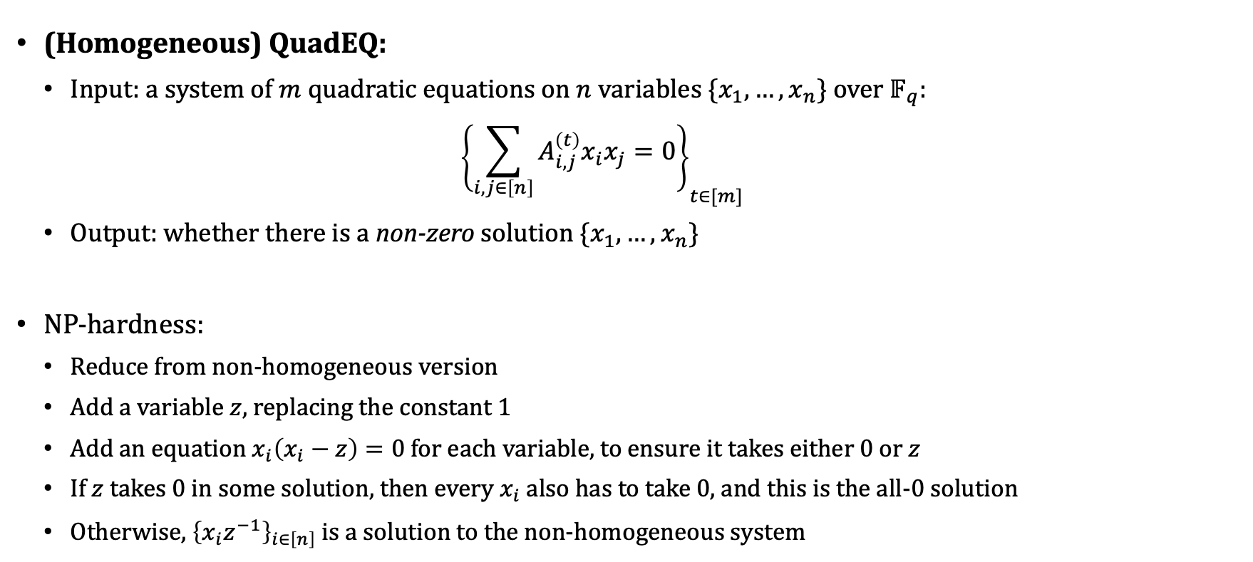
NP-hardness of QuadEQ
(Homogeneous) QuadEQ:
  Input: a system of $m$ quadratic equations on $n$ variables $\{x_{1},…,x_{n}\}$ over $𝔽_{q}$:
  ${\left\{\sum_{i,j∈\left[n\right]}{A_{i,j}^{\left(t\right)}x_{i}x_{j}}=0\right\}}_{t∈[m]}$
  Output: whether there is a non-zero solution $\{x_{1},…,x_{n}\}$
NP-hardness:
  Reduce from non-homogeneous version
  Add a variable $z$, replacing the constant 1
  Add an equation $x_{i}\left(x_{i}−z\right)=0$ for each variable, to ensure it takes either $0$ or $z$
  If $z$ takes 0 in some solution, then every $x_{i}$ also has to take 0, and this is the all-0 solution
  Otherwise, ${\left\{x_{i}z^{−1}\right\}}_{i∈\left[n\right]}$ is a solution to the non-homogeneous system

Slide 17
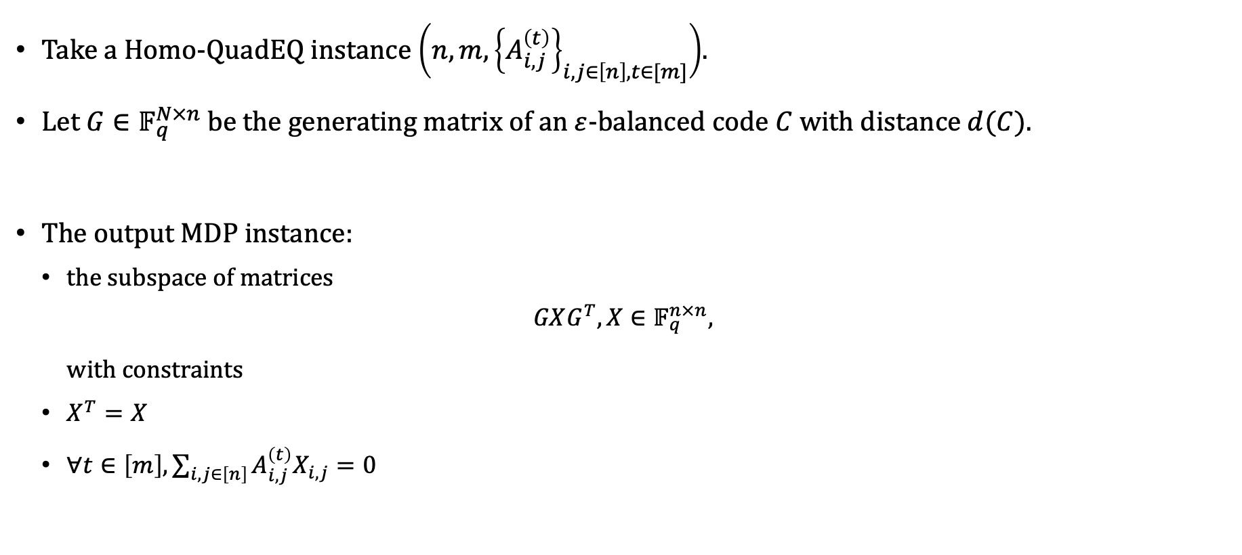
Reducing Homo-QuadEQ to gap MDP
Take a Homo-QuadEQ instance $\left(n,m,{\left\{A_{i,j}^{\left(t\right)}\right\}}_{i,j∈\left[n\right],t∈[m]}\right)$.
Let $G∈𝔽_{q}^{N×n}$ be the generating matrix of an $ε$-balanced code $C$with distance $d(C)$.
The output MDP instance:
  the subspace of matrices
$$GXG^{T}, X∈𝔽_{q}^{n×n},$$
with constraints
  $X^{T}=X$
  $∀t∈\left[m\right], \sum_{i,j∈\left[n\right]}{A_{i,j}^{\left(t\right)}X_{i,j}}=0$

Slide 18
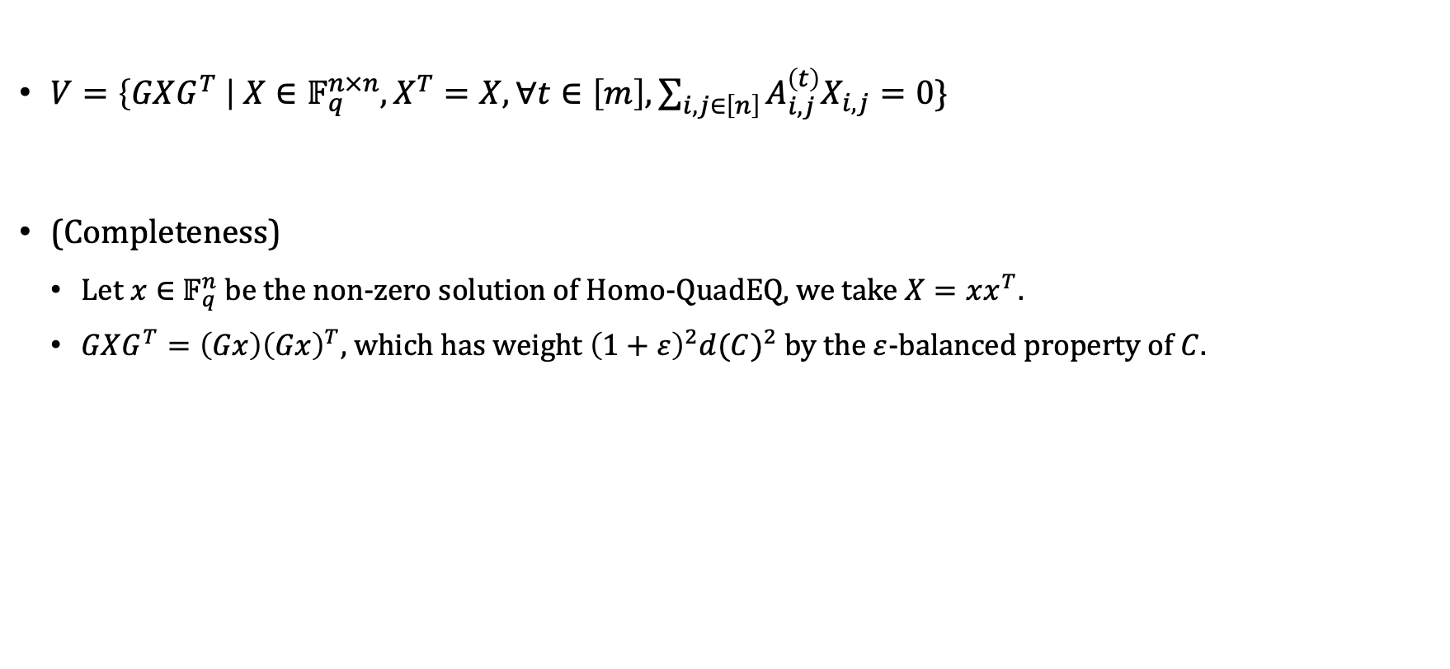
Reducing Homo-QuadEQ to gap MDP
$V=\left\{GXG^{T} \right| X∈𝔽_{q}^{n×n},X^{T}=X,∀t∈\left[m\right], \sum_{i,j∈\left[n\right]}{A_{i,j}^{\left(t\right)}X_{i,j}}=0\}$
(Completeness)
  Let $x∈$ $𝔽_{q}^{n}$ be the non-zero solution of Homo-QuadEQ, we take $X=xx^{T}.$
  $GXG^{T}=\left(Gx\right){\left(Gx\right)}^{T}$, which has weight ${\left(1+ε\right)}^{2}{d(C)}^{2}$ by the $ε$-balanced property of $C$.

Slide 19
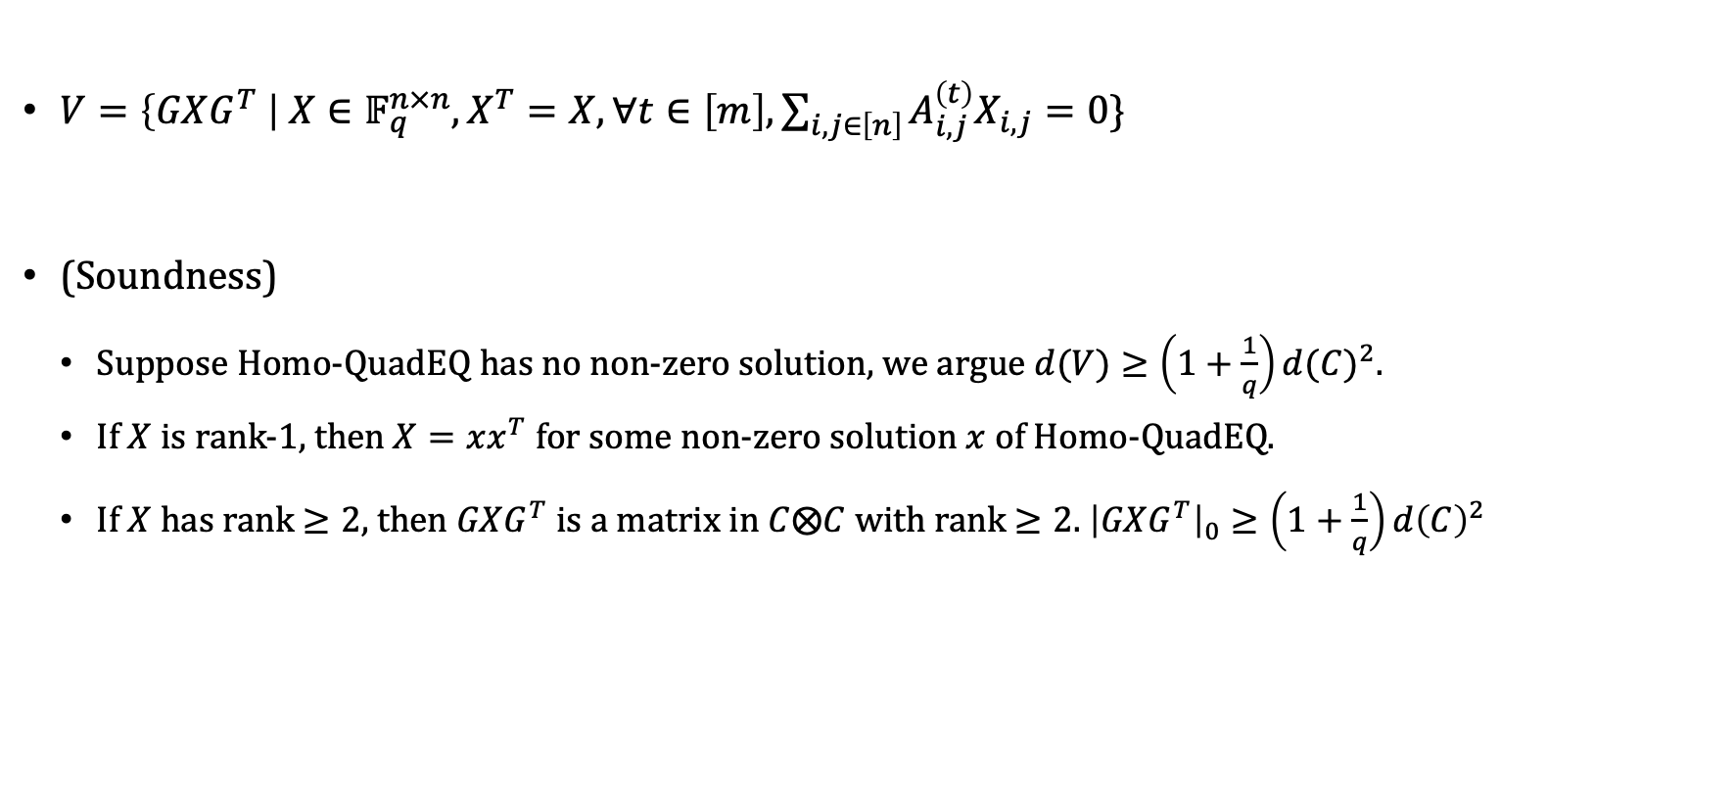
Reducing Homo-QuadEQ to gap MDP
$V=\left\{GXG^{T} \right| X∈𝔽_{q}^{n×n},X^{T}=X,∀t∈\left[m\right], \sum_{i,j∈\left[n\right]}{A_{i,j}^{\left(t\right)}X_{i,j}}=0\}$
(Soundness)
  Suppose Homo-QuadEQ has no non-zero solution, we argue $d(V)≥\left(1+\frac{1}{q}\right){d(C)}^{2}$.
  If $X$ is rank-1, then $X=xx^{T}$ for some non-zero solution $x$ of Homo-QuadEQ.
  If $X$ has rank $≥2$, then $GXG^{T}$ is a matrix in $C⨂C$ with rank $≥2$. ${\left|GXG^{T}\right|}_{0}≥\left(1+\frac{1}{q}\right)d{\left(C\right)}^{2}$

Slide 20
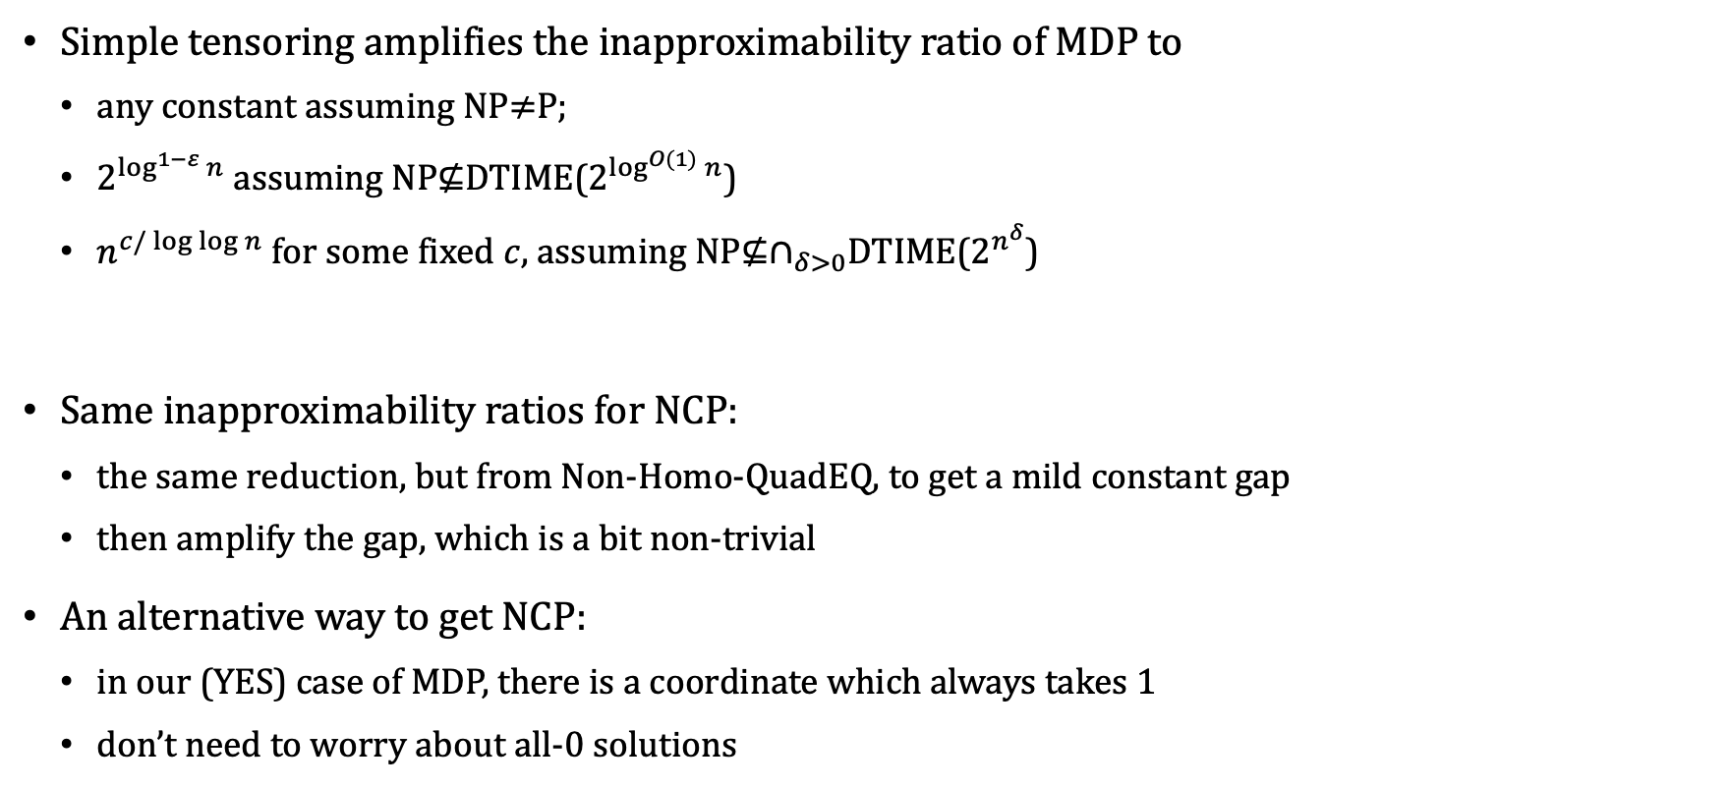
Corollaries
Simple tensoring amplifies the inapproximability ratio of MDP to
  any constant assuming NP$≠$P;
  $2^{\log^{1−ε}{n}}$ assuming NP$⊈$DTIME($2^{\log^{O(1)}{n}}$)
  $n^{c/\log{\log{n}}}$ for some fixed $c,$ assuming NP$⊈∩_{δ>0}$DTIME($2^{n^{δ}}$)
Same inapproximability ratios for NCP:
  the same reduction, but from Non-Homo-QuadEQ, to get a mild constant gap
  then amplify the gap, which is a bit non-trivial
An alternative way to get NCP:
  in our (YES) case of MDP, there is a coordinate which always takes 1
  don’t need to worry about all-0 solutions
Thanks!

