Slide 1


Baby PIH: Parameterized Inapproximability of Min CSP
Venkatesan Guruswami
UC Berkeley
Xuandi Ren
UC Berkeley
Sai Sandeep
UC Berkeley

Slide 2
Outline
Background
Parameterized Complexity
Constraint Satisfaction Problem (CSP)
Parameterized Inapproximability Hypothesis (PIH)
Our Result
Baby PIH
Proof Overview

Slide 3
Outline
Background
Parameterized Complexity
Constraint Satisfaction Problem (CSP)
Parameterized Inapproximability Hypothesis (PIH)
Our Result
Baby PIH
Proof Overview

Slide 4
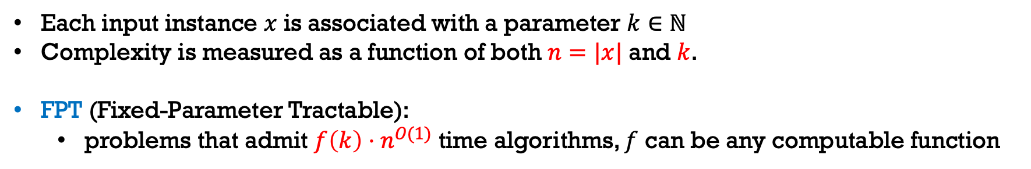
Parameterized Complexity
Each input instance $x$ is associated with a parameter $k∈ℕ$
Complexity is measured as a function of both $n=|x|$ and $k$.
FPT (Fixed-Parameter Tractable):
problems that admit $f\left(k\right)⋅n^{O(1)}$ time algorithms, $f$ can be any computable function

Slide 5
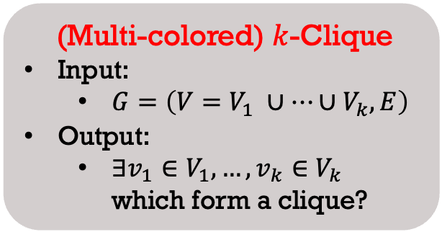
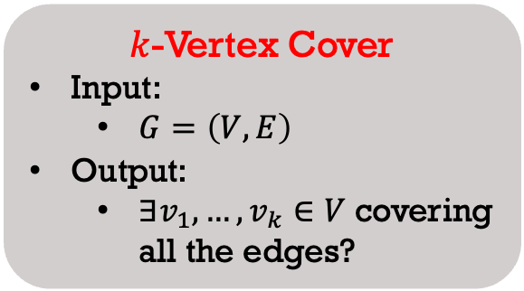
Parameterized Complexity
Each input instance $x$ is associated with a parameter $k∈ℕ$
Complexity is measured as a function of both $n=|x|$ and $k$.
FPT (Fixed-Parameter Tractable):
problems that admit $f\left(k\right)⋅n^{O(1)}$ time algorithms, $f$ can be any computable function
$k$-Vertex Cover
Input:
$G=\left(V,E\right)$
Output:
$∃v_{1},…, v_{k}∈V$ covering all the edges?
(Multi-colored) $k$-Clique
Input:
$G=\left(V=V_{1} ∪…∪V_{k},E\right)$
Output:
$∃v_{1}∈V_{1},…, v_{k}∈V_{k}$ which form a clique?

Slide 6

Parameterized Complexity
Each input instance $x$ is associated with a parameter $k∈ℕ$
Complexity is measured as a function of both $n=|x|$ and $k$.
FPT (Fixed-Parameter Tractable):
problems that admit $f\left(k\right)⋅n^{O(1)}$ time algorithms, $f$ can be any computable function
$k$-Vertex Cover
Input:
$G=\left(V,E\right)$
Output:
$∃v_{1},…, v_{k}∈V$ covering all the edges?
(Multi-colored) $k$-Clique
Input:
$G=\left(V=V_{1} ∪…∪V_{k},E\right)$
Output:
$∃v_{1}∈V_{1},…, v_{k}∈V_{k}$ which form a clique?
FPT
$$⊆$$
W[1]

Slide 7
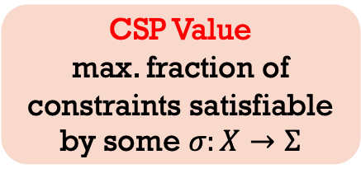
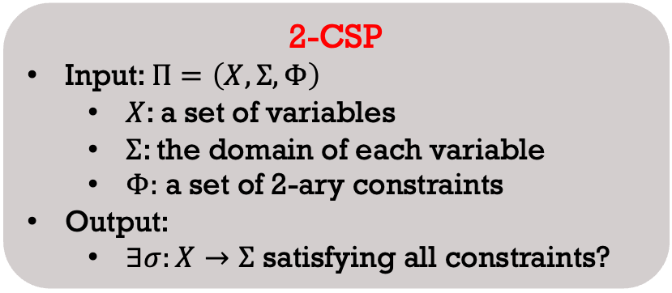
Constraint Satisfaction Problem
2-CSP
Input: $Π=\left(X,Σ,Φ\right)$
$X$: a set of variables
$Σ$: the domain of each variable
$Φ:$ a set of 2-ary constraints
Output:
$∃σ:X→Σ$ satisfying all constraints?
CSP Value
max. fraction of constraints satisfiable by some $σ:X→Σ$

Slide 8
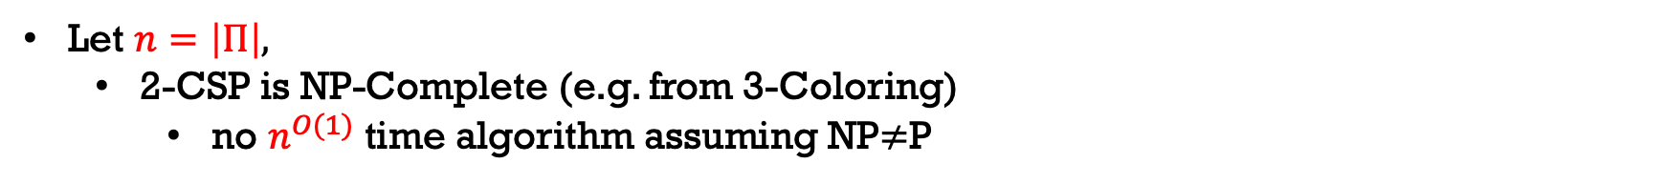
Constraint Satisfaction Problem
2-CSP
Input: $Π=\left(X,Σ,Φ\right)$
$X$: a set of variables
$Σ$: the domain of each variable
$Φ:$ a set of 2-ary constraints
Output:
$∃σ:X→Σ$ satisfying all constraints?
CSP Value
max. fraction of constraints satisfiable by some $σ:X→Σ$
Let $n=\left|Π\right|,$
2-CSP is NP-Complete (e.g. from 3-Coloring)
no $n^{O(1)}$ time algorithm assuming NP$≠$P

Slide 9
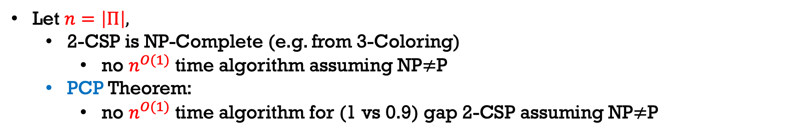
Constraint Satisfaction Problem
2-CSP
Input: $Π=\left(X,Σ,Φ\right)$
$X$: a set of variables
$Σ$: the domain of each variable
$Φ:$ a set of 2-ary constraints
Output:
$∃σ:X→Σ$ satisfying all constraints?
CSP Value
max. fraction of constraints satisfiable by some $σ:X→Σ$
Let $n=\left|Π\right|,$
2-CSP is NP-Complete (e.g. from 3-Coloring)
no $n^{O(1)}$ time algorithm assuming NP$≠$P
PCP Theorem:
no $n^{O(1)}$ time algorithm for (1 vs 0.9) gap 2-CSP assuming NP$≠$P

Slide 10
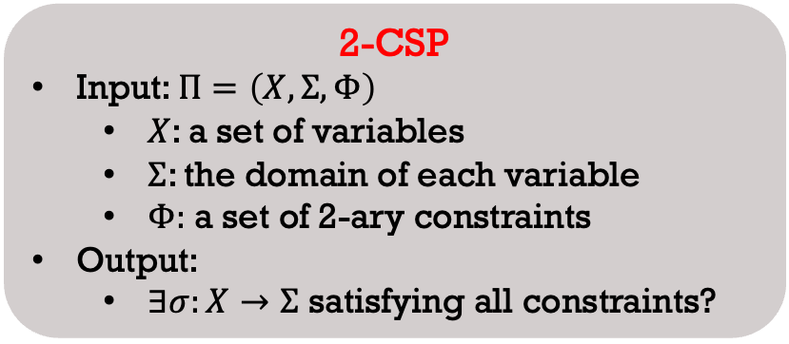
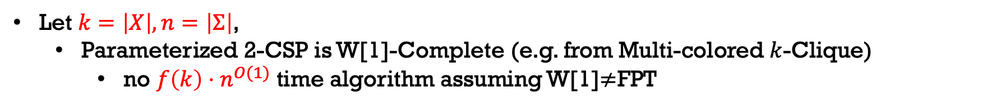
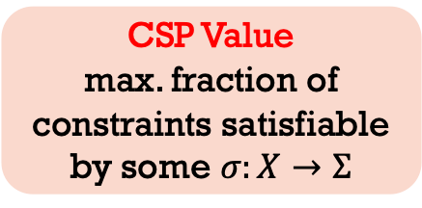
Parameterized 2-CSP
2-CSP
Input: $Π=\left(X,Σ,Φ\right)$
$X$: a set of variables
$Σ$: the domain of each variable
$Φ:$ a set of 2-ary constraints
Output:
$∃σ:X→Σ$ satisfying all constraints?
CSP Value
max. fraction of constraints satisfiable by some $σ:X→Σ$
Let $k=\left|X\right|,n=\left|Σ\right|$,
Parameterized 2-CSP is W[1]-Complete (e.g. from Multi-colored $k$-Clique)
no $f\left(k\right)⋅n^{O(1)}$ time algorithm assuming W[1]$≠$FPT

Slide 11
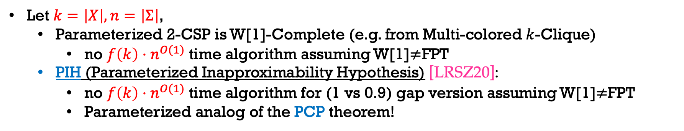
Parameterized 2-CSP
2-CSP
Input: $Π=\left(X,Σ,Φ\right)$
$X$: a set of variables
$Σ$: the domain of each variable
$Φ:$ a set of 2-ary constraints
Output:
$∃σ:X→Σ$ satisfying all constraints?
CSP Value
max. fraction of constraints satisfiable by some $σ:X→Σ$
Let $k=\left|X\right|,n=\left|Σ\right|$,
Parameterized 2-CSP is W[1]-Complete (e.g. from Multi-colored $k$-Clique)
no $f\left(k\right)⋅n^{O(1)}$ time algorithm assuming W[1]$≠$FPT
PIH (Parameterized Inapproximability Hypothesis) [LRSZ20]:
no $f\left(k\right)⋅n^{O(1)}$ time algorithm for (1 vs 0.9) gap version assuming W[1]$≠$FPT
Parameterized analog of the PCP theorem!

Slide 12




Parameterized Inapproximability Hypothesis
Error-Correcting Codes [Lin21, KK22, LRSW23b]
W[1]$≠$FPT
Distributed PCP Framework [KLM19]
Sidon Sets [CFLL23]
Threshold Graphs [Lin19, KL21, LRSW23a]
(Gap) $k$-Clique
(Unknown)
(Gap) $k$-SetCover
(Gap) $k$-ExactCover
and so on …

Slide 13

Parameterized Inapproximability Hypothesis
W[1]$≠$FPT
PIH
(Gap) Parameterized 2CSP
(Gap) $k$-Clique
Canonical Reductions
(Gap) $k$-SetCover
(Gap) $k$-ExactCover
and so on …

Slide 14

Parameterized Inapproximability Hypothesis
Gap-ETH
ETH
W[1]$≠$FPT
[DM18, CFM17]
(Unknown)
PIH
(Gap) Parameterized 2CSP

Slide 15
Outline
Background
Parameterized Complexity
Constraint Satisfaction Problem (CSP)
Parameterized Inapproximability Hypothesis (PIH)
Our Result
Baby PIH
Proof Overview

Slide 16
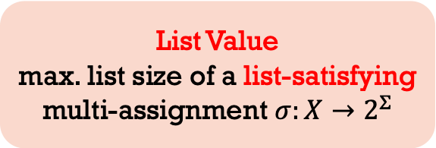
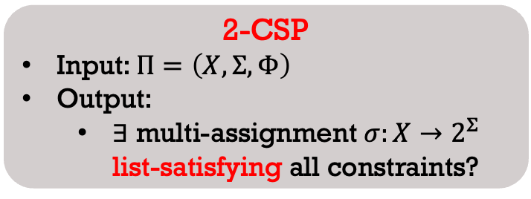
List Satisfiability of CSP
2-CSP
Input: $Π=\left(X,Σ,Φ\right)$
Output:
$∃$ multi-assignment $σ:X→2^{Σ}$ list-satisfying all constraints?
List Value
max. list size of a list-satisfying multi-assignment $σ:X→2^{Σ}$
A constraint on $(x,y)$ is list-satisfied iff $∃u∈σ\left(x\right), v∈σ(y)$, s.t. $(u,v)$ satisfies this constraint.

Slide 17







List Satisfiability of CSP
2-CSP
Input: $Π=\left(X,Σ,Φ\right)$
Output:
$∃$ multi-assignment $σ:X→2^{Σ}$ list-satisfying all constraints?
List Value
max. list size of a list-satisfying multi-assignment $σ:X→2^{Σ}$
A constraint on $(x,y)$ is list-satisfied iff $∃u∈σ\left(x\right), v∈σ(y)$, s.t. $(u,v)$ satisfies this constraint.
$$Σ=\{0,1,2,3\}$$
$$x_{2}$$
$$σ\left(x_{1}\right)=σ(x_{2})$$
$$σ\left(x_{2}\right)+σ\left(x_{3}\right)=2$$
$$x_{1}$$
$$x_{3}$$
$$σ\left(x_{1}\right)+σ\left(x_{3}\right)=3$$

Slide 18
List Satisfiability of CSP
2-CSP
Input: $Π=\left(X,Σ,Φ\right)$
Output:
$∃$ multi-assignment $σ:X→2^{Σ}$ list-satisfying all constraints?
List Value
max. list size of a list-satisfying multi-assignment $σ:X→2^{Σ}$
A constraint on $(x,y)$ is list-satisfied iff $∃u∈σ\left(x\right), v∈σ(y)$, s.t. $(u,v)$ satisfies this constraint.
$$Σ=\{0,1,2,3\}$$
$$x_{2}$$
[1]
$$σ\left(x_{1}\right)=σ(x_{2})$$
$$σ\left(x_{2}\right)+σ\left(x_{3}\right)=2$$
$$x_{1}$$
$$x_{3}$$
[1]
[1,2]
$$σ\left(x_{1}\right)+σ\left(x_{3}\right)=3$$

Slide 19

List Satisfiability of CSP
2-CSP
Input: $Π=\left(X,Σ,Φ\right)$
Output:
$∃$ multi-assignment $σ:X→2^{Σ}$ list-satisfying all constraints?
List Value
max. list size of a list-satisfying multi-assignment $σ:X→2^{Σ}$
A constraint on $(x,y)$ is list-satisfied iff $∃u∈σ\left(x\right), v∈σ(y)$, s.t. $(u,v)$ satisfies this constraint.
$$Σ=\{0,1,2,3\}$$
$$x_{2}$$
[1]
$$σ\left(x_{1}\right)=σ(x_{2})$$
$$σ\left(x_{2}\right)+σ\left(x_{3}\right)=2$$
$$x_{1}$$
$$x_{3}$$
[1]
[1,2]
$$σ\left(x_{1}\right)+σ\left(x_{3}\right)=3$$

Slide 20

List Satisfiability of CSP
2-CSP
Input: $Π=\left(X,Σ,Φ\right)$
Output:
$∃$ multi-assignment $σ:X→2^{Σ}$ list-satisfying all constraints?
List Value
max. list size of a list-satisfying multi-assignment $σ:X→2^{Σ}$
A constraint on $(x,y)$ is list-satisfied iff $∃u∈σ\left(x\right), v∈σ(y)$, s.t. $(u,v)$ satisfies this constraint.
$$Σ=\{0,1,2,3\}$$
$$x_{2}$$
[1]
$$σ\left(x_{1}\right)=σ(x_{2})$$
$$σ\left(x_{2}\right)+σ\left(x_{3}\right)=2$$
$$x_{1}$$
$$x_{3}$$
[1]
[1,2]
$$σ\left(x_{1}\right)+σ\left(x_{3}\right)=3$$

Slide 21

List Satisfiability of CSP
2-CSP
Input: $Π=\left(X,Σ,Φ\right)$
Output:
$∃$ multi-assignment $σ:X→2^{Σ}$ list-satisfying all constraints?
List Value
max. list size of a list-satisfying multi-assignment $σ:X→2^{Σ}$
A constraint on $(x,y)$ is list-satisfied iff $∃u∈σ\left(x\right), v∈σ(y)$, s.t. $(u,v)$ satisfies this constraint.
$$Σ=\{0,1,2,3\}$$
$$x_{2}$$
[1]
$$σ\left(x_{1}\right)=σ(x_{2})$$
$$σ\left(x_{2}\right)+σ\left(x_{3}\right)=2$$
$$x_{1}$$
$$x_{3}$$
[1]
[1,2]
$$σ\left(x_{1}\right)+σ\left(x_{3}\right)=3$$

Slide 22
List Satisfiability of CSP
2-CSP
Input: $Π=\left(X,Σ,Φ\right)$
Output:
$∃$ multi-assignment $σ:X→2^{Σ}$ list-satisfying all constraints?
List Value
max. list size of a list-satisfying multi-assignment $σ:X→2^{Σ}$
We say a 2-CSP is $r$-list satisfiable iff $∃σ$ with $\max_{x∈X}\left|σ\left(x\right)\right|≤r$ list-satisfying all constraints.

Slide 23
List Satisfiability of CSP
2-CSP
Input: $Π=\left(X,Σ,Φ\right)$
Output:
$∃$ multi-assignment $σ:X→2^{Σ}$ list-satisfying all constraints?
List Value
max. list size of a list-satisfying multi-assignment $σ:X→2^{Σ}$
We say a 2-CSP is $r$-list satisfiable iff $∃σ$ with $\max_{x∈X}\left|σ\left(x\right)\right|≤r$ list-satisfying all constraints.
CSP Value=1 $⇔$ 1-list satisfiable $⇒$ $r$-list satisfiable for $r≥2$
$r$-list satisfiable $⇒$ CSP Value $≥1/r^{2}$

Slide 24
Baby PCP
2-CSP
Input: $Π=\left(X,Σ,Φ\right)$
Output:
$∃$ multi-assignment $σ:X→2^{Σ}$ list-satisfying all constraints?
List Value
max. list size of a list-satisfying multi-assignment $σ:X→2^{Σ}$
We say a 2-CSP is $r$-list satisfiable iff $∃σ$ with $\max_{x∈X}\left|σ\left(x\right)\right|≤r$ list-satisfying all constraints.
CSP Value=1 $⇔$ 1-list satisfiable $⇒$ $r$-list satisfiable for $r≥2$
$r$-list satisfiable $⇒$ CSP Value $≥1/r^{2}$
Baby PCP [Barto-Kozik’22]
For any $r>1,$It’s NP-hard to distinguish between [1-list satisfiable] and [not even $r$-list satisfiable].

Slide 25


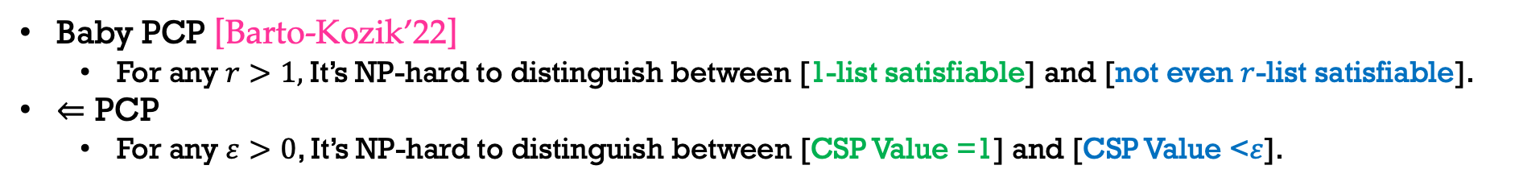

Baby PCP
2-CSP
Input: $Π=\left(X,Σ,Φ\right)$
Output:
$∃$ multi-assignment $σ:X→2^{Σ}$ list-satisfying all constraints?
List Value
max. list size of a list-satisfying multi-assignment $σ:X→2^{Σ}$
We say a 2-CSP is $r$-list satisfiable iff $∃σ$ with $\max_{x∈X}\left|σ\left(x\right)\right|≤r$ list-satisfying all constraints.
CSP Value=1 $⇔$ 1-list satisfiable $⇒$ $r$-list satisfiable for $r≥2$
$r$-list satisfiable $⇒$ CSP Value$≥1/r^{2}$
Baby PCP [Barto-Kozik’22]
For any $r>1,$It’s NP-hard to distinguish between [1-list satisfiable] and [not even $r$-list satisfiable].
$⇐$ PCP
For any $ε>0$, It’s NP-hard to distinguish between [CSP Value =1] and [CSP Value <$ε$].
$$⇐$$
$$⇐$$
(when $ε<1/r^{2}$)

Slide 26
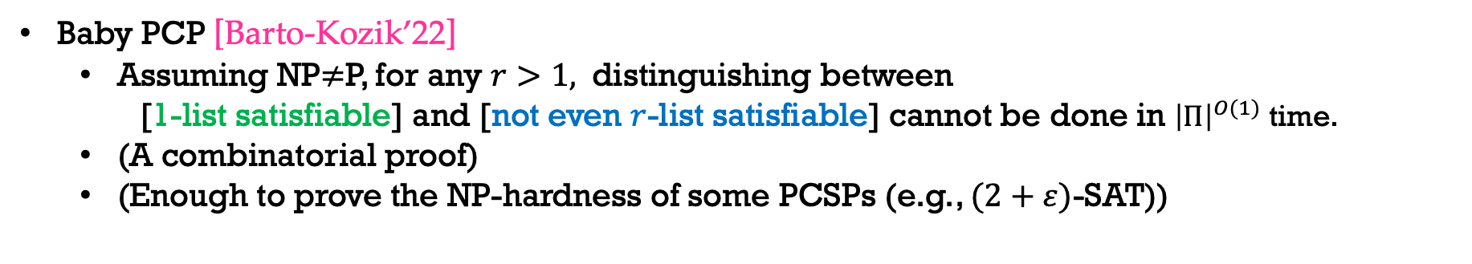
Baby PCP
Baby PCP [Barto-Kozik’22]
Assuming NP$≠$P, for any $r>1,$ distinguishing between
[1-list satisfiable] and [not even $r$-list satisfiable] cannot be done in ${\left|Π\right|}^{O(1)}$ time.
(A combinatorial proof)
(Enough to prove the NP-hardness of some PCSPs (e.g., $(2+ε)$-SAT))

Slide 27
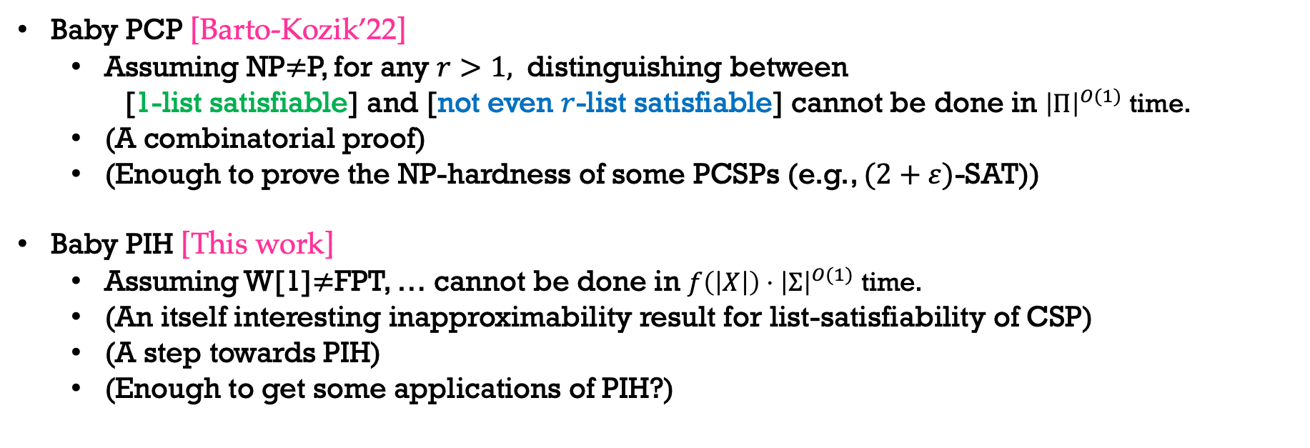
Baby PIH
Baby PCP [Barto-Kozik’22]
Assuming NP$≠$P, for any $r>1,$ distinguishing between
[1-list satisfiable] and [not even $r$-list satisfiable] cannot be done in ${\left|Π\right|}^{O(1)}$ time.
(A combinatorial proof)
(Enough to prove the NP-hardness of some PCSPs (e.g., $(2+ε)$-SAT))
Baby PIH [This work]
Assuming W[1]$≠$FPT, … cannot be done in $f\left(\left|X\right|\right)⋅{\left|Σ\right|}^{O(1)}$ time.
(An itself interesting inapproximability result for list-satisfiability of CSP)
(A step towards PIH)
(Enough to get some applications of PIH?)

Slide 28
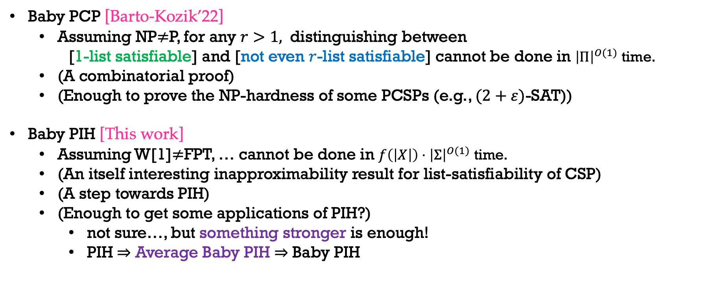
Baby PIH
Baby PCP [Barto-Kozik’22]
Assuming NP$≠$P, for any $r>1,$ distinguishing between
[1-list satisfiable] and [not even $r$-list satisfiable] cannot be done in ${\left|Π\right|}^{O(1)}$ time.
(A combinatorial proof)
(Enough to prove the NP-hardness of some PCSPs (e.g., $(2+ε)$-SAT))
Baby PIH [This work]
Assuming W[1]$≠$FPT, … cannot be done in $f\left(\left|X\right|\right)⋅{\left|Σ\right|}^{O(1)}$ time.
(An itself interesting inapproximability result for list-satisfiability of CSP)
(A step towards PIH)
(Enough to get some applications of PIH?)
not sure…, but something stronger is enough!
PIH $⇒$ Average Baby PIH $⇒$ Baby PIH

Slide 29
Outline
Background
Parameterized Complexity
Constraint Satisfaction Problem (CSP)
Parameterized Inapproximability Hypothesis (PIH)
Our Result
Baby PIH
Proof Overview

Slide 30
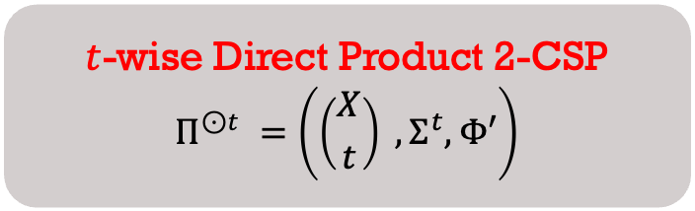
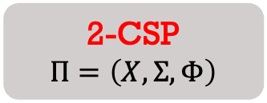
Proof Overview
Follows from and extends [Barto-Kozik’22]’s proof of Baby PCP Theorem
Direct Product Construction
$t$-wise Direct Product 2-CSP
$$Π^{⊙t }=\left(\left({X \atop t}\right) ,Σ^{t},Φ′\right)$$
2-CSP
$$Π=\left(X,Σ,Φ\right)$$
partial satisfying assignments
for the set of variables

Slide 31
Proof Overview
Follows from and extends [Barto-Kozik’22]’s proof of Baby PCP Theorem
Direct Product Construction
$t$-wise Direct Product 2-CSP
$$Π^{⊙t }=\left(\left({X \atop t}\right) ,Σ^{t},Φ′\right)$$
2-CSP
$$Π=\left(X,Σ,Φ\right)$$
consistency checks

Slide 32
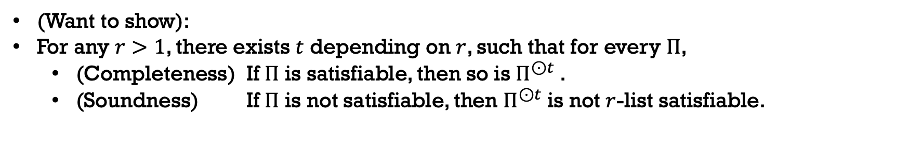
Proof Overview
Follows from and extends [Barto-Kozik’22]’s proof of Baby PCP Theorem
Direct Product Construction
$t$-wise Direct Product 2-CSP
$$Π^{⊙t }=\left(\left({X \atop t}\right) ,Σ^{t},Φ′\right)$$
2-CSP
$$Π=\left(X,Σ,Φ\right)$$
partial satisfying assignments
for the set of variables
consistency checks
(Want to show):
For any $r>1$, there exists $t$ depending on $r$, such that for every $Π$,
(Completeness) If $Π$ is satisfiable, then so is $Π^{⊙t }$.
(Soundness) If $Π$ is not satisfiable, then $Π^{⊙t }$is not $r$-list satisfiable.

Slide 33
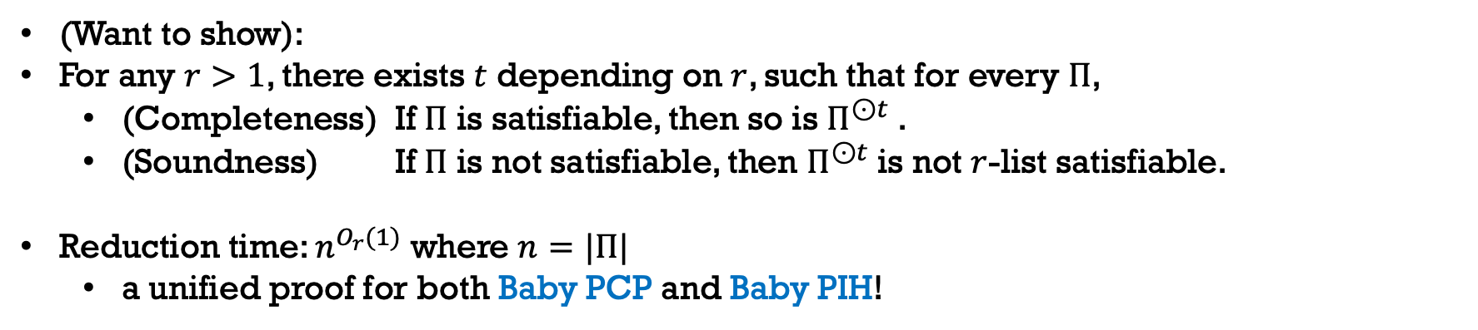
Proof Overview
Follows from and extends [Barto-Kozik’22]’s proof of Baby PCP Theorem
Direct Product Construction
$t$-wise Direct Product 2-CSP
$$Π^{⊙t }=\left(\left({X \atop t}\right) ,Σ^{t},Φ′\right)$$
2-CSP
$$Π=\left(X,Σ,Φ\right)$$
partial satisfying assignments
for the set of variables
consistency checks
(Want to show):
For any $r>1$, there exists $t$ depending on $r$, such that for every $Π$,
(Completeness) If $Π$ is satisfiable, then so is $Π^{⊙t }$.
(Soundness) If $Π$ is not satisfiable, then $Π^{⊙t }$is not $r$-list satisfiable.
Reduction time: $n^{O_{r}(1)}$ where $n=|Π|$
a unified proof for both Baby PCP and Baby PIH!

Slide 34
















Proof Overview
$$(1,3,1,2)$$
$$(1,1,1,2)$$
$$(3,3,2,1)$$
$$↦$$
$$(x_{1},x_{3},x_{4},x_{10})$$
$$(x_{1},x_{2},x_{5},x_{7})$$
$$↦$$
$$(2,1,2,3)$$
$$(2,2,3,1)$$
$$(3,1,2,2)$$
$$(1,1,3,2)$$
and so on …
$$(x_{1},x_{2},x_{4},x_{9})$$
$$↦$$
$$(2,2,3,3)$$
$$(1,1,3,1)$$
A 3-list satisfying assignment for $Π^{⊙4}$

Slide 35




Proof Overview
$$(1,3,1,2)$$
$$(1,1,1,2)$$
$$(3,3,2,1)$$
$$↦$$
$$(x_{1},x_{3},x_{4},x_{10})$$
$$(x_{1},x_{2},x_{5},x_{7})$$
$$↦$$
$$(2,1,2,3)$$
$$(2,2,3,1)$$
$$(3,1,2,2)$$
$$(1,1,3,2)$$
and so on …
$$(x_{1},x_{2},x_{4},x_{9})$$
$$↦$$
$$(2,2,3,3)$$
$$(1,1,3,1)$$
A 3-list satisfying assignment for $Π^{⊙4}$

Slide 36




Proof Overview
$$(1,3,1,2)$$
$$(1,1,1,2)$$
$$(3,3,2,1)$$
$$↦$$
$$(x_{1},x_{3},x_{4},x_{10})$$
$$(x_{1},x_{2},x_{5},x_{7})$$
$$↦$$
$$(2,1,2,3)$$
$$(2,2,3,1)$$
$$(3,1,2,2)$$
$$(1,1,3,2)$$
and so on …
$$(x_{1},x_{2},x_{4},x_{9})$$
$$↦$$
$$(2,2,3,3)$$
$$(1,1,3,1)$$
A 3-list satisfying assignment for $Π^{⊙4}$

Slide 37




Proof Overview
$$(1,3,1,2)$$
$$(1,1,1,2)$$
$$(3,3,2,1)$$
$$↦$$
$$(x_{1},x_{3},x_{4},x_{10})$$
$$(x_{1},x_{2},x_{5},x_{7})$$
$$↦$$
$$(2,1,2,3)$$
$$(2,2,3,1)$$
$$(3,1,2,2)$$
$$(1,1,3,2)$$
and so on …
$$(x_{1},x_{2},x_{4},x_{9})$$
$$↦$$
$$(2,2,3,3)$$
$$(1,1,3,1)$$
A 3-list satisfying assignment for $Π^{⊙4}$

Slide 38
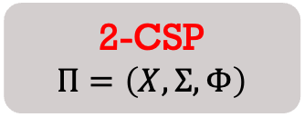
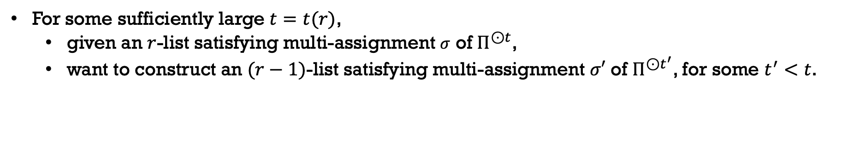
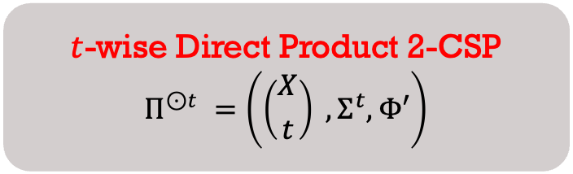
Proof Overview
$t$-wise Direct Product 2-CSP
$$Π^{⊙t }=\left(\left({X \atop t}\right) ,Σ^{t},Φ′\right)$$
2-CSP
$$Π=\left(X,Σ,Φ\right)$$
For some sufficiently large $t=t(r)$,
given an $r$-list satisfying multi-assignment $σ$ of $Π^{⊙t}$,
want to construct an $(r−1)$-list satisfying multi-assignment $σ′$ of $Π^{⊙t^{′}}$, for some $t^{′}<t$.

Slide 39
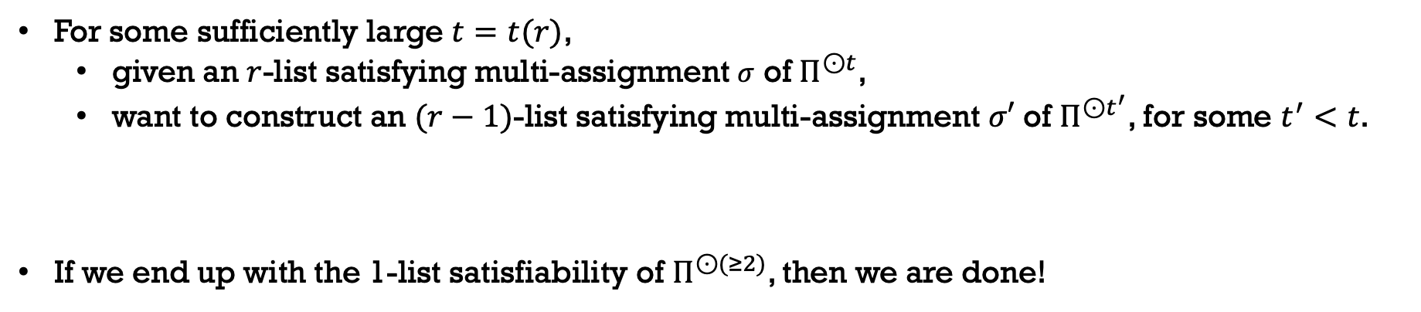
Proof Overview
$t$-wise Direct Product 2-CSP
$$Π^{⊙t }=\left(\left({X \atop t}\right) ,Σ^{t},Φ′\right)$$
2-CSP
$$Π=\left(X,Σ,Φ\right)$$
For some sufficiently large $t=t(r)$,
given an $r$-list satisfying multi-assignment $σ$ of $Π^{⊙t}$,
want to construct an $(r−1)$-list satisfying multi-assignment $σ′$ of $Π^{⊙t^{′}}$, for some $t^{′}<t$.
If we end up with the 1-list satisfiability of $Π^{⊙(≥2)}$, then we are done!

Slide 40
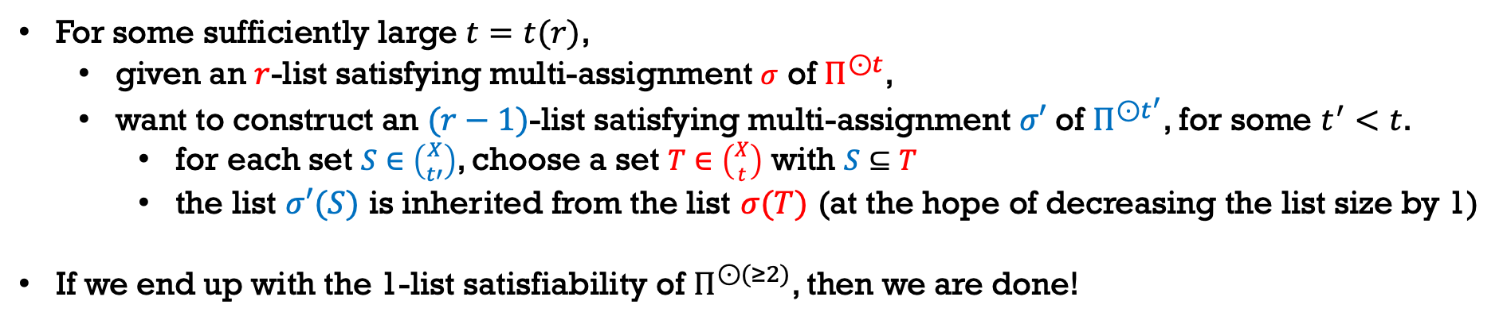
Proof Overview
$t$-wise Direct Product 2-CSP
$$Π^{⊙t }=\left(\left({X \atop t}\right) ,Σ^{t},Φ′\right)$$
2-CSP
$$Π=\left(X,Σ,Φ\right)$$
For some sufficiently large $t=t(r)$,
given an $r$-list satisfying multi-assignment $σ$ of $Π^{⊙t}$,
want to construct an $(r−1)$-list satisfying multi-assignment $σ′$ of $Π^{⊙t^{′}}$, for some $t^{′}<t$.
for each set $S∈\left({X \atop t′}\right)$, choose a set $T∈\left({X \atop t}\right)$ with $S⊆T$
the list $σ′(S)$ is inherited from the list $σ(T)$ (at the hope of decreasing the list size by 1)
If we end up with the 1-list satisfiability of $Π^{⊙(≥2)}$, then we are done!

Slide 41
Proof Overview
$$(1,3,1,2)$$
$$(1,1,1,2)$$
$$(3,3,2,1)$$
$$↦$$
$$(x_{1},x_{3},x_{4},x_{10})$$
$$(x_{1},x_{2},x_{5},x_{7})$$
$$↦$$
$$(2,1,2,3)$$
$$(2,2,3,1)$$
$$(3,1,2,2)$$
$$(1,1,3,2)$$
and so on …
$$(x_{1},x_{2},x_{4},x_{9})$$
$$↦$$
$$(2,2,3,3)$$
$$(1,1,3,1)$$
A 3-list satisfying assignment for $Π^{⊙4}$

Slide 42



















Proof Overview
$$(1,3,1,2)$$
$$(1,1,1,2)$$
$$(3,3,2,1)$$
$$↦$$
$$(x_{1},x_{3},x_{4},x_{10})$$
$$(x_{1},x_{2},x_{5},x_{7})$$
$$↦$$
$$(2,1,2,3)$$
$$(2,2,3,1)$$
$$(3,1,2,2)$$
$$(1,1,3,2)$$
inherit
and so on …
$$(x_{1},x_{2},x_{4},x_{9})$$
$$↦$$
$$(2,2,3,3)$$
$$(1,1,3,1)$$
A 3-list satisfying assignment for $Π^{⊙4}$
$$(1,3,1)$$
$$↦$$
$$(x_{1},x_{3},x_{4})$$
$$(x_{1},x_{2},x_{5})$$
$$(2,2,3)$$
and so on …
$$(x_{1},x_{2},x_{4})$$

Slide 43
















Proof Overview
$$(1,3,1,2)$$
$$(1,1,1,2)$$
$$(3,3,2,1)$$
$$↦$$
$$(x_{1},x_{3},x_{4},x_{10})$$
$$(x_{1},x_{2},x_{5},x_{7})$$
$$↦$$
$$(2,1,2,3)$$
$$(2,2,3,1)$$
$$(3,1,2,2)$$
$$(1,1,3,2)$$
and so on …
$$(x_{1},x_{2},x_{4},x_{9})$$
$$↦$$
$$(2,2,3,3)$$
inherit
$$(1,1,3,1)$$
A 3-list satisfying assignment for $Π^{⊙4}$
$$(1,3,1)$$
$$(1,1,1)$$
$$↦$$
$$(x_{1},x_{3},x_{4})$$
$$(x_{1},x_{2},x_{5})$$
$$↦$$
$$(2,2,3)$$
$$(3,1,2)$$
and so on …
$$(x_{1},x_{2},x_{4})$$

Slide 44











Proof Overview
$$(1,3,1,2)$$
$$(1,1,1,2)$$
$$(3,3,2,1)$$
$$↦$$
$$(x_{1},x_{3},x_{4},x_{10})$$
$$(x_{1},x_{2},x_{5},x_{7})$$
$$↦$$
$$(2,1,2,3)$$
$$(2,2,3,1)$$
$$(3,1,2,2)$$
$$(1,1,3,2)$$
and so on …
$$(x_{1},x_{2},x_{4},x_{9})$$
$$↦$$
$$(2,2,3,3)$$
$$(1,1,3,1)$$
A 3-list satisfying assignment for $Π^{⊙4}$
$$(1,3,1)$$
$$(1,1,1)$$
$$↦$$
$$(x_{1},x_{3},x_{4})$$
$$(x_{1},x_{2},x_{5})$$
$$↦$$
inherit
$$(2,2,3)$$
$$(3,1,2)$$
$$(1,1,3)$$
and so on …
$$(x_{1},x_{2},x_{4})$$
$$↦$$
$$(2,2,3)$$

Slide 45














Proof Overview
$$(1,3,1,2)$$
$$(1,1,1,2)$$
$$(3,3,2,1)$$
$$↦$$
$$(x_{1},x_{3},x_{4},x_{10})$$
$$(x_{1},x_{2},x_{5},x_{7})$$
$$↦$$
$$(2,1,2,3)$$
$$(2,2,3,1)$$
$$(3,1,2,2)$$
$$(1,1,3,2)$$
and so on …
$$(x_{1},x_{2},x_{4},x_{9})$$
$$↦$$
$$(2,2,3,3)$$
$$(1,1,3,1)$$
A 3-list satisfying assignment for $Π^{⊙4}$
$$(1,3,1)$$
$$(1,1,1)$$
$$↦$$
$$(x_{1},x_{3},x_{4})$$
$$(x_{1},x_{2},x_{5})$$
$$↦$$
$$(2,2,3)$$
$$(3,1,2)$$
$$(1,1,3)$$
and so on …
$$(x_{1},x_{2},x_{4})$$
$$↦$$
$$(2,2,3)$$
A 2-list satisfying assignment for $Π^{⊙3}$?

Slide 46
Proof Overview
How can we discard one assignment safely?
the one that is never used to meet any consistency constraints!

Slide 47































Proof Overview
How can we discard one assignment safely?
the one that is never used to meet any consistency constraints!
Suppose we have the following bipartite direct product instance:
$$(1,2,1)$$
$$(x_{1},x_{2},x_{3})$$
$$(x_{1},x_{2},x_{3})$$
$$(1,2,1)$$
$$↦$$
$$↦$$
$$(3,3,2)$$
$$(2,3,2)$$
$$(1,2,1)$$
$$(x_{1},x_{2},x_{4})$$
$$(x_{1},x_{2},x_{4})$$
$$(1,2,1)$$
$$↦$$
$$↦$$
$$(2,3,3)$$
$$(2,3,3)$$
$$(1,1,1)$$
$$(x_{1},x_{3},x_{4})$$
$$(x_{1},x_{3},x_{4})$$
$$(2,1,3)$$
$$↦$$
$$↦$$
$$(3,3,2)$$
$$(1,1,1)$$
$$(1,3,1)$$
$$(x_{2},x_{3},x_{4})$$
$$(x_{2},x_{3},x_{4})$$
$$(2,1,1)$$
$$↦$$
$$↦$$
$$(2,1,1)$$
$$(2,3,2)$$

Slide 48


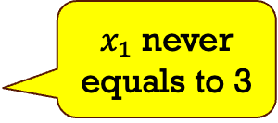







Proof Overview
How can we discard one assignment safely?
the one that is never used to meet any consistency constraints!
Suppose we have the following bipartite direct product instance:
$$(1,2,1)$$
$$(x_{1},x_{2},x_{3})$$
$$(x_{1},x_{2},x_{3})$$
$$(1,2,1)$$
$$↦$$
$$↦$$
$$(3,3,2)$$
$$(2,3,2)$$
$x_{1}$ never equals to 3
$$(1,2,1)$$
$$(x_{1},x_{2},x_{4})$$
$$(x_{1},x_{2},x_{4})$$
$$(1,2,1)$$
$$↦$$
$$↦$$
$$(2,3,3)$$
$$(2,3,3)$$
$$(1,1,1)$$
$$(x_{1},x_{3},x_{4})$$
$$(x_{1},x_{3},x_{4})$$
$$(2,1,3)$$
$$↦$$
$$↦$$
$$(3,3,2)$$
$$(1,1,1)$$
$$(1,3,1)$$
$$(x_{2},x_{3},x_{4})$$
$$(x_{2},x_{3},x_{4})$$
$$(2,1,1)$$
$$↦$$
$$↦$$
$$(2,1,1)$$
$$(2,3,2)$$

Slide 49


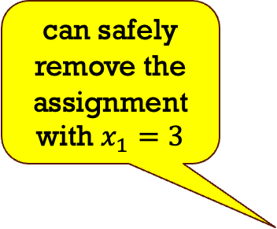
Proof Overview
How can we discard one assignment safely?
the one that is never used to meet any consistency constraints!
Suppose we have the following bipartite direct product instance:
$$(1,2,1)$$
$$(x_{1},x_{2},x_{3})$$
$$(x_{1},x_{2},x_{3})$$
$$(1,2,1)$$
can safely remove the assignment with $x_{1}=3$
$$↦$$
$$↦$$
$$(3,3,2)$$
$$(2,3,2)$$
$x_{1}$ never equals to 3
$$(1,2,1)$$
$$(x_{1},x_{2},x_{4})$$
$$(x_{1},x_{2},x_{4})$$
$$(1,2,1)$$
$$↦$$
$$↦$$
$$(2,3,3)$$
$$(2,3,3)$$
$$(1,1,1)$$
$$(x_{1},x_{3},x_{4})$$
$$(x_{1},x_{3},x_{4})$$
$$(2,1,3)$$
$$↦$$
$$↦$$
$$(3,3,2)$$
$$(1,1,1)$$
$$(1,3,1)$$
$$(x_{2},x_{3},x_{4})$$
$$(x_{2},x_{3},x_{4})$$
$$(2,1,1)$$
$$↦$$
$$↦$$
$$(2,1,1)$$
$$(2,3,2)$$

Slide 50
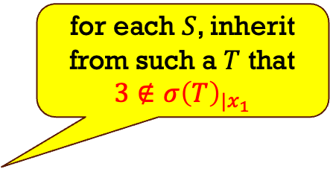
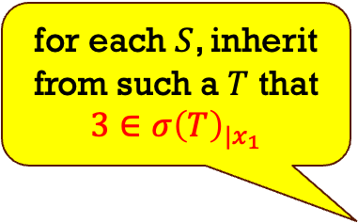
Proof Overview
How can we discard one assignment safely?
the one that is never used to meet any consistency constraints!
Suppose we have the following bipartite direct product instance:
$$(1,2,1)$$
$$(x_{1},x_{2},x_{3})$$
$$(x_{1},x_{2},x_{3})$$
$$(1,2,1)$$
$$↦$$
$$↦$$
for each $S$, inherit from such a $T$ that $3∈σ{\left(T\right)}_{|x_{1}}$
$$(3,3,2)$$
$$(2,3,2)$$
for each $S$, inherit from such a $T$ that $3∉σ{\left(T\right)}_{|x_{1}}$
$$(1,2,1)$$
$$(x_{1},x_{2},x_{4})$$
$$(x_{1},x_{2},x_{4})$$
$$(1,2,1)$$
$$↦$$
$$↦$$
$$(2,3,3)$$
$$(2,3,3)$$
$$(1,1,1)$$
$$(x_{1},x_{3},x_{4})$$
$$(x_{1},x_{3},x_{4})$$
$$(2,1,3)$$
$$↦$$
$$↦$$
$$(3,3,2)$$
$$(1,1,1)$$
$$(1,3,1)$$
$$(x_{2},x_{3},x_{4})$$
$$(x_{2},x_{3},x_{4})$$
$$(2,1,1)$$
$$↦$$
$$↦$$
$$(2,1,1)$$
$$(2,3,2)$$

Slide 51
Proof Overview
How can we discard one assignment safely?
the one that is never used to meet any consistency constraints!
Suppose we have the following bipartite direct product instance:
$$(1,2,1)$$
$$(x_{1},x_{2},x_{3})$$
$$(x_{1},x_{2},x_{3})$$
$$(1,2,1)$$
$$↦$$
$$↦$$
for each $S$, inherit from such a $T$ that $3∈σ{\left(T\right)}_{|x_{1}}$
$$(3,3,2)$$
$$(2,3,2)$$
for each $S$, inherit from such a $T$ that $3∉σ{\left(T\right)}_{|x_{1}}$
$$(1,2,1)$$
$$(x_{1},x_{2},x_{4})$$
$$(x_{1},x_{2},x_{4})$$
$$(1,2,1)$$
$$↦$$
$$↦$$
$$(2,3,3)$$
$$(2,3,3)$$
$$(1,1,1)$$
$$(x_{1},x_{3},x_{4})$$
$$(x_{1},x_{3},x_{4})$$
$$(2,1,3)$$
$$↦$$
$$↦$$
by discarding this assignment, list size is decreased by 1
$$(3,3,2)$$
$$(1,1,1)$$
$$(1,3,1)$$
$$(x_{2},x_{3},x_{4})$$
$$(x_{2},x_{3},x_{4})$$
$$(2,1,1)$$
$$↦$$
$$↦$$
$$(2,1,1)$$
$$(2,3,2)$$

Slide 52

Proof Overview
Bipartite $(r,1)$-case
Bipartite ($r,q$)-case
Non-bipartite $r$-case

Slide 53

Proof Overview
Bipartite $(r,1)$-case
Bipartite ($r,q$)-case
Non-bipartite $r$-case

Slide 54

Takeaway
Parameterized Inapproximability Hypothesis – parameterized analog of PCP
Baby PIH – inapproximability of the list-satisfiability of (parameterized) 2CSP
W[1]-hard to distinguish between [1-list satisfiable] and [not even $r$-list satisfiable]
Proof Idea: induction on the list size

Slide 55
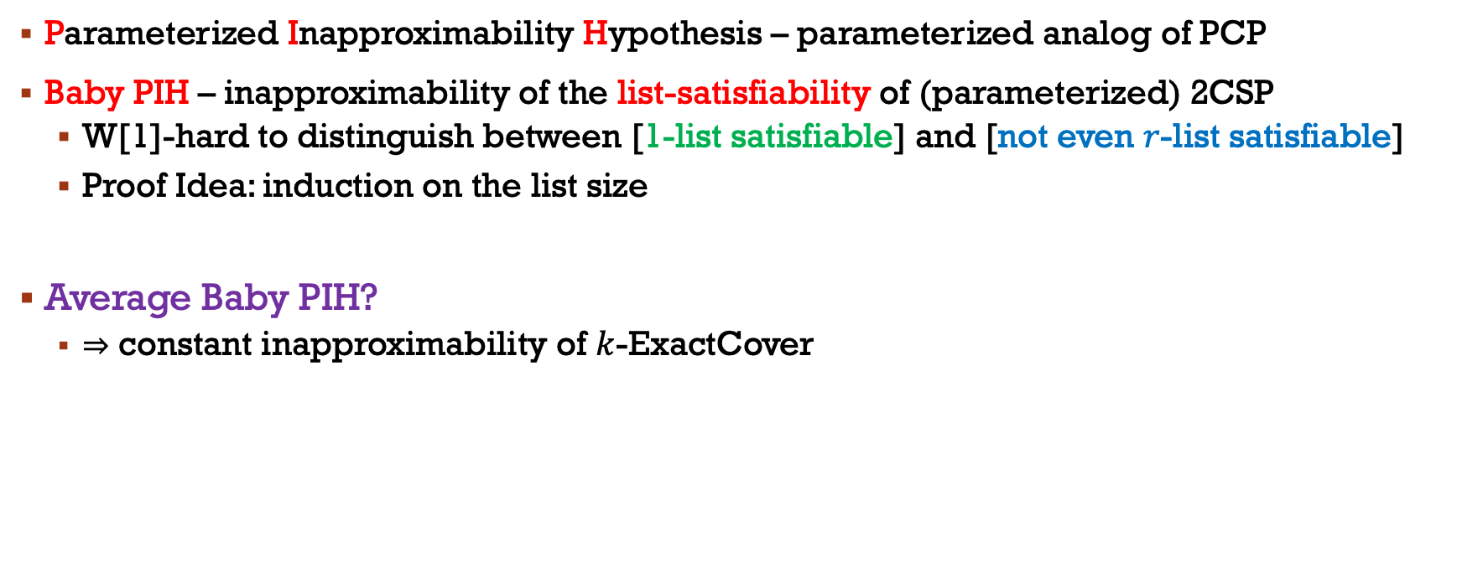
Takeaway
Parameterized Inapproximability Hypothesis – parameterized analog of PCP
Baby PIH – inapproximability of the list-satisfiability of (parameterized) 2CSP
W[1]-hard to distinguish between [1-list satisfiable] and [not even $r$-list satisfiable]
Proof Idea: induction on the list size
Average Baby PIH?
$⇒$ constant inapproximability of $k$-ExactCover

Slide 56
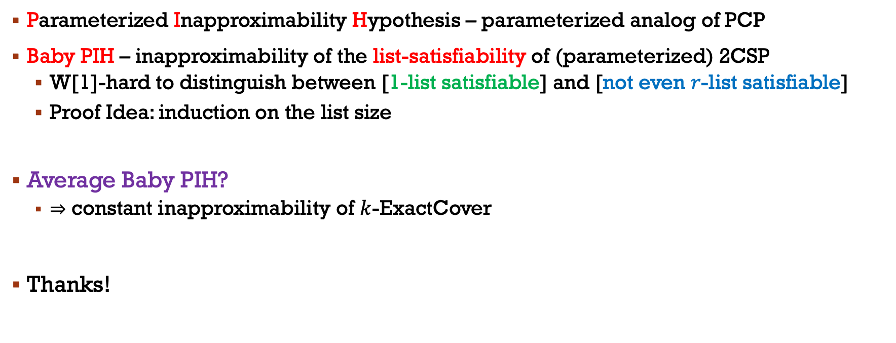
Takeaway
Parameterized Inapproximability Hypothesis – parameterized analog of PCP
Baby PIH – inapproximability of the list-satisfiability of (parameterized) 2CSP
W[1]-hard to distinguish between [1-list satisfiable] and [not even $r$-list satisfiable]
Proof Idea: induction on the list size
Average Baby PIH?
$⇒$ constant inapproximability of $k$-ExactCover
Thanks!

