Slide 1
Generalized Sorting with Predictions
Pinyan Lu
SUFE
Xuandi Ren
PKU
Enze Sun
SJTU
Yubo Zhang
PKU
January, 2021

Slide 2

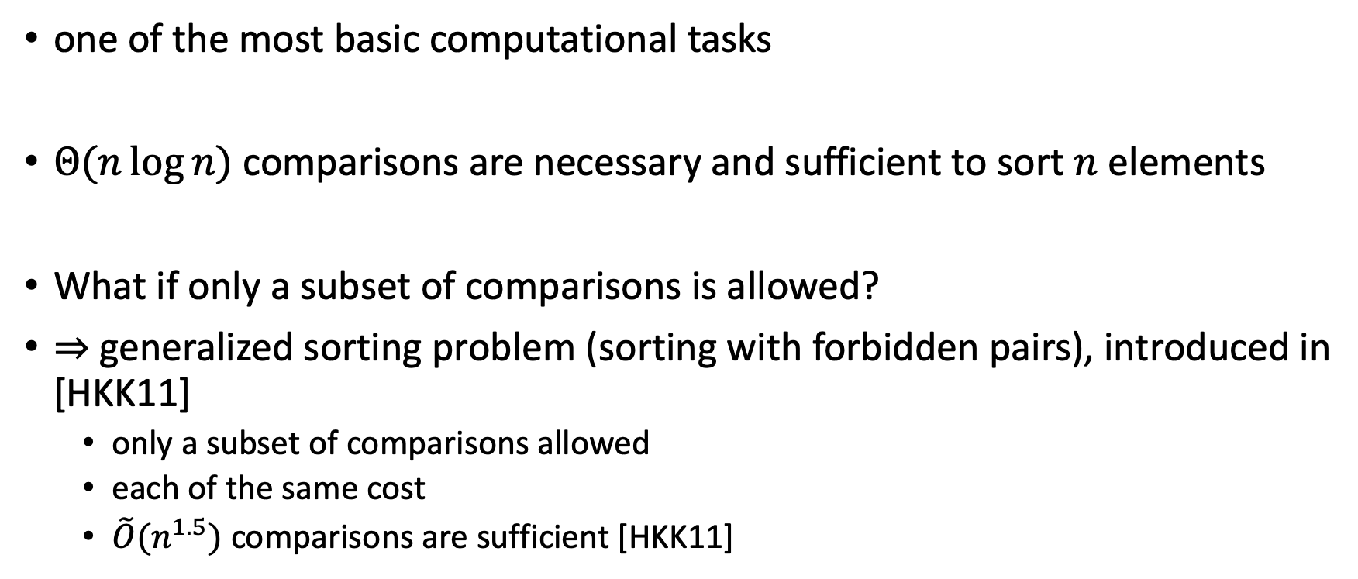
Sorting $→$ Generalized Sorting
one of the most basic computational tasks
$Θ(n\log{n})$ comparisons are necessary and sufficient to sort $n$ elements
What if only a subset of comparisons is allowed?
$⇒$ generalized sorting problem (sorting with forbidden pairs), introduced in [HKK11]
only a subset of comparisons allowed
each of the same cost
$\tilde{O}(n^{1.5})$ comparisons are sufficient [HKK11]

Slide 3



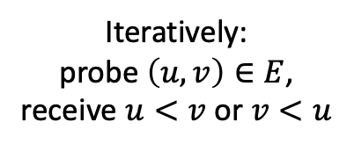
Graph Model
The problem can be viewed as a graph problem for convenience
It is guaranteed:
There is a orientation $\vec{G}=\left(V,\vec{E}\right)$ of $G$ representing the underlying total order
$\vec{G}$ is acyclic and there is a Hamiltonian path in $\vec{G}$
$\vec{G}$is fixed at the beginning
The goal is to find out the underlying Hamiltonian path using the smallest number of queries!
Input: an undirected graph $G=(V,E)$
each $v∈V$ represents an element,
each $\left(u,v\right)∈E$ represents an allowed comparison
Output: a total order of all elements
i.e. a sequence $v_{1}<v_{2}<…<v_{n}$
$$v_{i}∈V$$
Iteratively:
probe $\left(u,v\right)∈E$,
receive $u<v$ or $v<u$

Slide 4

Algorithm with Predictions
algorithm
Consistency: has near optimal performance when the predictions are good
Robustness: is no worse than the prediction-less case when the predictions have large errors
instance
results
instance
new
algorithm
results
ML
predictions
The quality of predictions is measured by an amount $w$
We want: the better the prediction, the better the performance

Slide 5

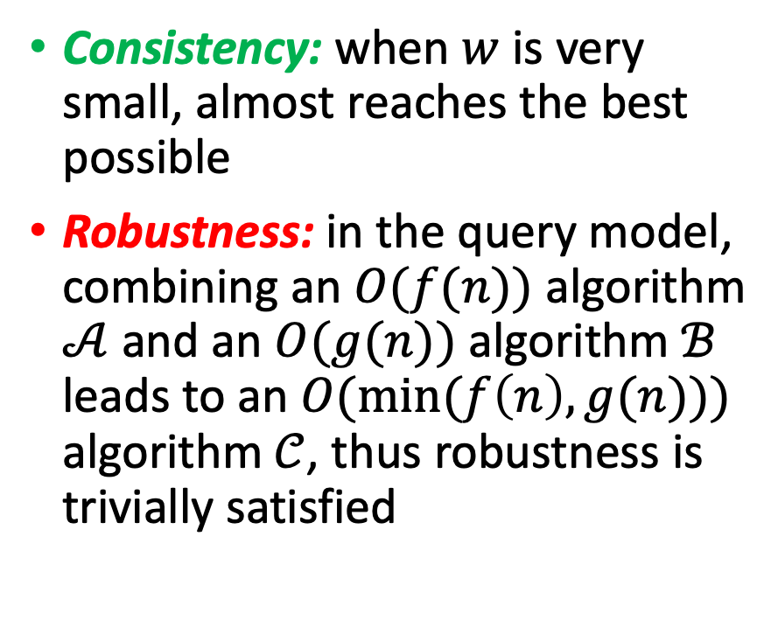

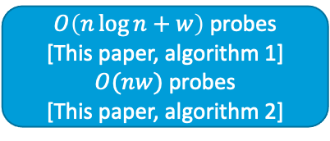

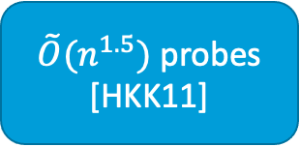
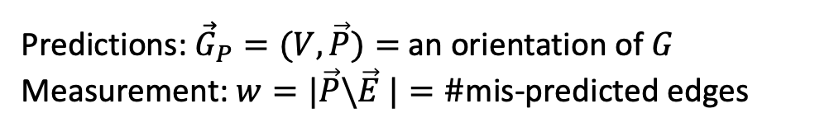
Generalized Sorting with Predictions
$\tilde{O}(n^{1.5})$ probes [HKK11]
Consistency: when $w$ is very small, almost reaches the best possible
Robustness: in the query model, combining an $O(f(n))$ algorithm $𝒜$ and an $O(g(n))$ algorithm $ℬ$ leads to an $O(\min{(f\left(n\right),g(n))})$ algorithm $𝒞$, thus robustness is trivially satisfied
$$G=(V,E)$$
results
$$G=(V,E)$$
$O\left(n\log{n}+w\right)$ probes
[This paper, algorithm 1]
$O(nw)$ probes
[This paper, algorithm 2]
results
ML
$${\vec{G}}_{P}$$
Predictions: ${\vec{G}}_{P}=(V,\vec{P})=$ an orientation of $G$
Measurement: $w=|\vec{P}\backslash \vec{E} |=\#$mis-predicted edges

Slide 6




An Example
a
a
b
d
b
d
c
c
f
e
f
e
$G$: the undirected graph (input)
${\vec{G}}_{P}$: the predicted digraph (input)
a
a
b
d
b
d
: allowed comparisons
: the predicted directions
: correct directions
: edges in the Hamiltonian path
: mis-predicted edges
c
c
f
e
f
e
$\vec{G}$: the correct digraph
$w$ = #mis-predicted edges = 4

Slide 7




Some Notations
a
?
a
a
$N_{u}≜𝒩_{in}\left({\vec{G}}_{P},u\right)=u$’s in-neighbors in the predicted graph
$S_{u}≜u$’s real in-neighbors among $N_{u}$
$T_{u}≜u$’s in-neighbors among $N_{u}$ which are not yet wrong
either correct or unprobed
b
d
b
d
b
d
c
c
c
f
e
f
e
f
e
$$N_{b}=𝒩_{in}\left({\vec{G}}_{P},b\right)=\{a,c,f\}$$
$$T_{b}=\{a,c,f\}$$
$$S_{b}=\{a\}$$

Slide 8
Some Notations
a
a
a
$N_{u}≜𝒩_{in}\left({\vec{G}}_{P},u\right)=u$’s in-neighbors in the predicted graph
$S_{u}≜u$’s real in-neighbors among $N_{u}$
$T_{u}≜u$’s in-neighbors among $N_{u}$ which are not yet wrong
either correct or unprobed
b
d
b
?
d
b
d
c
c
c
f
e
f
e
f
e
$$N_{b}=𝒩_{in}\left({\vec{G}}_{P},b\right)=\{a,c,f\}$$
$$T_{b}=\{a,c,f\}$$
$$S_{b}=\{a\}$$

Slide 9

Some Notations
a
a
a
$N_{u}≜𝒩_{in}\left({\vec{G}}_{P},u\right)=u$’s in-neighbors in the predicted graph
$S_{u}≜u$’s real in-neighbors among $N_{u}$
$T_{u}≜u$’s in-neighbors among $N_{u}$ which are not yet wrong
either correct or unprobed
b
d
b
d
b
d
c
c
c
?
f
e
f
e
f
e
$$N_{b}=𝒩_{in}\left({\vec{G}}_{P},b\right)=\{a,c,f\}$$
$$T_{b}=\{a,f\}$$
$$S_{b}=\{a\}$$

Slide 10

Some Notations
a
a
a
$N_{u}≜𝒩_{in}\left({\vec{G}}_{P},u\right)=u$’s in-neighbors in the predicted graph
$S_{u}≜u$’s real in-neighbors among $N_{u}$
$T_{u}≜u$’s in-neighbors among $N_{u}$ which are not yet wrong
either correct or unprobed
b
d
b
d
b
d
c
c
c
f
e
f
e
f
e
$$N_{b}=𝒩_{in}\left({\vec{G}}_{P},b\right)=\{a,c,f\}$$
$$T_{b}=\{a\}$$
$$S_{b}=\{a\}$$

Slide 11

Overall Idea
a
a
a
$N_{u}⊇T_{u}⊇S_{u}$ all the time
$T_{u}=N_{u}$ initially
$T_{u}$ shrinks to $S_{u}$ finally
We want to determine each $S_{u}$ for all $u∈V$, using the smallest number of probes
b
d
b
d
b
d
c
c
c
f
e
f
e
f
e
$$N_{b}=𝒩_{in}\left({\vec{G}}_{P},b\right)=\{a,c,f\}$$
$$T_{b}=\{a\}$$
$$S_{b}=\{a\}$$

Slide 12




Overall Idea
a
a
a
We maintain a vertex set $A$ s.t.
$∀u∈A$, direction of edges between $N_{u}$ and $u$ are all known to us
Initially $A=∅$
When $A=V$ we succeed
$A≈$ currently sorted elements
b
d
b
d
b
d
c
c
c
f
e
f
e
f
e
$${\vec{G}}_{P}$$
$$A=\left\{b,c\right\}$$
(an example)
$$\vec{G}$$

Slide 13
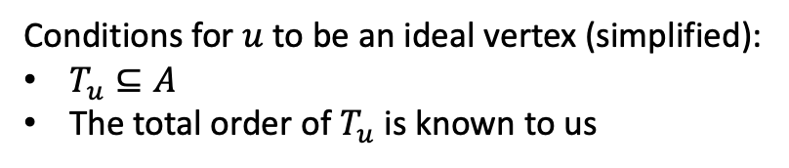
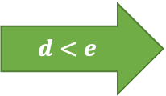
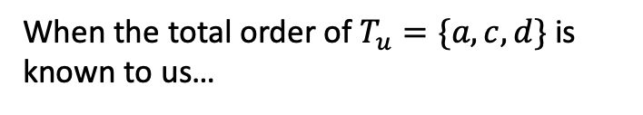
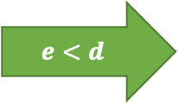
Ideal Vertex
b
c
b
c
a
d
$$d<e$$
a
d
?
u
u
can conclude $a<u$ and $c<u$ by transitivity
: edges that have been probed
: edges in the prediction graph
b
c
When the total order of $T_{u}=\{a,c,d\}$ is known to us…
$$e<d$$
a
d
Conditions for $u$ to be an ideal vertex (simplified):
$T_{u}⊆A$
The total order of $T_{u}$ is known to us
u
find a mis-predicted edge $(d,u)$, this probe is charged to the term $w$

Slide 14


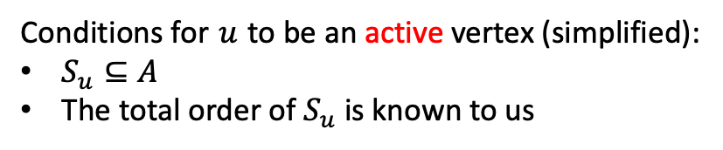

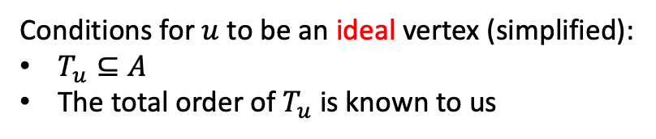


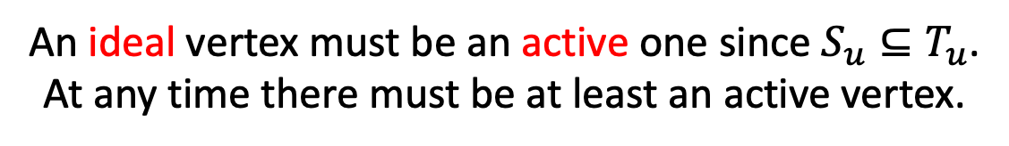
Ideal Vertex $→$ Active Vertex
a
c
a
c
a
c
b
b
b
$b$ is not ideal,
but is active!
$${\vec{G}}_{P}$$
$$A=\{a,c\}$$
$$\vec{G}$$
There may be no ideal vertices at some time!
Conditions for $u$ to be an ideal vertex (simplified):
$T_{u}⊆A$
The total order of $T_{u}$ is known to us
weaken
Conditions for $u$ to be an active vertex (simplified):
$S_{u}⊆A$
The total order of $S_{u}$ is known to us
An ideal vertex must be an active one since $S_{u}⊆T_{u}$.
At any time there must be at least an active vertex.

Slide 15

Active Vertex
a
c
a
c
a
c
b
b
b
Active, but how can we know that?
$${\vec{G}}_{P}$$
$$A=\{a,c\}$$
$$\vec{G}$$
$S_{u}$ is not known to us…
Therefore whether a vertex is active is not known to us…
However we can identify some vertices that are not active!

Slide 16
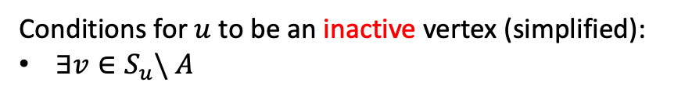
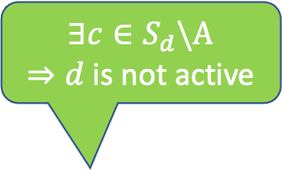



Inactive Vertex
$$∃c∈S_{d}\backslash A$$
$⇒d$ is not active
a
c
a
c
a
c
d
b
d
b
d
b
$${\vec{G}}_{P}$$
$$A=\{a\}$$
$$\vec{G}$$
Conditions for $u$ to be an active vertex (simplified):
$S_{u}⊆A$
The total order of $S_{u}$ is known to us
Conditions for $u$ to be an inactive vertex (simplified):
$∃v∈S_{u}\backslash A$

Slide 17


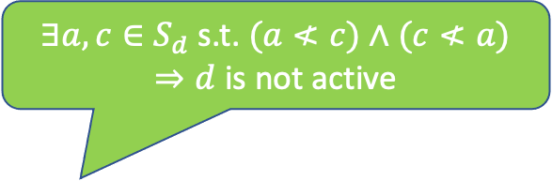

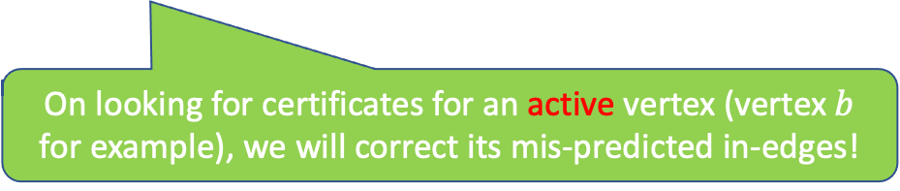
Inactive Vertex
$∃a,c∈S_{d}$ s.t. $(a≮c)∧(c≮a)$
$⇒d$ is not active
a
c
a
c
a
c
d
b
d
b
d
b
$${\vec{G}}_{P}$$
$$A=\{a,c\}$$
$$\vec{G}$$
On looking for certificates for an active vertex (vertex $b$ for example), we will correct its mis-predicted in-edges!
Conditions for $u$ to be an active vertex (simplified):
$S_{u}⊆A$
The total order of $S_{u}$ is known to us
Conditions for $u$ to be an inactive vertex (simplified):
$∃v∈S_{u}\backslash A$
(or) $∃v_{1},v_{2}∈S_{u}$ s.t. $(v_{1}≮v_{2})∧(v_{2}≮v_{1})$
Such a $v$or such a pair of $(v_{1},v_{2})$ is called a certificate for $u$,
which indicates that $u$ is not active and is not the vertex we are looking for!

Slide 18
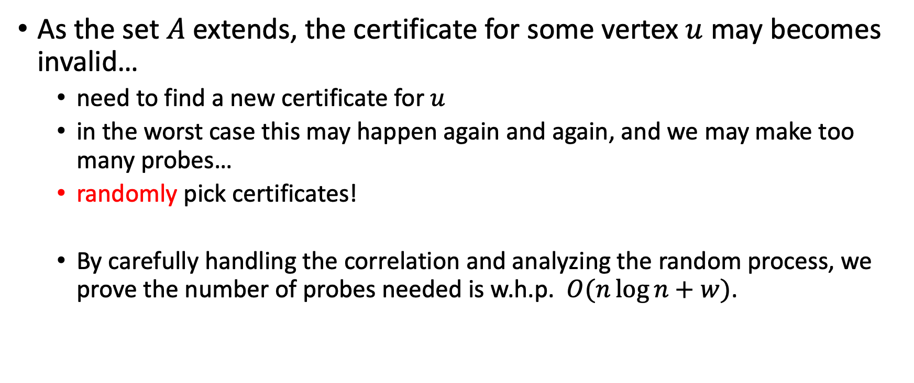
Re-searching for Certificates
As the set $A$ extends, the certificate for some vertex $u$ may becomes invalid…
need to find a new certificate for $u$
in the worst case this may happen again and again, and we may make too many probes…
randomly pick certificates!
By carefully handling the correlation and analyzing the random process, we prove the number of probes needed is w.h.p. $O(n\log{n}+w)$.

Slide 19

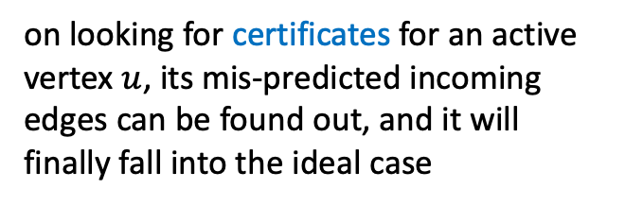
Sketch
certificate:
a proof for inactiveness
on looking for certificates for an active vertex $u$, its mis-predicted incoming edges can be found out, and it will finally fall into the ideal case
ideal vertices
inactive vertices
active vertices
re-searching certificates again and again?
introduce randomness to help
must exist, but is invisible to us!
need to carefully handle the correlation and analyze the process
may not exist due to the mis-predicted edges
re-searching for certificates, w.h.p.
# mis-predicted edges
$$O(n\log{n}+w)$$

Slide 20

Open Questions
Can this problem be solved in $O(n+w)$ probes or even better?
Can the prediction-less version of generalized sorting problem be solved in $O(n^{1.5−ε})$ probes?

Slide 21
The End
Thanks!

