Slide 1

On Lower Bounds of Approximating Parameterized $k$-Clique
Bingkai Lin, Xuandi Ren, Yican Sun, Xiuhan Wang

Slide 2






$k$-Clique Problem
Given a graph $G$ with a positive integer $k$, decide if G contains $K_{k}—$a complete subgraph of size $k$
In the $c$-approximation (c-gap) version, distinguish between:
$G$ has $k$-clique
$G$ has no $k/c$-clique
$$K_{3}$$
G
$$⊆$$
$$K_{k}$$
$$⊆$$
G
OR
$$K_{k/c}$$
$$⊈$$
G
Notes:
c-Gap
W[1] v.s. FPT == NP v.s P

Slide 3
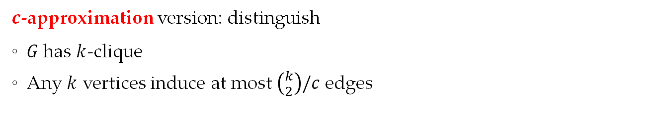



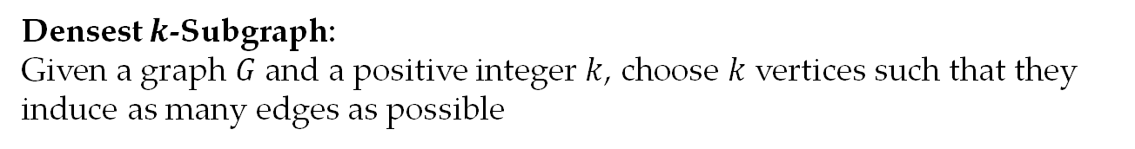
Densest $k$-Subgraph:
Given a graph $G$ and a positive integer $k$, choose $k$ vertices such that they induce as many edges as possible
$c$-approximation version: distinguish
$G$ has $k$-clique
Any $k$ vertices induce at most $\left({k \atop 2}\right)/c$ edges
$$k$$
$$⊆$$
$$G$$
OR
$$k$$
$$⊈$$
$$G$$
Parameterized Inapproximability Hypothesis [Lokshtanov-Ramanujan-Saurabh-Zehavi’20]
There is no constant approximation FPT($f\left(k\right)⋅n^{O(1)}$-time) algorithm for Densest $k$-Subgraph
Parameterized
PCP-theorem!
Notes:
K-Clique problem can be treated as a special case of densest k subgraph problem.
We also consider the approximation version of densest k-subgraph problem.
The original PIH states that it is W[1]-hard to c-approximate densest-k-subgraph.
We use a relaxed version of PIH: there is no FPT algorithm to c-approximate densest-k-subgraph.

Slide 4
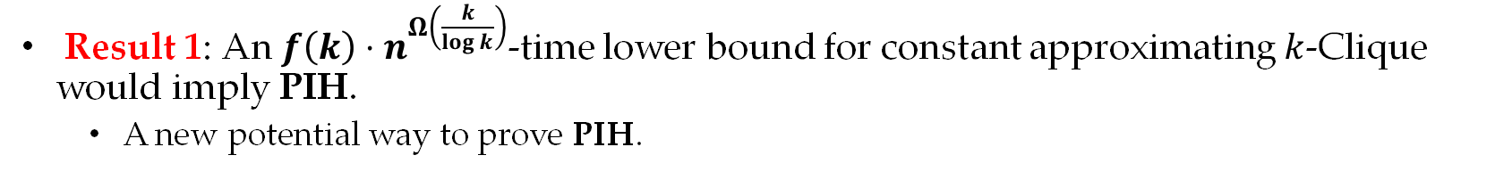
PIH and Gap $k$-Clique
PIH
easy from definition
Constant Inapproximability of k-Clique
Our Result 1
Open problem [Feldmann-Karthik-Lee-Manurangsi’20]:
Does PIH hold if we assume that constant Gap 𝑘-Clique has no FPT algorithm?
Result 1: An $f\left(k\right)⋅n^{Ω\left(\frac{k}{\log{k}}\right)}$-time lower bound for constant approximating $k$-Clique would imply PIH.
A new potential way to prove PIH.
Notes:
It is obvious that if PIH is true, then k-Clique problem has no constant FPT approximation algorithm.
We proved that an n^{k/log k}-time lower bound for constant Gap-k-Clique could imply PIH.
An immediate question is can we improve the lower bound for gap-k-clique?

Slide 5
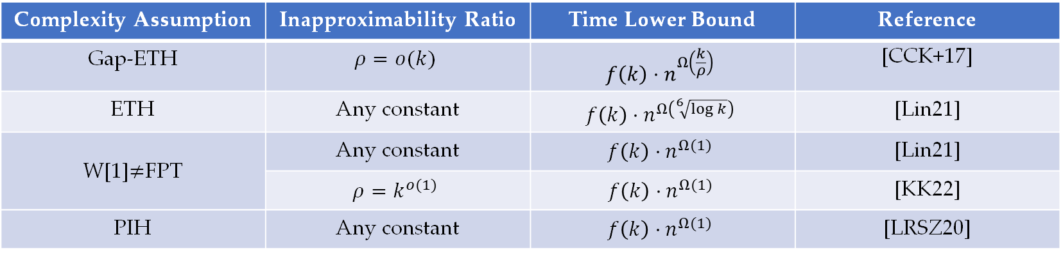
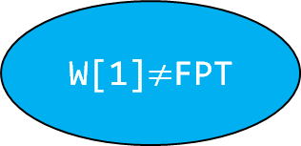
Previous Works for Gap-$k$-Clique
Complexity Assumption | Inapproximability Ratio | Time Lower Bound | Reference
Gap-ETH | $$ρ=o(k)$$ | $$f\left(k\right)⋅n^{Ω\left(\frac{k}{ρ}\right)}$$ | [CCK+17]
ETH | Any constant | $$f\left(k\right)⋅n^{Ω\left(\sqrt[6]{\log{k}}\right)}$$ | [Lin21]
W[1]$≠$FPT | Any constant | $$f\left(k\right)⋅n^{Ω(1)}$$ | [Lin21]
W[1]$≠$FPT | $$ρ=k^{o(1)}$$ | $$f\left(k\right)⋅n^{Ω(1)}$$ | [KK22]
PIH | Any constant | $$f\left(k\right)⋅n^{Ω(1)}$$ | [LRSZ20]
Gap-ETH
ETH
W[1]$≠$FPT
?
?
PIH

Slide 6
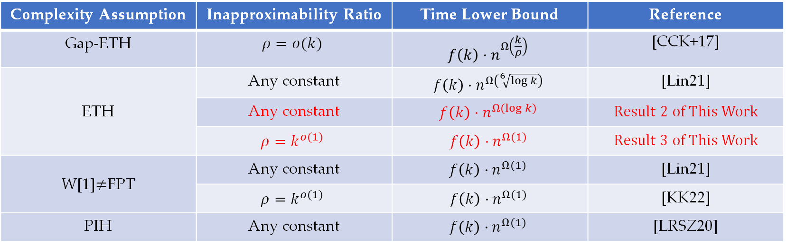
Our Results
Complexity Assumption | Inapproximability Ratio | Time Lower Bound | Reference
Gap-ETH | $$ρ=o(k)$$ | $$f\left(k\right)⋅n^{Ω\left(\frac{k}{ρ}\right)}$$ | [CCK+17]
ETH | Any constant | $$f\left(k\right)⋅n^{Ω\left(\sqrt[6]{\log{k}}\right)}$$ | [Lin21]
 | Any constant | $$f\left(k\right)⋅n^{Ω(\log{k)}}$$ | Result 2 of This Work
 | $$ρ=k^{o(1)}$$ | $$f\left(k\right)⋅n^{Ω(1)}$$ | Result 3 of This Work
W[1]$≠$FPT | Any constant | $$f\left(k\right)⋅n^{Ω(1)}$$ | [Lin21]
W[1]$≠$FPT | $$ρ=k^{o(1)}$$ | $$f\left(k\right)⋅n^{Ω(1)}$$ | [KK22]
PIH | Any constant | $$f\left(k\right)⋅n^{Ω(1)}$$ | [LRSZ20]
Notes:
Result 2: Proved an $f\left(k\right)⋅n^{Ω(\log{k)}}$ lower bound for constant approximating $k$-Clique under ETH.
A new reduction from 3SAT to $k$-VectorSum, and obtained $n^{o(k)}$-time lower bound for $k$-VectorSum.
Simplified the reduction from $k$-VectorSum to constant gap $k$-Clique in [Lin21] by Reed-Muller Codes.
Result 3: Proved an $f\left(k\right)⋅n^{Ω(1)}$ lower bound for $ρ$-approximating $k$-Clique under ETH, where $ρ$ is some $k^{o(1)}$.
Applied traditional gap amplification technique by expander graphs to the above.

Slide 7
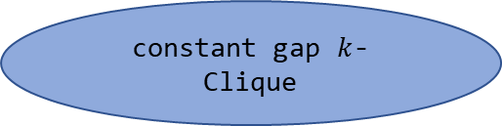

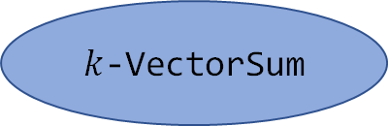
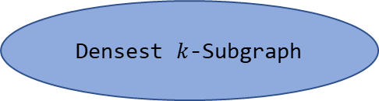
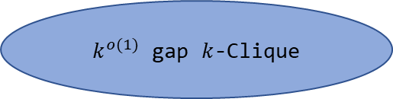
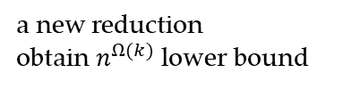
Our Techniques
$k^{o(1)}$ gap $k$-Clique
Densest $k$-Subgraph
using expander graphs
using dispersers
（Result 3）
（Result 1）
3SAT
constant gap $k$-Clique
(Result 2)
a new reduction
obtain $n^{Ω(k)}$ lower bound
Modified FGLSS-reduction
$k$-VectorSum
(weak) Gap $k$-CSP
a generalized reduction via Reed-Muller Codes

Slide 8
Our Techniques
$k^{o(1)}$ gap $k$-Clique
Densest $k$-Subgraph
using expander graphs
using dispersers
（Result 3）
（Result 1）
3SAT
constant gap $k$-Clique
(Result 2)
a new reduction
obtain $n^{Ω(k)}$ lower bound
Modified FGLSS-reduction
$k$-VectorSum
(weak) Gap $k$-CSP
a generalized reduction via Reed-Muller Codes

Slide 9






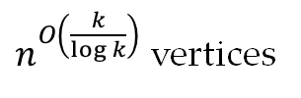




From Gap $k$-Clique to Gap-Densest-$k$-Subgraph
$$K_{k}$$
$$⊆$$
$$G$$
$$k′$$
$$⊆$$
$$G′$$
$$K_{k/c}$$
$$⊈$$
$$G$$
$$k’$$
$$⊈$$
$$G′$$
$n^{O\left(\frac{k}{\log{k}}\right)}$ vertices
$n$ vertices
Result 1
An $f\left(k\right)⋅n^{Ω\left(\frac{k}{\log{k}}\right)}$-time lower bound for constant approximating $k$-Clique would imply PIH.

Slide 10





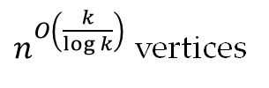

From Gap $k$-Clique to Gap-Densest-$k$-Subgraph
$$K_{k}$$
$$⊆$$
$$G$$
$$⊆$$
$$k′$$
$$⊆$$
$$G′$$
disperser
$$K_{k′,k′}$$
$$H$$
$$K_{k/c}$$
$$⊈$$
$$G$$
$$⊈$$
$$k’$$
$$⊈$$
$$G′$$
$$K_{δlog{k′},δlog{k′}}$$
$$H$$
$n^{O\left(\frac{k}{\log{k}}\right)}$ vertices
$n^{O\left(\frac{k}{\log{k}}\right)}$ vertices
$n$ vertices
Kővári–Sós–Turán theorem
Any $O(k)$-vertex graph without $K_{δlog{k},δlog{k}}$ subgraph has at most $k^{2−1/δ\log{k}}≤εk^{2}$ edges
Result 1
An $f\left(k\right)⋅n^{Ω\left(\frac{k}{\log{k}}\right)}$-time lower bound for constant approximating $k$-Clique would imply PIH.

Slide 11
Our Techniques
$k^{o(1)}$ gap $k$-Clique
Densest $k$-Subgraph
using expander graphs
using dispersers
（Result 3）
（Result 1）
3SAT
constant gap $k$-Clique
(Result 2)
a new reduction
obtain $n^{Ω(k)}$ lower bound
Modified FGLSS-reduction
$k$-VectorSum
(weak) Gap $k$-CSP
a generalized reduction via Reed-Muller Codes

Slide 12

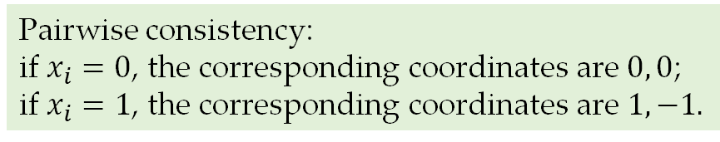
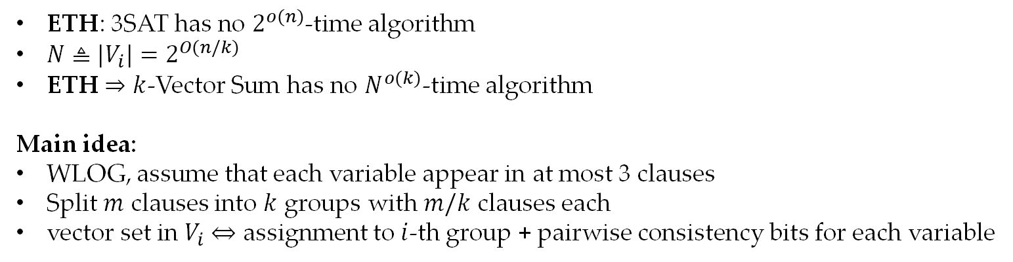
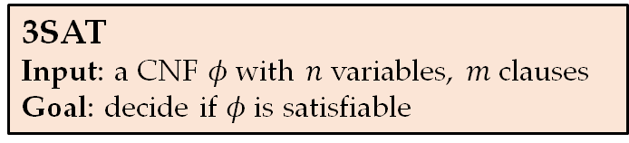
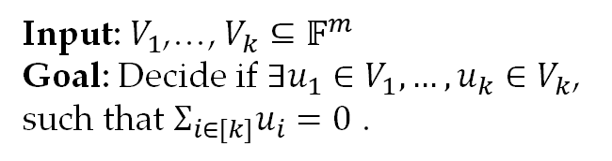
Reducing 3SAT to $k$-VectorSum
$k$-Vector Sum Problem
3SAT
Input: a CNF $φ$ with $n$ variables, $m$ clauses
Goal: decide if $φ$is satisfiable
Input: $V_{1}$,…, $V_{k}⊆𝔽^{m}$
Goal: Decide if $∃u_{1}∈V_{1},…,u_{k}∈V_{k}$, such that $Σ_{i∈[k]}u_{i}=0$ .
ETH: 3SAT has no $2^{o(n)}$-time algorithm
$N≜|V_{i}|=2^{O(n/k)}$
ETH $⇒$ $k$-Vector Sum has no $N^{o(k)}$-time algorithm
Main idea:
WLOG, assume that each variable appear in at most 3 clauses
Split $m$ clauses into $k$ groups with $m/k$ clauses each
vector set in $V_{i}$ $⇔$ assignment to $i$-th group + pairwise consistency bits for each variable
Pairwise consistency:
if $x_{i}=0$, the corresponding coordinates are $0, 0$;
if $x_{i}=1$, the corresponding coordinates are $1,−1.$

Slide 13





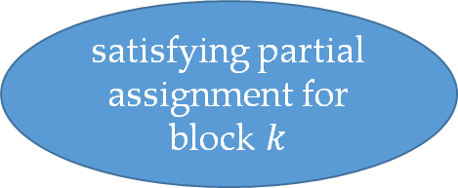




Reducing 3SAT to $k$-VectorSum
$$\left(x_{1}∨x_{2}∨x_{3}\right)∧…∧\left(¬x_{4}∨x_{5}∨¬x_{2}\right)∧…∧(x_{6}∨x_{7}∨x_{8})∧…∧(¬x_{6}∨¬x_{1}∨x_{2})$$
Pairwise consistency check!
$k$ blocks
satisfying partial assignment for block 1
 |  | $$1$$ | $$1$$
$$+$$
satisfying partial assignment for block 2
 |  | $$−1$$ | $$0$$
$$=? \vec{0}$$
$$⋯$$
$$⋯$$
entry for ($x_{2}$,block1, block2)
entry for ($x_{2}$,block1, block3)
satisfying partial assignment for block $k$
$$+$$
$$0$$
$$±1$$
$x_{i}=0$ in the assignment
 |  | $$0$$ | $$−1$$
$x_{i}=1$ in the assignment
Notes:
$x_{i}=1$

Slide 14
Reducing 3SAT to $k$-VectorSum
$$\left(x_{1}∨x_{2}∨x_{3}\right)∧…∧\left(¬x_{4}∨x_{5}∨¬x_{2}\right)∧…∧(x_{6}∨x_{7}∨x_{8})∧…∧(¬x_{6}∨¬x_{1}∨x_{2})$$
Pairwise consistency check!
$k$ blocks
satisfying partial assignment for block 1
 |  | $$0$$ | $$0$$
$$+$$
satisfying partial assignment for block 2
 |  | $$0$$ | $$0$$
$$=? \vec{0}$$
$$⋯$$
$$⋯$$
entry for ($x_{2}$,block1, block2)
entry for ($x_{2}$,block1, block3)
satisfying partial assignment for block $k$
$$+$$
$$0$$
$$±1$$
$x_{i}=0$ in the assignment
 |  | $$0$$ | $$0$$
$x_{i}=1$ in the assignment

Slide 15

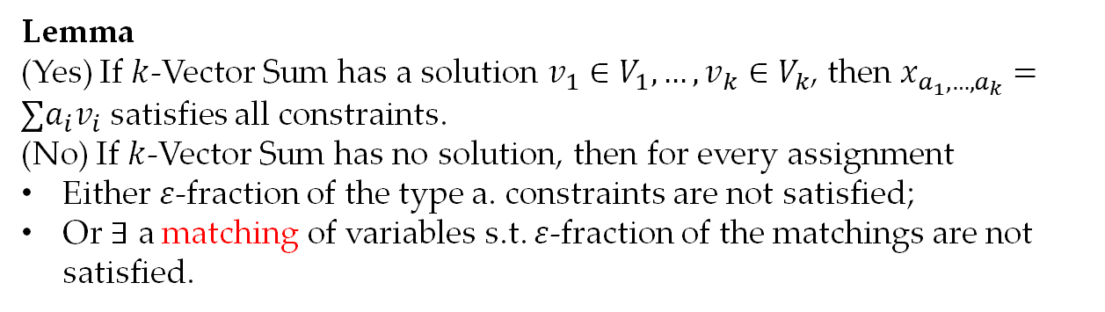


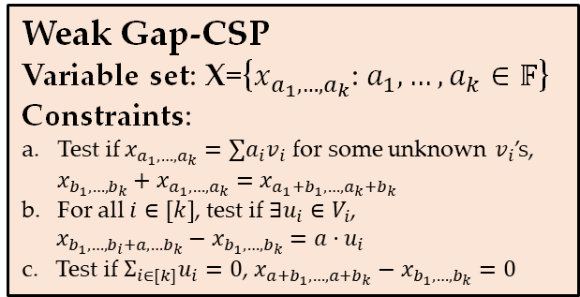
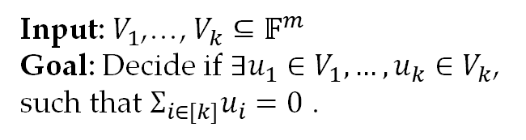
Reducing $k$-Vector Sum to Gap-Clique
Weak Gap-CSP
Variable set: X={$x_{a_{1},…,a_{k}}$: $a_{1},…,a_{k}∈𝔽$}
Constraints:
Test if $x_{a_{1},…,a_{k}}=∑a_{i}v_{i}$ for some unknown $v_{i}$’s, $x_{b_{1},…,b_{k}}+x_{a_{1},…,a_{k}}=x_{a_{1}{+b}_{1},…,a_{k}+b_{k}}$
For all $i∈[k]$, test if $∃u_{i}∈V_{i}$,
$x_{b_{1},…,b_{i}+a,…b_{k}}−x_{b_{1},…,b_{k}}=a⋅u_{i}$
c. Test if $Σ_{i∈[k]}u_{i}=0$, $x_{{a+b}_{1},…,{a+b}_{k}}−x_{b_{1},…,b_{k}}=0$
Gap Clique
type a. constraints
$k$-Vector Sum Problem
Input: $V_{1}$,…, $V_{k}⊆𝔽^{m}$
Goal: Decide if $∃u_{1}∈V_{1},…,u_{k}∈V_{k}$, such that $Σ_{i∈[k]}u_{i}=0$ .
$$A$$
$$B$$
Lemma
(Yes) If $k$-Vector Sum has a solution $v_{1}∈V_{1},…,v_{k}∈V_{k}$, then $x_{a_{1},…,a_{k}}=∑a_{i}v_{i}$ satisfies all constraints.
(No) If $k$-Vector Sum has no solution, then for every assignment
Either $ε$-fraction of the type a. constraints are not satisfied;
Or $∃$ a matching of variables s.t. $ε$-fraction of the matchings are not satisfied.

Slide 16
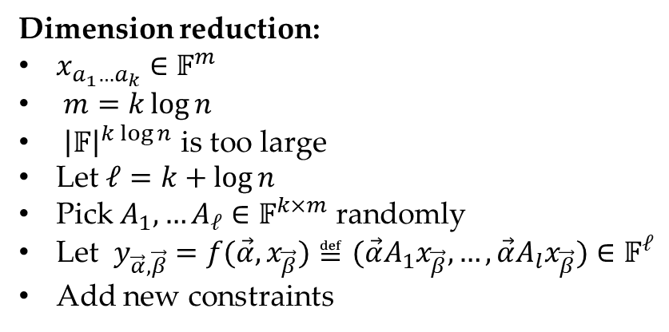
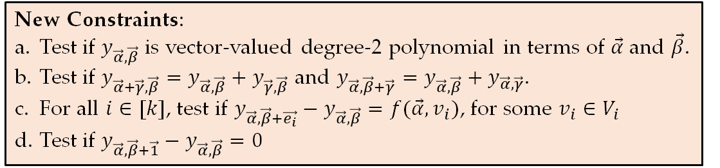
Dimension Reduction
Weak Gap-CSP
Variable set: X={$x_{a_{1},…,a_{k}}$: $a_{1},…,a_{k}∈𝔽$}
Constraints:
Test if $x_{a_{1},…,a_{k}}=∑a_{i}v_{i}$ for some unknown $v_{i}$’s, $x_{b_{1},…,b_{k}}+x_{a_{1},…,a_{k}}=x_{a_{1}{+b}_{1},…,a_{k}+b_{k}}$
For all $i∈[k]$, test if $∃u_{i}∈V_{i}$,
$x_{b_{1},…,b_{i}+a,…b_{k}}−x_{b_{1},…,b_{k}}=a⋅u_{i}$
c. Test if $Σ_{i∈[k]}u_{i}=0$, $x_{{a+b}_{1},…,{a+b}_{k}}−x_{b_{1},…,b_{k}}=0$
Gap Clique
type a. constraints
$k$-Vector Sum Problem
Input: $V_{1}$,…, $V_{k}⊆𝔽^{m}$
Goal: Decide if $∃u_{1}∈V_{1},…,u_{k}∈V_{k}$, such that $Σ_{i∈[k]}u_{i}=0$ .
$$A$$
$$B$$
Dimension reduction:
$x_{a_{1}…a_{k}}∈𝔽^{m}$
$m=k\log{n}$
${\left|𝔽\right|}^{k\log{n}}$ is too large
Let $ℓ=k+\log{n}$
Pick $A_{1},…A_{ℓ}∈𝔽^{k×m}$ randomly
Let $y_{\vec{α},\vec{β}}=f(\vec{α},x_{\vec{β}})≝(\vec{α}A_{1}x_{\vec{β}},…,\vec{α}A_{l}x_{\vec{β}})∈𝔽^{ℓ}$
Add new constraints
New Constraints:
Test if $y_{\vec{α},\vec{β}}$ is vector-valued degree-2 polynomial in terms of $\vec{α}$ and $\vec{β}$.
Test if $y_{\vec{α}+\vec{γ},\vec{β}}=y_{\vec{α},\vec{β}}+y_{\vec{γ},\vec{β}}$ and $y_{\vec{α},\vec{β}+\vec{γ}}=y_{\vec{α},\vec{β}}+y_{\vec{α},\vec{γ}}$.
For all $i∈[k]$, test if $y_{\vec{α},\vec{β}+\vec{e_{i}}}−y_{\vec{α},\vec{β}}=f(\vec{α},v_{i})$, for some $v_{i}∈V_{i}$
Test if $y_{\vec{α},\vec{β}+\vec{1}}−y_{\vec{α},\vec{β}}=0$

Slide 17
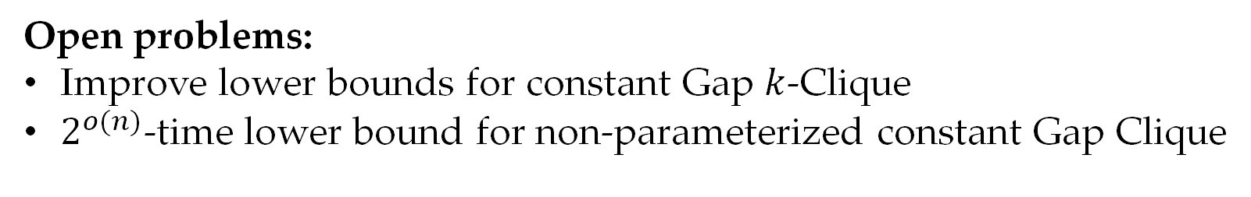
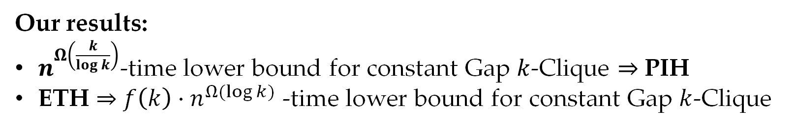
Conclusion
Our results:
$n^{Ω\left(\frac{k}{\log{k}}\right)}$-time lower bound for constant Gap $k$-Clique $⇒$ PIH
ETH $⇒$ $f\left(k\right)⋅n^{Ω(\log{k)}}$ -time lower bound for constant Gap $k$-Clique
Open problems:
Improve lower bounds for constant Gap $k$-Clique
$2^{o(n)}$-time lower bound for non-parameterized constant Gap Clique

Slide 18
Thanks for listening!

