Slide 1

Parameterized Inapproximability Hypothesis under ETH
Venkatesan Guruswami
UC Berkeley
Bingkai Lin
Nanjing University
Xuandi Ren
UC Berkeley
Yican Sun
Peking University
Kewen Wu
UC Berkeley

Slide 2

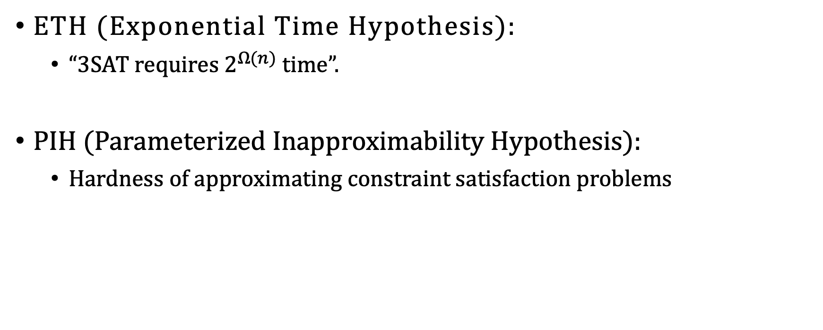
ETH $⇒$ PIH
ETH (Exponential Time Hypothesis):
“3SAT requires $2^{Ω(n)}$ time”.
PIH (Parameterized Inapproximability Hypothesis):
Hardness of approximating constraint satisfaction problems

Slide 3



Parameterized Complexity
How to cope with an NP-hard problem?
Associate each instance $x$ with a parameter $k∈ℕ$
$k≪|x|$
Measure complexity over $n=\left|x\right|$ and $k$
FPT (Fixed-Parameter Tractable, Analogue of P):
Problems that admit $f(k)∙n^{O(1)}$ time algorithms for some computable function $f$
$k$-Vertex Cover
Input:
$G=\left(V,E\right)$ and parameter $k$
Output:
$∃v_{1},…, v_{k}∈V$ covering all the edges?
has an $O(2^{k}⋅n^{O(1)})$ enumeration algorithm
Efficient for small $k$!
$$∈$$
FPT

Slide 4




Parameterized Complexity
How to cope with an NP-hard problem?
Associate each instance $x$ with a parameter $k∈ℕ$
$k≪|x|$
Measure complexity over $n=\left|x\right|$ and $k$
W[1] (Analogue of NP): widely believed W[1] $≠$ FPT
$k$-Clique
Input:
$G=\left(V,E\right)$ and parameter $k$
Output:
$∃v_{1},…, v_{k}∈V$ forming a clique?
Unlikely to have an $f(k)∙n^{O(1)}$ time algorithm
No algorithm known with runtime $n^{o(k)}$
W[1]
-complete

Slide 5
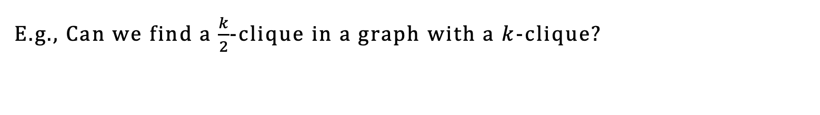
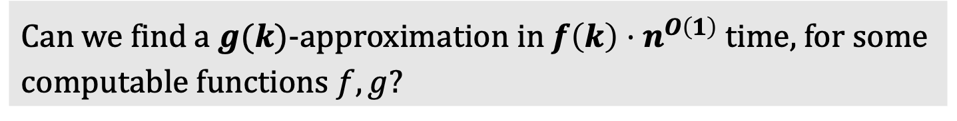
Parameterized Approximation
Can we find a $g(k)$-approximation in $f\left(k\right)⋅n^{O\left(1\right)}$ time, for some computable functions $f,g$?
E.g., Can we find a $\frac{k}{2}$-clique in a graph with a $k$-clique?

Slide 6
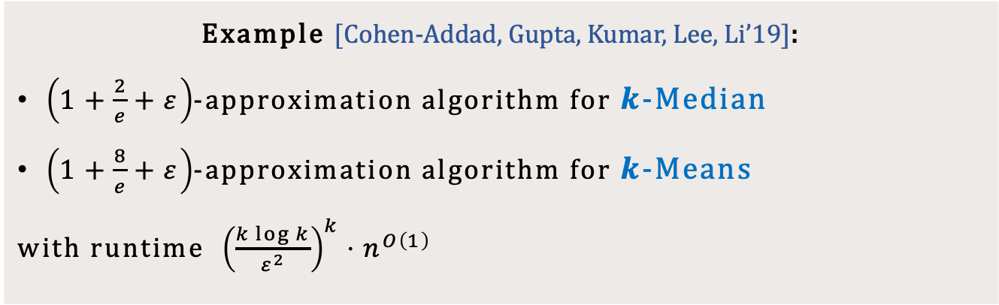

Parameterized Approximation
Can we find a $g(k)$-approximation in $f\left(k\right)⋅n^{O\left(1\right)}$ time, for some computable functions $f,g$?
Optimal ratio in FPT
Beat polytime algorithms: $2.611+ε$ for $k$-Median, $9+ε$ for $k$-Means
Example [Cohen-Addad, Gupta, Kumar, Lee, Li’19]:
$\left(1+\frac{2}{e}+ε\right)$-approximation algorithm for $k$-Median
$\left(1+\frac{8}{e}+ε\right)$-approximation algorithm for $k$-Means
with runtime ${\left(\frac{k\log{k}}{ε^{2}}\right)}^{k}⋅n^{O\left(1\right)}$

Slide 7
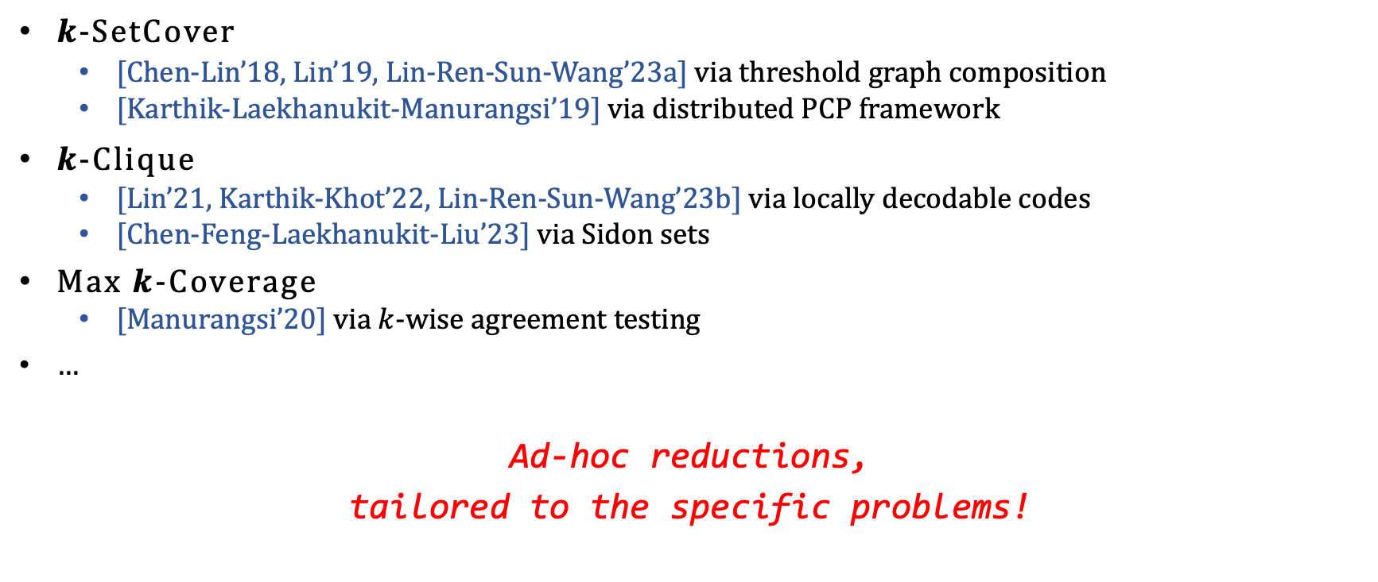
Parameterized Hardness of Approximation
$k$-SetCover
[Chen-Lin’18, Lin’19, Lin-Ren-Sun-Wang’23a] via threshold graph composition
[Karthik-Laekhanukit-Manurangsi’19] via distributed PCP framework
$k$-Clique
[Lin’21, Karthik-Khot’22, Lin-Ren-Sun-Wang’23b] via locally decodable codes
[Chen-Feng-Laekhanukit-Liu’23] via Sidon sets
Max $k$-Coverage
[Manurangsi’20] via $k$-wise agreement testing
…
Ad-hoc reductions,
tailored to the specific problems!

Slide 8
Parameterized Hardness of Approximation
Unified and powerful machinery for parameterized inapproximability?
Parameterized PCP-type theorem!

Slide 9

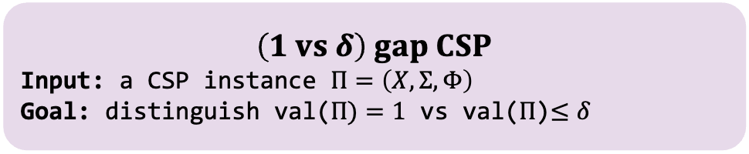
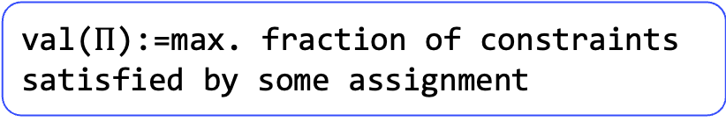

Recall: PCP Theorem
PCP Theorem:
For any constant $Σ$ and let $n=|X|$, there is no $n^{O(1)}$ time algorithm for (1 vs 0.9) gap CSP assuming P$≠$NP.
val($Π$):=max. fraction of constraints satisfied by some assignment
$$Constraint Satisfaction Problem$$
Input: $Π=\left(X,Σ,Φ\right)$
$X$: variables
$Σ$: alphabet
$Φ:$ constraints
Output:
$∃σ:X→Σ$ satisfying all constraints?
$$\left(1 vs δ\right) gap CSP$$
Input: a CSP instance $Π=\left(X,Σ,Φ\right)$
Goal: distinguish val($Π)=1$ vs val($Π$)$≤δ$

Slide 10
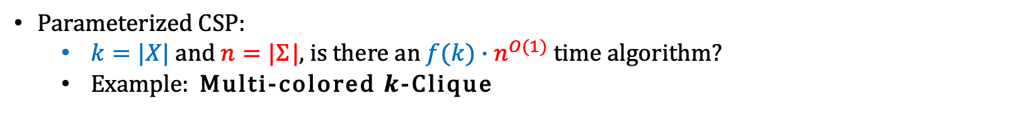
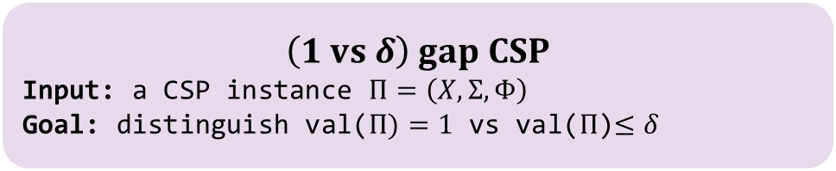
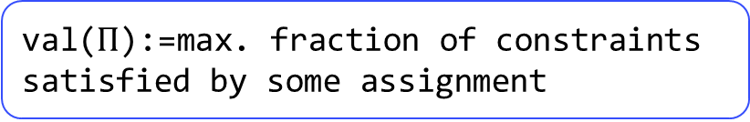
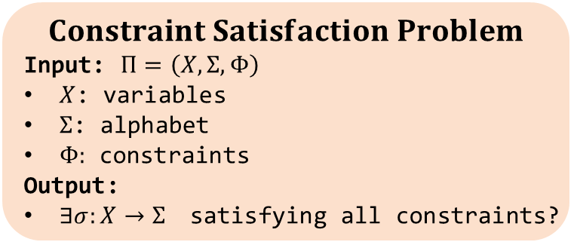
Parameterized Inapproximability Hypothesis
val($Π$):=max. fraction of constraints satisfied by some assignment
$$Constraint Satisfaction Problem$$
Input: $Π=\left(X,Σ,Φ\right)$
$X$: variables
$Σ$: alphabet
$Φ:$ constraints
Output:
$∃σ:X→Σ$ satisfying all constraints?
$$\left(1 vs δ\right) gap CSP$$
Input: a CSP instance $Π=\left(X,Σ,Φ\right)$
Goal: distinguish val($Π)=1$ vs val($Π$)$≤δ$
Parameterized CSP:
$k=|X|$ and $n=|Σ|$, is there an $f(k)∙n^{O(1)}$ time algorithm?
Example: Multi-colored $k$-Clique
PIH (Parameterized Inapproximability Hypothesis) [Lokshtanov-Ramanujan-Saurabh-Zehavi’20]:
Let $k=|X|$ and $n=|Σ|$, there is no ${f(k)∙n}^{O(1)}$ time algorithm for (1 vs 0.9) gap parameterized CSP.

Slide 11
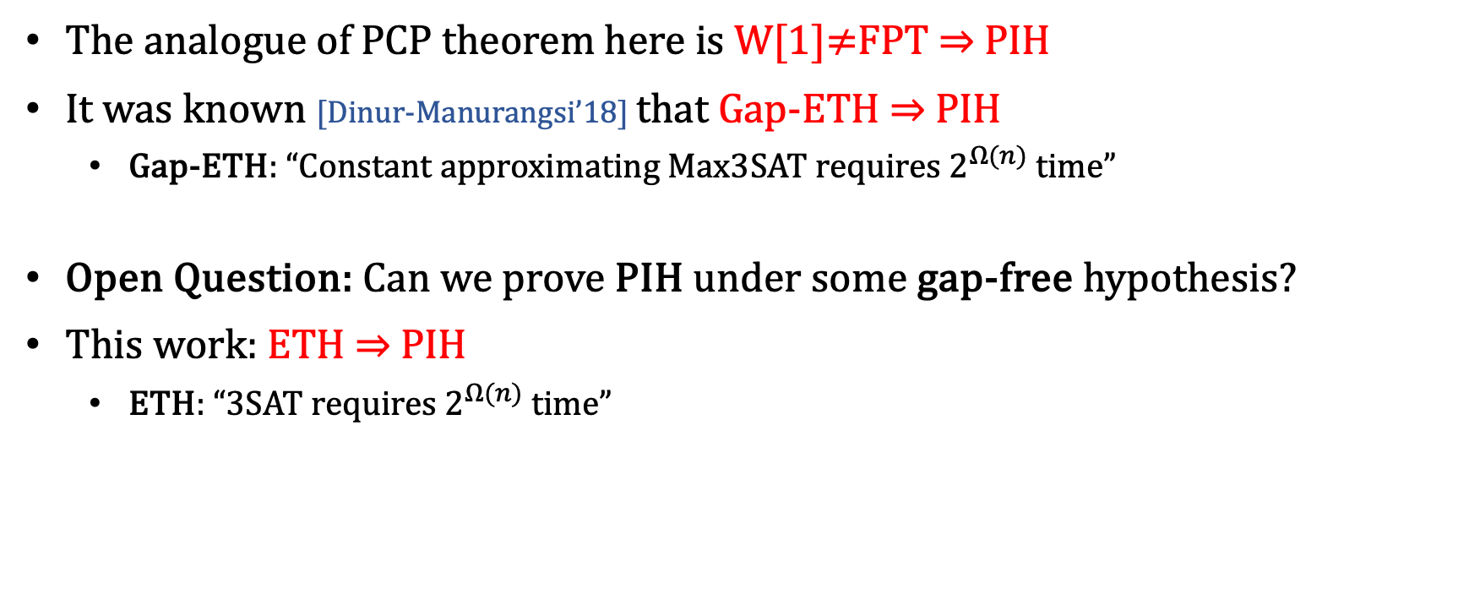
Parameterized Inapproximability Hypothesis
The analogue of PCP theorem here is W[1]$≠$FPT $⇒$ PIH
It was known [Dinur-Manurangsi’18] that Gap-ETH $⇒$ PIH
Gap-ETH: “Constant approximating Max3SAT requires $2^{Ω(n)}$ time”
Open Question: Can we prove PIH under some gap-free hypothesis?
This work: ETH $⇒$ PIH
ETH: “3SAT requires $2^{Ω(n)}$ time”

Slide 12


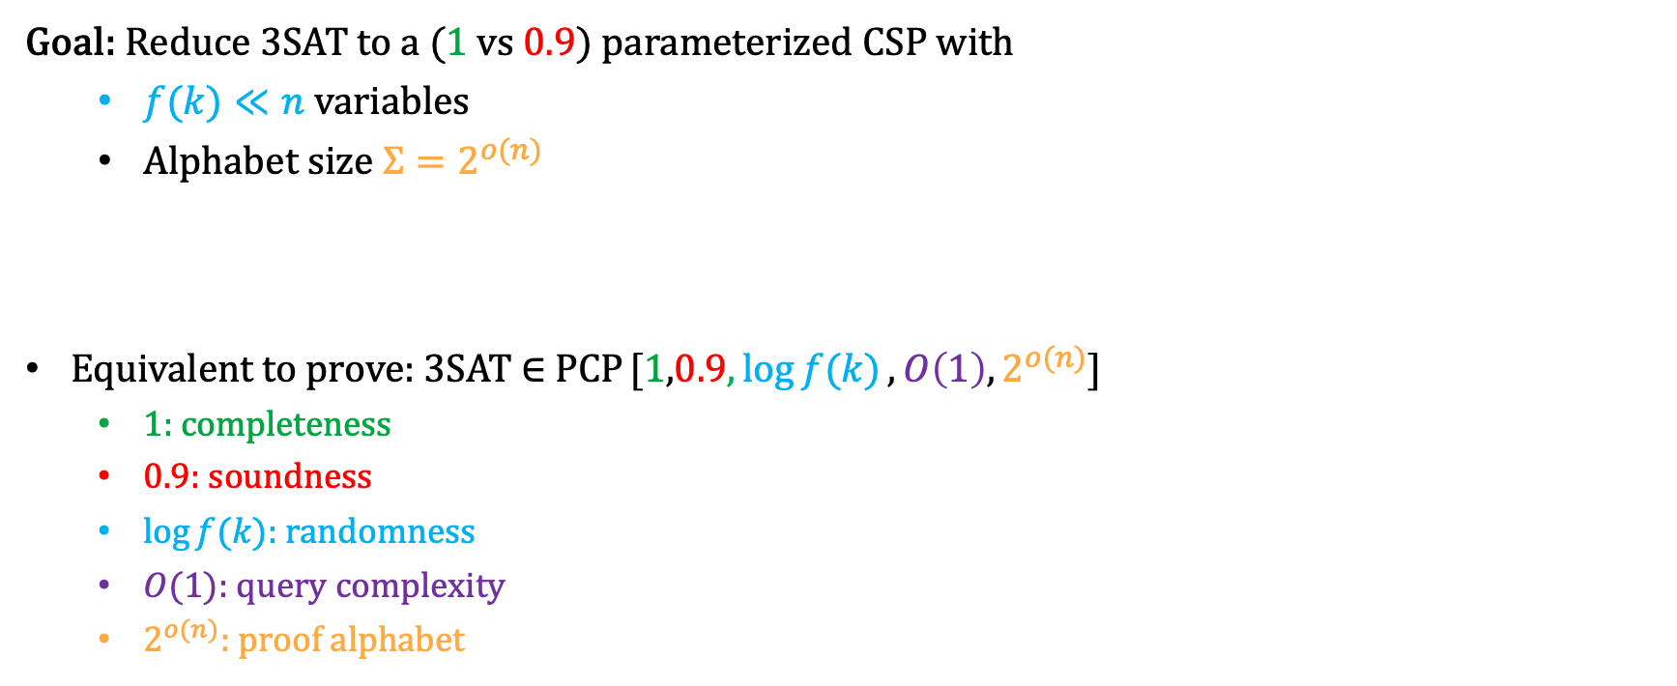


ETH $⇒$ PIH
Goal: Reduce 3SAT to a (1 vs 0.9) parameterized CSP with
$f(k)≪n$ variables
Alphabet size ${Σ=2}^{o(n)}$
Equivalent to prove: 3SAT $∈$ PCP [1,0.9$, \log{f(k)}, O\left(1\right), 2^{o(n)}$]
1: completeness
0.9: soundness
$\log{f(k)}$: randomness
$O(1)$: query complexity
$2^{o(n)}$: proof alphabet
Classical PCP: 3SAT $∈$ PCP [1,0.9$, O(log{n)}, O\left(1\right), O(1)$]
…
V
Proof
$$φ$$
If $φ∈$3SAT then ∃ proof $\operatorname{Pr}\left[V accepts\right]=1$
If $φ∉$3SAT then $∀$ proof $\operatorname{Pr}\left[V^{ }accepts\right]≤0.9$

Slide 13
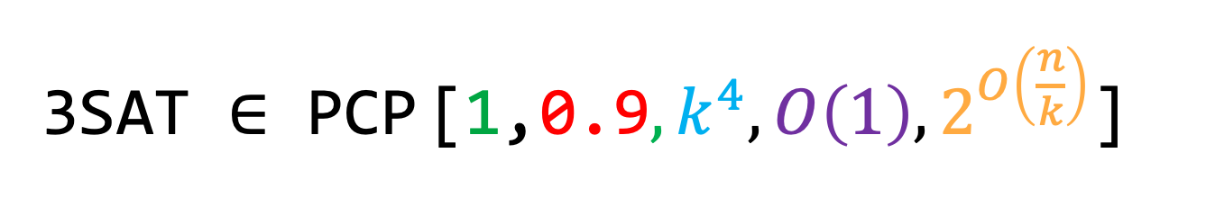

ETH $⇒$ PIH
Goal: Reduce 3SAT to a (1 vs 0.9) parameterized CSP with
$f(k)≪n$ variables
Alphabet size ${Σ=2}^{o(n)}$
In particular, we prove:
3SAT $∈$ PCP [1,0.9$, k^{4}, O\left(1\right), 2^{O\left(\frac{n}{k}\right)}$]

Slide 14
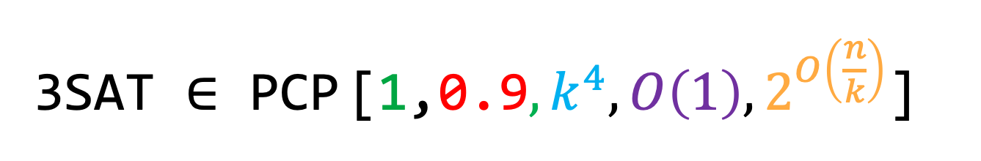
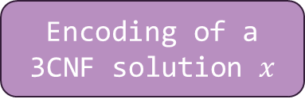
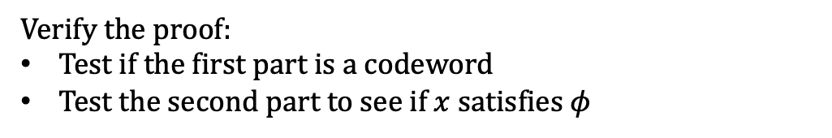
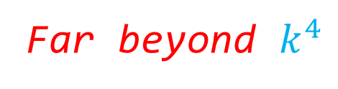

3SAT $∈$ PCP [1,0.9$, k^{4}, O\left(1\right), 2^{O\left(\frac{n}{k}\right)}$]
Given a 3CNF $φ$, Typical PCP Proof:
Encoding of a 3CNF solution $x$
Auxiliary proof
Verify the proof:
Test if the first part is a codeword
Test the second part to see if $x$ satisfies $φ$
Hadamard encoding: randomness = $poly\left(n\right)$
Reed-Muller encoding: randomness = $O(\log{n)}$
Far beyond $k^{4}$

Slide 15
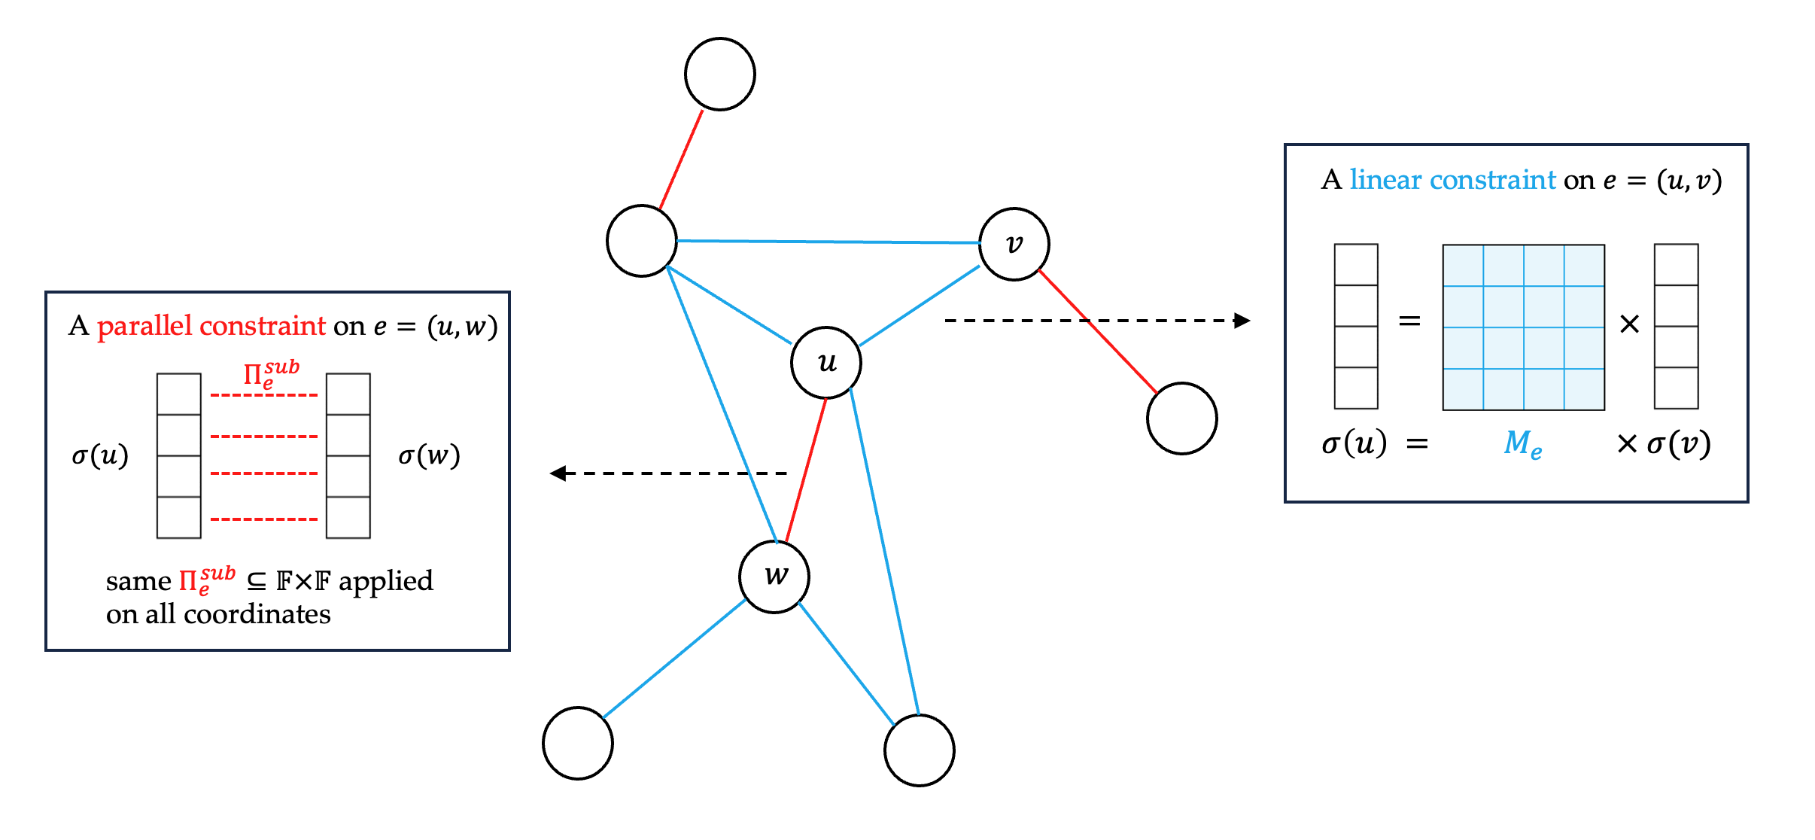
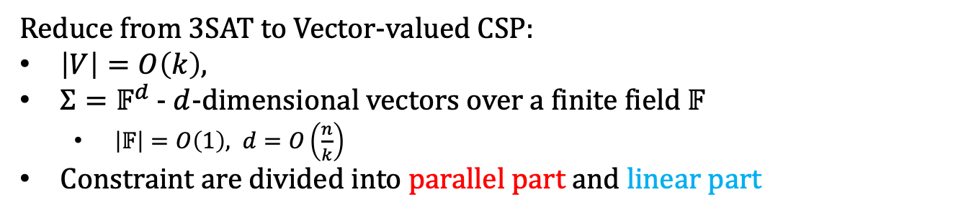
Vectorization
Reduce from 3SAT to Vector-valued CSP:
$\left|V\right|=O\left(k\right),$
$Σ=𝔽^{d}$ - $d$-dimensional vectors over a finite field $𝔽$
$\left|𝔽\right|=O\left(1\right), d=O\left(\frac{n}{k}\right)$
Constraint are divided into parallel part and linear part
Notes:
structured enough, rich enough …

Slide 16
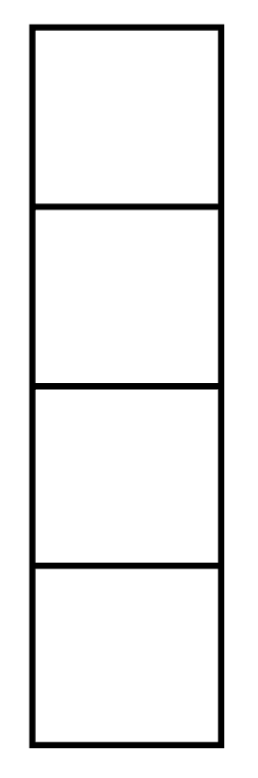



















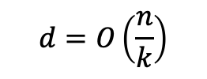


Parallel Encoding
Given a vector-valued CSP with variables $\{x_{1},…,x_{k}\}$:
Hadamard
Encoding
$$x_{1}$$
$$x_{2}$$
$$x_{k}$$
$$y_{1}$$
$$y_{2}$$
$$y_{𝔽^{k}}$$
$$d=O\left(\frac{n}{k}\right)$$
$$…$$
$$…$$
$$∈$$
$$∈$$
$$∈$$
$$∈$$
$$∈$$
$$∈$$
$$𝔽^{d}$$
$$𝔽^{d}$$
$$𝔽^{d}$$
$$𝔽^{d}$$
$$𝔽^{d}$$
$$𝔽^{d}$$
Admit parallel codeword testing and verification!
Randomness only depends on $k$!

Slide 17
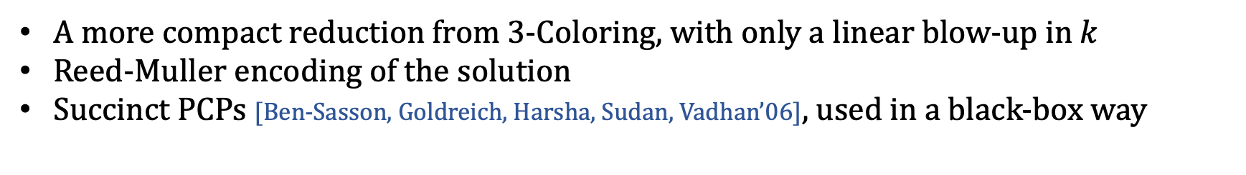
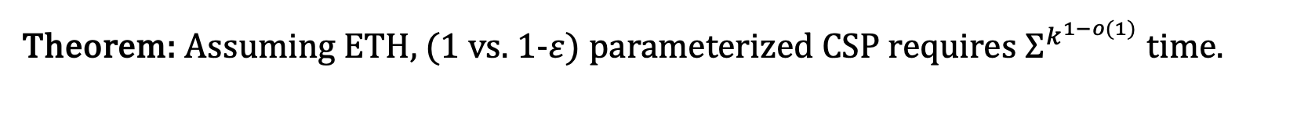
Recent Improvement
Theorem: Assuming ETH, (1 vs. 1-$ε$) parameterized CSP requires $Σ^{k^{1−o(1)}}$ time.
A more compact reduction from 3-Coloring, with only a linear blow-up in $k$
Reed-Muller encoding of the solution
Succinct PCPs [Ben-Sasson, Goldreich, Harsha, Sudan, Vadhan’06], used in a black-box way

Slide 18
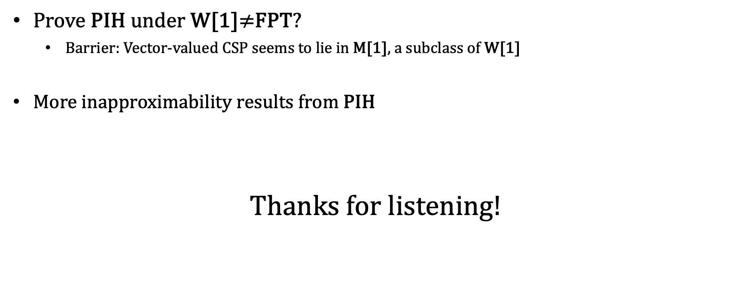
Open Questions
Prove PIH under W[1]$≠$FPT?
Barrier: Vector-valued CSP seems to lie in M[1], a subclass of W[1]
More inapproximability results from PIH
Thanks for listening!

Slide 19
Proof Sketch
1. Reduce 3SAT to Vector-Valued CSP (VecCSP)
VecCSP: an intermediate vectorized problem, where the constraints are divided into a parallel part and a linear part
2. Design Parallel PCP of Proximity for both parts
Use Hadamard Code based PCPP [Arora-Lund-Motwani-Sudan-Szegedy’98] due to its simplicity and ease of parallelization

Slide 20
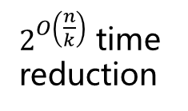
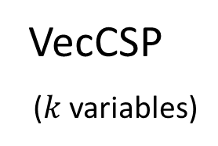
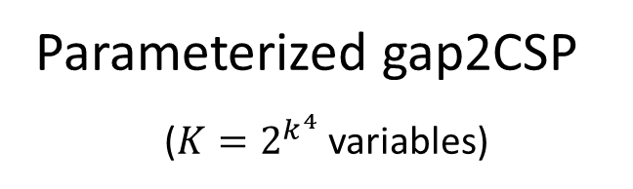
Proof Sketch
$2^{O\left(\frac{n}{k}\right)}$ time
reduction
3-SAT
VecCSP
($k$ variables)
Parameterized gap2CSP
($K=2^{k^{4}}$ variables)
Let’s construct
a PCP!

Slide 21
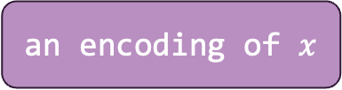

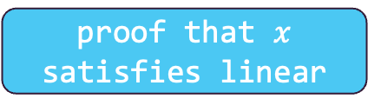
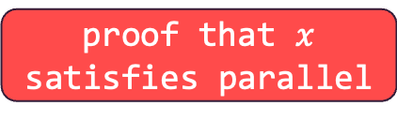
PCP of Proximity
Suppose Alice wants to convince you that a VecCSP instance is satisfiable.
She could give you a proof that the parallel part is satisfiable, and a proof that the linear part is satisfiable.
Wait! How to ensure the two parts share the same solution?
We need PCP of proximity! The statement to prove is not “$Γ$ is satisfiable”, but “$x$ is (the encoding of) a solution to $Γ$”!
final proof:
an encoding of $x$
proof that $x$ satisfies parallel
proof that $x$ satisfies linear

Slide 22

PCP of Proximity
Suppose Alice wants to convince you that a VecCSP instance is satisfiable.
She could give you a proof that the parallel part is satisfiable, and a proof that the linear part is satisfiable.
Wait! How to ensure the two parts share the same solution?
We need PCP of proximity! The statement to prove is not “$Γ$ is satisfiable”, but “$x$ is (the encoding of) a solution to $Γ$”!
PCPP verifier for linear
final proof:
an encoding of $x$
proof that $x$ satisfies parallel
proof that $x$ satisfies linear
PCPP verifier for parallel

Slide 23

















PCPP for the Parallel Part
$$x_{1}$$
$$x_{2}$$
$$x_{k}$$
$$x^{1}≜$$
WH($x^{1}$)
WH($x^{1}{\left(x^{1}\right)}^{T}$)
$$…$$
$$…$$
the same circuit!
$$…$$
$$…$$
$$x^{d}≜$$
WH($x^{d}$)
WH($x^{d}{\left(x^{d}\right)}^{T}$)
$$∈$$
$$∈$$
$$∈$$
$$𝔽^{d}$$
$$𝔽^{d}$$
$$𝔽^{d}$$

Slide 24
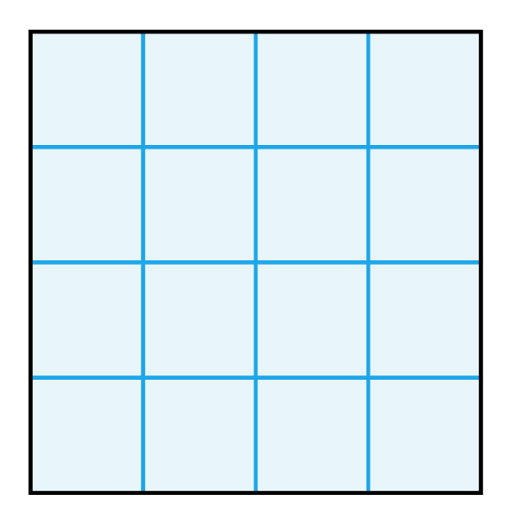


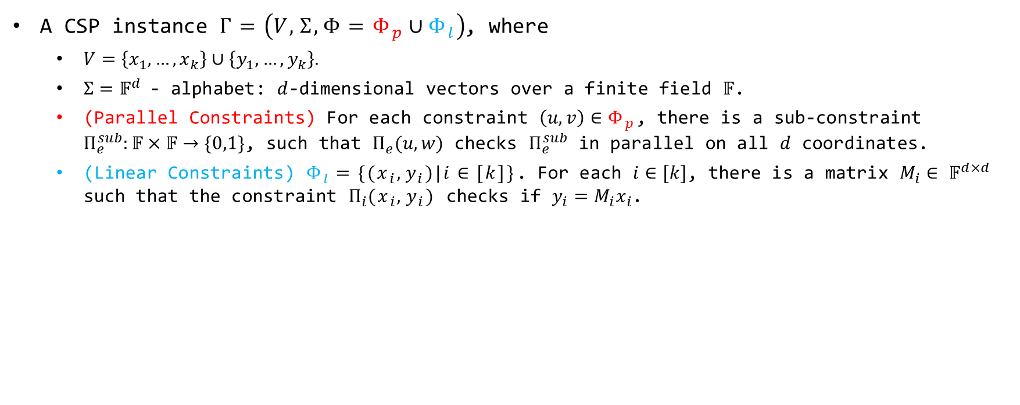







Vector-Valued CSP
A CSP instance $Γ=\left(V,Σ,Φ=Φ_{p}∪Φ_{l}\right)$, where
$V=\left\{x_{1},…,x_{k}\right\}∪\left\{y_{1},…,y_{k}\right\}.$
$Σ=𝔽^{d}$- alphabet: $d$-dimensional vectors over a finite field $𝔽$.
(Parallel Constraints) For each constraint $\left(u,v\right)∈Φ_{p}$, there is a sub-constraint $Π_{e}^{sub}:𝔽×𝔽→\{0,1\}$, such that $Π_{e}(u,w)$ checks $Π_{e}^{sub}$ in parallel on all $d$ coordinates.
(Linear Constraints) $Φ_{l}=\{(x_{i},y_{i})|i∈[k]\}$. For each $i∈[k]$, there is a matrix $M_{i}∈$ $𝔽^{d×d}$ such that the constraint $Π_{i}(x_{i},y_{i})$ checks if $y_{i}=M_{i}x_{i}$.
A parallel constraint on $e=(u,w)$
A linear constraint on $e=(x_{i},y_{i})$
$$Π_{e}^{sub}$$
$$σ(u)$$
$$σ(w)$$
$$=$$
$$×$$
$$σ(w)$$
$$Π_{e}^{sub}$$
same $Π_{e}^{sub}⊆𝔽×𝔽$ applied on a subset of coordinates
$σ\left(y_{i}\right) = M_{e}$ $× σ(x_{i})$

Slide 25


3SAT$→$VecCSP
3SAT $→$3-Coloring $→$VecCSP
Lemma (folklore): 3SAT is reducible to 3-Coloring, with a linear blow-up ($\left|G\right|=O(|φ|)$).

Slide 26


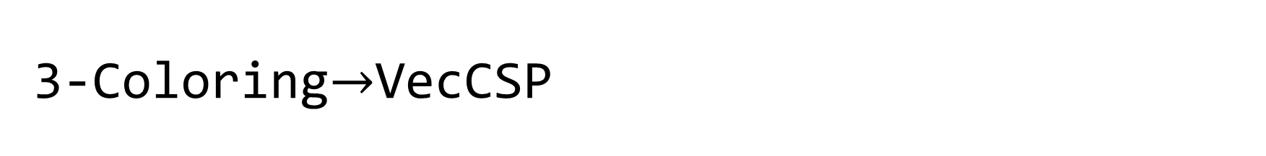






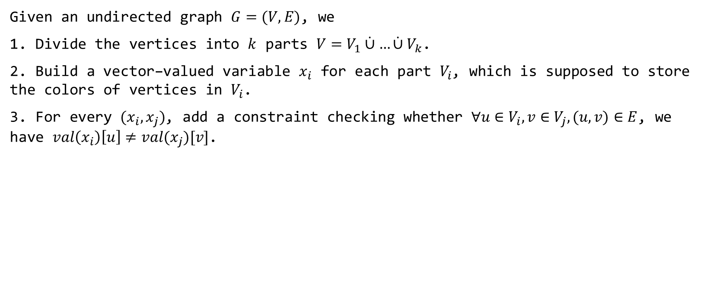


3-Coloring$→$VecCSP
Given an undirected graph $G=(V,E)$, we
1. Divide the vertices into $k$ parts $V=V_{1}\dot{∪}…\dot{∪}V_{k}$.
2. Build a ${\text{vector}\text{−}\text{valued} \text{variable} x_{i} \text{for} \text{each} \text{part} V}_{i}$, which is supposed to store the colors of vertices in $V_{i}$.
3. For every $(x_{i},x_{j})$, add a constraint checking whether $∀u∈V_{i},v∈V_{j},(u,v)∈E$, we have $val\left(x_{i}\right)\left[u\right]≠val(x_{j})[v]$.
$$z_{1}$$
$$z_{2}$$
$$z_{3}$$
$$z_{4}$$
$$z_{5}$$
$$z_{6}$$
$$z_{1}$$
$$z_{3}$$
$$z_{4}$$
$$z_{2}$$
$$z_{5}$$
$$z_{6}$$
$$x_{1}$$
$$x_{2}$$
Notes:
For simplicity, the example here is not 4-regular

Slide 27

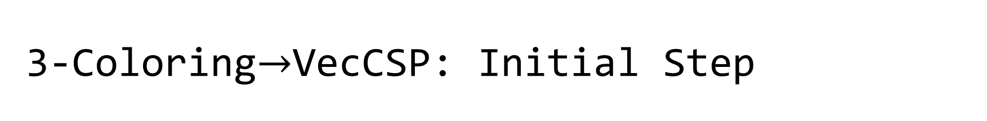









3-Coloring$→$VecCSP: Initial Step
Given an undirected graph $G=(V,E)$, we
1. Divide the vertices into $k$ parts $V=V_{1}\dot{∪}…\dot{∪}V_{k}$.
2. Build a ${\text{vector}\text{−}\text{valued} \text{variable} x_{i} \text{for} \text{each} \text{part} V}_{i}$, which is supposed to store the colors of vertices in $V_{i}$.
3. For every $(x_{i},x_{j})$, add a constraint checking 3-color constraints among $V_{i}∪V_{j}$
$$z_{1}$$
$$z_{2}$$
$$z_{3}$$
$$z_{4}$$
$$z_{5}$$
$$z_{6}$$
$$z_{1}$$
$$z_{3}$$
$$z_{4}$$
$$z_{2}$$
$$z_{5}$$
$$z_{6}$$
$$x_{1}$$
$$x_{2}$$
$G=(\{z_{1},z_{2},…,z_{6}\},E)$
Initial CSP

Slide 28



















3-Coloring$→$VecCSP
4. Make many copies of each variable, and split the constraints onto different copies, such that
each copy is adjacent to only one constraint
the only constraint is a (partial) matching on the $d×d$ entries
$$z_{1}$$
$$z_{2}$$
$$z_{3}$$
$$z_{4}$$
$$z_{5}$$
$$z_{6}$$
$$z_{1}$$
$$z_{2}$$
$$z_{3}$$
$$z_{4}$$
$$z_{5}$$
$$z_{6}$$
$$z_{1}$$
$$z_{2}$$
$$z_{3}$$
$$z_{4}$$
$$z_{5}$$
$$z_{6}$$
$$z_{1}$$
$$z_{2}$$
$$z_{3}$$
$$z_{1}$$
$$z_{2}$$
$$z_{3}$$
$$z_{4}$$
$$z_{5}$$
$$z_{6}$$
$$z_{4}$$
$$z_{5}$$
$$z_{6}$$
$$x_{1}$$
$$x_{2}$$
$$x_{1}^{1}$$
$$x_{2}^{1}$$
$$x_{1}^{2}$$
$$x_{2}^{2}$$
$$x_{1}^{3}$$
$$x_{1}^{4}$$
$$x_{2}^{3}$$
$$x_{2}^{4}$$

Slide 29

















3-Coloring$→$VecCSP
5. Then, permute the $d$ coordinates of each variable according to its only constraint, such that the constraints are all parallel.
6. We also need to check the consistency between different copies, which is a permuted equality, which are linear constraints.
$$z_{1}$$
$$z_{2}$$
$$z_{3}$$
$$z_{5}$$
$$z_{6}$$
$$z_{4}$$
$$z_{1}$$
$$z_{2}$$
$$z_{3}$$
$$z_{6}$$
$$z_{5}$$
$$z_{4}$$
$$z_{1}$$
$$z_{2}$$
$$z_{3}$$
$$z_{3}$$
$$z_{1}$$
$$z_{2}$$
$$z_{4}$$
$$z_{5}$$
$$z_{6}$$
$$z_{6}$$
$$z_{4}$$
$$z_{5}$$
$$x_{1}^{1}$$
$$x_{2}^{1}$$
$$x_{1}^{2}$$
$$x_{2}^{2}$$
$$x_{1}^{3}$$
$$x_{1}^{4}$$
$$x_{2}^{3}$$
$$x_{2}^{4}$$

Slide 30








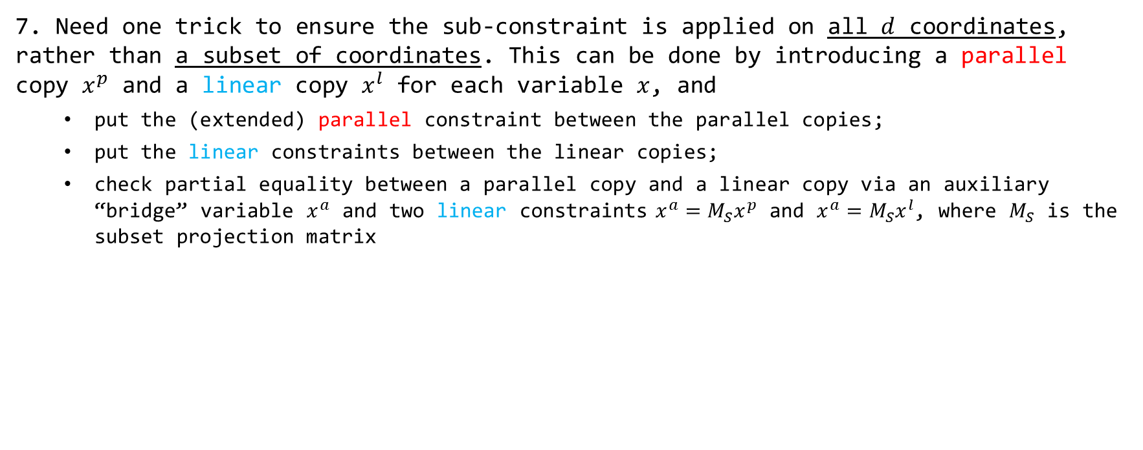
3-Coloring$→$VecCSP
7. Need one trick to ensure the sub-constraint is applied on all $d$ coordinates, rather than a subset of coordinates. This can be done by introducing a parallel copy $x^{p}$ and a linear copy $x^{l}$ for each variable $x$, and
put the (extended) parallel constraint between the parallel copies;
put the linear constraints between the linear copies;
check partial equality between a parallel copy and a linear copy via an auxiliary “bridge” variable $x^{a}$ and two linear constraints $x^{a}=M_{S}x^{p}$ and $x^{a}=M_{S}x^{l}$, where $M_{S}$ is the subset projection matrix
$$x^{p}$$
$$y^{p}$$
$$z^{p}$$
$$G$$
$$x$$
$$y$$
$$z$$
$$G′$$
$$x^{a}$$
$$y^{a}$$
$$z^{a}$$
$$x^{l}$$
$$y^{l}$$
$$z^{l}$$
: a parallel constraint, on a subset of coordinates
: a parallel constraint on all coordinates
: a linear constraint, the arrow shows the direction
: a linear constraint which computes the projection

Slide 31










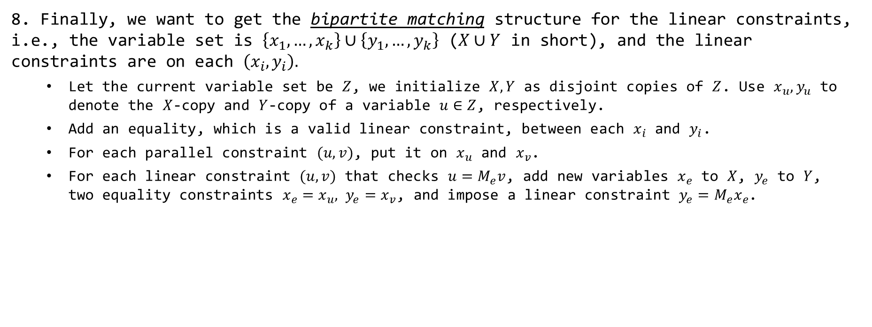


3-Coloring$→$VecCSP
8. Finally, we want to get the bipartite matching structure for the linear constraints, i.e., the variable set is $\left\{x_{1},…,x_{k}\right\}∪\left\{y_{1},…,y_{k}\right\}$ ($X∪Y$ in short), and the linear constraints are on each $\left(x_{i},y_{i}\right).$
Let the current variable set be $Z$, we initialize $X,Y$ as disjoint copies of $Z$. Use $x_{u},y_{u}$ to denote the $X$-copy and $Y$-copy of a variable $u∈Z$, respectively.
Add an equality, which is a valid linear constraint, between each $x_{i}$ and $y_{i}$.
For each parallel constraint $(u,v)$, put it on $x_{u}$ and $x_{v}$.
For each linear constraint $(u,v)$ that checks $u=M_{e}v$, add new variables $x_{e}$ to $X$, $y_{e}$ to $Y$, two equality constraints $x_{e}=x_{u}, y_{e}=x_{v}$, and impose a linear constraint $y_{e}=M_{e}x_{e}$.
$$x_{e_{2}}$$
$$x_{u}$$
$$x_{v}$$
$$x_{w}$$
$$G′$$
$$u$$
$$v$$
$$e_{2}$$
$$w$$
$$G′′$$
$$e_{1}$$
$$y_{e_{2}}$$
$$y_{u}$$
$$y_{v}$$
$$y_{w}$$
: a linear constraint checking equality
: a parallel constraint checking equality

Slide 32





Hadamard Code Based PCPP
QuadEq Problem
$q$ quadratic equations on $c$ binary variables
Input: $q,c∈ℤ,D_{1},…,D_{q}∈𝔽_{2}^{c×c},b_{1},…,b_{q}∈𝔽_{2};$
Output: whether $∃u∈𝔽_{2}^{c}$ s.t. $∀i∈\left[q\right], u^{T}D_{i}u=b_{i}$.
NP-hardness: reduce from CircuitSAT
Let $u$ $∈𝔽_{2}^{c}$ be a solution to QuadEQ, and let $w=uu^{T}$ $∈𝔽_{2}^{c×c}$. The proof consists of the Walsh-Hadamard encoding of $u$, and of $w$.
WH($u$)
WH($w$)
$$2^{c}$$
$$2^{c^{2}}$$

Slide 33




Hadamard Code Based PCPP
QuadEq Problem
$q$ quadratic equations on $c$ binary variables
Input: $q,c∈ℤ,D_{1},…,D_{q}∈𝔽_{2}^{c×c},b_{1},…,b_{q}∈𝔽_{2};$
Output: whether $∃u∈𝔽_{2}^{c}$ s.t. $∀i∈\left[q\right], u^{T}D_{i}u=b_{i}$.
WH($u$)
WH($w$)
The verifier performs 3 types of checks:
1. Check whether and are close to Hadamard codewords.
2. Check whether $w=uu^{T}.$ This can be done by picking random $r,r′∈𝔽_{2}^{c}$, and checking whether $r^{T}wr′=(r^{T}u)(u^{T}r′)$, where $r^{T}u$, $u^{T}r′$ can be locally corrected from , and $r^{T}wr′$ can be locally corrected from .
3. Check whether $∀i∈\left[q\right], u^{T}D_{i}u=b_{i}$. This can be done by picking a random subset $S$ of $[q]$, and checking whether $\sum_{i∈S}{u^{T}D_{i}u}=\sum_{i∈S}{b_{i}}$, where $\sum_{i∈S}{u^{T}D_{i}u}$ can be locally corrected from .

Slide 34



















PCPP for the Parallel Part
$$x_{1}$$
$$x_{2}$$
$$x_{k}$$
$$x^{1}≜$$
WH($x^{1}$)
WH($x^{1}{\left(x^{1}\right)}^{T}$)
$$…$$
$$…$$
the same circuit!
$$…$$
$$…$$
$$x^{d}≜$$
WH($x^{d}$)
WH($x^{d}{\left(x^{d}\right)}^{T}$)
$$∈$$
$$∈$$
$$∈$$
$$𝔽^{d}$$
$$𝔽^{d}$$
$$𝔽^{d}$$
Notes:
same randomness for each row

Slide 35

PCPP for the Parallel Part
$$x_{1}$$
$$x_{2}$$
$$x_{k}$$
$$x^{1}≜$$
WH($x^{1}$)
WH($x^{1}{\left(x^{1}\right)}^{T}$)
$$…$$
$$…$$
the same circuit!
$$…$$
$$…$$
$$x^{d}≜$$
WH($x^{d}$)
WH($x^{d}{\left(x^{d}\right)}^{T}$)
$$∈$$
$$∈$$
$$∈$$
$$𝔽^{d}$$
$$𝔽^{d}$$
$$𝔽^{d}$$
PCPP verifier

Slide 36

PCPP for the Linear Part
Suppose the matrix for a constraint $e=(u_{e}, v_{e})$ is $M_{e}$,
i.e., we want to check $σ\left(u_{e}\right)=M_{e}σ\left(v_{e}\right)∈𝔽^{d×d}$.
1. Build an auxiliary variable $z_{w,e}∈𝔽^{d}$ for each (variable, constraint) pair (even if the constraint does not involve this variable!).
$z_{w,e}$ is supposed to store $M_{e}σ\left(w\right)$
Proof: parallel Walsh-Hadamard encoding of ${\left\{z_{w,e}\right\}}_{w∈V,e∈E}$
2. Check whether $∀w∈V,e∈E,$ $z_{w,e}$ takes value $M_{e}σ\left(w\right)$.
3. Check whether ${σ\left(u_{e}\right)=z}_{v_{e},e}$.

Slide 37














PCPP for the Linear Part
Linear Constraints on
variables $x_{1}…,x_{k},y_{1},…,y_{k}$
$$c_{1}y_{1}+c_{2}y_{2}…+c_{k}y_{k}$$
=
$$c_{1}z_{11}+c_{2}z_{22}…+c_{k}z_{kk}$$
$$y_{1}=A_{1}x_{1}$$
WH Code of
$y_{1}…,y_{k}$
WH Code of
$x_{1}…,x_{k}$
WH Code of $z_{11},z_{21}…z_{k1},z_{12}…z_{kk}$
$$y_{2}=A_{2}x_{2}$$
…
Expecting $z_{ij}=A_{i}x_{j}$
$$y_{k}=A_{k}x_{k}$$
$$a_{1}b_{1}z_{11}+a_{1}b_{2}z_{21}…a_{1}b_{k}z_{k1} +…+a_{k}b_{1}z_{1k}+a_{k}b_{2}z_{2k}…a_{k}b_{k}z_{kk}$$
$$\left(b_{1}A_{1}+b_{2}A_{2}…b_{k}A_{k}\right)⋅$$
$$(a_{1}x_{1}+…+a_{k}x_{k})$$
=
The verifier performs 3 types of checks:
1. Check whether and are close to Hadamard codewords.
2. Check $y_{i}=z_{ii}$
3. Check $z_{ij}=A_{i}x_{j}$

Slide 38






Combine Things Together
3SAT$→$VecCSP(parallel part, linear part)[$𝔽=O\left(1\right),d=O(n/k)$]
VecCSP $∈$ PCP_{1,1-}$ε$[$O(k^{4})$,$O(1)$]$Σ$_{=2^{O(n/k)}}
PCPP verifier for linear
PWH($x$)
proof that $x$ satisfies parallel
proof that $x$ satisfies linear
$$d$$
final proof:
PCPP verifier for parallel
$$2^{O(k^{4})}$$

