Slide 1
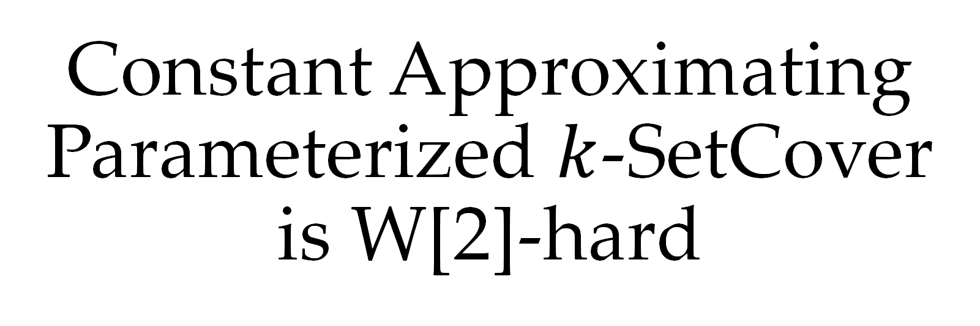
Constant Approximating Parameterized $k$-SetCover is W[2]-hard
Bingkai Lin, Xuandi Ren, Yican Sun, Xiuhan Wang
Jan, 2023

Slide 2



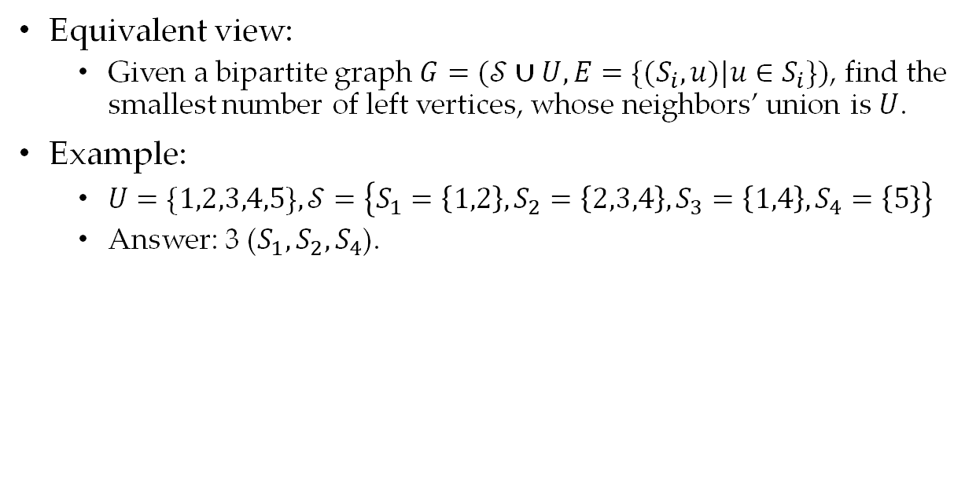

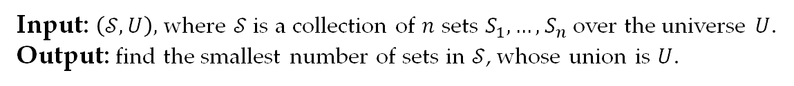




SetCover Problem
1
$$S_{1}$$
Input: $\left(𝒮,U\right),$ where $𝒮$is a collection of $n$ sets $S_{1},…, S_{n}$over the universe $U$.
Output: find the smallest number of sets in $𝒮$, whose union is $U$.
$$2$$
$$S_{2}$$
Equivalent view:
Given a bipartite graph $G=(𝒮∪U,E=\{(S_{i},u)|u∈S_{i}\})$, find the smallest number of left vertices, whose neighbors’ union is $U$.
Example:
$U=\{1,2,3,4,5\},𝒮=\left\{S_{1}=\left\{1,2\right\},S_{2}=\left\{2,3,4\right\},S_{3}=\left\{1,4\right\},S_{4}=\left\{5\right\}\right\}$
Answer: 3 ($S_{1},S_{2},S_{4}$).
$$3$$
$$S_{3}$$
$$4$$
$$S_{4}$$
$$5$$

Slide 3

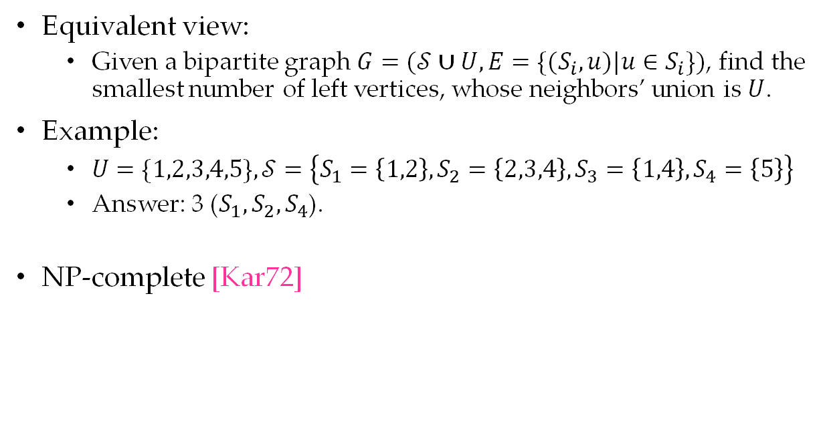



SetCover Problem
1
$$S_{1}$$
Input: $\left(𝒮,U\right),$ where $𝒮$is a collection of $n$ sets $S_{1},…, S_{n}$over the universe $U$.
Output: find the smallest number of sets in $𝒮$, whose union is $U$.
$$2$$
$$S_{2}$$
Equivalent view:
Given a bipartite graph $G=(𝒮∪U,E=\{(S_{i},u)|u∈S_{i}\})$, find the smallest number of left vertices, whose neighbors’ union is $U$.
Example:
$U=\{1,2,3,4,5\},𝒮=\left\{S_{1}=\left\{1,2\right\},S_{2}=\left\{2,3,4\right\},S_{3}=\left\{1,4\right\},S_{4}=\left\{5\right\}\right\}$
Answer: 3 ($S_{1},S_{2},S_{4}$).
NP-complete [Kar72]
$$3$$
$$S_{3}$$
$$4$$
$$S_{4}$$
$$5$$

Slide 4

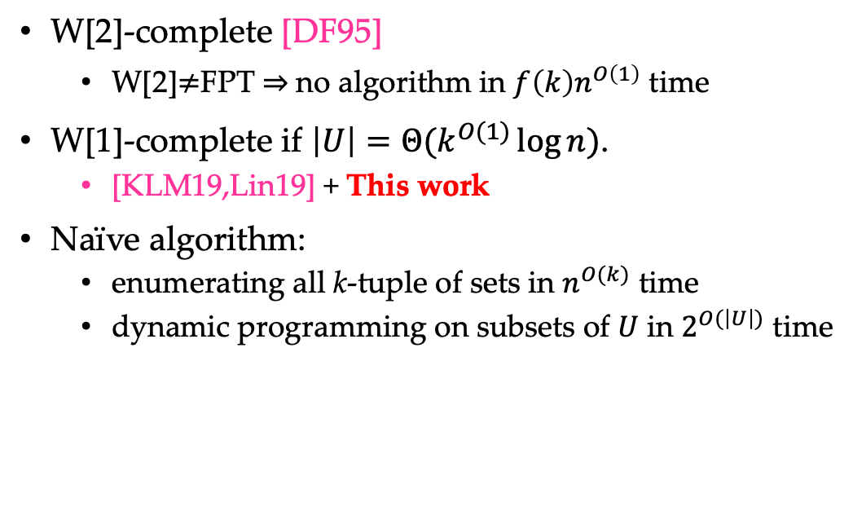



Parameterized SetCover Problem
$k$-SetCover
Input: $\left(𝒮,U,k\right),$ where $𝒮$is a collection of $n$ sets $S_{1},…, S_{n}$over the universe $U$.
Output: find the smallest number of sets in $𝒮$, whose union is $U$. It’s guaranteed that the optimum is $k$.
W[2]-complete [DF95]
W[2]$≠$FPT $⇒$no algorithm in $f\left(k\right)n^{O\left(1\right)}$ time
W[1]-complete if $\left|U\right|=Θ(k^{O(1)}\log{n})$.
[KLM19,Lin19] + This work
Naïve algorithm:
enumerating all k-tuple of sets in $n^{O(k)}$ time
dynamic programming on subsets of $U$ in $2^{O(\left|U\right|)}$ time
W[2]
W[1]
$k$-Clique
$k$-SetCover
$k$-SetCover
$($small $U$)

Slide 5
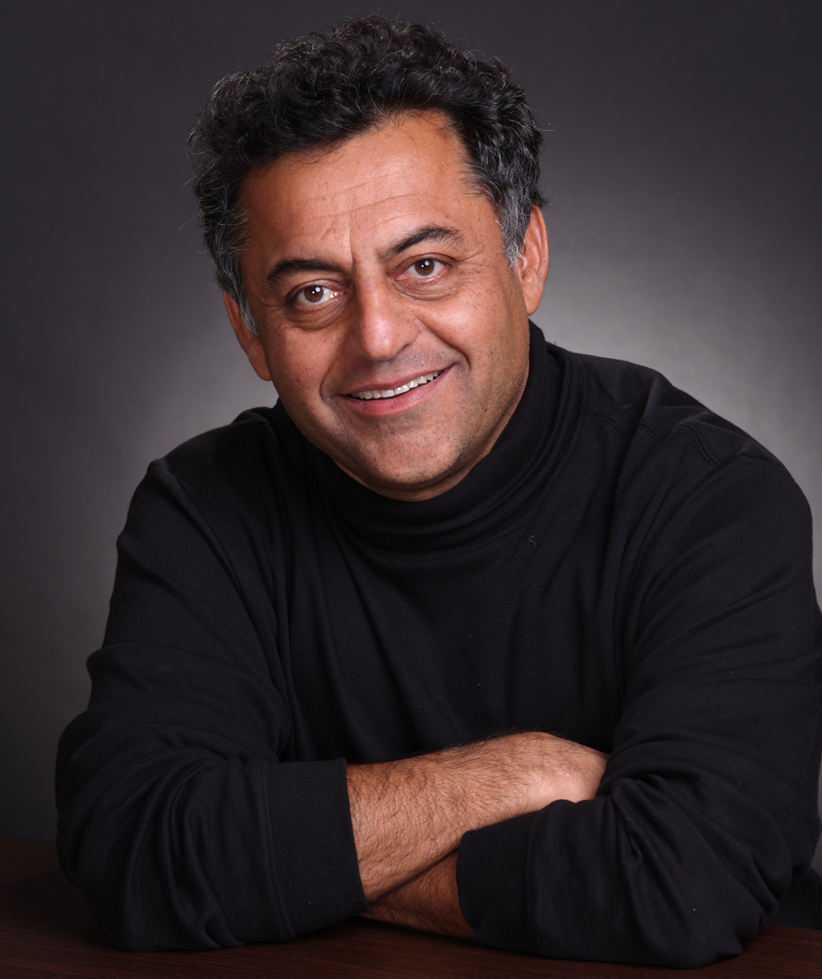
Approximation of SetCover Problem
“The set cover problem plays the same role in approximation algorithms that the maximum matching problem played in exact algorithms - as a problem whose study led to the development of fundamental techniques for the entire field.”
Approximation Algorithms, by Vijay V. Vazirani

Slide 6
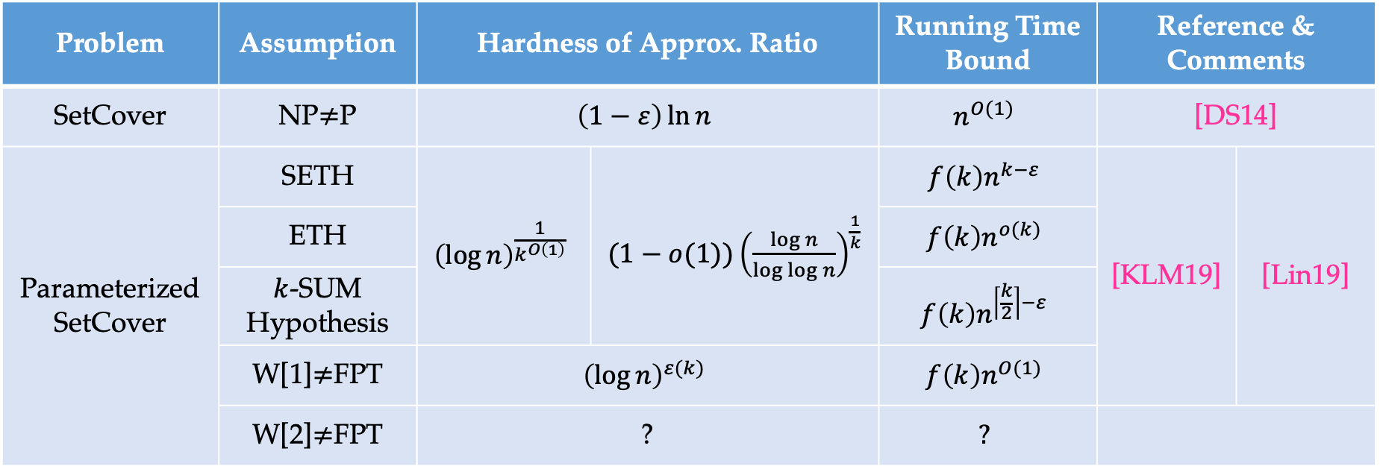
Approximation of SetCover Problem
A simple greedy algorithm reaches $(\ln{n}−\ln{\ln{n}}+Θ(1))$ approximation ratio [Sla97].
Problem | Assumption | Hardness of Approx. Ratio |  | Running Time Bound | Reference & Comments
SetCover | NP$≠$P | $$\left(1−ε\right)\ln{n}$$ |  | $$n^{O(1)}$$ | [DS14]
Parameterized SetCover | SETH | $${\left(\log{n}\right)}^{\frac{1}{k^{O\left(1\right)}}}$$ | $(1−o(1)){\left(\frac{\log{n}}{\log{\log{n}}}\right)}^{\frac{1}{k}}$ | $$f\left(k\right)n^{k−ε}$$ | [KLM19] | [Lin19]
 | ETH |  |  | $$f\left(k\right)n^{o(k)}$$
 | $k$-SUM Hypothesis |  |  | $$f\left(k\right)n^{\left\lceil \frac{k}{2}\right\rceil −ε}$$
 | W[1]$≠$FPT | $${\left(\log{n}\right)}^{ε(k)}$$ |  | $$f\left(k\right)n^{O(1)}$$
 | W[2]$≠$FPT | ? |  | $$?$$

Slide 7
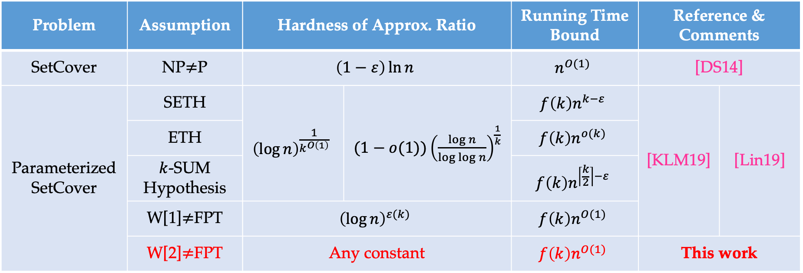
Approximation of SetCover Problem
A simple greedy algorithm reaches $(\ln{n}−\ln{\ln{n}}+Θ(1))$ approximation ratio [Sla97].
Problem | Assumption | Hardness of Approx. Ratio |  | Running Time Bound | Reference & Comments
SetCover | NP$≠$P | $$\left(1−ε\right)\ln{n}$$ |  | $$n^{O(1)}$$ | [DS14]
Parameterized SetCover | SETH | $${\left(\log{n}\right)}^{\frac{1}{k^{O\left(1\right)}}}$$ | $(1−o(1)){\left(\frac{\log{n}}{\log{\log{n}}}\right)}^{\frac{1}{k}}$ | $$f\left(k\right)n^{k−ε}$$ | [KLM19] | [Lin19]
 | ETH |  |  | $$f\left(k\right)n^{o(k)}$$
 | $k$-SUM Hypothesis |  |  | $$f\left(k\right)n^{\left\lceil \frac{k}{2}\right\rceil −ε}$$
 | W[1]$≠$FPT | $${\left(\log{n}\right)}^{ε(k)}$$ |  | $$f\left(k\right)n^{O(1)}$$
 | W[2]$≠$FPT | Any constant |  | $$f\left(k\right)n^{O(1)}$$ | This work

Slide 8

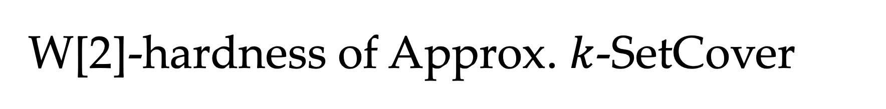




W[2]-hardness of Approx. $k$-SetCover
W[2]
W[2]
W[1]
W[1]
[Lin21,KK22]
$k$-Clique
Gap $k$-Clique
$k$-SetCover
with small $U$
[Lin19]
[KLM19]
$k$-SetCover
Gap $k$-SetCover
This work

Slide 9
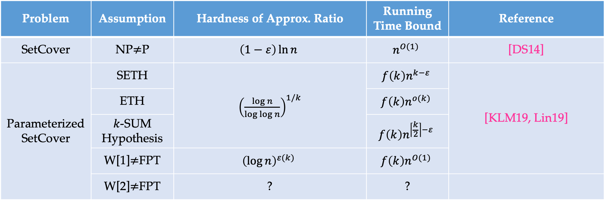
Approximation of SetCover Problem
A simple greedy algorithm reaches $(\ln{n}−\ln{\ln{n}}+Θ(1))$ approximation ratio [Sla97].
Problem | Assumption | Hardness of Approx. Ratio | Running Time Bound | Reference
SetCover | NP$≠$P | $$\left(1−ε\right)\ln{n}$$ | $$n^{O(1)}$$ | [DS14]
Parameterized SetCover | SETH | ${\left(\frac{\log{n}}{\log{\log{n}}}\right)}^{1/k}$ | $$f\left(k\right)n^{k−ε}$$ | [KLM19, Lin19]
 | ETH |  | $$f\left(k\right)n^{o(k)}$$
 | $k$-SUM Hypothesis |  | $$f\left(k\right)n^{\left\lceil \frac{k}{2}\right\rceil −ε}$$
 | W[1]$≠$FPT | $${\left(\log{n}\right)}^{ε(k)}$$ | $$f\left(k\right)n^{O(1)}$$
 | W[2]$≠$FPT | ? | ?

Slide 10
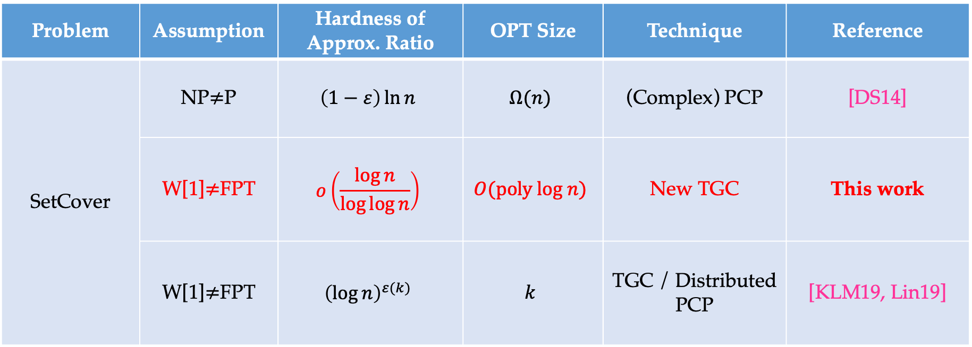
Approx. SetCover with Small OPT Size
Problem | Assumption | Hardness of Approx. Ratio | OPT Size | Technique | Reference
SetCover | NP$≠$P | $$\left(1−ε\right)\ln{n}$$ | $$Ω(n)$$ | (Complex) PCP | [DS14]
 | W[1]$≠$FPT | $$o\left(\frac{\log{n}}{\log{\log{n}}}\right)$$ | $$O(poly log n)$$ | New TGC | This work
 | W[1]$≠$FPT | $${\left(\log{n}\right)}^{ε(k)}$$ | $$k$$ | TGC / Distributed PCP | [KLM19, Lin19]

Slide 11

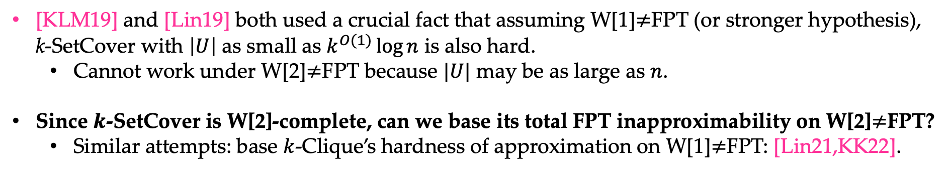




Approximation of SetCover Problem
[KLM19] and [Lin19] both used a crucial fact that assuming W[1]$≠$FPT (or stronger hypothesis), k-SetCover with $\left|U\right|$ as small as $k^{O(1)}\log{n}$ is also hard.
Cannot work under W[2]$≠$FPT because $|U|$ may be as large as $n$.
Since $k$-SetCover is W[2]-complete, can we base its total FPT inapproximability on W[2]$≠$FPT?
Similar attempts: base $k$-Clique’s hardness of approximation on W[1]$≠$FPT: [Lin21,KK22].
W[2]
W[1]
[Lin21,KK22]
Gap $k$-Clique
$k$-Clique
[KLM19]
$k$-SetCover
Gap $k$-SetCover
$k$-SetCover
with small $U$
[Lin19]
This work

Slide 12


Our Technique
Threshold Graph Composition [Lin18, CL19, Lin19, BBE+21]
exploited new properties of threshold graphs
used the construction from error-correcting codes [KN21]
discovered new composition scheme
Constant Approximating k-SetCover is W[2]-hard!
k-SetCover Instance
Threshold Graphs
$$=$$
Constant Gap k’-SetCover Instance
$$+$$

Slide 13

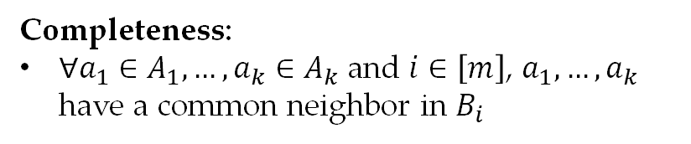









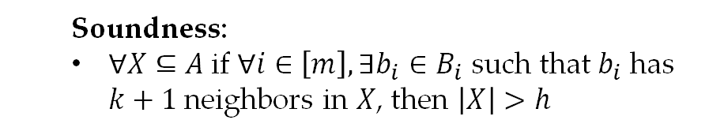
Threshold Graph in [Lin19]
Threshold Graph $G_{T}$: a bipartite graph $(A∪B,E)$ with $A=A_{1}∪…∪A_{k}$ and $B=B_{1}∪…∪B_{m}$, satisfying
$$B_{1}$$
Completeness:
$∀a_{1}∈A_{1},…,a_{k}∈A_{k}$ and $i∈\left[m\right]$, $a_{1},…,a_{k}$ have a common neighbor in $B_{i}$
$$A_{1}$$
$$B_{2}$$
$$A_{2}$$
Soundness:
$∀X⊆A$if $∀i∈\left[m\right],∃b_{i}∈B_{i}$ such that $b_{i}$ has $k+1$ neighbors in $X$, then $\left|X\right|>h$
$$B_{3}$$
$$…$$
$$…$$
$$A_{k}$$
$$B_{m}$$

Slide 14
Threshold Graph in [Lin19]
Threshold Graph $G_{T}$: a bipartite graph $(A∪B,E)$ with $A=A_{1}∪…∪A_{k}$ and $B=B_{1}∪…∪B_{m}$, satisfying
$$B_{1}$$
Completeness:
$∀a_{1}∈A_{1},…,a_{k}∈A_{k}$ and $i∈\left[m\right]$, $a_{1},…,a_{k}$ have a common neighbor in $B_{i}$
$$A_{1}$$
$$B_{2}$$
$$A_{2}$$
Soundness:
$∀X⊆A$if $∀i∈\left[m\right],∃b_{i}∈B_{i}$ such that $b_{i}$ has $k+1$ neighbors in $X$, then $\left|X\right|>h$
$$B_{3}$$
$$…$$
$$…$$
$$A_{k}$$
$$B_{m}$$

Slide 15
Threshold Graph in [Lin19]
Threshold Graph $G_{T}$: a bipartite graph $(A∪B,E)$ with $A=A_{1}∪…∪A_{k}$ and $B=B_{1}∪…∪B_{m}$, satisfying
$$B_{1}$$
Completeness:
$∀a_{1}∈A_{1},…,a_{k}∈A_{k}$ and $i∈\left[m\right]$, $a_{1},…,a_{k}$ have a common neighbor in $B_{i}$
$$A_{1}$$
$$B_{2}$$
$$A_{2}$$
Soundness:
$∀X⊆A$if $∀i∈\left[m\right],∃b_{i}∈B_{i}$ such that $b_{i}$ has $k+1$ neighbors in $X$, then $\left|X\right|>h$
$$B_{3}$$
$$…$$
$$…$$
$$A_{k}$$
$$B_{m}$$

Slide 16
Threshold Graph in [Lin19]
Threshold Graph $G_{T}$: a bipartite graph $(A∪B,E)$ with $A=A_{1}∪…∪A_{k}$ and $B=B_{1}∪…∪B_{m}$, satisfying
$$B_{1}$$
Completeness:
$∀a_{1}∈A_{1},…,a_{k}∈A_{k}$ and $i∈\left[m\right]$, $a_{1},…,a_{k}$ have a common neighbor in $B_{i}$
$$A_{1}$$
$$B_{2}$$
$$A_{2}$$
Soundness:
$∀X⊆A$if $∀i∈\left[m\right],∃b_{i}∈B_{i}$ such that $b_{i}$ has $k+1$ neighbors in $X$, then $\left|X\right|>h$
$$B_{3}$$
$$…$$
$$…$$
$$A_{k}$$
$$B_{m}$$

Slide 17
Threshold Graph in [Lin19]
Threshold Graph $G_{T}$: a bipartite graph $(A∪B,E)$ with $A=A_{1}∪…∪A_{k}$ and $B=B_{1}∪…∪B_{m}$, satisfying
$$B_{1}$$
Completeness:
$∀a_{1}∈A_{1},…,a_{k}∈A_{k}$ and $i∈\left[m\right]$, $a_{1},…,a_{k}$ have a common neighbor in $B_{i}$
$$A_{1}$$
$$B_{2}$$
$$A_{2}$$
Soundness:
$∀X⊆A$if $∀i∈\left[m\right],∃b_{i}∈B_{i}$ such that $b_{i}$ has $k+1$ neighbors in $X$, then $\left|X\right|>h$
$$B_{3}$$
$$…$$
$$…$$
$$A_{k}$$
$$B_{m}$$

Slide 18

Threshold Graph in [Lin19]
Threshold Graph $G_{T}$: a bipartite graph $(A∪B,E)$ with $A=A_{1}∪…∪A_{k}$ and $B=B_{1}∪…∪B_{m}$, satisfying
$$B_{1}$$
Completeness:
$∀a_{1}∈A_{1},…,a_{k}∈A_{k}$ and $i∈\left[m\right]$, $a_{1},…,a_{k}$ have a common neighbor in $B_{i}$
$$A_{1}$$
$$≥k+1$$
$$B_{2}$$
$$A_{2}$$
Soundness:
$∀X⊆A$if $∀i∈\left[m\right],∃b_{i}∈B_{i}$ such that $b_{i}$ has $k+1$ neighbors in $X$, then $\left|X\right|>h$
$$B_{3}$$
$$…$$
$$…$$
$$A_{k}$$
$$B_{m}$$

Slide 19
Threshold Graph in [Lin19]
Threshold Graph $G_{T}$: a bipartite graph $(A∪B,E)$ with $A=A_{1}∪…∪A_{k}$ and $B=B_{1}∪…∪B_{m}$, satisfying
$$B_{1}$$
Completeness:
$∀a_{1}∈A_{1},…,a_{k}∈A_{k}$ and $i∈\left[m\right]$, $a_{1},…,a_{k}$ have a common neighbor in $B_{i}$
$$A_{1}$$
$$B_{2}$$
$$A_{2}$$
$$≥k+1$$
Soundness:
$∀X⊆A$if $∀i∈\left[m\right],∃b_{i}∈B_{i}$ such that $b_{i}$ has $k+1$ neighbors in $X$, then $\left|X\right|>h$
$$B_{3}$$
$$…$$
$$…$$
$$A_{k}$$
$$B_{m}$$

Slide 20

Threshold Graph in [Lin19]
Threshold Graph $G_{T}$: a bipartite graph $(A∪B,E)$ with $A=A_{1}∪…∪A_{k}$ and $B=B_{1}∪…∪B_{m}$, satisfying
$$B_{1}$$
Completeness:
$∀a_{1}∈A_{1},…,a_{k}∈A_{k}$ and $i∈\left[m\right]$, $a_{1},…,a_{k}$ have a common neighbor in $B_{i}$
$$A_{1}$$
$$B_{2}$$
$$A_{2}$$
Soundness:
$∀X⊆A$if $∀i∈\left[m\right],∃b_{i}∈B_{i}$ such that $b_{i}$ has $k+1$ neighbors in $X$, then $\left|X\right|>h$
$$≥k+1$$
$$B_{3}$$
$$…$$
$$…$$
$$A_{k}$$
$$B_{m}$$

Slide 21
Threshold Graph in [Lin19]
Threshold Graph $G_{T}$: a bipartite graph $(A∪B,E)$ with $A=A_{1}∪…∪A_{k}$ and $B=B_{1}∪…∪B_{m}$, satisfying
$$B_{1}$$
Completeness:
$∀a_{1}∈A_{1},…,a_{k}∈A_{k}$ and $i∈\left[m\right]$, $a_{1},…,a_{k}$ have a common neighbor in $B_{i}$
$$A_{1}$$
$$B_{2}$$
$$A_{2}$$
Soundness:
$∀X⊆A$if $∀i∈\left[m\right],∃b_{i}∈B_{i}$ such that $b_{i}$ has $k+1$ neighbors in $X$, then $\left|X\right|>h$
$$B_{3}$$
$$…$$
$$…$$
$$A_{k}$$
$$≥k+1$$
$$B_{m}$$

Slide 22


Threshold Graph in [Lin19]
Threshold Graph $G_{T}$: a bipartite graph $(A∪B,E)$ with $A=A_{1}∪…∪A_{k}$ and $B=B_{1}∪…∪B_{m}$, satisfying
$$B_{1}$$
Completeness:
$∀a_{1}∈A_{1},…,a_{k}∈A_{k}$ and $i∈\left[m\right]$, $a_{1},…,a_{k}$ have a common neighbor in $B_{i}$
$$A_{1}$$
$$B_{2}$$
$$A_{2}$$
Soundness:
$∀X⊆A$if $∀i∈\left[m\right],∃b_{i}∈B_{i}$ such that $b_{i}$ has $k+1$ neighbors in $X$, then $\left|X\right|>h$
$$B_{3}$$
$$…$$
$$…$$
$$A_{k}$$
$$B_{m}$$
$$⇒$$
$\#$ of $>h$

Slide 23
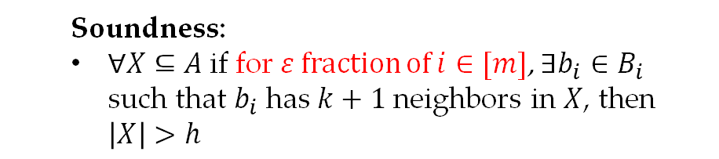
Our Threshold Graph
Threshold Graph $G_{T}$: a bipartite graph $(A∪B,E)$ with $A=A_{1}∪…∪A_{k}$ and $B=B_{1}∪…∪B_{m}$, satisfying
$$B_{1}$$
Completeness:
$∀a_{1}∈A_{1},…,a_{k}∈A_{k}$ and $i∈\left[m\right]$, $a_{1},…,a_{k}$ have a common neighbor in $B_{i}$
$$A_{1}$$
$$B_{2}$$
$$A_{2}$$
Soundness:
$∀X⊆A$if for $ε$ fraction of $i∈[m]$, $∃b_{i}∈B_{i}$ such that $b_{i}$ has $k+1$ neighbors in $X$, then $\left|X\right|>h$
$$B_{3}$$
$$…$$
$$…$$
$$A_{k}$$
$$B_{m}$$

Slide 24
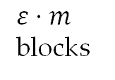
Our Threshold Graph
Threshold Graph $G_{T}$: a bipartite graph $(A∪B,E)$ with $A=A_{1}∪…∪A_{k}$ and $B=B_{1}∪…∪B_{m}$, satisfying
$$B_{1}$$
Completeness:
$∀a_{1}∈A_{1},…,a_{k}∈A_{k}$ and $i∈\left[m\right]$, $a_{1},…,a_{k}$ have a common neighbor in $B_{i}$
$$A_{1}$$
$$≥k+1$$
$$B_{2}$$
$$A_{2}$$
$ε⋅m$ blocks
Soundness:
$∀X⊆A$if for $ε$ fraction of $i∈[m]$, $∃b_{i}∈B_{i}$ such that $b_{i}$ has $k+1$ neighbors in $X$, then $\left|X\right|>h$
$$B_{3}$$
$$…$$
$$…$$
$$A_{k}$$
$$B_{m}$$

Slide 25
Our Threshold Graph
Threshold Graph $G_{T}$: a bipartite graph $(A∪B,E)$ with $A=A_{1}∪…∪A_{k}$ and $B=B_{1}∪…∪B_{m}$, satisfying
$$B_{1}$$
Completeness:
$∀a_{1}∈A_{1},…,a_{k}∈A_{k}$ and $i∈\left[m\right]$, $a_{1},…,a_{k}$ have a common neighbor in $B_{i}$
$$A_{1}$$
$$B_{2}$$
$$A_{2}$$
$$≥k+1$$
$ε⋅m$ blocks
Soundness:
$∀X⊆A$if for $ε$ fraction of $i∈[m]$, $∃b_{i}∈B_{i}$ such that $b_{i}$ has $k+1$ neighbors in $X$, then $\left|X\right|>h$
$$B_{3}$$
$$…$$
$$…$$
$$A_{k}$$
$$B_{m}$$

Slide 26
Our Threshold Graph
Threshold Graph $G_{T}$: a bipartite graph $(A∪B,E)$ with $A=A_{1}∪…∪A_{k}$ and $B=B_{1}∪…∪B_{m}$, satisfying
$$B_{1}$$
Completeness:
$∀a_{1}∈A_{1},…,a_{k}∈A_{k}$ and $i∈\left[m\right]$, $a_{1},…,a_{k}$ have a common neighbor in $B_{i}$
$$A_{1}$$
$$B_{2}$$
$$A_{2}$$
$ε⋅m$ blocks
Soundness:
$∀X⊆A$if for $ε$ fraction of $i∈[m]$, $∃b_{i}∈B_{i}$ such that $b_{i}$ has $k+1$ neighbors in $X$, then $\left|X\right|>h$
$$≥k+1$$
$$B_{3}$$
$$…$$
$$…$$
$$A_{k}$$
$$B_{m}$$

Slide 27
Our Threshold Graph
Threshold Graph $G_{T}$: a bipartite graph $(A∪B,E)$ with $A=A_{1}∪…∪A_{k}$ and $B=B_{1}∪…∪B_{m}$, satisfying
$$B_{1}$$
Completeness:
$∀a_{1}∈A_{1},…,a_{k}∈A_{k}$ and $i∈\left[m\right]$, $a_{1},…,a_{k}$ have a common neighbor in $B_{i}$
$$A_{1}$$
$$B_{2}$$
$$A_{2}$$
$ε⋅m$ blocks
Soundness:
$∀X⊆A$if for $ε$ fraction of $i∈[m]$, $∃b_{i}∈B_{i}$ such that $b_{i}$ has $k+1$ neighbors in $X$, then $\left|X\right|>h$
$$B_{3}$$
$$…$$
$$…$$
$$A_{k}$$
$$B_{m}$$
$$⇒$$
$\#$ of $>h$

Slide 28
Our Threshold Graph
Threshold Graph $G_{T}$: a bipartite graph $(A∪B,E)$ with $A=A_{1}∪…∪A_{k}$ and $B=B_{1}∪…∪B_{m}$, satisfying
$$B_{1}$$
Completeness:
$∀a_{1}∈A_{1},…,a_{k}∈A_{k}$ and $i∈\left[m\right]$, $a_{1},…,a_{k}$ have a common neighbor in $B_{i}$
$$A_{1}$$
$$B_{2}$$
$$A_{2}$$
$ε⋅m$ blocks
Soundness:
$∀X⊆A$if for $ε$ fraction of $i∈[m]$, $∃b_{i}∈B_{i}$ such that $b_{i}$ has $k+1$ neighbors in $X$, then $\left|X\right|>h$
$$B_{3}$$
$$…$$
$$…$$
$$A_{k}$$
$$B_{m}$$
Such threshold graphs can be constructed via error correcting codes with benign distance [KN21]!
$$⇒$$
$\#$ of $>h$

Slide 29

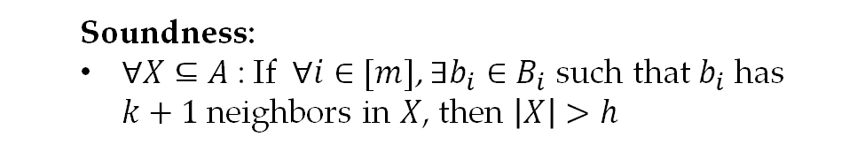
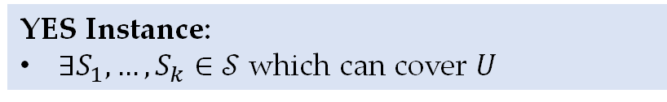



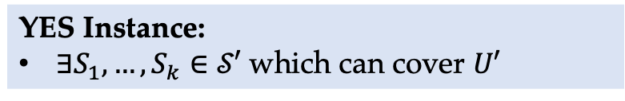
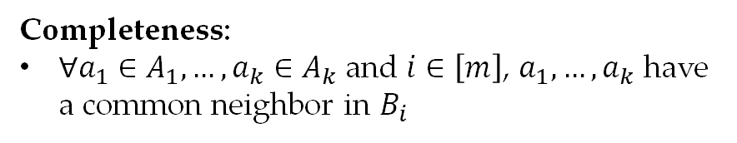
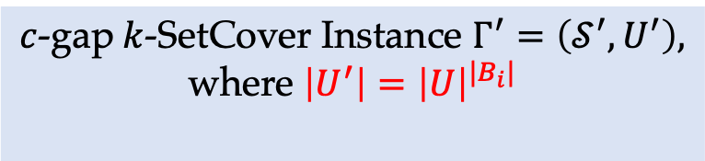
Threshold Graph Composition in [Lin19]
$k$-SetCover Instance $Γ=(𝒮,U)$
YES Instance:
$∃S_{1},…,S_{k}∈𝒮$ which can cover $U$
NO Instance:
any covering of $U$ has size $≥k+1$
$c$-gap$k$-SetCover Instance $Γ^{′}=\left(𝒮^{′},U^{′}\right),$
where $\left|U^{′}\right|={\left|U\right|}^{|B_{i}|}$
Threshold Graph $G_{T}=(A∪B,E)$
YES Instance:
$∃S_{1},…,S_{k}∈𝒮′$ which can cover $U′$
Completeness:
$∀a_{1}∈A_{1},…,a_{k}∈A_{k}$ and $i∈\left[m\right]$, $a_{1},…,a_{k}$ have a common neighbor in $B_{i}$
NO Instance:
any covering of $U$ has size $≥h$
Soundness:
$∀X⊆A$: If $∀i∈[m]$, $∃b_{i}∈B_{i}$ such that $b_{i}$ has $k+1$ neighbors in $X$, then $\left|X\right|>h$

Slide 30
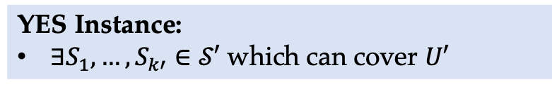
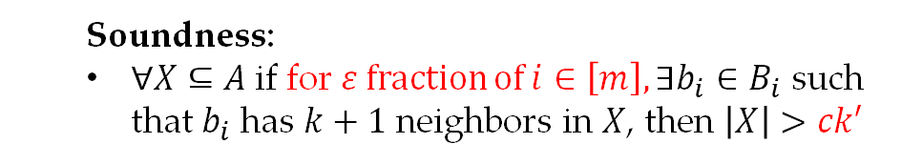
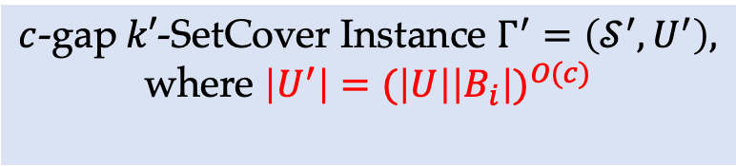
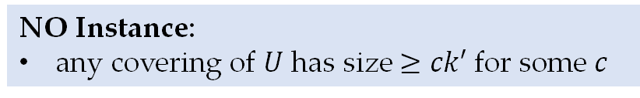
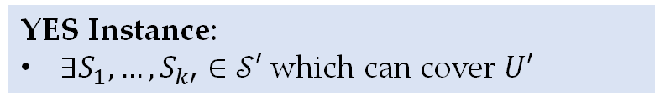


Threshold Graph Composition
$k$-SetCover Instance $Γ=(𝒮,U)$
YES Instance:
$∃S_{1},…,S_{k}∈𝒮$ which can cover $U$
NO Instance:
any covering of $U$ has size $≥k+1$
$c$-gap$k′$-SetCover Instance $Γ^{′}=\left(𝒮^{′},U^{′}\right),$
where $\left|U^{′}\right|={(\left|U\right|\left|B_{i}\right|)}^{O(c)}$
$c$-gap$k′$-SetCover Instance $Γ′=(𝒮′,U′)$
YES Instance:
$∃S_{1},…,S_{k′}∈𝒮′$ which can cover $U′$
YES Instance:
$∃S_{1},…,S_{k′}∈𝒮′$ which can cover $U′$
Threshold Graph $G_{T}=(A∪B,E)$
NO Instance:
any covering of $U$ has size $≥ck′$ for some $c$
Completeness:
$∀a_{1}∈A_{1},…,a_{k}∈A_{k}$ and $i∈\left[m\right]$, $a_{1},…,a_{k}$ have a common neighbor in $B_{i}$
NO Instance:
any covering of $U$ has size $>ck′$
Soundness:
$∀X⊆A$if for $ε$ fraction of $i∈\left[m\right], ∃b_{i}∈B_{i}$ such that $b_{i}$ has $k+1$ neighbors in $X$, then $\left|X\right|>ck′$

Slide 31

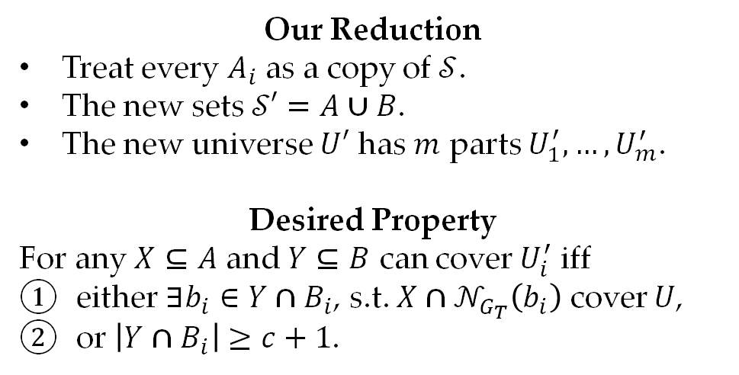


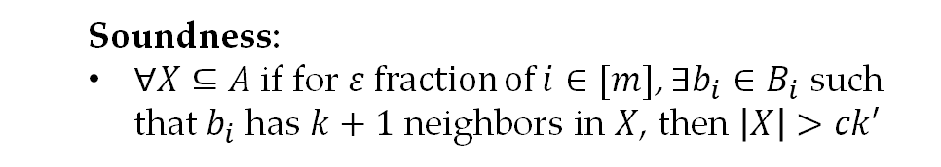
Threshold Graph Composition
Our Reduction
Treat every $A_{i}$ as a copy of $𝒮$.
The new sets $𝒮′=A∪B$.
The new universe $U′$ has $m$ parts $U_{1}^{′},…,U_{m}^{′}$.
Desired Property
For any $X⊆A$ and $Y⊆B$ can cover $U_{i}^{′}$ iff
either $∃b_{i}∈Y∩B_{i}$, s.t. ${X∩𝒩}_{G_{T}}\left(b_{i}\right)$ cover $U$,
or $\left|Y∩B_{i}\right|≥c+1$.
$k$-SetCover Instance $Γ=(𝒮,U)$
YES Instance:
$∃S_{1},…,S_{k}∈𝒮$ which can cover $U$
NO Instance:
any covering of $U$ has size $≥k+1$
Threshold Graph $G_{T}=(A∪B,E)$
Completeness:
$∀a_{1}∈A_{1},…,a_{k}∈A_{k}$ and $i∈\left[m\right]$, $a_{1},…,a_{k}$ have a common neighbor in $B_{i}$
Soundness:
$∀X⊆A$if for $ε$ fraction of $i∈[m]$, $∃b_{i}∈B_{i}$ such that $b_{i}$ has $k+1$ neighbors in $X$, then $\left|X\right|>ck′$

Slide 32

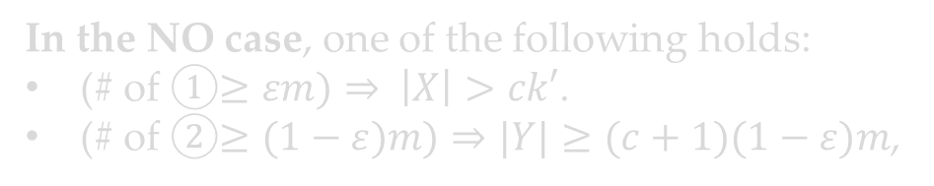
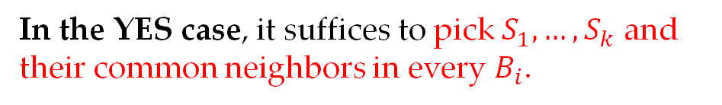
Analysis of the YES Case
Our Reduction
Treat every $A_{i}$ as a copy of $𝒮$.
The new sets $𝒮′=A∪B$.
The new universe $U′$ has $m$ parts $U_{1}^{′},…,U_{m}^{′}$.
Desired Property
For any $X⊆A$ and $Y⊆B$ can cover $U_{i}^{′}$ iff
either $∃b_{i}∈Y∩B_{i}$, s.t. ${X∩𝒩}_{G_{T}}\left(b_{i}\right)$ cover $U$,
or $\left|Y∩B_{i}\right|≥c+1$.
$k$-SetCover Instance $Γ=(𝒮,U)$
YES Instance:
$∃S_{1},…,S_{k}∈𝒮$ which can cover $U$
NO Instance:
any covering of $U$ has size $≥k+1$
Threshold Graph $G_{T}=(A∪B,E)$
Completeness:
$∀a_{1}∈A_{1},…,a_{k}∈A_{k}$ and $i∈\left[m\right]$, $a_{1},…,a_{k}$ have a common neighbor in $B_{i}$
In the YES case, it suffices to pick $S_{1},…,S_{k}$ and their common neighbors in every $B_{i}$.
Soundness:
$∀X⊆A$if for $ε$ fraction of $i∈[m]$, $∃b_{i}∈B_{i}$ such that $b_{i}$ has $k+1$ neighbors in $X$, then $\left|X\right|>ck′$
In the NO case, one of the following holds:
(# of ①$≥εm)⇒ \left|X\right|>ck′$.
(# of ②$≥(1−ε)m)⇒|Y|≥(c+1)(1−ε)m$,

Slide 33
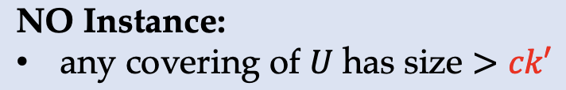
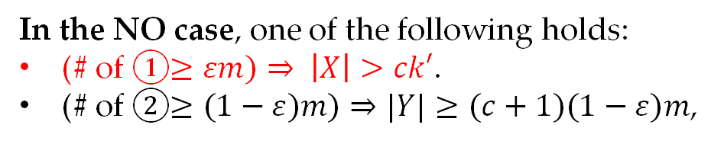
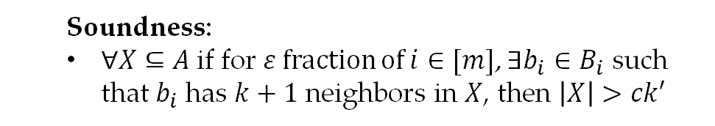
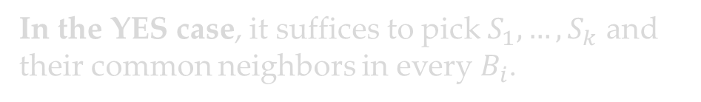
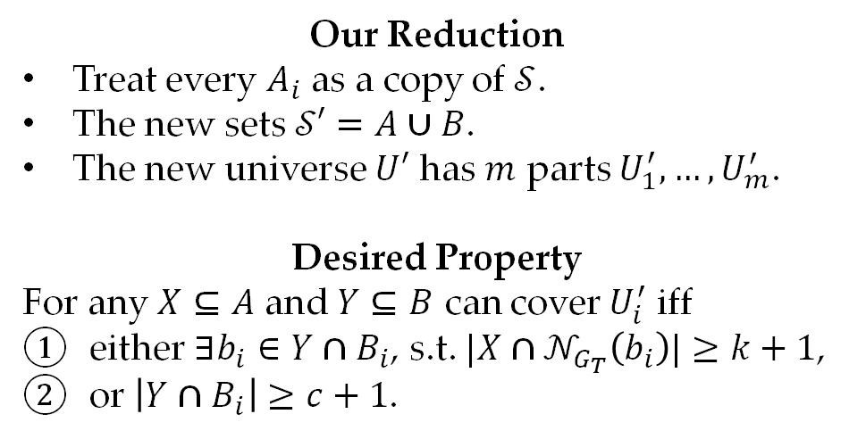
Analysis of the NO case
Our Reduction
Treat every $A_{i}$ as a copy of $𝒮$.
The new sets $𝒮′=A∪B$.
The new universe $U′$ has $m$ parts $U_{1}^{′},…,U_{m}^{′}$.
Desired Property
For any $X⊆A$ and $Y⊆B$ can cover $U_{i}^{′}$ iff
either $∃b_{i}∈Y∩B_{i}$, s.t. ${|X∩𝒩}_{G_{T}}\left(b_{i}\right)|≥k+1$,
or $\left|Y∩B_{i}\right|≥c+1$.
$k$-SetCover Instance $Γ=(𝒮,U)$
YES Instance:
$∃S_{1},…,S_{k}∈𝒮$ which can cover $U$
NO Instance:
any covering of $U$ has size $≥k+1$
Threshold Graph $G_{T}=(A∪B,E)$
Completeness:
$∀a_{1}∈A_{1},…,a_{k}∈A_{k}$ and $i∈\left[m\right]$, $a_{1},…,a_{k}$ have a common neighbor in $B_{i}$
In the YES case, it suffices to pick $S_{1},…,S_{k}$ and their common neighbors in every $B_{i}$.
Soundness:
$∀X⊆A$if for $ε$ fraction of $i∈[m]$, $∃b_{i}∈B_{i}$ such that $b_{i}$ has $k+1$ neighbors in $X$, then $\left|X\right|>ck′$
In the NO case, one of the following holds:
(# of ①$≥εm)⇒ \left|X\right|>ck′$.
(# of ②$≥(1−ε)m)⇒|Y|≥(c+1)(1−ε)m$,

Slide 34
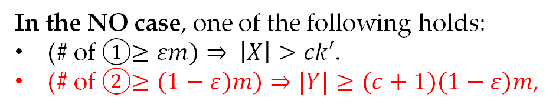
Analysis of the NO case
Our Reduction
Treat every $A_{i}$ as a copy of $𝒮$.
The new sets $𝒮′=A∪B$.
The new universe $U′$ has $m$ parts $U_{1}^{′},…,U_{m}^{′}$.
Desired Property
For any $X⊆A$ and $Y⊆B$ can cover $U_{i}^{′}$ iff
either $∃b_{i}∈Y∩B_{i}$, s.t. ${|X∩𝒩}_{G_{T}}\left(b_{i}\right)|≥k+1$,
or $\left|Y∩B_{i}\right|≥c+1$.
$k$-SetCover Instance $Γ=(𝒮,U)$
YES Instance:
$∃S_{1},…,S_{k}∈𝒮$ which can cover $U$
NO Instance:
any covering of $U$ has size $≥k+1$
Threshold Graph $G_{T}=(A∪B,E)$
Completeness:
$∀a_{1}∈A_{1},…,a_{k}∈A_{k}$ and $i∈\left[m\right]$, $a_{1},…,a_{k}$ have a common neighbor in $B_{i}$
In the YES case, it suffices to pick $S_{1},…,S_{k}$ and their common neighbors in every $B_{i}$.
Soundness:
$∀X⊆A$if for $ε$ fraction of $i∈[m]$, $∃b_{i}∈B_{i}$ such that $b_{i}$ has $k+1$ neighbors in $X$, then $\left|X\right|>ck′$
In the NO case, one of the following holds:
(# of ①$≥εm)⇒ \left|X\right|>ck′$.
(# of ②$≥(1−ε)m)⇒|Y|≥(c+1)(1−ε)m$,

Slide 35
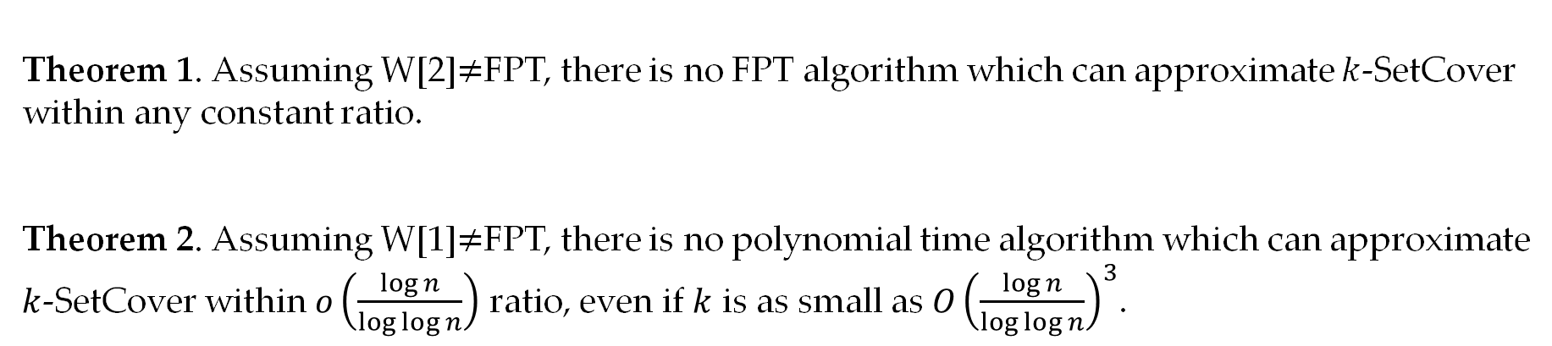
Summary
Theorem 1. Assuming W[2]$≠$FPT, there is no FPT algorithm which can approximate $k$-SetCover within any constant ratio.
Theorem 2. Assuming W[1]$≠$FPT, there is no polynomial time algorithm which can approximate $k$-SetCover within $o\left(\frac{\log{n}}{\log{\log{n}}}\right)$ ratio, even if $k$ is as small as $O{\left(\frac{\log{n}}{\log{\log{n}}}\right)}^{3}$.

Slide 36

Open Questions
Open Question 1. Is it W[2]-hard to approximate $k$-SetCover within $ω(1)$ ratio?
Our reduction has running time ${Ω(|U|}^{c})$, thus can not get super-constant inapproximability.
Open Question 2. Is there any FPT algorithm which can approximate $k$-SetCover with approximation ratio $o(\log{n})$?
Current best lower bound is ${\left(\log{n}\right)}^{ε(k)}$ for any function $ε\left(k\right)=o(1)$.

Slide 37
Q&A
Thanks!

Slide 38
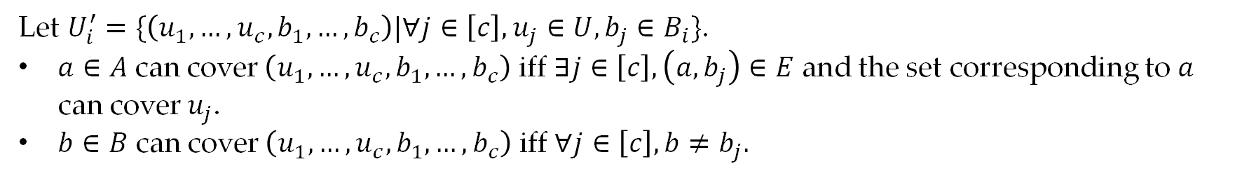
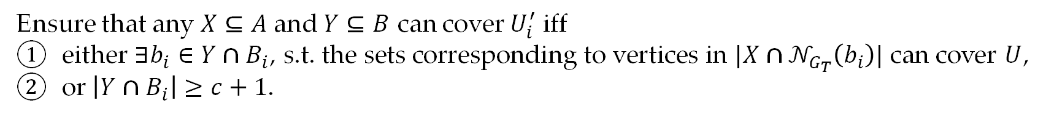
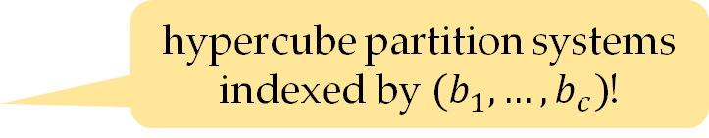
Threshold Graph Composition
Ensure that any $X⊆A$ and $Y⊆B$ can cover $U_{i}^{′}$ iff
either $∃b_{i}∈Y∩B_{i}$, s.t. the sets corresponding to vertices in ${|X∩𝒩}_{G_{T}}\left(b_{i}\right)|$ can cover $U$,
or $\left|Y∩B_{i}\right|≥c+1$.
hypercube partition systems indexed by $(b_{1},…,b_{c})$!
Let $U_{i}^{′}=\{\left(u_{1},…,u_{c},b_{1},…,b_{c}\right)|∀j∈\left[c\right],u_{j}∈U,b_{j}∈B_{i}\}$.
$a∈A$ can cover $\left(u_{1},…,u_{c},b_{1},…,b_{c}\right)$ iff $∃j∈\left[c\right], \left(a,b_{j}\right)∈E$ and the set corresponding to $a$ can cover $u_{j}$.
$b∈B$ can cover $\left(u_{1},…,u_{c},b_{1},…,b_{c}\right)$ iff $∀j∈\left[c\right], b≠b_{j}.$

Slide 39
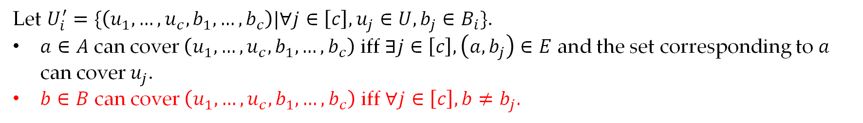
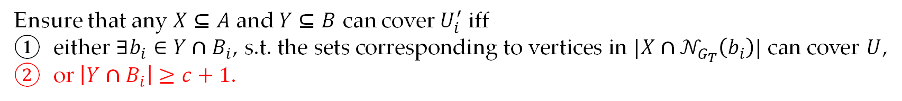
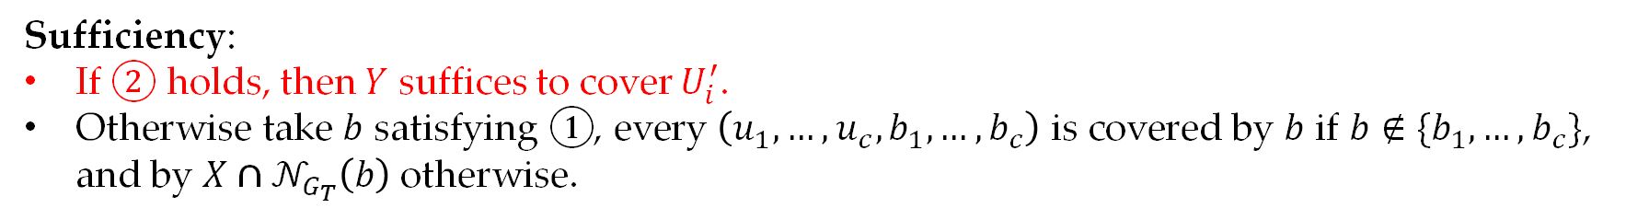
Threshold Graph Composition
Ensure that any $X⊆A$ and $Y⊆B$ can cover $U_{i}^{′}$ iff
either $∃b_{i}∈Y∩B_{i}$, s.t. the sets corresponding to vertices in ${|X∩𝒩}_{G_{T}}\left(b_{i}\right)|$ can cover $U$,
or $\left|Y∩B_{i}\right|≥c+1$.
hypercube partition systems indexed by $(b_{1},…,b_{c})$!
Let $U_{i}^{′}=\{\left(u_{1},…,u_{c},b_{1},…,b_{c}\right)|∀j∈\left[c\right],u_{j}∈U,b_{j}∈B_{i}\}$.
$a∈A$ can cover $\left(u_{1},…,u_{c},b_{1},…,b_{c}\right)$ iff $∃j∈\left[c\right], \left(a,b_{j}\right)∈E$ and the set corresponding to $a$ can cover $u_{j}$.
$b∈B$ can cover $\left(u_{1},…,u_{c},b_{1},…,b_{c}\right)$ iff $∀j∈\left[c\right], b≠b_{j}.$
Sufficiency:
If ② holds, then $Y$ suffices to cover $U_{i}^{′}$.
Otherwise take $b$ satisfying ①, every $\left(u_{1},…,u_{c},b_{1},…,b_{c}\right)$ is covered by $b$ if $b∉\{b_{1},…,b_{c}\}$, and by ${X∩𝒩}_{G_{T}}\left(b\right)$ otherwise.

Slide 40
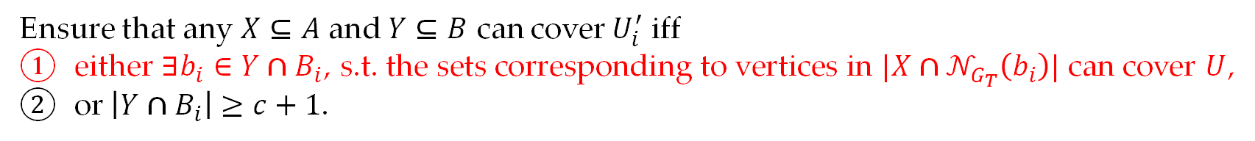
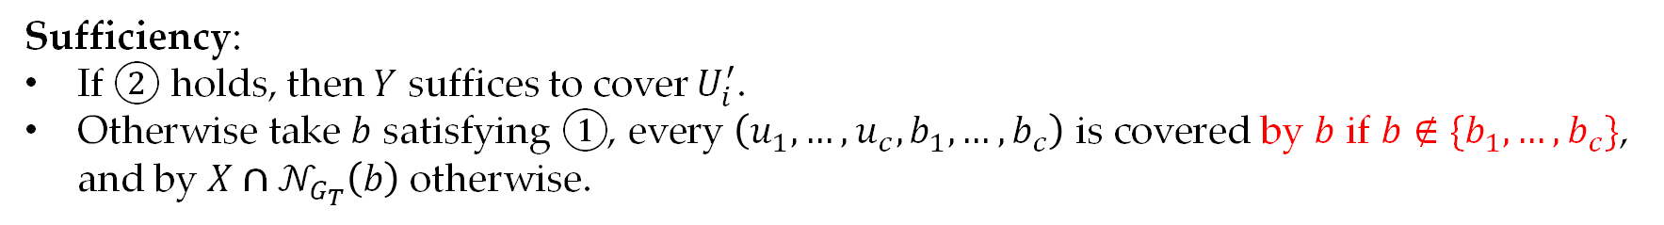
Threshold Graph Composition
Ensure that any $X⊆A$ and $Y⊆B$ can cover $U_{i}^{′}$ iff
either $∃b_{i}∈Y∩B_{i}$, s.t. the sets corresponding to vertices in ${|X∩𝒩}_{G_{T}}\left(b_{i}\right)|$ can cover $U$,
or $\left|Y∩B_{i}\right|≥c+1$.
hypercube partition systems indexed by $(b_{1},…,b_{c})$!
Let $U_{i}^{′}=\{\left(u_{1},…,u_{c},b_{1},…,b_{c}\right)|∀j∈\left[c\right],u_{j}∈U,b_{j}∈B_{i}\}$.
$a∈A$ can cover $\left(u_{1},…,u_{c},b_{1},…,b_{c}\right)$ iff $∃j∈\left[c\right], \left(a,b_{j}\right)∈E$ and the set corresponding to $a$ can cover $u_{j}$.
$b∈B$ can cover $\left(u_{1},…,u_{c},b_{1},…,b_{c}\right)$ iff $∀j∈\left[c\right], b≠b_{j}.$
Sufficiency:
If ② holds, then $Y$ suffices to cover $U_{i}^{′}$.
Otherwise take $b$ satisfying ①, every $\left(u_{1},…,u_{c},b_{1},…,b_{c}\right)$ is covered by $b$ if $b∉\{b_{1},…,b_{c}\}$, and by ${X∩𝒩}_{G_{T}}\left(b\right)$ otherwise.

Slide 41
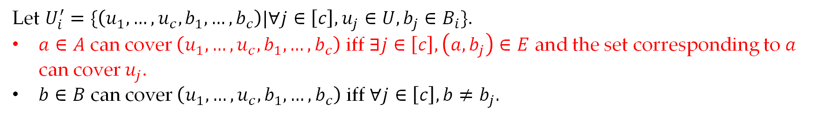
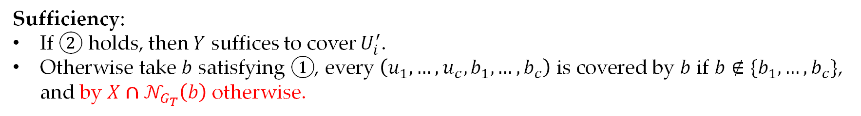
Threshold Graph Composition
Ensure that any $X⊆A$ and $Y⊆B$ can cover $U_{i}^{′}$ iff
either $∃b_{i}∈Y∩B_{i}$, s.t. the sets corresponding to vertices in ${|X∩𝒩}_{G_{T}}\left(b_{i}\right)|$ can cover $U$,
or $\left|Y∩B_{i}\right|≥c+1$.
hypercube partition systems indexed by $(b_{1},…,b_{c})$!
Let $U_{i}^{′}=\{\left(u_{1},…,u_{c},b_{1},…,b_{c}\right)|∀j∈\left[c\right],u_{j}∈U,b_{j}∈B_{i}\}$.
$a∈A$ can cover $\left(u_{1},…,u_{c},b_{1},…,b_{c}\right)$ iff $∃j∈\left[c\right], \left(a,b_{j}\right)∈E$ and the set corresponding to $a$ can cover $u_{j}$.
$b∈B$ can cover $\left(u_{1},…,u_{c},b_{1},…,b_{c}\right)$ iff $∀j∈\left[c\right], b≠b_{j}.$
Sufficiency:
If ② holds, then $Y$ suffices to cover $U_{i}^{′}$.
Otherwise take $b$ satisfying ①, every $\left(u_{1},…,u_{c},b_{1},…,b_{c}\right)$ is covered by $b$ if $b∉\{b_{1},…,b_{c}\}$, and by ${X∩𝒩}_{G_{T}}\left(b\right)$ otherwise.

Slide 42
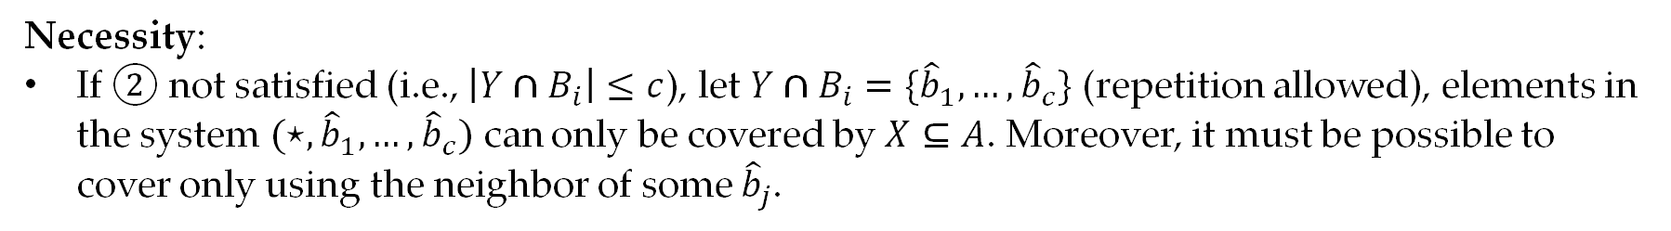
Threshold Graph Composition
Ensure that any $X⊆A$ and $Y⊆B$ can cover $U_{i}^{′}$ iff
either $∃b_{i}∈Y∩B_{i}$, s.t. the sets corresponding to vertices in ${|X∩𝒩}_{G_{T}}\left(b_{i}\right)|$ can cover $U$,
or $\left|Y∩B_{i}\right|≥c+1$.
hypercube partition systems indexed by $(b_{1},…,b_{c})$!
Let $U_{i}^{′}=\{\left(u_{1},…,u_{c},b_{1},…,b_{c}\right)|∀j∈\left[c\right],u_{j}∈U,b_{j}∈B_{i}\}$.
$a∈A$ can cover $\left(u_{1},…,u_{c},b_{1},…,b_{c}\right)$ iff $∃j∈\left[c\right], \left(a,b_{j}\right)∈E$ and the set corresponding to $a$ can cover $u_{j}$.
$b∈B$ can cover $\left(u_{1},…,u_{c},b_{1},…,b_{c}\right)$ iff $∀j∈\left[c\right], b≠b_{j}.$
Necessity:
If ② not satisfied (i.e., $\left|Y∩B_{i}\right|≤c$), let $Y∩B_{i}=\{{\hat{b}}_{1},…,{\hat{b}}_{c}\}$ (repetition allowed), elements in the system $(⋆,{\hat{b}}_{1},…,{\hat{b}}_{c})$ can only be covered by $X⊆A$. Moreover, it must be possible to cover only using the neighbor of some ${\hat{b}}_{j}$.

Slide 43

Threshold Graph Composition
Ensure that any $X⊆A$ and $Y⊆B$ can cover $U_{i}^{′}$ iff
either $∃b_{i}∈Y∩B_{i}$, s.t. the sets corresponding to vertices in ${|X∩𝒩}_{G_{T}}\left(b_{i}\right)|$ can cover $U$,
or $\left|Y∩B_{i}\right|≥c+1$.
hypercube partition systems indexed by $(b_{1},…,b_{c})$!
Let $U_{i}^{′}=\{\left(u_{1},…,u_{c},b_{1},…,b_{c}\right)|∀j∈\left[c\right],u_{j}∈U,b_{j}∈B_{i}\}$.
$a∈A$ can cover $\left(u_{1},…,u_{c},b_{1},…,b_{c}\right)$ iff $∃j∈\left[c\right], \left(a,b_{j}\right)∈E$ and the set corresponding to $a$ can cover $u_{j}$.
$b∈B$ can cover $\left(u_{1},…,u_{c},b_{1},…,b_{c}\right)$ iff $∀j∈\left[c\right], b≠b_{j}.$
Necessity:
If ② not satisfied (i.e., $\left|Y∩B_{i}\right|≤c$), let $Y∩B_{i}=\{{\hat{b}}_{1},…,{\hat{b}}_{c}\}$ (repetition allowed), elements in the system $(⋆,{\hat{b}}_{1},…,{\hat{b}}_{c})$ can only be covered by $X⊆A$. Moreover, it must be possible to cover only using the neighbor of some ${\hat{b}}_{j}$.

Slide 44



Threshold Graph from Error Correcting Codes
Proposed by [KN21]
Let $C:Σ^{r}→Σ^{m}$ be an error correcting code with relative distance $δ∈(0,1)$, we can construct a threshold graph as follows.
$∀i∈\left[k\right], A_{i}=\{C\left(x\right):x∈Σ^{r}\}$
$∀j∈\left[m\right],B_{j}=Σ^{k}$
$a∈A_{i}$ and $b∈B_{j}$ are linked iff ${\left(a\right)}_{j}={\left(b\right)}_{i}$
Example: $C=\left\{abcd, bcda,cdab\right\}$
“cdac”$∈B_{3}$ is a common neighbor of
“abcd”$∈A_{1},$“bcda”$∈A_{2},$“cdab”$∈A_{3}$ and “abcd”$∈A_{4}$.
$m$ columns
a | b | c | d
b | c | d | a
c | d | a | b
a | b | c | d
$k$ rows

Slide 45



Threshold Graph from Error Correcting Codes
Threshold properties:
(Completeness) $∀a_{1}∈A_{1},…,a_{k}∈A_{k}$ and $i∈\left[m\right]$, $a_{1},…,a_{k}$ have a common neighbor in $B_{i}$
(Soundness) $∀X⊆A$ and $I⊆\left[m\right]$ with $\left|I\right|≥εm$, if $∀i∈I∃b_{i}∈B_{i}$ such that $b_{i}$ has $k+1$ neighbors in $X$, then $\left|X\right|>h$
$b_{i}$ has $k+1$ neighbors
$⇒$ There must be two vertices in $X$ which are from the same block $j∈[m]$.
$⇒$ The $j$-th character of the two codewords must be same
However we know that for any two different codewords,
the distance between them is at least $δm$.
By a double counting argument, we can get $h≥\sqrt{\frac{2ε}{1−δ}}$.
$m$ columns
a | b | c | d
b | c | d | a
c | d | a | b
a | b | c | d
$k$ rows

