Slide 1
Lecture 06
Arbitrary-sized data
  All my favorite hocky teams (L06)
  All the eggs falling around Mario (L07)
  All the balls bouncing around the box (Pset 4)
  …
Self-referential type comments
Naturally recursive functions
Sound theory makes it easy to understand functions that might otherwise be confusing

Slide 2
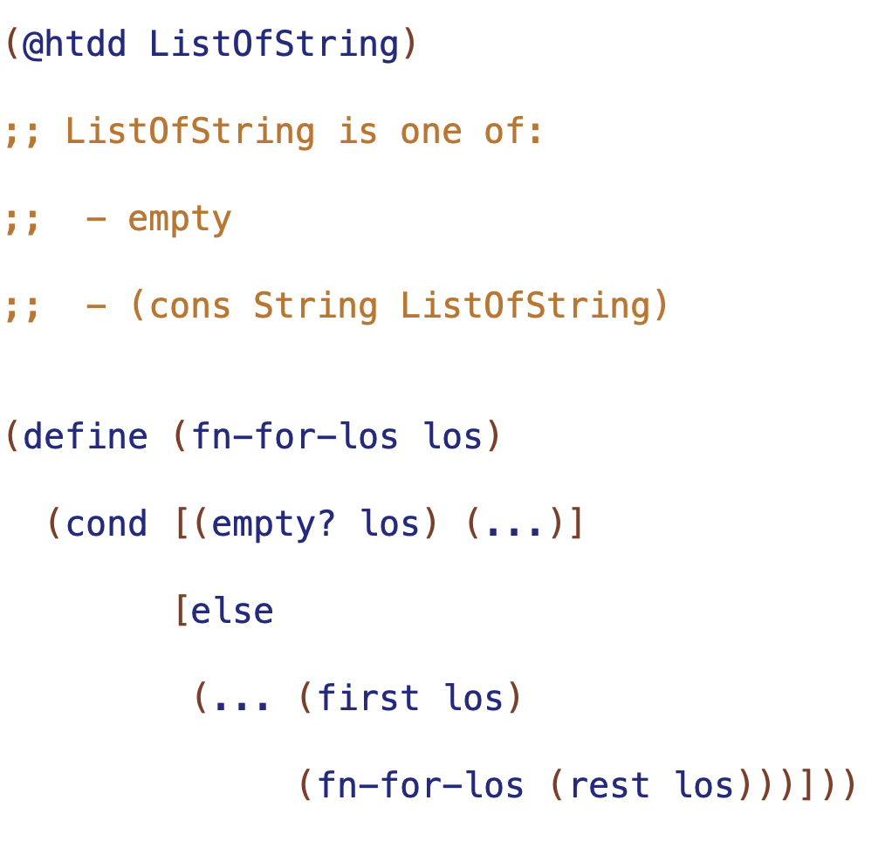

Slide 3
self reference
natural recursion

Slide 4
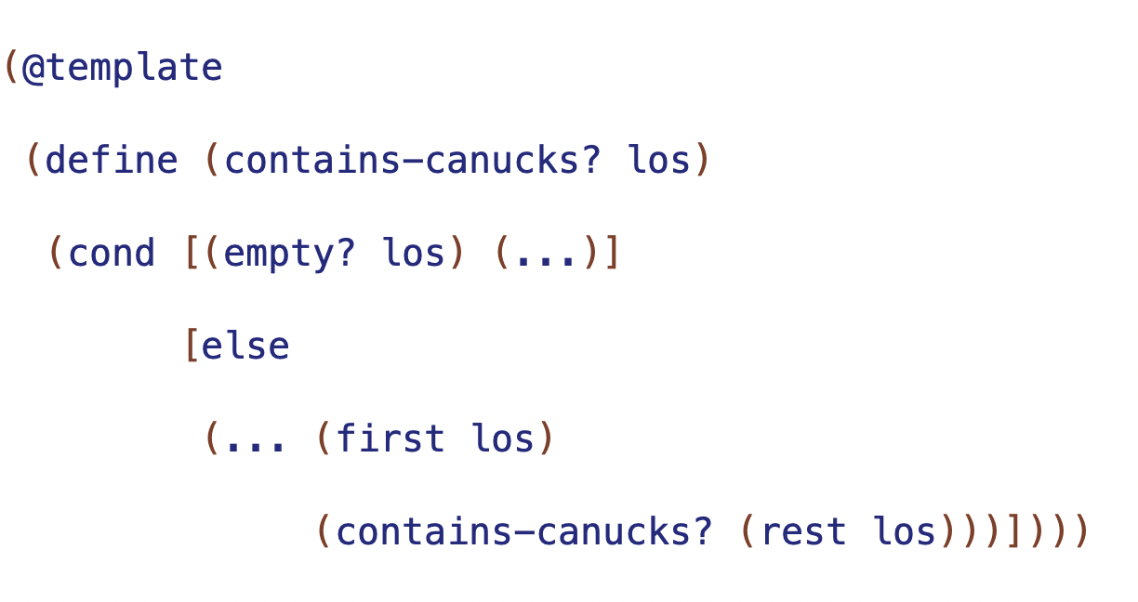

Slide 5
Trusting the Natural Recursion
result of natural recursion (RNR) will be correct if and only if
- correct base case result
- correct contribution of first
- correct combination of contribution and RNR
base case result
correct result for empty
combination
how to combine (first los) and result of natural recursion

Slide 6
arbitrary-sized information -> requires well-formed self-referential data definition
one of with:
one or more base subclass
one or more self-reference subclasses

Slide 7
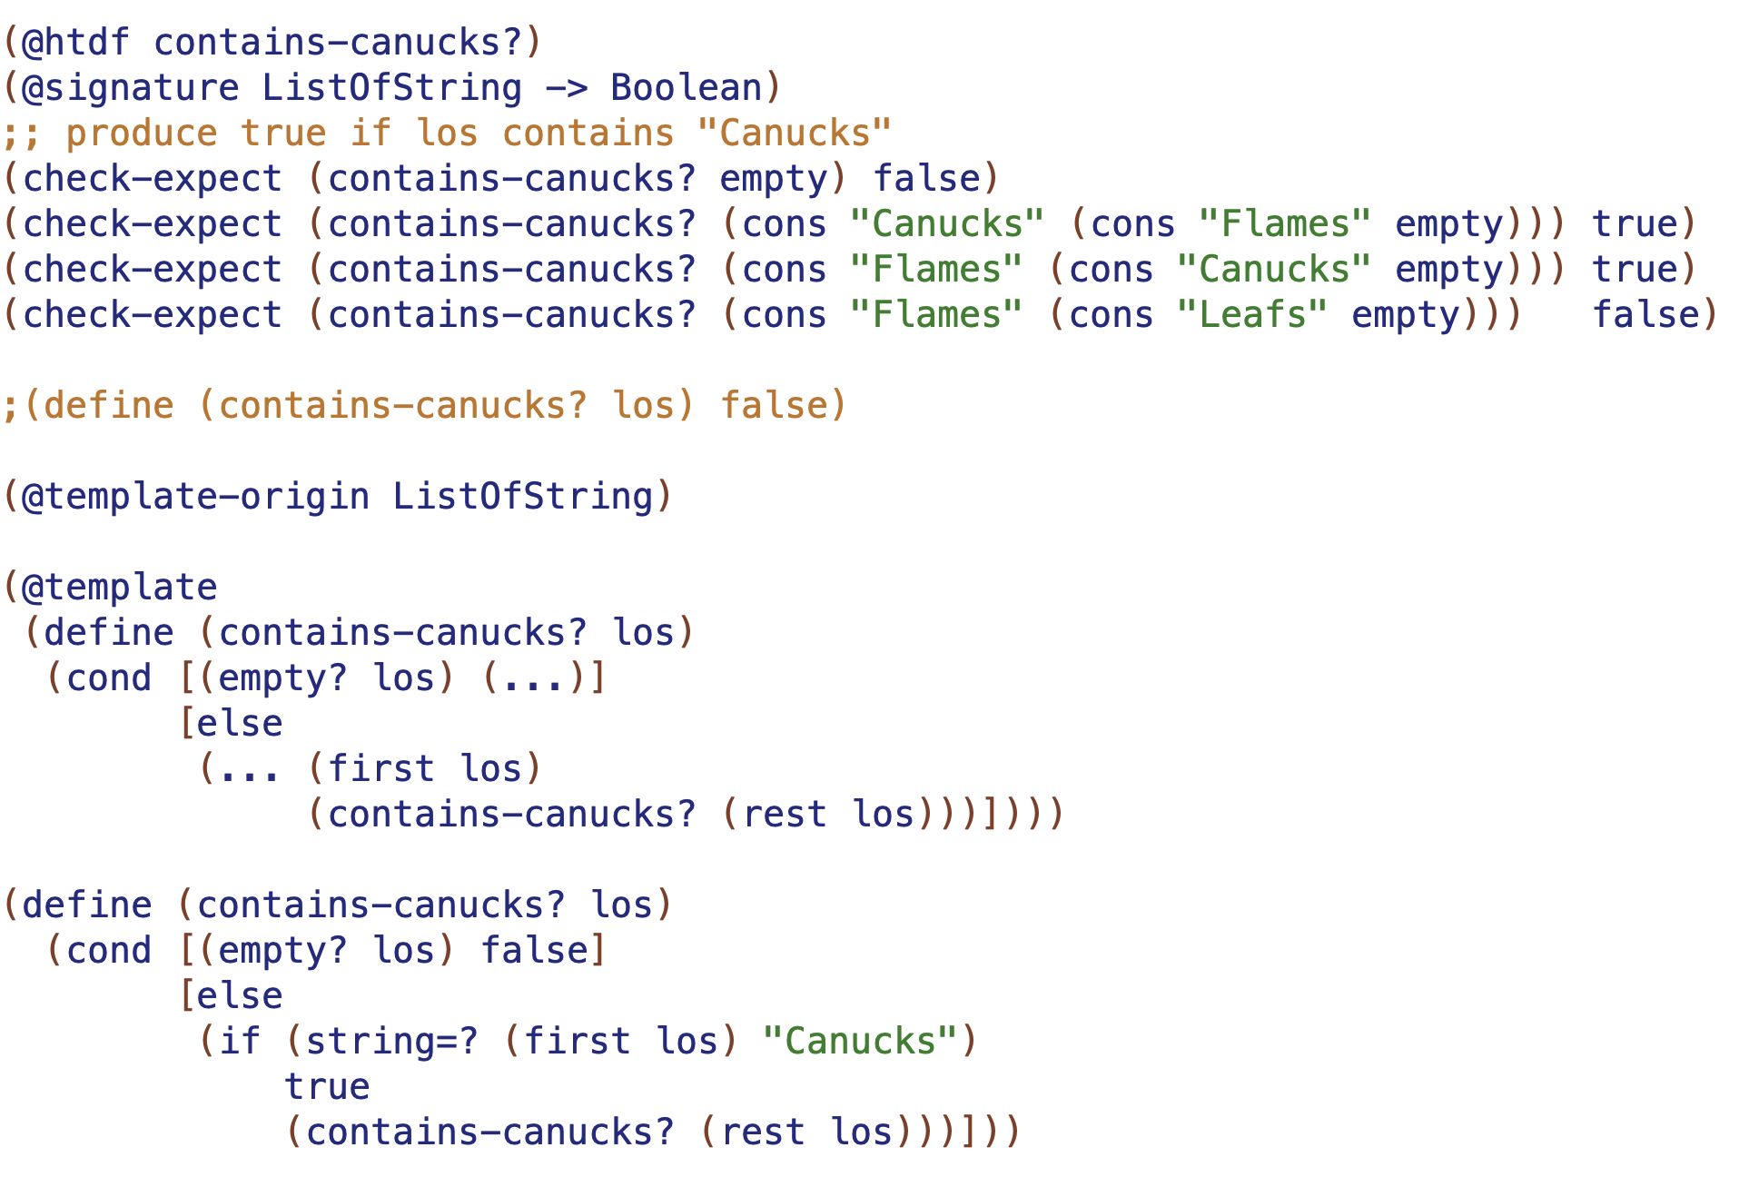
arbitrary-sized information -> requires self-referential data definition
test base case first
test 2 long
test recursion on both sides of conditional
rename natural recursion when templating
can "trust the natural recursion” if and only if:
- correct base case result
- correct contribution of first
- correc combination

Slide 8
Function | Base case result | Combination

Slide 9
Function | Base case result | Combination
sum | 0 | (+ <first> RNR)
product | 1 | (* <first> RNR)
count | 0 | (+ 1 RNR)
doubles | empty | (cons (* 2 <first>) RNR)

