Slide 1
TODAY
Another day of reaping the rewards of the work you have done so far
Two important new ideas
  mutual reference / recursion
    The hard parts won’t actually be very hard
      just trusting natural recursions as usual
      not blind trust - we have to get base, contribution and combination right!
    The easy parts will require learning some new details
    minor housekeeping changes with @htdf @htdd organization
  Functions that can fail
    or false in signatures
    Try-catch template

Slide 2
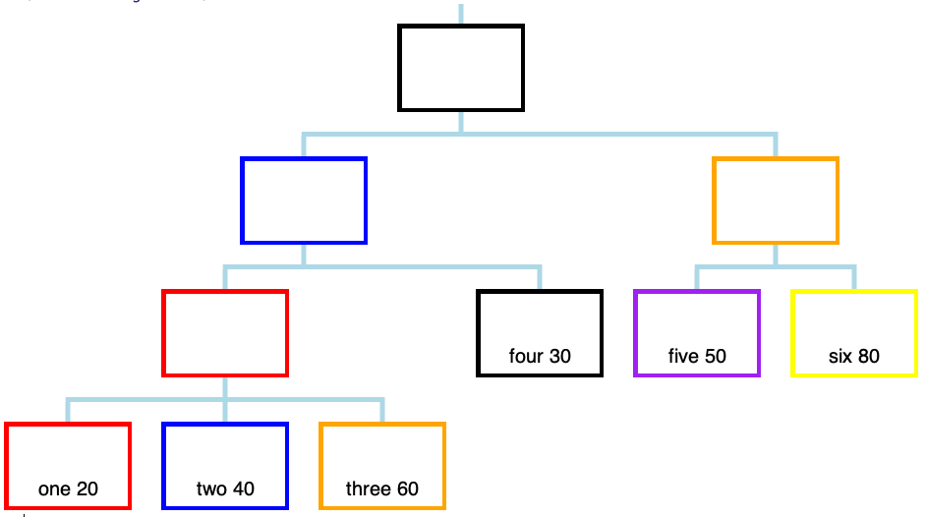
Some tree terminology:
- leaf nodes have no subs
- inner nodes do have subs

Slide 3
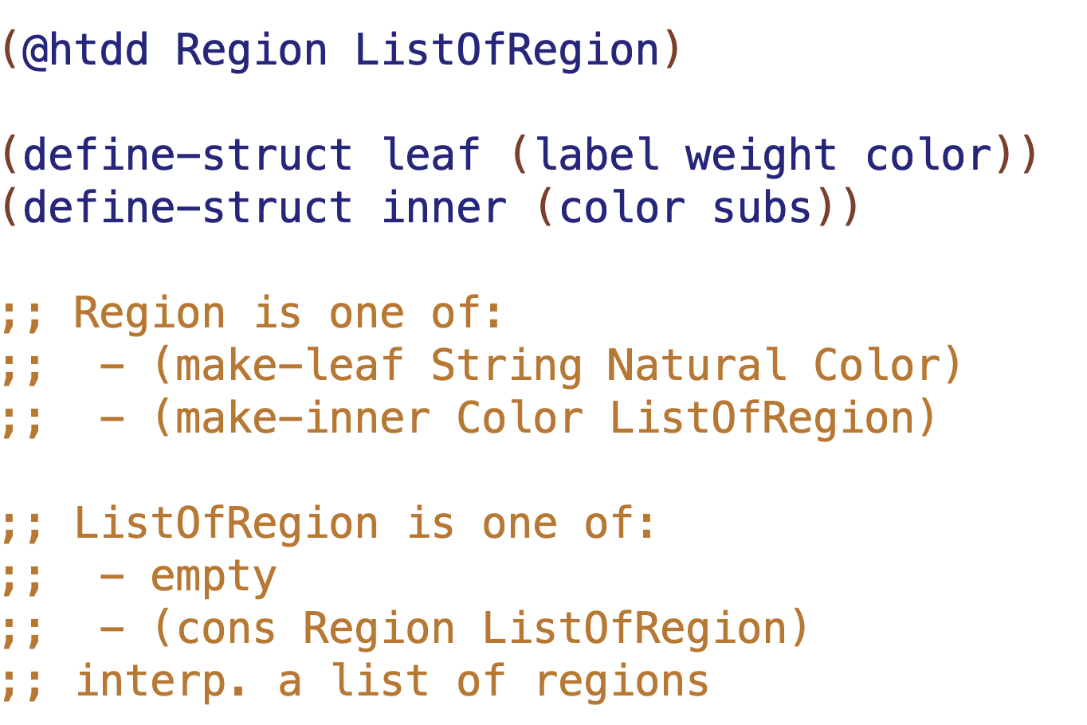

Slide 4
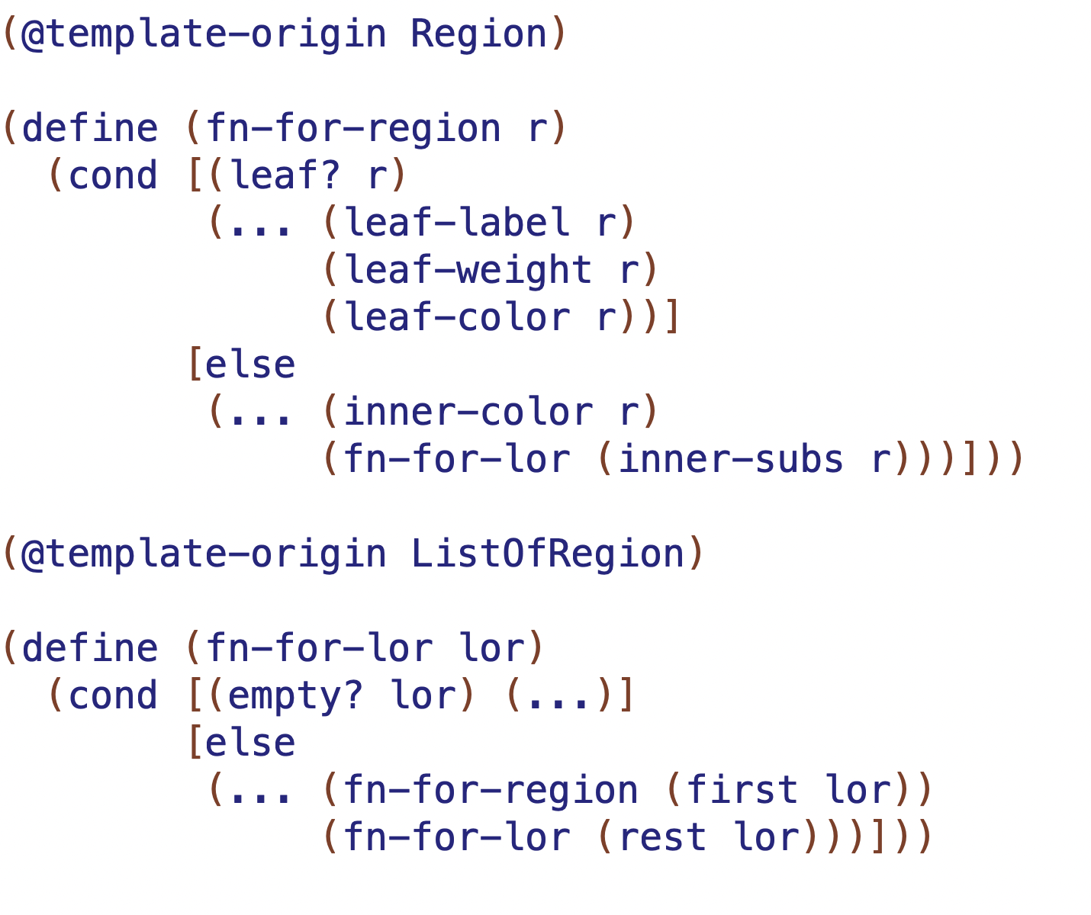
mutual recursion means these functions come in pairs (2 or more in general)
NMR
NMR
NR

Slide 5
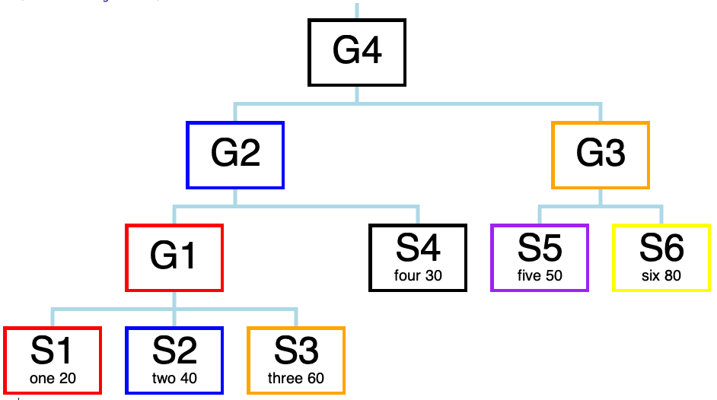
L1, L2, I4 etc. are the
NAMES OF THE CONSTANTS
I4
I2
I3
I1
L4
L5
L6
L1
L2
L3

Slide 6
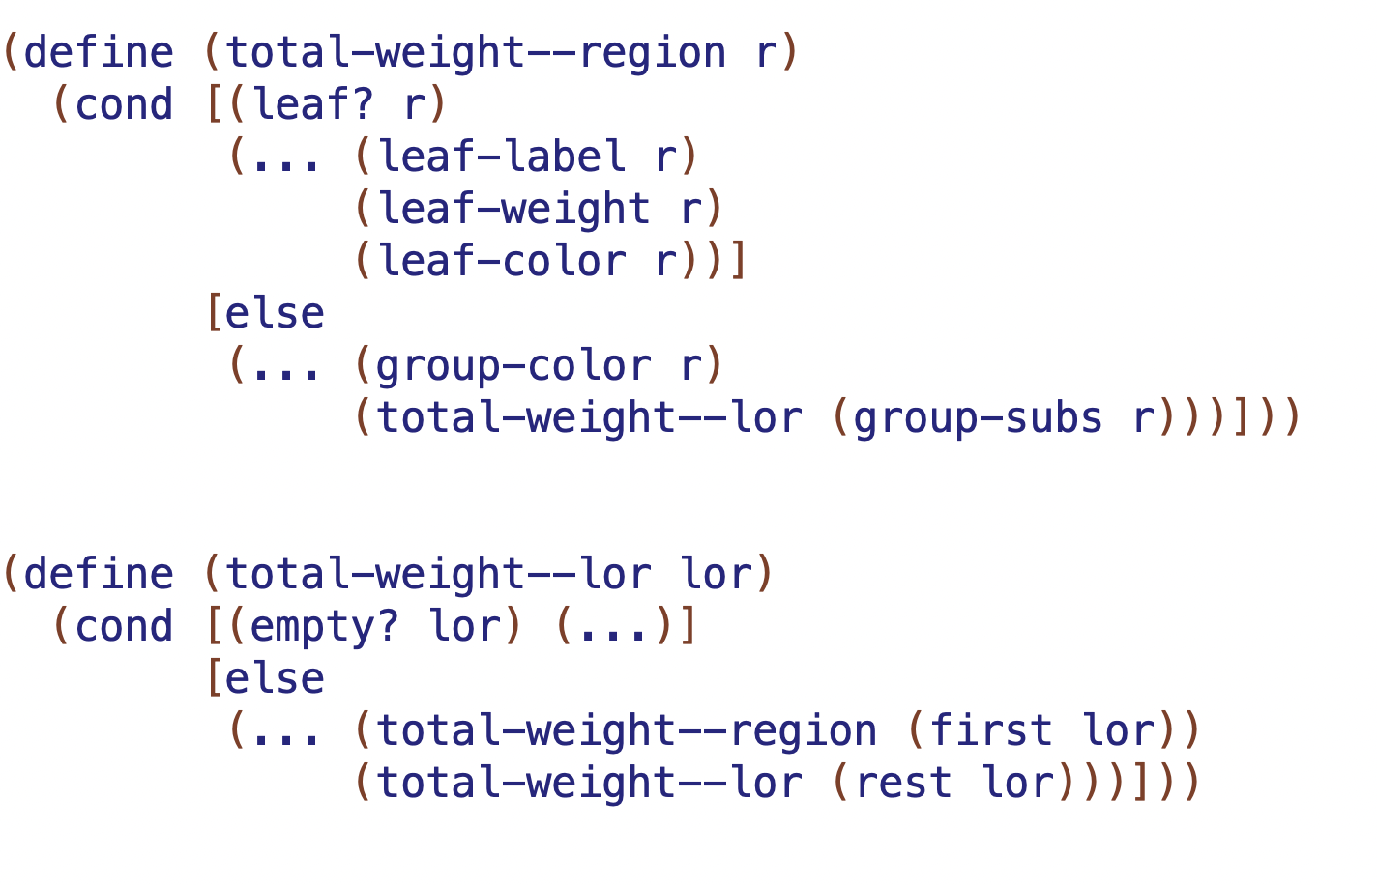

result will be?
result will be?
result will be?

Slide 7
L1, L2, I4 etc. are the
NAMES OF THE CONSTANTS
I4
I2
I3
I1
L4
L5
L6
L1
L2
L3

Slide 8
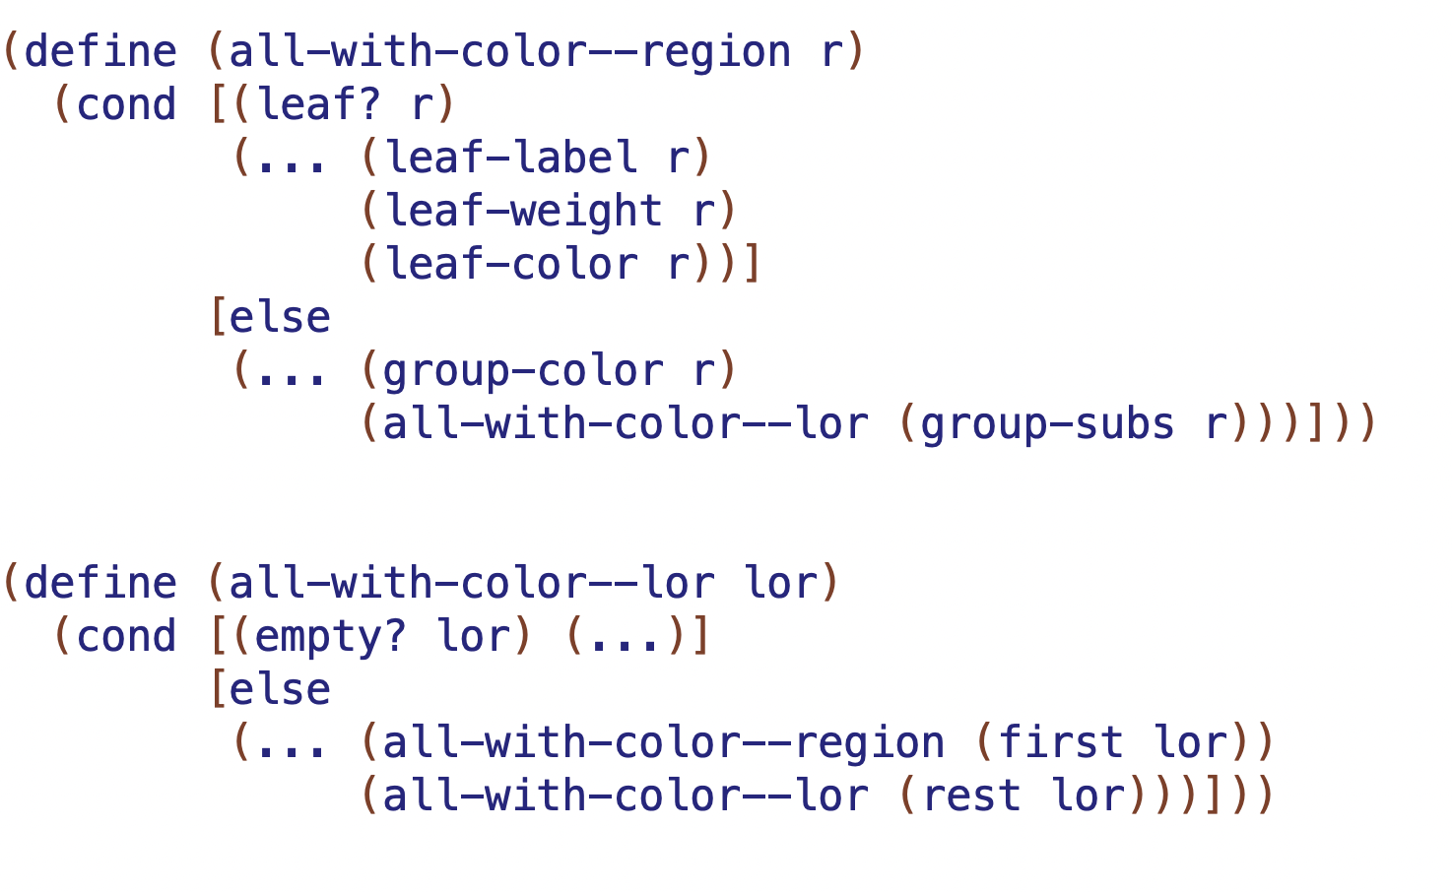
result will be?
result will be?
result will be?

Slide 9
L1, L2, I4 etc. are the
NAMES OF THE CONSTANTS
I4
I2
I3
I1
L4
L5
L6
L1
L2
L3

Slide 10
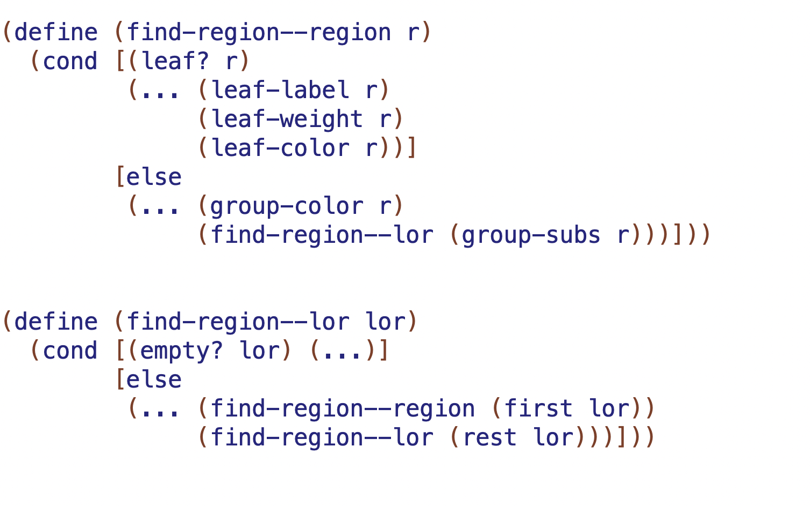
result will be?
result will be?
result will be?

