Slide 1
lecture 07 – main topics
designing with lists of non-primitive types
2 types X and ListOfX
reference and self-reference
the reference rule and natural helpers

Slide 3
Constants:
width, height
egg image
y speed
r speed
background
Changing:
number of eggs
for each egg
x
y
angle
big-bang options:
on-tick
to-draw
on-mouse
on-key

Slide 4
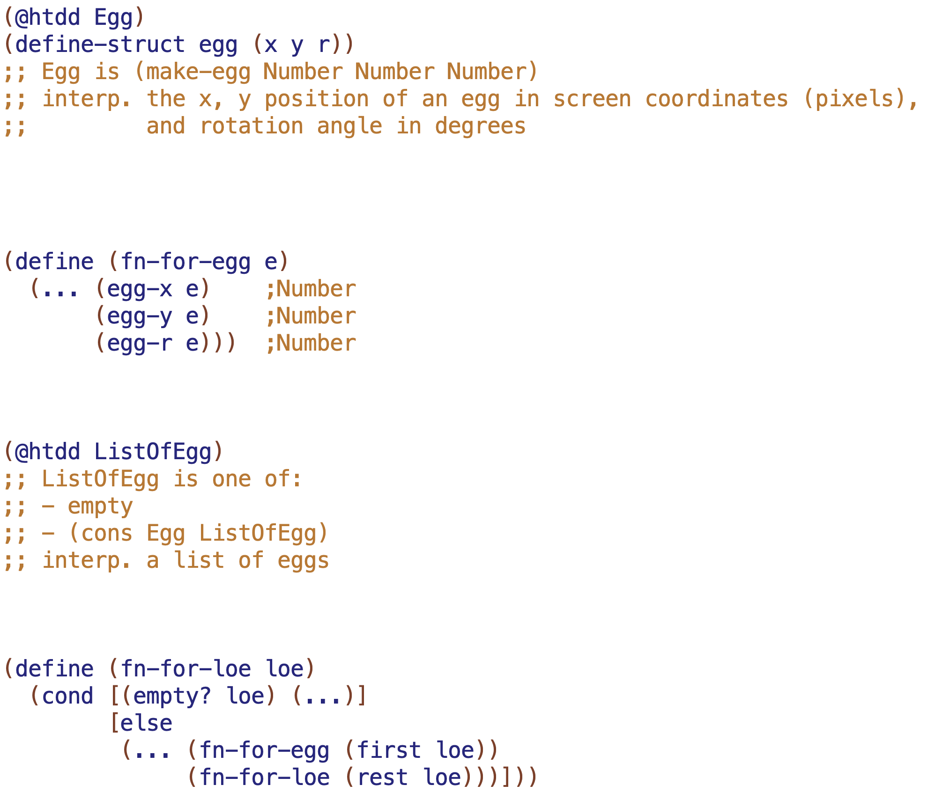

Slide 5
