Slide 1
Hands-on Practice
Scenario:
Multiple services that would like to access data with RESTful API
You’ll try to implement this RESTful server
website
fullstack
Service A
Main Service
Service B
RESTful: get/post/put/delete …

Slide 2
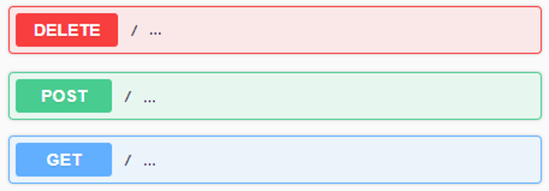
Hands-on Requirement
Create a RESTful server with following RESTful APIs:
A POST API to create a user with “name” and “age” fields.
A DELETE API to delete a specific user by “name”.
A GET API to get a list of users who have been added.
A POST API to add multiple users from CSV file.
The CSV file should be uploaded in API request.
Refer to the attached CSV file: backend_users.csv
A GET API to calculate average age of each group of users.
Please use pandas package to calculate it.
Group by the first character of the usernames.
Example
Note
Please live demonstrate your API specifications by using Swagger.
You can use any libraries.
An explanation of your code structure is necessary.

Slide 3
Bonus requirement
Use unittest to test your create user API
TC1: User name is empty when request to create user API
TC2: User age is 999 when request to create user API
Use docker to execute demo

Slide 4
Demo
Try RESTful APIs with swagger
or try RESTful APIs with postman

