Slide 1
Sam Schwartz Engineering
Data​ ​Exercise – Determine Travel Times for Q70SBS (12/10)
Rachel Lim

Slide 2
Task 1: Calculate travel times of the complete route between the following Stop IDs:
Time Interval | Duration in Seconds | Duration in minutes
00:00 – 05:00 | 2172 | 36
06:00 – 11:00 | 2664 | 44
12:00 – 17:00 | 3053 | 50
18:00 – 23:00 | 2599 | 43

Slide 3
Method and Assumptions
Check:
Unique routes, select only Q70+
Direction, assume only Northbound
Origin and destination stops, ensure no bus terminate midway
Identify 10 buses serving route
Cleaning:
Convert time to date-time format, sort ascending
Filter to reduce columns, include only at stops boolean
Groupby vehicle_id to calculate time for each bus
Sort time into time interval bins to calculate travel duration for each bracket

Slide 4
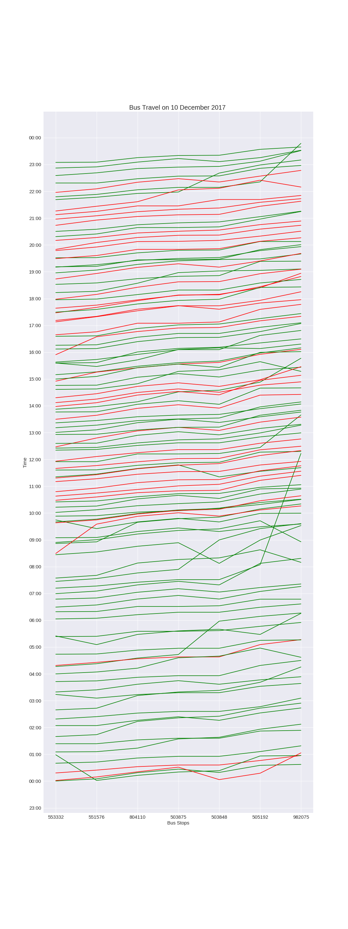
Task 2: Visualize travel times to get the sense of delays for that selected route.
Notes:
Each line represents a bus service, showing the bus making its way along the route over time. The gradient of the line represents speed.
Red shows that the line is delayed, green shows no delay

Slide 5
Bus Travel from Morning to Noon
Frequency of buses lower in the morning
Less delays
Some error in data

Slide 6
Bus Travel from Noon to Night
Frequency of buses increases over the course of a day
More delays
Some error in data

Slide 7
Limitations
Visualization of Delay
Intended to compare actual time delta between bus stops with average time
Each line will be made up of 6 short lines (represent travel between stops)
Short lines will be colored according to level of delay compared to its respective average time
Added dimension of time brackets
Different time of the day, different levels of travel conditions (traffic), different travel times
Missing data was filled in by using average travel time between those stops

