Slide 1
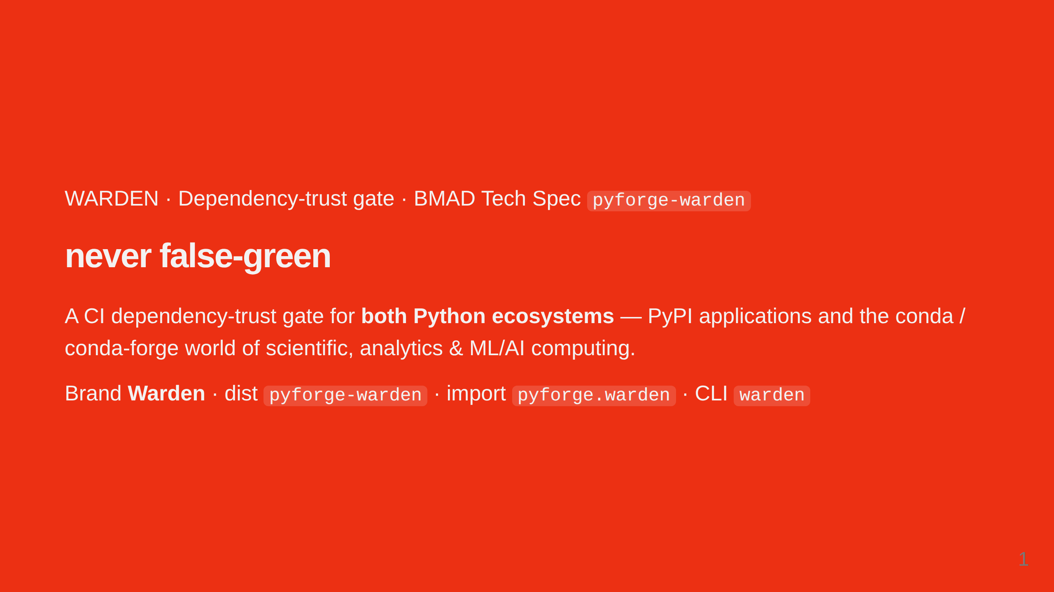
Notes:
The thesis in three words: never false-green. A green check must mean the dependencies were actually assessed and found safe. Warden is a CI gate for BOTH Python ecosystems: pip/PyPI apps and the conda/conda-forge scientific and ML/AI world.

Slide 2
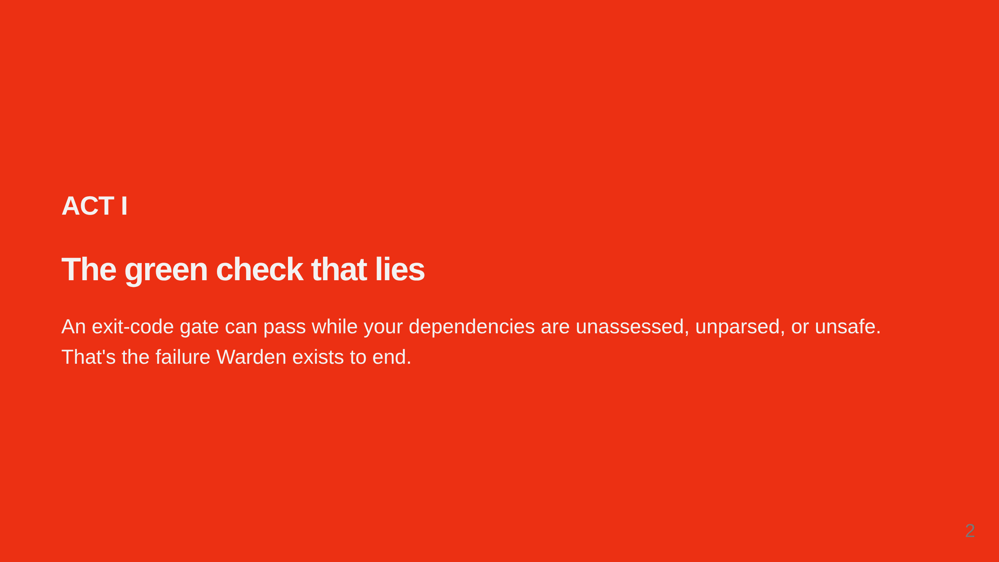
Notes:
Act I frames the problem. The danger isn't a red X — it's a green check that never actually looked.

Slide 3
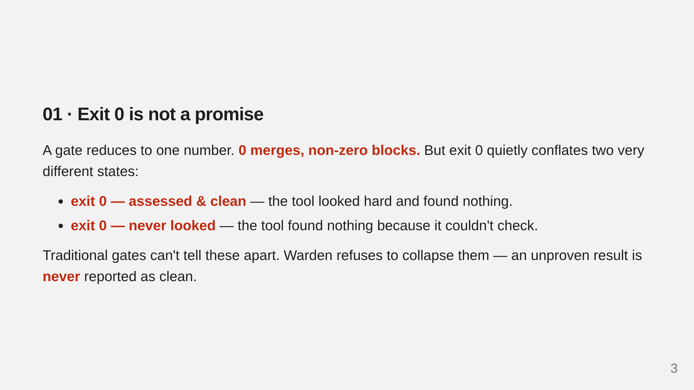
Notes:
Exit 0 conflates 'I checked and it's clean' with 'I didn't really check.' A scanner that finds nothing returns 0 whether it looked or not.

Slide 4
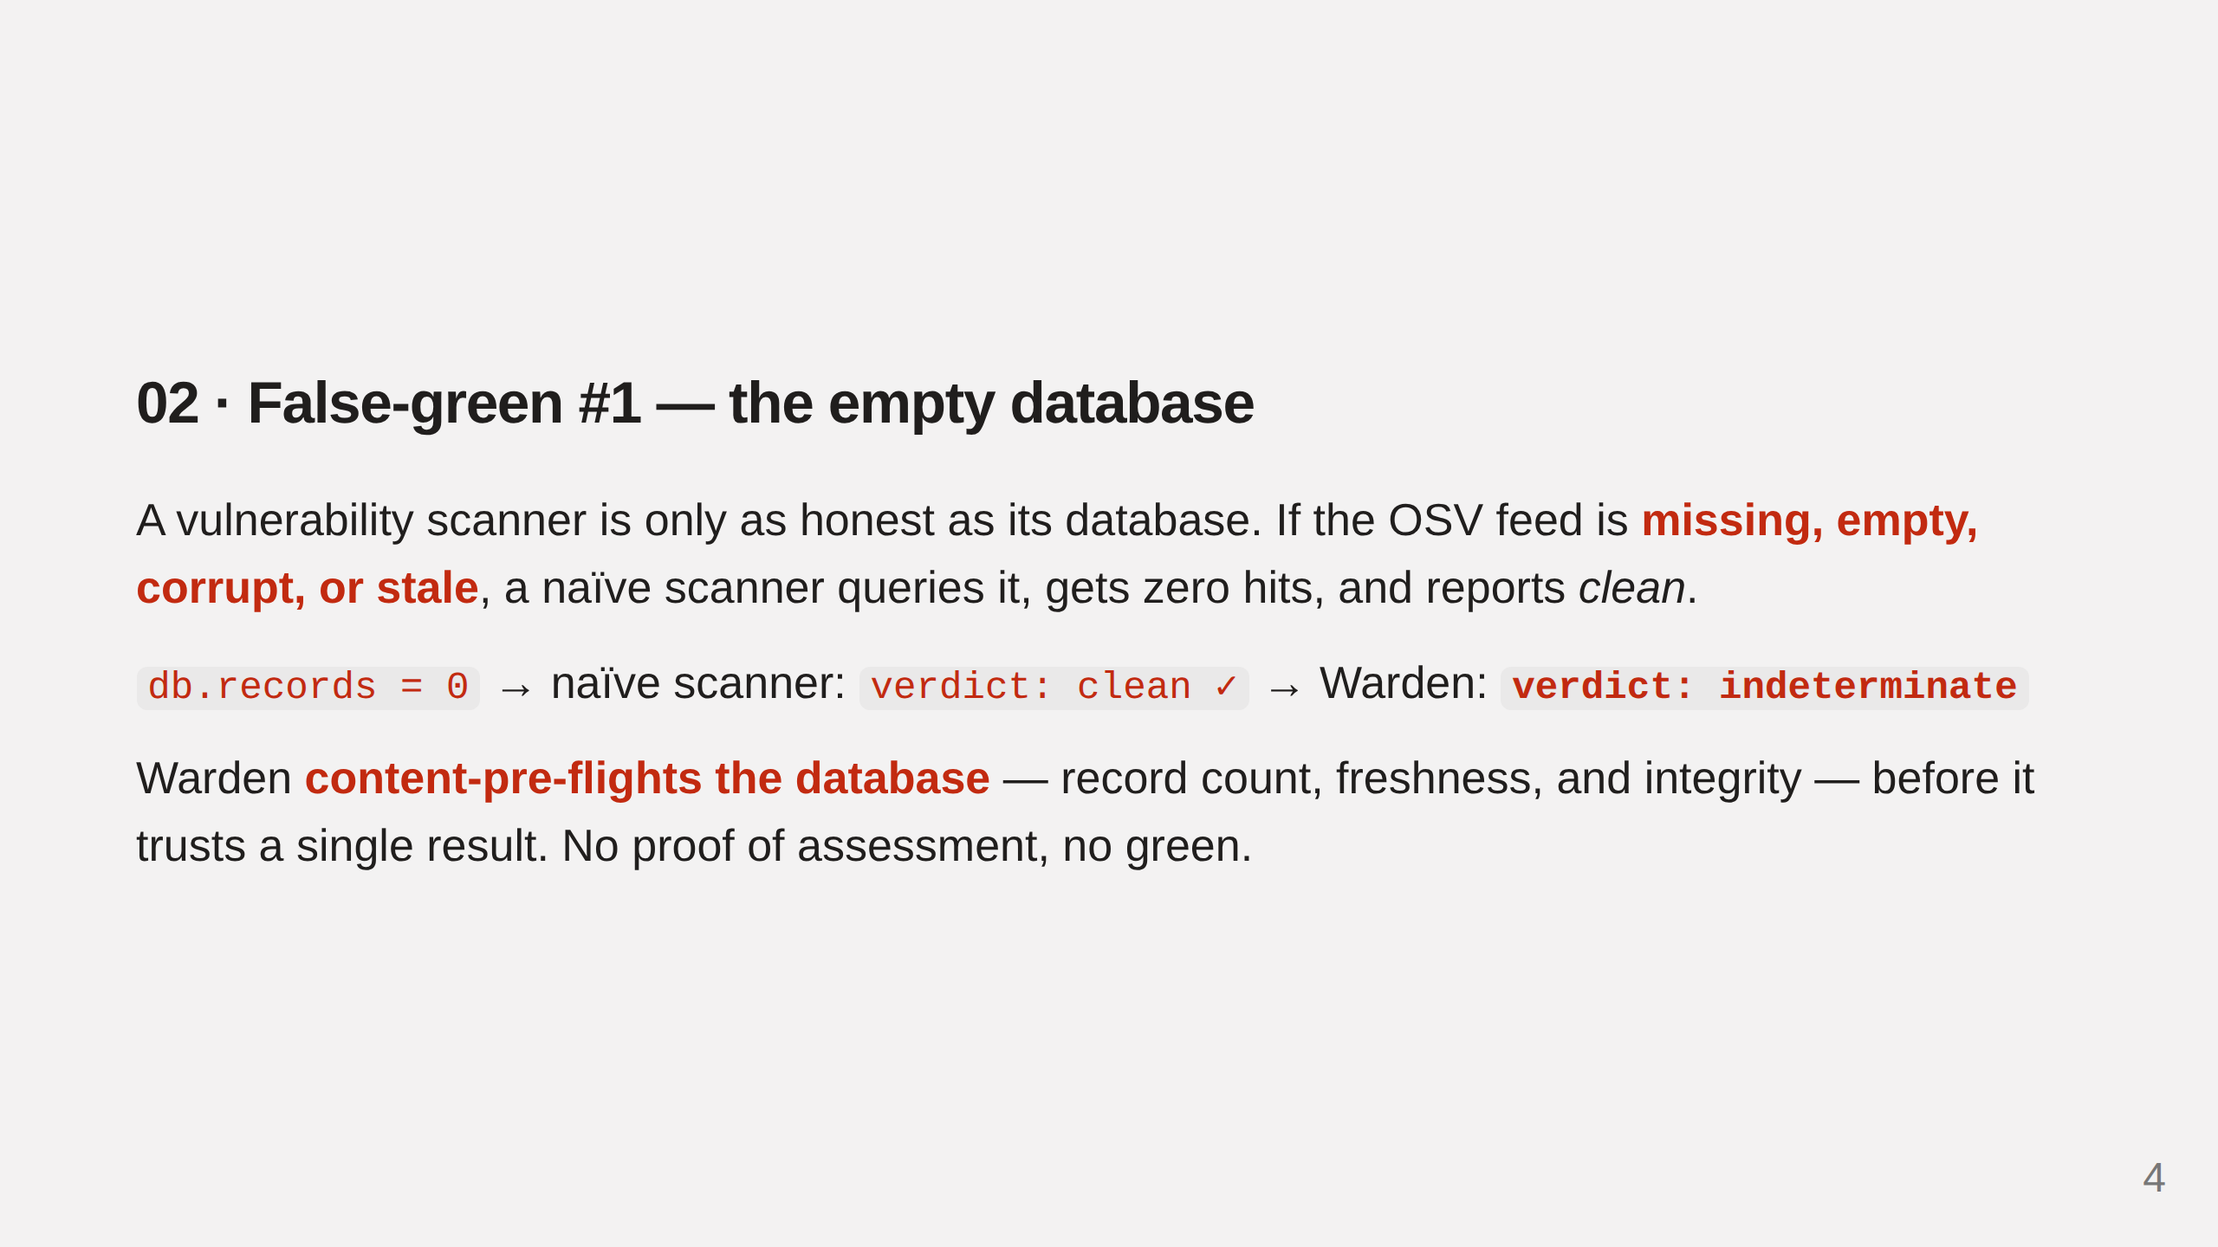
Notes:
If the OSV database failed to download, is empty, or stale, a naive scanner gets zero hits and reports clean — a green check that means the opposite of safe.

Slide 5
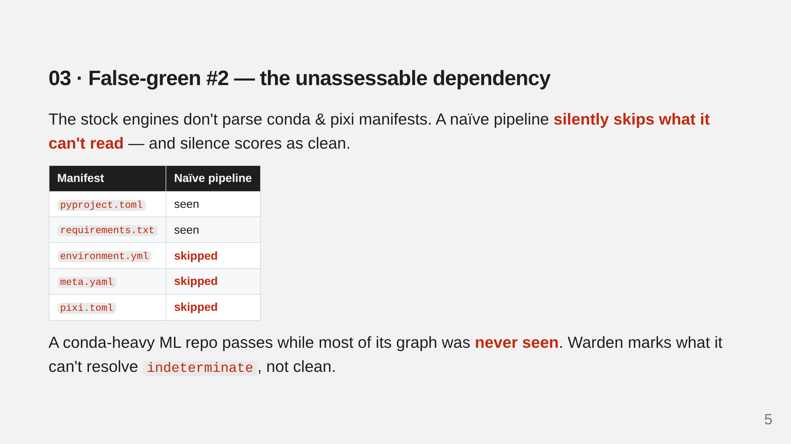
Notes:
deptry and osv-scanner don't parse conda meta.yaml/recipe.yaml/environment.yml/pixi.toml. A conda-heavy ML repo scans 'clean' while most deps were never seen.

Slide 6
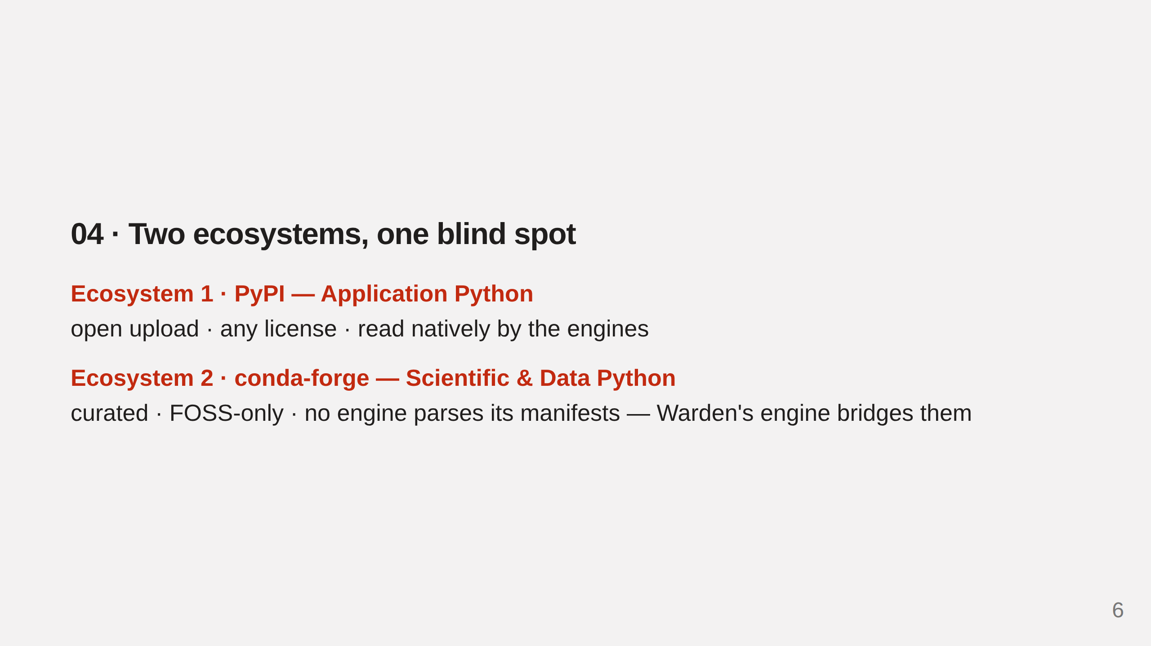
Notes:
Python is two ecosystems: application Python on PyPI, and the scientific / ML / AI / data stack on conda-forge. Warden covers both.

Slide 7
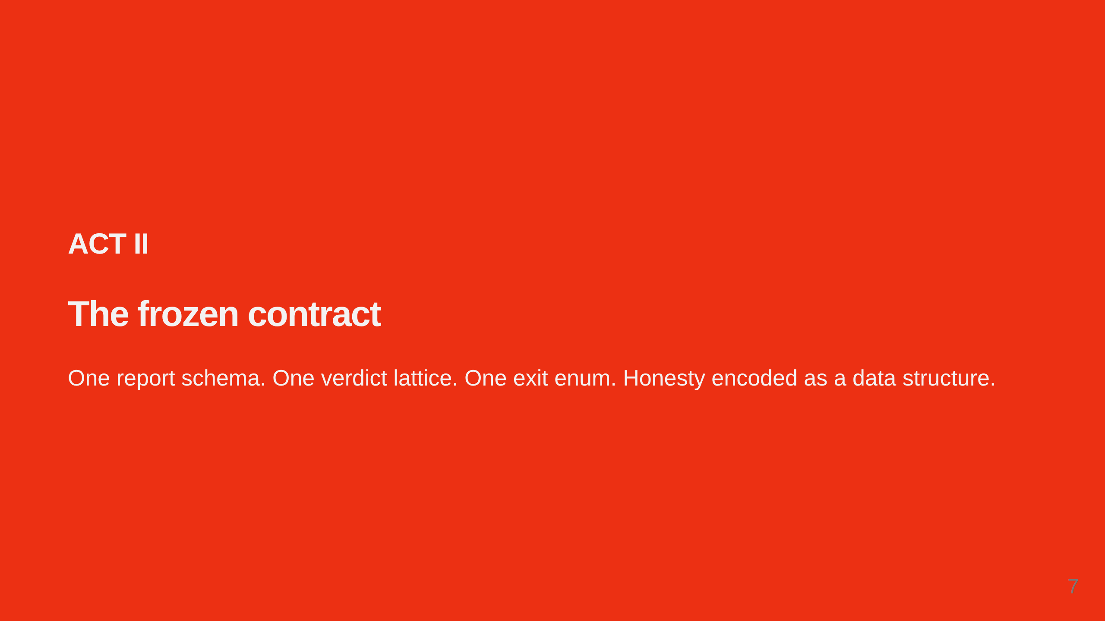
Notes:
Warden's answer to false-green is a single, frozen, machine-readable contract. Nothing downstream has to guess.

Slide 8
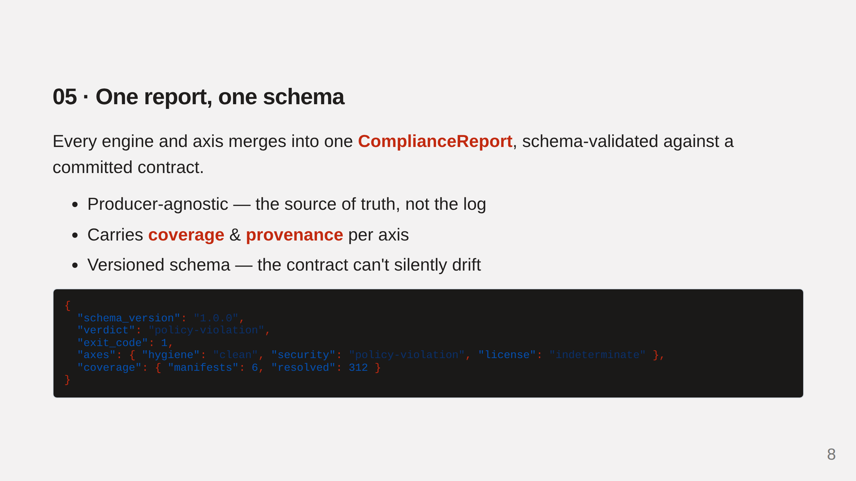
Notes:
Everything flows into one artifact, validated against a committed JSON Schema. The human summary is just a rendering of it.

Slide 9
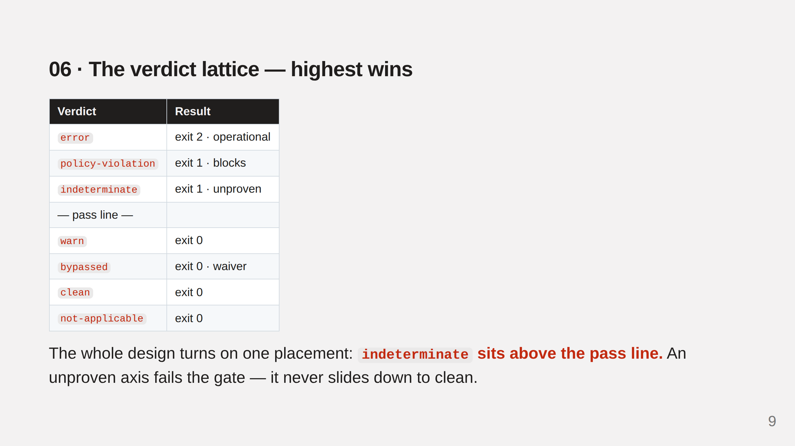
Notes:
Seven rungs, highest wins. indeterminate sits ABOVE the pass line — an unproven result blocks, never slides to clean.

Slide 10
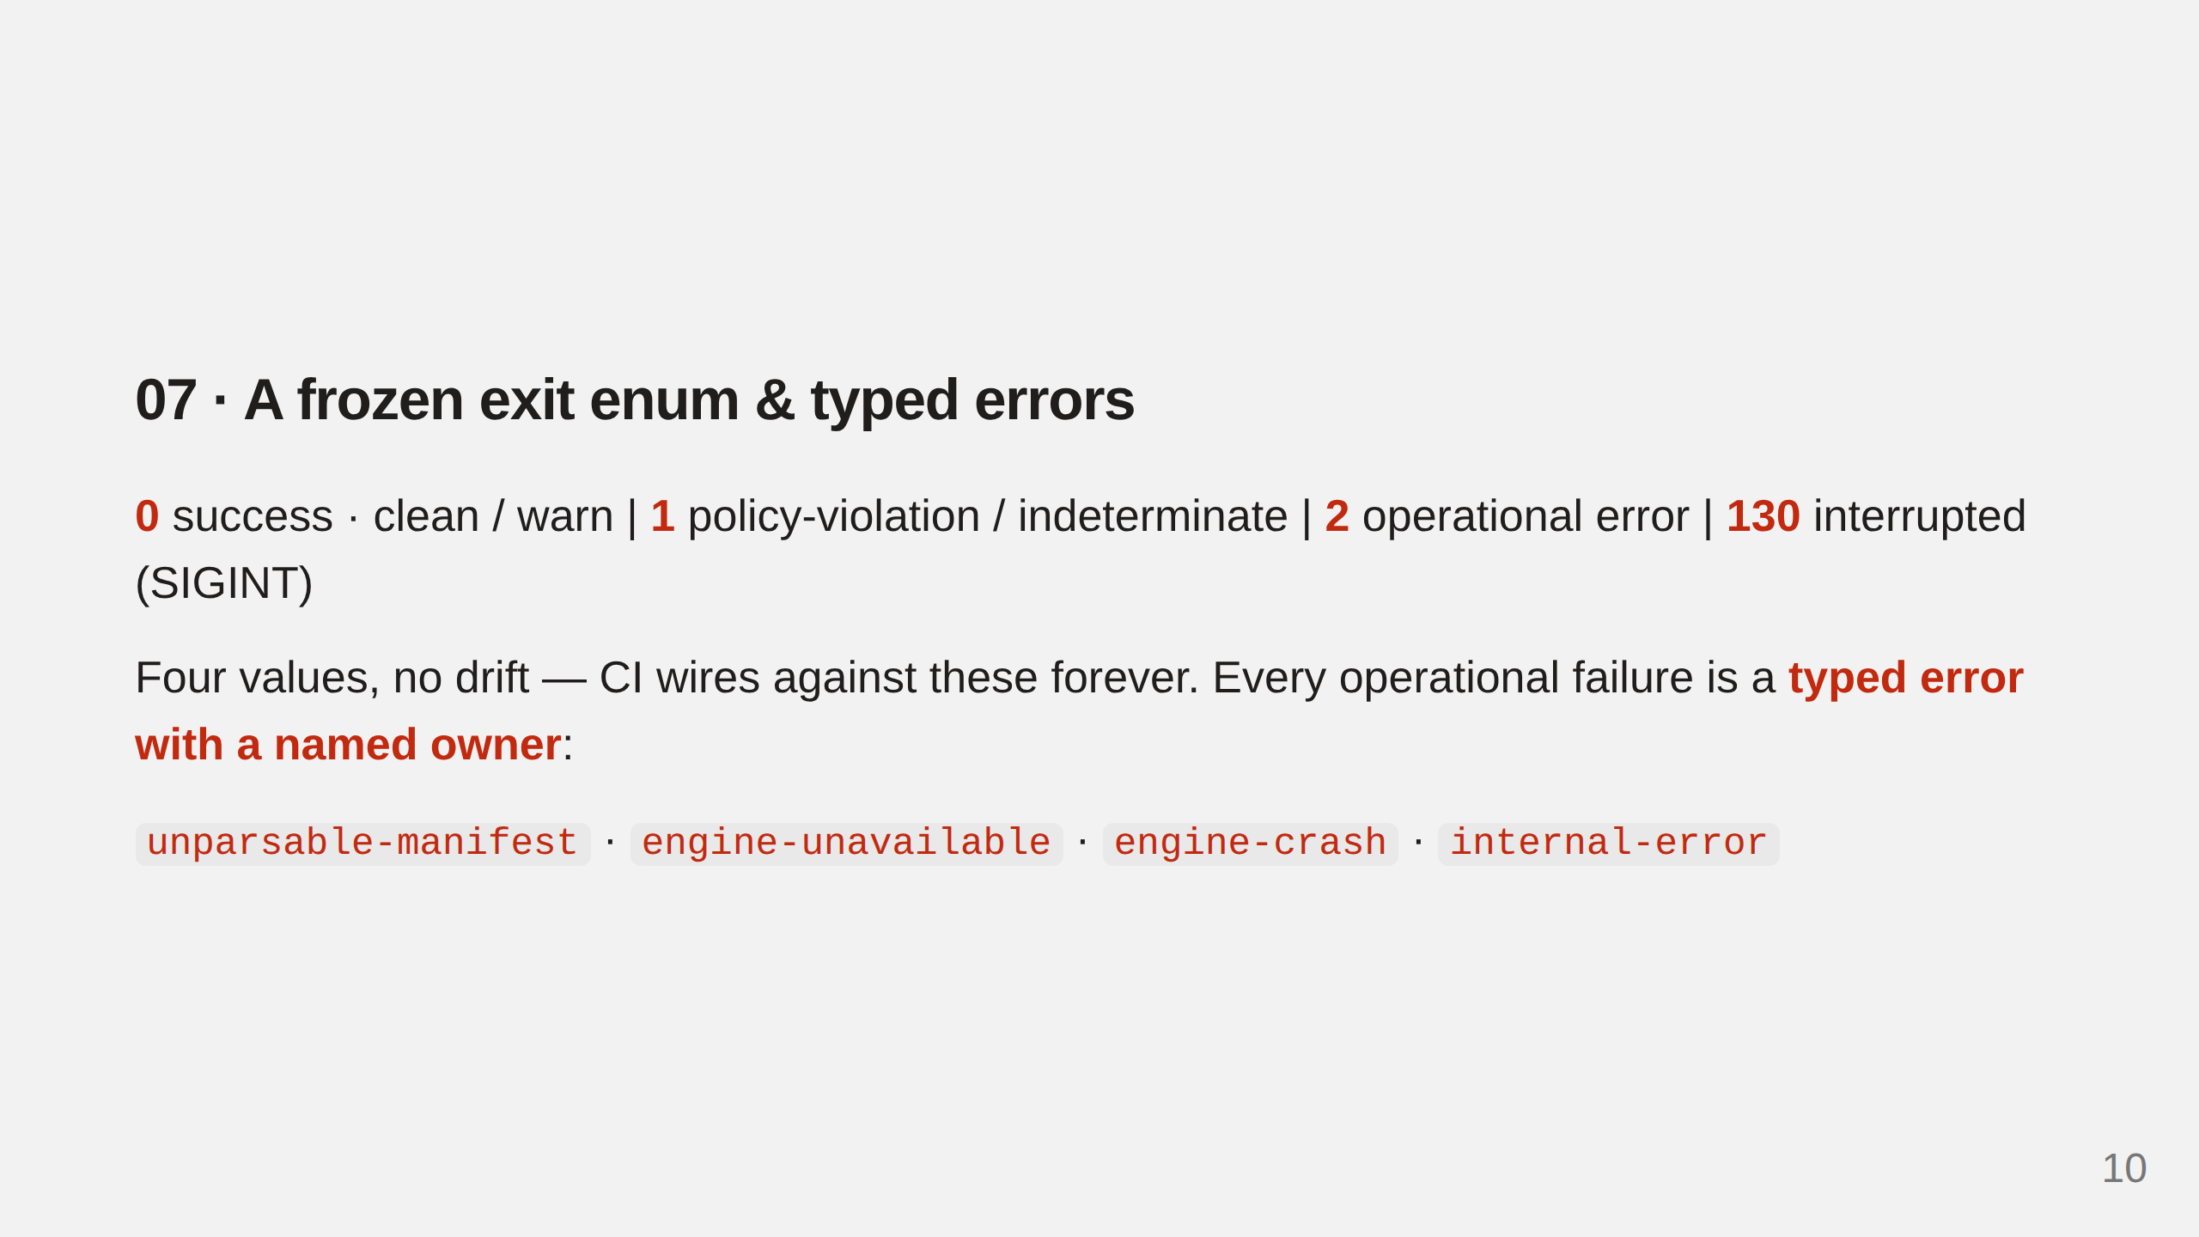
Notes:
The exit enum is frozen. Every operational failure is a typed error with a named owner, so a failure routes to whoever can fix it.

Slide 11
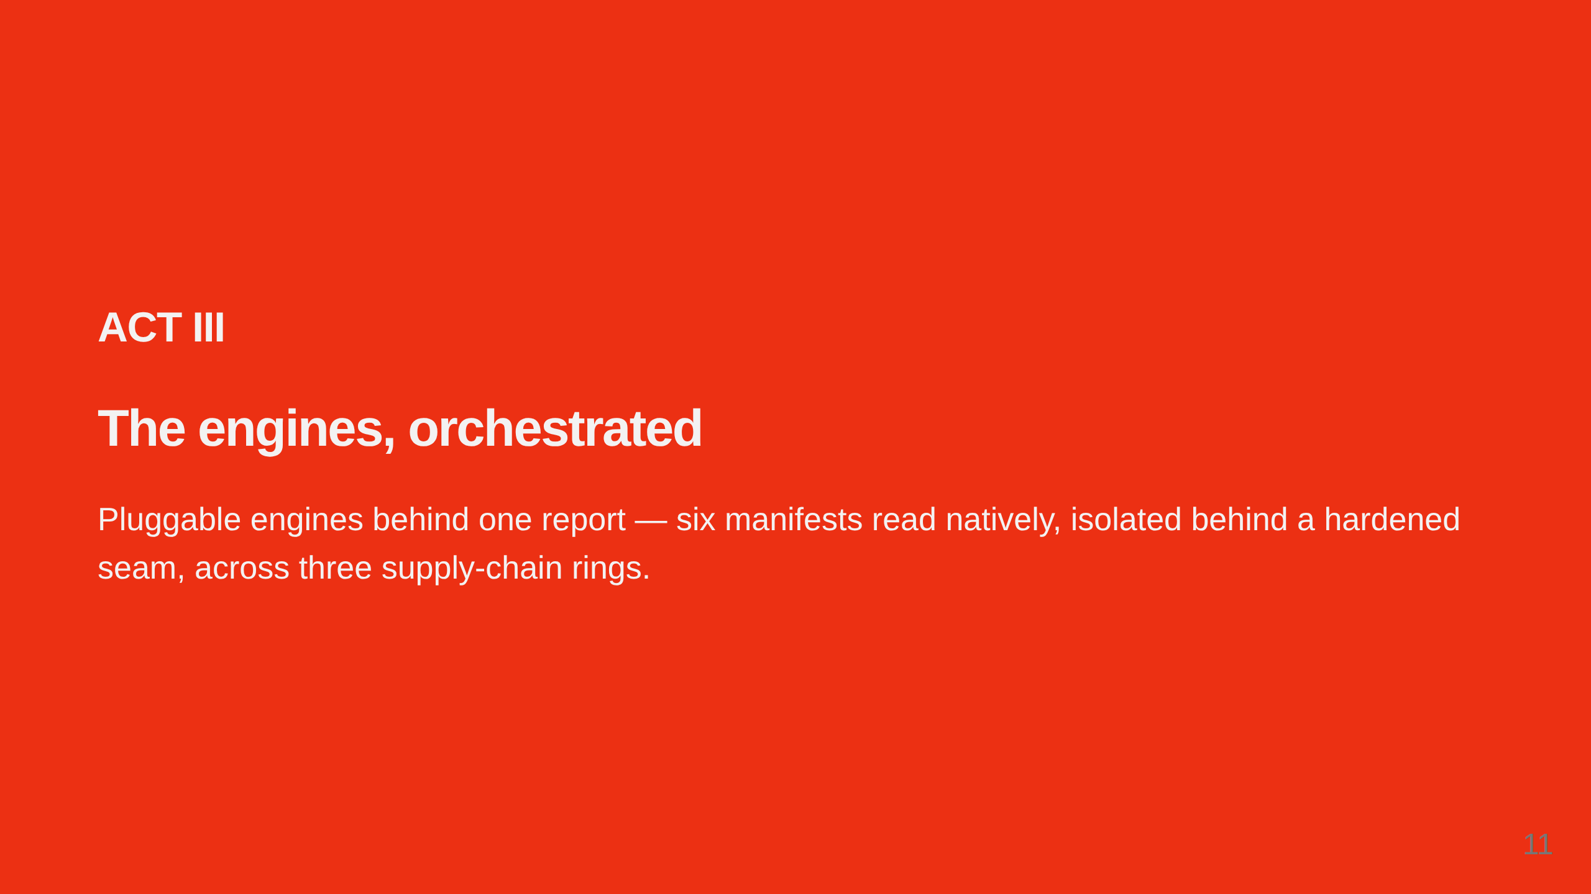
Notes:
Warden orchestrates deptry and osv-scanner behind one report, reads six manifest formats natively, isolates each engine, and scans at three concentric rings.

Slide 12
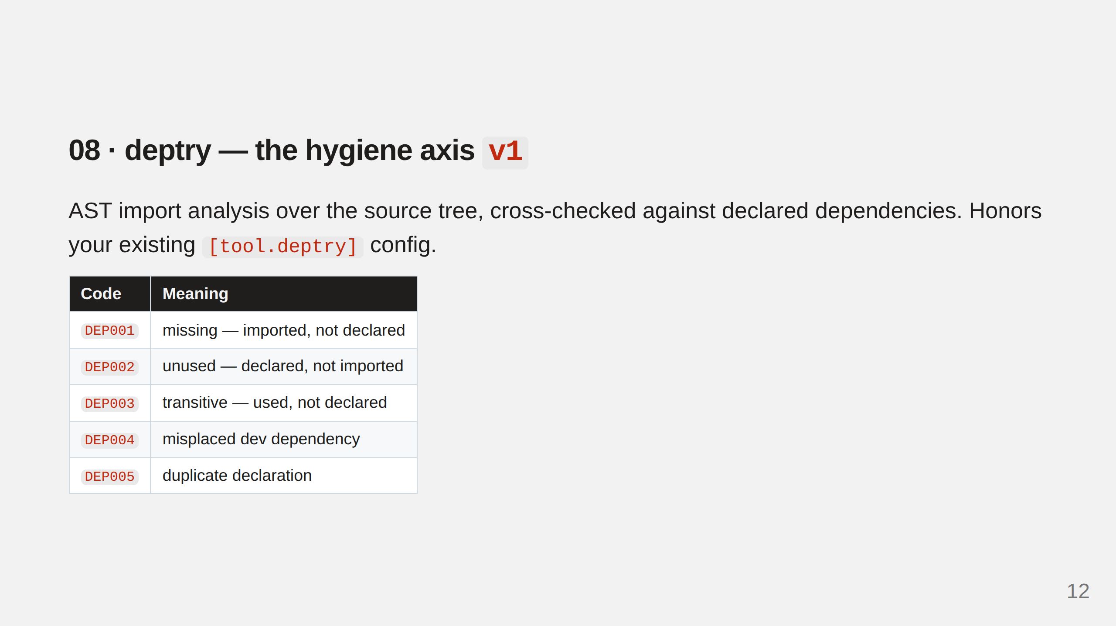
Notes:
Axis 1, hygiene, ships in v1 with deptry — AST import analysis emitting DEP001–005, honoring existing tool.deptry ignore config.

Slide 13
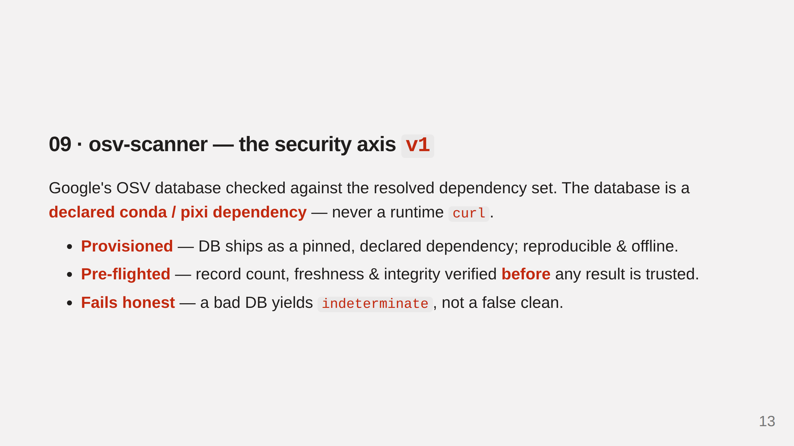
Notes:
Axis 2 ships in v1 with osv-scanner. The DB is a declared dependency (never a runtime curl) and Warden pre-flights it before trusting a result. That's the fix for false-green #1.

Slide 14
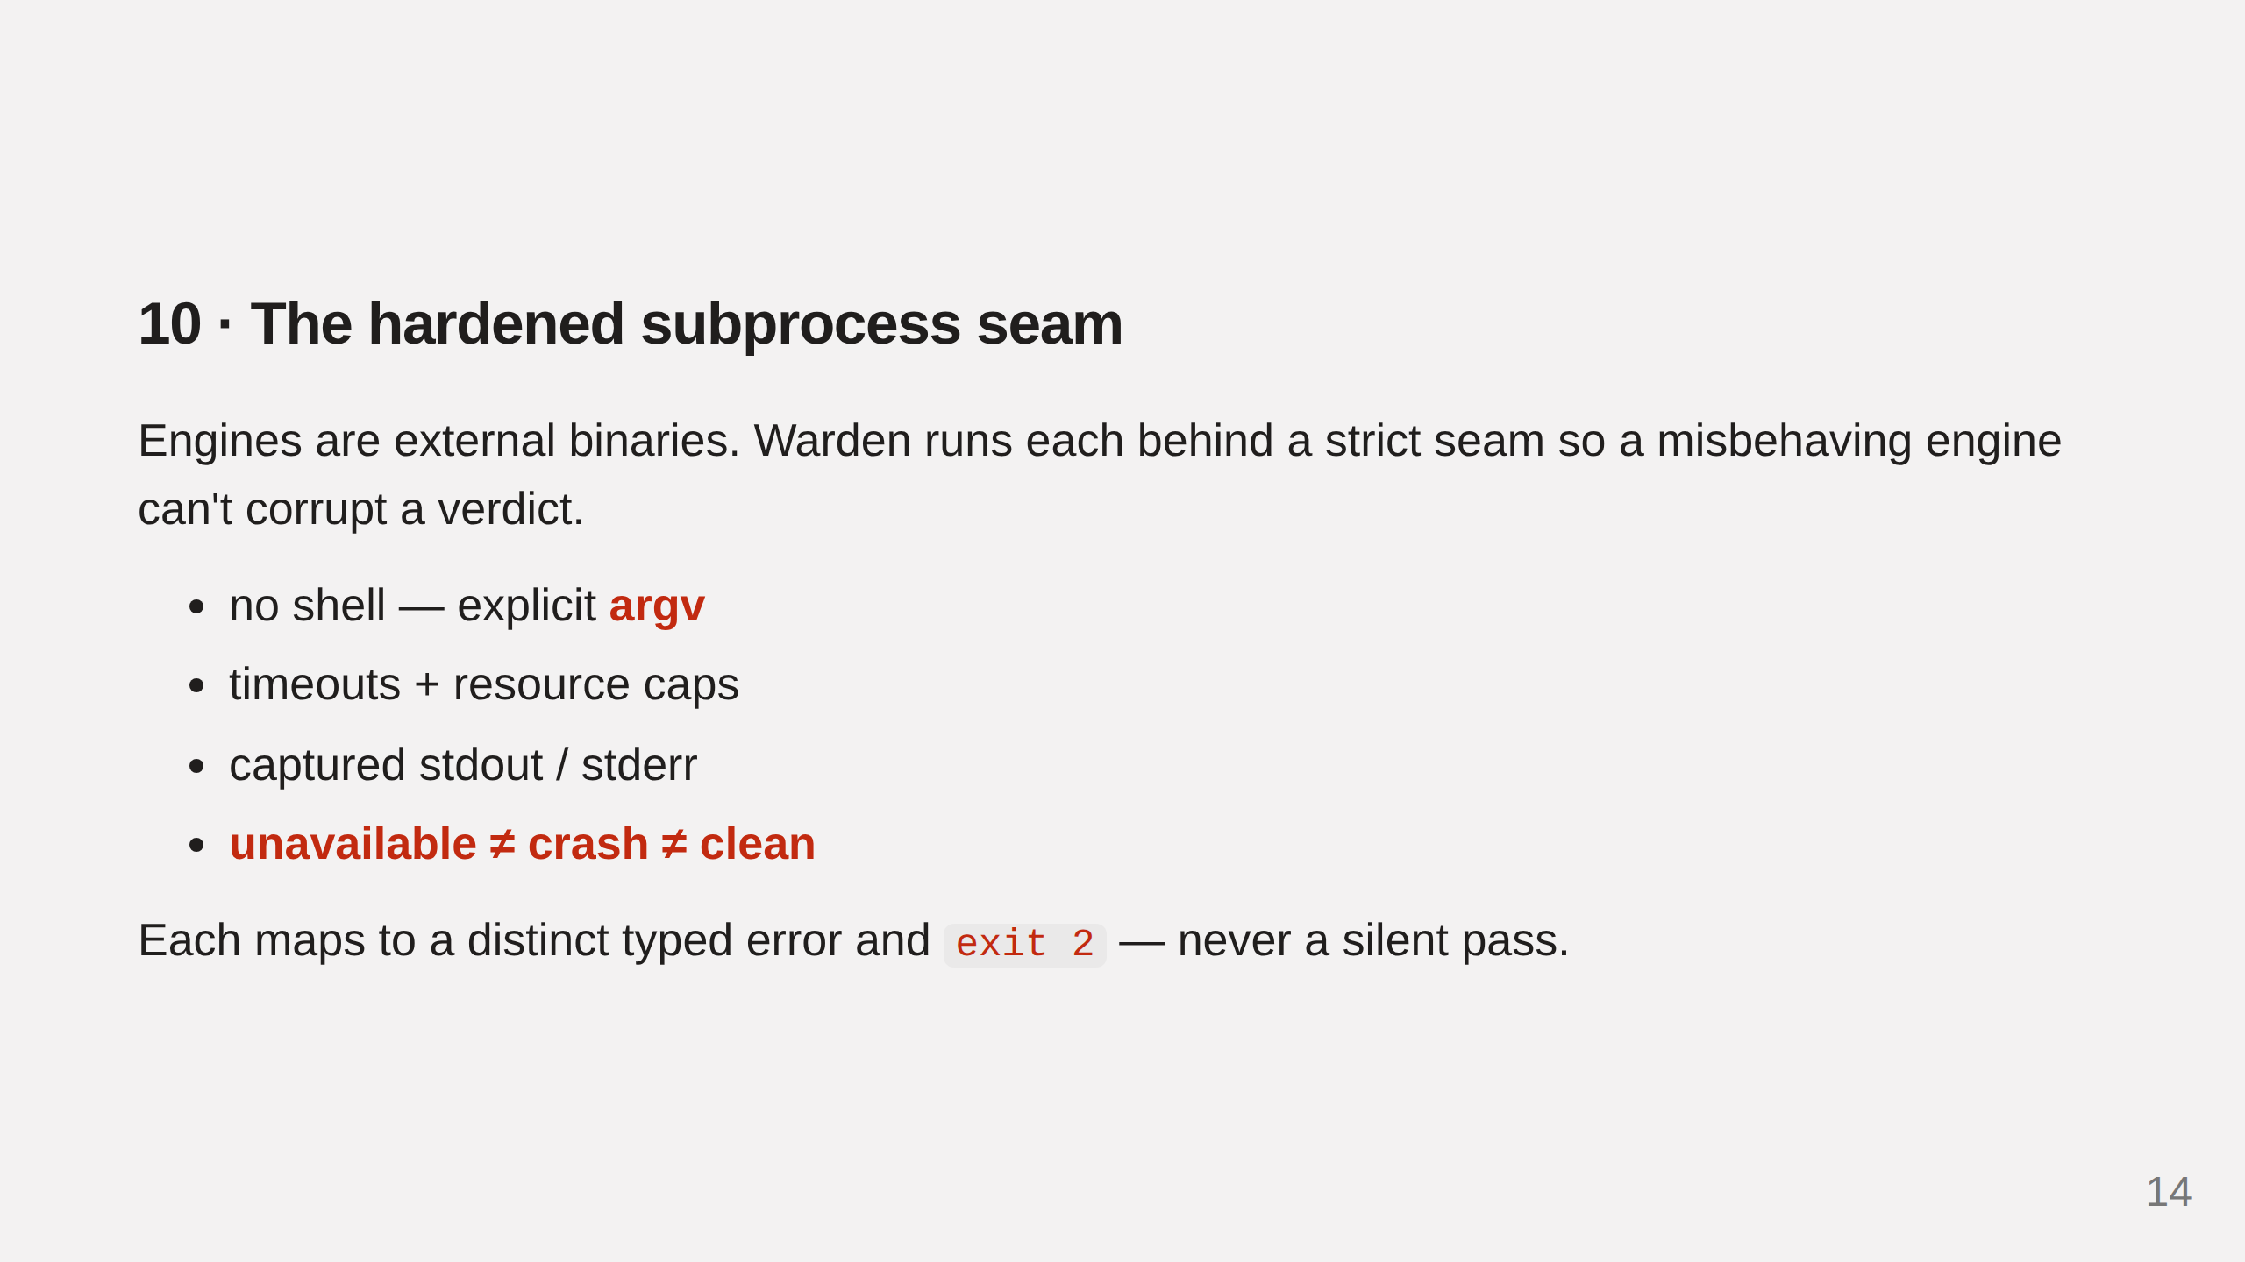
Notes:
Warden isolates each engine behind a hardened subprocess seam. A misbehaving engine becomes a typed error and exit 2 — never a silent pass.

Slide 15
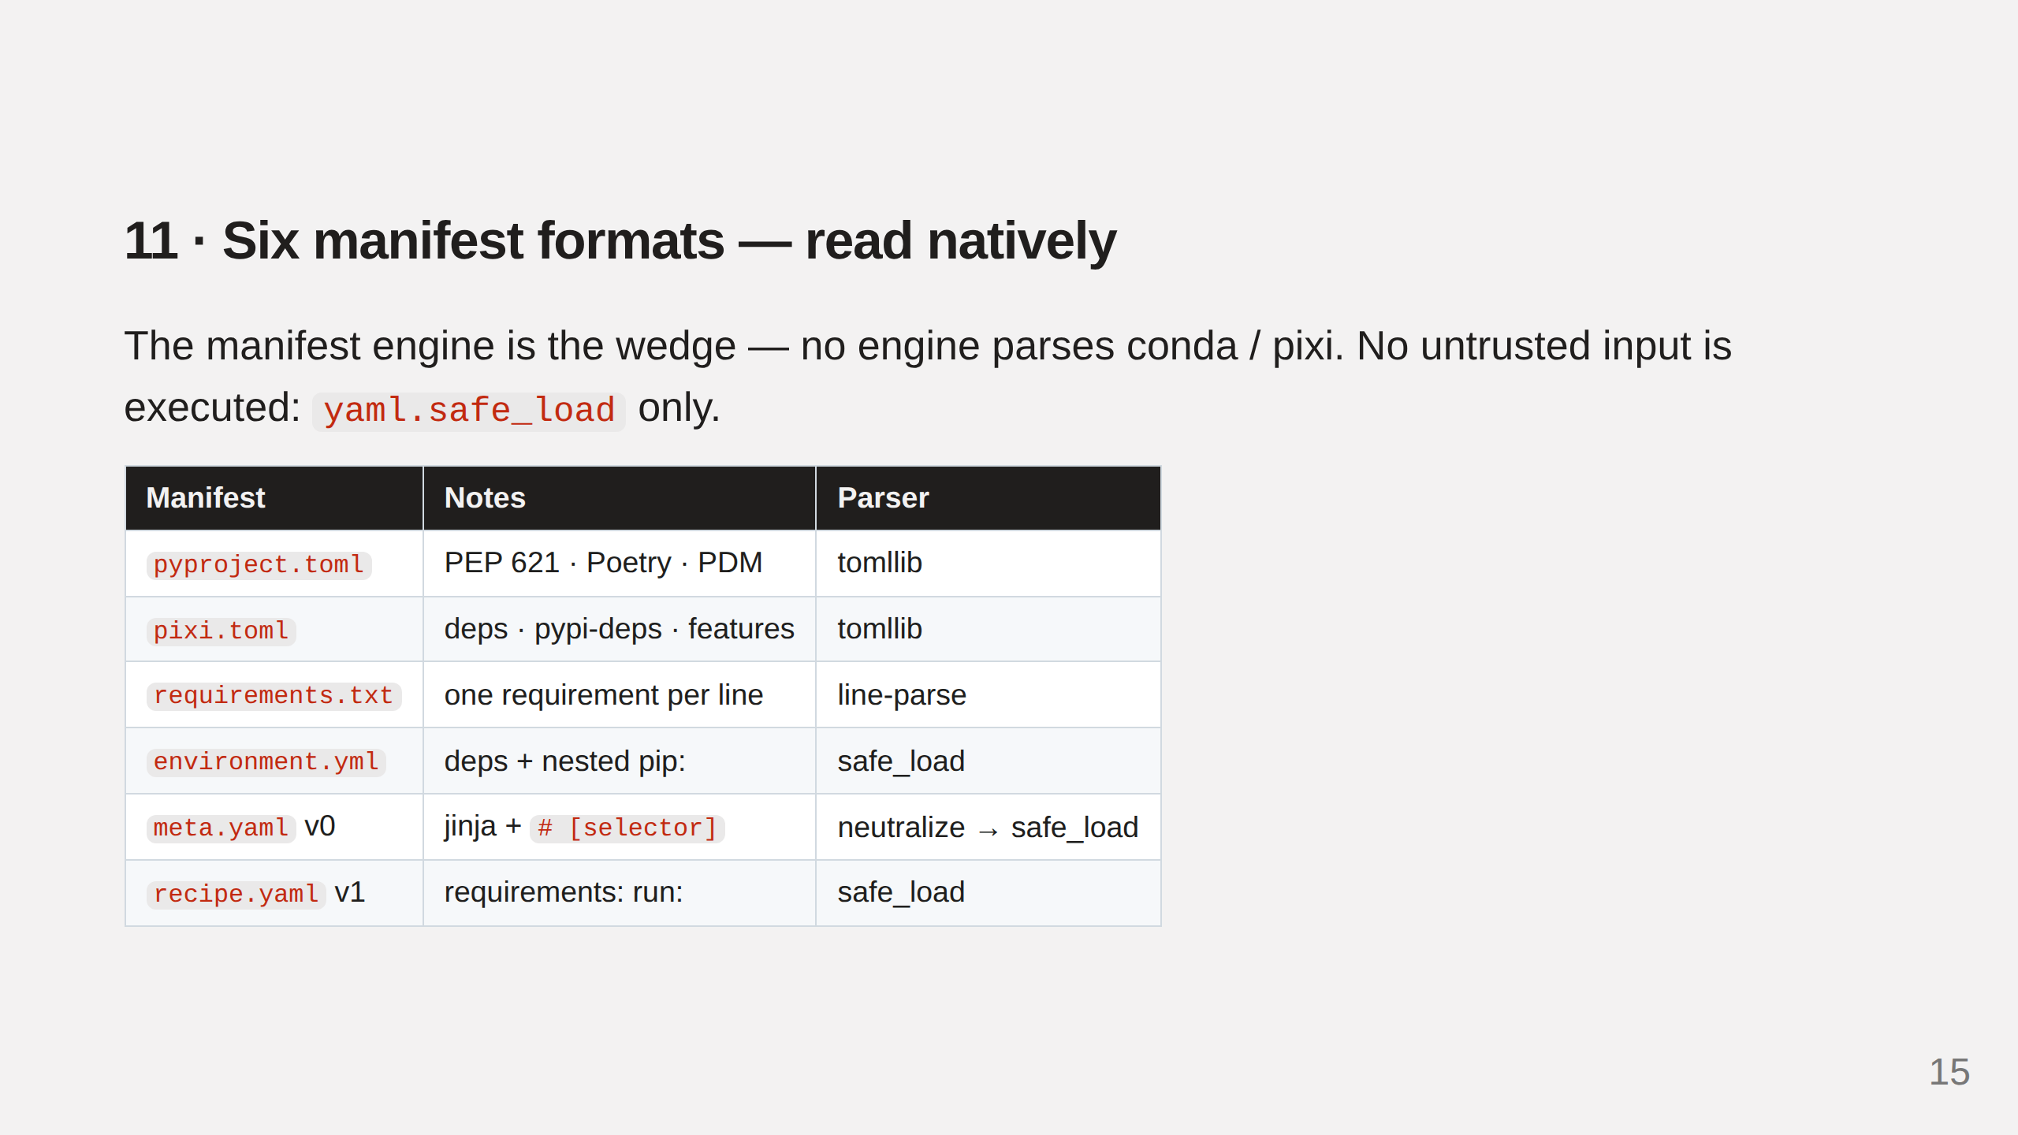
Notes:
Neither stock engine parses conda/pixi. Warden reads all six formats; meta.yaml v0 needs jinja/selector neutralization. safe_load only — no untrusted input executed.

Slide 16
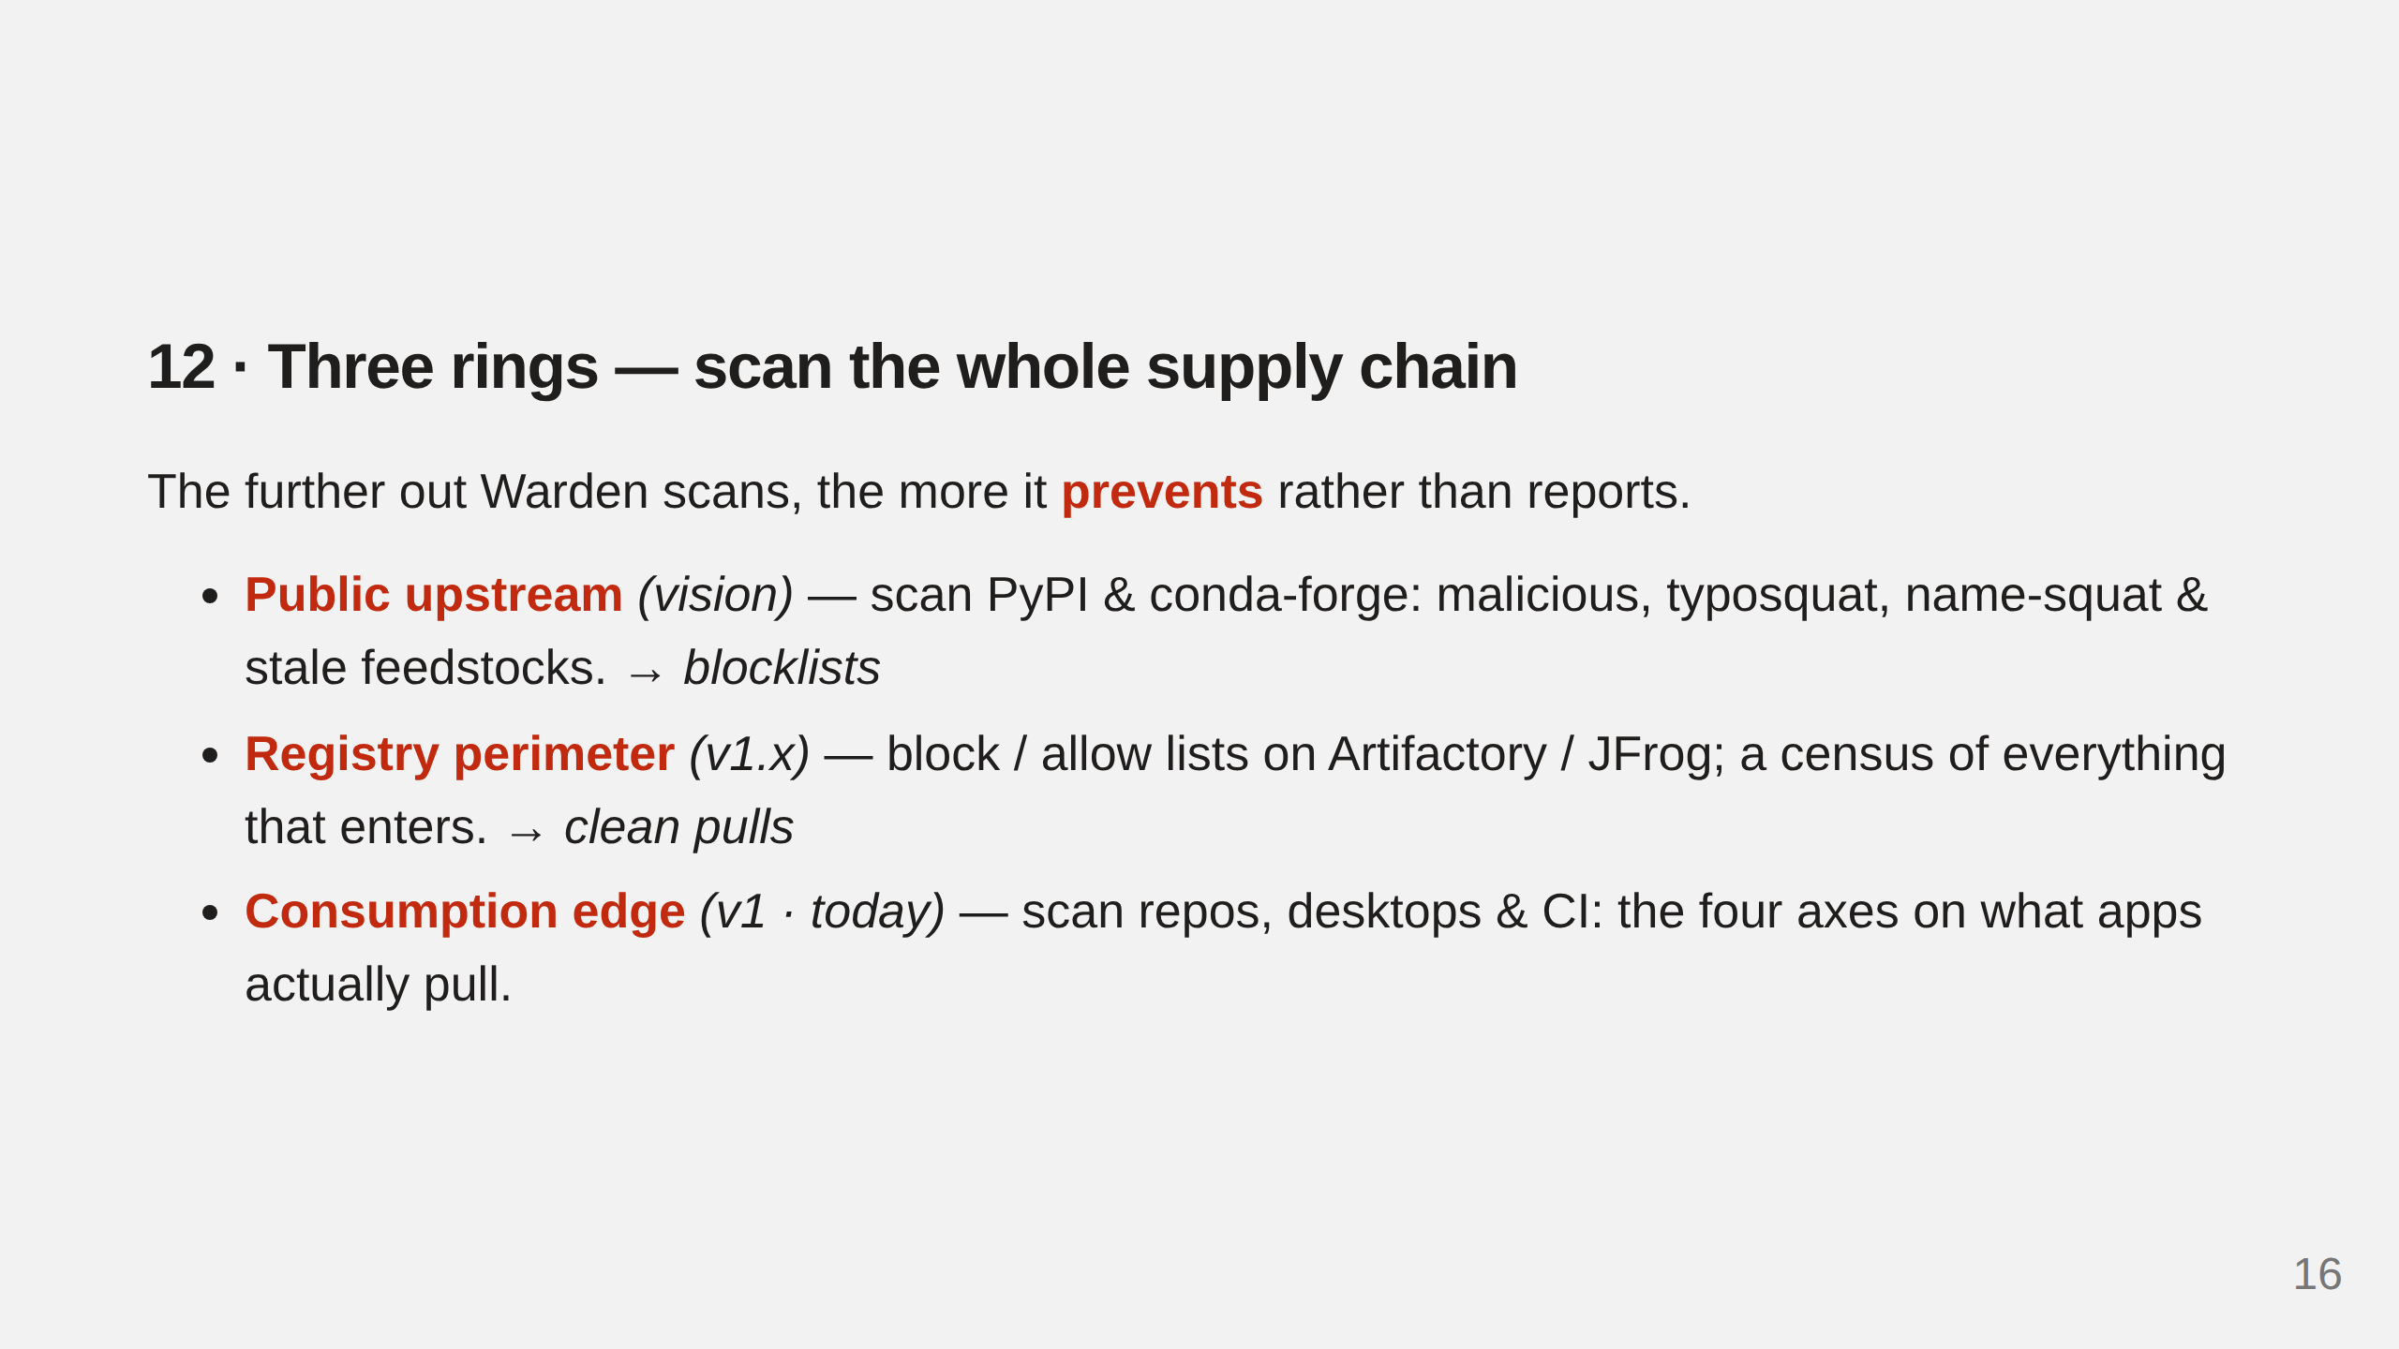
Notes:
Warden runs at three depths. Edge is v1 (today); registry perimeter (JFrog blocklists) is v1.x and the star; public upstream scanning is the vision.

Slide 17
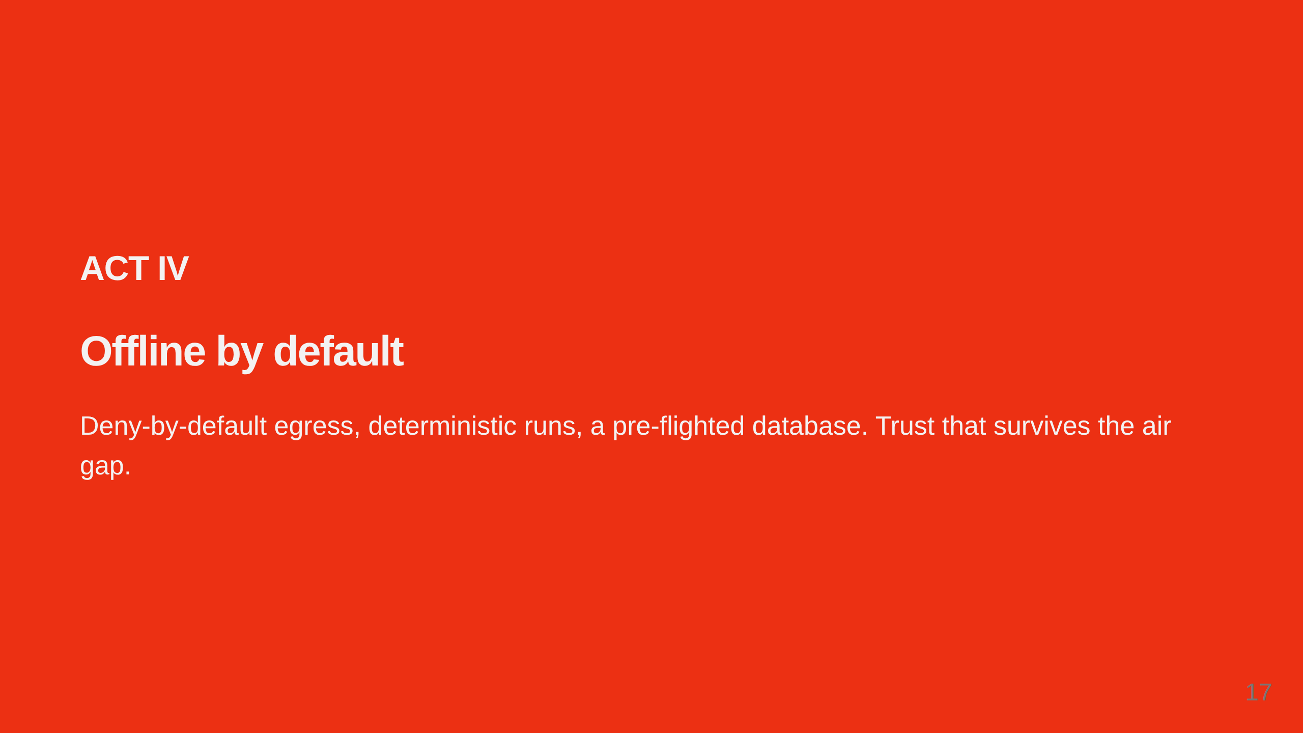
Notes:
Enterprise Python often runs where the internet doesn't reach. Warden is built for that.

Slide 18
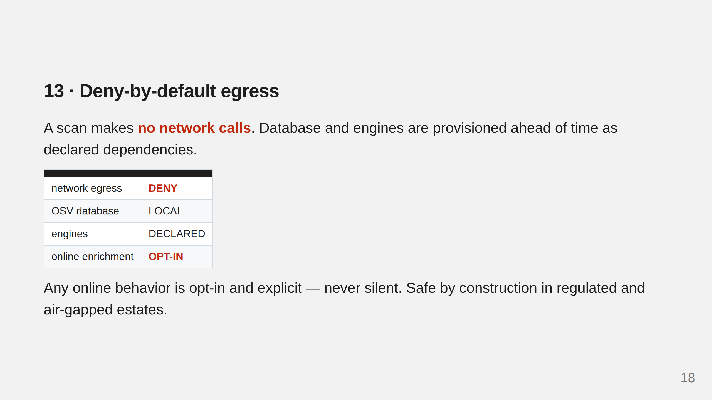
Notes:
Warden makes no network calls during a scan by default. Any online behavior is opt-in and explicit, never silent.

Slide 19
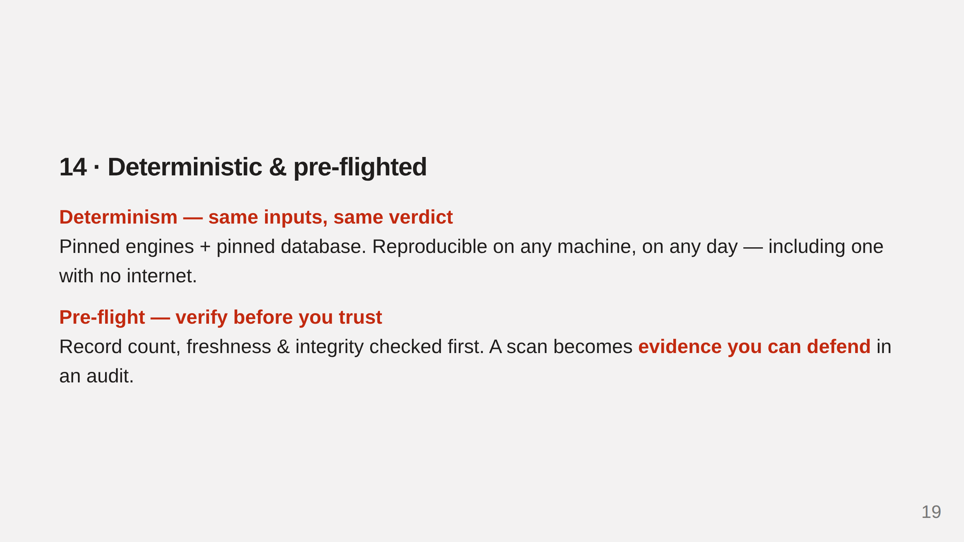
Notes:
Determinism plus the pre-flight turn a scan into evidence you can defend in an audit.

Slide 20
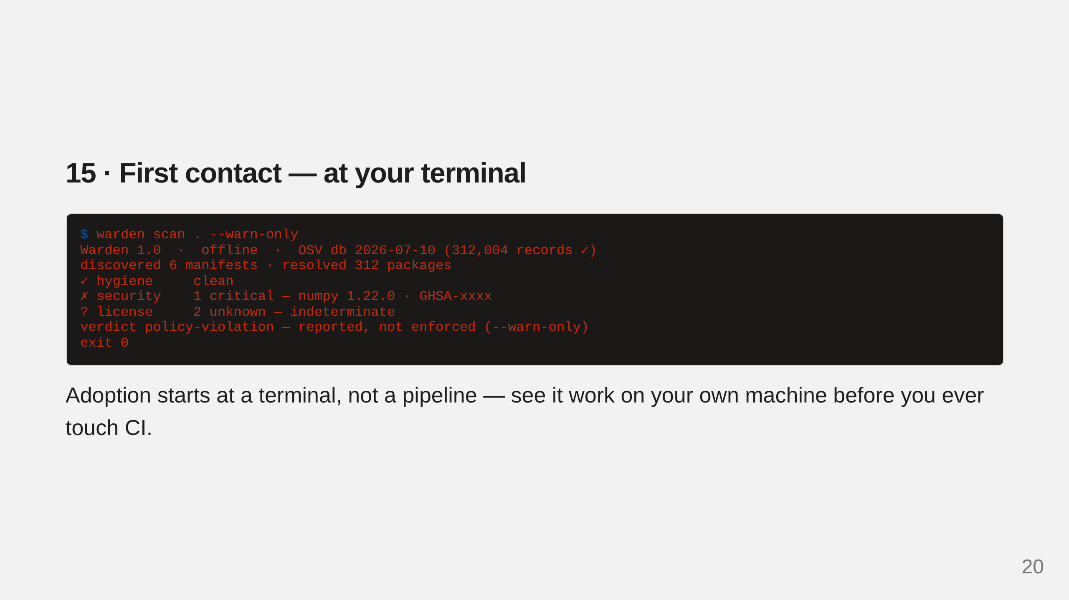
Notes:
warden scan . --warn-only runs locally, shows real findings, and exits 0 so nobody is blocked on day one. This is the on-ramp.

Slide 21
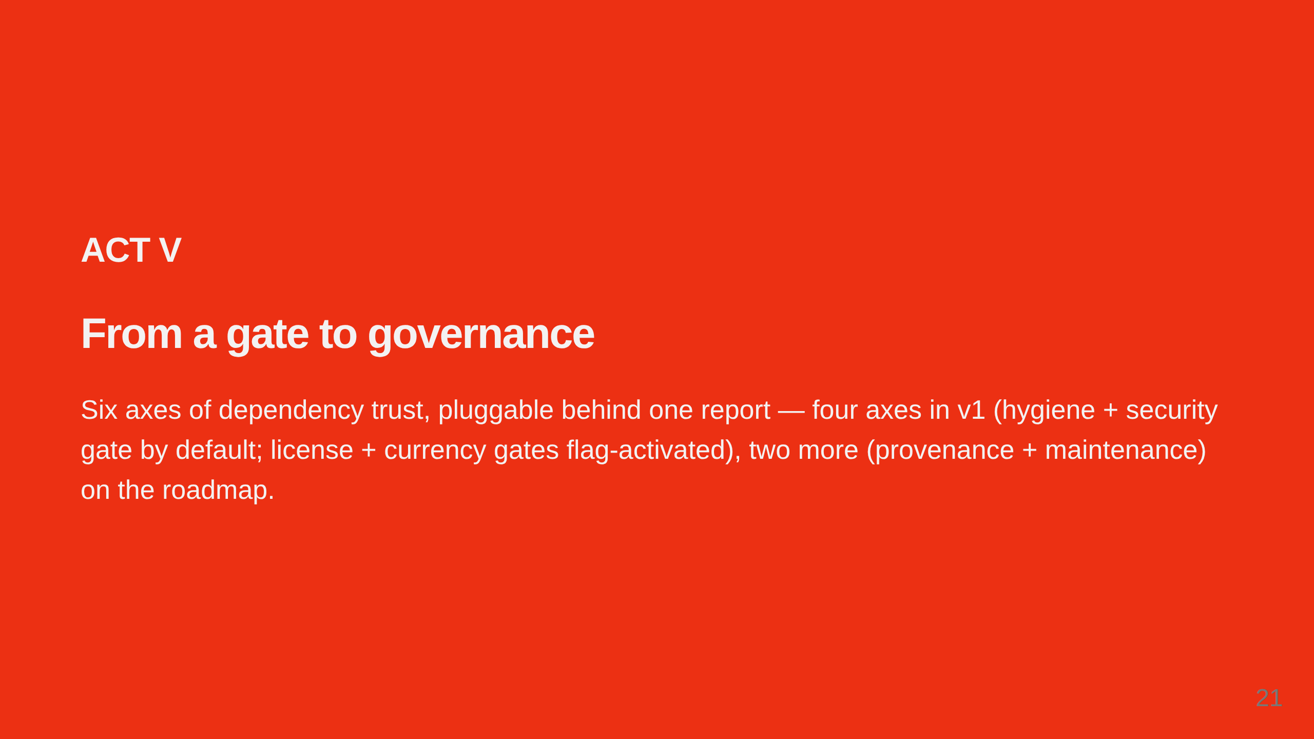
Notes:
The same contract extends across six axes. Engines are pluggable, so new signals slot in behind the same report and lattice.

Slide 22
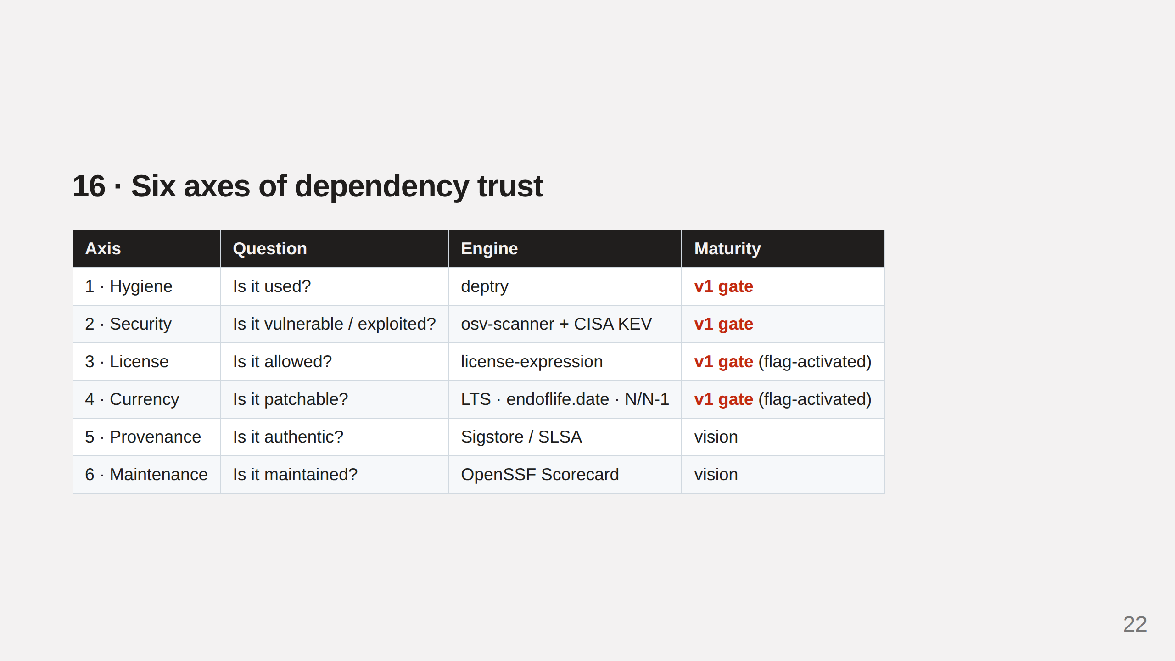
Notes:
Six axes, each a different question. v1 runs all four with their gates: hygiene + security gate by default (incl. KEV + EPSS); license + currency gates are flag-activated (unconfigured -> visible warn). Provenance + maintenance are the vision.

Slide 23
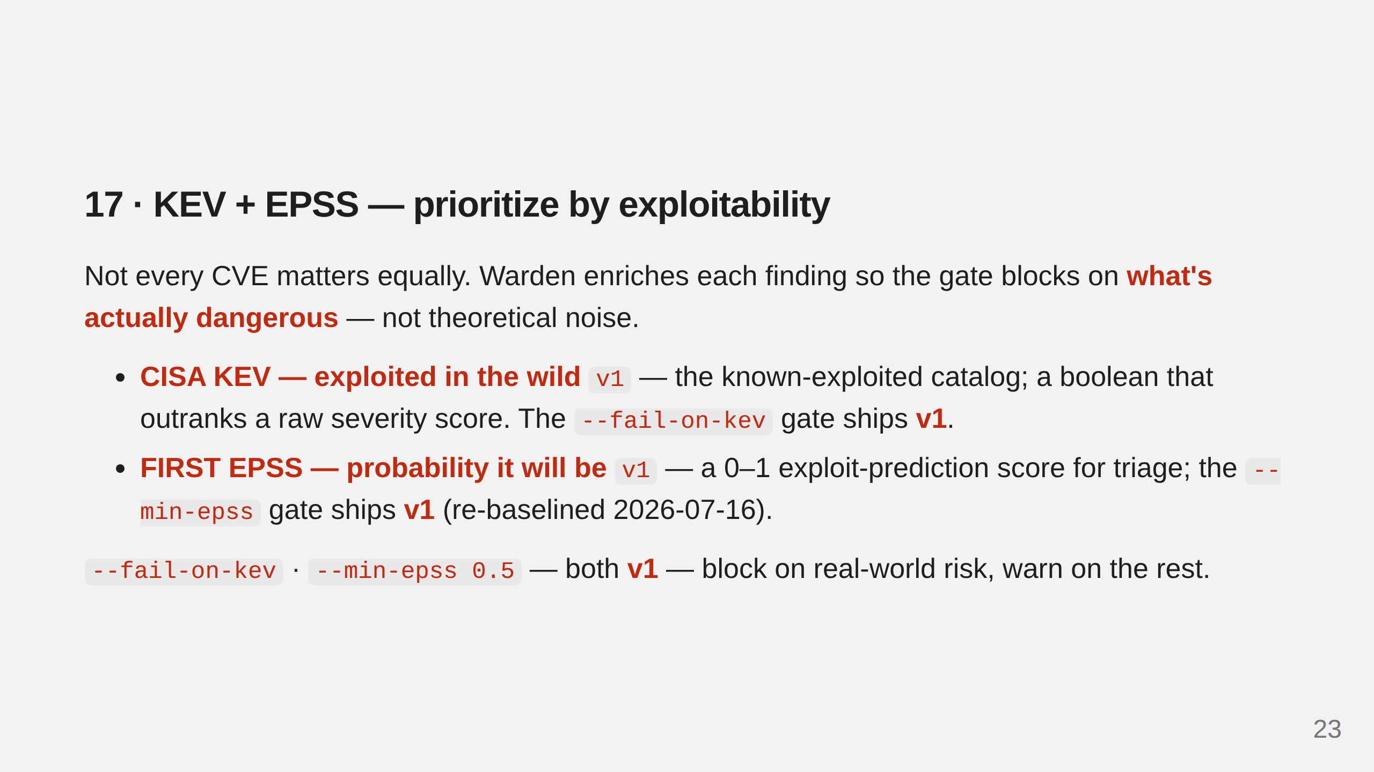
Notes:
KEV + EPSS enrichment and both gates ship v1. KEV = exploited now; EPSS = probability it will be.

Slide 24
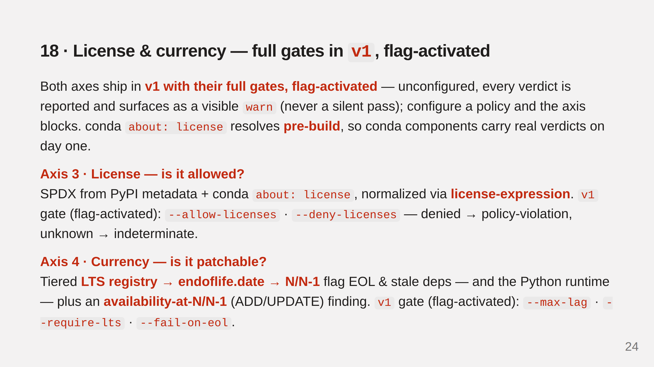
Notes:
License + currency ship v1 with flag-activated gates (unconfigured -> visible warn). Conda about:license resolves pre-build.

Slide 25
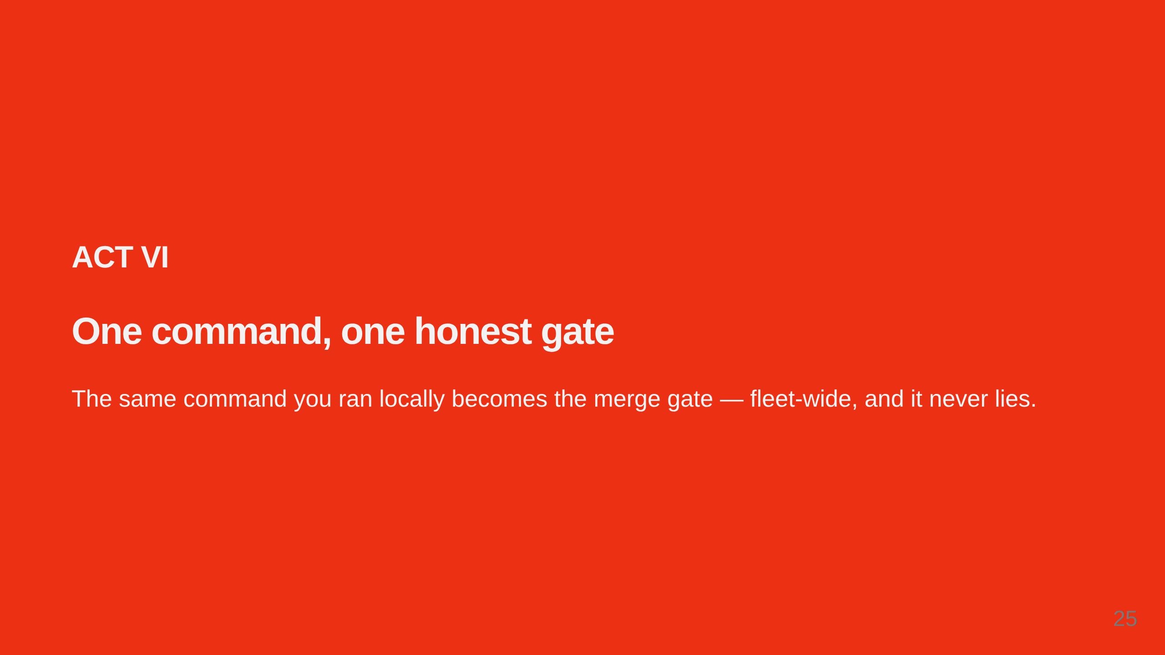
Notes:
Everything reduces to one command with one trustworthy exit code. Wire it into CI and the same honest verdict runs fleet-wide.

Slide 26
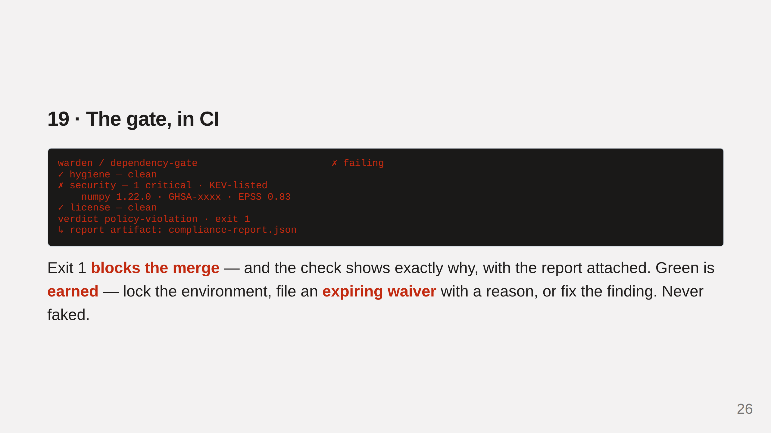
Notes:
The same command as a CI check. Blocks the merge with exit 1 on a KEV-listed critical. Green is earned — never faked.

Slide 27
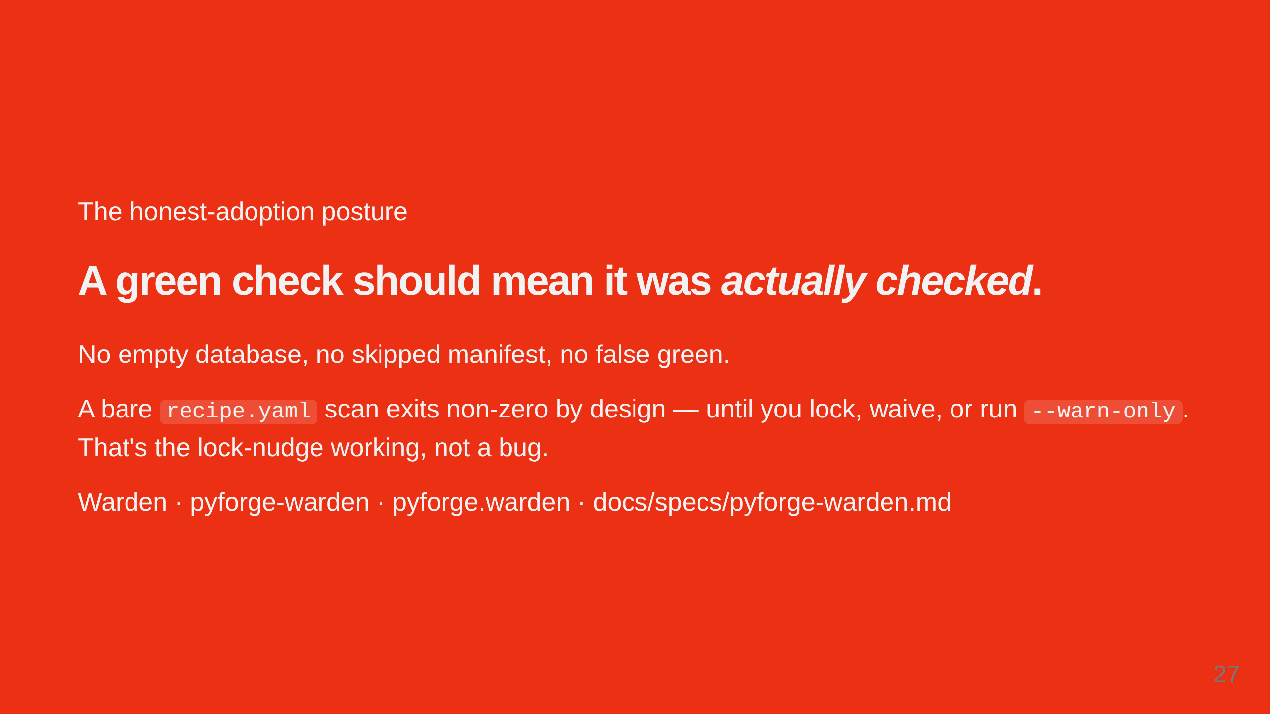
Notes:
The close: a green check means it was actually checked. A bare recipe.yaml scan exits non-zero by design until you lock, waive, or warn-only.

Slide 28
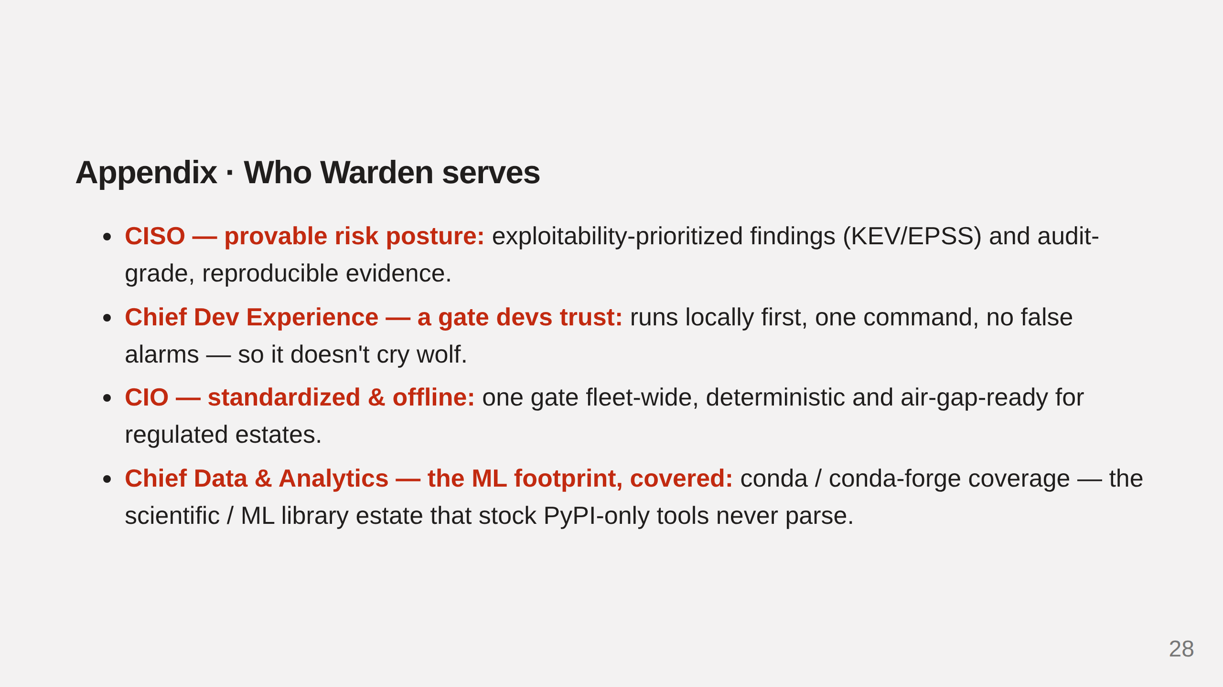
Notes:
Executive personas: CISO, Chief Developer Experience Officer, CIO, Chief Data & Analytics Officer.
herald-ledger-band

Slide 29
