Slide 1
A FIELD GUIDE FOR ENGINEERS
Agentic AI across the software lifecycle
Not autocomplete on steroids — a structured way to build software with AI agents as expert collaborators, from first idea to shipped code.
BMAD METHOD
GROUNDED IN AN OPEN-SOURCE FRAMEWORK
Notes:
Open here. This deck explains what agentic AI across the software development lifecycle actually looks like in practice, using the BMad Method as our concrete framework. Audience: working engineers. The arc runs in six acts: the case for change, spec-driven development, choosing a framework, the BMAD agent team, the four phases, and scaling plus the ecosystem.

Slide 2
CONTENTS
The story arc, in six acts
01
The case for change
p.03
Why AI-augmented isn’t enough
02
Spec-driven development
p.07
The operating model — docs as the brain
03
Choosing your framework
p.11
The SDD landscape, and why BMAD
04
The BMAD agent team
p.16
Roles, party mode & file-based artifacts
05
The four phases
p.23
Analysis → planning → solutioning → build
06
Scale, governance & ecosystem
p.32
Adapting the method & extending it
BMAD METHOD · AGENTIC SDLC
02 / 45
Notes:
The road map. Six acts. First, why the augmented SDLC most teams run isn't enough and what agentic means. Second, spec-driven development as the operating model. Third, the tool landscape and why we settle on BMAD. Fourth, how the BMAD agent team is structured. Fifth, a walk through the four phases end to end. Sixth, scaling the method, governing it, and the wider ecosystem. About forty minutes end to end; each act stands alone if you want to jump.

Slide 3
ACT I
The case for change
Why the AI-augmented SDLC most teams already run isn’t enough — and what agentic actually means.
BMAD METHOD · AGENTIC SDLC
03 / 45
Notes:
Act I opener: the problem framing.

Slide 4
THE SHIFT
The problem isn't that AI writes bad code. It's that it makes decisions you never saw.
PROMPT-AND-PRAY
AGENTIC DEVELOPMENT
You describe a feature, the model produces average code from vague context, and the architectural choices are buried inside the output. Great for a snippet. Fragile for a system.
Specialized agents guide you through a real process — analysis, planning, design, build — producing decisions and documents you can read, review, and reuse.
BMAD METHOD · AGENTIC SDLC
04 / 45
Notes:
Frame the problem. Most AI coding tools generate for you and leave you to sort out the mess. That works for a snippet and falls apart on a real system. The shift is from a tool that types to a collaborator that follows a process.

Slide 5
DEFINITION
What is the agentic AI‑SDLC?
The software lifecycle you already know — analyze, plan, design, build, test, ship — with specialized AI agents doing the heavy lifting at every phase, coordinated through persistent specs, and humans owning judgment and approval.
SAME PHASES
NEW WORKERS
NEW CONTRACT
The lifecycle survives
Agents execute, humans direct
Specs carry the state
Decades of agile practice still apply — AI doesn’t replace the process, it runs inside it.
Specialist agents — analyst, PM, architect, developer — do each phase’s work; you review and decide.
Documents move context between phases — not meetings, not memory, not a chat scrollback.
BMAD METHOD · AGENTIC SDLC
05 / 45
Notes:
Define the term before going further. The AI-SDLC is not a new lifecycle — it's the one you already know: analyze, plan, design, build, test, ship. What changes is who does the work and how state moves between phases. Specialized agents execute each phase, humans keep judgment and approval, and persistent specs — not meetings or chat memory — carry the state from one phase to the next.

Slide 6
THE MATURITY SPECTRUM
From AI-augmented to agentic: who executes the phase?
1 · MANUAL
2 · AI-AUGMENTED
3 · AGENTIC — THIS DECK
4 · AUTONOMOUS
Humans do everything
Humans execute, AI assists
Agents execute, humans direct
Unattended loops
The classic SDLC — no AI in the loop.
Intent in, code out (dev-auto); humans set direction and review outcomes.
Autocomplete, generated tests you curate, review hints. Plans and decisions stay in heads and meetings.
Specialist agents run each phase; humans gate through specs and reviews.
The jump from 2 to 3 isn’t better models — it’s where the context lives : out of your head and chat history, into documents agents read and write.
BMAD METHOD · AGENTIC SDLC
06 / 45
Notes:
Where does agentic sit relative to the AI-augmented SDLC most teams already have? It's a spectrum. Manual: humans do everything. AI-augmented: humans still execute every phase, AI assists inside each one — autocomplete, generated tests you curate, review hints. Agentic: agents execute the phases, humans direct and gate through specs — that's this deck. Autonomous: unattended loops where you set intent and review outcomes. The real jump from augmented to agentic: context moves out of your head and chat history into documents agents read and write.

Slide 7
THE CORE IDEA
Traditional AI tools do the thinking for you. Agentic workflows act as expert collaborators who bring the best thinking out of you.
The output isn't just code. It's a chain of reviewable artifacts — a brief, a spec, an architecture, a story — each one grounding the next.
BMAD METHOD · AGENTIC SDLC
07 / 45
Notes:
The core idea in one line: agents are collaborators, not oracles. They pull your best thinking out through a structured process instead of doing the thinking for you. This is the whole philosophy.

Slide 8
ACT II
Spec-driven development
The operating model: treat the documentation as the brain, agents as transient workers.
BMAD METHOD · AGENTIC SDLC
08 / 45
Notes:
Act II opener: spec-driven development.

Slide 9
DEFINITION
What is spec‑driven development?
Write the specification first — a precise, versioned document of behavior, constraints, and acceptance criteria — then have AI generate and validate code against it. The spec is the contract; the code is its translation.
VIBE CODING
prompt → code → hope
SPEC-DRIVEN
intent → spec → human review → generate → validate
Written first. Nothing is built that wasn’t specified.
An executable contract. Tests and reviews validate against the spec.
Versioned in git. Specs evolve by amendment, next to the code they govern.
BMAD METHOD · AGENTIC SDLC
09 / 45
Notes:
Define spec-driven development before we build on it. SDD means you write the specification first — a precise, versioned document stating behavior, constraints, and acceptance criteria — and the AI generates and validates code against it. Contrast that with vibe coding: prompt, get code, hope. In SDD the pipeline is intent → spec → human review → generate → validate. The spec is the contract; a bug means the contract was wrong or violated.

Slide 10
THE OPERATING MODEL
Specs are code. Documentation is programmable infrastructure.
01
02
03
Institutionalize knowledge
Automate execution
Compound intelligence
Individual expertise becomes a permanent, accessible markdown asset — no key-person dependencies.
Structured specs become machine-readable instructions that drive tasks, processes, and procedures.
Every document is clean semantic context — each agent run makes the next one smarter.
Instead of sprawling monolithic documents, work is sharded into modular, atomic, versioned step-files in the repo — eliminating LLM context drift.
BMAD METHOD · AGENTIC SDLC
10 / 45
Notes:
Spec-driven development is the universal operating model. Specs aren't paperwork — they're programmable infrastructure. Three payoffs: expertise becomes a permanent asset instead of living in one person's head; structured specs become machine-readable instructions agents can execute; and every document compounds — it's semantic context that makes the next agent run smarter. V6 shards work into atomic, versioned step-files to eliminate context drift.

Slide 11
THE MENTAL MODEL · CONTEXT ENGINEERING
The documentation is the brain. Agents are transient workers.
Agents read from and write to persistent docs — nothing relies on an LLM’s leaky chat memory. The lifecycle is a funnel of increasing resolution:
WHY
Analysis — stress-test the idea into a brief
WHAT
Planning — the PRD is the source of truth; if it’s not there, it doesn’t exist
HOW
Solutioning — architecture and tasks, frozen before code
BUILD
Implementation — translate the spec into syntax
Each document becomes the input to the next, so every agent inherits the decisions already made — and no agent touches code until the what and the how are frozen in a text file.
BMAD METHOD · AGENTIC SDLC
11 / 45
Notes:
The mental model that makes all of this click: the documentation is the brain, and agents are transient workers who read from and write to it. Never rely on an LLM's leaky chat memory to hold the plan. And the SDLC isn't a loop — it's a funnel of increasing resolution: why, what, how, build. No agent writes code until the what and the how are frozen in a text file.

Slide 12
ACT III
Choosing your framework
The spec-driven landscape in 2026 — and why we settle on BMAD.
BMAD METHOD · AGENTIC SDLC
12 / 45
Notes:
Act III opener: the tool landscape and the BMAD choice.

Slide 13
THE LANDSCAPE · 2026
SDD is a category now — three families of tools
AGENT-TEAM FRAMEWORKS
SPEC-FIRST SCAFFOLDING
LIVING SPECS
A simulated agile team — role personas, file-based handoffs, full lifecycle.
Specify → plan → tasks structure bolted onto a coding session.
The spec is the evolving source of truth, synced with the code.
BMAD-METHOD
GitHub Spec Kit
OpenSpec
The archetype — 12+ agents, MIT, this deck’s framework
Constitution-driven; broadest agent support
Delta specs; lightest fit for brownfield change
AWS Kiro
Tessl
Agent OS
Spec-native IDE; EARS requirements built in
Betting on spec-as-source
Standards injection for house conventions
GSD
Augment Intent
Lightweight meta-prompting for solo work
Agents write changes back to the spec
AGENT INFRASTRUCTURE
CrewAI · Agno · LangGraph · AutoGen — orchestration SDKs, not methodologies. They provide the multi-agent machinery an SDD pipeline can be built on.
Rules of thumb: complex greenfield with a paper trail → BMAD · brownfield, lightweight → OpenSpec · broad default → Spec Kit · AWS-native IDE → Kiro
BMAD METHOD · AGENTIC SDLC
13 / 45
Notes:
SDD is a category now, not one tool — 30+ frameworks by early 2026. Three broad buckets. Agent-team frameworks simulate a full agile team with role personas and file-based handoffs — BMAD is the archetype and what this deck follows. Spec-first scaffolding adds a specify-plan-tasks structure to a coding session — GitHub Spec Kit with its constitution, AWS Kiro baking specs into the IDE, GSD as the lightweight option. Living-spec tools treat the spec as the evolving source of truth — OpenSpec with delta specs for brownfield, Tessl betting on spec-as-source, Augment Intent writing changes back to the spec. Below all of these sits agent infrastructure — CrewAI, Agno, LangGraph, AutoGen — orchestration SDKs that provide multi-agent machinery, not a development methodology. Rules of thumb: complex greenfield with a paper trail, BMAD. Brownfield and lightweight, OpenSpec. Broad default, Spec Kit. AWS-native, Kiro.

Slide 14
METHOD × MACHINERY
Method and machinery are different layers
NEED AN SDK WITH BMAD? — USUALLY NOT
NEED A METHOD WITH AN SDK? — FOR SOFTWARE, YES
BMAD installs as skills into Claude Code, Cursor, or Codex — the host is already the runtime (tool calling, files, context) and humans drive the checkpoints.
Orchestration SDKs are empty machinery — no roles, no artifacts, no gates. Building software? Borrow BMAD (personas→roles, artifacts→messages, gates→edges) or reinvent every piece.
Reach for CrewAI or LangGraph only to build your own pipeline product — unattended CI loops, parallel story agents. Then personas become crews or nodes, and BMAD’s artifacts stay the contracts.
Not building software — research crews, bots, data pipelines? SDD is irrelevant; the SDK plus your own workflow is all there is.
THE ASYMMETRY
The methodology defines what agents do and hand off; the SDK only changes where they run. Method without SDK works out of the box — SDK without method only when you’re not shipping software. The process layer is non-negotiable; the SDK is optional plumbing.
BMAD METHOD · AGENTIC SDLC
14 / 45
Notes:
Method and machinery are different layers, and engineers ask two questions when they see orchestration SDKs next to BMAD. First: do you need an SDK with BMAD? Usually not — BMAD installs as skills into your coding agent (Claude Code, Cursor, Codex), which is already the runtime: tool calling, files, context, with humans driving checkpoints. Reach for CrewAI or LangGraph only to build your own pipeline product — unattended CI loops, parallel story agents — where personas become crews or graph nodes and BMAD's artifacts stay the contracts. Second, the reverse: on an SDK already, do you need a method? For software, yes — orchestration SDKs are empty machinery with no roles, artifacts, or gates; borrow BMAD (personas become roles, artifacts the messages, gates the edges) or reinvent them. Not building software — research, bots, data pipelines? SDD is irrelevant. The relationship is asymmetric: method without SDK works out of the box; SDK without method only when you're not shipping software.

Slide 15
WHY THIS FRAMEWORK
Four reasons BMAD earns the choice
01
02
Structure without rigidity
Context persistence
Guardrails, not gates: skip optional phases, load agents directly, reorder workflows once you know the flow.
Every plan is a file in git. Start a fresh chat and agents pick up where you left off; the whole team sees the same artifacts.
03
04
Scale-domain-adaptive
100% free & open
A bug fix gets 3 commands; an enterprise system gets security & compliance reviews. A dating app and a medical device don’t get the same planning.
MIT license. No paywalls, no gated content, no premium tiers — and an ecosystem of modules on top.
BMAD METHOD · AGENTIC SDLC
15 / 45
Notes:
Why this framework and not another from the landscape? Four reasons. Structure without rigidity: phases are guardrails, not gates you can't skip — drop optional phases, load agents directly, reorder once you know the flow. Context persistence: every plan is a file in git — new chat, agents pick up where you left off; the whole team sees the same artifacts. Scale-domain-adaptive: it sizes the ceremony to the work — bug fix gets three commands, an enterprise system gets compliance and security reviews — and adapts to domain: a dating app and a medical device don't get the same planning. And it's 100% free, MIT, no gated content.

Slide 16
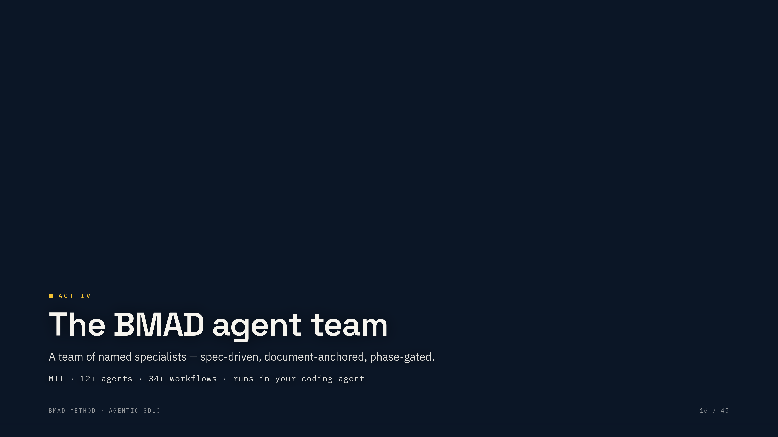
ACT IV
The BMAD agent team
A team of named specialists — spec-driven, document-anchored, phase-gated.
MIT · 12+ agents · 34+ workflows · runs in your coding agent
BMAD METHOD · AGENTIC SDLC
16 / 45
Notes:
Chapter break into the concrete half of the deck: the BMAD framework itself.

Slide 17
THE CREW · NAMED AGENTS
A team of specialists, one per phase
Mary
ANALYSIS
Paige
ANALYSIS
John
PLANNING
Business Analyst
Technical Writer
Product Manager
Brainstorming, research, briefs, PRFAQs
Docs, diagrams, doc validation
PRDs, epics & stories, readiness
Sally
PLANNING
Winston
SOLUTIONING
Amelia
IMPLEMENTATION
UX Designer
System Architect
Senior Engineer
Experience & design specs
Technical architecture, alignment
Story execution, code review, sprints
BMAD METHOD · AGENTIC SDLC
17 / 45
Notes:
You don't talk to one monolithic AI. You talk to named agents, each anchored to a phase and a role, each with a persona and a menu of skills. Say 'Hey Mary, let's brainstorm' and she activates. The point: it feels like a team of specialists, not a slash-command menu.

Slide 18
WHY PERSONAS
“Hey Mary, let’s brainstorm.” And she just gets on with it.
MENU
BLANK PROMPT
NAMED AGENT
You meet the tool halfway
You guess the magic words
You talk to a teammate
Memorize that brainstorming is a skill on the analyst, not the PM.
Results depend on how you happened to phrase the ask.
Consistent persona, discoverable skills, menu as fallback.
Identity is fixed, behavior is customizable — teams reshape an agent’s principles, integrations, and templates without forking the framework.
BMAD METHOD · AGENTIC SDLC
18 / 45
Notes:
Why personas instead of a menu or a blank prompt? A menu makes you memorize where each capability lives. A blank prompt makes you guess the magic words. Named agents invert it: you say what you want, in your words, to a teammate who already knows the work and their menu is there as a fallback.

Slide 19
MULTI-AGENT COLLABORATION
Party mode: the whiteboard meeting, minus the scheduling
you: bmad-party-mode PM, Architect, Security — we’re adding payments
PM: what payment methods do users actually expect?
Architect: Stripe for PCI scope; idempotent webhooks for reliability
Security: never store raw cards; rate-limit and audit-log every transaction
Design reviews — UX, architect, and developer weigh a screen together.
Troubleshooting — dev, DevOps, and DBA triangulate a production issue.
Architecture calls — trade-offs argued from three seats before you commit.
BMAD METHOD · AGENTIC SDLC
19 / 45
Notes:
One agent at a time is the default, but some decisions need several perspectives at once. Party mode brings multiple personas into one session and lets them respond in turn. Three canonical uses: a design review where UX, architect, and developer weigh in together; a troubleshooting session where dev, DevOps, and DBA triangulate a production issue; and architecture decisions where PM, architect, and security argue trade-offs before you commit. It's the whiteboard meeting, minus the scheduling.

Slide 20
QUICK REFERENCE
The execution matrix
PHASE
PERSONA
READS
PRODUCES
Analysis
Analyst (Mary)
Raw idea · brain dump
brief.md
Planning
Product Manager (John)
brief.md
prd.md
Solutioning
Architect (Winston)
prd.md
architecture.md · epics & stories
Implementation
Developer (Amelia)
architecture.md · story files
source code + tests
Each artifact is the anchor for the next persona. The handoff is a file, not a chat thread.
BMAD METHOD · AGENTIC SDLC
20 / 45
Notes:
One reference slide before we walk the phases: the execution matrix. Each phase has a persona, an input artifact, and an output artifact. Each output becomes the anchor for the next persona — the handoff is a file, not a chat thread. Keep this in your head as we go phase by phase.

Slide 21
THE SKILL ROSTER · V6
Every phase ships with skills, every skill has an owner
01 ANALYSIS
02 PLANNING
03 SOLUTIONING
04 IMPLEMENTATION
Mary Analyst · Paige Writer
John PM · Sally UX
Winston Architect
Amelia Developer
brainstorming forge-idea market-research domain-research technical-research product-brief prfaq document-project
prd create · update · validate ux DESIGN + EXPERIENCE
architecture create-epics-and-stories check-implementation- readiness
sprint-planning create-story dev-story code-review correct-course sprint-status retrospective qa-generate-e2e-tests
CROSS-CUTTING
help · party-mode · customize · generate-project-context · advanced-elicitation · quick-dev · dev-auto (quick flow)
ALL SKILLS INVOKED AS bmad-* — DIRECTLY, OR FROM AN AGENT'S MENU
21 / 45
Notes:
The full skill roster in the latest release, aligned to agents and phases. Every workflow ships as an installable skill — invoke it directly by its bmad- id, or through the owning agent's menu. Mary and Paige cover analysis, John and Sally planning, Winston solutioning, Amelia the whole implementation loop. And a set of cross-cutting skills — help, party-mode, customize, project-context generation — plus the quick-dev and dev-auto parallel track work across all phases.

Slide 22
IN YOUR REPO
What it physically looks like: two folders
No context loss
your-project/
Start a new chat — agents pick up from the files.
├─ _bmad/ ← the machinery
Version controlled
│ ├─ core/ bmm/ agents/ workflows/
Plans live in git, right next to the code they govern.
└─ _bmad-output/ ← your artifacts
├─ planning-artifacts/
Team visibility
Everyone — human or agent — reads the same artifacts.
│ ├─ PRD.md
│ ├─ architecture.md
AI grounding
│ └─ epics/ stories
Agents reference concrete documents, not hallucinations.
├─ implementation-artifacts/
│ └─ sprint-status.yaml
└─ project-context.md
BMAD METHOD · AGENTIC SDLC
22 / 45
Notes:
What this all physically looks like: two folders in your repo. _bmad holds the machinery — agent definitions, workflows, config. _bmad-output holds your artifacts, split in v6 into planning-artifacts (PRD, architecture, epics) and implementation-artifacts (sprint status), plus a project-context file. Four consequences: no context loss because a new chat picks up from the files; version control because plans live in git next to code; team visibility because everyone reads the same documents; and AI grounding because agents cite concrete files instead of hallucinating.

Slide 23
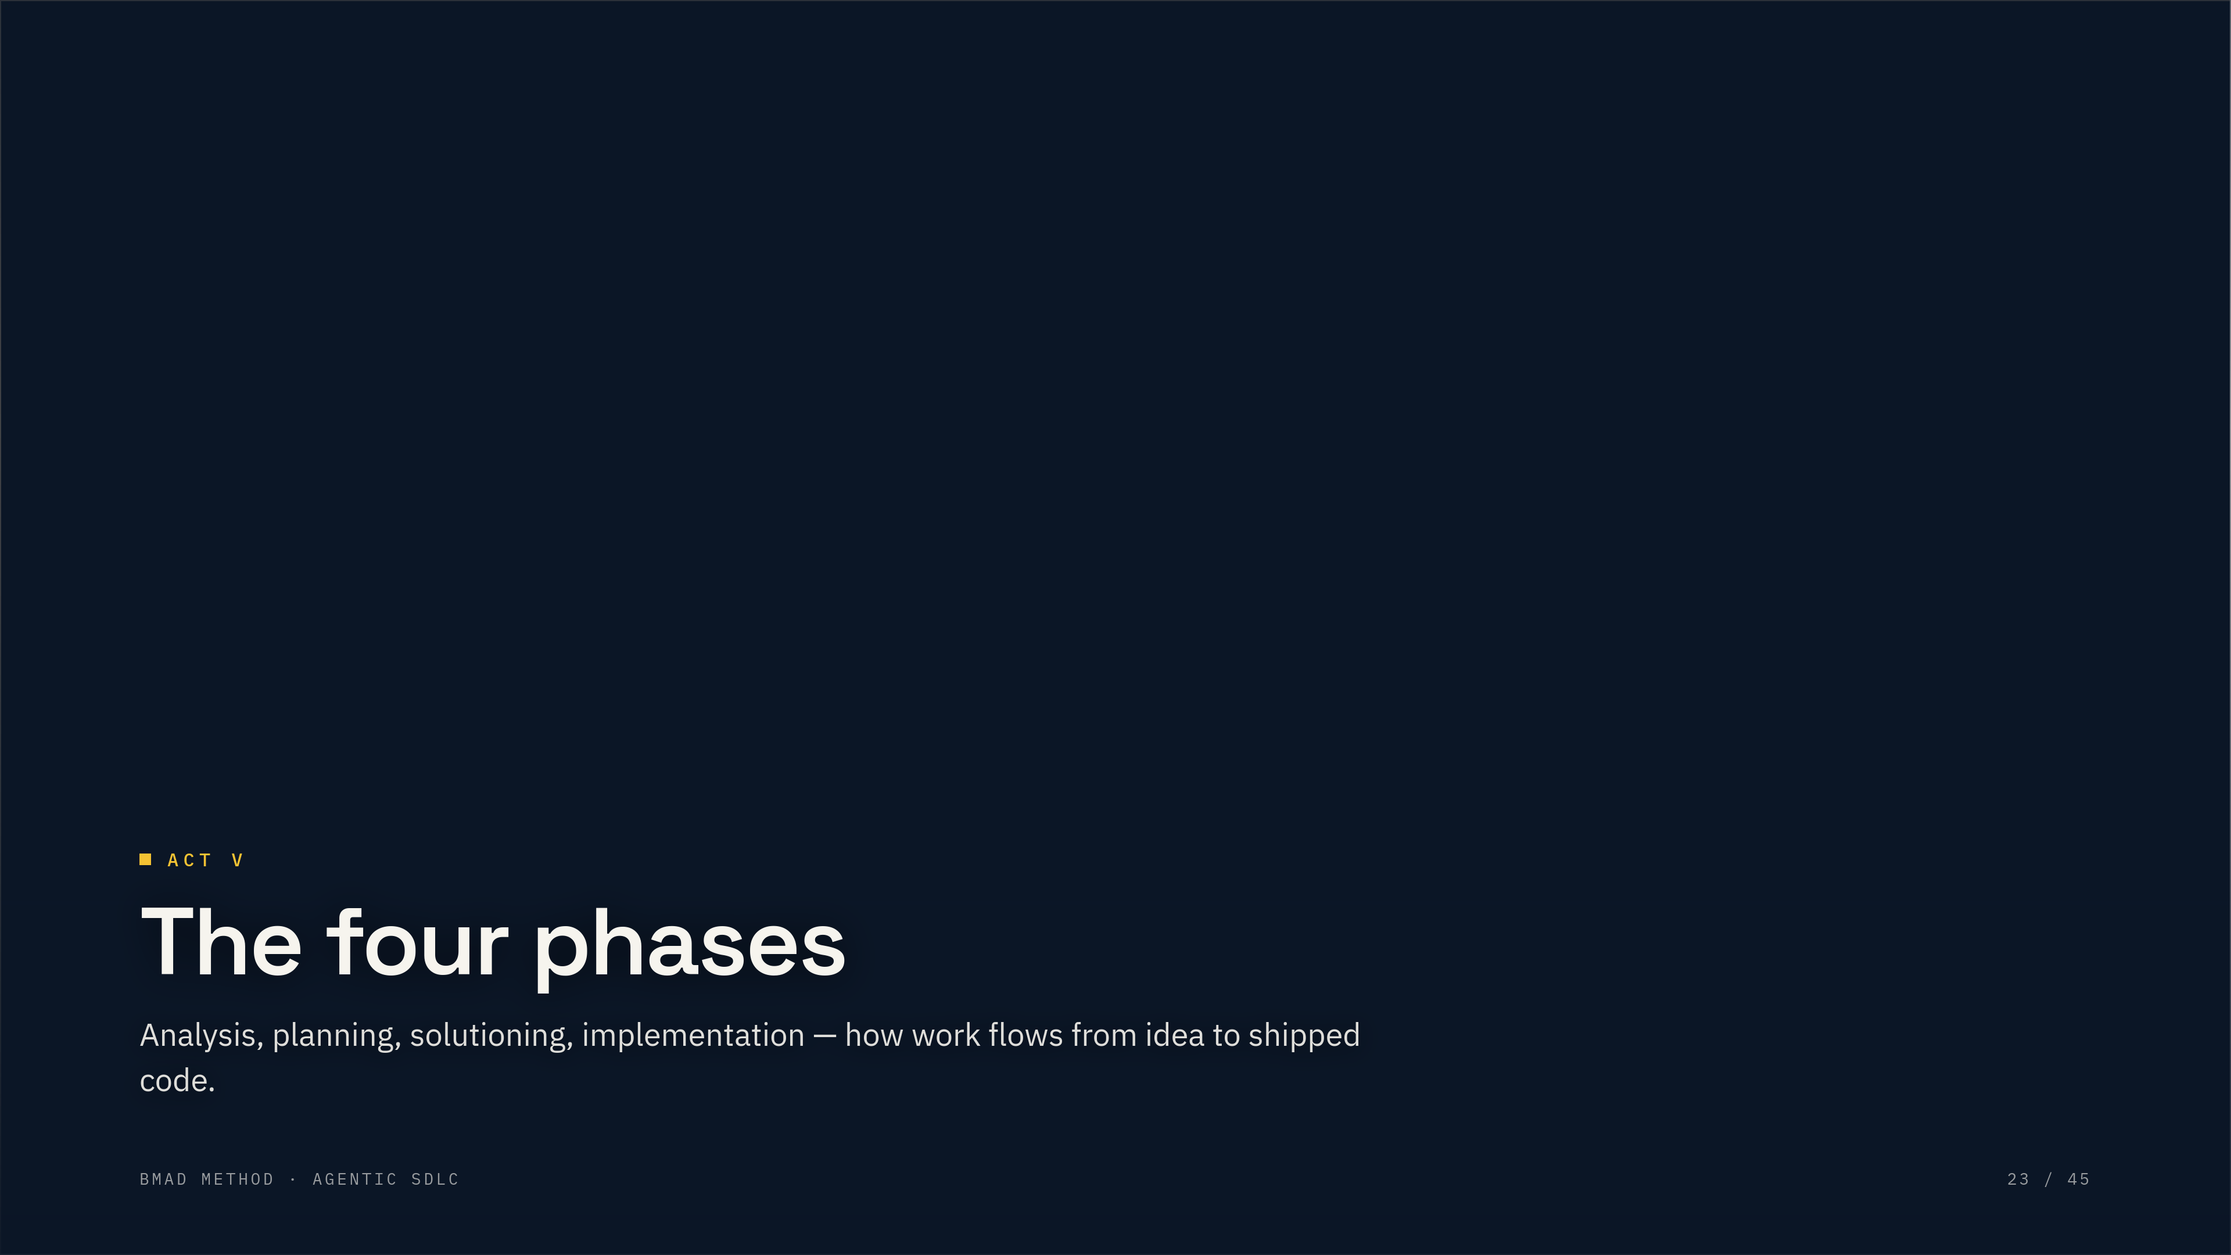
ACT V
The four phases
Analysis, planning, solutioning, implementation — how work flows from idea to shipped code.
BMAD METHOD · AGENTIC SDLC
23 / 45
Notes:
Chapter break opening the phase walkthrough.

Slide 24
THE MAP
Four phases, one throughline
01
02
03
04
Analysis
Planning
Solutioning
Implementation
OPTIONAL
WHAT & WHY
HOW
BUILD
Explore the problem before committing.
Define what to build, and for whom.
Decide how, break work into stories.
Build it, one story at a time.
Story · Dev · Review · Retro
Brainstorm · Research · Brief · PRFAQ
PRD · UX spec
Architecture · Epics · Readiness
BMAD METHOD · AGENTIC SDLC
24 / 45
Notes:
This is the map for the rest of the deck. Four phases: Analysis, Planning, Solutioning, Implementation. Each is a set of workflows that produce documents. We'll walk through each one. Phase 1 is optional; the real spine is Planning to Implementation.

Slide 25
PHASE 01
OPTIONAL
Analysis
Think clearly about the product before committing to build it. Attack the idea from four angles.
bmad-brainstorming
bmad-*-research
bmad-product-brief
bmad-prfaq
Brainstorm
Research
Product brief
PRFAQ
Coach-facilitated ideation. Pulls ideas out of you, not for you.
Market, domain, and technical feasibility — grounded in reality.
A 1–2 page vision when your concept is already clear.
Working Backwards. Write the launch press release before the code.
BMAD METHOD · AGENTIC SDLC
25 / 45
Notes:
Phase 1, Analysis, is optional but it makes everything downstream sharper. Four ways to think clearly before you build: brainstorm to generate, research to ground, brief to document, PRFAQ to stress-test. Skipping analysis means your PRD is built on assumptions.

Slide 26
PHASE 01 · IN PRACTICE
Which tool, when?
“I have a vague idea, not sure where to start.”
Brainstorming
“I need to understand the market before deciding.”
Research
“I know what I want — just document it.”
Product Brief
“Make sure this is actually worth building.”
PRFAQ
Brief and PRFAQ both feed the PRD. The brief is collaborative discovery; the PRFAQ is a gauntlet. Same destination — the PRFAQ tests whether your concept deserves to get there.
BMAD METHOD · AGENTIC SDLC
26 / 45
Notes:
Practical guidance: which analysis tool fits your situation. Vague idea, brainstorm. Need market truth, research. Know what you want, brief. Want it stress-tested, PRFAQ. Both brief and PRFAQ feed the PRD — the difference is how much challenge you want.

Slide 27
PHASE 02
WHAT & WHY
Planning
Define what to build and for whom. Everything downstream inherits the clarity — or the vagueness — you set here.
bmad-prd
bmad-ux
Product Requirements
UX Design
Facilitated discovery that produces functional & non-functional requirements. One skill, three intents: create, update, validate.
When experience matters, a spine pair: DESIGN.md for the visual, EXPERIENCE.md for the behavioral.
BMAD METHOD · AGENTIC SDLC
27 / 45
Notes:
Phase 2, Planning. This is where you define what to build and for whom. The PRD is the anchor — it answers what and why, and every downstream document inherits its clarity or its vagueness. UX runs alongside when experience matters.

Slide 28
PHASE 03
HOW → UNITS OF WORK
Solutioning
Decide how to build it, then break the work into implementable units.
STEP 1
STEP 2
GATE
Architecture
Epics & stories
Readiness check
Make technical decisions explicit so every agent builds consistently.
Break requirements into focused, implementable stories.
A pass / concerns / fail decision before implementation begins.
BMAD METHOD · AGENTIC SDLC
28 / 45
Notes:
Phase 3, Solutioning. Translate what into how. The architect makes technical decisions explicit, the PM breaks requirements into epics and stories, and a readiness gate decides pass, concerns, or fail before anyone writes code.

Slide 29
WHY IT MATTERS
Decide the hard things once — or agents decide them differently.
WITHOUT SOLUTIONING
WITH SOLUTIONING
Agent 1 builds Epic 1 → REST
Architecture decides → GraphQL for all
Agent 2 builds Epic 2 → GraphQL
Every agent follows the decision
= inconsistent API, integration pain
= consistent build, clean integration
10×
Catching alignment issues in solutioning is roughly ten times cheaper than discovering them mid-sprint.
BMAD METHOD · AGENTIC SDLC
29 / 45
Notes:
Concrete reason solutioning matters. Without shared architectural decisions, two agents on two epics pick REST and GraphQL independently, and integration becomes a nightmare. Decide once, up front, and everyone follows. Catching alignment issues here is 10x cheaper than during implementation.

Slide 30
PHASE 04
BUILD
Implementation
Build it, one story at a time — each with complete, focused context so the dev agent never guesses. Sprint planning sequences the cycle once; then you repeat the loop.
bmad-sprint-planning
bmad-create-story
bmad-dev-story
bmad-code-review
Sequence work
Prep the story
Working code + tests
Validate quality
BMAD METHOD · AGENTIC SDLC
30 / 45
Notes:
Phase 4, Implementation. Build one story at a time. Each story carries complete, focused context so the dev agent isn't guessing. Sprint planning sequences the work once; then it's a tight loop per story.

Slide 31
THE HEARTBEAT · PER-STORY LOOP
A tight loop, one story at a time
→
→
↻
01
02
03
04
Create story
Dev story
Code review
Retrospective
focused context
code + tests
approve / revise
at epic's end
correct-course handles significant mid-sprint changes without derailing the plan.
You choose the tightness — review every story, or let the loop run further on its own.
BMAD METHOD · AGENTIC SDLC
31 / 45
Notes:
Zoom into the loop. Create story, implement, review, and on to the next — with correct-course to handle mid-sprint changes and a retrospective at the end of each epic. Human stays in the loop; you choose how tight. This is the heartbeat of implementation.

Slide 32
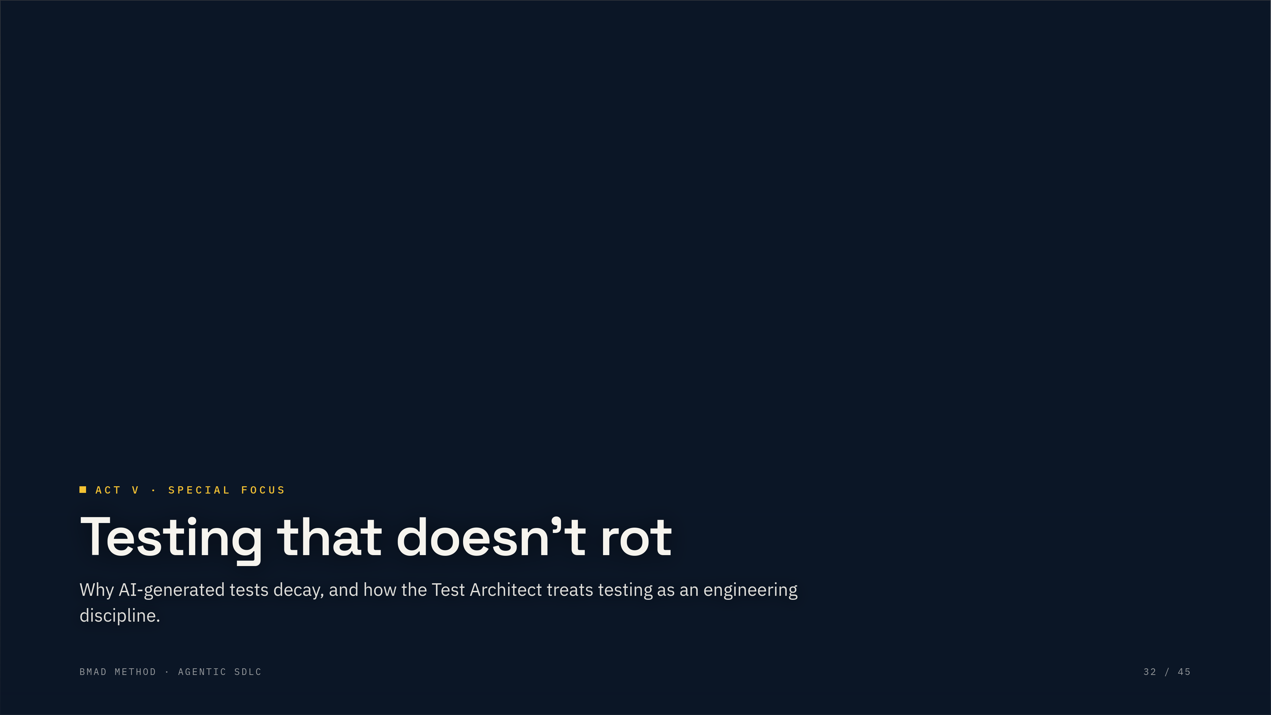
ACT V · SPECIAL FOCUS
Testing that doesn’t rot
Why AI-generated tests decay, and how the Test Architect treats testing as an engineering discipline.
BMAD METHOD · AGENTIC SDLC
32 / 45
Notes:
Chapter break introducing the TEA testing module.

Slide 33
TESTING · TEA MODULE
AI-generated tests rot. Test architecture doesn’t.
“Write tests for this” produces assertions that match current behavior — flaky in three sprints. TEA treats testing as engineering: strategy before generation.
DESIGN FIRST
FLAKINESS KILLED
RELEASE GATE
Risk-based priorities
Network-first patterns
Traceability & the gate
Probability × impact scores every scenario P0–P3 . The payment flow gets depth; the theme toggle gets a smoke test.
Tests wait on real responses, not waitForTimeout(2000) . Composable fixtures decouple tests from implementation.
Tests map to requirements; the gate rules PASS / CONCERNS / FAIL / WAIVED with evidence — audit-trail ready.
bmad-tea → framework → test-design → automate — zero to a risk-planned suite in ~30 min
BMAD METHOD · AGENTIC SDLC
33 / 45
Notes:
The complaint heard most from teams using AI for development: the tests are garbage. They pass, they look fine in review, and three sprints later half are flaky and nobody trusts the suite — because the AI had no testing strategy, it just wrote assertions matching current behavior. TEA, the Test Architect module, treats testing as an engineering discipline: risk-based test design scores probability times impact into P0 to P3 priorities, so the checkout flow gets deep coverage and the settings page gets a smoke test. Network-first patterns kill flaky waits. And the trace workflow maps tests to requirements and issues a release-gate decision: pass, concerns, fail, or waived.

Slide 34

ACT VI
Scale, governance & ecosystem
The wider ecosystem — testing, game dev, creative intelligence, and your own custom agents.
BMAD METHOD · AGENTIC SDLC
34 / 45
Notes:
Chapter break opening the ecosystem section.

Slide 35
SCALE-ADAPTIVE
Three tracks, sized to the work
TRACK
BEST FOR
DOCUMENTS CREATED
Quick Flow
Bug fixes, clear scope · 1–15 stories
Tech-spec only
BMad Method
Products & platforms · 10–50+ stories
PRD + Architecture + UX
Enterprise
Compliance, multi-tenant · 30+ stories
+ Security + DevOps
Story counts are guidance, not rules — pick the track by how much planning the work needs. bmad-help recommends one if you’re unsure.
BMAD METHOD · AGENTIC SDLC
35 / 45
Notes:
BMad v6 offers three planning tracks, and bmad-help picks one for you. Quick Flow for bug fixes and clear-scope work (1-15 stories) produces just a tech-spec. BMad Method for products and platforms (10-50+ stories) produces a PRD, architecture, and UX. Enterprise for compliance and multi-tenant systems (30+ stories) adds security and DevOps. Story counts are guidance, not definitions — choose by planning need. Same primitives throughout, different depth. Quick flow for a bug fix, simple for a small feature, complex when solutioning is required, enterprise when governance is. The process adjusts to complexity instead of forcing one-size-fits-all.

Slide 36
PARALLEL TRACK
Small, well-understood work skips the ceremony
bmad-quick-dev
bmad-dev-auto
Quick Dev
Dev Auto
One unified flow: clarify intent, plan, implement, review, and present. Skips phases 1–3.
One unattended development-loop iteration — small intent in, code out.
Rule of thumb: if multiple epics could be built by different agents, you need the full method. A single well-scoped change does not.
BMAD METHOD · AGENTIC SDLC
36 / 45
Notes:
Not everything needs four phases. For small, well-understood work there's a parallel track: quick-dev clarifies, plans, implements, reviews, and presents in one flow; dev-auto runs a single unattended iteration. Use the full method for the enterprise system, quick flow for the bug fix.

Slide 37
THE UNIFYING IDEA · AT SCALE
The documents are the product’s memory — at scale, a constitution
A project-context.md makes a dozen separate agent runs feel like one coherent team. At enterprise scale it hardens into a constitution:
SINGLE SOURCE OF TRUTH
AGENTS ENFORCE IT
The constitution supersedes ad-hoc practice. When conventions conflict, it wins — for humans and agents alike.
Agents audit every PR against the mandates and report failures by citing the specific clause violated.
HUMANS AMEND IT
SIMPLICITY GATE
Changes go through ADRs, team consensus, and versioned amendments — a living document, not a frozen one.
YAGNI is codified: complexity requires documented justification, metrics, and a plan to remove it.
BMAD METHOD · AGENTIC SDLC
37 / 45
Notes:
Pull the docs idea together and scale it. The documents aren't paperwork — they're the product's memory. A project-context file makes a dozen separate agent runs feel like one coherent team, and at enterprise scale it matures into a constitution: a single, versioned source of truth that supersedes ad-hoc practice. The interesting part: agents are empowered to enforce it — they audit every PR and cite the exact clause a change violates. Humans amend it through ADRs and sign-off. And a simplicity gate keeps complexity honest: YAGNI, with justification required.

Slide 38
THE FLIP SIDE
Don’t just build with agents. Build for them.
INTERFACES
APIS
THE HARNESS
Semantic structure
Idempotent & self-documenting
Guardrails & traces
Clean DOM hierarchies, ARIA, deterministic layouts agents can navigate. No vibe UI.
Strict OpenAPI schemas, retry-safe mutations, and errors actionable enough for an agent to self-correct mid-flight.
Tools explicitly exposed for LLM calling, schema validation on behavior, exhaustive run-trace logs for context.
BMAD METHOD · AGENTIC SDLC
38 / 45
Notes:
The flip side: it's not just about using agents to build — it's about building systems agents can operate. Three layers: interfaces with semantic structure and deterministic layouts, no vibe UI; APIs that are idempotent and self-documenting with errors clear enough for an agent to self-correct; and an agent harness — explicit tool exposure, strict guardrails, exhaustive run-trace logs.

Slide 39
THE MODULE ECOSYSTEM · V6
One core, a growing family of modules
CORE · BMM
BMB
TEA
BMad Method
BMad Builder
Test Architect
Create your own agents & workflows.
Risk-based test strategy & automation.
The 34+ workflow framework this deck walks through — analysis, planning, architecture, implementation. Everything else builds on it.
BMGD
CIS
Game Dev Studio
Creative Intelligence
npx bmad-method install
Unity, Unreal & Godot workflows.
Brainstorming, innovation, design thinking.
All MIT, all installed the same way — during setup or any time after. Stuck between steps? The bmad-help skill tells you what’s next and what’s optional.
BMAD METHOD · AGENTIC SDLC
39 / 45
Notes:
BMAD isn't one thing — the core is a module in a wider ecosystem, and V6 leans hard into that. The core, BMM, is the 34+ workflow framework this deck walks through. On top of it, official modules extend the same scale-adaptive discipline into new domains, each installable during setup or any time after: BMad Builder to create your own agents and workflows; Test Architect (TEA) for risk-based test strategy; Game Dev Studio for Unity, Unreal, and Godot pipelines; and the Creative Intelligence Suite for brainstorming, innovation, and design-thinking facilitation. All MIT, all installed the same way. And when you're unsure what's next, the bmad-help skill tells you what to do and what's optional.

Slide 40
EXTEND IT · BMAD BUILDER
When the roster doesn’t cover your domain, build your own agent
Everything is a skill — a folder with a SKILL.md (open Agent Skills standard). The builder walks you there by conversation, not configuration. Agents come in three types:
STATELESS
MEMORY
AUTONOMOUS
Every session fresh
Remembers you
Works unattended
A persona and capabilities, no memory. Formatters, diagram generators, focused domain experts.
Keeps a persistent sanctum of identity & knowledge files, re-read each launch. Coaches, writing partners, advisors.
Adds a PULSE file and wakes on a schedule — monitoring, curation, maintenance between sessions.
Package skills into modules , validate them, and distribute via GitHub — the same mechanism that ships TEA, Game Dev Studio, and the Creative Intelligence Suite.
BMAD METHOD · AGENTIC SDLC
40 / 45
Notes:
When the built-in agents don't cover your domain — HIPAA reviews, a house deployment process — BMad Builder creates your own. The packaging model: everything is a skill, a folder with a SKILL.md, following the open Agent Skills standard; agents, workflows, and utilities all ship the same way. Agents come in three types: stateless for single-session experts; memory agents that keep a persistent 'sanctum' of identity and knowledge files and greet you by name next session; and autonomous agents that add a PULSE file and wake on a schedule to work unattended. Builders run as guided conversations, then modules package skills for distribution on GitHub.

Slide 41
THE WIDER ECOSYSTEM
Planning runs anywhere your LLM does
WEB BUNDLES · 6 PLANNING COACHES
MODULES & COMMUNITY
Brainstorming · Product Brief · PRFAQ · PRD · UX · Market & Industry Research — installable as ChatGPT Custom GPTs, Gemini Gems, or Microsoft Copilot agents .
Builder (custom agents) · Test Architect (risk-based testing) · Game Dev Studio · Creative Intelligence Suite.
Community: VS Code dashboard, GitHub Projects sync, n8n automation personas, and a growing skill marketplace.
Do the heavy planning on a flat-rate subscription; bring polished artifacts into the IDE for implementation.
BMAD METHOD · AGENTIC SDLC
41 / 45
Notes:
The method isn't locked to one tool. Six planning coaches ship as web bundles you can install as ChatGPT Custom GPTs, Gemini Gems, or Microsoft Copilot agents — do the heavy planning on a flat-rate subscription, then bring the artifacts into your IDE for implementation. And a growing ecosystem of modules and community tools extends the same discipline to testing, game dev, automation, and more.

Slide 42
SEE IT IN ACTION
From install to artifacts — the method in the terminal
zsh — your-project
John · PM — prd
zsh — git
$ npx bmad-method install
◆ John (PM) · workflow: prd · create
$ git status --short _bmad-output/
? Select modules › ◉ BMM ◉ CIS ○ TEA
Q1 · Who is this for, specifically?
A planning-artifacts/PRD.md
✓ _bmad/ — core · agents · workflows
you: solo devs shipping side projects
A planning-artifacts/architecture.md
✓ Claude Code integration configured
Q2 · What must v1 do on day one?
A epics/epic-1.md · stories/story-1-1.md
$ claude
you: capture → transcribe → search
A implementation-artifacts/sprint-status.yaml
> Hey Mary, let’s brainstorm
✓ drafted → planning-artifacts/PRD.md
5 artifacts — the next agent’s context
Install & kickoff
A live agent session
The generated artifacts
npx bmad-method install, then your first workflow prompt
Party mode or a phase workflow running in your IDE
PRD, architecture & stories in _bmad-output/ or the docs site
Recreated terminal views — swap in live captures from your own runs before presenting for extra credibility.
BMAD METHOD · AGENTIC SDLC
42 / 45
Notes:
Show-and-tell slide. Three recreated terminal views walk the arc end to end: the one-command install and first prompt, a live PRD workflow session with the PM agent, and the artifacts landing in git. If you have real captures from your own runs, swap them in before presenting — live screenshots land even better. If not, these stand on their own.

Slide 43
TRY IT
Three steps to your first run
1
$ npx bmad-method install
2
Open your AI IDE — Claude Code, Cursor, Codex — in your project folder
3
Unsure what’s next? Ask bmad-help — it tells you exactly what to do
Prerequisites: Node.js 20.12+, Python 3.10+, uv. 100% free and open source (MIT).
BMAD METHOD · AGENTIC SDLC
43 / 45
Notes:
How to actually try it. One install command, open your AI IDE, and if you're ever unsure, ask bmad-help and it tells you what's next. It's free and open source. The fastest way to understand it is to run it once on something small.

Slide 44
WHAT TO REMEMBER
Six principles that transfer to any tool
01
Structure beats prompting
02
Documents are context
A process gets better output than a clever one-liner.
Each artifact grounds the next agent’s decisions.
03
Decide hard things once
04
Match ceremony to scale
Explicit architecture prevents agent conflicts.
Quick flow for small; full method for complex.
05
Keep a human in the loop
06
Fix the doc, not the code
You choose how tight the automation runs.
Wrong output is an upstream spec flaw — correct it and rerun.
BMAD METHOD · AGENTIC SDLC
44 / 45
Notes:
The takeaways that transfer even if you never use this specific framework. Structure beats prompting. Documents are context. Decide the hard things once. Match ceremony to complexity. Keep a human in the loop. And when output is wrong, fix the upstream document and rerun — don't patch the code. These are the durable lessons of agentic development.

Slide 45
THE TAKEAWAY
Don’t hand off your judgment. Give it a structure to work in.
Pick something small this week and run it end to end. The fastest way to understand agentic development is to do one full loop.
↳ docs.bmad-method.org
↳ github.com/bmad-code-org/BMAD-METHOD
↳ bmadcode.com/web-bundles
BMAD METHOD
AGENTIC SDLC · A FIELD GUIDE
45 / 45
Notes:
Close. Agentic development isn't about handing off your judgment — it's about giving your judgment a structure to work in. Try it on something small this week. Resources on screen.

