Slide 1
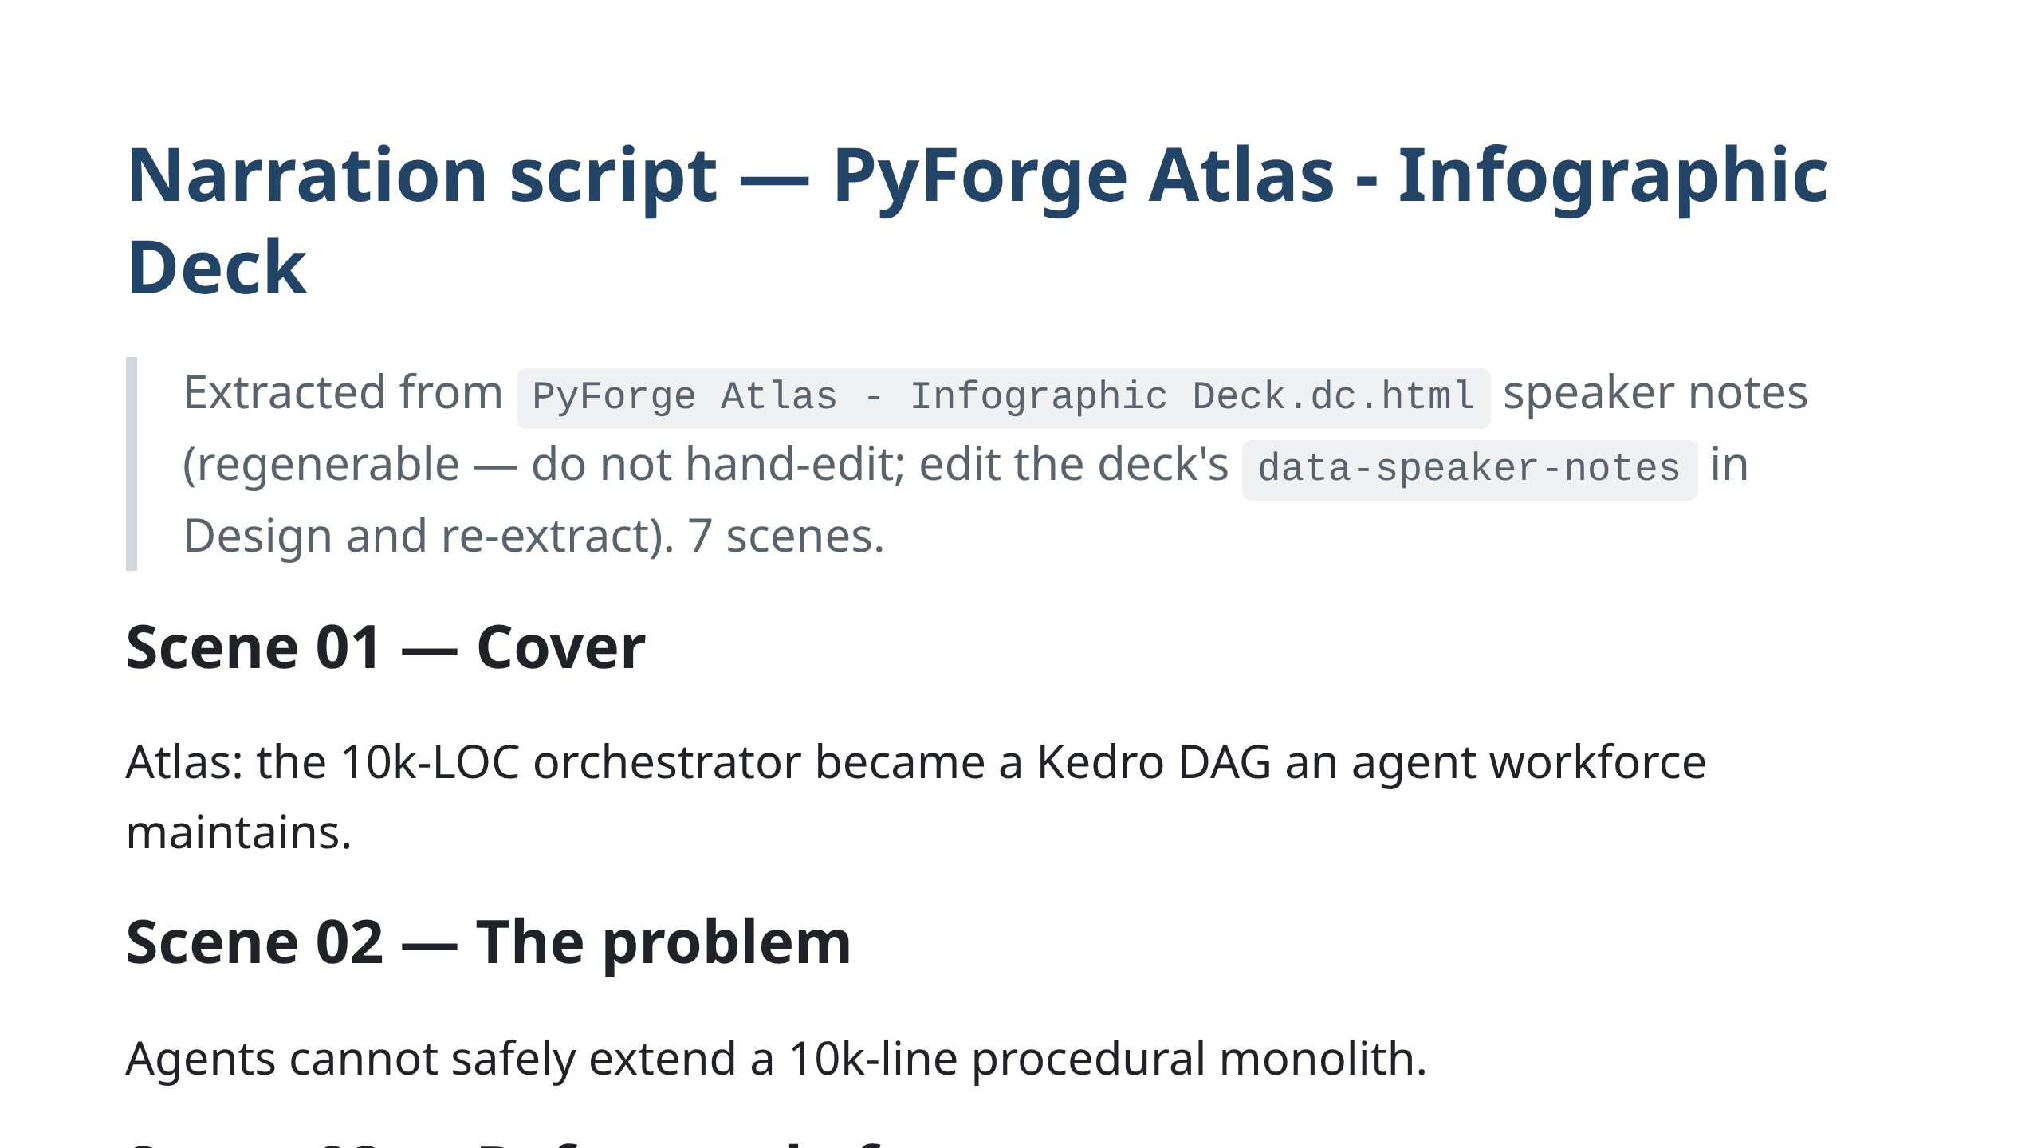
Notes:
herald-ledger-band

Slide 2


