Slide 1

Modern muse
Interactive DRESSING room

Slide 2
It would ask your usual sizes and style and it would show you suggested pieces on screen – on a mannequin so you can pair the outfit together and a sales advisor would bring the clothes to you if you like what you see. Mannequin of your body proportions would be rotating in 360 degrees.

Slide 3
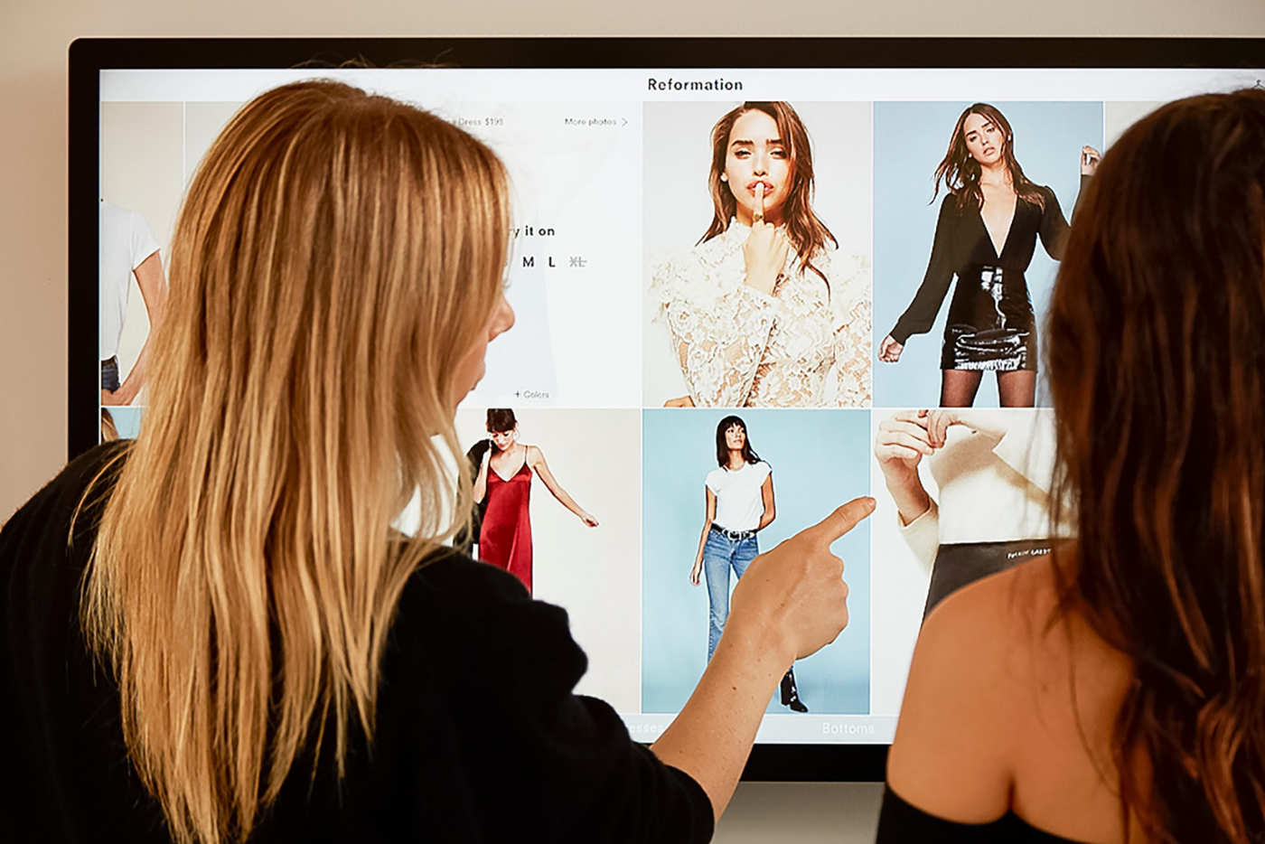
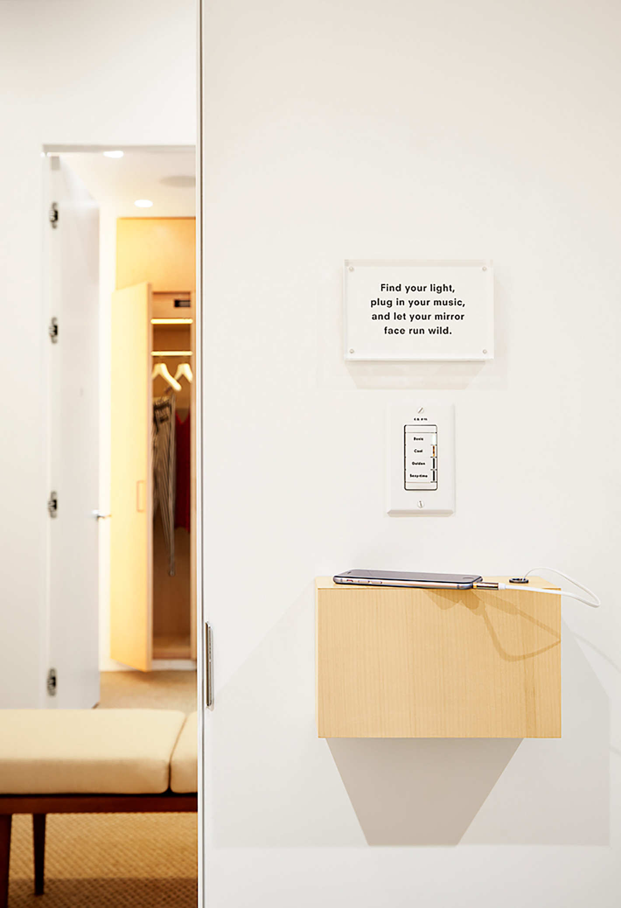
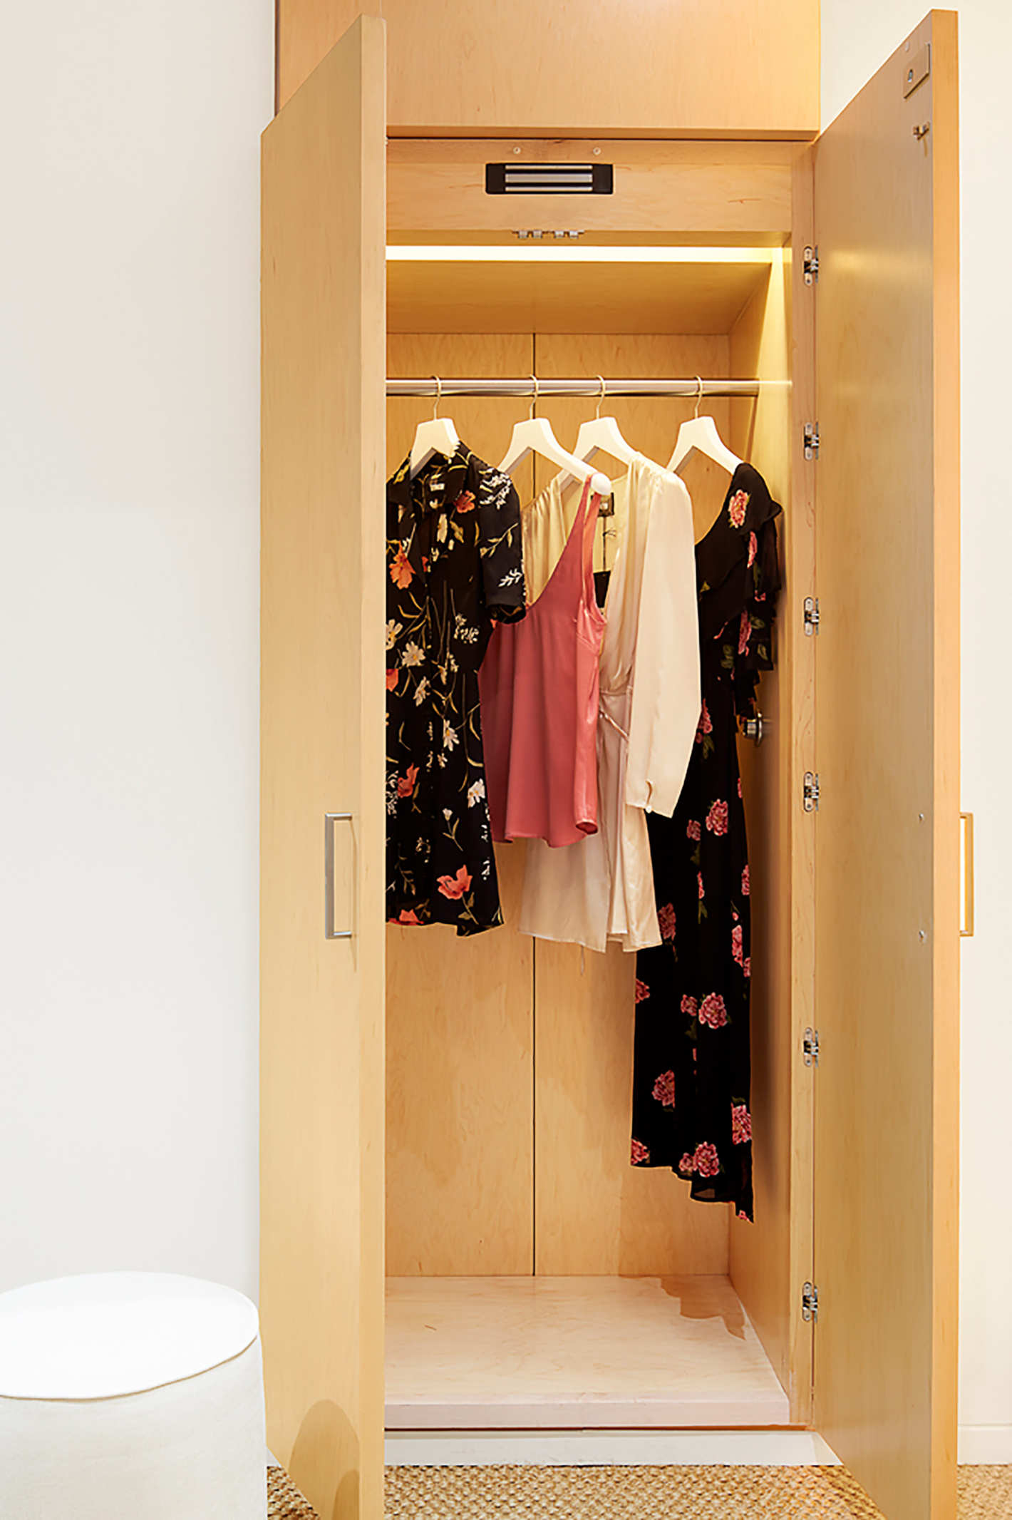
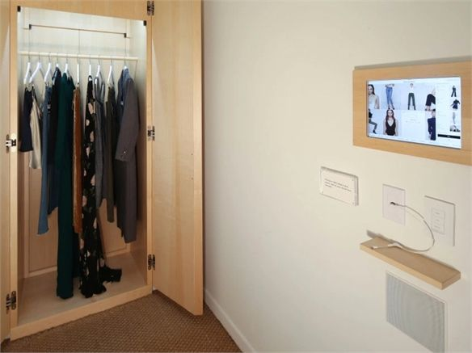
INSPIRATION

Slide 4
Modern woman
Store/fitting room is a minimal mid-century modern design for the working 20-30 year old woman.

Slide 5
Location
Miami Design District

