Slide 1
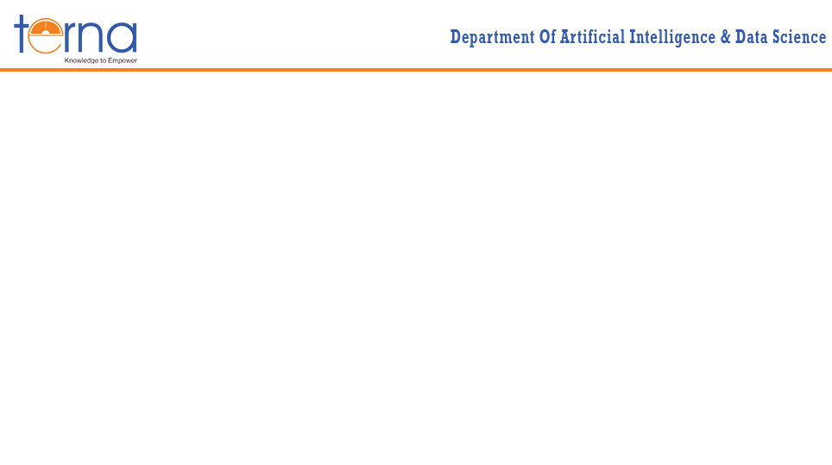
A Presentation on Abstractive summarization system for news articles
Presented By
Rohan Jadhav [A49, TU8F2122058]
Vasudha Singh [A45, TU8F2122053]
Srushti Mhatre [A47, TU8F2122055]
CLASS: BE – A BATCH: A3 Under the Guidance of
Prof. Saima Sayyed

Slide 2
CONTENTS
Introduction
Problem Statement
Methodology
Progress Work
Future Scope
Conclusion

Slide 3
INTRODUCTION
Abstractive Summarization involves generating a concise version of a given text while using new phrases and words instead of simply extracting key sentences. Unlike extractive summarization, which selects and assembles existing phrases, abstractive summarization relies on understanding the content and rephrasing it. The T5 model, or Text-to-Text Transfer Transformer, treats all NLP problems as text-generation tasks, which makes it highly versatile for tasks like summarization, translation, and text classification. In this project, the T5 model is trained on a dataset of news articles to generate summaries that capture the essence of each article.
.

Slide 4
PROBLEM STATEMENT
The task of summarizing news articles is challenging due to the need to retain essential information while being concise. The objective is to build a machine learning model that can generate human-like abstractive summaries from given news articles
The model should be :
Capable of understanding the content of the news articles.
Produce summaries that convey the same key points as the original content in a shorter form.

Slide 5
HARDWARE & SOFTWARE REQUIREMENTS
1. Environment: The project requires the use of Google Colab, which offers GPU support, and access to Google Drive to store and retrieve the dataset.
2. Python Libraries:
transformers (version 4.10.0 or higher): For pre-trained models that can be fine-tuned.
simplet5 (version 0.1.1 or higher): To simplify the training and implementation of the T5 model.
pandas and numpy: For data manipulation and numerical operations,

Slide 6
METHODOLOGY
Dataset Preparation: The dataset used is a collection of news articles stored in a CSV file (news_summary.csv). It includes the columns headlines and text, which contain the headline and the full news article text, respectively. The data was loaded from Google Drive and preprocessed to remove any inconsistencies.
Preprocessing: Basic preprocessing techniques, such as removing unnecessary characters and handling missing values, were applied. The dataset was then split into training and testing sets to evaluate the model's performance.
Model Selection: The simplet5 library was used to train the T5 model, which is particularly well-suited for abstractive summarization. The model was trained using the headlines as targets and the text as inputs.

Slide 7
METHODOLOGY
Load Dataset
Preprocess data
Load T5 model
Set model parameters
Train and evaluate model
Split data into training and testing sets
Fig 1. Workflow for Abstractive Summarization

Slide 8
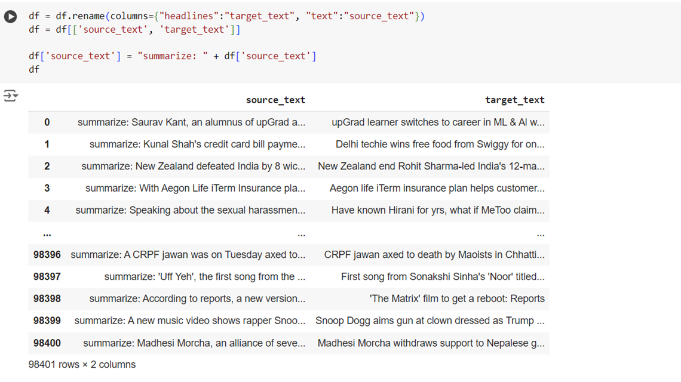
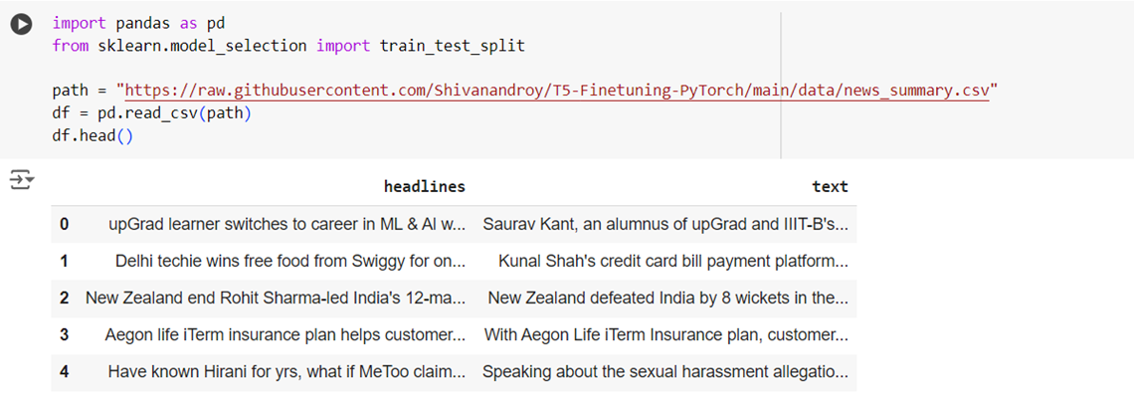
PROGRESS WORK
Fig 2. Data loading and preprocessing

Slide 9
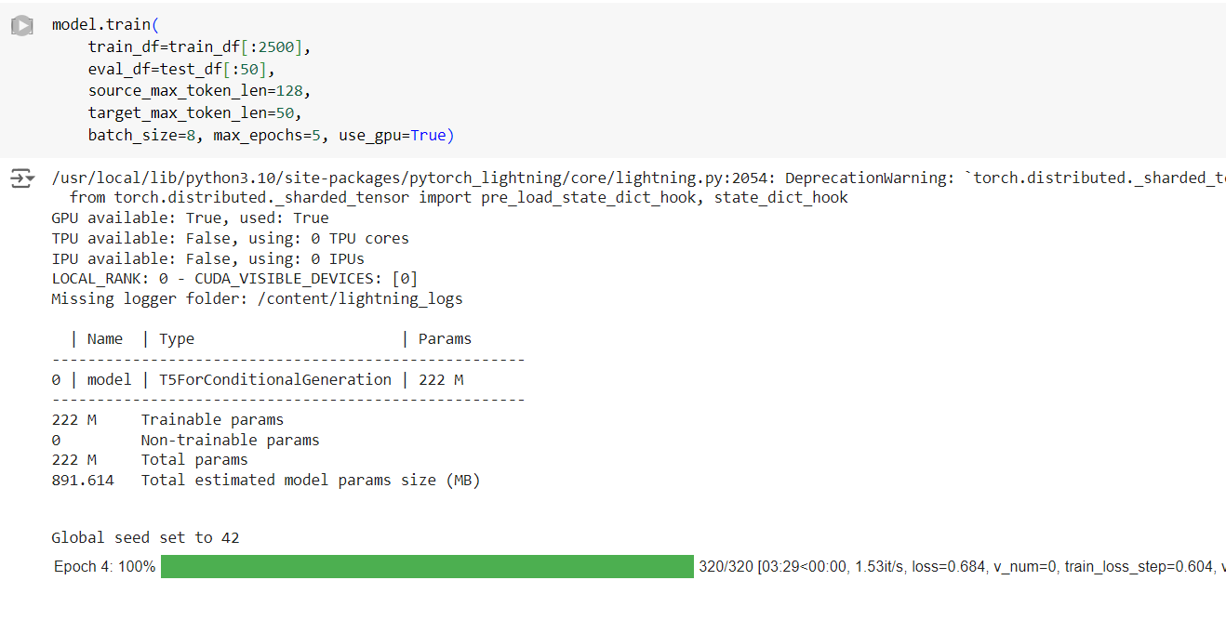
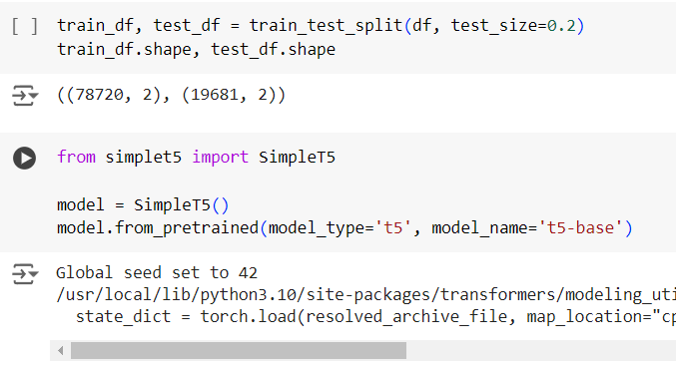
PROGRESS WORK
Fig 3. Loading and training Model

Slide 10
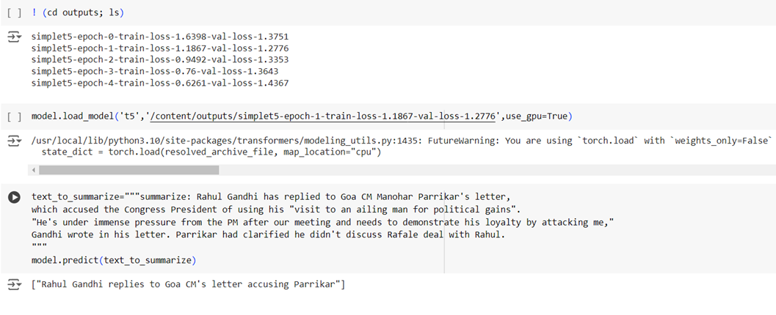
PROGRESS WORK
Fig 4. Validating and testing the model

Slide 11
FUTURE SCOPE
Model Refinement: Future work could focus on enhancing the coherence and quality of generated summaries by using larger, more diverse datasets and applying advanced fine-tuning techniques.
Alternative Models: Exploring other transformer-based models such as BART or Pegasus might yield improved results, as these models have been optimized specifically for summarization tasks.
Evaluation: Implementing more comprehensive evaluation techniques, including human evaluation, could provide better insights into the quality and readability of the generated summaries.
Deployment: As a future step, the summarization model could be deployed as a web application where users can input articles and receive concise summaries in real-time.

Slide 12
CONCLUSION
In conclusion, the project successfully implemented an abstractive summarization model using the T5 architecture, which was able to generate concise summaries of news articles. The T5 model, trained using the simplet5 library, performed well in terms of summarizing content, as evaluated by the ROUGE metric.

