Slide 1

ABET-style Evaluation for IT114
Michael Halper

Slide 2
Course Outcomes
Students are able to:
Utilize Java library classes in the solution to data processing problems
Carry out interprocess communication using sockets
Formulate a recursive solution
IT114
M. Halper, Informatics

Slide 3
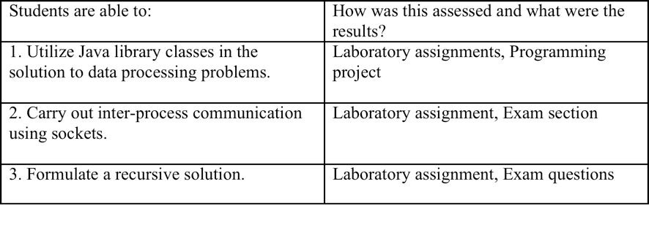
Assessments of these Outcomes
This is displayed according to the FCAR form
IT114
M. Halper, Informatics

Slide 4
Evaluating Outcome #2
Assessment Item (a): Lab assignment #7, completing and working with a pair of programs, a client and a server, that together carry out a “question and answer” interaction. The programs use the socket facilities of Java
Assessment Item (b): Part D (“Client/Server Computing”) of the final exam. Out of the 25 total points allotted for this part, 22 points were deemed to be directly relevant to this outcome.
IT114
M. Halper, Informatics

Slide 5
The Results of the Evaluation
Assessment of Course Outcome 2
 | Item (a) | Item (b) | Total Points | %
Student 1 | 0 | 0 | 0 | 0.0%
Student 2 | 0 | 3 | 3 | 10.7%
Student 3 | 6 | 10 | 16 | 57.1%
Student 4 | 6 | 3.5 | 9.5 | 33.9%
Student 5 | 6 | 16 | 22 | 78.6%
Student 6 | 6 | 19.5 | 25.5 | 91.1%
Student 7 | 6 | 9.5 | 15.5 | 55.4%
Student 8 | 0 | 7 | 7 | 25.0%
Student 9 | 0 | 4 | 4 | 14.3%
Possible: | 6 | 22 | 28
High: | 6 | 19.5 | 25.5
Average: | 6.0 | 9.1 | 12.8 | 70.5%
 |  |  |  | Note: This average excludes %'s <= 50
IT114
M. Halper, Informatics

Slide 6
Statement on Student Performance
Student performance: The attached spreadsheet shows that Item (a) was an “all or nothing” exercise. Students who attempted it accomplished it perfectly. The results of Item (b) were rather disappointing, with less than a 50% average score (9.1 out of 22). Overall, the students showed approximately a 70% average performance, excluding those students who did not even attempt Assessment Item (a) with respect to the assessment of this course outcome
IT114
M. Halper, Informatics

Slide 7
Improvements Issue
Did you make any changes to the course this semester based on previous assessments of this course? If so, did the changes improve student outcomes?
Answer: This was my first time teaching the course.
IT114
M. Halper, Informatics

Slide 8
Planned Changes for Improvements
There is probably a need to spend more class time on outcome (2), inter-process communication. Most students seemed excited by the topic, but the overall performance of the class was unspectacular, and a number of students did not even bother to attempt the lab assignment
IT114
M. Halper, Informatics

