Slide 1

A report on “Shopping site: HOME-TOWN” , The Furniture Store
Our Team:
Ankitha K A
Chandan H
Shifa R
Supreeth Steve Jason
Vadiraj S

Slide 2
Objective
Long term objective:
To become a Full Stack Developer by gaining all the skills required to work with Front End and Back End web technologies required for the application.
Short term objective:
To design a shopping furniture site called ‘Home-Town’ using the concepts learned.

Slide 3
Framework for 8 weeks of training
1st Week: Database Concepts and SQL
2nd Week: Data structures, JAVA Programming
3rd Week: JDBC and Web Design Fundamentals
4th Week: HTML,CSS,
Bootstrap, AJAX
5th Week: Javascript,Angular 7
6th Week: Architecture and Framework of Angular, Maven
7th Week: JSP Servlets, Springboot,
GitHub, JSON
8th Week: Project on Shopping Site, Mybatis, Jenkins

Slide 4

Project ‘Home-Town’
This online shopping site will provide the basic service to user for ordering furniture's online.
User can browse through different types of furniture and add the required item to the cart.

Slide 5
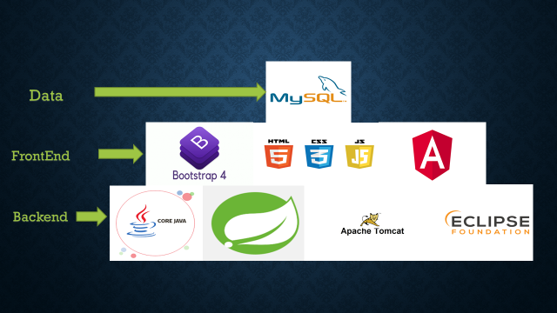
Technologies Used:
The required softwares used for the project are as follows:

Slide 6
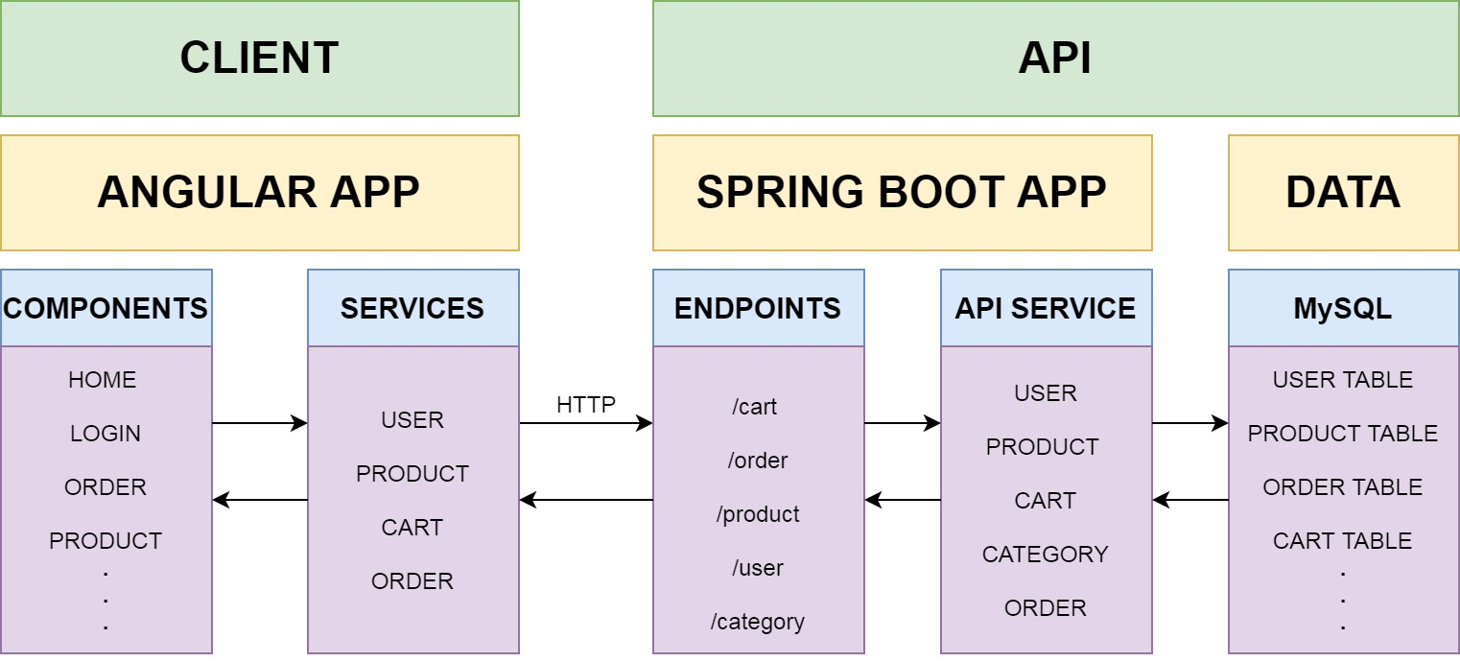
Application Architecture

Slide 7
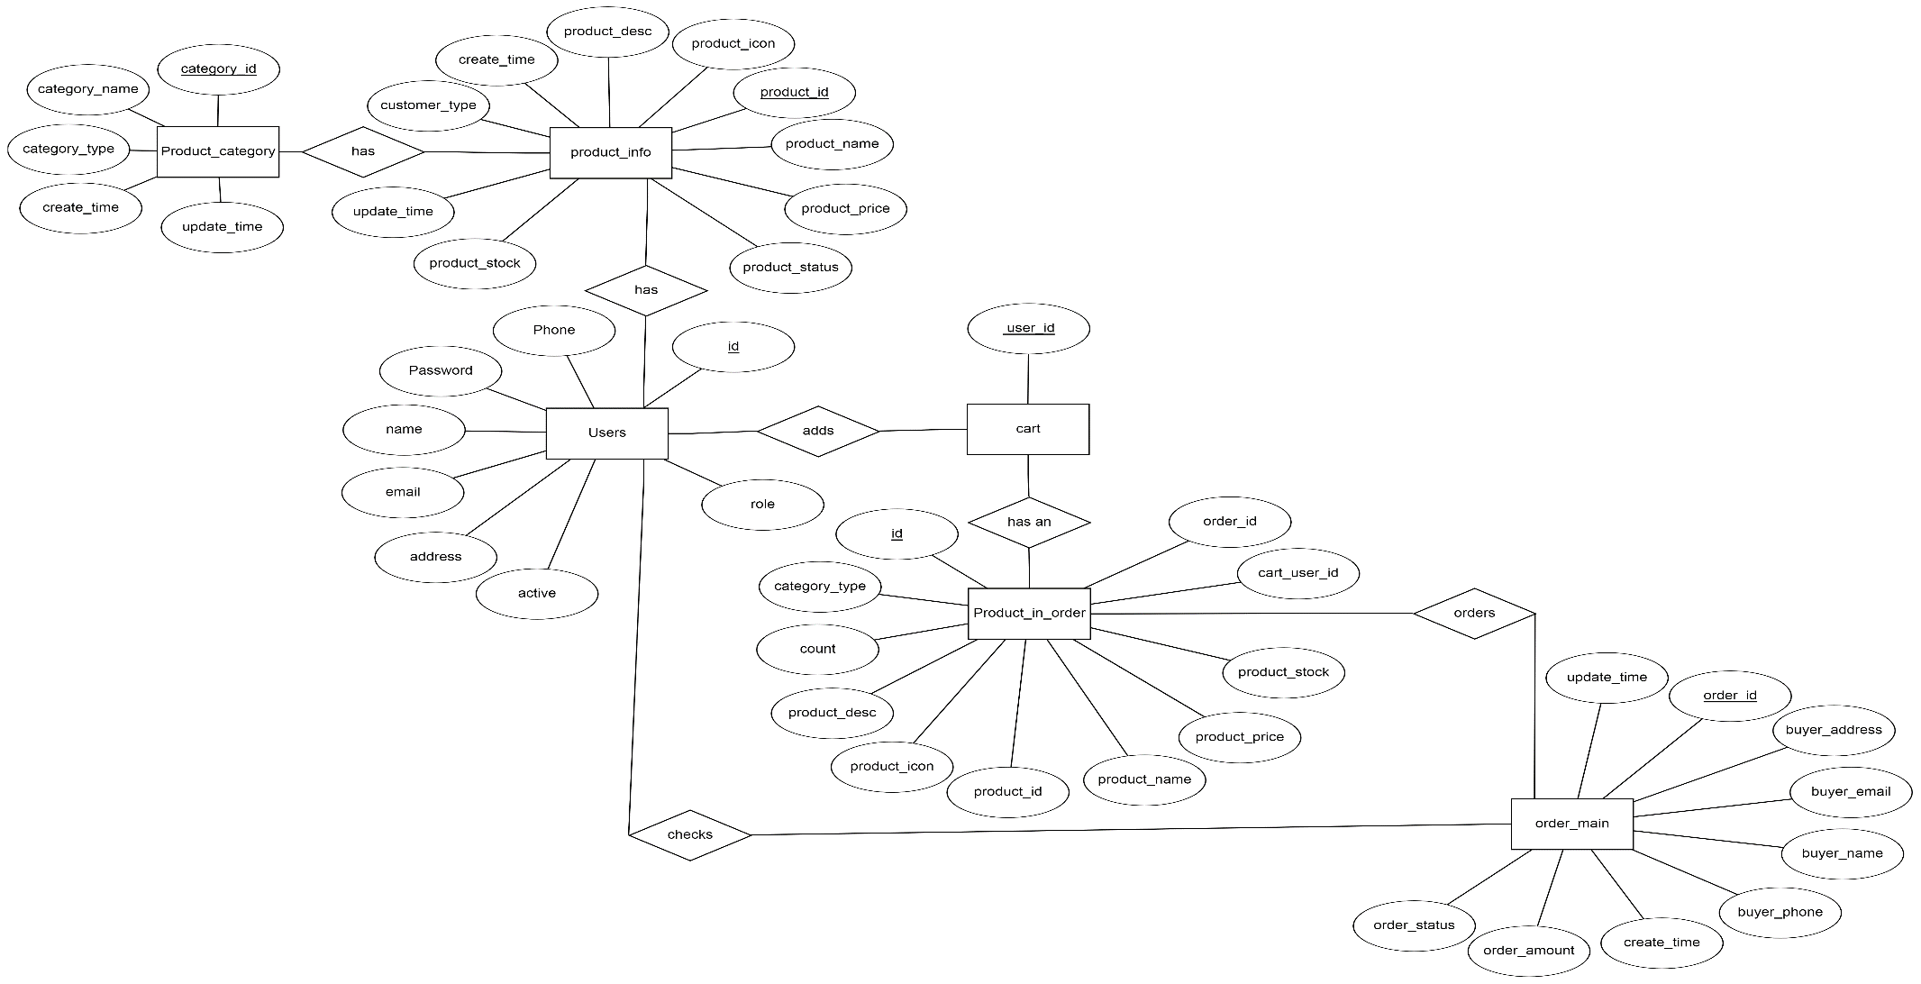
Entity relationship diagram

Slide 8
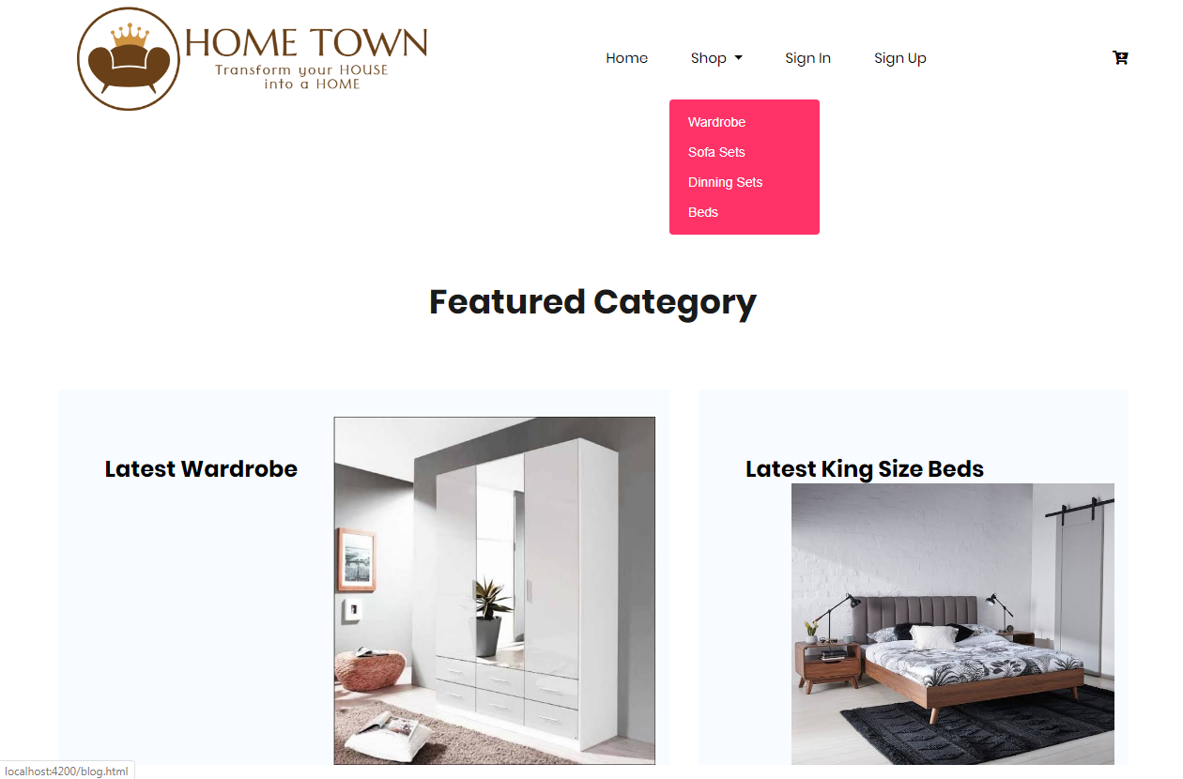
Snapshot of the application

Slide 9
Scope and Conclusion
Scope of the project:
This project can be implemented in any shopping site by fulfilling basic requirements.
Conclusion of the project:
This application will allow the customer to create the account and browse through products.
All information will be updated automatically by using the information stored in database system.

Slide 11
Thank You

