Slide 1


SLK SOFTWARE

Slide 2
Our Trainer
Upasana
Our Team
Adithya S Patil
Akshata Putlekar
Prajwal B M
Pratibha Ishwar Bhat
Shravani P

Slide 3
OBECTIVES
To become a full stack developer by gaining all the skills required to work with front end and back end web technologies.
To be confident in all the concepts and become a successful developer.

Slide 4
WHERE DO WE STAND?
Earlier | Now
Basic theoretical and less practical knowledge | Practical knowledge in java
OOPs basics | Angular 7
 | Spring boot
 | DBMS
 | HTML, CSS, Bootstrap
 | J2EE, JSP
 | Agile Methodology, Junit, GitHub, Maven, Tomcat, Jenkins.

Slide 5
PROBLEM STATEMENT
This project is a web based shopping system for an existing shop.
Online shopping is the process whereby consumers directly buy goods or. services from a seller in real- time, without an intermediary service, over.

Slide 6

OUR LEARNINGS
5th week
JDBC and Web Design fundamentals
Bootstrap
1st week
Object oriented programming concepts
Database concepts and SQL
3rd week
Data model and DB applications.
Core Java Programming
7th week
Spring REST (Core & MVC)
myBatis
Framework of Angular
2nd week
MySQL
Data structures
4th week
Exceptions
Collections
HTML
CSS
6th week
Javascript
Angular
J2EE Architecture
8th week
Agile
Methodology
Junit, Jenkins
GitHub
Maven
Tomcat
Project Completion

Slide 7



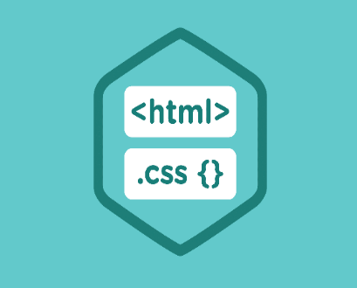






TOOLS USED
FRONTEND
BACKEND
DATA

Slide 8
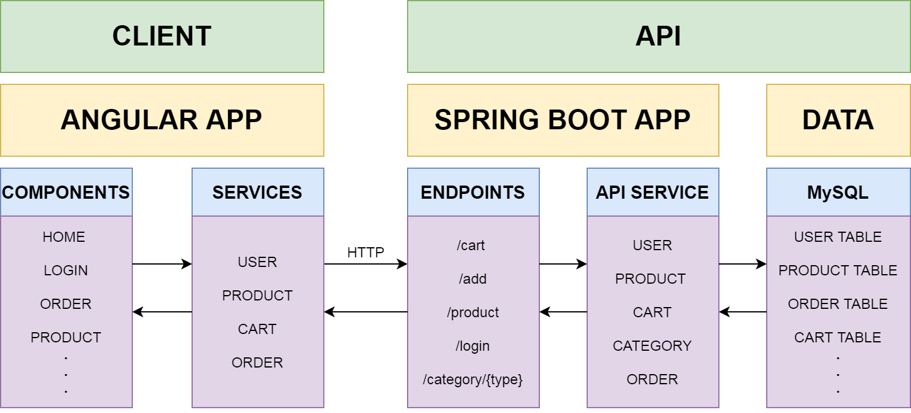
STRUCTURE OF THE PROJECT

Slide 9
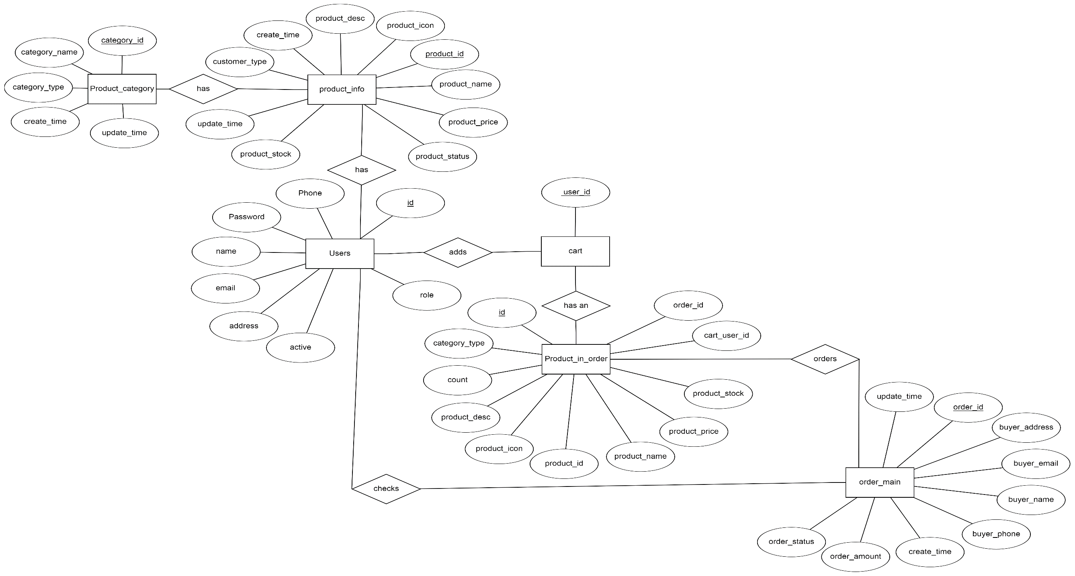
ER DIAGRAM

Slide 10
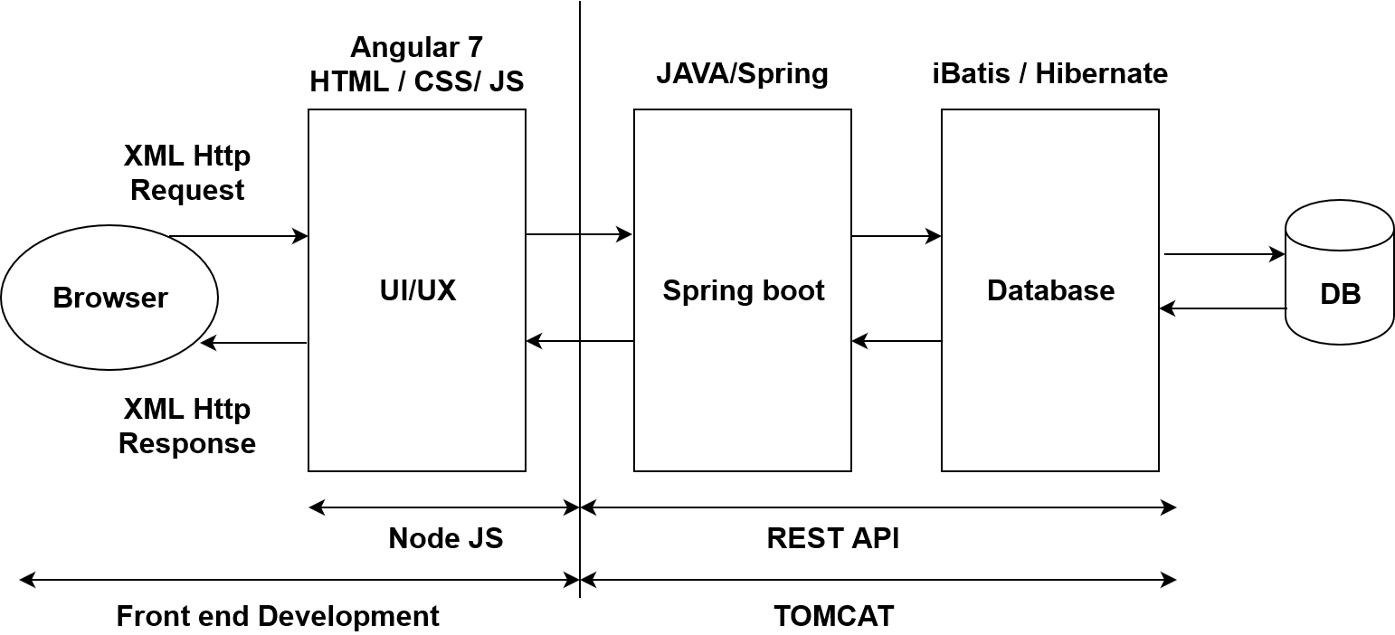
FLOW OF APPLICATION

Slide 11

SNAPSHOTS

Slide 12
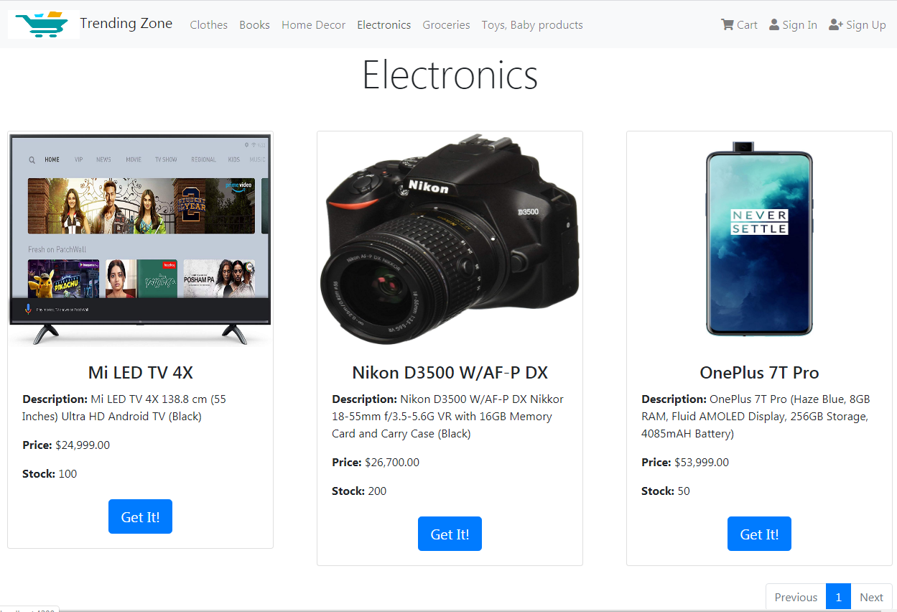

Slide 13
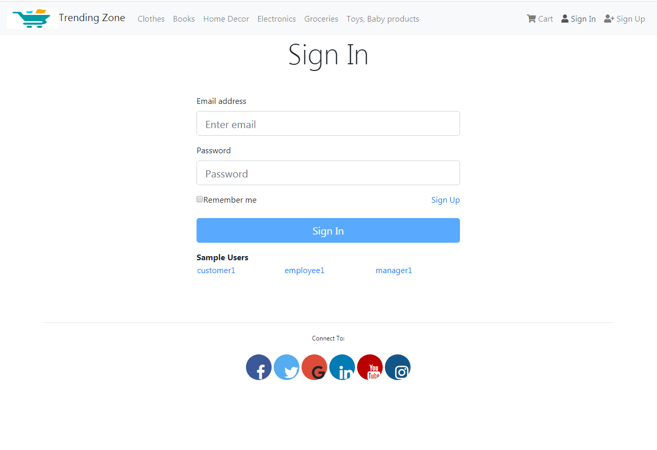

Slide 14
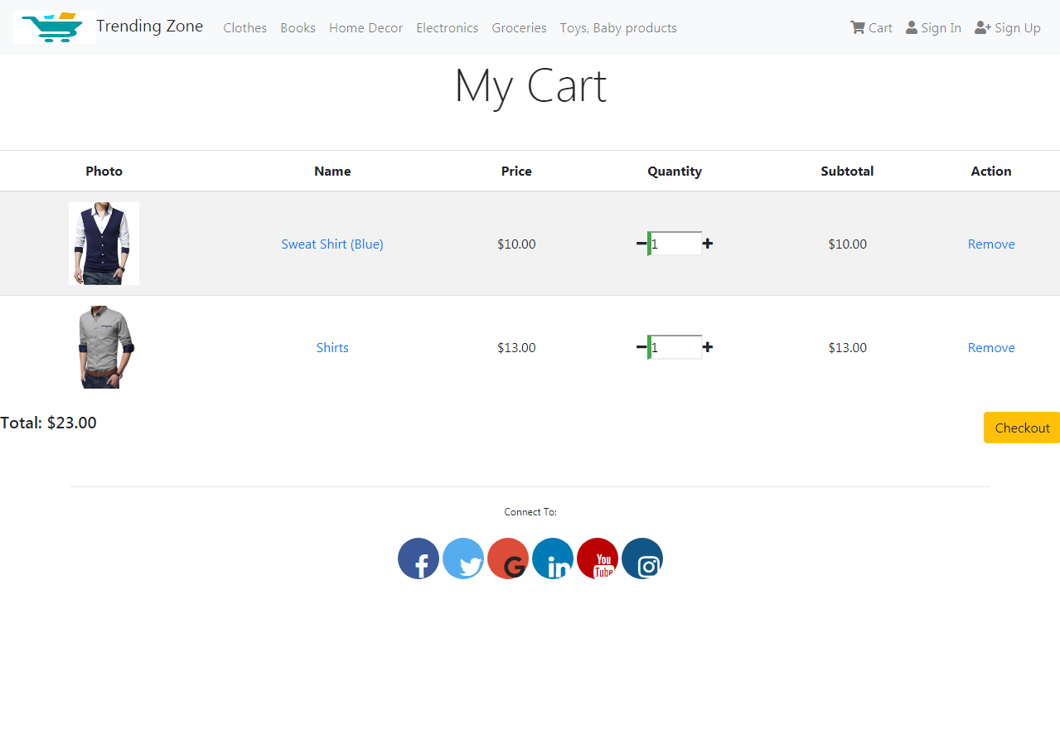

Slide 15
SCOPE AND CONCLUSION
Scope:
The project can be implemented in commercial transactions – ordering ,
Delivery, payments, etc.
Conclusion:
This shopping cart application will allow the customers to search and buy the products they want.

Slide 16
THANK
YOU

